Slide 1

Graduation Project DEPI
Predicting Used Car Prices with ML
Accurate prediction of used car prices is crucial for both buyers and sellers to ensure fair transactions. This presentation will showcase a machine learning model developed to tackle this challenge, highlighting its exceptional performance in the Egyptian market.

Slide 2

Our Team
Abdulrahman Nabil
Kareem Saad
Abdulrahman Tarek
Zyad Nabil

Slide 3
Steps of Project
Libraries & Toolkits
5
Feature Selection
1
Importing Dataset & Exploration
6
Data Modeling
2
Exploratory Data Analysis (EDA)
7
Model Evaluation & Saving
3
Data Preprocessing &
Feature Engineering
8
Deploy on Stream lit
4

Slide 4
Dataset
Sample of Data

Slide 5
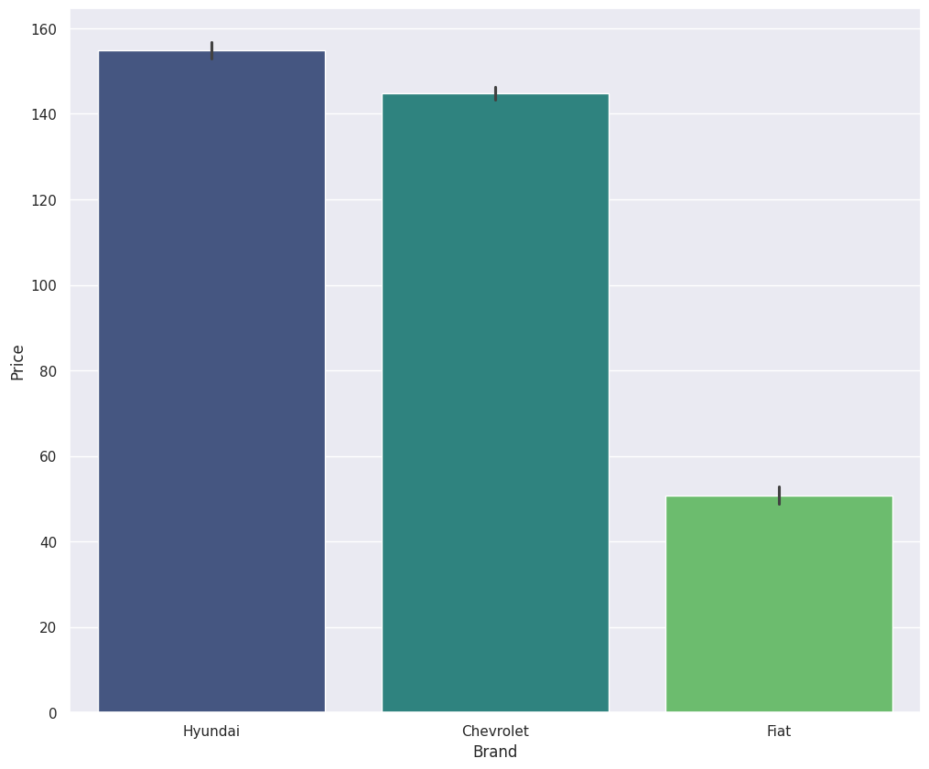
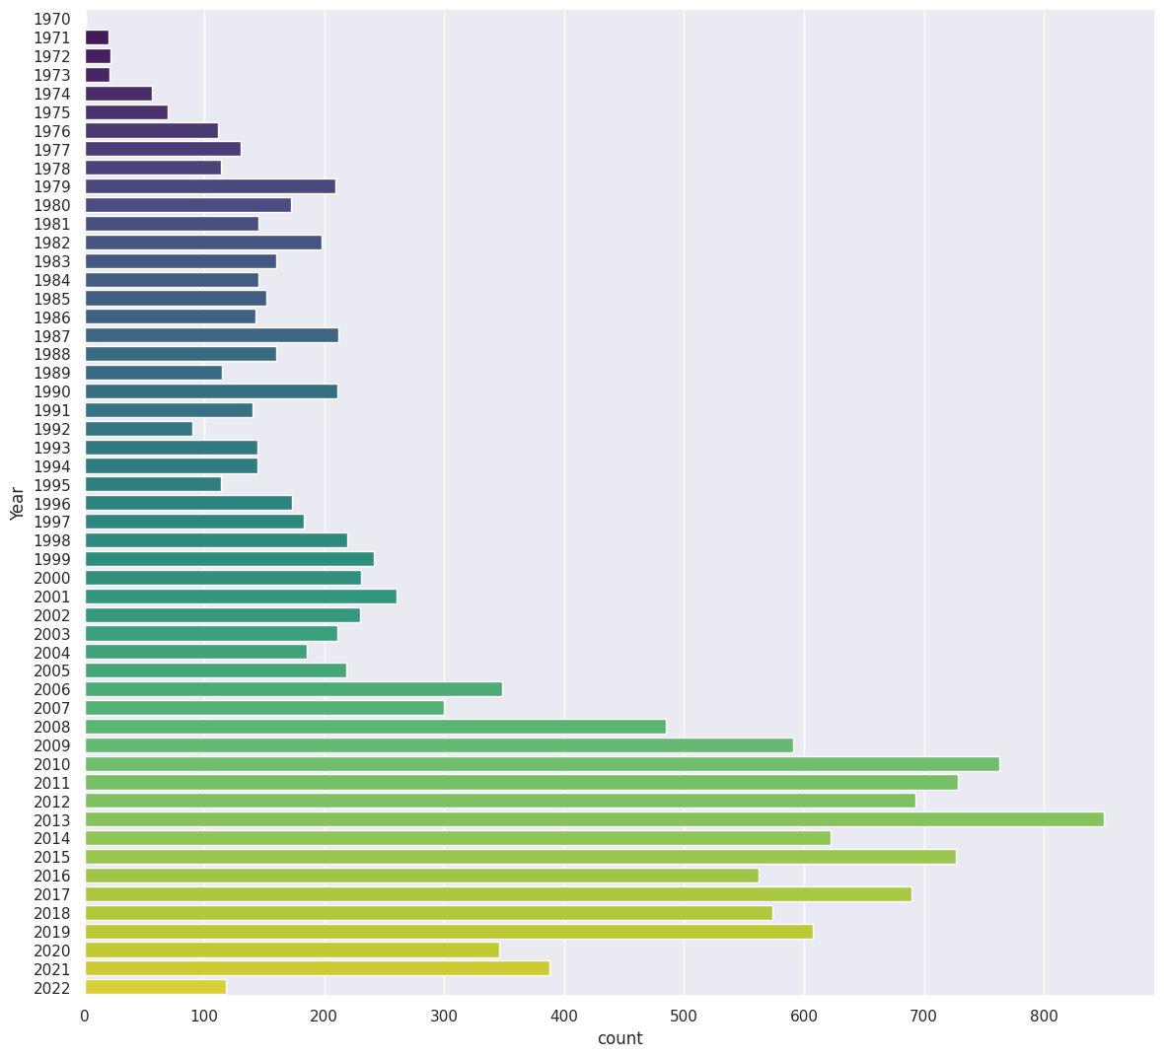
Exploratory Data Analysis (EDA)
Analyze categorical variables and their relationship with price
Distribution of cars by manufacturing year

Slide 6
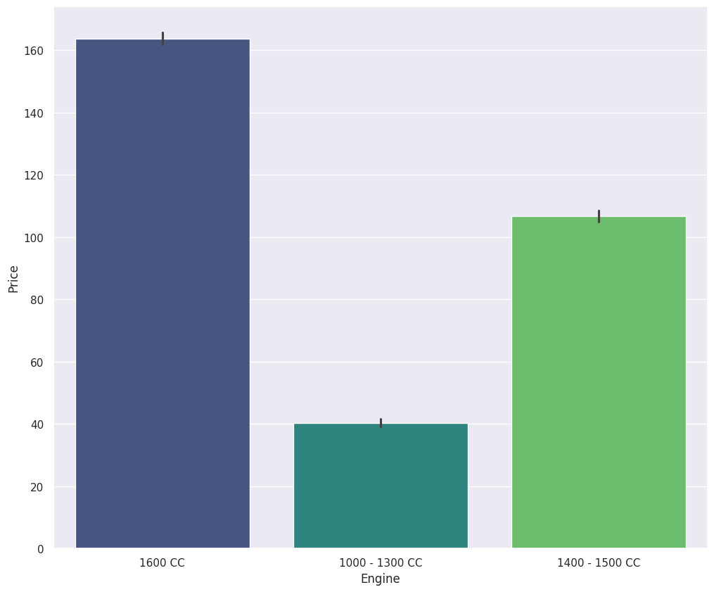
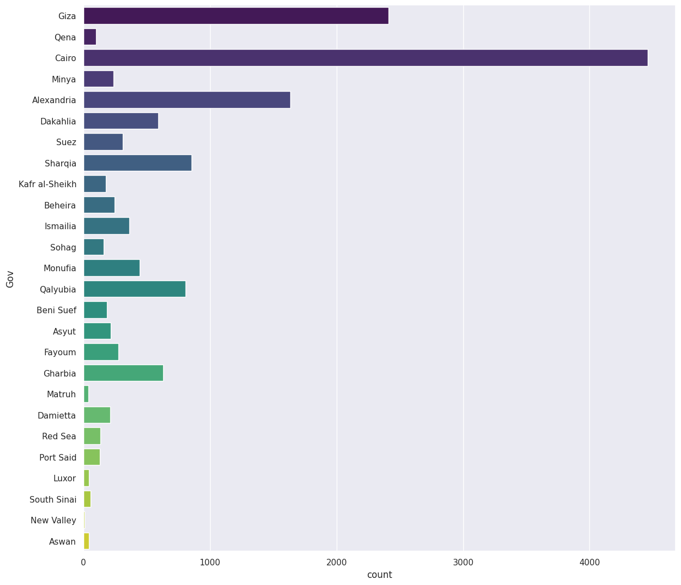
Exploratory Data Analysis (EDA)
Engine size distribution and impact on price
Distribution of cars by governorate (location)

Slide 7
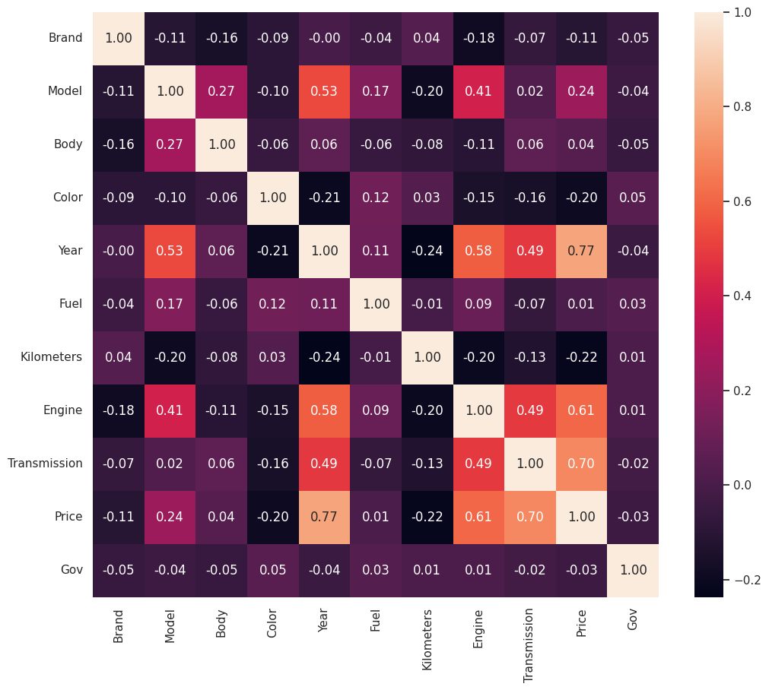
Feature Selection
Separate independent and dependent variables
Display the correlation matrix between variables

Slide 8
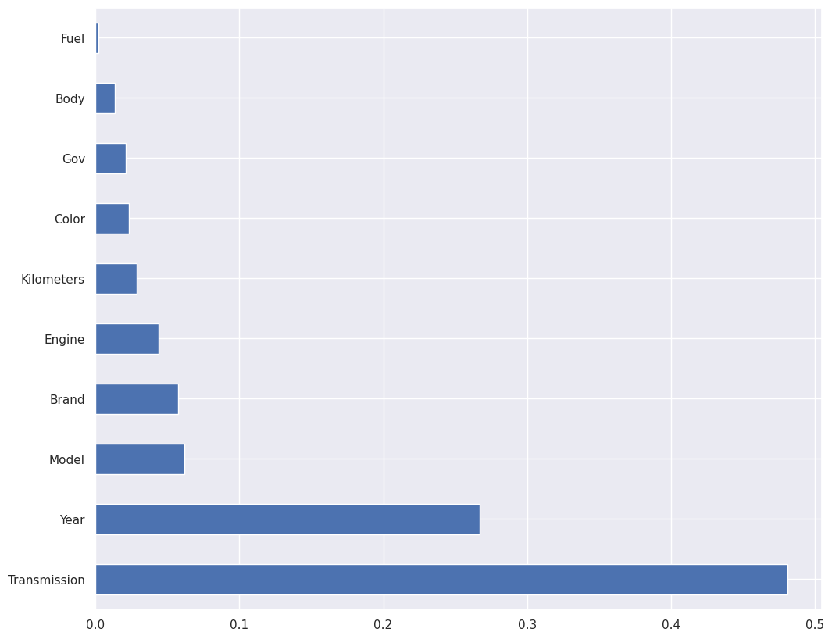
Feature Selection
Use Extra Trees Regressor to identify important features
Split the data into features (x) and target (y).
Visualize the correlation between features using a heatmap.
Use Extra Trees Regressor to identify the most important features that influence the car price

Slide 9
Accuracy for Models
K-neighbors Regressor
Decision Tree Regressor
Random Forest Regressor
The model achieved a high R2 score of 88.1%, indicating its excellent ability to explain the variance in used car prices.
The model achieved a high R2 score of 88.0%, indicating its excellent ability to explain the variance in used car prices.
The model achieved a high R2 score of 91.6 %indicating its excellent ability to explain the variance in used car prices.
XGB Regressor (Best Model)
The model achieved a high R2 score of 92.3 %, indicating its excellent ability to explain the variance in used car prices.

Slide 10
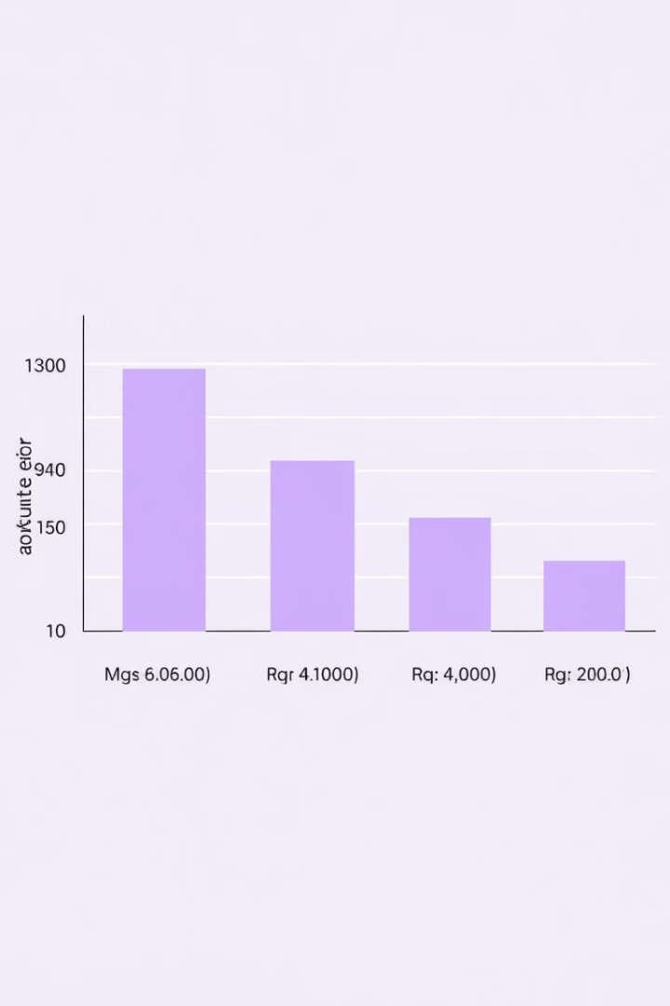
Model Evaluation: R2 Score, MAE, and RMSE
R2 Score
Mean Absolute Error (MAE)
The model achieved a high R2 score of 92.5%, indicating its excellent ability to explain the variance in used car prices.
The model's MAE of 13.36 suggests a low average error in its price predictions.
Root Mean Squared Error (RMSE)
The RMSE of 22.39 further confirms the model's high accuracy in forecasting used car prices.

Slide 11
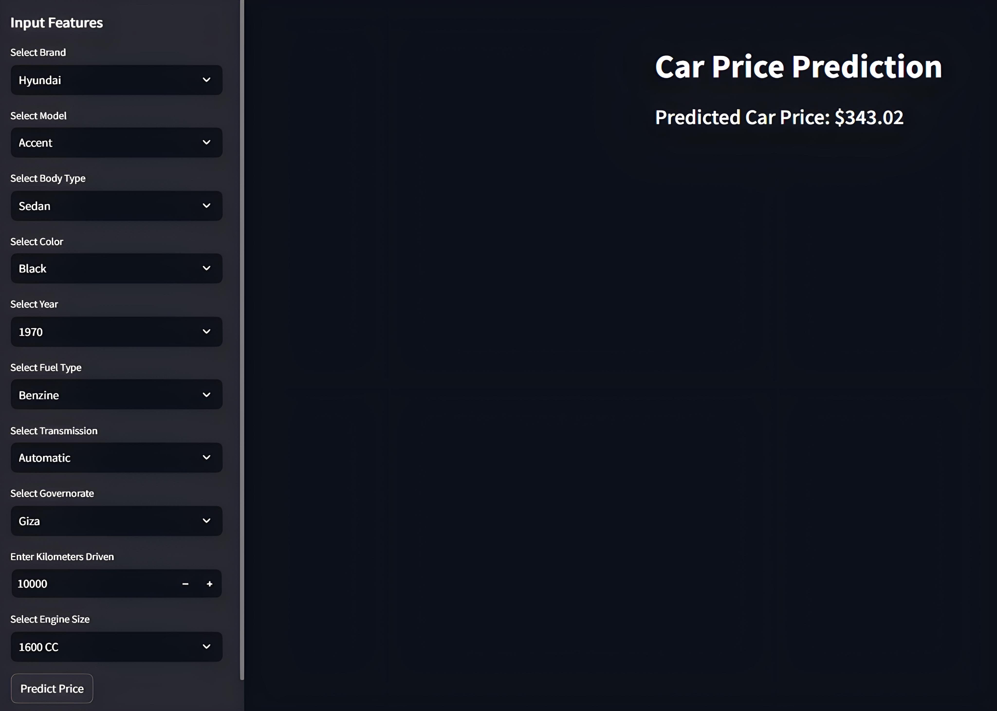
Stream lit
This Stream lit app predicts car prices based on user-selected features. Simply choose options for:
Brand
Model
Body type
Color
Year
Fuel type
Transmission
Governorate
Kilometers driven
Engine size
Notebook Link

Slide 12
Thank You !

