Slide 1

MR-FIT
Your AI-Powered Fitness Companion
Graduation Project Defense • Team MR-Fit • 2026
MR-Fit — AI Fitness Companion
01
Notes:
PRESENTER 1 (Cold open, ~0:45). Hook: 'How many fitness apps have you downloaded — and deleted?' Pause, then reveal MR-Fit. Keep energy high; do not read the slide. Set up that fitness apps are everywhere but intelligent ones are not.

Slide 2
PRESENTER 1 • THE PROBLEM
Fitness apps are everywhere.
Intelligent ones aren’t.
GENERIC
STATIC
SILOED
One template for millions of different bodies and goals.
Plans never adapt to how your week, sleep, or recovery actually went.
Workouts, nutrition, and wearable data never talk to each other.
MR-Fit — AI Fitness Companion
02
Notes:
PRESENTER 1 (~1:30). Walk through the three pains slowly, one card at a time. Land the line: the problem isn't tracking — it's that nothing thinks. Transition: 'What if one platform could see everything and actually think? Here's [Presenter 2].'

Slide 3
PRESENTER 2 • THE VISION
One platform that sees everything — and adapts.
MR-Fit unifies your training, nutrition, and wearable data, then lets AI act on the full picture — generating plans, coaching you, and counting your reps automatically.
UNIFY
UNDERSTAND
ADAPT
MR-Fit — AI Fitness Companion
03
Notes:
PRESENTER 2 (~1:30). Introduce MR-Fit as the AI fitness companion. Core idea: unify the data, then let AI act on it. Keep it visionary and confident. Then move into the product tour.

Slide 4
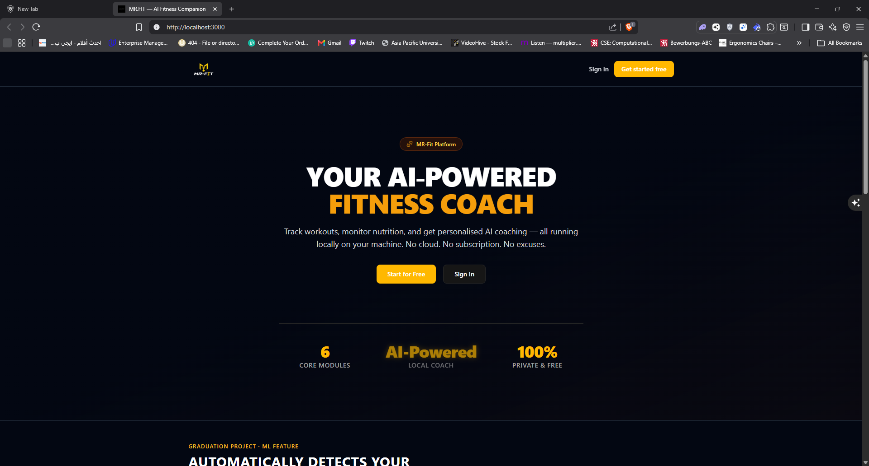
PRESENTER 2 • FEATURE — LANDING
FEATURE — LANDING
A launch that sells the vision
▸ Modern marketing landing page
▸ Clear value proposition up front
▸ Sign-in / sign-up flow
MR-Fit — AI Fitness Companion
04
Notes:
PRESENTER 2. Show the polished entry point — this is a product, not a school project. Mention auth (NextAuth / Supabase JWT).

Slide 5
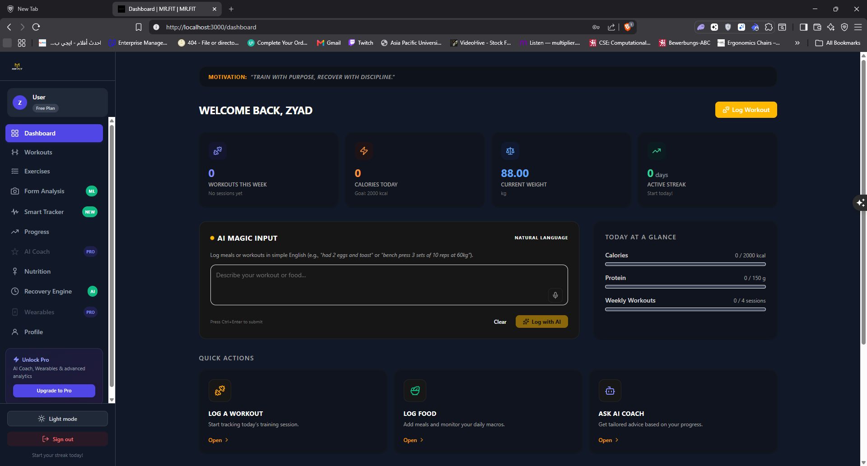
PRESENTER 2 • FEATURE — DASHBOARD
FEATURE — DASHBOARD
Everything in one glance
▸ Unified home for training + nutrition
▸ Daily macros vs. goals
▸ Quick access to AI tools
MR-Fit — AI Fitness Companion
05
Notes:
PRESENTER 2. The dashboard is where the 'unify' promise becomes real. Transition to Presenter 3 for the deep feature tour.

Slide 6
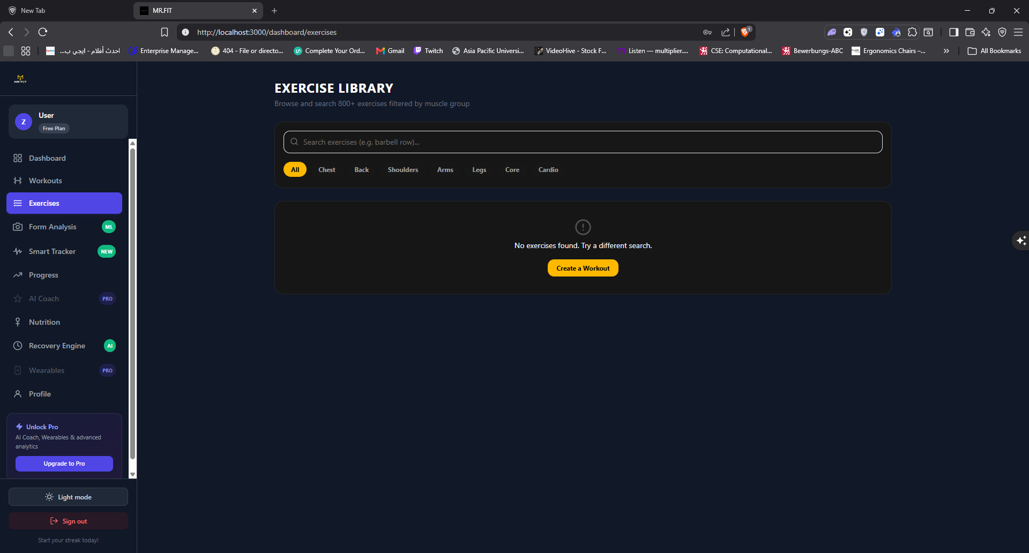
PRESENTER 3 • FEATURE — WORKOUTS
FEATURE — WORKOUTS
Log every set, rep & weight
▸ Create and log workouts in seconds
▸ Sets, reps, weights and notes
▸ AI-generated plans flagged as source: ai
MR-Fit — AI Fitness Companion
06
Notes:
PRESENTER 3 (~start). Walk through logging UX. Note plans can be AI- or user-created.

Slide 7
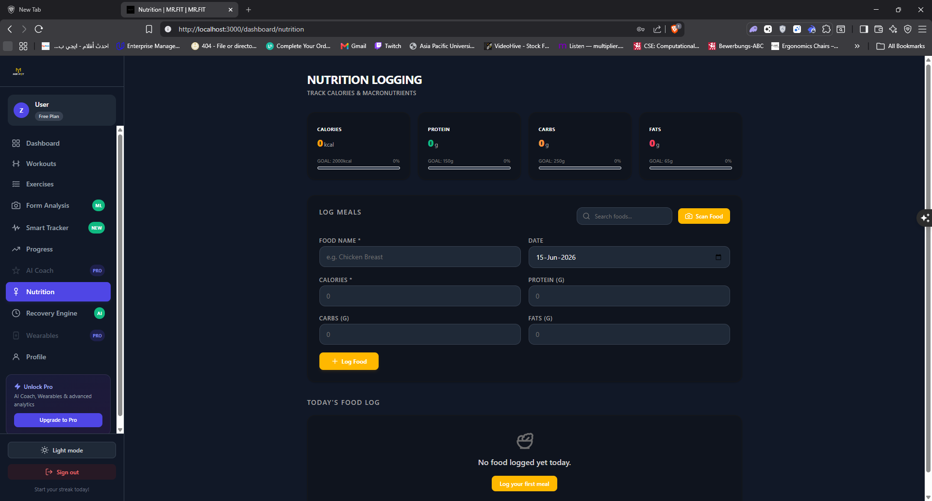
PRESENTER 3 • FEATURE — NUTRITION
FEATURE — NUTRITION
Eat with intent
▸ Search a large food database
▸ Track daily macros against goals
▸ Nutrition and training in one place
MR-Fit — AI Fitness Companion
07
Notes:
PRESENTER 3. Emphasise nutrition + training living together — the data silo problem solved.

Slide 8
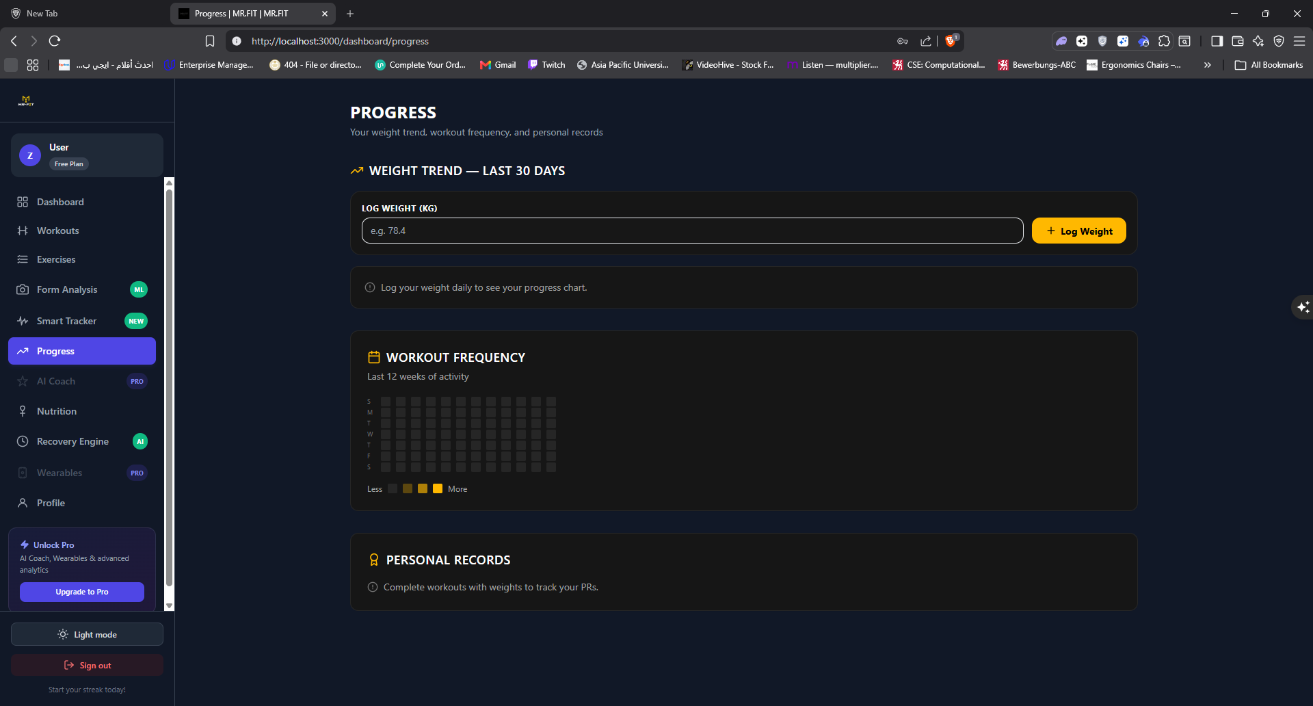
PRESENTER 3 • FEATURE — PROGRESS
FEATURE — PROGRESS
See the trend, not just the day
▸ Weight trend chart
▸ Workout frequency heatmap
▸ Personal records table
MR-Fit — AI Fitness Companion
08
Notes:
PRESENTER 3. Progress visualisation drives motivation. Transition: 'All of this feeds the part that makes us different — the AI brain. Here's [Presenter 4].'

Slide 9
PRESENTER 4 • THE AI BRAIN
The AI Brain
Three AI systems working on your real data.
RAG WORKOUT GENERATION
AI COACH
SMART TRACKER (EDGE AI)
800+ exercises embedded as 1536-dim vectors (pgvector). On 'Generate Plan', a similarity search picks the top candidates, then GPT-4o returns a structured JSON plan tailored to your goal and level.
A chat coach that reads live wearable context — sleep, HRV, resting heart rate — to give advice grounded in how your body is actually doing.
IMU sensor data streams into a trained Random Forest model (FastAPI) that classifies the exercise and counts reps automatically.
MR-Fit — AI Fitness Companion
09
Notes:
PRESENTER 4 (~3:30). The crown jewel. Explain WHY RAG (grounds the LLM in our real exercise catalog, cuts hallucination). Be ready for: how does the Random Forest rep-counter work, what accuracy. Keep it concrete.

Slide 10
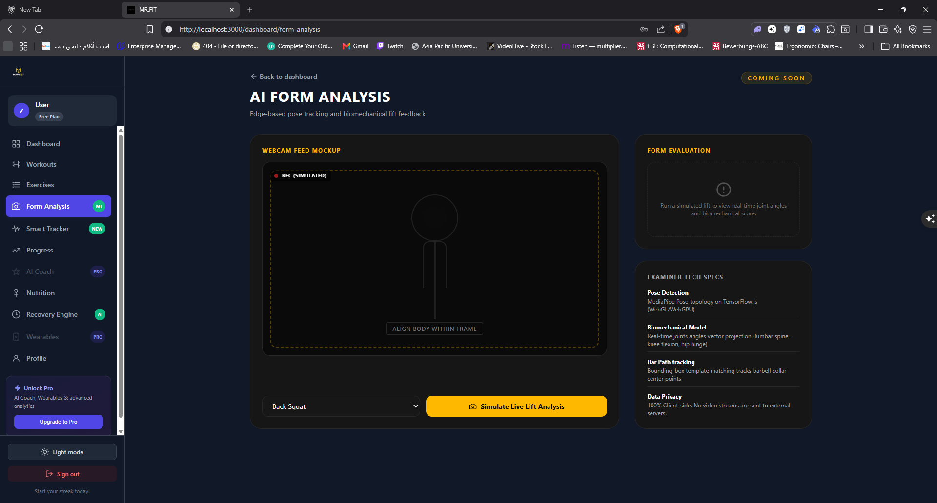
PRESENTER 4 • AI — FORM ANALYSIS
AI — FORM ANALYSIS
AI form analysis
▸ Computer-vision / sensor-driven feedback
▸ Flags technique issues
▸ Helps prevent injury
MR-Fit — AI Fitness Companion
10
Notes:
PRESENTER 4. Show form analysis output. Tie back to Smart Tracker data.

Slide 11
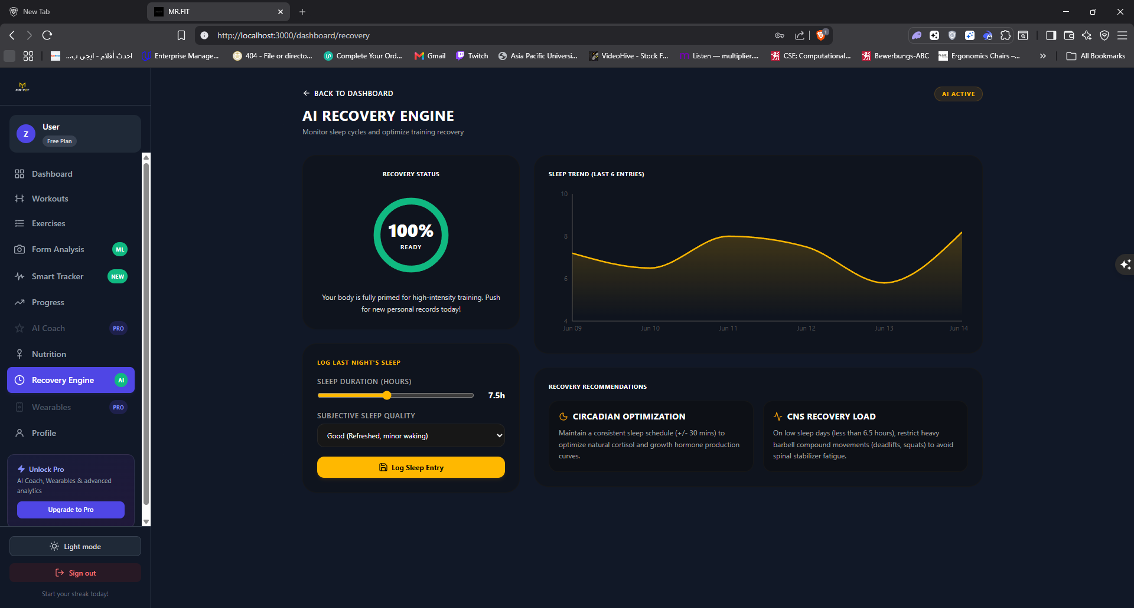
PRESENTER 4 • AI — RECOVERY ENGINE
AI — RECOVERY ENGINE
AI recovery engine
▸ Reads wearable recovery signals
▸ Recommends rest vs. push
▸ Adapts the plan to your body
MR-Fit — AI Fitness Companion
11
Notes:
PRESENTER 4. The recovery engine closes the loop — data in, smarter plan out. Transition to Presenter 5 for architecture.

Slide 12
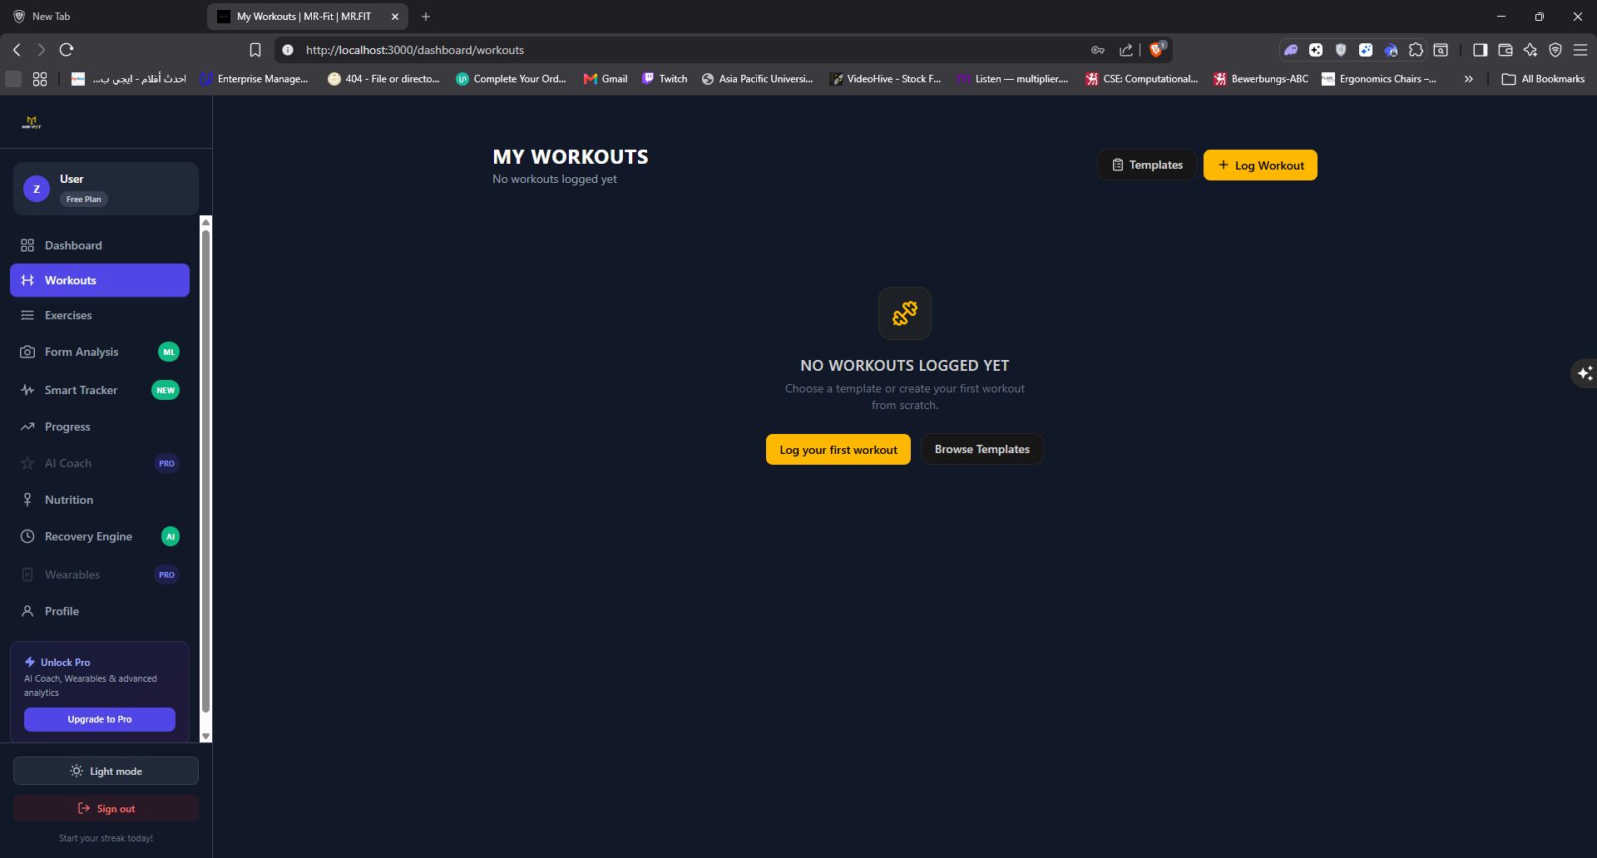
PRESENTER 4 • AI — COACH
AI — COACH
Chat that knows your data
▸ Conversational fitness guidance
▸ Pulls live wearable context
▸ Personalized, not generic
MR-Fit — AI Fitness Companion
12
Notes:
PRESENTER 4. Demo-style narration of the coach. Then hand to Presenter 5.

Slide 13
PRESENTER 5 • ARCHITECTURE
How it all fits together
CLIENT
Next.js 14 App Router — Server Components, Tailwind UI
EDGE / BFF
Next.js Route Handlers — validate & proxy requests
DATA — SUPABASE
Postgres 15 • Row-Level Security • Realtime • pgvector • Storage
AUTOMATION — n8n
workout-plan-generator • wearable-sync (cron) • progress-report
AI / EXTERNAL
OpenAI GPT-4o + embeddings • Garmin / Fitbit / Apple Health
MR-Fit — AI Fitness Companion
13
Notes:
PRESENTER 5 (~3:00). Build the stack top-to-bottom. Stress security: Row-Level Security isolates user data at the DB layer; service-role key never reaches the browser. Be ready for 'why Supabase + n8n'.

Slide 14
PRESENTER 6 • LIVE DEMO
LIVE DEMO
Sign in → Generate AI plan → Log a set → Watch the chart update live → Ask the AI Coach → Open the wearables dashboard
MR-Fit — AI Fitness Companion
14
Notes:
PRESENTER 6 drives; Presenters 2 & 4 narrate features/AI. HAVE A BACKUP VIDEO and pre-seed demo_seed.sql (17 workouts, 30 nutrition entries, 15 weight logs) in case of network issues.

Slide 15
PRESENTER 6 • RESULTS & ROADMAP
What we built — and what’s next
DELIVERED
ROADMAP
▸ Full-stack AI fitness platform
▸ RAG workout generation
▸ Realtime tracking + charts
▸ Edge-AI rep counting
▸ Wearables integration
▸ Native mobile app
▸ More wearable providers
▸ Social / community challenges
▸ On-device model for offline
▸ Coach voice mode
MR-Fit — AI Fitness Companion
15
Notes:
PRESENTER 6. Summarise impact and learning. Be ready for: 'is it production-ready, hardest problem solved, what's next'.

Slide 16
Thank you.
MR-Fit — a fitness companion that sees your whole picture and adapts.
Team MR-Fit • Questions welcome
MR-Fit — AI Fitness Companion
16
Notes:
PRESENTER 6 closing line: 'MR-Fit isn't just another tracker — it's a companion that sees your whole picture and adapts. We're Team MR-Fit. Thank you — we'd love your questions.'

