Slide 1

Exploratory Data Analysis
<Pink Cab VS Yellow Cab>
<19/06/2023>

Slide 2

Agenda
Executive Summary
Problem Statement
Approach
EDA
EDA Summary
Recommendations

Slide 3
Executive Summary
Provide analysis on each company’s data.
Identify the ideal company based on performance.
Provide recommendations for investing to ensure great ROI.
Explain ideas behind recommendations.

Slide 4
Problem Statement
Two Cab service-providing companies, Yellow Cab and Pink Cab.
Identification of the better performing company for investing.
Both companies operate in United States of America.
Companies' performance data such as transaction records, customers age records, kilometers driven, and profits made by each company were provided.

Slide 5
Approach
Identification of customer characteristics will yield great interpretations on the usage of both companies' services.
Identification of correlations between customers and the service usage is necessary.
Identification of usage of services in each city will provide great comparison between both companies’ performances.
Identification of profit made by each company on every trip provides estimation of the annual profit. Hence, estimation of ROI

Slide 6
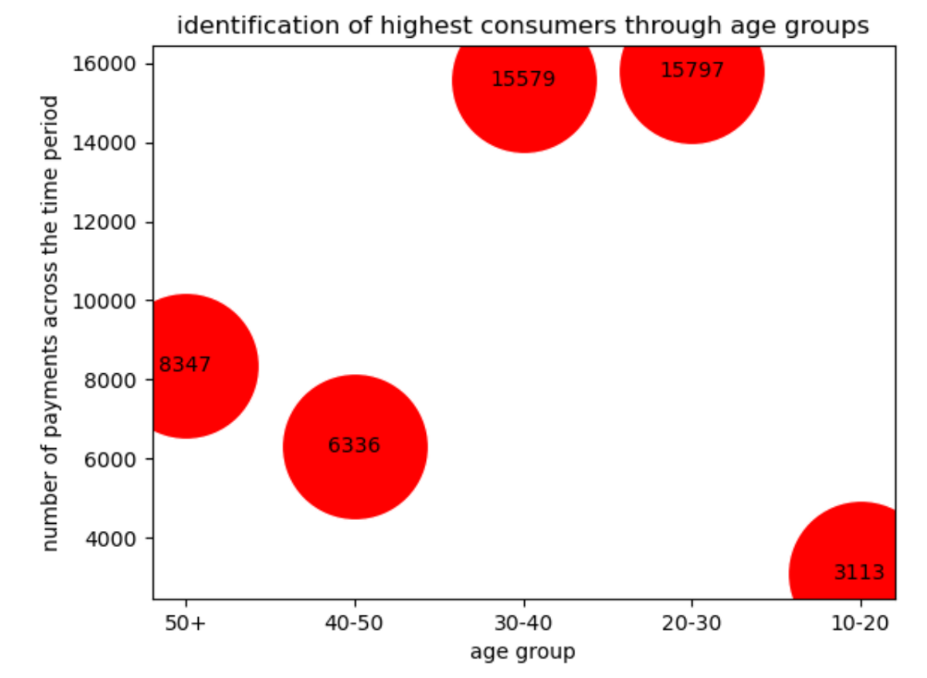
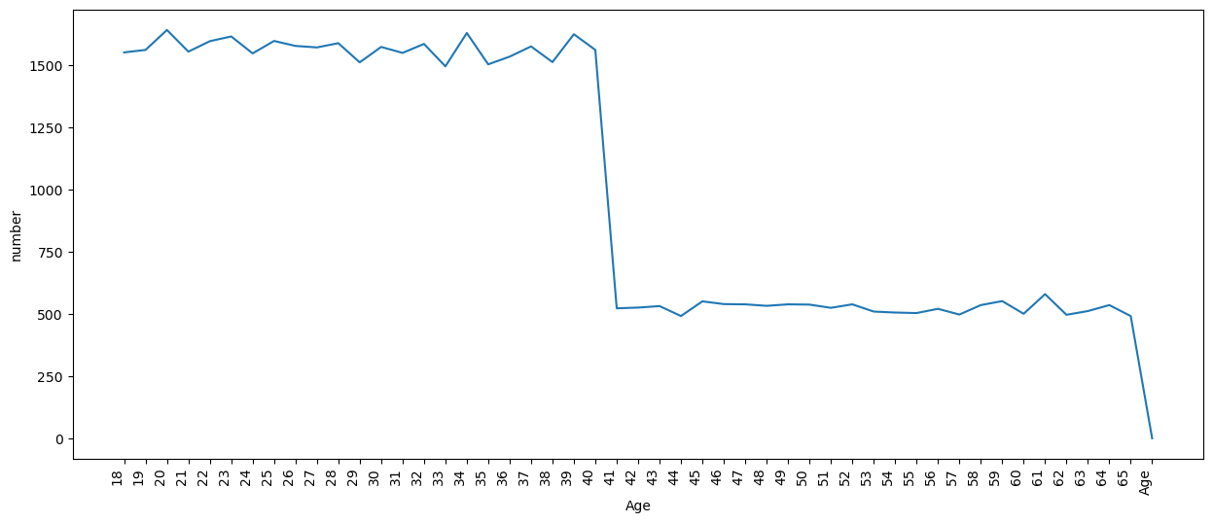
Age groups
Fig 2. highest number of consumers according to age group and frequency in transactions
Fig 1. age of consumers
Figure 1 revealed the number of customers using the services of both companies according to their ages. A significant increase in consumers aged between 18 and 40 is observed. Figure 2 displays the frequency of customers utilization of the services through analysis of the number of transactions and correlating the transactions made by customers to their age group. It revealed that customers in age groups 20-30 and 30-40 utilize the services more frequently according to the number of transactions made by them. Such results illustrates the main customers that are expected to be targeted by companies to boost profits.

Slide 7
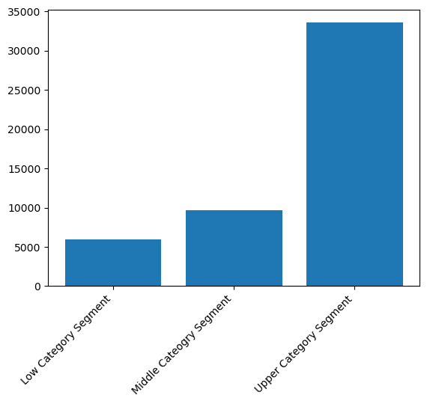
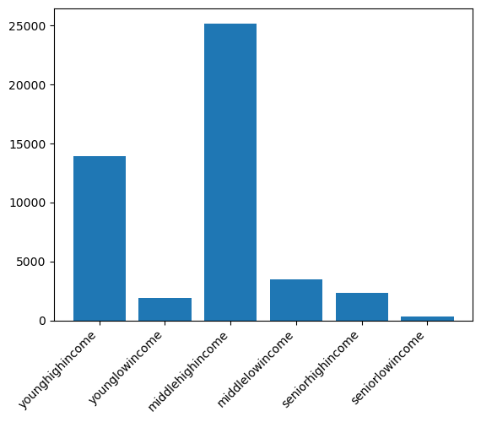
Income based analysis
Fig 3. income based classification
Fig 4. age & income-based classification
Figure 3 provides an illustration on the general category of consumers
a high-income category is a consumer earning above 10,000 dollars per months
Middle income consumer earning between 5,000 and 10,000 dollars per month
low-income category consumer earning less than 5,000 dollars per month.
High-income category consumer utilizes services more frequently.
Figure 4 provides an illustration of consumers usage based on their income and age.
Young age and middle age high income main consumers.

Slide 8
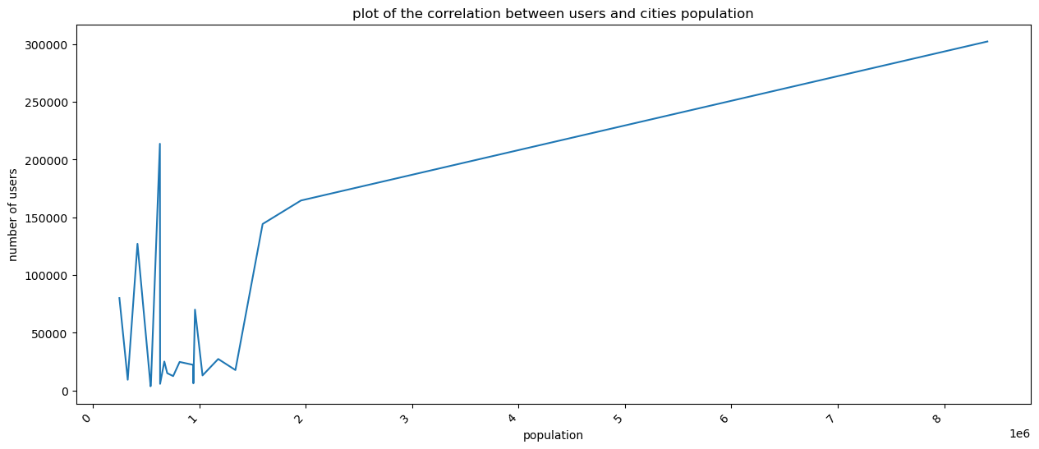
population based analysis
Fig 5. population vs customers
Figure 5 is a produced graph from the comparison of customers in cities and the population of cities customers live in.
Graph shows the increase in customers as population increases.

Slide 9
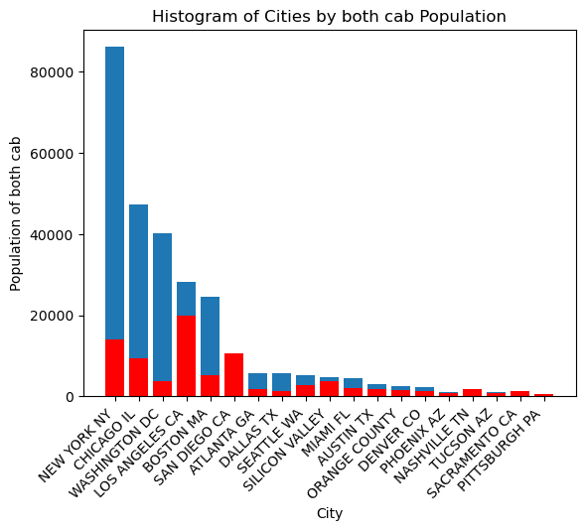
Cab Companies comparison
Figure 6 provides illustration on cab companies’ performances in cities
Blue bars denotes Yellow Cabs
Red bars denotes Pink Cabs
Yellow cab is significantly performing better than pink cab in all of the cities.
Yellow cab is performing significantly well in new York, Chicago, Washington, Los Angeles and Boston where populations are significantly high.
According to previous analysis, it is believed that young and middle-aged high-income customers are based in the mentioned cities.
Fig 6. cab companies’ performances in cities

Slide 10
Profits comparison
 | pink Cab profit | yellow Cab profit
Average profit per ride | 62.652 | 160.26
Average profit per km | 2.76 | 7.1055
Table 1 provides illustration of the average profit per ride and profit per km for each cab company
Yellow Cab company is gaining higher profit than pink company and it acquires a higher customer number than pink cab companies.
Table 1. profits per km and rides

Slide 11
Recommendations
Profit wise: yellow company is earning higher profits per rides and per km whereas pink company is performing poorly in terms of profits.
Customer wise: yellow cab is dominating the customers segment as it recorded a significantly higher number of customers than pink company in all cities
Return on Investment wise: given that the profit per km and profit per ride is higher in yellow company and yellow company is recording higher number of customers than pink company, it is believed that the return on investment in yellow company will be significantly higher than investment in ink company.
Therefore, it is believed that it is best to invest in Yellow Cab company

Slide 12
Thank You

