Slide 1
De-orphaning UNCONFIRMED candidate bins
A reverse / containment match: which candidates are artifacts of compounds we already have?
LCBinBase · HILIC-negative · reverse-score pipeline · 2026-06-16

Slide 2
The problem
UNCONFIRMED = the promote / don't-promote pile (26,527 candidates, HILIC-negative)
• BinBase generates candidate bins; the UNCONFIRMED ones passed every QC gate (ion count, S/N, scans, ISTD, clean-spectra) and await acceptance as real compounds.
• But some candidates aren't new — they're in-source fragments, adducts, or isotope peaks of compounds we've ALREADY confirmed.
• A recurring in-source fragment recurs as often as its parent, so it clears the threshold and becomes its own candidate.
• Question: which candidates should NOT be promoted (artifact of an existing compound) vs are genuinely novel?

Slide 3
The method — reverse / containment
• Flag a candidate O as a related ion of a confirmed bin C when ALL hold:
• they co-elute (Δ retention-index ≤ 4)
• prec(C) − prec(O) is a neutral-loss / adduct / ¹³C-isotope spacing
• O's ions are CONTAINED in C's spectrum (reverse score)
• Why containment, not forward cosine: a fragment is a SUBSPECTRUM of its parent — forward cosine is dragged down by the parent's extra ions and misses the link; one-sided containment stays high.
• Isotopes restricted to ¹³C (³⁴S/³⁷Cl need a parent formula the table doesn't carry).

Slide 4
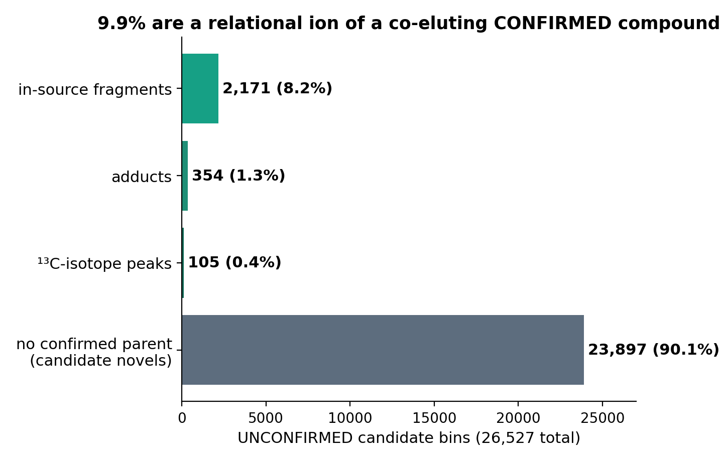
Result — HILIC (polar metabolites)
2,630 / 26,527 (9.9%) flagged as relational artifacts → don't-promote list; 1,576 link to a NAMED confirmed parent. Dominated by in-source fragments.

Slide 5
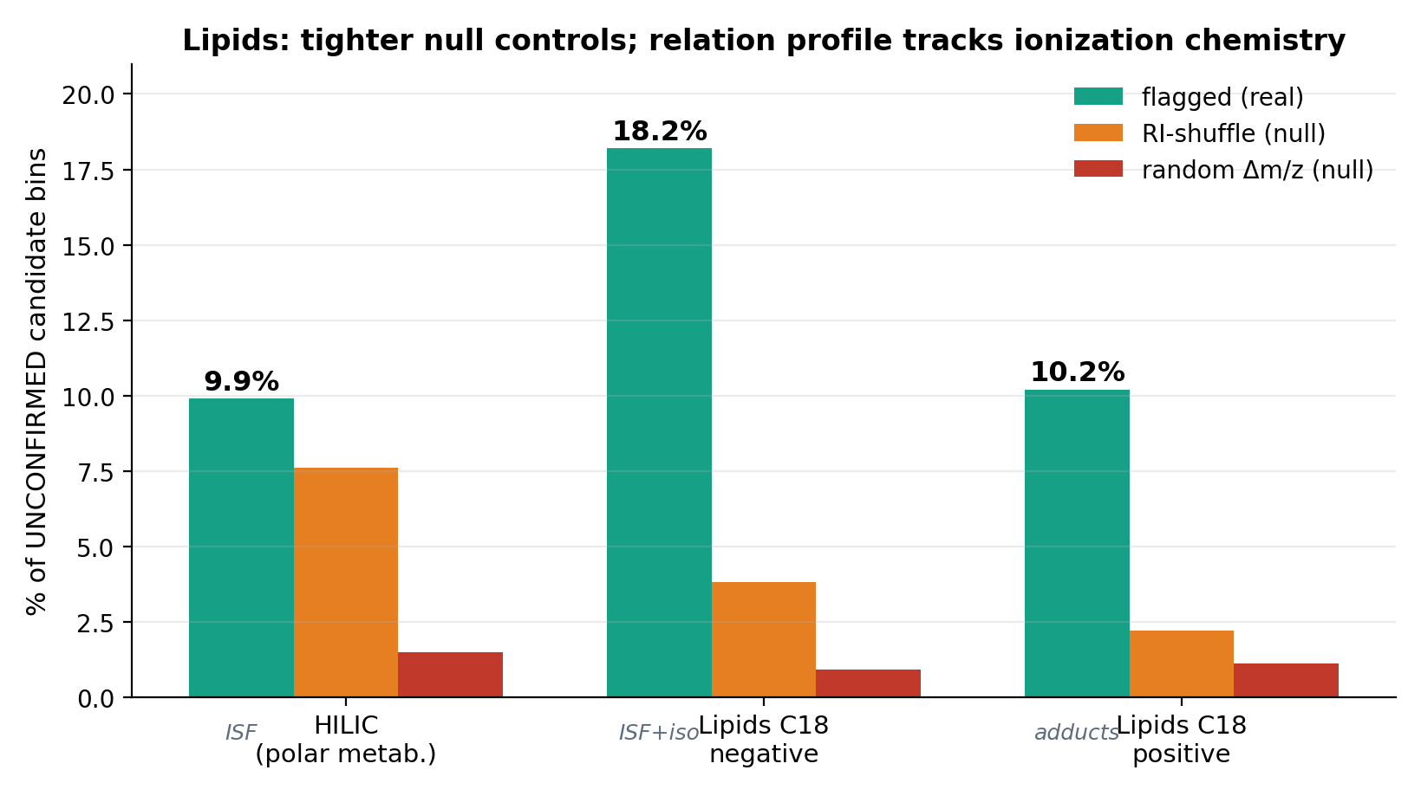
Generalizes across methods — and tracks the chemistry
C18-neg 18.2% (ISF-dominated: water/CO₂/acetate); C18-pos 10.2% (ADDUCT-dominated: TG [M+NH₄]⁺, PC [M+Na/K]⁺ — exactly what positive-mode lipids form). RP co-elution is strongly discriminating both polarities (RI-shuffle 2–4% vs HILIC's 8%). The relation profile shifting neg→pos is itself a validation.

Slide 6
Examples — candidate → confirmed parent it's a related ion of
candidate m/z | relation | contain. | confirmed parent | parent m/z
102.0562 | −CO2 | 0.99 | glutamic acid | 146.0464
128.0354 | −NH3 | 0.95 | glutamine | 145.0619
383.1199 | −hexose | 0.99 | NP-022519 | 545.1725
191.0200 | −H2O | 0.98 | saccharic acid | 209.0303
213.0058 | iso 13C | 0.93 | indoxyl sulfate isomer | 212.0023
259.0416 | iso 13C | 0.91 | glucosamine 1-phosphate | 258.0383
341.0154 | adduct K-H | 0.99 | oxypurinol | 303.0596
411.0876 | adduct Na-H | 0.98 | MOPS b | 389.1058
Textbook in-source losses (carboxylic acids shedding CO₂, etc.); ¹³C peaks; same fragment often spawns several candidates.

Slide 7
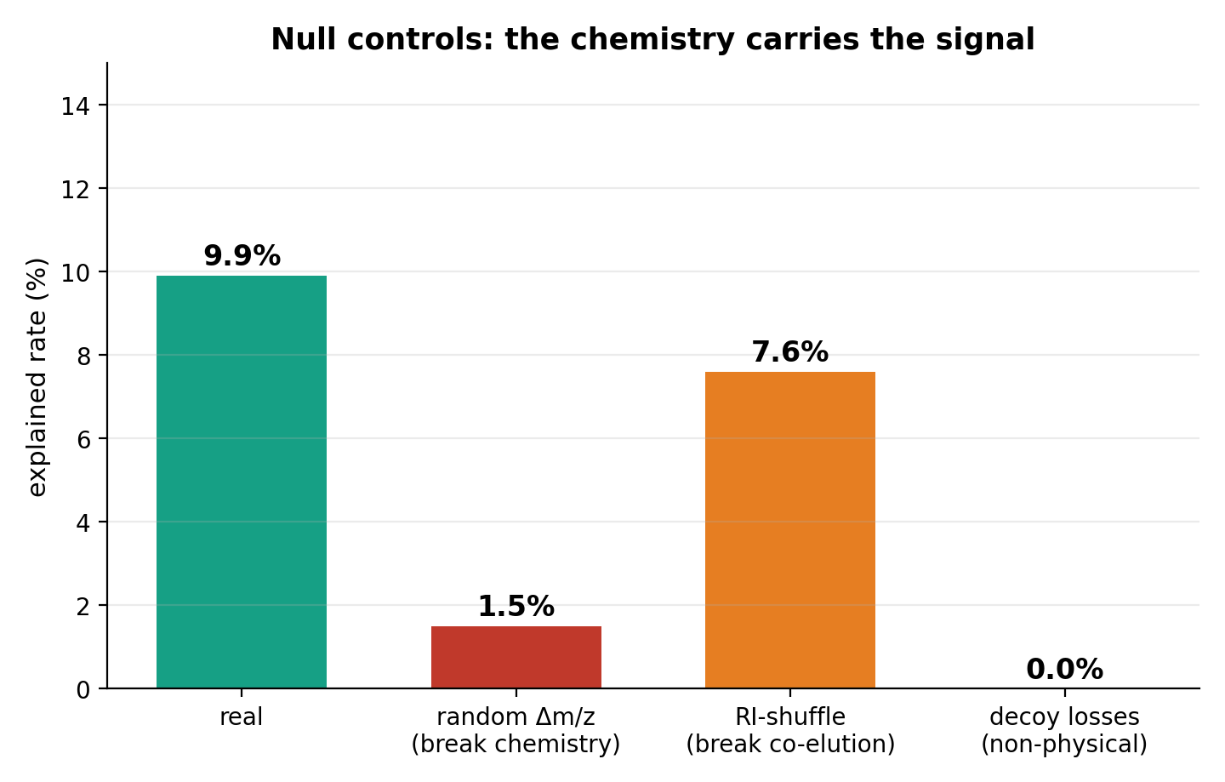
How far to trust it
Scramble masses → 1.5% (chemistry is real); non-physical losses → 0%. Not sparse spectra (median 9 peaks).

Slide 8
Honest caveats + a side finding
• Method-level co-elution is WEAK on its own — the confirmed-bin retention axis is crowded, so most candidates have some neighbour within a few RI units (RI-shuffle 7.6%).
• → firmest calls are the named-parent in-source fragments and adducts.
• Isotopes are a small slice (105) — they MUST be the heavier ion of a confirmed bin; an earlier two-sided match inflated them ~10×, now fixed.
• The 'novel' 90% residual is candidate novels — still needs the spectrum-quality (S_norm) check before being called real.
• Side finding: the same test among CONFIRMED bins flags ~13% (858/6,398) as related-ions of another confirmed bin — a separate library-cleanup list (re-finds cases already yy_-flagged).

Slide 9
Suggested use + next steps
• Per pending pile: auto-label each candidate 'in-source fragment / ¹³C-isotope / adduct of [compound] — don't promote' vs 'no confirmed parent — review'.
• Stops redundant artifacts competing for promotion; surfaces the genuinely-new candidates.
• Next: (a) spot-check ~20 flagged candidates; (b) ship the confirmed-bin cleanup list; (c) run on HILIC-pos / C18 / lipidomics to confirm it generalizes.

