Slide 1
SEPTA CUTs impact analysis

Slide 2
Verbalize summary

Slide 3
Counts of Difference in Peak/Midday Headways (Post-Service Reduction - Original)

Slide 4
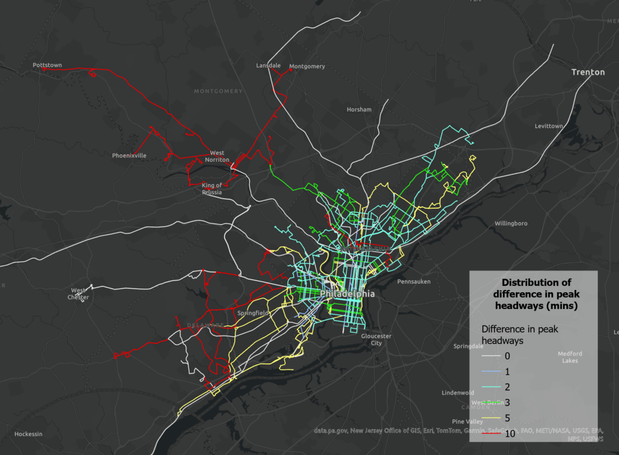
Distribution of difference in peak headways (mins) (Post-Service Reduction - Original)
The rescheduled routes with a 10-minute difference in peak headways
Line | Line_Name
53 | Route 53: Wayne-Carpenter to Broad-Hunting Pk
93 | Route 93: Pottstown to Norristown Transit Center
96 | Route 96: Lansdale to Norristown Transit Center
98 | Route 98: Plymouth Meeting to Norristown Transit Center
99 | Route 99: Phoenixville to Norristown Transit Center
103 | Route 103: Ardmore to 69th St TC
110 | Route 110: Penn State U to 69th St TC
111 | Route 111: Chadds Ford to 69th St TC
112 | Route 112: Delaware County Community College to 69th St Transit Center
117 | Route 117: Penn State University to I-95 Industrial Park
118 | Route 118: Newtown Square to Chester TC
131 | Route 131: Audubon to Norristown TC

Slide 5
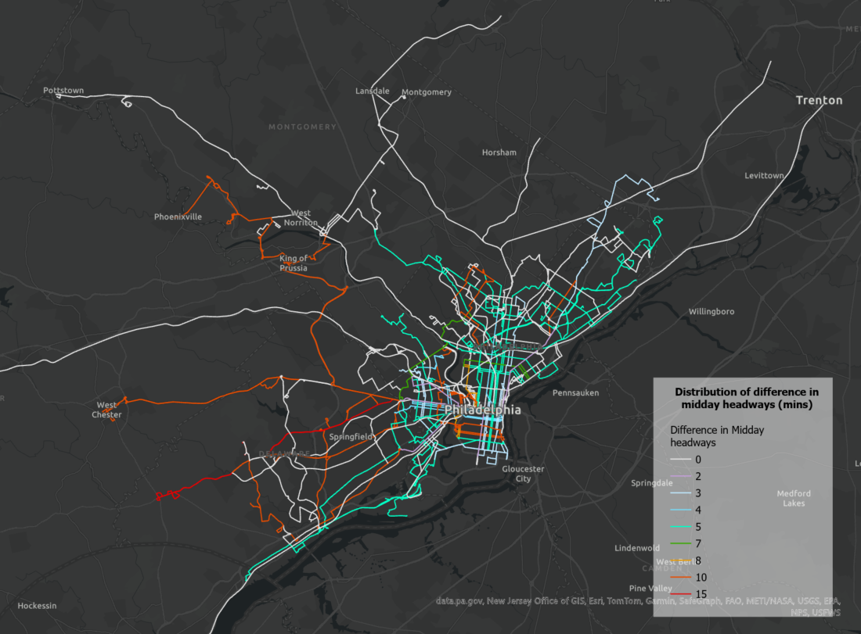
Distribution of difference in midday headways (mins) (Post-Service Reduction - Original)
The rescheduled routes with a 10-minute difference in midday headways
Line | Line_Name
29 | Route 29: Pier 70 to 33rd-Dickinson
38 | Route 38: 5th-Market to Wissahickon Transit Center
59 | Route 59: Castor-Bustleton to Arrott TC
64 | Route 64: 50th-Parkside to Pier 70
99 | Route 99: Phoenixville to Norristown Transit Center
104 | Route 104: West Chester University to 69th St Transit Center
109 | Route 109: Chester Transit Center to 69th St Transit Center
110 | Route 110: Penn State U to 69th St TC
114 | Route 114: Wawa Railroad Station to Darby Transit Center
123 | Route 123: King of Prussia to 69th St TC
71 (H) | Route 71 (H): Broad-Erie to Cheltenham-Ogontz
81 (XH) | Route 81 (XH): Broad-Erie to Cheltenham-Ogontz
Route 111: Chadds Ford to 69th St TC

Slide 6
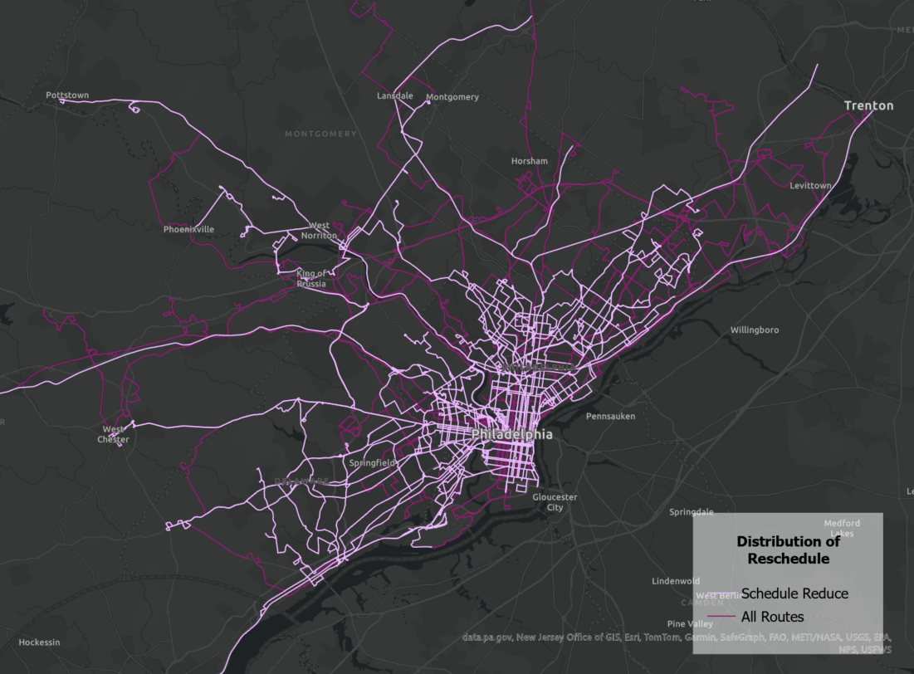
Distribution of Reschedule / Headway Change

Slide 7
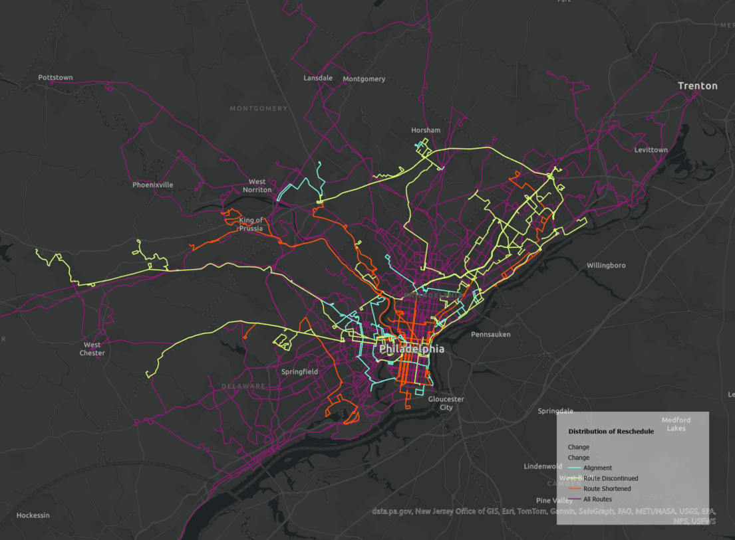
Distribution of Route Change / Alignment Change

Slide 8
GTFS Analysis

Slide 9
Peak hour and midday assumption
Peak period: 7:30 AM – 9:30 AM
Midday period: 11:00 AM – 1:00 PM
Note on limitations: A margin of error of approximately ±1 trip. For example, a bus scheduled at 7:29 AM would fall outside the peak-hour window and therefore not be counted. If the schedule is later updated and the same trip is shifted to 7:31 AM, it would now be included. In this sense, a slight schedule change can result in a difference of approximately one trip in the total count for a given time window.

Slide 10
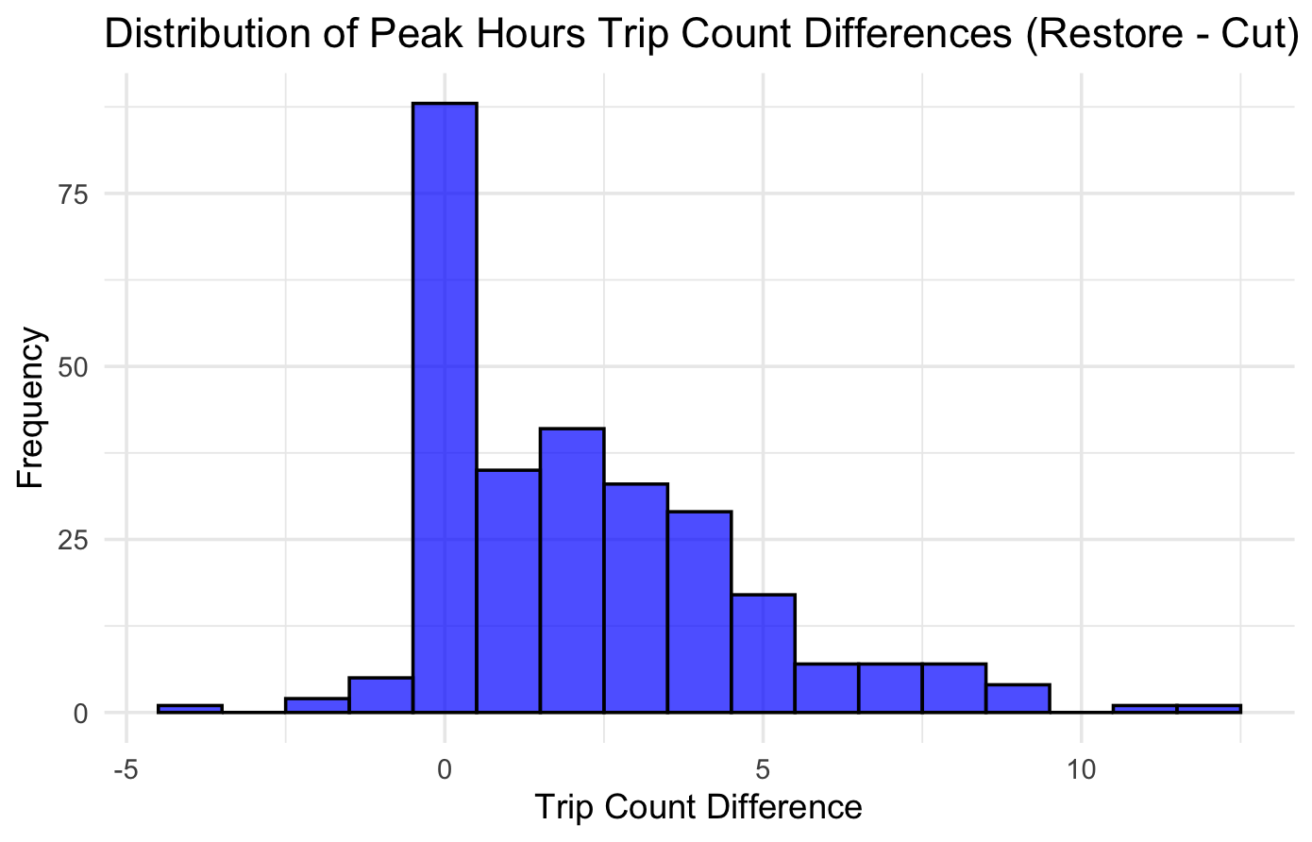
Peak hour capacity changes by route

Slide 11
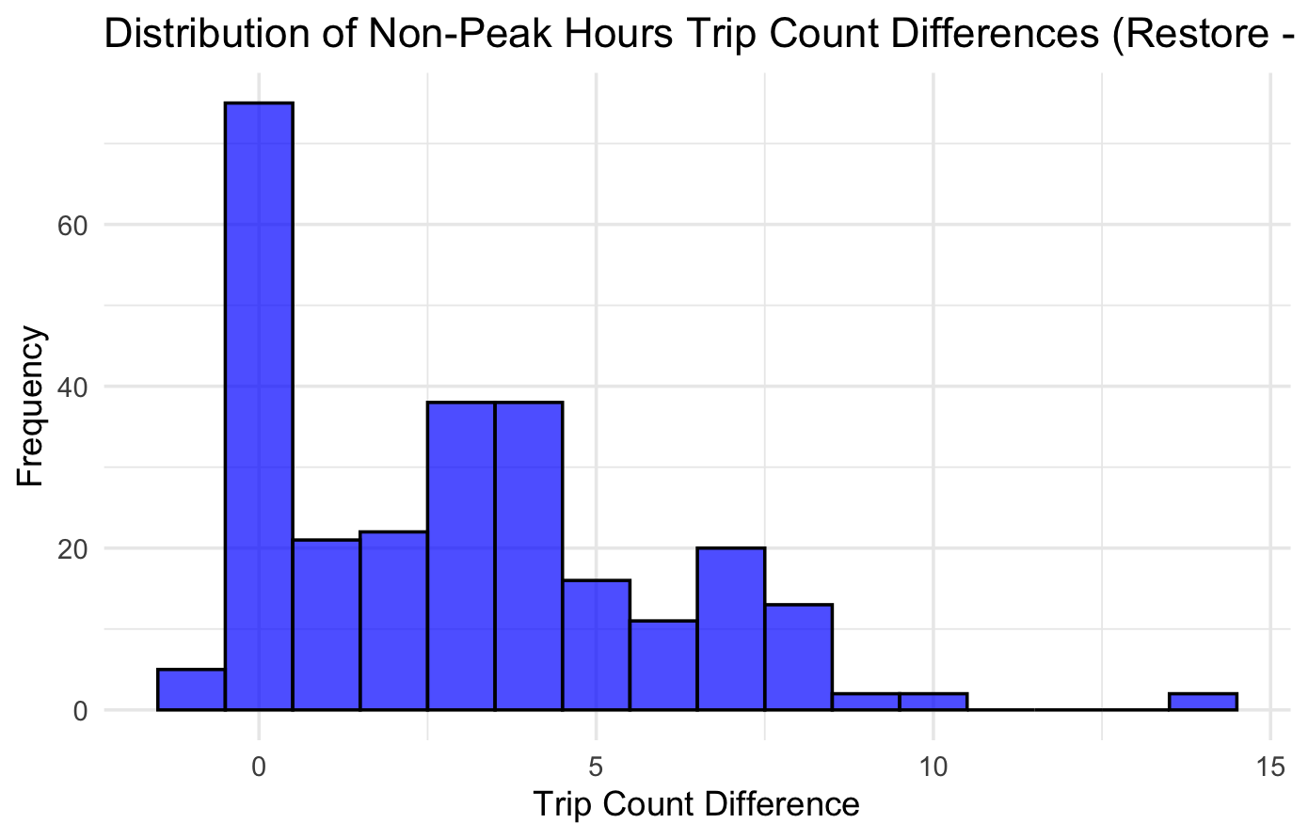
Non-peak hour capacity changes by route

Slide 12
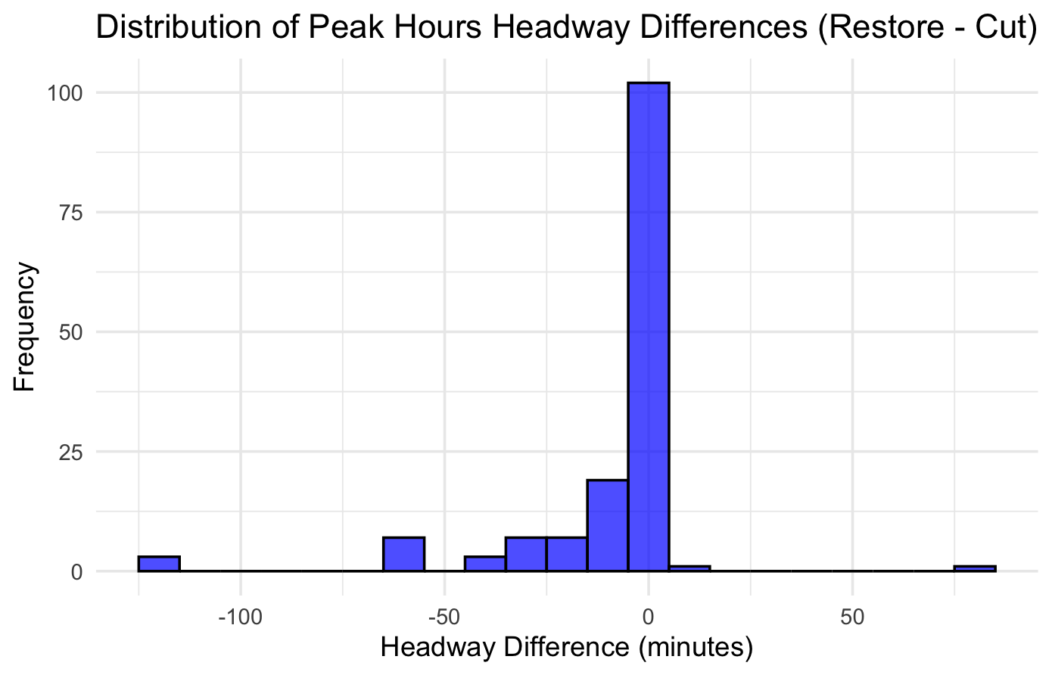
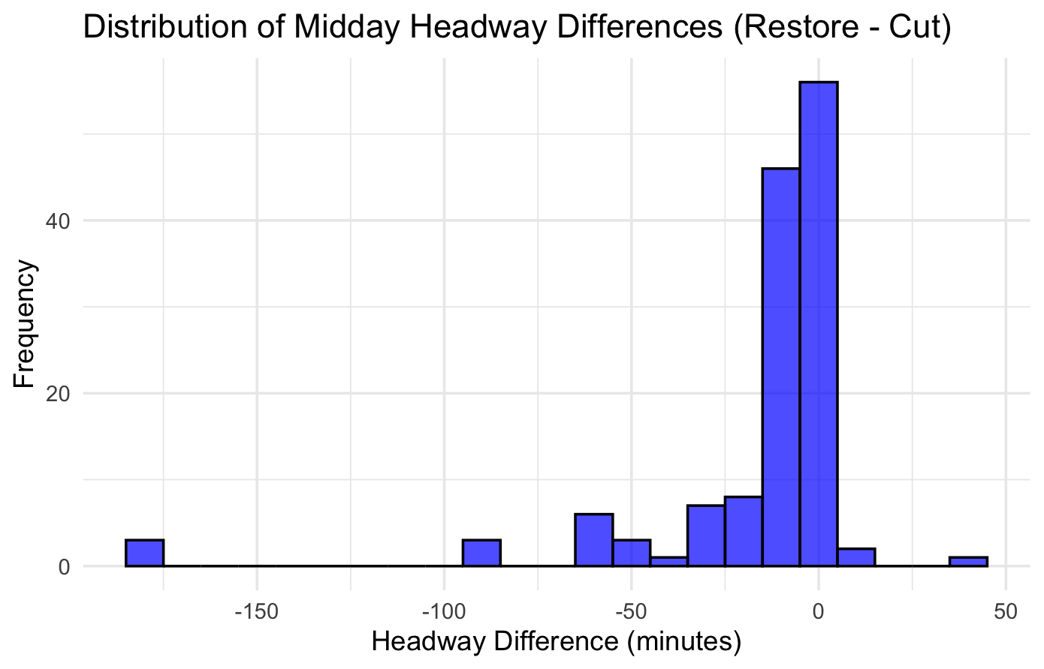
Headway analysis using GTFS

