Slide 1
Unif ied fonts make reading
more fluent.
T e xt here
Te xt here
Text here
Theme color makes PPT more convenient to change.
Adjust the spacing to adapt to Chinese typesetting, use the reference line in PPT.
Unified fonts make reading more fluent.Copy paste fonts. Choose the only optio to retain text……
Theme color makes PPT more convenient to chang e.
Theme color makes PPT more convenient to change.
Adjust the spacing to adapt to Chinese typesetting, use the reference line in PPT.
Unified fonts make reading more fluent.Copy paste fonts. Choose the only optio to retain text……
Th eme color makes PPT more convenient to change.
Theme color makes PPT more convenient to change.
Adju st the spacing to adapt to Chinese typesetting, use the reference line in PPT.
Unified fonts make reading more fluent.Copy paste fonts. Choose the only optio to retain text……
Theme color makes PPT more convenient to change.

Slide 2
T ext here
T ext here
Text h ere
Copy paste fonts. Choose the o nly option to retain text.
Copy paste fonts. Choose the only option to retain text.
Copy paste fonts. Choose th e only option to retain text.
Copy p aste fonts. Choose the only option to retain text.
Copy paste fonts. Choose the only op tion to retain text.
Copy paste fonts. Choose the only option to re tain text.
Te xt here
Text here
Text he re

Slide 3
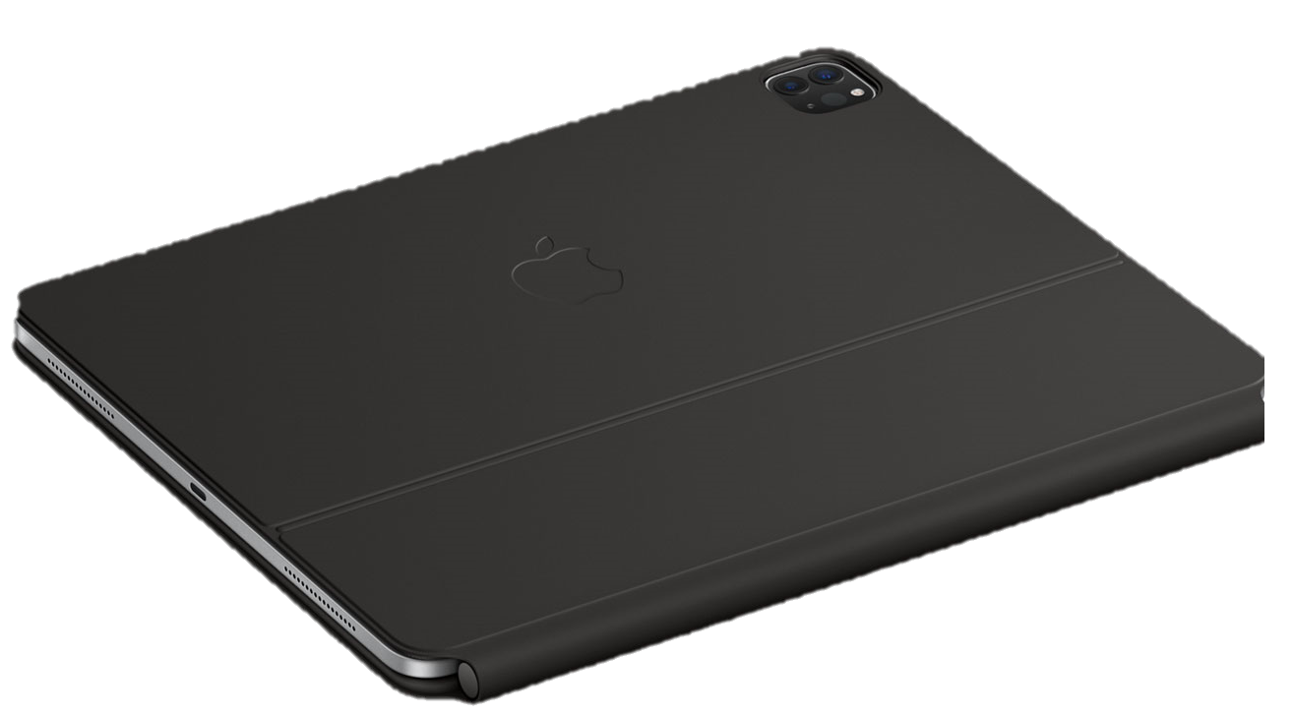

Slide 4
￥
$
62%
58%
TEXT HERE
TEXT HERE
Supporting text here
Supporting text here
….
Supporting text here
Supporting text here
….

