Slide 1
Movie Industry Analysis
for Microsoft
Aziza Gulyamova
January 8, 2021

Slide 2
Summary
Descriptive Analysis of the movie industry reveals useful information for Microsoft on how to produce movies that will bring the most profit and hit the top ratings.
Choose the right genre of movies to produce, such that “Action and Adventure”.
Choose the appropriate time to release a movie to get the highest amount of profit.
Choose the proper content rating, such that the most popular one or the least. The most popular rating might predict large scale of audience, but the least popular one can become “personal” niche in have less competitiveness.

Slide 3
Outline
Business Problem
Data & Methods
Results
Conclusion
Further Analysis

Slide 4
Business Problem
Produce movies that have popular genres and high rate of profits
Find the most profitable time to release the movies
Choose the right content rate for movies to produce

Slide 5
Data & Methods
Datasets are provided from different sources, such that:
IMDB
Box Office Mojo
The Number movie Budgets
Rotten Tomatoes

Slide 6
Data & Methods
The Project uses descriptive analysis method, such that distribution and bar graphs, statistical functions. The method helps to explore the dataset, filter out less meaningful data, compare different databases and provide insights on relations between datasets.

Slide 7
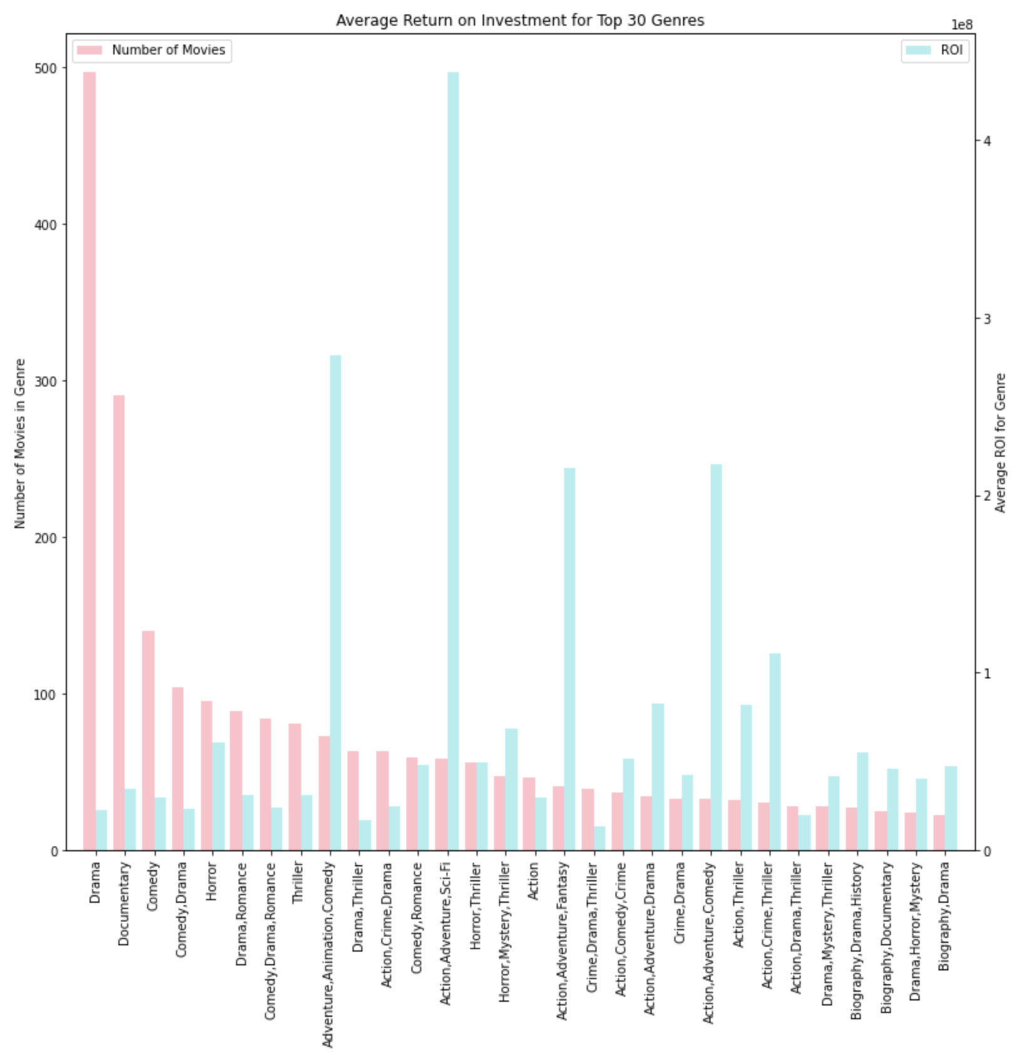
Results
Out of 30 Top genres the most profitable ones are "Adventure, Animation, Comedy", "Action, Adventure, Sci-Fi", "Action, Adventure, Fantasy" and "Action, Adventure, Comedy" genres.
The most produced genres are "Drama", "Documentary" and "Comedy" while having low return on investment.

Slide 8
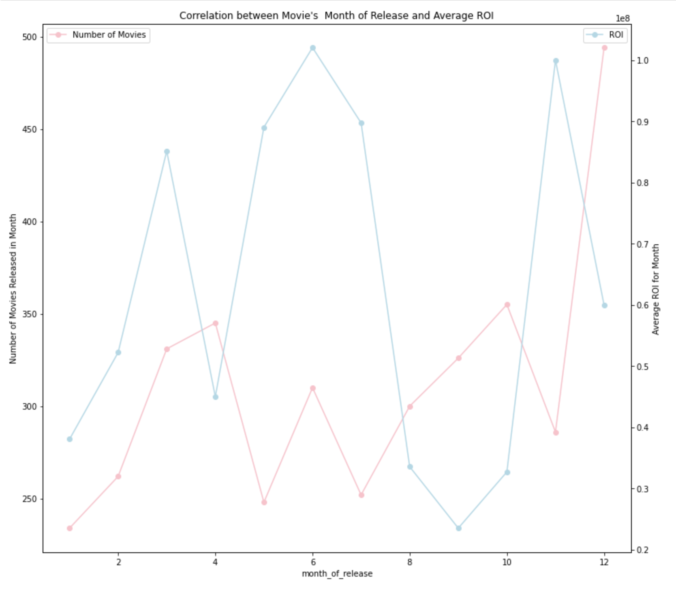
Results
The calculation of correlation between average rating and runtime of the movie, shows that these two datasets are not related.
The most profitable months for movie releasing are May, June, July, November. During these months tickets sales are high, because of the summertime, whereas in April, September, October and December are the least profitable times. The largest number of movies are released in December, due to holiday season.

Slide 9
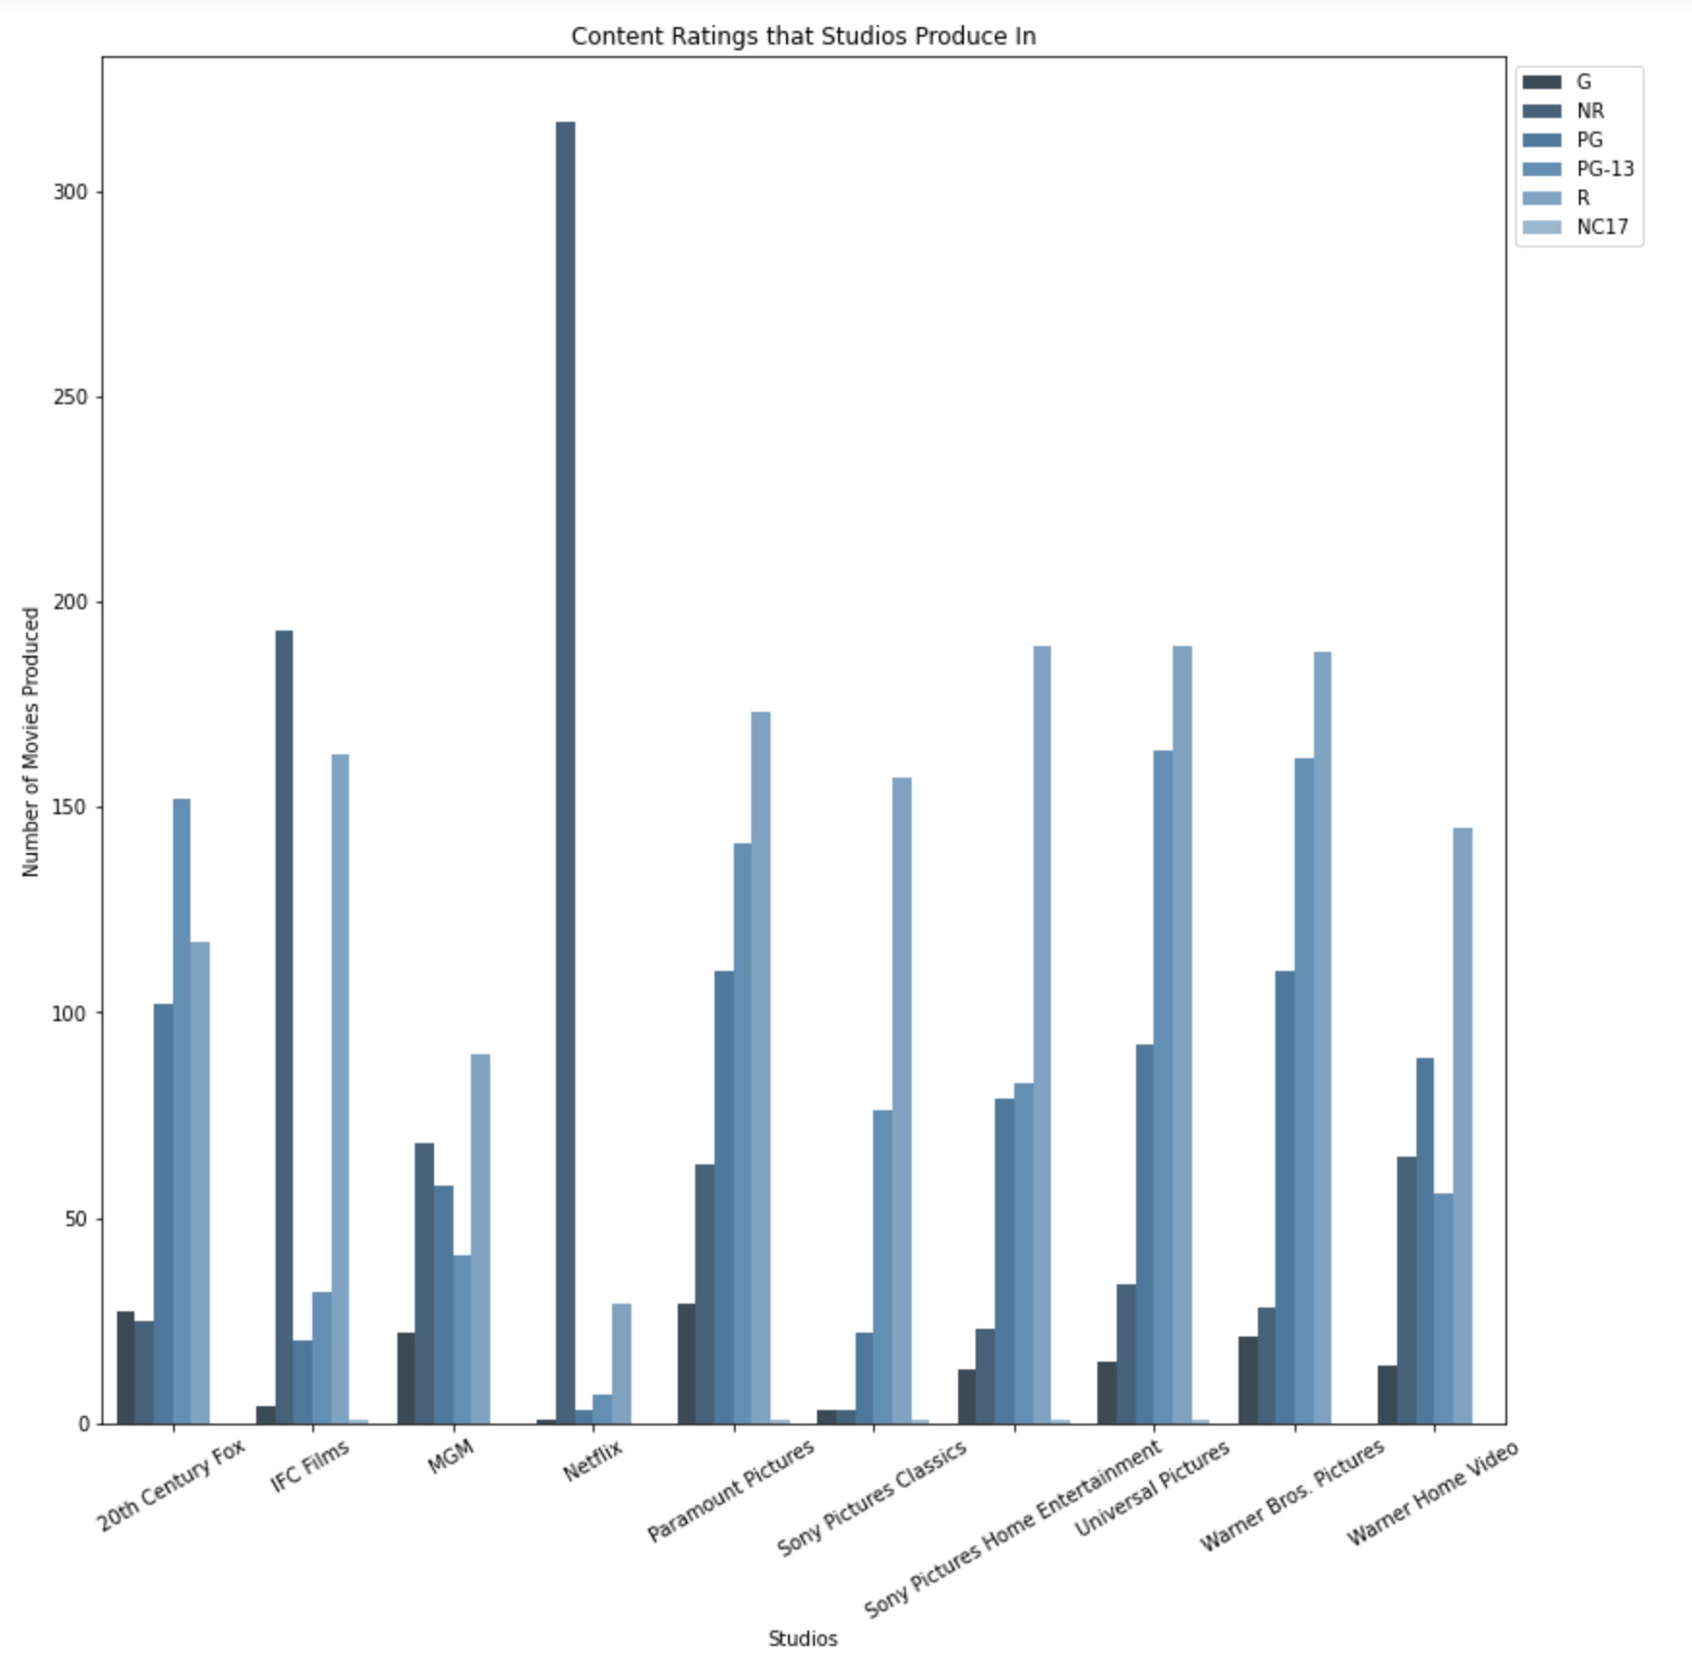
Results
The most common content rating is "R" rating, which is movies for audience older than 17. The least produced ones are "G"- General Audience and "PG" - Parental Guidance Suggested. Large number of movies by "Netflix" have not been rated("NR" - not rated).

Slide 10
Conclusion
It would be the most profitable for Microsoft to make movies in "Adventure, Animation, Comedy", "Action, Adventure, Sci-Fi", "Action, Adventure, Fantasy" and "Action, Adventure, Comedy", because they have highest return on investment and not the most produced genres. Thus, increasing the chances to get interest of audience.
When producing movies, do not give extra attention to runtime, because the ratings are not correlated with length of movie.
The most profitable months for movie release are May, June, July and November. Microsoft would hit highest ROI during these months. Also, it is recommended to avoid releasing in April, September, October and December, since profits are low during these times and December has the highest number of releases.
When choosing the content rating, it would be suggested to choose the most popular one, such that "R". Because it would have high chances to get interest of audience. Or choose the least produced one as a niche, which might be less competitive.

Slide 11
Further Analysis
Modeling following analysis could give more detailed insights to Microsoft about the industry:
Study of relation between average rating and actors in the movie could be helpful to strategize the casting for the moving
Comparing the profits from domestic gross and worldwide gross will help to focus on proper audience and market
Analysis of movies based on critics rating and directors, will help to identify which directors get the highest ratings from critics.

