Slide 1
Kings County home sale price analysis

Slide 2
goals
Use Linear Regression Modeling on provided data to make a recommendation of home improvement projects for King County homeowners.

Slide 3
Data
Datasets provided by Kings County Department of Assessments:
Parcel Record
Real Property Sale Record
Residential Building Record
Look Up Record

Slide 4
Methods
Libraries used for the Project analysis and visualization:
Pandas, Statsmodels, Scikit Learn, Seaborn and NumPy

Slide 5
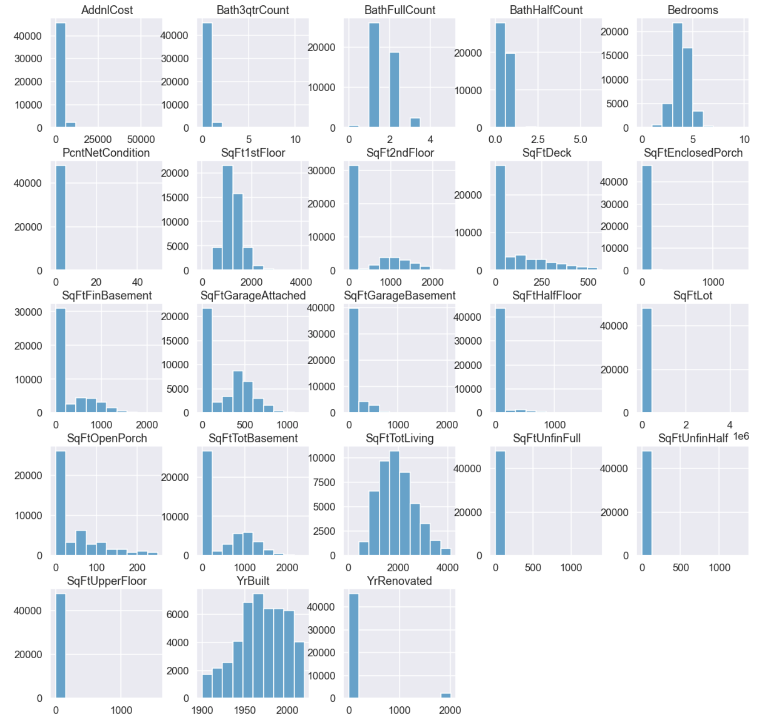
process
Most of the features are not normally distributed
SqFt1stFloor, Bedroom, SqFtTotLiving, YearBuilt close to normal distribution
* Normal Distribution resembles bell shape curve.

Slide 6
Modeling
Baseline Model – Linear Regression with SqFtTotLiving Feature and SalePrice target.
Final Model – Linear Regression with following features:
SqFtTotLiving_sqrt
SqFtEnclosedPorch
SqFtOpenPorch
Hot Water
Radiant
Elec BB
Gravity
Other (Heat System)
Assumptions of linear regression were checked for all models.

Slide 7
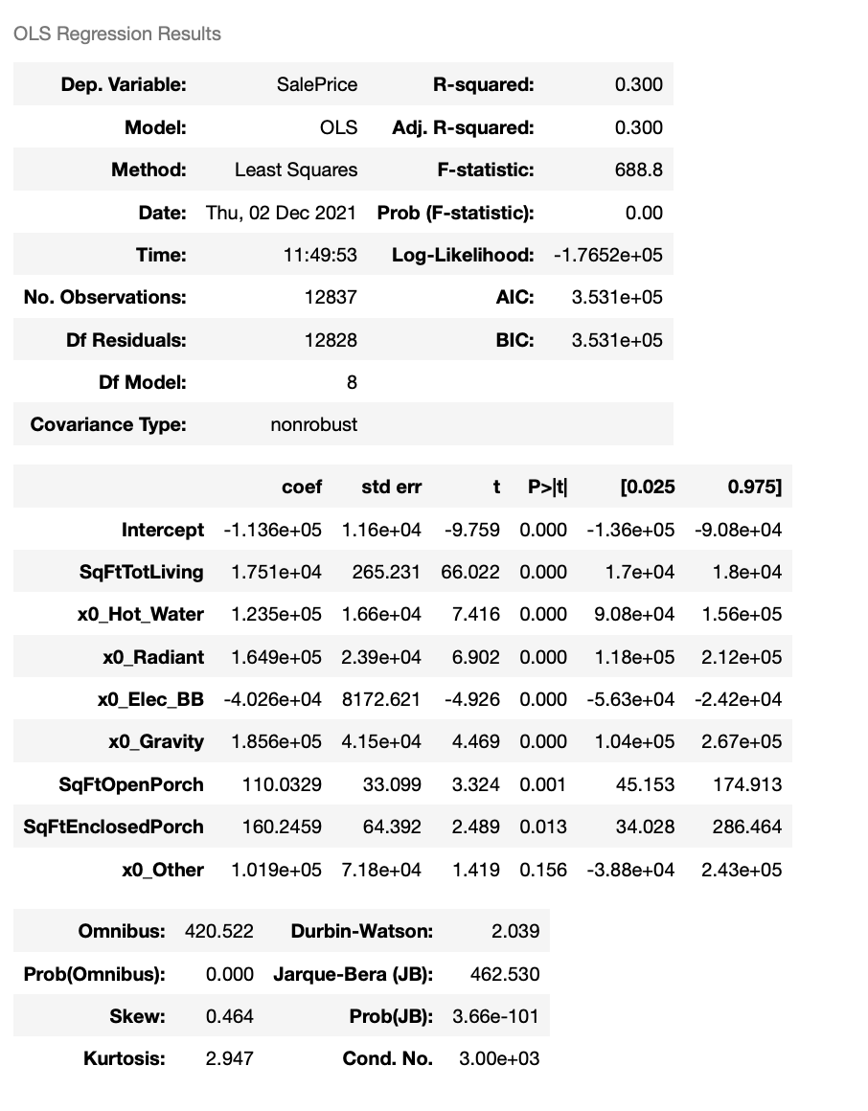
modeling
Square Feet of living space increases house price by $17 500
Electric Baseboard heating system – low price
Enclosed porch – higher price

Slide 8
Results
Enclose porch - the price of the house increases by $160 per square feet if the porch is enclosed.
Upgrade to Forced Air system the Elec BB Heat Systems due to price increase.
Increase the square feet of Living Space - every foot upgrade increases house price by $17 500.

Slide 9
Next Steps
Further investigation of houses with fully open porches and fully enclosed porches. Find average price for both features.
Increase the Living Space by converting Basement Garage to living area and investigate effect on the sale price.
Further analysis of heat system to calculate average sale price for each heat system.

Slide 10
Thank you! email:agulyamova14@gmail.com GitHub

