Slide 1

Top 5 zip codes in Florida to invest in
Author: Aziza Gulyamova

Slide 2
Summary
Analyze median monthly housing sales prices for Florida zip codes and choose the best zip codes to further analyze for potential investment.

Slide 3
outline
Business Problem
Data Information
Data Preparation
Modeling
Summary

Slide 4
Business Problem
The real investment firms are interested in Top 5 Florida Zip codes and their possible ROI. The following are assumptions of firms:
The minimum capital of investment is $200,000
The goal is to invest in highly urbanized Florida areas
Low risk factor (low volatility threshold)

Slide 5
Data Information
Data Obtaining
Data cleaning
The Home Listing and Sales dataset was provided by Zillow Research.
The data represents median monthly housing sales prices over the period of April 1996 through April 2018.
Each row represents a unique zip code. Each record contains location info and median housing sales prices for each month.
Select observation of Florida State
Select urbanization rank in top 15 quantile
The minimum median price of housing $200,000
The volatility range of the median price 1.7 - 2.9
The ROI rate greater than 9.5%

Slide 6

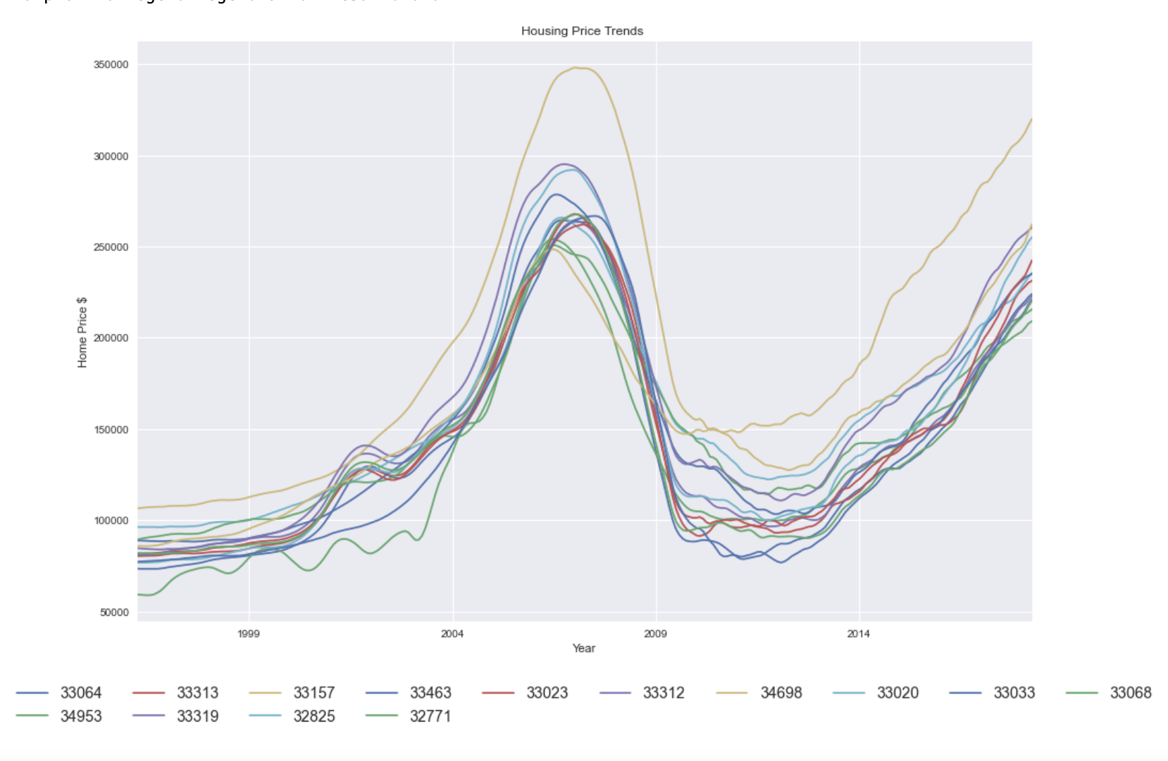
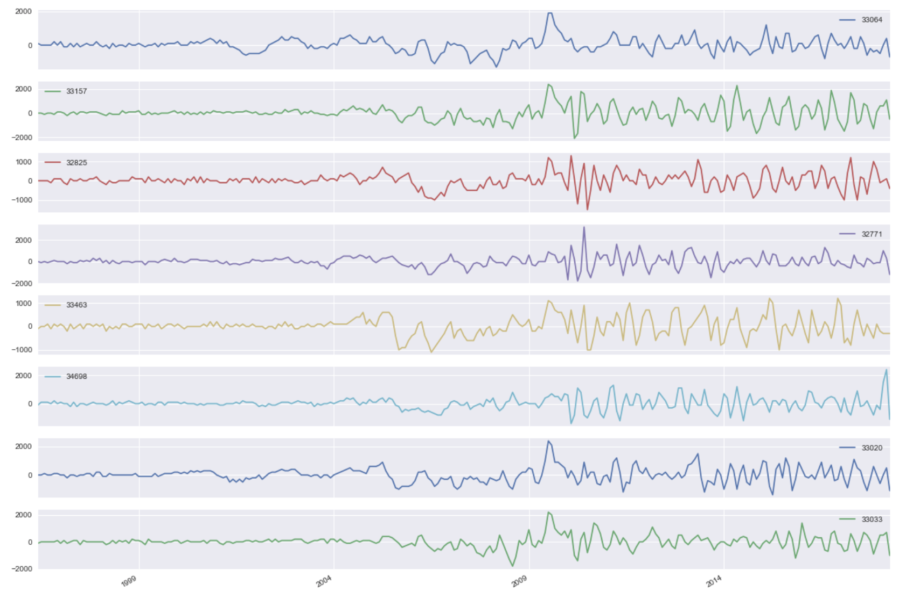
Data Preparation
Stationarity – mean, variance and covariance are constant over time – no upward/downward trends
Convert non-stationary data to stationary.

Slide 7
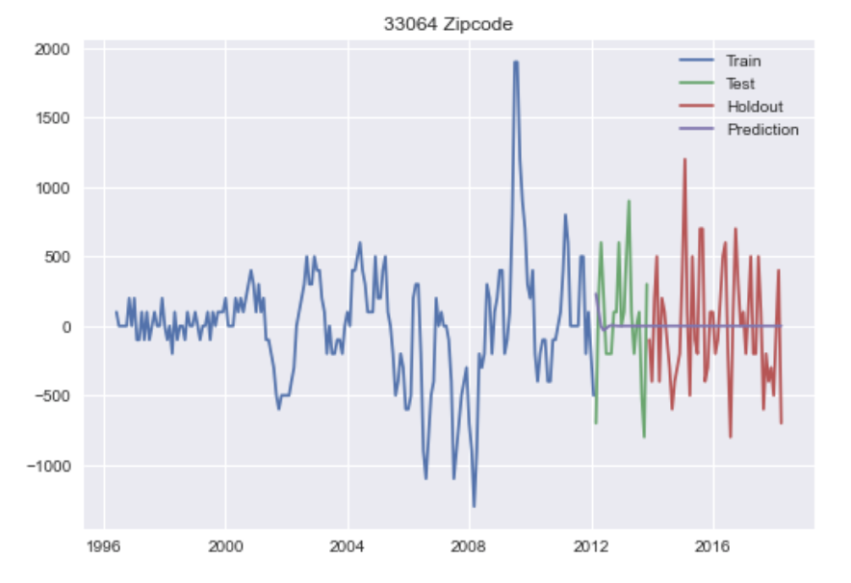
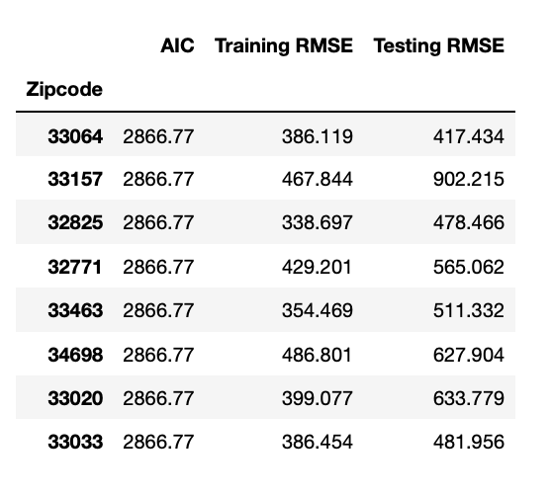
modeling
Models built: Auto – ARIMA, SARIMAX(2,0,0), Facebook Prophet.
Best Performance – SARIMAX (2,0,0)
Metrics: lowest AIC value and RMSE values.

Slide 8
Summary
Results:
All training data overfitted models.
The models are all very skewed because of the market crash in 2009.
Relying on the project assumptions, data exploration and modeling, following zip codes are chosen as best ones to invest in:33064, 32825, 32771, 33033, 34698
Notes:
Real estate predictions may vary due to unseen fluctuations in the market.
Next Steps:
Obtain data after 2018 for current predictions.
Use samples only after Great Recession period to model.
Set ROI threshold to lower values.

Slide 9
Thank you!
GitHub: https://github.com/zyazyaG/Top_5_Zipcodes
Email: agulyamova14@gmail.com

