Slide 1

Predicting Students’ Performance
Aziza Gulyamova

Slide 2
Business Problem
With COVID-19 accelerating online learning method, Educational Institutions are interested in increasing the success rate of the students.
Academies are interested in gaining knowledge of students' outcomes ahead.

Slide 3
Business Understanding
Advantages of predicting student’s performance outcome:
Learn student’s current educational status
Navigate student in proper direction
Improve institution’s success rate

Slide 4
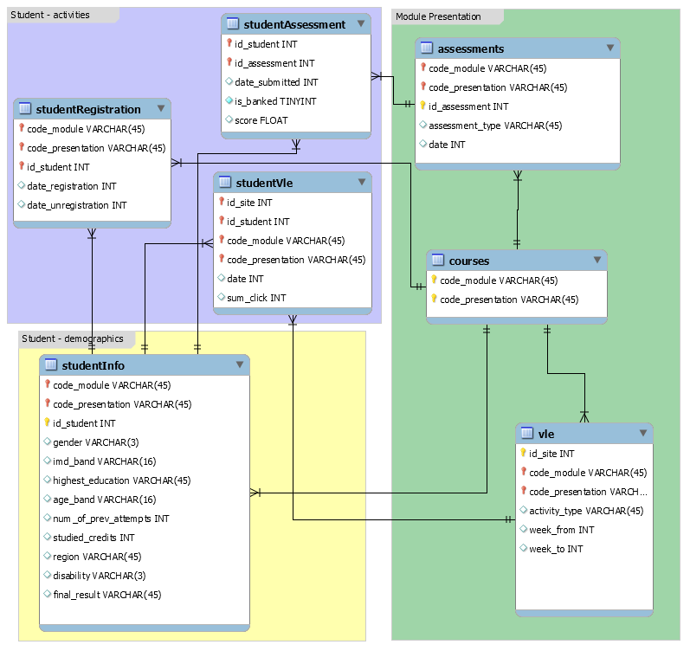
Data
Open University Learning Analytics Data:
7 tabular files connected via specific keys
3 categories of data: Demographic, Students Activities, Module Information
32,593 student observations, 7 modules
Figure Source: https://analyse.kmi.open.ac.uk/open_dataset

Slide 5
Data Cleaning
Observations from beginning of the course to half term – 135 days
Drop unnecessary features
Bin target variable into two categories: Pass and Fail
Merge required features into one table

Slide 6
Features and Target
Features:
Course ID
Date of registration
Number of clicks on VLE
Gender
Region
Highest education
Index of Multiple Deprivation
Age
Number of attempts
Studied credits
Disability
Mean score of assessments
Length of the course
Target: final result

Slide 7
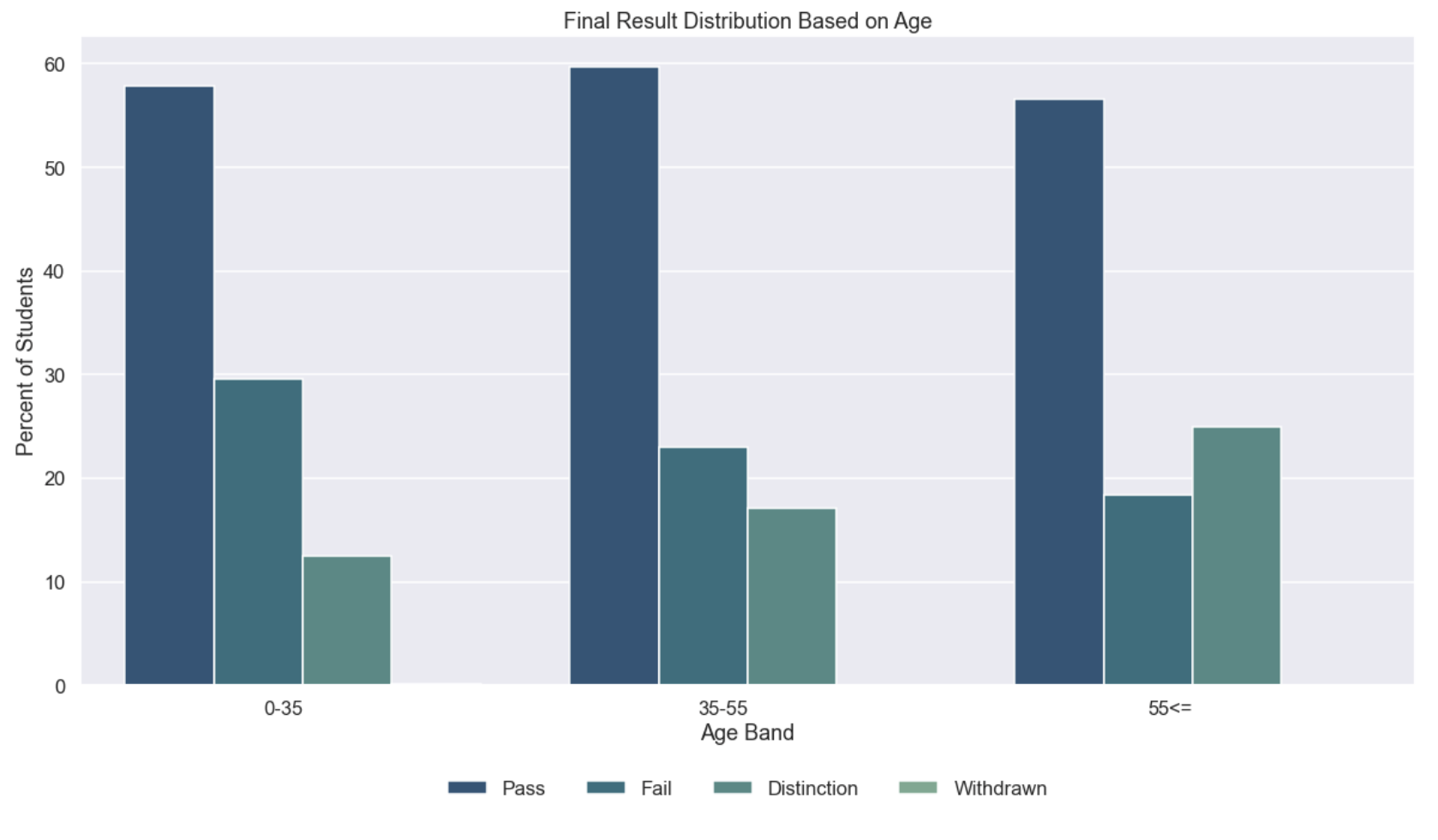
Explorations
With age getting higher, the rate of passing gets higher also
Students in 55 and up range have higher values of distinct results

Slide 8
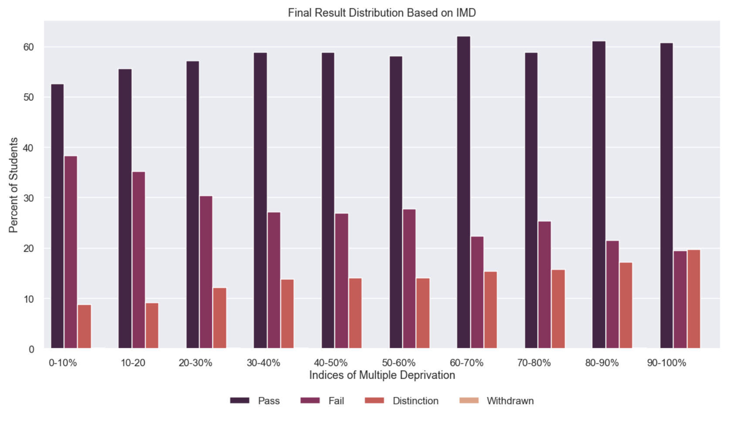
Exploration
In all groups, the passing percentage has highest value.
The lower the level of IMD, the higher is the fail rate.
Note: Index of Multiple Deprivation (IMD) - is the official measure of relative deprivation for small areas in England.

Slide 9
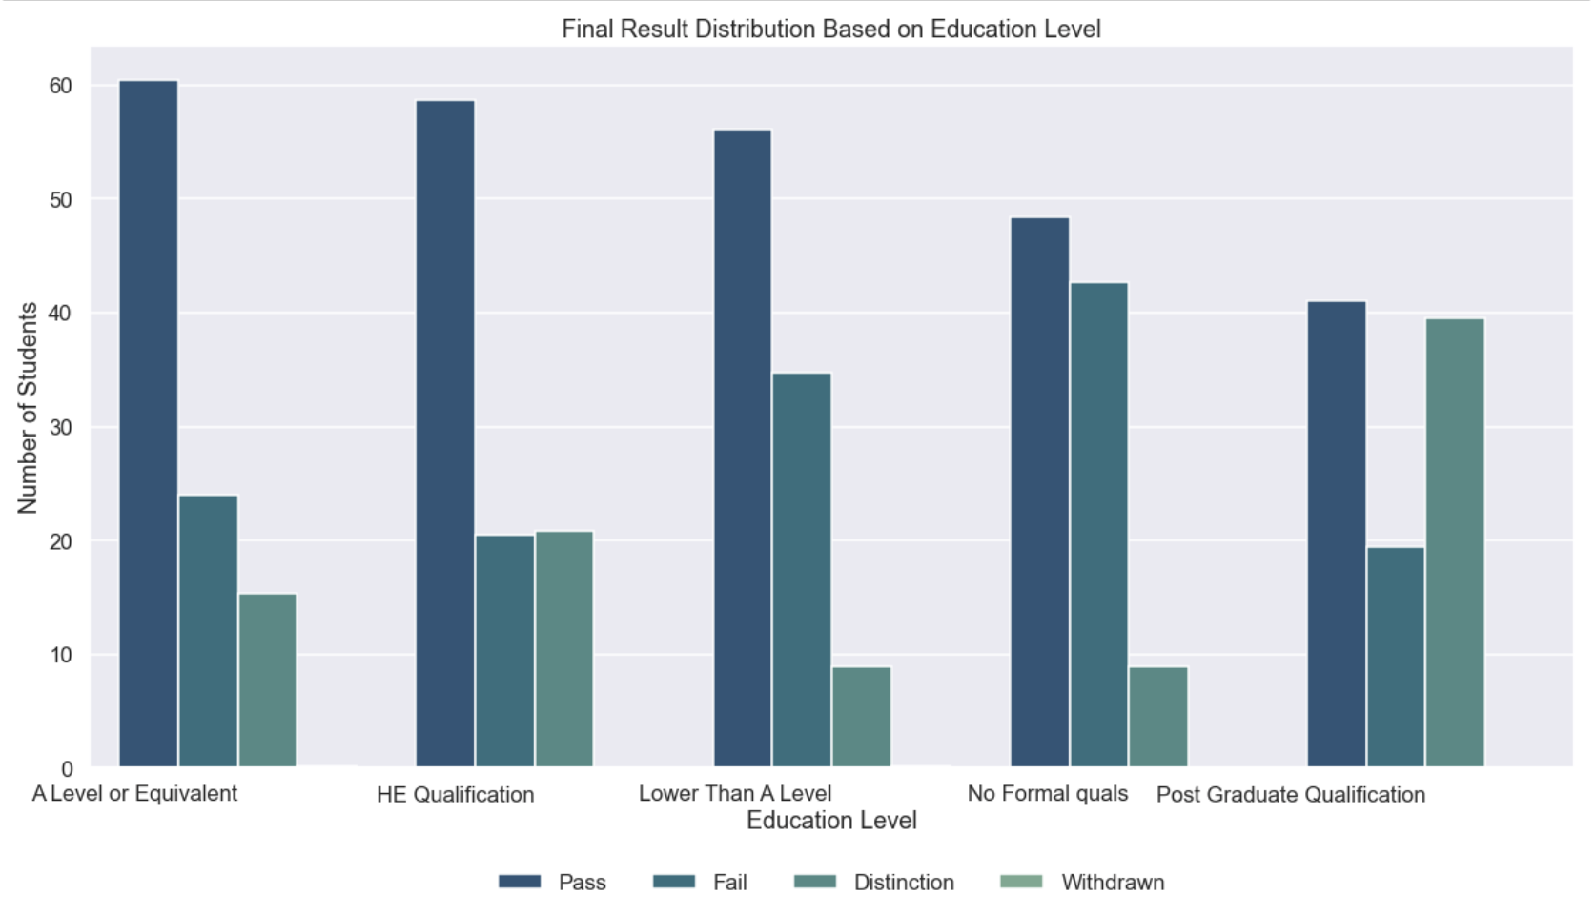
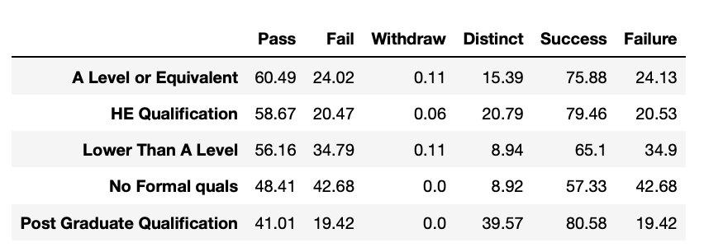
Explorations
Students with no formal qualifications have lowest rate of passing.
Students with A level of education or lower tend to withdraw.

Slide 10
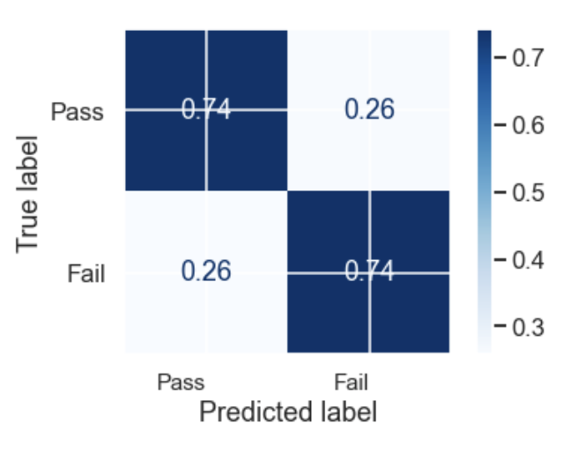
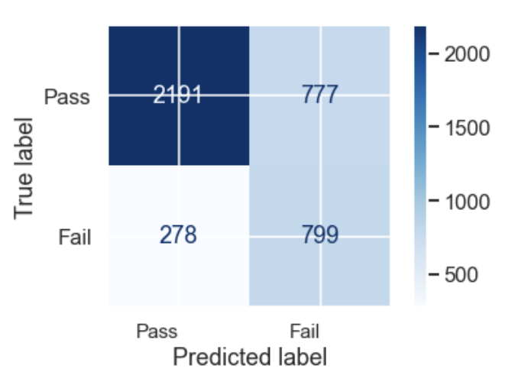
Modeling
Best performed model – Logistic Regression with Recall Score of 0.73 and Accuracy Score of 0.73.
The model predicted 74% of failing students as failing, and only 26% were falsely predicted as passing.

Slide 11
Recommendations
Provide additional study sources and tools.
Advise students to closely interact with online study materials
Determine optimal course length.
Provide excessive support for students who are in regions with low IMD.
Advise students in lower age range to closely communicate with students that are older.

Slide 12
Thank You!
GitHub: https://github.com/zyazyaG/Students_Performance
Email: agulyamova14@gmail.com

