Slide 1
Classification of Customers complains
Author: Aziza Gulyamova

Slide 2
Business Problem
The customer service plays important role in business success. Most of the businesses have to deal with clients’ unsatisfaction. This project aims to categorize the customers complaints in banking system.
Help to automatically categorize the reason of client's unsatisfaction
Get insights on how to optimize the work of customer service
Improve the success of banking companies

Slide 3
Overview
Data
Data Cleaning
EDA
Modeling
Conclusion

Slide 4
Data
The data for this project was obtained from Consumer Financial Protection Bureau. It is a collection of complaints about consumer financial products and services that were sent to companies for response. The data consists of more than 2 million observations and 17 features related to complaint.
Link to data: https://catalog.data.gov/dataset/consumer-complaint-database

Slide 5
Data cleaning
Remove unnecessary features
Drop missing values
Convert complaint narrative to vectors

Slide 6
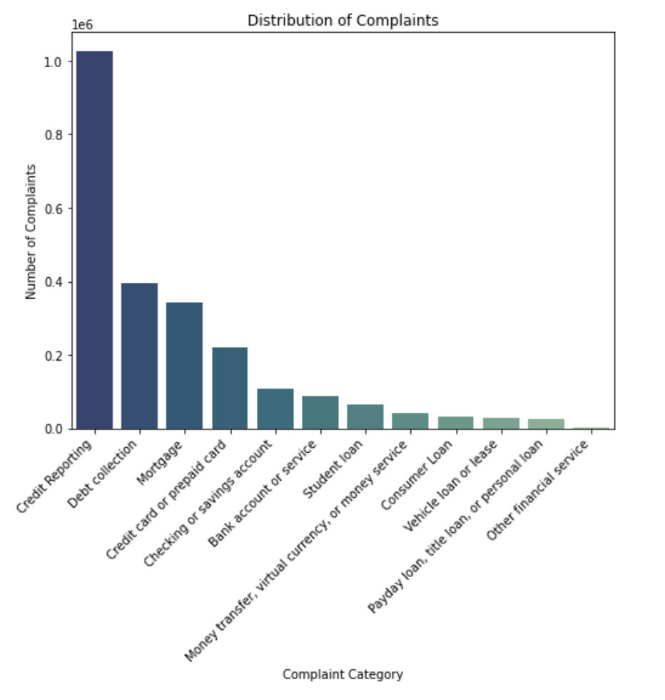
EDA (Exploratory analysis of data)
Most of the complaints are related to Credit Reporting Category

Slide 7
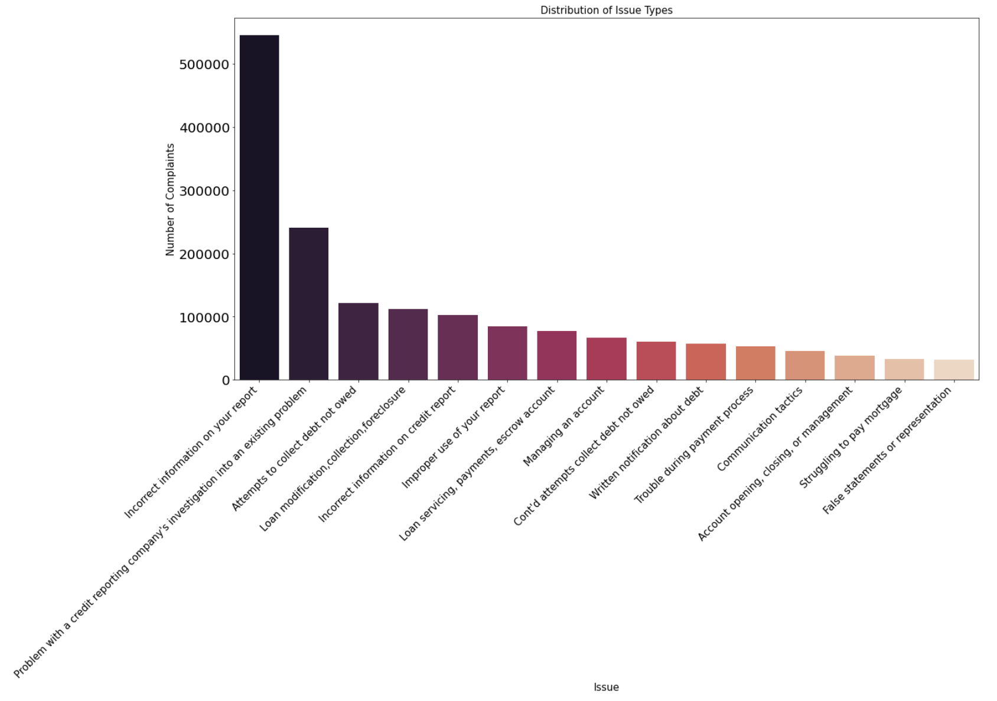
EDA
The most common issue is that company has incorrect information

Slide 8
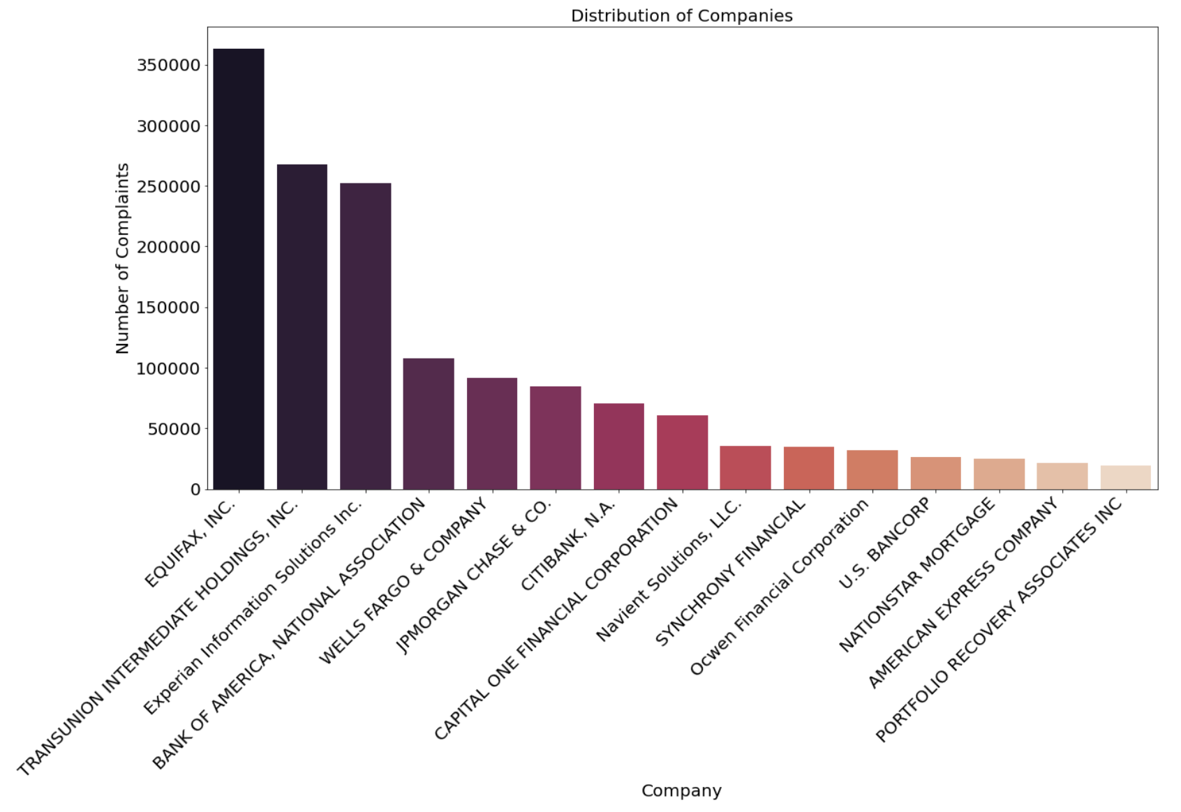
eda
Companies that have most complaints are EQUIFAX and Transunion

Slide 9
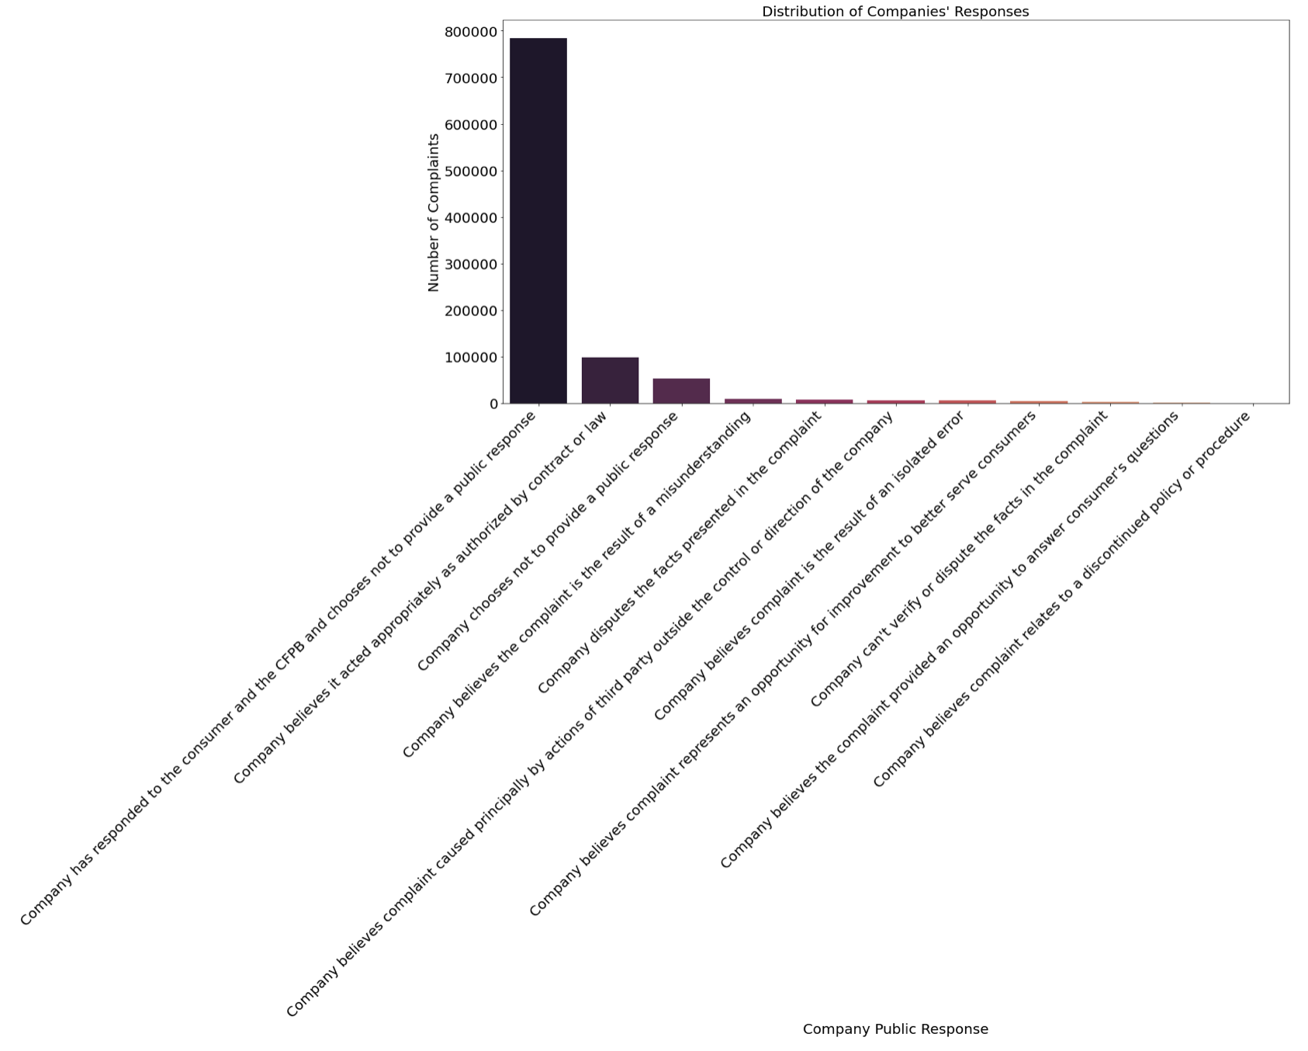
eda
Vast amount of the complaints were responded by companies to customer and CFBP

Slide 10
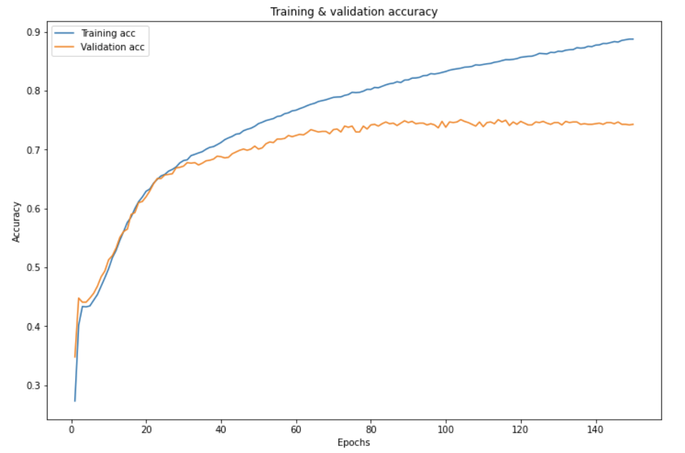
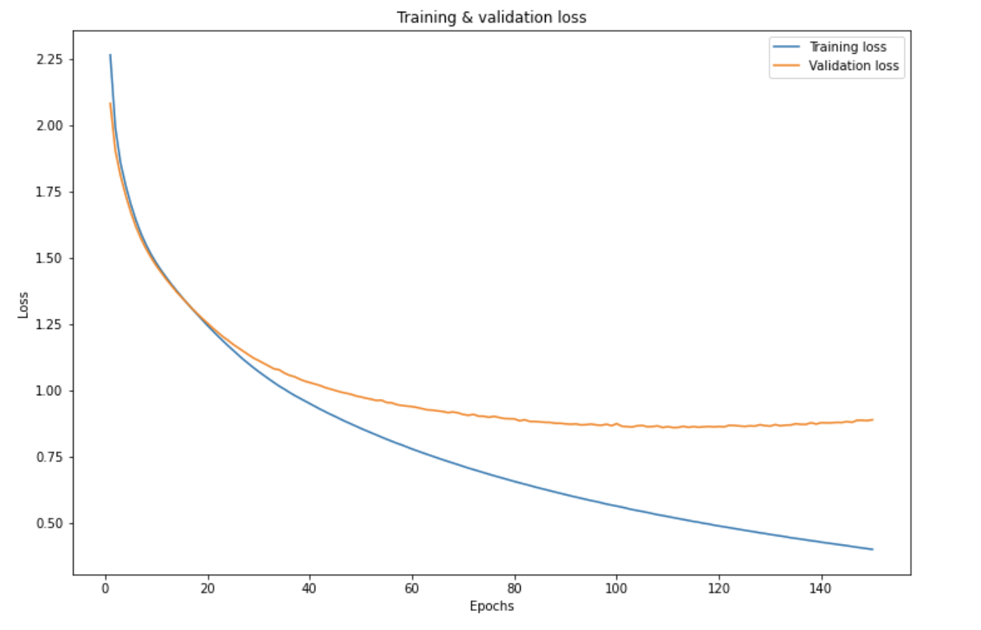
modeling
Baseline Model – Sequential with 2 hidden layers
Accuracy Score – 0. 88
High Accuracy but overfitting

Slide 11
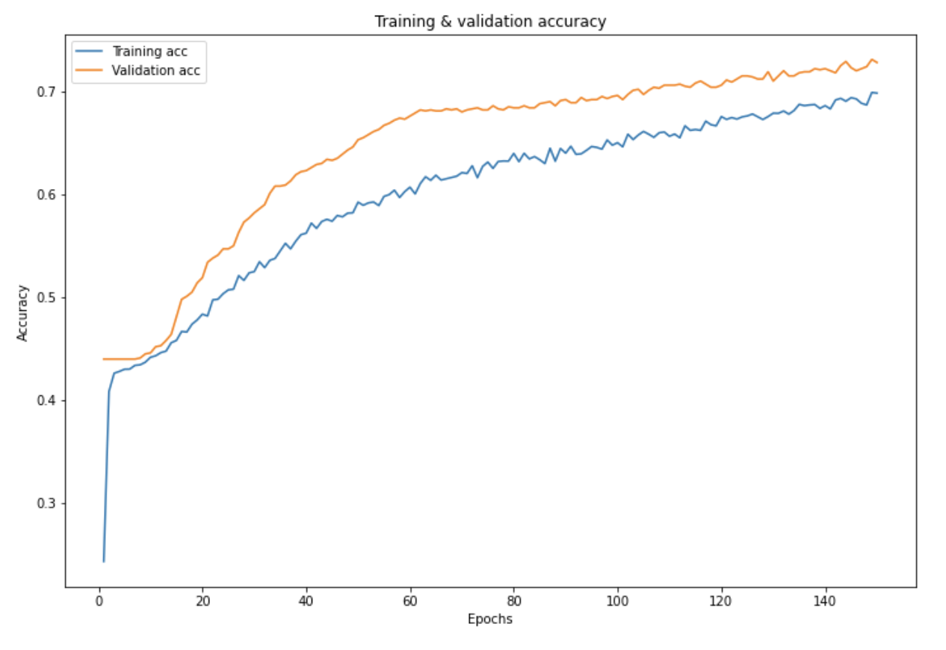
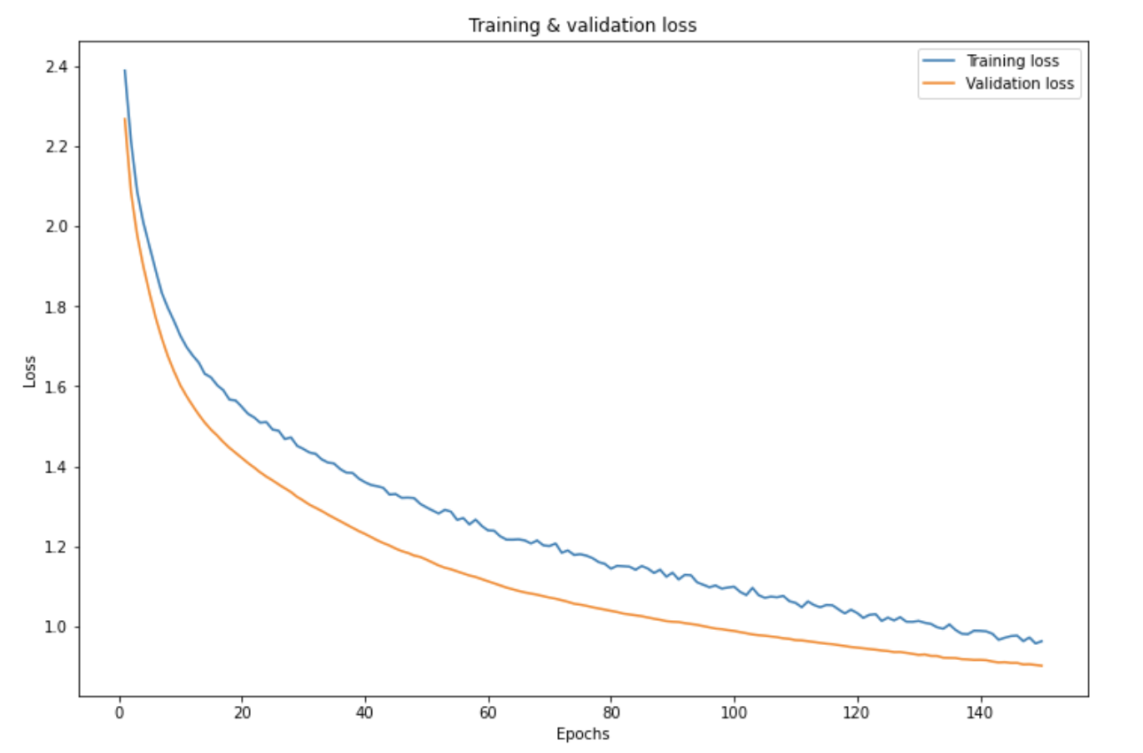
modeling
Final Model – Sequential with 2 hidden layers and Dropout Regularization
Accuracy Score – 0. 78
High Accuracy and No Overfitting

Slide 12
Conclusion
Most of the complaints are about credit reporting and it would be suggested to closely investigate the credit department of the banks.
Since the complaints are mostly related to incorrect information, it would be beneficial to improve the ability of proper data handling
The companies such as Equifax and Transunion should closely investigate their credit report department.

