Slide 1
Detecting phenological transition dates by multiple deep learning models
Zhaoyang Cheng
August 28, 2018

Slide 2
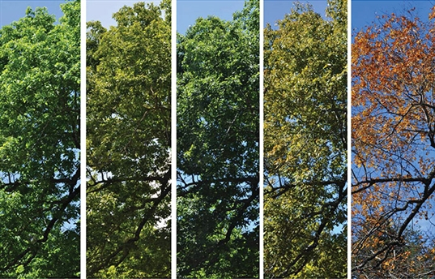
Vegetation phenology
Vegetation Ecosystem

Slide 3
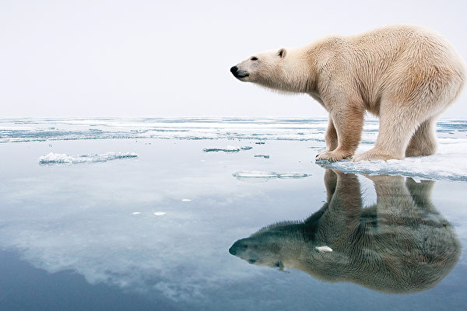
Background
Global Warming
Extreme Weather
Deep learning wave

Slide 4
Phenological transition dates
1. majority of trees starts leafing out
2. green leaves area reaches maximum
3. the leaves first start changing color after summer
4. the majority of trees loses all leaves

Slide 5
Detect transition dates: Requirements
Automatic
Time-saving
Accurate

Slide 6
Botanist’s idea
Vegetation Index (VI)
Green Chromatic Coordinate (GCC)
GCC= $\frac{G}{R+G+B}$
Red Chromatic Coordinate (RCC)
RCC= $\frac{R}{R+G+B}$

Slide 7
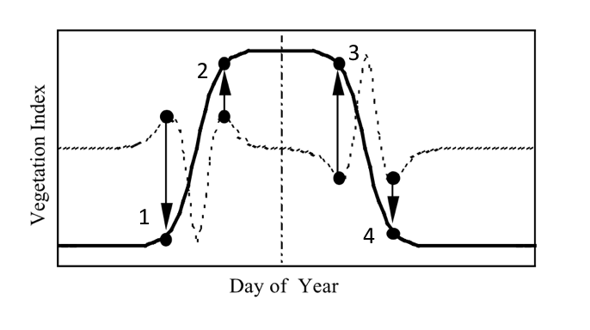
Botanist’s idea
1. Fitting model by VI
2. Calculate Rate of change of curvature (K)
3. Extremas of K
Transition dates
Ref. Zhang, Xiaoyang, et al. "Monitoring vegetation phenology using MODIS." Remote sensing of environment 84.3 (2003): 471-475.

Slide 8
Limitations
Greenness & Redness is inadequate
Difficult in defining fitting equation
Not robust to weather-induced noise

Slide 9
Characteristic of Data&Label
Data:
Annual images taken per 30 min.
Label:
For each event, one transition date in a year

Slide 10
Solutions to computer vision problem
1. Classification after data processing
2. Regression: images & dates
3. Shot boundary detection of ‘video’

Slide 11
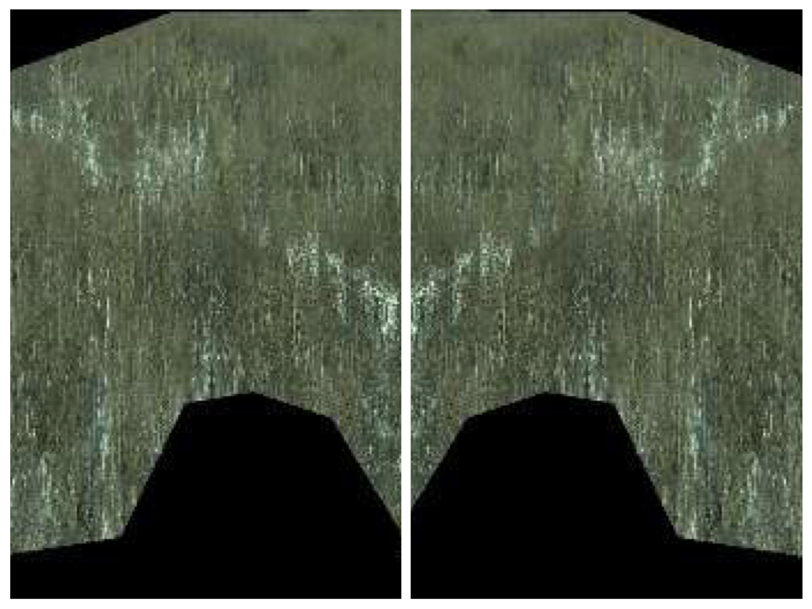
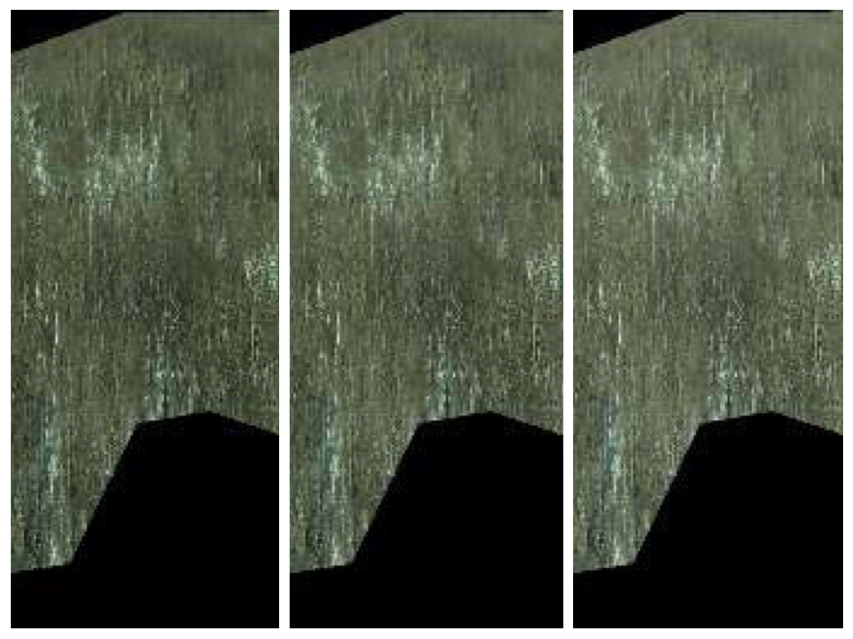
Classification
Shortage of labeled images
Data augmentation
Horizontal flipping
Gamma Correction
original
flipped
darker
original
lighter

Slide 12

Classification
Label augmentation
June 9
June 4
June 5
June 6
June 7
June 8
June 9
June 10
June 11
June 12
June 13
June 14
4 event classes+1 ‘noise’ class

Slide 13
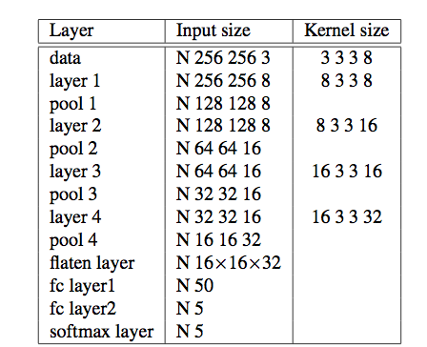
Classification
Two principles when designing CNN
1. multiple stacked small size kernel
2. Pyramid structure:
the number of feature maps increases by a factor of multiple

Slide 14
Classification
Pipeline in detecting transition dates:
1. Augment data and label
2. Train a CNN model
3. Feed test images to trained model and get predicted dates of each event
4. Using the averaged predicted date of each event to represent their transition date

Slide 15
Regression: images & dates
Independent variables X:
Network-extracted feature
Dependent variables Y:
Day of year of image
CNN without softmax layer
Output dimension of last fully connected layer is one

Slide 16
Regression Network
Pipeline in detecting transition dates:
1. Train the regression net
2. Feed test images to trained net and get their predicted date
3. Find those test images whose predicted dates are identical or
close to transition dates on training dataset
4. Dates of above test images are regared as transition dates

Slide 17
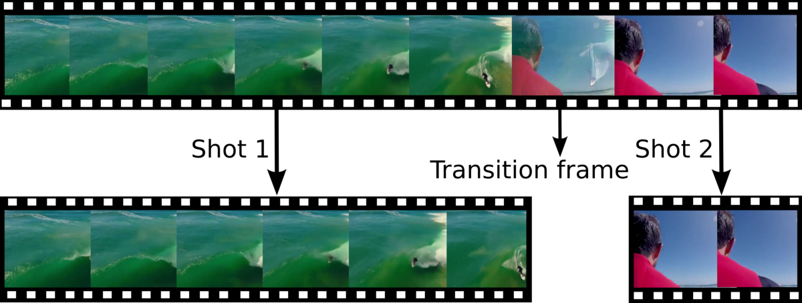
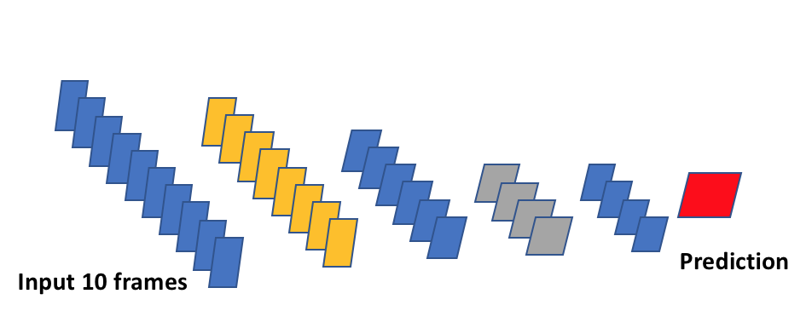
Shot boundary detection
Ref. Gygli, Michael. "Ridiculously fast shot boundary detection with fully convolutional neural networks." arXiv preprint arXiv:1705.08214 (2017).
Fully convolution network (FCN) and
‘valid’ padding

Slide 18
Shot boundary detection
Pipeline in detecting transition dates:
1. Divide annual images into snippets of 10 frames
2. Label snippet as positive if containing a boundary
3. Train and find test snippets predicted as positive
4. For each snippet, using date of central frame as transition date
5. Clustering all transition dates into 4 groups, average them to yield final ‘transition date’

Slide 19
Another solution
Transition dates are so short
The rest of dates are too long
Only focus on transition dates pattern
Learn a difference between data on different transition dates

Slide 20
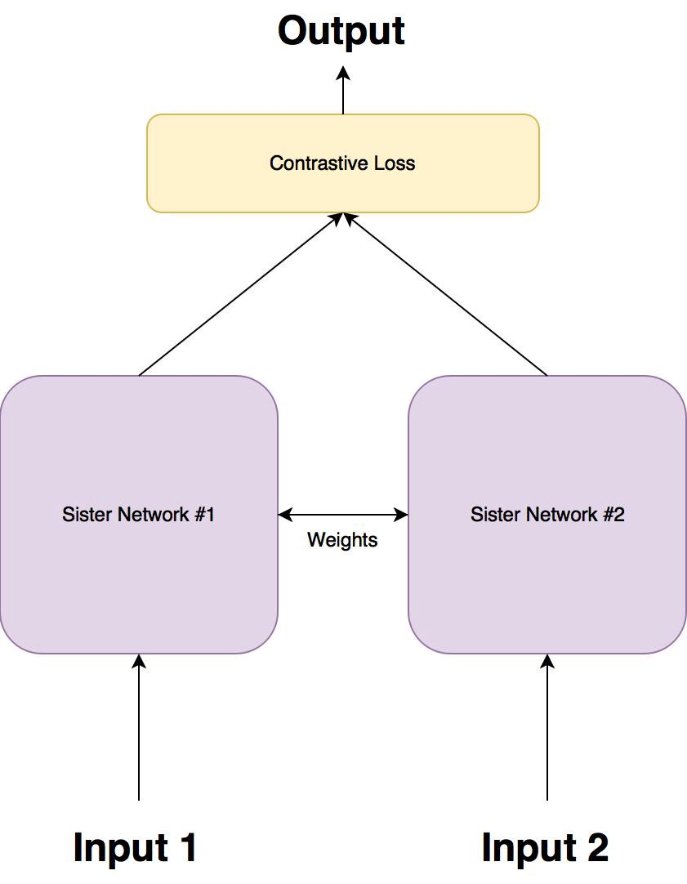
Siamese Network
Input: a pair of images
Binary label: 1 if two images from same class, otherwise 0.
Net output 1
Net output 2

Slide 21

Siamese Network
Contrastive loss
=$\frac{1}{2}YD^{2}$+ $\frac{1}{2}(1−Y){(max⁡\{0,M−D\})}^{2}$
Net output 1
Net output 2
D: Euclidean distance between net output 1 and net output 2
Y: Binary label
M: Margin size

Slide 22
Siamese Network
Pipeline in detecting transition dates:
1. Pair images and label the pairs
2. Train model until accuracy of validation set is minimum
3. Feed test images to model, get their output feature
4. Match test output features with output features of transition
images on training dataset
Rank and find top 10 test output features and their correspond
dates, average them and find final transition date

Slide 23
Evaluation
Ground-truth:
human-annotated transition dates
Evaluation metrics:
Gap of days between transition date deceted by algorithms and
ground-truth

Slide 24
Results
GS:
Generalized sigmoid
CNN:
Convolution neural network
SN:
Siamese Network
RN:
Regression Network
FCN:
Fully convolution network
Gap
Algorithms:

Slide 25
Thanks

