Slide 1
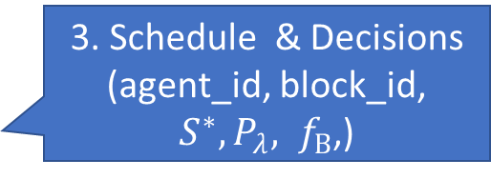
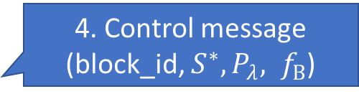
Network information
(link capacity & traffic of latency-sensitive data)
BDS
Controller
Network Monitor
2. Monitor information
(block_id, block_num, server_status)
3. Schedule & Decisions
(agent_id, block_id,
$S^{∗},P_{λ}, f_{B}$,)
Agent Monitor
1. Report requirements & local status
(block_id,server_status)
4. Control message
(block_id, $S^{∗},P_{λ}, f_{B}$)
Agent
…
Agent
…
Agent
Server
Server
Server

Slide 2
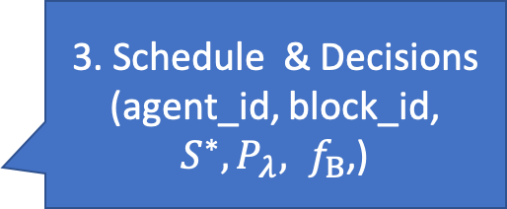
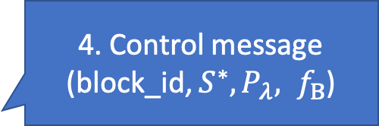
BDS+
Controller
2. Monitor information
(block_id, block_num, server_status, link capacity, Predicted link capacity )
3. Schedule & Decisions
(agent_id, block_id,
$S^{∗},P_{λ}, f_{B}$,)
Agent Monitor
1. Report requirements & local status
(block_id,server_status)
4. Control message
(block_id, $S^{∗},P_{λ}, f_{B}$)
Agent
…
Agent
…
Agent
Server
Server
Server

