Slide 1
Theory Lecture 1
Algorithms

Slide 2
Learning Objectives
Understand the concept of an algorithm
Define the specification of an algorithm using inputs and outputs.
Write pseudocode describing and algorithm
Use proof techniques to verify the correctness of an algorithm

Slide 3
What is an algorithm?

Slide 4
Algorithms
An algorithm describes a method for solving a problem with some desirable properties:
Inputs Zero or more inputs
Outputs One or more outputs
Termination Finishes in a finite number of steps
Definiteness The description is precise and unambiguous
Interesting algorithms typically solve a general problem, the input gives the specific instance we want to solve.

Slide 5
Definiteness
Computer code satisfies these requirements
A precise set of instructions for computing outputs from inputs
Code is designed to be translated precisely into a set of machine-level instructions by a computer
An algorithm is a higher level concept intended to be understood by people
The description does not need to be so exact, but we must be able to translate it into something exact (i.e. code) possibly using other algorithms we know

Slide 6
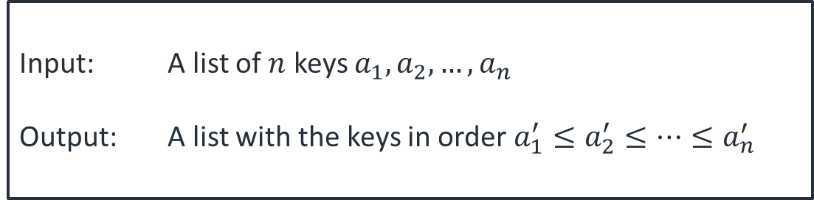
Defining a problem
An algorithm solves a computational problem
A typical problem definition looks like this
There is a problem name, a definition of the input and a precise relationship between the input and output
Problem: Sorting
Input: A list of $n$ keys $a_{1},a_{2},…,a_{n}$
Output: A list with the keys in order $a_{1}^{′}≤a_{2}^{′}≤…≤a_{n}^{′}$

Slide 7
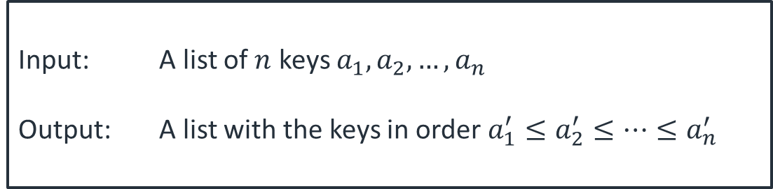
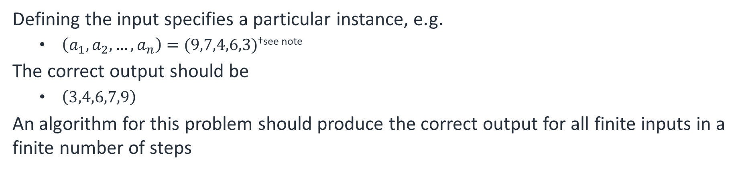
Problem instance
Problem: Sorting
Input: A list of $n$ keys $a_{1},a_{2},…,a_{n}$
Output: A list with the keys in order $a_{1}^{′}≤a_{2}^{′}≤…≤a_{n}^{′}$
Defining the input specifies a particular instance, e.g.
$\left(a_{1},a_{2},…,a_{n}\right)=(9,7,4,6,3)$^{†see note}
The correct output should be
$\left(3,4,6,7,9\right)$
An algorithm for this problem should produce the correct output for all finite inputs in a finite number of steps
† I will use (…) to denote a list, where order matters, and {…} for a set which is unordered. Skiena uses {..} for both

Slide 8
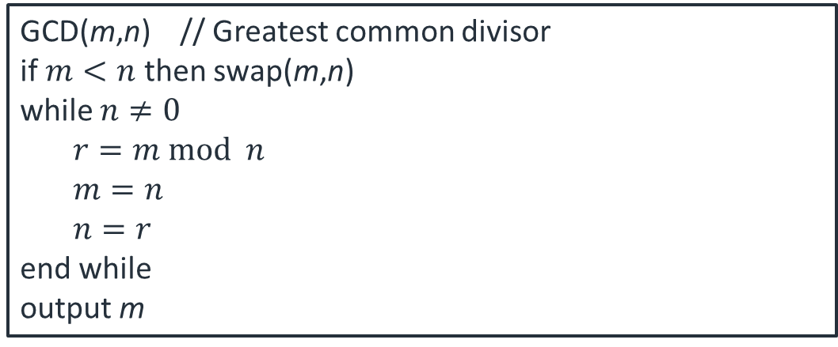
Pseudocode
Algorithms are usually described by pseudocode.
Pseudocode varies widely
We will use a mixture of words and mathematical statements
Human-readable, precise enough to be translated to code
Algorithm
GCD(m,n) // Greatest common divisor
if $m<n$ then swap(m,n)
while $n≠0$
$r=m mod n$
$m=n$
$n=r$
end while
output m

Slide 9

Example
Algorithm
Code
Insertion_sort[$(a_{1},a_{2},…,a_{n})]$
for $i=2…n$
for $j=i…2$
if $a_{j}<a_{j−1}$ swap($a_{j},a_{j−1}$)
else end loop
output $(a_{1},a_{2},…,a_{n})$
static void insertionSort(int a[]) {
int t;
for (int i = 1; i < a.length; i++) {
for (j = i; j > 0; j--) {
if (a[j] < a[j-1]) {
t = a[j];
a[j] = a[j-1];
a[j-1] = t;
}
else break;
}
}
}

Slide 10
Correctness

Slide 11
Correctness
An algorithm must be correct. We mean this in the mathematic sense that, for every input, the output should be that given in the problem specification.
Possible to prove this using mathematical techniques applied to the algorithm steps
We will look at this informally not rigorously
For more complex algorithms, can be very difficult
Often easier to show that an algorithm is incorrect

Slide 12

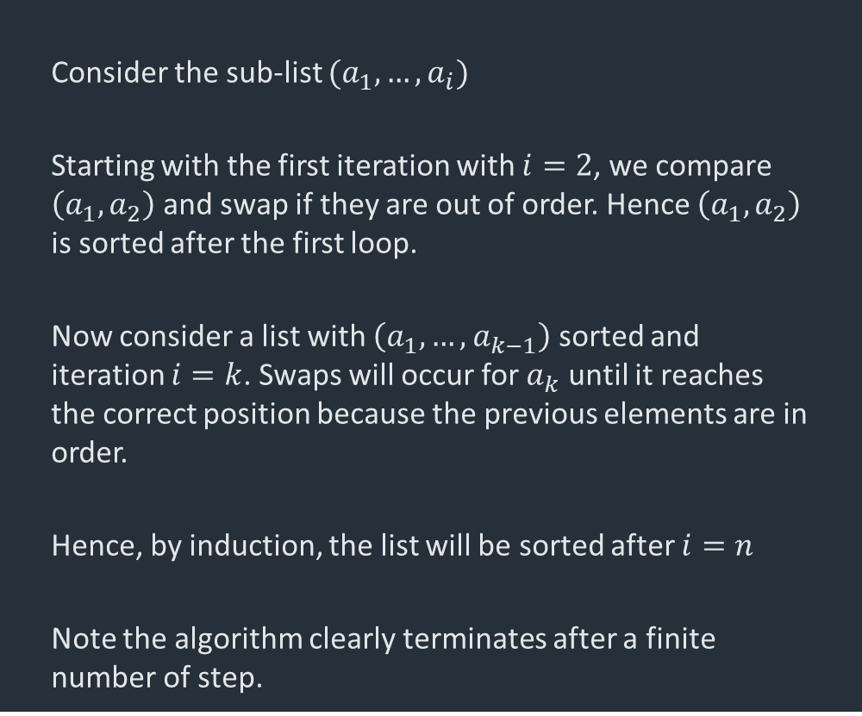
Example
Consider the sub-list $(a_{1},…,a_{i})$
Starting with the first iteration with $i=2$, we compare $\left(a_{1},a_{2}\right)$ and swap if they are out of order. Hence $\left(a_{1},a_{2}\right)$ is sorted after the first loop.
Now consider a list with $\left(a_{1},…,a_{k−1}\right)$ sorted and iteration $i=k$. Swaps will occur for $a_{k}$ until it reaches the correct position because the previous elements are in order.
Hence, by induction, the list will be sorted after $i=n$
Note the algorithm clearly terminates after a finite number of step.
Algorithm
Insertion_sort[$(a_{1},a_{2},…,a_{n})]$
for $i=2…n$
for k$=i…2$
if $a_{k}<a_{k−1}$ swap($a_{k},a_{k−1}$)
else end loop
output $(a_{1},a_{2},…,a_{n})$

Slide 13

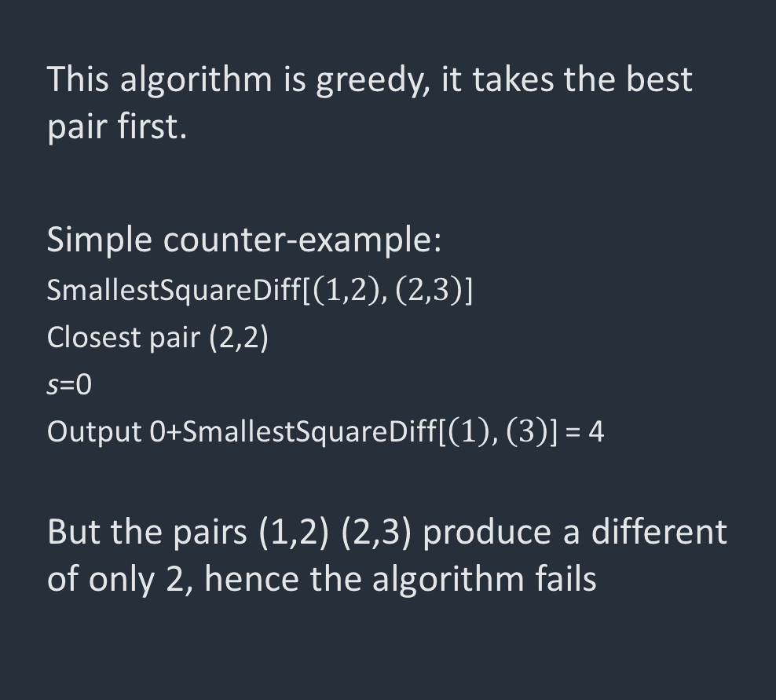
Example
This algorithm is greedy, it takes the best pair first.
Simple counter-example:
SmallestSquareDiff[$\left(1,2\right),\left(2,3\right)$]
Closest pair (2,2)
s=0
Output 0+SmallestSquareDiff[$\left(1\right),\left(3\right)$] = 4
But the pairs (1,2) (2,3) produce a different of only 2, hence the algorithm fails
Non-Algorithm
SmallestSquareDiff[$\left(a_{1},…,a_{n}\right),\left(b_{1},…,b_{n}\right)$]
// Match pairs $(a_{i},b_{j})$ to find the minimum total
// squared difference $∑{\left(a_{i}−b_{j}\right)}^{2}$
Find pair $(a_{i},b_{j})$ with smallest squared difference $s={\left(a_{i}−b_{j}\right)}^{2}$
Remove pair from list
Output s+SmallestSquareDiff [$\left({a′}_{1},…,{a′}_{n}\right),\left({b′}_{1},…,{b′}_{n}\right)$]

Slide 14
Proof techniques
There are a number of different approaches to proving an algorithm correct or incorrect
Counter-example
For proving incorrect. Look for unusual or extreme cases that might not be handled. Similar idea to testing
Induction
Prove a base case, and then that all other cases follow from base case. Particularly useful for iterative or recursive algorithms
Contradiction
Assume algorithm is incorrect, then show that this leads to a contradictory statement.
Invariant

Slide 15

Efficiency

Slide 16
Efficiency
There is often more than one algorithm for a problem
There are many sorting algorithms – will look at some later
BubbleSort, InsertionSort, MergeSort, HeapSort, QuickSort…
Why? There isn’t an algorithm which is strictly best in all circumstances
What considerations affect algorithm choice
Ease of implementation
Amount of memory it takes
Amount of time it takes

Slide 17
Efficiency
Programs consume time and memory. Algorithms also consume resources, in a more abstract sense
Space (equivalent to memory) – the amount of storage needed to complete the algorithm
Time – the number of steps needed to complete the algorithm
The resource consumed usually depends on the size of the input
Example: Longer to sort 100 objects rather than 10
Algorithm efficiency can be measured by the relationship between the input size and the resources consumed
More about this in Lecture 3 – Complexity of algorithms

Slide 18
Summary
Understand:
What an algorithm is
The definition of a problem
Description of an algorithm using pseudocode
An outline of how we can prove algorithms correct/incorrect
Read
Skiena, Chapter 1
Attempt exercise 1-7 and 1-10
Next
Data types

