Slide 1
Theory Lecture 2
Linear Data Structures

Slide 2
Learning Objectives
Understand the idea of an abstract data type
Introduce list, stack, queue
Become familiar with the difference between contiguous and linked data
Learn the difference in the complexity of simple algorithms on lists

Slide 3
What is an Abstract Data Type?
public interface Stack<T> {
boolean push(T value);
T pop();
}

Slide 4
Abstract Data Type
Actual data comes in types
Primitive types such as int, byte, short, float, double,…
Compound structures build from these primitives (e.g. Rectangle)
Some data structures can be used with many or all of these different types of data
Example: We can have list of any of the above types
We will study the properties of these data structures independent of the type of data they represent
These are called Abstract Data Types (ADTs)
The type of data represented is undefined or abstract

Slide 5
ADTs and Programming Languages
Nearly all programming languages have library implementations of standard ADTs
This includes the data structures and common algorithm implementations
May be implemented concretely for a particular type or in an abstract way (e.g. Java generics)
In this module, we will look at some standard ADTs and analyse their properties
Understanding how they work will help you to choose the right data structure for the job
Choosing the right data structure can make a huge difference to the speed of your programs

Slide 6

Lists

Slide 7
List Operations
You should be familiar with lists (SOF1 week 3) and singly linked lists (SOF1 week 9)
The list is an ADT since we can make a list of any data type
List Data Structure
Organization
Ordered
Linear
Random access
Common operations
Insert(v,i) Insert element v at position i
Delete(i) Delete element at position i
Lookup(i) Return the value of element i
Search(v) Find the index of an element equal to v
Length() Return the number of elements in the list

Slide 8
Contiguous List
Ultimately, the list must be represented in memory in some way
The obvious arrangement is to use a contiguous block of memory:
This is a (1D) array
An example of a contiguous data structure
The elements are accessed by the appropriate memory location
Memory
0
1
2
3
4
5
6
7
…
Size of one element
Element 4 stored here

Slide 9
Operations on Contiguous List
Advantages of contiguously stored list
Direct access to element given index (constant time)
Efficient in memory space – only the elements themselves are stored
Memory locality – all data in one place may help memory access speed
Disadvantages of contiguously stored list
Inserting and deleting elements difficult
Insertion at end uses memory at a specific location, which may not be free
Worse, insertion at other locations must move part of the list
Insert here
Shift these elements
0
1
2
3
4
5
6
7
…

Slide 10
Linked List
The alternative to an array is linked data
An extra piece of data, the link, indicates where the next item is in memory
This is a linked list
An example of a linked data structure
The elements are accessed by moving through the list
To access item 3, start at the Head and follow next 3 times
Head
0
next
1
next
2
next
3
next
…
Size of one element

Slide 11
Operations on Linked List
Advantages of linked list
Inserting and deleting elements easy (constant number of operations when position known)
No moving of data, new item can be anywhere in memory
Disadvantages of linked list
List must be scanned to locate element (n links to find element n)
Extra memory for links
Non-locality in memory, may increase access time
Head
0
next
1
next
2
next
x
next

Slide 12
Doubly Linked List
A doubly linked list contains an additional link to the previous item
This allows us to traverse the list in either direction
Also store head(first) and tail(last), so we can traverse from end
Example: Delete item y
Need to update both the previous element x and next element z
In singly linked list must traverse from the start to find element x
x
next
prev
y
next
prev
z
next
prev

Slide 13

Stack

Slide 14

Stack Operations
The stack is a last-in, first-out (LIFO) data structure
Can only access top item
Can be implemented as a list, top is last item
All operations O(1) time implemented as a contiguous array
If we know the maximum size
See SOF1 week 9 practical
Stack Data Structure
Organization
Ordered
Linear
Access top element only
Common operations
Push(v) ($s)→(s,v)$ add v to top of stack
Pop() $\left(s,v\right)→(s)$ remove v from top and return v
Top() $\left(s,v\right)→(s,v) r$eturn v
Depth() Return the number of elements in the stack

Slide 15
Queue

Slide 16

Queue Operations
The queue is a first-in, first-out (FIFO) data structure
Access items at the start, add items at the end
Can be implemented as a list
All operations O(1) time implemented as a linked list
See SOF1 week 9 practical
Queue Data Structure
Organization
Ordered
Linear
Access first element only
Common operations
Enqueue(v) ($s)→(s,v)$ add v to end of queue
Pop() $\left(v, s\right)→(s)$ remove v from start and return v
Peek() $\left(v,s\right)→(v,s) r$eturn v
Length() Return the number of elements in the queue

Slide 17

Order Relations

Slide 18
Order relation
We are highly familiar with ordering through the real numbers, i.e. 1<2
An order relation like this on a data type is a useful thing to have
Examples
Ordering on numeric types (int, float, …) from the real numbers
Lexicographical order (string) based on character set order
‘aa’<‘ab’

Slide 19
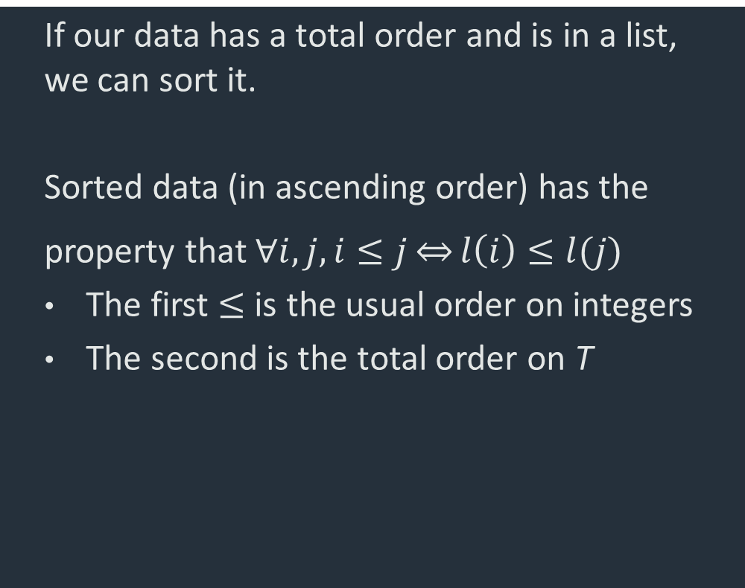
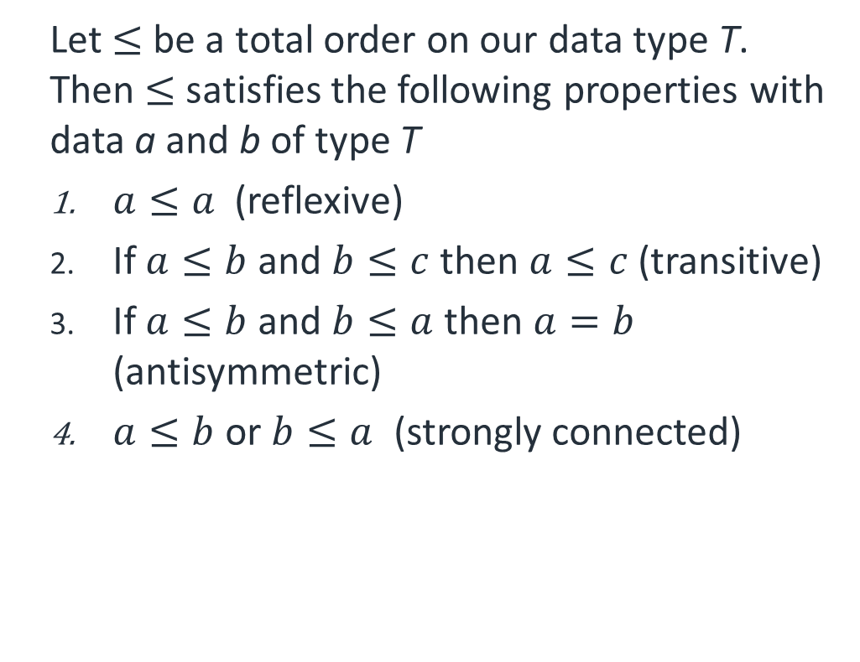
Total Order
Let $≤$ be a total order on our data type T. Then $≤$ satisfies the following properties with data a and b of type T
$a≤a$ (reflexive)
If $a≤b$ and $b≤c$ then $a≤c$ (transitive)
If $a≤b$ and $b≤a$ then $a=b$ (antisymmetric)
$a≤b$ or $b≤a$ (strongly connected)
If our data has a total order and is in a list, we can sort it.
Sorted data (in ascending order) has the property that $∀i,j, i≤j\underset{⇔}{}l\left(i\right)≤l(j)$
The first $≤$ is the usual order on integers
The second is the total order on T

Slide 20
Other order relations
Not all relations are total orders
Example: Family tree, relation ‘ancestor of’ (you are taken to be your own ancestor)
Alice is an ancestor of Alice (reflexive and antisymetric)
Alice is an ancestor of Bob and Bob is an ancestor of David, hence Alice is an ancestor of David (transitive)
Bob is not an ancestor of Charlie and Charlie is not an ancestor of Bob, hence it is not strongly connected – not everything is comparable
In general, the leaves of trees have a partial order
We cannot sort them without additional information
Alice
Bob
Charlie
Charlie
David

Slide 21

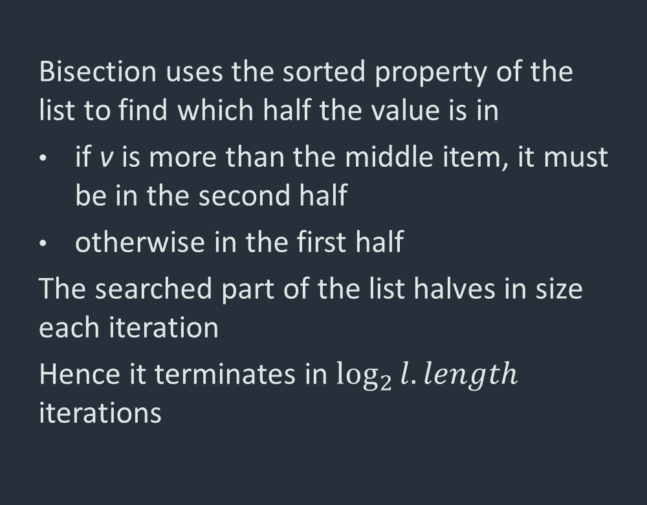
Example: search a sorted list
Algorithm
Bisection uses the sorted property of the list to find which half the value is in
if v is more than the middle item, it must be in the second half
otherwise in the first half
The searched part of the list halves in size each iteration
Hence it terminates in $\log_{2}{l.length}$ iterations
Bisection[$l,v,start:ℕ=0,end:ℕ=l.length]$
// Find v in list l using bisection
do
$middle=(start+end+1)/2$
if $l\left(middle\right)==v$ then return $middle$
if $start==end$ then return None
if $l\left(middle\right)≤v$
$start=middle$
else
$end=middle$
end if
while true

Slide 22
Summary
Understand:
An abstract data type
Advantages and disadvantages of contiguous vs linked storage
Linked lists
Total orders on data
Read
Revise SOF1 week 9
Skiena, Sections 3.1, 3.2
Attempt exercise 3-3 and 3-10
Next
Sorting and Algorithmic Complexity

