Slide 1
Theory Lecture 3
Sorting and Algorithm Complexity

Slide 2
Learning Objectives
Appreciate that algorithms take different amounts of resource
Understand the concept of complexity and the Big-O notation
Become familiar with a variety of sorting algorithms
Be able to analyse the complexity of simple algorithms

Slide 3
Complexity

Slide 4
Computational Resource(1)
Some algorithms are better than others, or may be better under certain conditions.
But how do we measure this and compare algorithms?
We could implement both, and measure the time taken to run.
But what if one algorithm suits your hardware better, or your code is not equally good for both algorithms? You might get a different answer with another machine or implementation.
The comparison might be different for different inputs, and it may take too long to try them all.

Slide 5
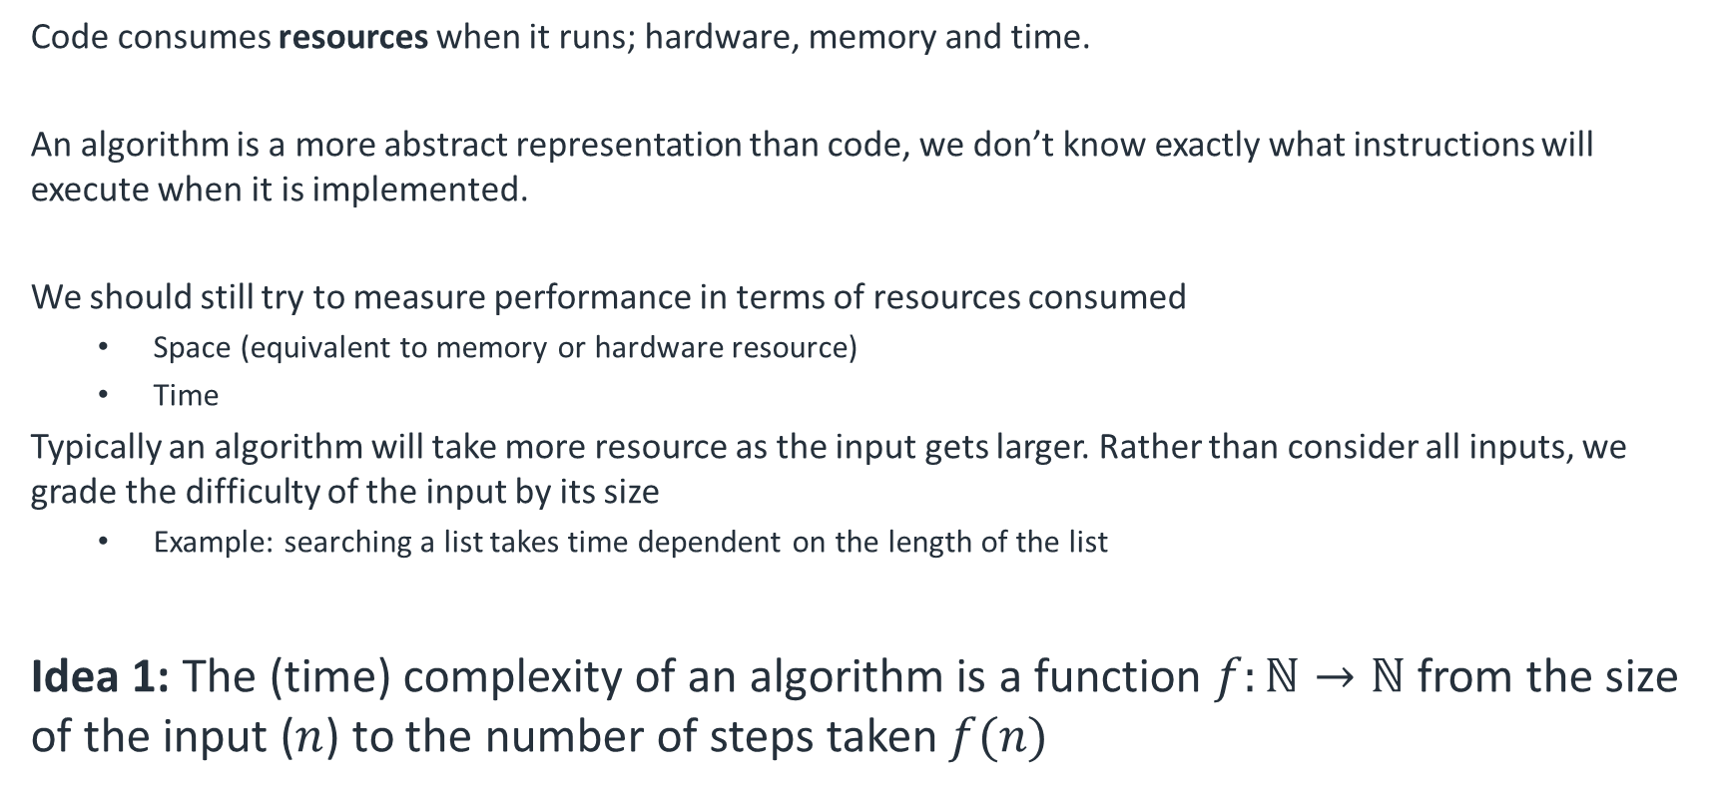
Computational Resource(2)
Code consumes resources when it runs; hardware, memory and time.
An algorithm is a more abstract representation than code, we don’t know exactly what instructions will execute when it is implemented.
We should still try to measure performance in terms of resources consumed
Space (equivalent to memory or hardware resource)
Time
Typically an algorithm will take more resource as the input gets larger. Rather than consider all inputs, we grade the difficulty of the input by its size
Example: searching a list takes time dependent on the length of the list
Idea 1: The (time) complexity of an algorithm is a function $f:ℕ→ℕ$ from the size of the input ($n$) to the number of steps taken $f(n)$

Slide 6
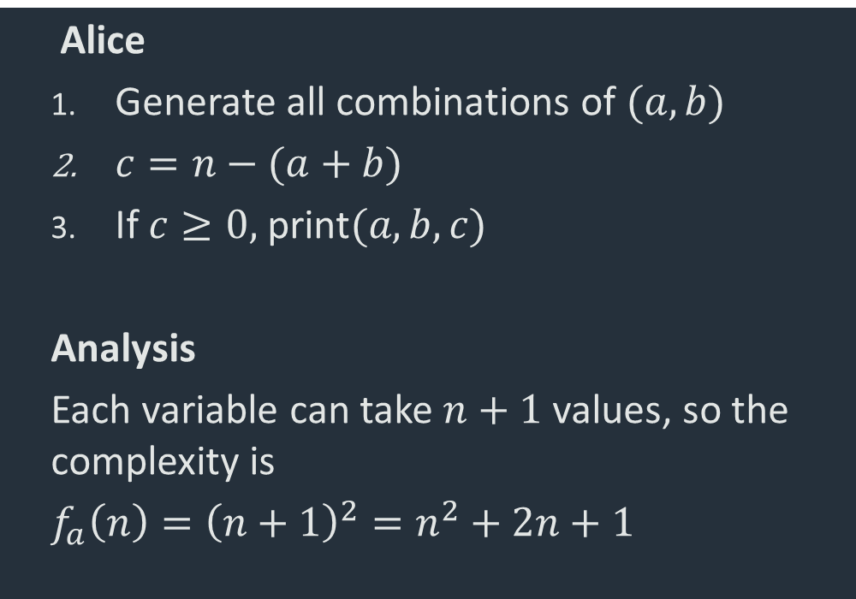
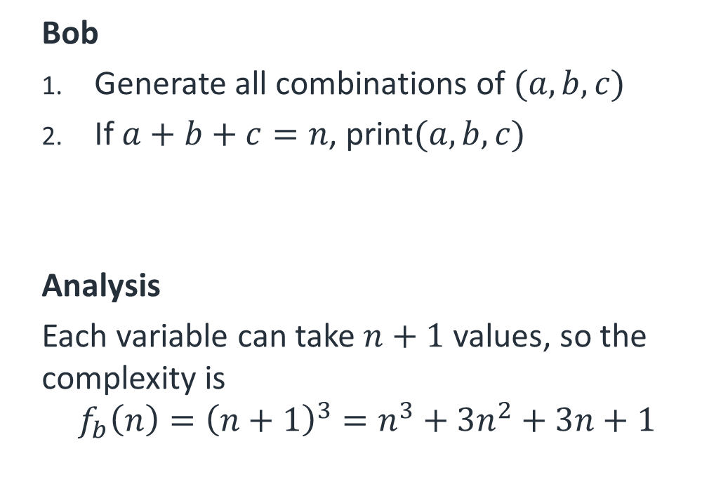
Measuring Complexity(1)
We introduced complexity in SOF1 week 09 with Bob and Alice’s algorithms for finding all non-negative integers $\left(a,b,c\right)$ such than $a+b+c=n$
Bob
Generate all combinations of $(a,b,c)$
If $a+b+c=n$, print$(a,b,c)$
Analysis
Each variable can take $n+1$ values, so the complexity is
$${f_{b}\left(n\right)=\left(n+1\right)}^{3}=n^{3}+3n^{2}+3n+1$$
Alice
Generate all combinations of $(a,b)$
$c=n−(a+b)$
If $c≥0,$ print$(a,b,c)$
Analysis
Each variable can take $n+1$ values, so the complexity is
$f_{a}\left(n\right)={\left(n+1\right)}^{2}=n^{2}+2n+1$

Slide 7
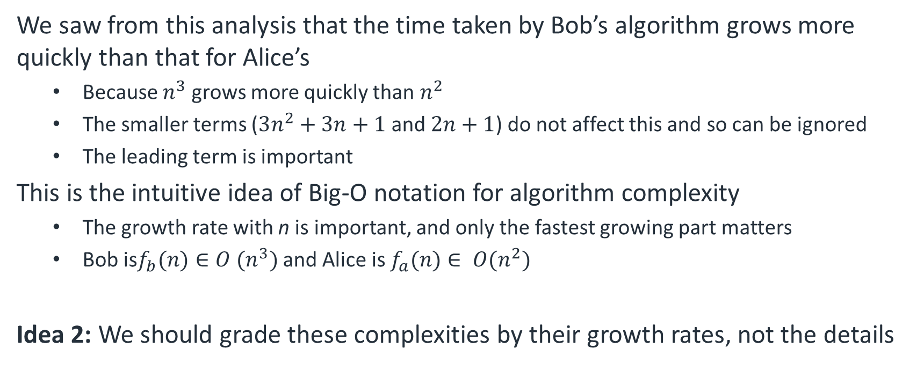
Measuring Complexity(2)
We saw from this analysis that the time taken by Bob’s algorithm grows more quickly than that for Alice’s
Because $n^{3}$ grows more quickly than $n^{2}$
The smaller terms ($3n^{2}+3n+1$ and $2n+1$) do not affect this and so can be ignored
The leading term is important
This is the intuitive idea of Big-O notation for algorithm complexity
The growth rate with n is important, and only the fastest growing part matters
Bob is$f_{b}(n)∈O (n^{3})$ and Alice is $f_{a}(n)∈ O(n^{2})$
Idea 2: We should grade these complexities by their growth rates, not the details

Slide 8
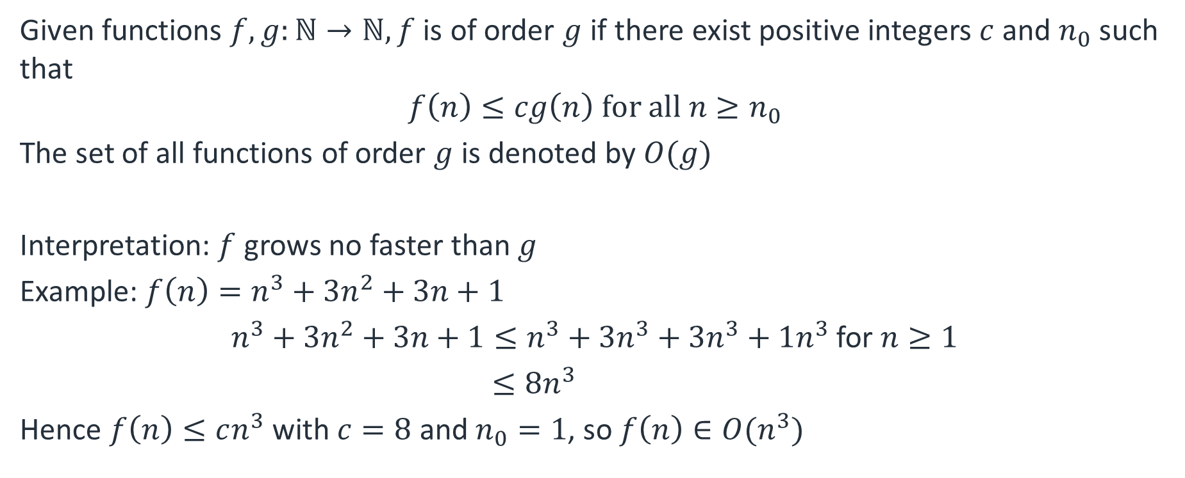
Formal Definition
Given functions $f,g:ℕ→ℕ, f$ is of order $g$ if there exist positive integers $c$ and $n_{0}$ such that
$$f\left(n\right)≤cg\left(n\right) for all n≥n_{0}$$
The set of all functions of order $g$ is denoted by $O(g)$
Interpretation: $f$ grows no faster than $g$
Example: $f\left(n\right)=n^{3}+3n^{2}+3n+1$
$n^{3}+3n^{2}+3n+1≤n^{3}+3n^{3}+3n^{3}+1n^{3}$ for $n≥1$
$≤8n^{3}$
Hence $f\left(n\right)≤cn^{3}$ with $c=8$ and $n_{0}=1$, so $f\left(n\right)∈O(n^{3})$

Slide 9
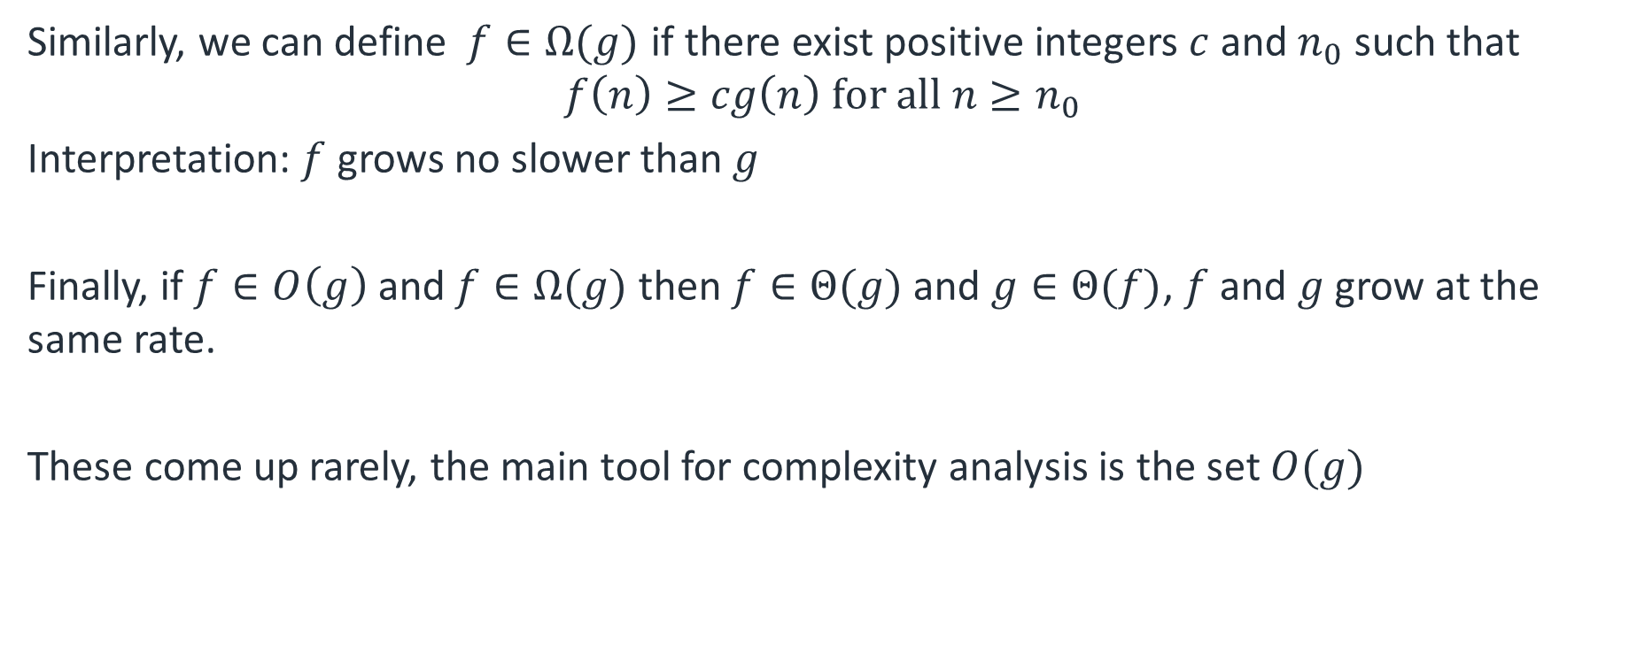
Definition of Ω and Θ
Similarly, we can define$f∈Ω(g)$ if there exist positive integers $c$ and $n_{0}$ such that
$$f\left(n\right)≥cg\left(n\right) for all n≥n_{0}$$
Interpretation: $f$ grows no slower than $g$
Finally, if $f∈O\left(g\right)$ and $f∈Ω(g)$ then $f∈Θ(g)$ and $g∈Θ(f)$, $f$ and $g$ grow at the same rate.
These come up rarely, the main tool for complexity analysis is the set $O(g)$

Slide 10
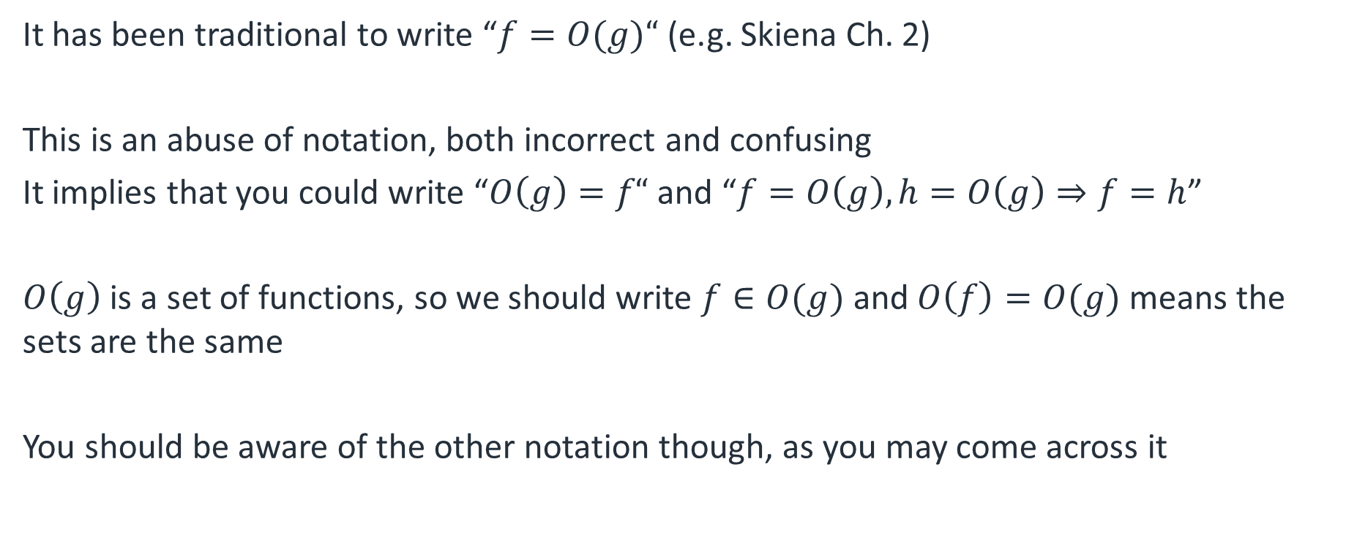
Notation Warning
It has been traditional to write “$f=O(g)“$ (e.g. Skiena Ch. 2)
This is an abuse of notation, both incorrect and confusing
It implies that you could write “$O\left(g\right)=f“$ and “$f=O\left(g\right), h=O\left(g\right)⇒f=h$”
$O\left(g\right)$ is a set of functions, so we should write $f∈O(g)$ and $O\left(f\right)=O(g)$ means the sets are the same
You should be aware of the other notation though, as you may come across it

Slide 11
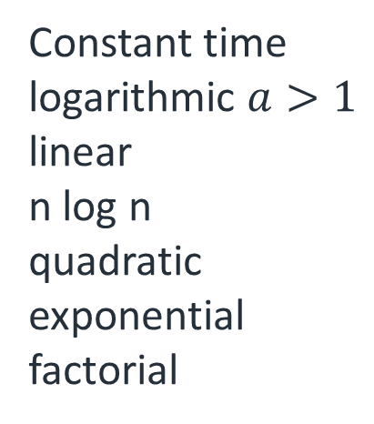
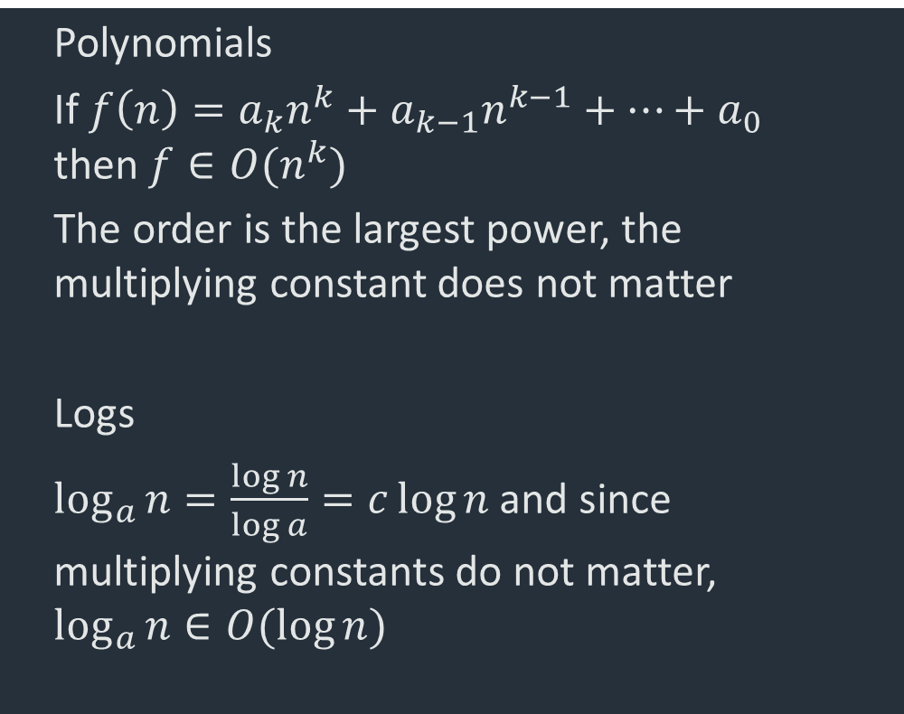
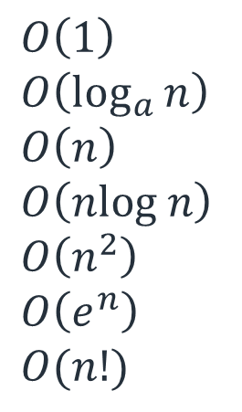
Simple Big-O orderings
Complexity sets getting larger
Polynomials
If $f\left(n\right)=a_{k}n^{k}+a_{k−1}n^{k−1}+…+a_{0}$ then $f∈O(n^{k})$
The order is the largest power, the multiplying constant does not matter
Logs
$\log_{a}{n}=\frac{\log{n}}{\log{a}}=c\log{n}$ and since multiplying constants do not matter, $\log_{a}{n}∈O(\log{n})$
$$O\left(1\right) \\ O\left(\log_{a}{n}\right) \\ O\left(n\right) \\ O\left(nlog n\right) \\ O\left(n^{2}\right) \\ O\left(e^{n}\right) \\ O(n!)$$
Constant time
logarithmic $a>1$
linear
n log n
quadratic
exponential
factorial

Slide 12
Sorting

Slide 13
Why sort?
Sorting is a basic algorithmic building block, and can form the basis of performance gains for many other algorithms.
It highlights important ideas in the design of algorithms and in the study of complexity.
It is one of the most thoroughly studied problems in CS with numerous different algorithms highlighting different considerations

Slide 14

The setting
Problem: Sorting
We defined this problem in lecture 1. We have added the necessary condition that there is a total order on the data type in the list (lecture 2).
Input: A list of $n$ keys $a_{1},a_{2},…,a_{n}$ and a total order relation $≤$
Output: A list with the keys in order
$$a_{1}^{′}≤a_{2}^{′}≤…≤a_{n}^{′}$$

Slide 15
Designing an algorithm
We will start by designing a algorithm using a method called invariants.
Idea: Iterate and, at each operation, maintain some property of the data (the invariant). At the start, the input has the property, and at the end, the output has the property
Sorting invariant: At iteration k, the list 0…k is sorted.
At the start elements 0…0 are sorted (i.e. nothing)
At the end elements 0…(n-1) are sorted (i.e. everthing)

Slide 16
Selection sort
Selection sort
In the loop body, we put instructions to maintain the invariant
At the start of iteration k, we are sorted up to k-1
After iteration k, we should be sorted up to k
Need to find the element in position k
This will be the smallest element left
Then move it into position
SelectionSort(l : list)
for k=0…l.length-1
i=IndexOfMin(l(k…end))
swap(l(i),l(k))
end for

Slide 17
Complexity analysis - Inputs
Input considerations
What is the size of the input?
Clearly the length of the list n=l.length
Selection sort
SelectionSort(l : list)
for k=0…l.length-1
i=IndexOfMin(l(k…end))
swap(l(i),l(j))
end for

Slide 18
Complexity analysis – Inputs(1)
Input considerations
What type of input?
Best case
List already in order
No swaps necessary, checked in linear time
Unrealistic and not informative
Average case
Maybe, but need to analyse all cases
Need to know probability of different inputs
Worst case
Gives an upper bound on the run time
Very useful analysis
Selection sort
SelectionSort(l : list)
for k=0…l.length-1
i=IndexOfMin(l(k…end))
swap(l(i),l(j))
end for

Slide 19
Complexity analysis – Inputs(2)
Time complexity is the time taken to run the worst case of a list of length n
A completely unsorted list
Occasionally we will look at the average time complexity for some algorithms
Selection sort
SelectionSort(l : list)
for k=0…l.length-1
i=IndexOfMin(l(k…end))
swap(l(i),l(j))
end for

Slide 20
Complexity analysis – Computational Model
Now to calculate the number of steps, we need a computational model for basic operations
Arithmetic operations take unit time
Memory access takes unit time
No limit to memory size or variation in speed
Subroutines take the sum of their individual operations, no overheads
Selection sort
SelectionSort(l : list)
for k=0…l.length-1
i=IndexOfMin(l(k…end))
swap(l(i),l(j))
end for

Slide 21
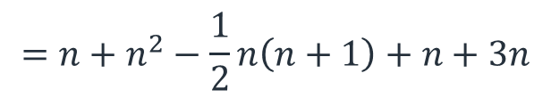
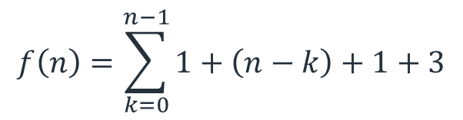

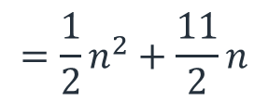
Complexity analysis – Algorithm
$$f\left(n\right)=\sum_{k=0}^{n−1}{1+\left(n−k\right)+1+3}$$
Set k, 1 per iteration
Selection sort
$$=n+n^{2}−\frac{1}{2}n\left(n+1\right)+n+3n$$
SelectionSort(l : list)
for k=0…l.length-1
i=IndexOfMin(l(k…end))
swap(l(i),l(j))
end for
Scan every item to find min, so n-k
1 to set i
$$={\frac{1}{2}n}^{2}+\frac{11}{2}n$$
3 operations per iteration
$$f∈O(n^{2})$$

Slide 22
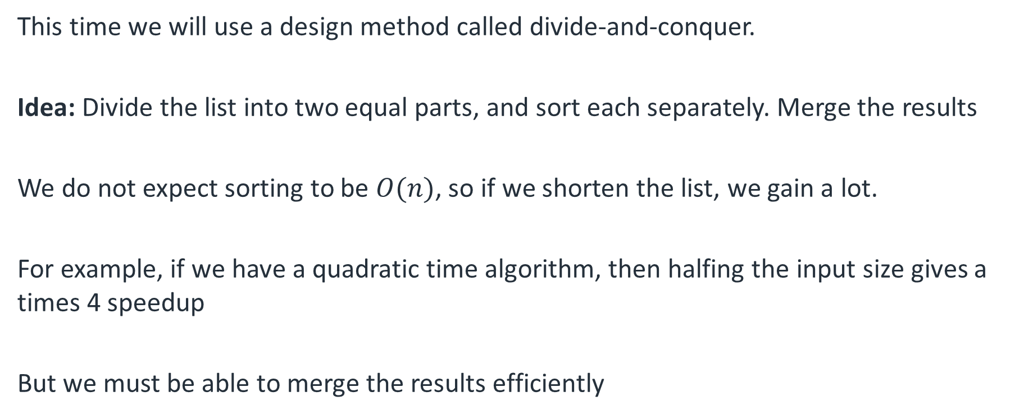
Designing a better algorithm
This time we will use a design method called divide-and-conquer.
Idea: Divide the list into two equal parts, and sort each separately. Merge the results
We do not expect sorting to be $O(n)$, so if we shorten the list, we gain a lot.
For example, if we have a quadratic time algorithm, then halfing the input size gives a times 4 speedup
But we must be able to merge the results efficiently

Slide 23
MergeSort
MergeSort
We recursively call MergeSort.
It sorts the first and second halves of the list
They are combined in the Merge subroutine
MergeSort(l : list) if l.length==1 then return l
m=l.length/2
l₁=l(0…m-1)
l₂=l(m…end)
MergeSort(l₁)
MergeSort(l₂)
return Merge(l₁,l₂)

Slide 24
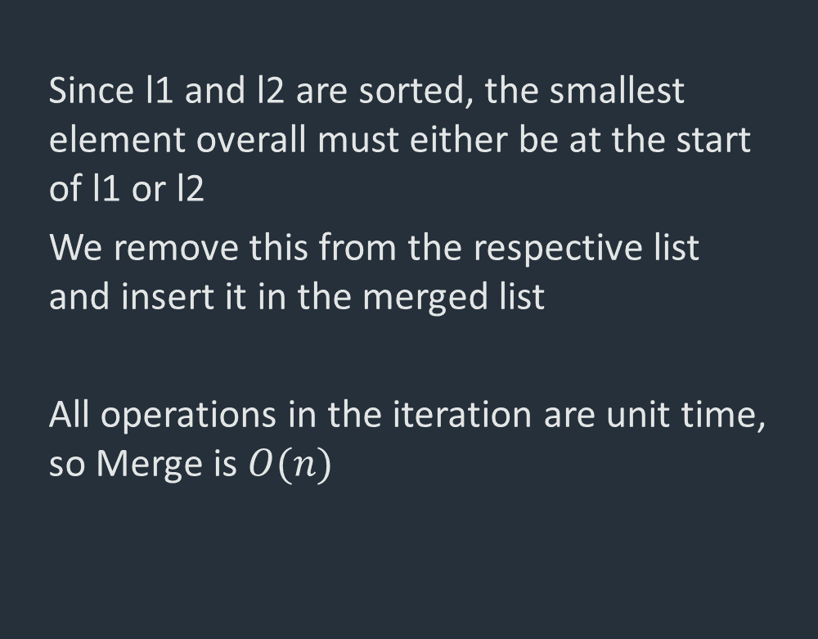
Merging
Merge
Since l1 and l2 are sorted, the smallest element overall must either be at the start of l1 or l2
We remove this from the respective list and insert it in the merged list
All operations in the iteration are unit time, so Merge is $O(n)$
Merge(l₁ : list, l₂ : list)
m=new list
while l₁ and l₂ are not empty
if l₁(0)≤l₂(0)
insert l₁(0) in m
delete l₁(0)
else
insert l₂(0) in m
delete l₂(0)
end if
end while
return m

Slide 25
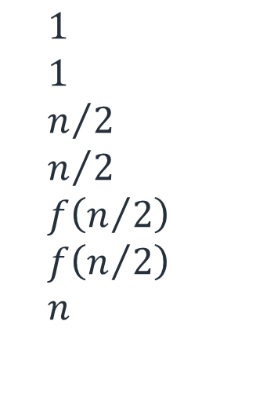
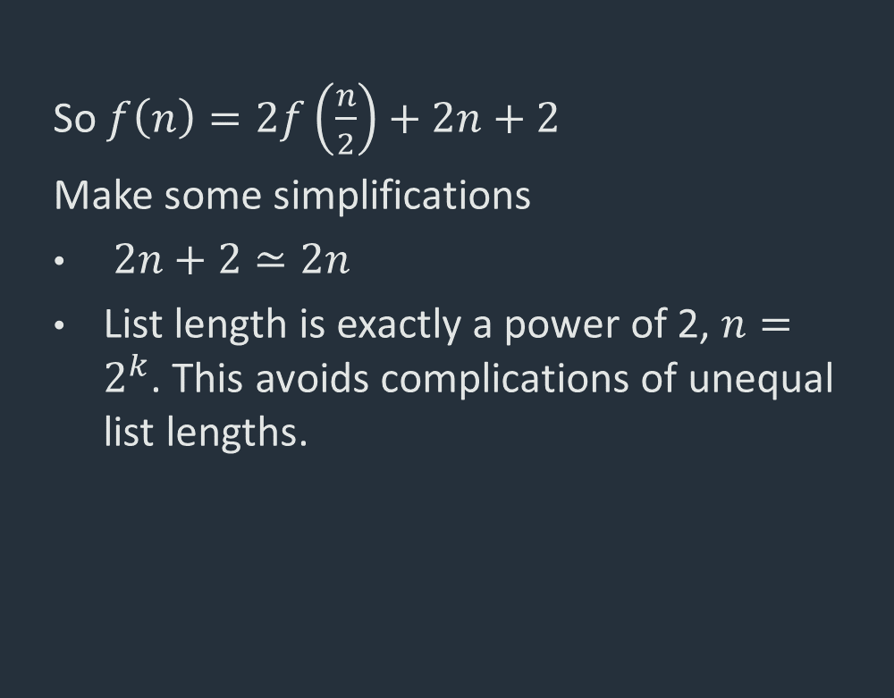
MergeSort – Complexity analysis(1)
MergeSort
So $f\left(n\right)=2f\left(\frac{n}{2}\right)+2n+2$
Make some simplifications
$2n+2≃2n$
List length is exactly a power of 2, $n=2^{k}$. This avoids complications of unequal list lengths.
$$1 \\ 1 \\ n/2 \\ n/2 \\ f\left(n/2\right) \\ f\left(n/2\right) \\ n$$
MergeSort(l : list)
if l.length==1 then return l
m=l.length/2
l₁=l(0…m)
l₂=l(m+1…end)
MergeSort(l₁)
MergeSort(l₂)
return Merge(l₁,l₂)

Slide 26

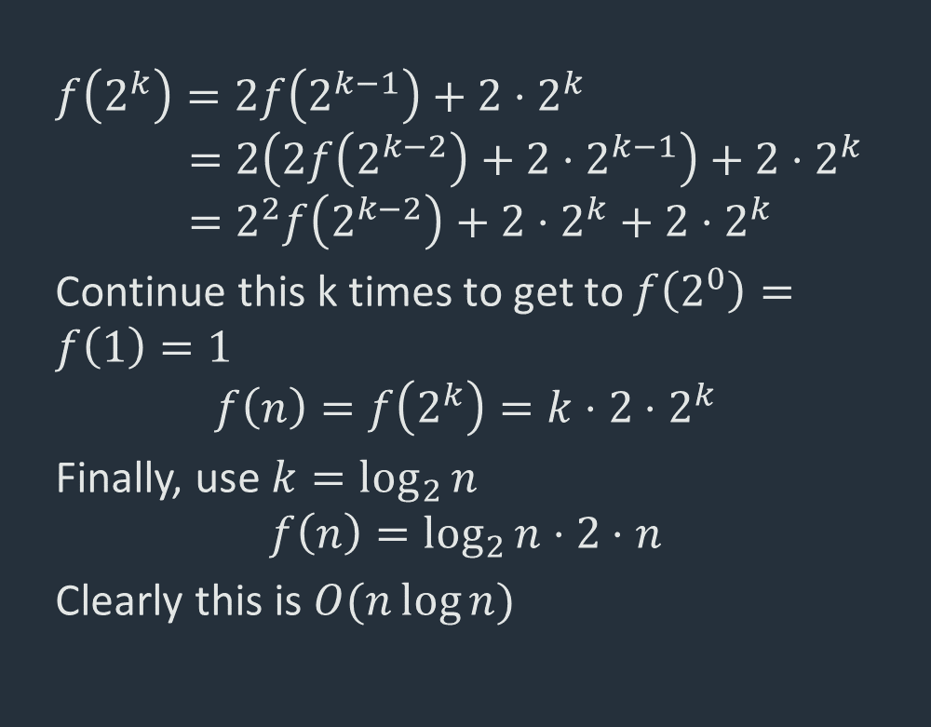
MergeSort – Complexity analysis(2)
MergeSort
$$f\left(2^{k}\right)=2f\left(2^{k−1}\right)+2⋅2^{k} \\ =2\left(2f\left(2^{k−2}\right)+2⋅2^{k−1}\right)+2⋅2^{k} \\ =2^{2}f\left(2^{k−2}\right)+2⋅2^{k}+2⋅2^{k}$$
Continue this k times to get to $f\left(2^{0}\right)=f\left(1\right)=1$
$$f\left(n\right)=f\left(2^{k}\right)=k⋅2⋅2^{k}$$
Finally, use $k=\log_{2}{n}$
$$f\left(n\right)=\log_{2}{n}⋅2⋅n$$
Clearly this is $O(n\log{n})$
$$1 \\ 1 \\ n/2 \\ n/2 \\ f\left(n/2\right) \\ f\left(n/2\right) \\ n$$
MergeSort(l : list)
if l.length==1 then return l
m=l.length/2
l₁=l(0…m)
l₂=l(m+1…end)
MergeSort(l₁)
MergeSort(l₂)
return Merge(l₁,l₂)

Slide 27
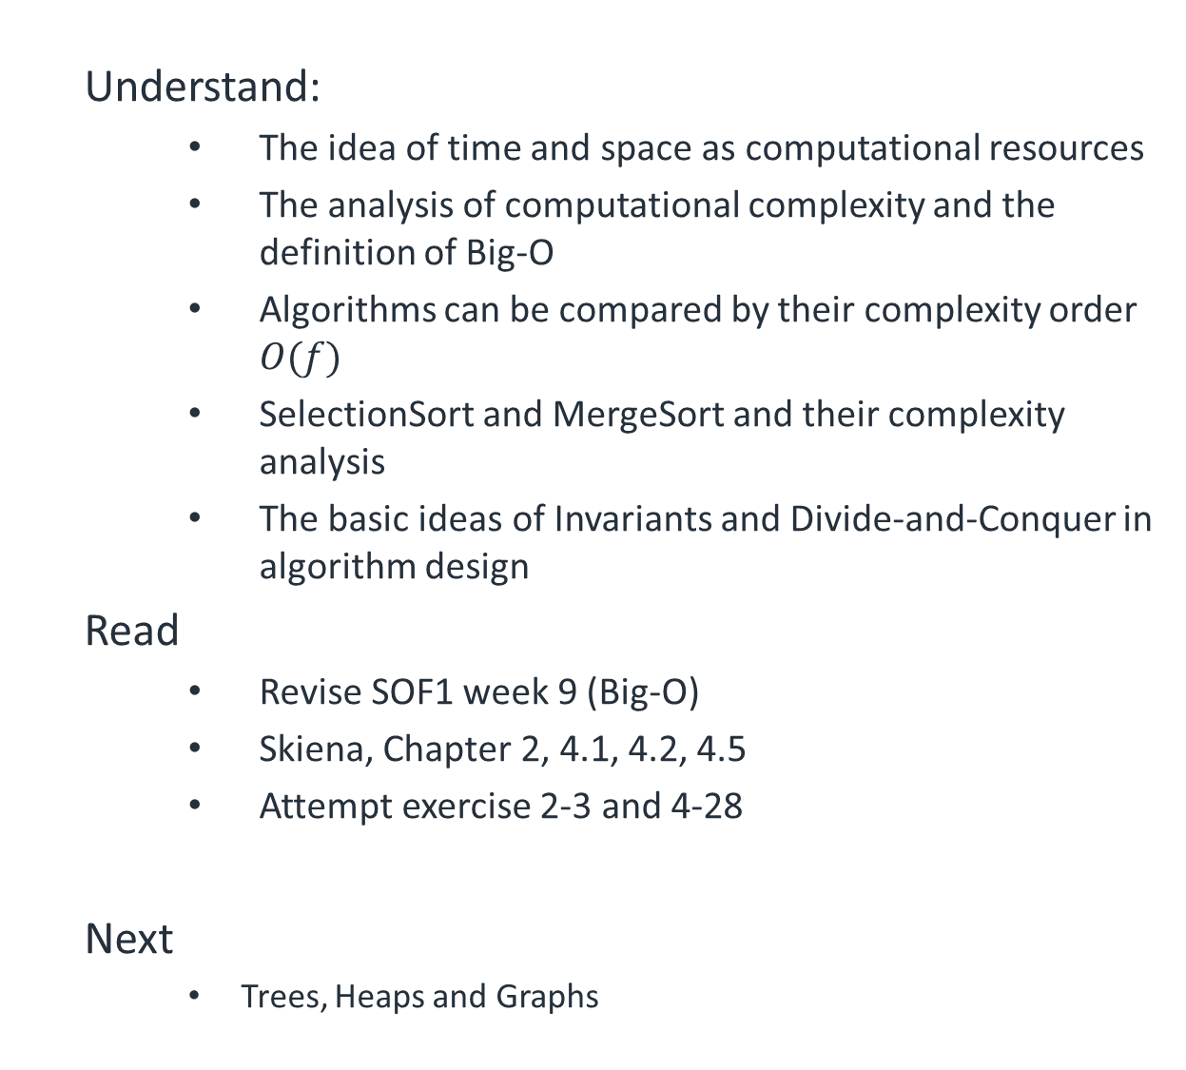
Summary
Understand:
The idea of time and space as computational resources
The analysis of computational complexity and the definition of Big-O
Algorithms can be compared by their complexity order $O(f)$
SelectionSort and MergeSort and their complexity analysis
The basic ideas of Invariants and Divide-and-Conquer in algorithm design
Read
Revise SOF1 week 9 (Big-O)
Skiena, Chapter 2, 4.1, 4.2, 4.5
Attempt exercise 2-3 and 4-28
Next
Trees, Heaps and Graphs

