Slide 1








TECH & DATA TEAM
T&D
CONNECT
Games, lunch & bowling with the team
Thursday, October 22
Notes:
Welcome everyone to T&D Connect! Quick overview of the day on the next slide.

Slide 2


Today's Game Plan
10:00 – 11:20 AM
11:30 AM – 1:30 PM
2:00 – 3:30 PM
Team Session
Lunch
Bowling
Big Guess
Spaghetti Tower Challenge
Kahoot trivia & fun facts
Prizes for top performers
Private room at Café Landwer
Playtime Bowling
Notes:
10:00–11:20 team games in the office, 11:30–1:30 lunch in our private room at Café Landwer, then 2:00–3:30 bowling at Playtime Bowling.

Slide 3
Team Session
PART 1
Big Guess
1
Spaghetti Tower Challenge
2
Kahoot Trivia & Fun Facts
3
10:00 – 11:20 AM · Get into your teams!
Prizes for Top Performers
★

Slide 4


Big Guess
ROUND 1
Think big. Guess smart.
30 sec
per question
Notes:
Each team writes one numerical guess, everyone reveals at once, closest team wins the round.

Slide 5
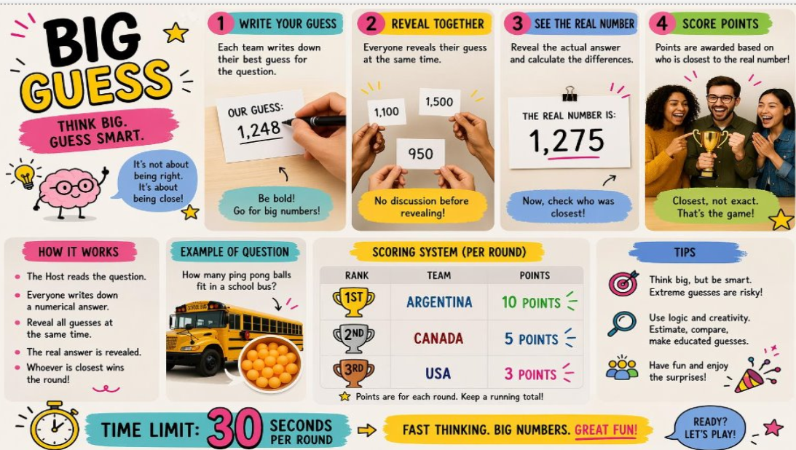

Slide 6


Spaghetti Tower Challenge
ROUND 2
Build the tallest tower that holds the marshmallow on top
20 min
to plan, build & test
Notes:
Hand out spaghetti, tape and one marshmallow per team. Freestanding, marshmallow on top, no hands at the end.

Slide 7
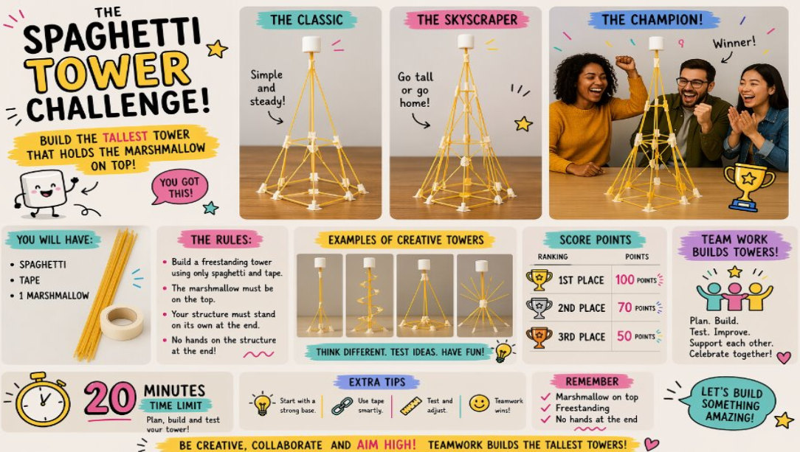

Slide 8

Team Trivia & Fun Facts
ROUND 3
How to join
Go to kahoot.it
Enter the game PIN
Join with your team name
PIN: ________
Kahoot! Fastest correct answers win
Paste QR code here (optional)
Notes:
Open the Kahoot on the main screen, then type the game PIN onto this slide or share it out loud.

Slide 9




And the Winners Are…
KENVUE GIFTS FOR TOP PERFORMERS
Drumroll, please!
1st
2nd
3rd
Notes:
Announce the 3rd, 2nd, then 1st place teams out loud and hand out the Kenvue gifts.

Slide 10

Lunch at Café Landwer
PART 2
Paste a photo of the restaurant
11:30 AM – 1:30 PM · Private room

Slide 11
Bowling at Playtime Bowling
PART 3
Paste a bowling photo
2:00 – 3:30 PM

Slide 12

THANKS FOR
PLAYING!
Great work today, T&D team. See you at the next Connect!

