Slide 1

SAVA

Slide 2
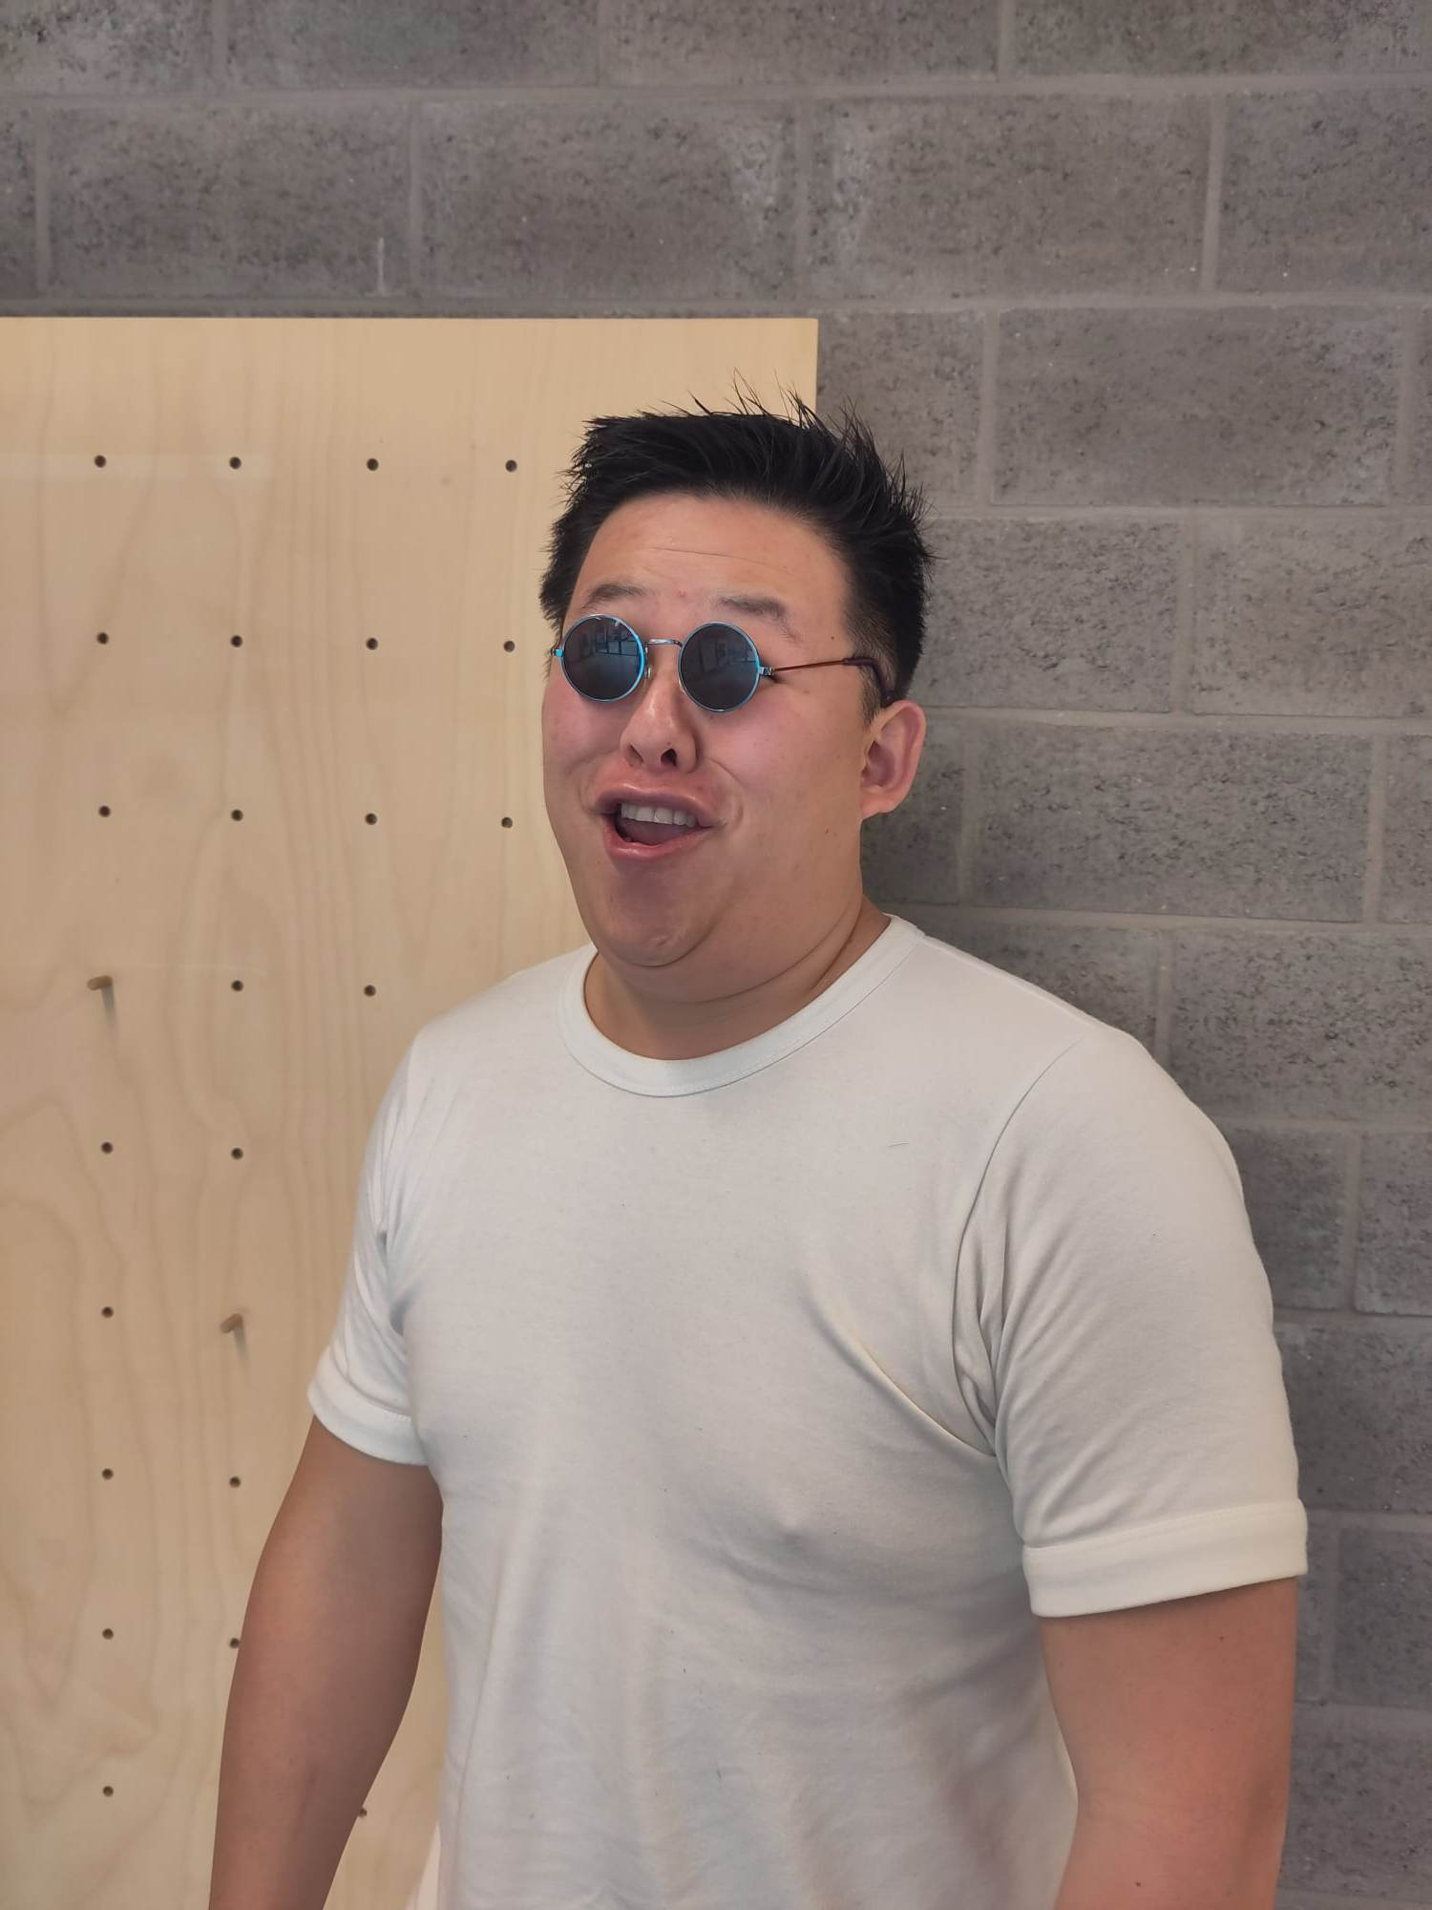
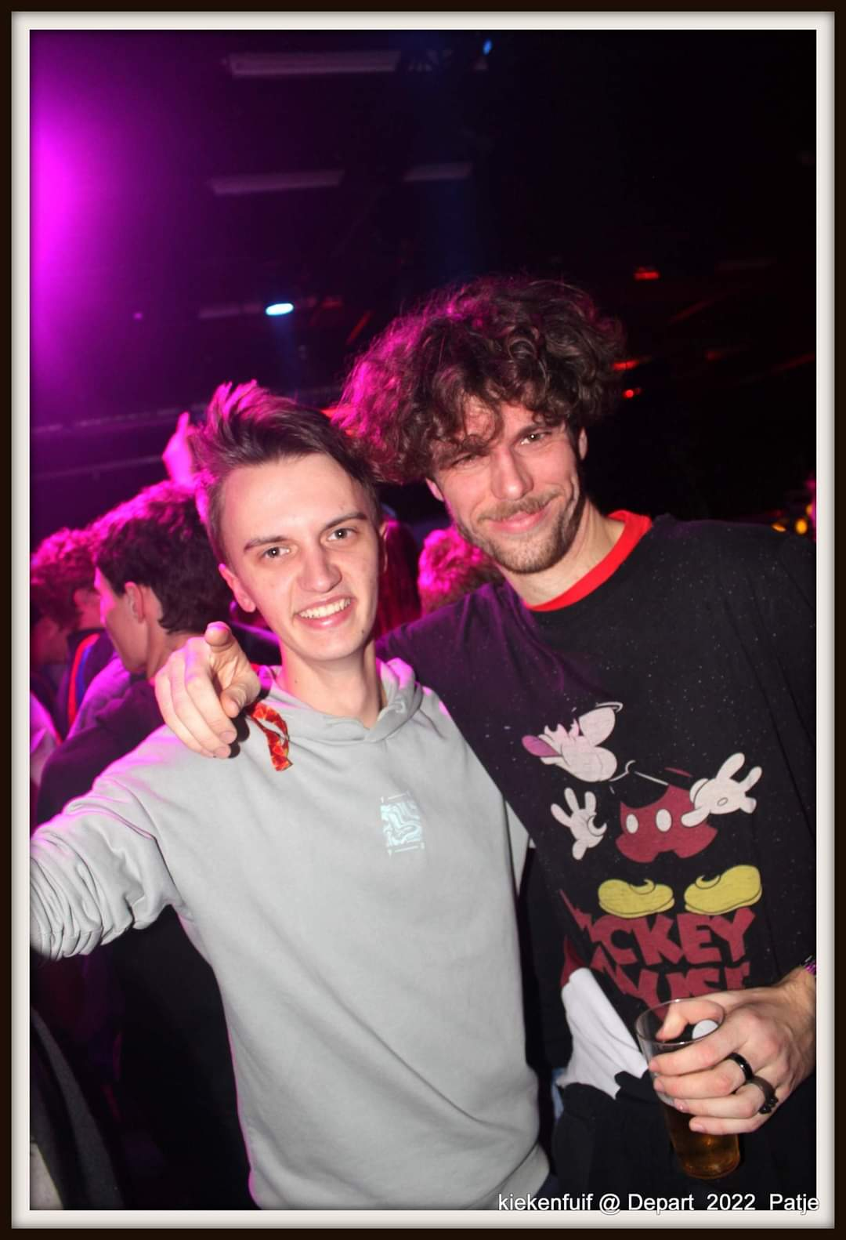

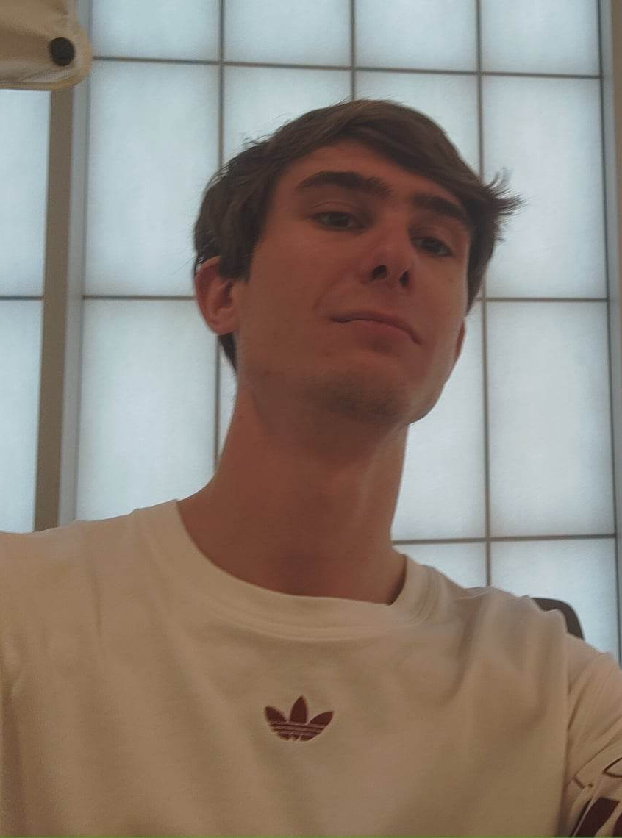


Team
Yi-hong
R-studio engeneer
Douwe
Qualtrics pro
Ward
R-studio engeneer
Jarne
App developer

Slide 3
How can we improve the shopping experience for people with allergies?

Slide 4

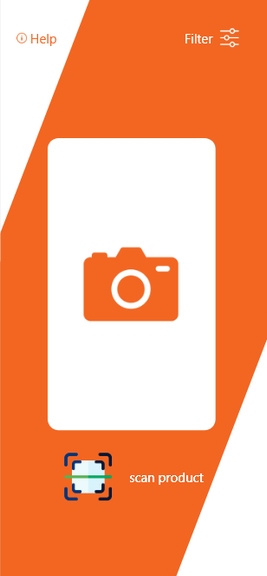
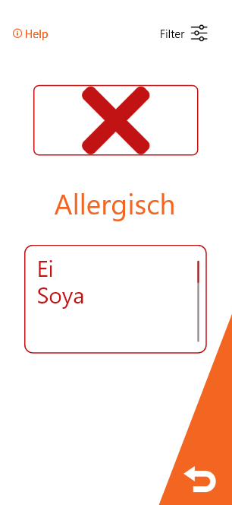
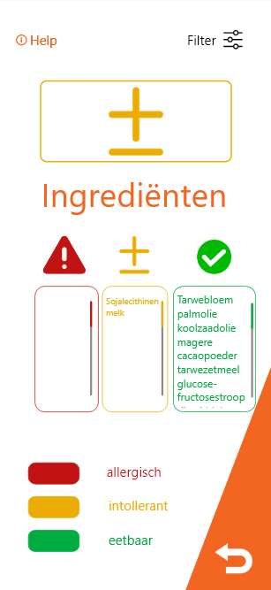
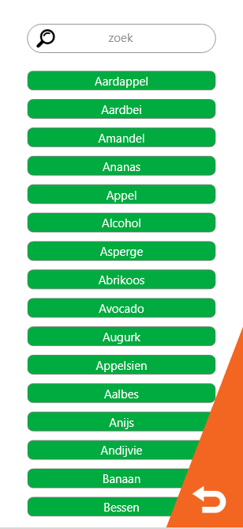
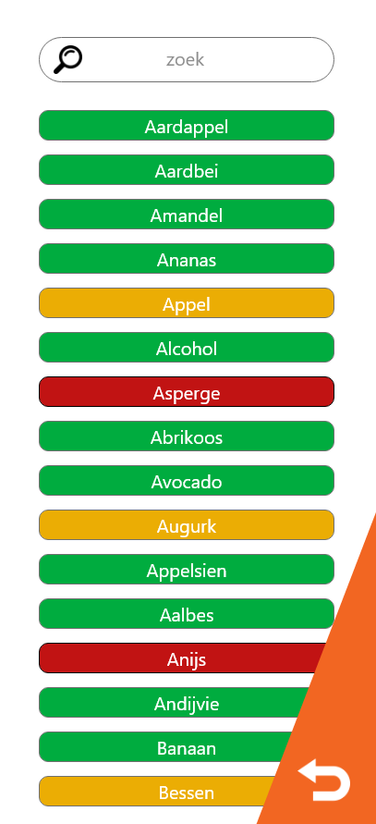
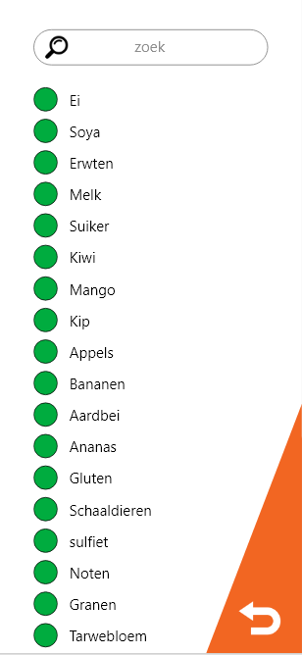
APP design 1

Slide 5

APP design 2

Slide 6
Qualtrics
QUIS – questionnaire of user interface satisfaction
Bipolar from 9 dots
26 questions
1 moeilijk
2
3
4
5
6
7
8
9 makkelijk

Slide 7
Topics
QUIS – questionnaire of user interface satisfaction
Screen
Terminology and system information
Learning
System capabilities
General impressions

Slide 8
Questions
QUIS – questionnaire of user interface satisfaction
Screen layouts make tasks easier
Sequence of screens
Screens items are easy to select
Remembering terms ands use of commands
Tasks can be performed in a straight-forward manner
Help messages on the screen
System speed
Correcting your mistakes
Screens are aesthetically pleasing
System is impressive

Slide 9

Entries
29 awnsers
12 design 1
17 design 2

Slide 10
Cronbach Tests
Cronbach test1
Prototype 1 cronbach alpha: 0,93
Cronbach test2
Prototype 2 cronbach alpha: 0,94

Slide 11
Normality Tests
Shapiro-Wilk test1
Test statistics: 0,969 p-value: 0,907
Shapiro-Wilk test2
Test statistics: 0,983 p-value: 0,979

Slide 12
Normality Tests
Lillie test1 (Kolmogorov-Smirnov)
Test statistics: 0,151 p-value: 0,629
Lilie test2 (Kolmogorov-Smirnov)
Test statistics: 0,092 p-value: 0,963

Slide 13
Homegenious Test
Levene’s test
Pr(>F)value: 0,624
It is homogene

Slide 14
Independent t-test
Independent t-test
Two-sample test
Group d1: 69,05
Group d2: 68,55

Slide 15
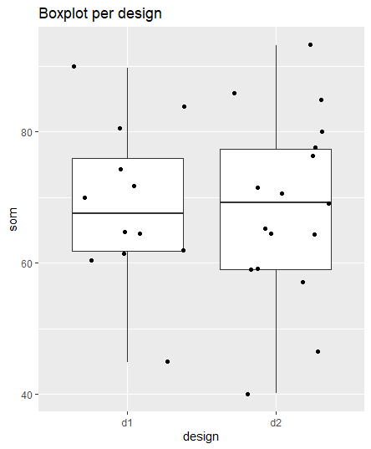
Boxplot

Slide 16
Conclusie
Uit de box plot bleek dat app 1 de beste is en we deze zouden gebruiken als app

