Slide 1
CS215: Implementing a Compiler
Jiashun zhu 5100109194
Notes:
这个project从构思到完成代码一共花了3周左右的时间，前两周在想数据结构和架构，然后打代码。后一周在优化和调试。所以我现在要把花了3周的东西在10分钟里面讲出来，大家能听懂最好，当场不能听懂但有兴趣的话我们可以私下再交流

Slide 2
Outline
Intermediate code
Expression Calculation
Activation record
Symbol table
Function call
Type Checking and Error Checking
Test
Pains and gains
Notes:
我主要讨论一些重要的东西，中间代码，表达式的计算，Activation Record， Symbol table， 然后函数是怎么调用的， 然后是type checking， TEST，痛苦和体会

Slide 3
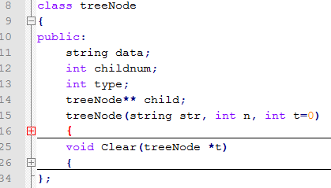
Intermediate code
Syntax Tree
Treenode:
Notes:
我曾经考虑过用三地址码作为中间代码，但总觉得没有一棵树当中间代码好用。这是我写的树的结点类

Slide 4
Data: the actual data of the node;
Childnum: the number of child of the current node.
Type: indicate which reduction is taken place.
Child: is the array storing the pointer to its child
Notes:
Data 代表结点的真实数据， childnum代表这个结点有多少个儿子， type代表 这个nonterminal 发生了哪一个reduction， child是一个指针数组，指向儿子们

Slide 5
Expression Calculation
No Register allocation
Only $t0 and $t1 is enough to calculate expression, put anything else into stack
I always keep the current value in the register $t0, which simplified the problem in a great way.
Notes:
对于Small C来说， 我觉得只两个寄存器就足够了，所以我并没有涉及寄存器分配的内容。把其他任何信息都存放在栈里面， 然后我的Compiler最重要的一个特点是所有当前的值都存在了$t0里面， 这使得整个编译器简化了很多很多，

Slide 6
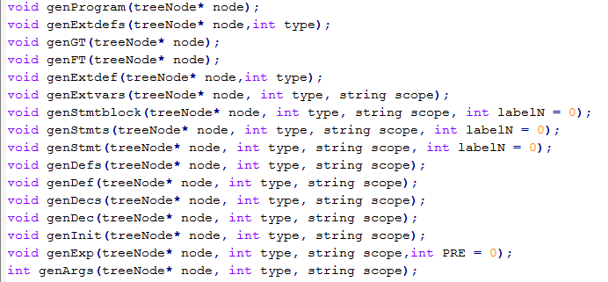

Slide 7
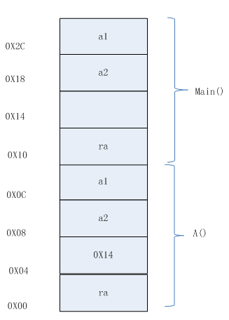
Activation record
$s0 == 0x14
$s0 == 0x04
Notes:
在讲怎样调用函数之前，我先来讲一讲activation record是怎样的。由三部分组成，第一部分是参数和局部变量， 第二部分是$s0，第三部分事return address。解释一下$s0,是干嘛的。 比如看这个main函数，这个红色箭头地址的值存放在$s0里用来索引变量，比如a2的$S0+4,这个偏移量存在一个数据结构里，等会会讲。这一块地址是用来存放以前的$s0的，因为没有函数调用main，所以这里为空。当main调用A（）的时候

Slide 8

Symbol table
FT: It is hash table. The first string is to index the function. The second string is used to index the parameter or the local variables in this function, and the int value is the offset used with $0 to find the location of the variable in the stack.
Eg: FT[“main”][“a2”] = 4
Notes:
然后介绍一下symbol table，数组实在不太好用，最后决定用STL。FT是一个hash table..第一个string。。。第二个string。。。Int是偏移量。比如说，在上一个例子中。

Slide 9
ST: similarly as FT. The first string is to index the struct name. The second string is used to index the attribute of the this struct, and the int is the offset used to find the specified attribute.
STAC: the map from specified struct to abstract struct.
Eg: struct name id; then STAC[“id”] = “name”. )
It is also used to type checking.
ISA : meas Is Array or not. The first string is to index the function, since we can define array in every function. The second string is the variable name. If (*ISA[“main”])[“a”] = 1, it means that a is an array in the function main. It is also used to type checking.

Slide 10
Function call
put all the parameters into the stack.
Reserve the places for local variable.
Store current value of $s0 into $sp-4, then Put the value of $sp-4 into $s0, which is a new value.
Jump to the Function Code, after executing the function, jump back and restore $s0 and $sp
Notes:
接着来解释一下我是怎么调用函数的，首先，把参数入栈，为局部变量留出栈空间，然后把原来的s0存起来，更新s0的值，然后跳转到函数体。 函数执行完毕以后恢复s0和sp的值

Slide 11


Type Checking and Error Checking
1. checking redefined element:
FT[“main”][“a”] != NULL
Means “a” has been declared.

Slide 12

Type Checking and Error Checking
2. checking assigning exp to left-value

Slide 13

Type Checking and Error Checking
3. checking variable/function without declaring first:

Slide 14

Type Checking and Error Checking
4. checking wrong array initialization:

Slide 15

Type Checking and Error Checking
5. array checking:
Use ISA and STAC to implement this.

Slide 16

Type Checking and Error Checking
6. struct checking:

Slide 17

Type Checking and Error Checking
7. Function parameters checking:
wrong number of parameters is not allowed.

Slide 18
TEST
I have written code to test all my operators, such as +=, <<=, %, *=, ++ , --….
All the operators appearing in the Gammar are tested and the result is in my expectation.
I also test all the pretests given by our TA and pass them all.

Slide 19
Pains and gains
Pains:
1) good data structure is hard to select
2) function call
3) deal with local variable
4) initial value
5) debug
Gains:
1) more than 2200 lines of codes make me more proficient in programming.

Slide 20
Thanks
Thanks to Prof.Fwu
Thanks to TA GuoTeng Rao
Thank all of you present in this presentation
ANY QUESTIONS?

