Slide 1
Introduction
Purpose of the presentation.

Slide 2

Authorization Middleware Testing
Explanation of the Authorization middleware. Mention of testing frameworks used: Mocha.

Slide 3
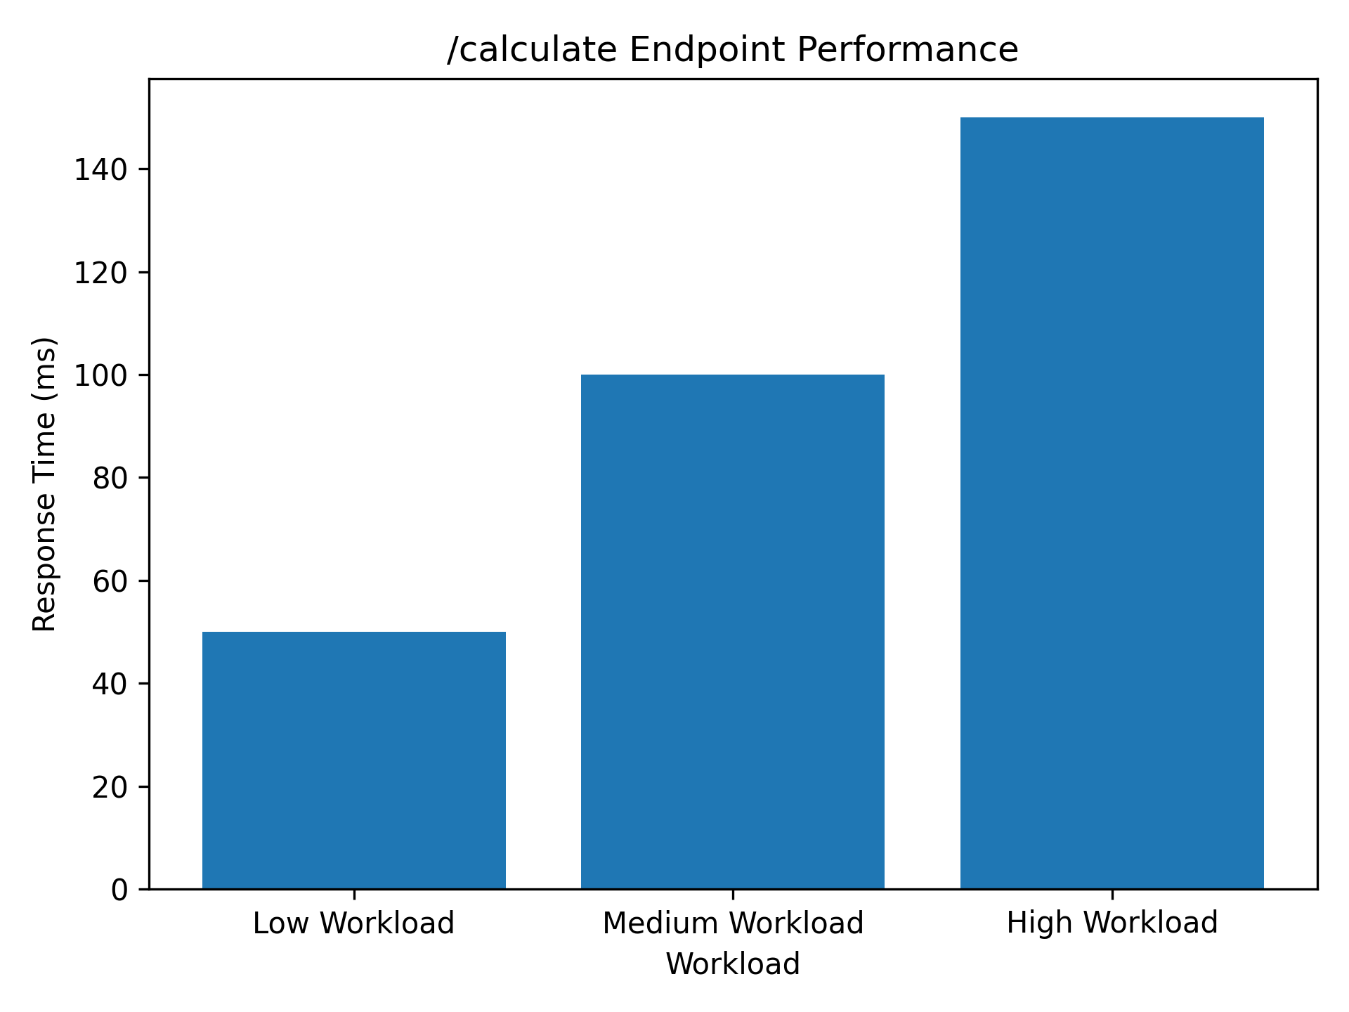
API Response Time (Part 1)
Bar chart showing response time for the /calculate endpoint

Slide 4

API Response Time (Part 2)
Bar chart showing response time for the /addCourse endpoint

Slide 5
Database Performance Evaluation
Analyzed the response times for database-related operations.
Identified potential bottlenecks in the database queries.
Conclusion: The database is efficient, but slow due to hosting on atlas which has great network latency to our server (atlas hosted in Sydney, webserver in west coast USA). We also had inefficient use of the database, making more calls than necessary causing extra delay specifically when more connections to the database are opened showing us a direct linear correlation to API response time.

Slide 6
Conclusion
Overall we found that our database is our main bottleneck and causes our webapp to respond slowly, alongside a lot of our code not being designed for optimal efficiency and rather functional effectiveness.

