Slide 1

CSIE3310 - Operating Systems
Machine Problem 2
Demand Paging and Swapping
Department of Computer Science and Information Engineering

Slide 2
01
TA Contact
林祥瑞 / Jerry Lin
Mail: ntuos@googlegroups.com
TA hours on Tue. 13:00-14:00 at room B04, CSIE building.
Please ask your questions on NTU COOL discussion page,
except that you have personal issues that should go to TA mailbox.

Slide 3
Outline
PART 01
Introduction
PART 02
Launching
PART 03
Assignment
PART 04
Test Programs
PART 05
Submission
Notes:
這是這次研究的大綱主要如下。

Slide 4
01
PART ONE
Introduction

Slide 5
01
Logical View of Virtual Memory
Virtual memory for process 1
Page table for process 1
Physical memory
virtual address space
Virtual page
PTE
Physical page
Virtual page
PTE
Physical page
Virtual memory for process 2
Page table for process 2
virtual address space
physical address space
Physical page
Virtual page
PTE
(page table entry)
per-process virtual memory space
per-process page table
physical memory space

Slide 6
01
Demand Paging
Virtual memory for process 1
Page table for process 1
Physical memory
virtual address space
Virtual page
PTE
not accessed yet
Virtual page
PTE
(not allocated)
Physical page
Virtual memory for process 2
Page table for process 2
virtual address space
physical address space
Physical page
Virtual page
PTE
(page table entry)
In C, a page can be accessed by reading a variable or by pointer dereference.

Slide 7
01
Page Hit Workflow
Physical memory
Page table
PTE w/ V bit
dereference physical address (pa)
Process code
Physical Page (4k)
Load [va]
virtual address (va) lookup

Slide 8
01
Page Miss Workflow
Kernel code
Physical memory
Page table
trap
Page fault handler
va lookup
Insert PTE and set V bit
PTE w/o V bit
Process code
allocate new physical page
Physical Page (4k)
Load [va]

Slide 9
01
Page Miss w/ Swap
Kernel code
Physical memory
Page table
trap
Page fault handler
va lookup
Set V bit and erase S bit
PTE w/ S bit
Process code
Find page in disk
Disk
Physical Page
Load [va]
Swapped Page
Move to physical memory

Slide 10
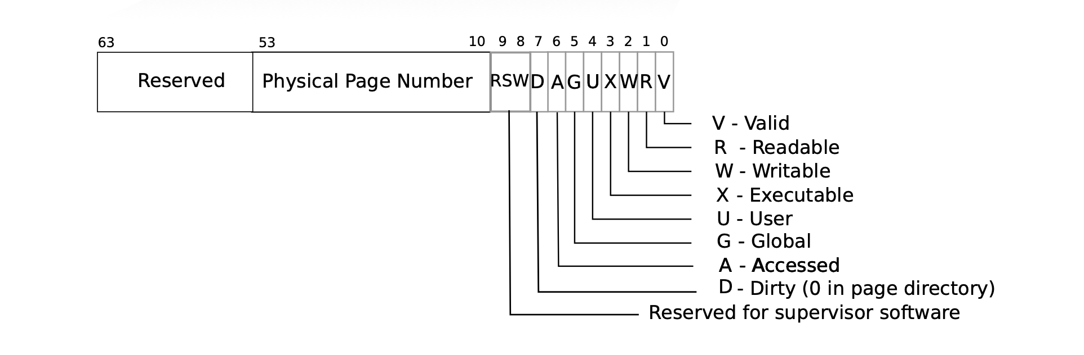
01
Page Table Entry Format
0
0
Page table
Unused PTE
physical page number
V=1, S=0
PTE w/ V bit
PTE w/ S bit
disk block number
V=0, S=1

Slide 11
01
Summary
Learned Concepts
Virtual Memory
  It is an isolated and abstracted memory space for each process.
  A portion of virtual memory pages are mapped to physical memory through per-process page table.
Swapping
  It can not only map virtual memory pages to physical memory pages, but also to blocks on a disk.
  The OS can swap out “cold” memory pages to disk blocks, or swap in disk blocks to physical memory when needed.
With these features, OS can maintain processes with large virtual memory spaces but small physical memory in use. We will add these features to XV6 in this assignment.

Slide 12
02
PART TWO
Launching

Slide 13
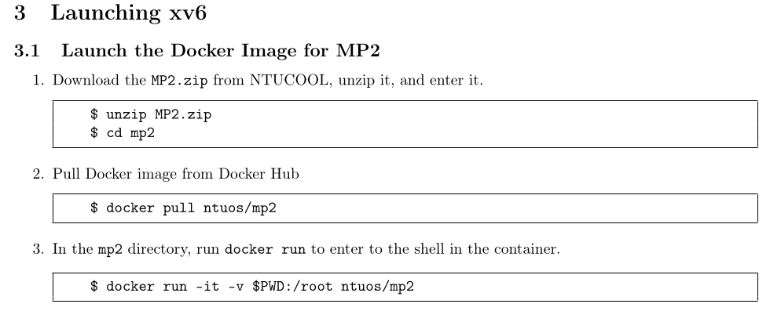
02
Launching

Slide 14
03
PART THREE
Assignment

Slide 15
03
Scoring
Public program tests (70%)
Private program tests (15%)
Report (15%)
Public test program is provided in MP2.zip.
Private test will be performed after submission and will be disclosed after deadline.

Slide 16
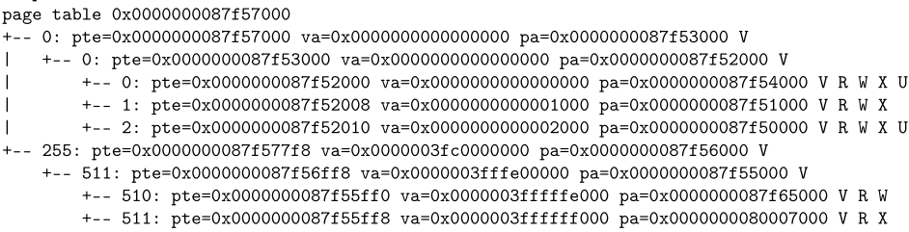
03
Assignment
1. Print a Page Table (Public Test 5% + Report 5%)
  Traverse the 3-level page table on xv6 and print the tree hierarchy.
  Print physical addresses and flags, and compute corresponding virtual addresses.
PT
PTE
PT
PTE
Page

Slide 17
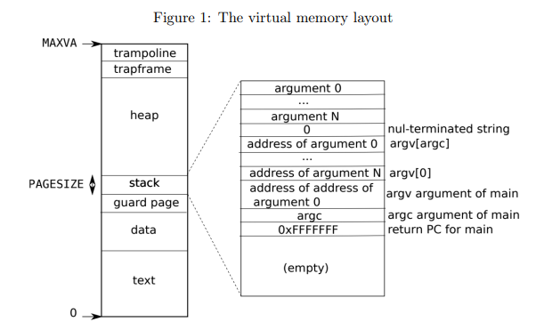
03
Assignment
1. Print a Page Table (Public Test 5% + Report 5%)
Report Part: (5%)
Explain the correspondence from your vmprint to the memory layout and explain the reason.
Explain

Slide 18
03
Assignment
2. Generate a Page Fault (Public Test 20%)
sbrk(n) adds n bytes to process memory if n > 0, or decreases by |n| bytes if n < 0.
Change sbrk(n) so that it does not allocate.
Implement page fault handler so that physical pages are allocated only when page fault.
myproc()->sz
after sbrk(n)
Original: Pages are allocateed for +n bytes.
Changed: Do not allocate.
+n bytes
myproc()->sz
before sbrk(n)

Slide 19
03
Assignment
3. Demand Paging and Swapping
(Public Test 45% + Private Test 15% + Report 10%)
Add the `madvise()` system call with this signature:
int madvise(char *base, int length, int option)
option := MADV_NORMAL | MADV_WILLNEED | MADV_DONTNEED
base and length describes the [base, base + length) virtual address range in bytes.
The memory region is the minimum set of pages covering the range.
It returns 0 if success, otherwise -1. Invalid region should return -1.

Slide 20
03
Assignment
MADV_NORMAL: Do nothing but range check.
Return 0 if the all pages in the memory region are valid. That is, pages were claimed by one or many earlier sbrk() calls.
Physical memory
Virtual memory
lookup
Physical Page(s)
Region

Slide 21
03
Assignment
MADV_DONTNEED: Move all pages to the disk in the memory region.
Physical memory
Virtual memory
Move to disk
(if page exists)
lookup
Disk
Physical Page(s)
Region
Swapped Page

Slide 22
03
Assignment
MADV_WILLNEED: Move swapped pages within the memory region from the disk to physical memory.
Physical memory
Disk
Move back to physical memory
(if swapped page exists)
Virtual memory
lookup
Physical Page(s)
Swapped Page
Region
New physical Page(s)
Allocate new pages if not exist

Slide 23
03
Assignment
3. Demand Paging and Swapping
(Public Test 45% + Private Test 15% + Report 10%)
Program Part I (Public Test 17%)
Test range check option with MADV_NORMAL
Program Part II (Public Test 28%)
MADV_DONTNEED + MADV_WILLNEED test
Program Part III (Private Test 15%)
MADV_DONTNEED + MADV_WILLNEED + page fault on swapped pages
Report (10%)

Slide 24
04
PART FORE
Test Programs

Slide 25
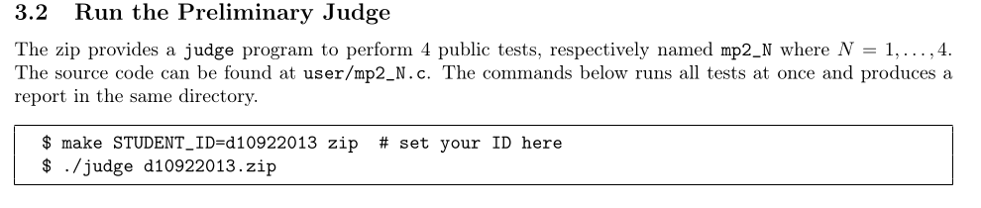
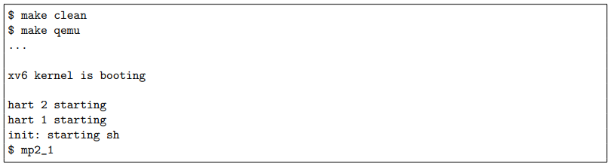
04
Test Programs
Fill in your implementation in places marked TODO in kernel/*.c.
To run the public test for user/mp2_{1,2,3,4}.c,
To run a single program manually,

Slide 26
05
PART FIVE
Submission

Slide 27
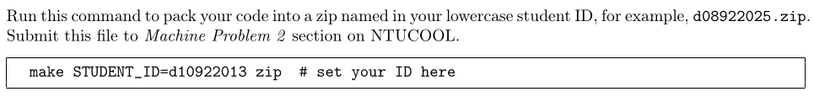
05
Submission
MP2 assignment deadline : April 10, 23:59:00
Immediate 20pts penalty if deadline is missed. Minus 20 points per 24 hours after deadline.
Source code
  Submit your d08922025.zip to “Machine Problem 2” on NTU COOL.
Report
  Submit a PDF file to “Machine Problem 2” on Gradescope.
To pack your source code to a zip file,

