Slide 1
Lab 6

Slide 2
Outline
1. Result of Assignment 4
2. Assignment 6

Slide 3
1. Result of Assignment 4
30 Students Score:10
Students Score:9
3 Students Not received
Notes:
9分的一个没有图片在报告中 一个SQL statement数量不够 我们要求是最少7条语句

Slide 4
Assignment6
Notes:
Now this is the 6th assignment

Slide 5
Content
Internet bookstore
Web based or other format you familiar
Three tiered architecture
B/S or C/S
Database: Access , MySQL , …
Improved database
Improved function
Notes:
MFC or Java application is both ok
Three tiered architecture ：User interface layer，Business logic layer， Data access layer

Slide 6
Client Functionality
Pages we demand
Home Page
Search Page
Book Information Page
Account Creation Page
Shopping Basket
Login Page
Checkout Page
Notes:
MFC or Java application is both ok
Three tiered architecture ：User interface layer，Business logic layer， Data access layer

Slide 7
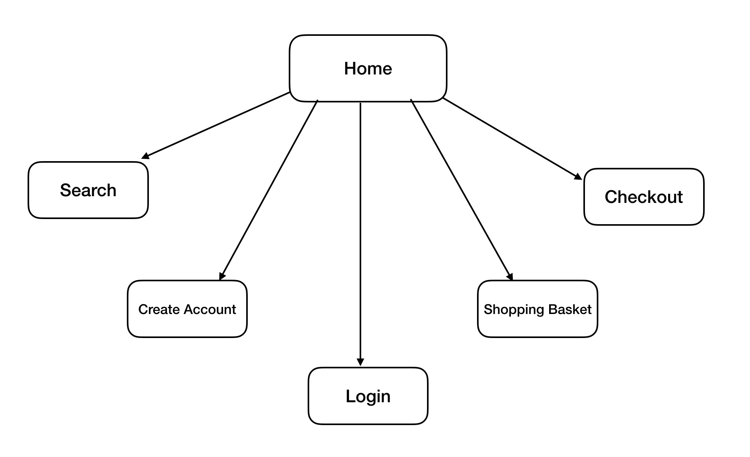
Common to All Page
We suggest:
Every page will have a menu bar at the top. This will allow users to move fluidly around our system from any page. The menu bar will offer the following options:

Slide 8
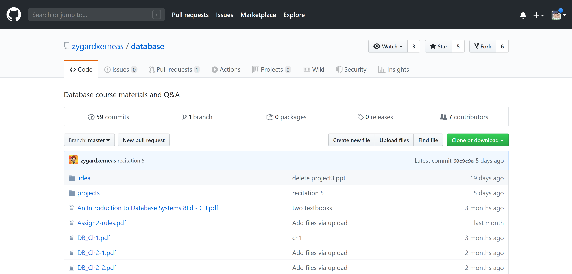
Common to All Page

Slide 9
Page 1: Home Page
The home page will be the first page users see when they connect to the website or use the application. Users will be greeted by a welcome message for our web site or application. They will also be presented with the following list of options:
Action | Directed to
Creat new Account | Page Account Creation
Login | Page Login

Slide 10
Page 2: Search Page
This page will consist of a series of questions that will assist a user in searching our database. A User selects whether they would like to search for a book by author, title, or ISBN number. They then enter a non-case sensitive text string used to search for their book. Some examples of possible queries are:
Author = Charles Dickens
Title = American Pastoral
ISBN = 1829853333
Users will be presented with a list of books and have the ability to view individual books book information pages, Page Book Information, for each book in the database.

Slide 11
Page 3: Book Information Page
For each book in system, users will be presented with information such as the books title, author, price, and quantity.

Slide 12
Page 4: Account Creation Page
Users without accounts or those wishing to create new ones can do so by choosing to create a new account from the system Page Home. They will be asked a series of personal questions including choosing a new username for the system as well as a password. If any of the information they provide is incorrect, missing, or invalid, they will be asked to enter it again. For example, if the user enters a password that is too short or choosing a username that is all ready in the system, they will be informed that these fields are invalid and that they must re-enter their information before proceeding.

Slide 13
Page 4: Account Creation Page
After the account information has been entered correctly, the account will be created by the system and the user will be automatically logged in and directed to their shopping basket, Page Shopping Basket(or Page Search).
The application layer will check the information the user enters thoroughly each time they submit it before attempting to create the account. If all the data passes, the server will attempt to make the account and check for account creation errors.
In addition, the Account Creation Page will invoke the Login Page in order to log the user into their account directly after it has been created.

Slide 14
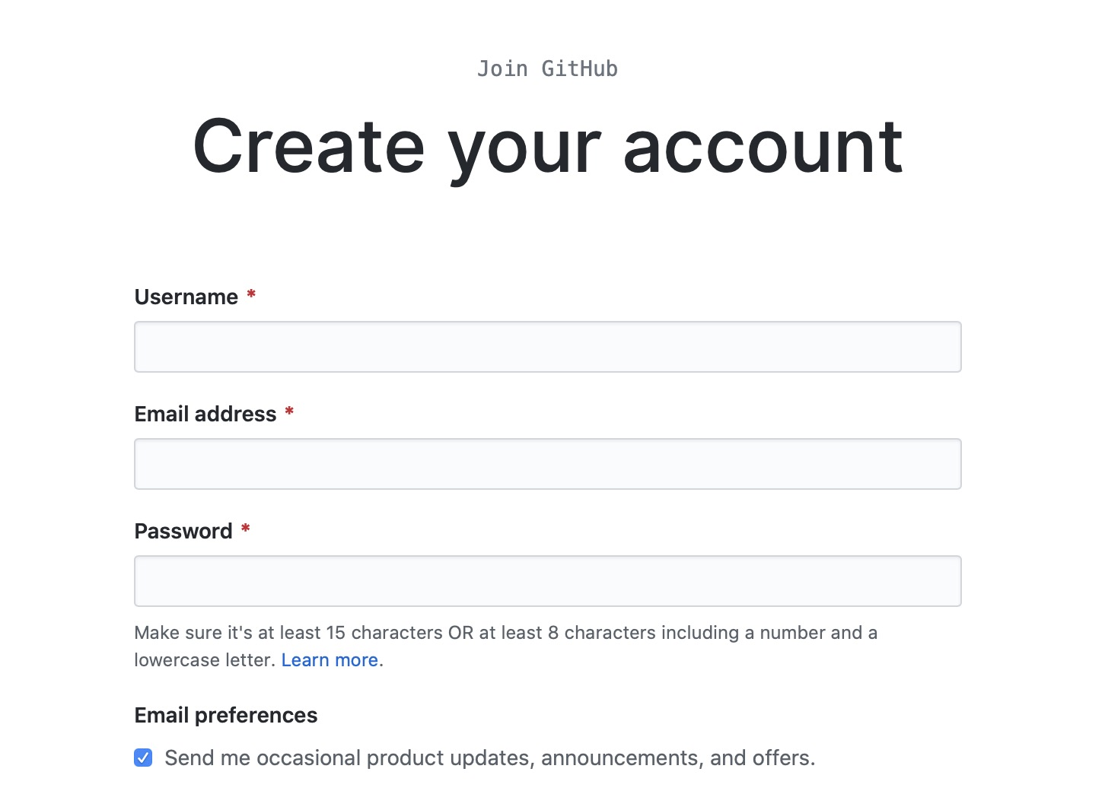
Page 4: Account Creation Page

Slide 15
Page 5: Shopping Basket Page
The shopping basket is a temporary state page that shows the user which items they have added to their order during their current visit. In addition, users can change their shopping cart by both modifying the quantities of books in their baskets, as well as deleting books from their basket. To make changes to their shopping cart, users will need to click an Update button that will reload their shopping cart with their new options present.
Note that no information contained in the shopping basket is maintained by the system permanently; so that a user’s shopping basket is erased each time they connect to our server.

Slide 16
Page 5: Shopping Basket Page
The application layer will present a form to the user listing each of their books and the current quantities of each book they wish to order. The form will allow users to modify these quantities taking care to allow only valid integers from a valid numerical range

Slide 17
Page 6: Login Page
The login page will ask a user for their username and password to use to log into the system. In addition, they will have the following options based on the information they provided:
The application layer will query the database with the information the user has provided and if it is valid for a user in the system, it will log a user in by creating a cookie on the user’s machine.
Action | Directed to
Forgot Password | E-mail Message to Administrator
Login: Incorrect Information | Login page
Login: Correct Information | Search page

Slide 18
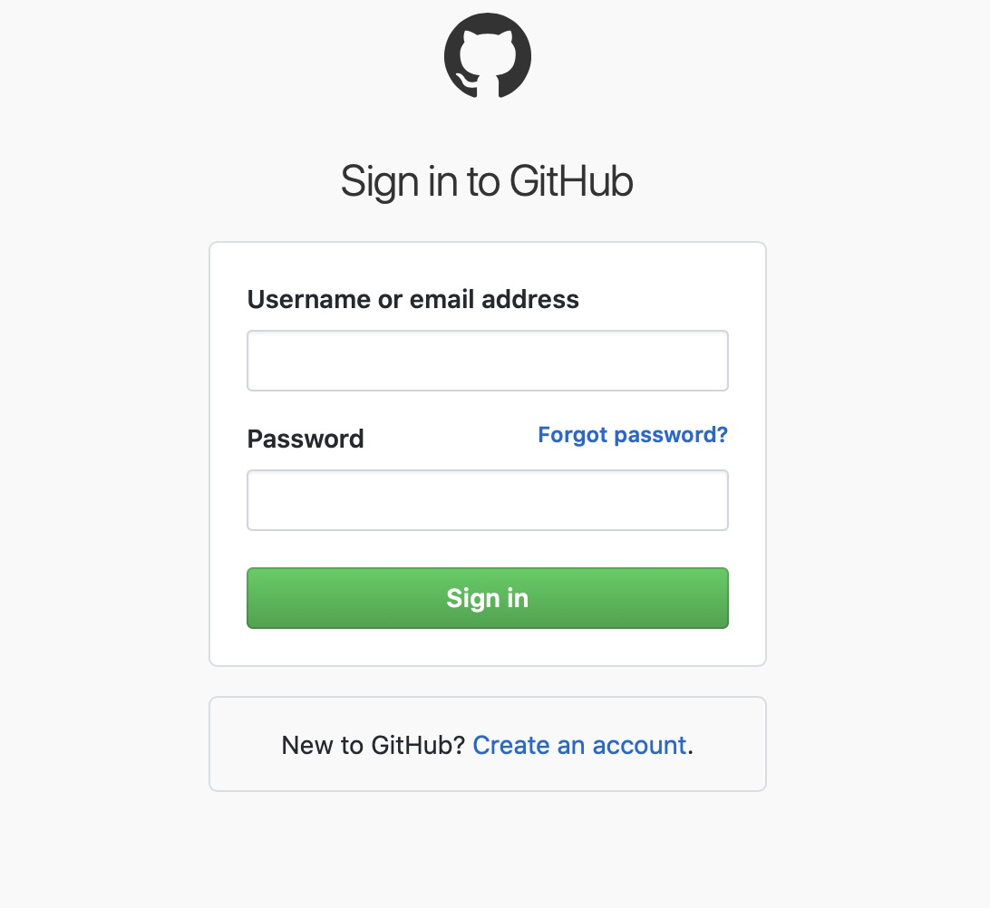
Page 6: Login Page

Slide 19
Page 7: Checkout Page
The Logged In User
Only when a user has at least one item in their shopping basket and has logged into our system will they be able to proceed to the checkout page. First, they will be asked to confirm the items in their order. Next, they will be asked to provide a valid credit card for the order as well as shown their shipping address for the order. Finally, they will be shown the information for their entire order and asked to confirm it. Once they confirm the order, it is sent to the database for processing.
Even if quantities of a specific book are not available at the time of purchase, the transaction will still be completed. If a book’s quantity in stock falls to below zero, that will represent to the store owners that X number of holds have been placed on the book, to be filled as soon as new copies of the book arrives.

Slide 20
Page 7: Checkout Page
The application layer will present multiple forms to the user each asking them a small set of questions including asking them for their credit card information and whether they would like to confirm their order or not. When all the information has been processed and confirmed, the order will be added to the database and the user will be informed.
In addition, the quantities of the books in stock will be decremented by the quantities of books the user purchased for each book.

Slide 21
Demand
Hand in a report about the assignment
Main contents
Database design(Including ER diagram)
Function design
Software design & implementation(Including UML)
Database query
Package your database, source code, executable file into a zip file Sno_A6.zip
Two/Three students a group
Notes:
This is the demand of this assignment
Note that for any question, when you finish SQL query, you must save it
And the database should contains the answers to the twelve questions, twelve queries should be named as :query1, query 2……
And hand in a report

Slide 22
Submission
File name format:
Sno1_Sno2_A6.zip
including:
report_A6.doc
database
source code
executable file
Deadline:
Beijing time, December, 10th ,23:59:59

