Slide 1
Outline
1. Assignment3 situation
2. Midterm exam
3. Assignment5

Slide 2
Assignment3 Situation

Slide 3
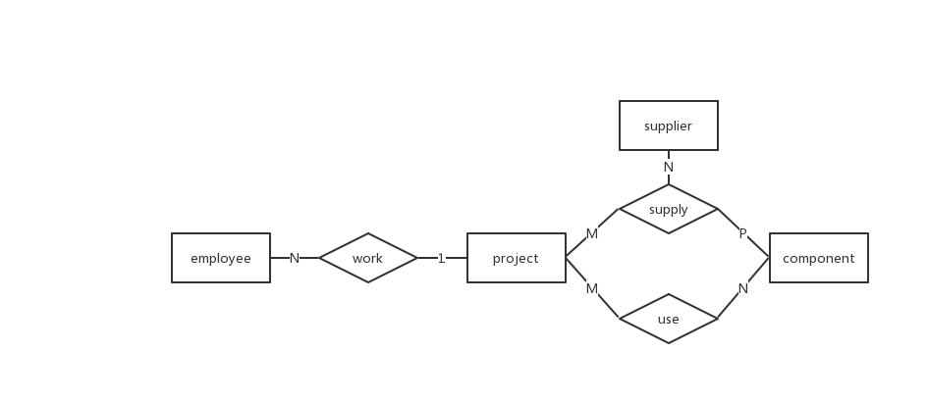
Midterm Exam
Please draw the E-R diagram of the engineering relationship, the entities including employees, engineering, suppliers, components, the relationship between the entities are as follows: (8)
A project has multiple employees, and one employee can only work in one project;
A project has multiple suppliers, and one supplier can supply multiple projects;
A project requires multiple components, which can come from the same supplier or from different suppliers, and one kind of components can be used by multiple projects.

Slide 4
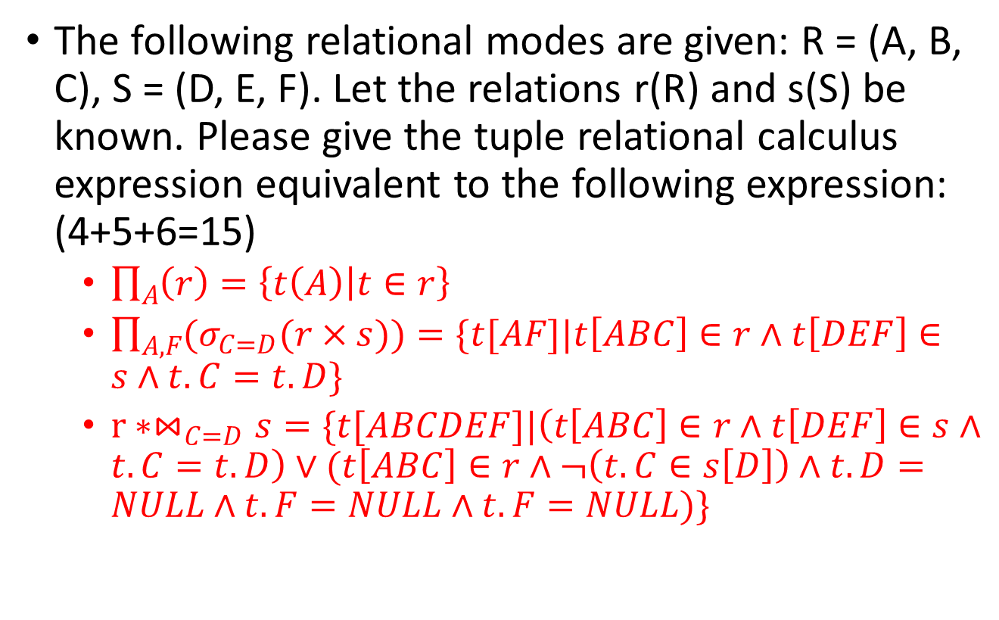
Midterm Exam
The following relational modes are given: R = (A, B, C), S = (D, E, F). Let the relations r(R) and s(S) be known. Please give the tuple relational calculus expression equivalent to the following expression: (4+5+6=15)
$\prod_{A}{\left(r\right)}=\left\{t\left(A\right) | t∈r\right\}$
$\prod_{A,F}{(σ_{C=D}(r×s))}=\{t[AF]|t\left[ABC\right]∈r∧t\left[DEF\right]∈s∧t.C=t.D\}$
$r∗⋈_{C=D}s=\{t[ABCDEF]|\left(t\left[ABC\right]∈r∧t\left[DEF\right]∈s∧t.C=t.D\right)∨(t\left[ABC\right]∈r∧¬\left(t.C∈s\left[D\right]\right)∧t.D=NULL∧t.F=NULL∧t.F=NULL)\}$

Slide 5
Assignment5
Notes:
Now this is the second assignment

Slide 6
Content
Improved the former application (programming)
Use ODBC or JDBC to access database
Use Java/VC/VB/Delphi to program
Improve functions which is hard to implement in the former exercise
Login / logout (general customer / administrator)
Associating between interface components
Mutual access to database
…

Slide 7
Demand
Hand in a report about the assignment:
Main Contents
Database design
Function design（include login）
Software design & implementation(at least 2 interface)
Database query
Package your database, source code, executable file into a zip file Sno_A5.zip.

Slide 8
Submission
File name format:
Sno_A5.zip
including:
report_A5.doc
university_A5.accdb
source code
executable file
Deadline:
Beijing time, November, 28th ,23:59:59

