Slide 1
Lab 4
Notes:
Hello everyone im sunkai and this is guobaoshen, today we will introduce lab 4 to help you familiar to sql query

Slide 2
outline
1. Result of Assignment 4
2. Analysis of difficult questions
3. SQL:DELETE, INSERT, UPDATE
4. Integrity constraint
Notes:
Our class has 4 part . We will tell you how to Download lab2.accdb first. And we will introduce how to use sql in access step by step. Then we will give you 4 examples to practise. Finally part4 is assignment2, and please finish it under class and hand in it in 2 weeks.

Slide 3
1. Result of Assignment 4
Notes:
放github截图及网址，分两部分，数据库 和txt ，指出 并说明 兼容性问题

Slide 4
2. Analysis of difficult questions
Question 4: Print the course names, course numbers and section numbers of all classes with less than six students enrolled in them.
Notes:
放github截图及网址，分两部分，数据库 和txt ，指出 并说明 兼容性问题

Slide 5
2. Analysis of difficult questions
SELECT Course.cname, Enroll.cno, Enroll.sectno
FROM Enroll,Course
WHERE Course.cno=Enroll.cno
and Enroll.dname=Course.dname
GROUP BY Course.cname, Enroll.cno, Enroll.sectno
HAVING count(*)<6;
Notes:
放github截图及网址，分两部分，数据库 和txt ，指出 并说明 兼容性问题

Slide 6
2. Analysis of difficult questions
Question 9: Print the names of students who are taking both a Computer Sciences course and a Mathematics course.
Notes:
放github截图及网址，分两部分，数据库 和txt ，指出 并说明 兼容性问题

Slide 7
2. Analysis of difficult questions
SELECT S.sname
FROM Student AS S, Enroll AS E
WHERE S.sid=E.sid
AND ‘Computer Sciences’ in (
SELECT E.dname FROM Enroll E
WHERE S.sid=E.sid)
AND ‘Mathematics’ in (
SELECT E.dname FROM Enroll E
WHERE S.sid=E.sid)
GROUP BY S.sname
Notes:
放github截图及网址，分两部分，数据库 和txt ，指出 并说明 兼容性问题

Slide 8
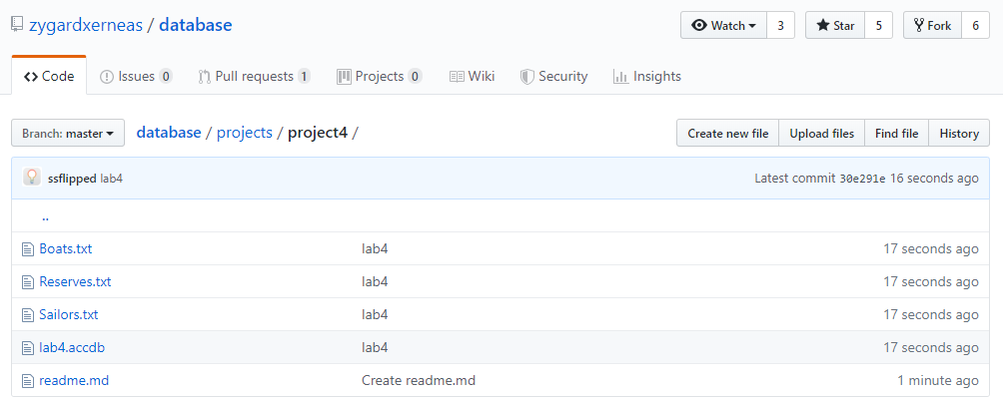
2. Download lab4.accdb
https://github.com/zygardxerneas/database
The database of lab4 is same as lab2.accdb
Notes:
放github截图及网址，分两部分，数据库 和txt ，指出 并说明 兼容性问题

Slide 9
3.1 INSERT
INSERT INTO Boats values(222,'Summer','black‘);
Notes:
放github截图及网址，分两部分，数据库 和txt ，指出 并说明 兼容性问题

Slide 10
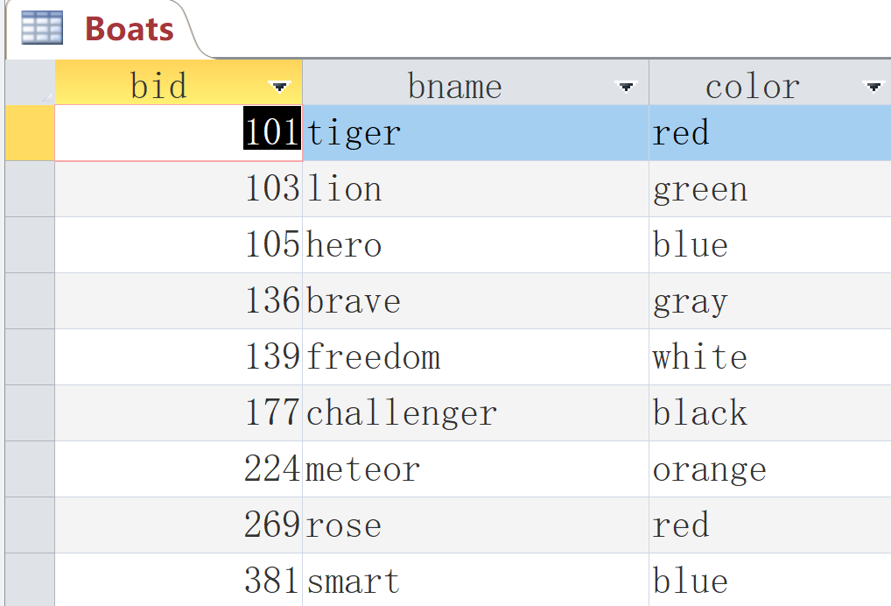
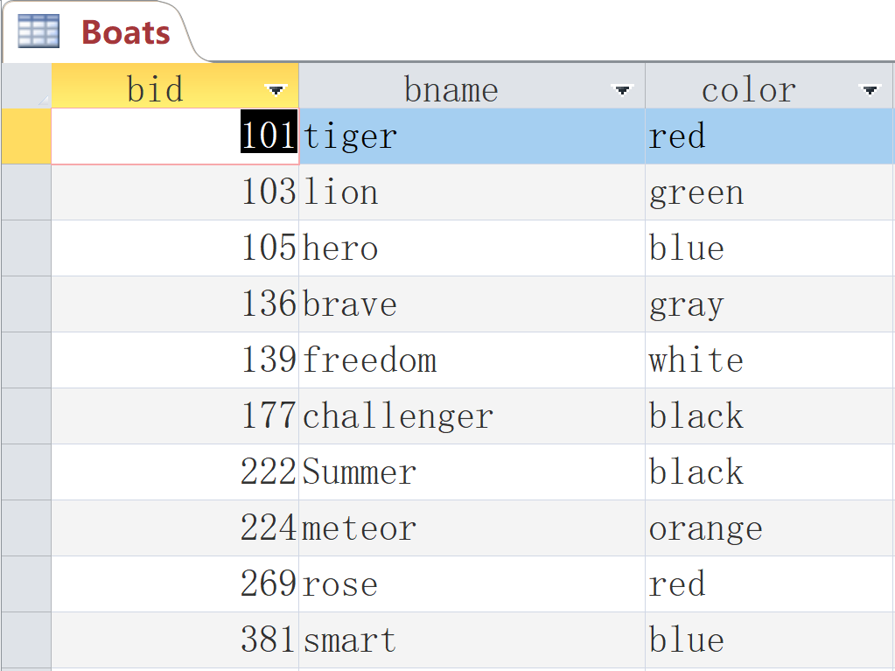
3.1 INSERT
Notes:
放github截图及网址，分两部分，数据库 和txt ，指出 并说明 兼容性问题

Slide 11
3.2 DELETE
DELETE from Boats
where bid = 12345;
Notes:
放github截图及网址，分两部分，数据库 和txt ，指出 并说明 兼容性问题

Slide 12
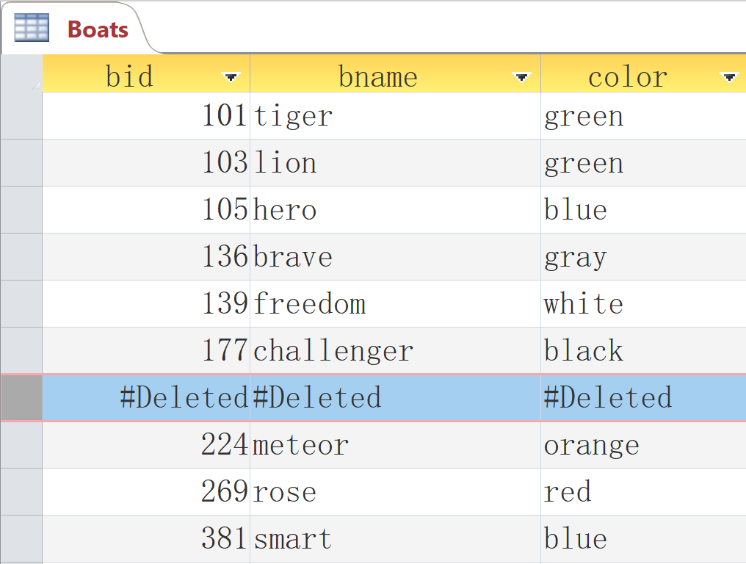
3.2 DELETE
Notes:
放github截图及网址，分两部分，数据库 和txt ，指出 并说明 兼容性问题

Slide 13
3.3 UPDATE
UPDATE Boats set color = 'green' where bid = 101
Notes:
放github截图及网址，分两部分，数据库 和txt ，指出 并说明 兼容性问题

Slide 14
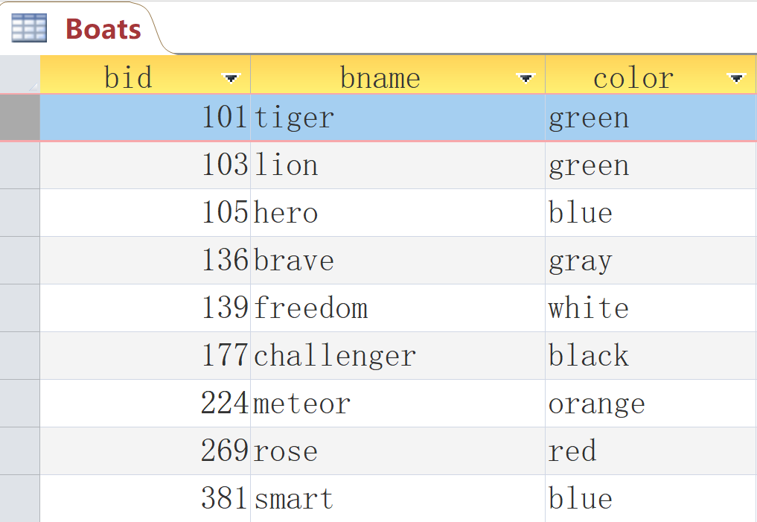
3.3 UPDATE
Notes:
放github截图及网址，分两部分，数据库 和txt ，指出 并说明 兼容性问题

Slide 15
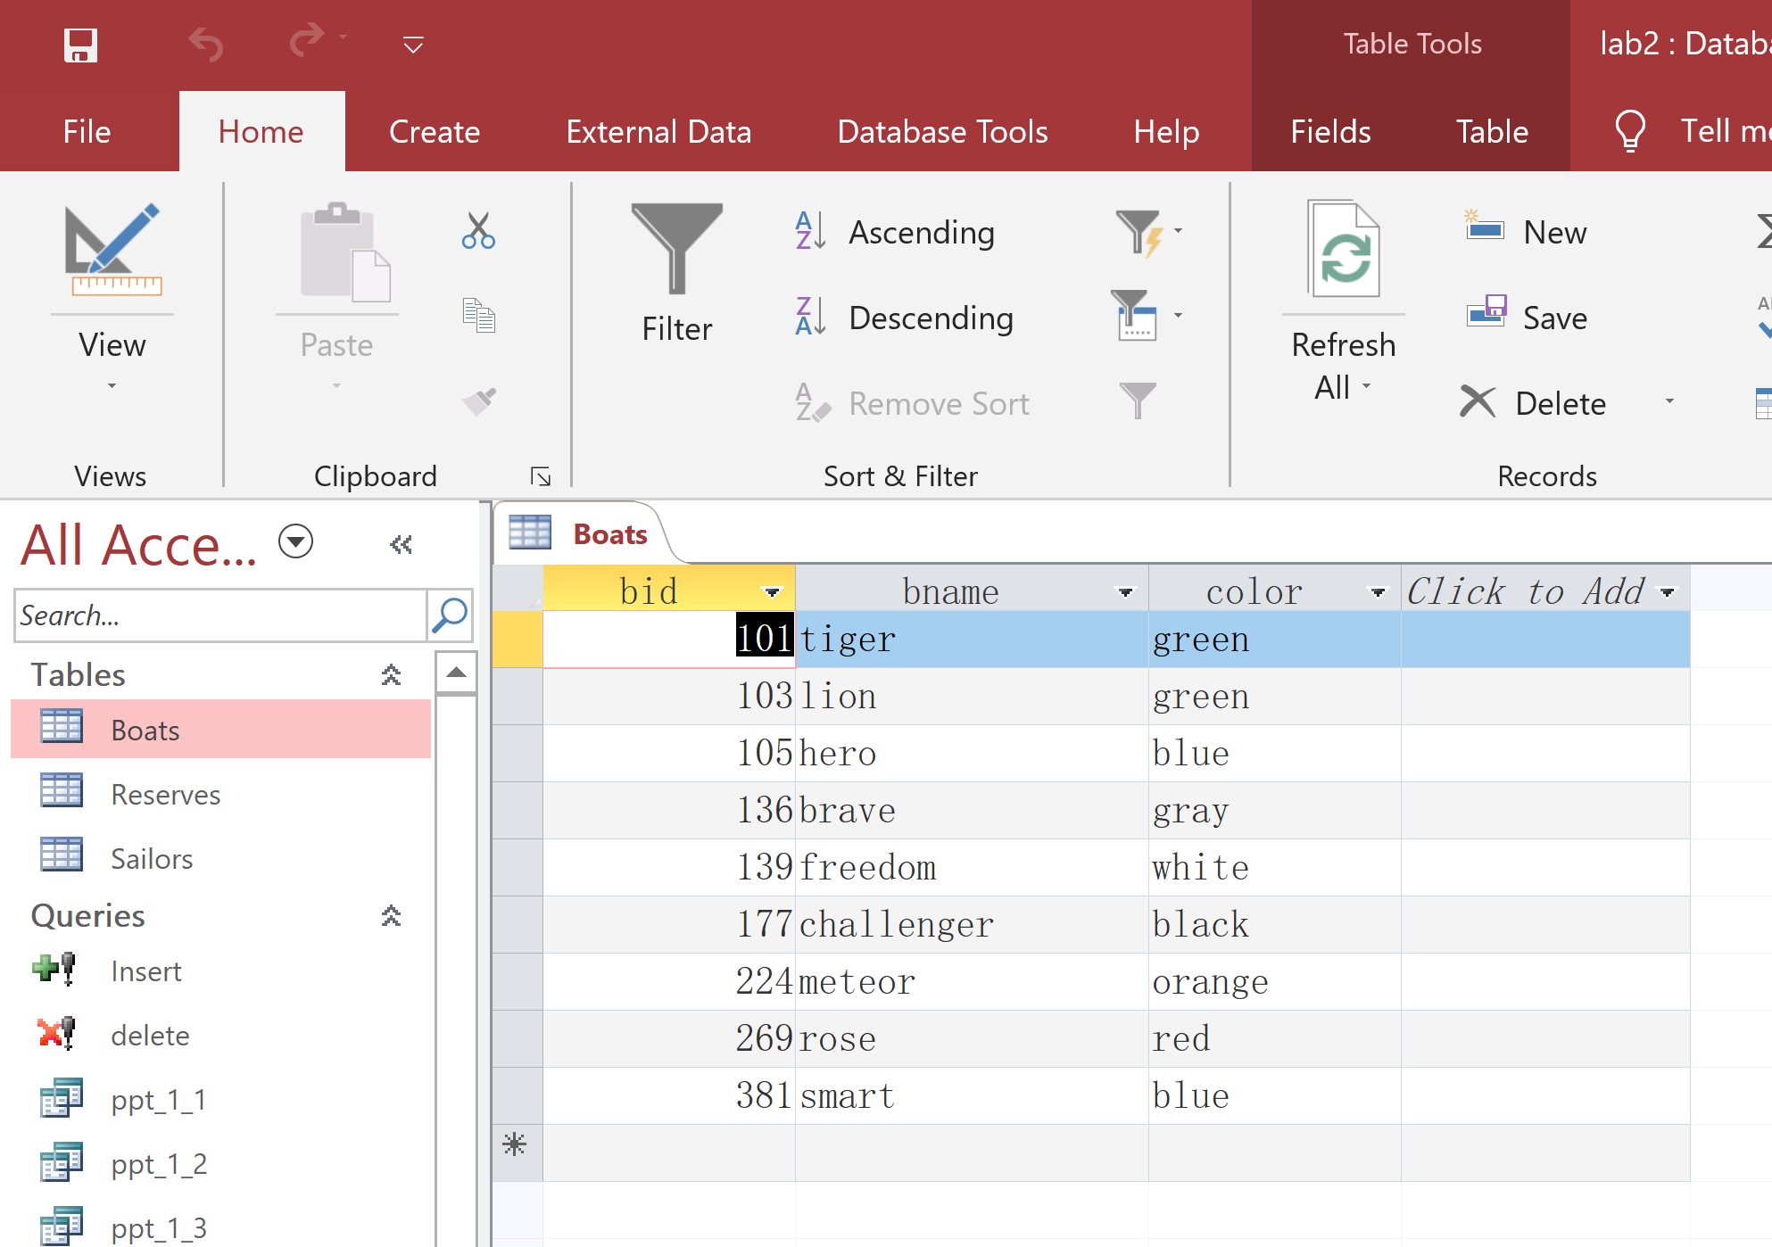
4.1 Domain integrity constraint
Notes:
放github截图及网址，分两部分，数据库 和txt ，指出 并说明 兼容性问题

Slide 16
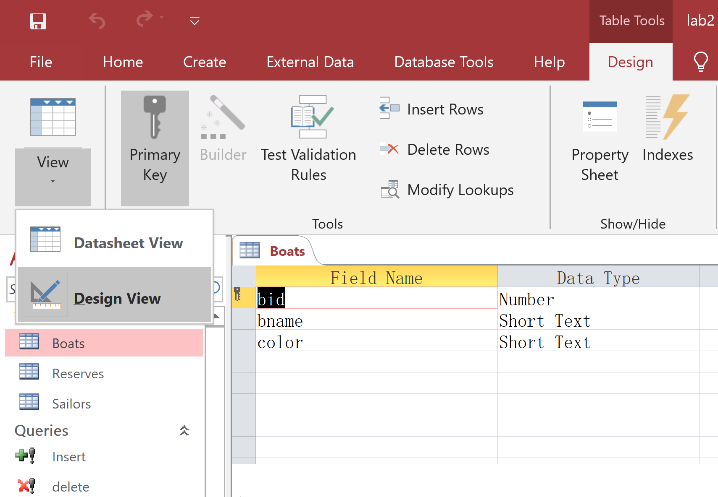
4.1 Domain integrity constraint
Notes:
放github截图及网址，分两部分，数据库 和txt ，指出 并说明 兼容性问题

Slide 17
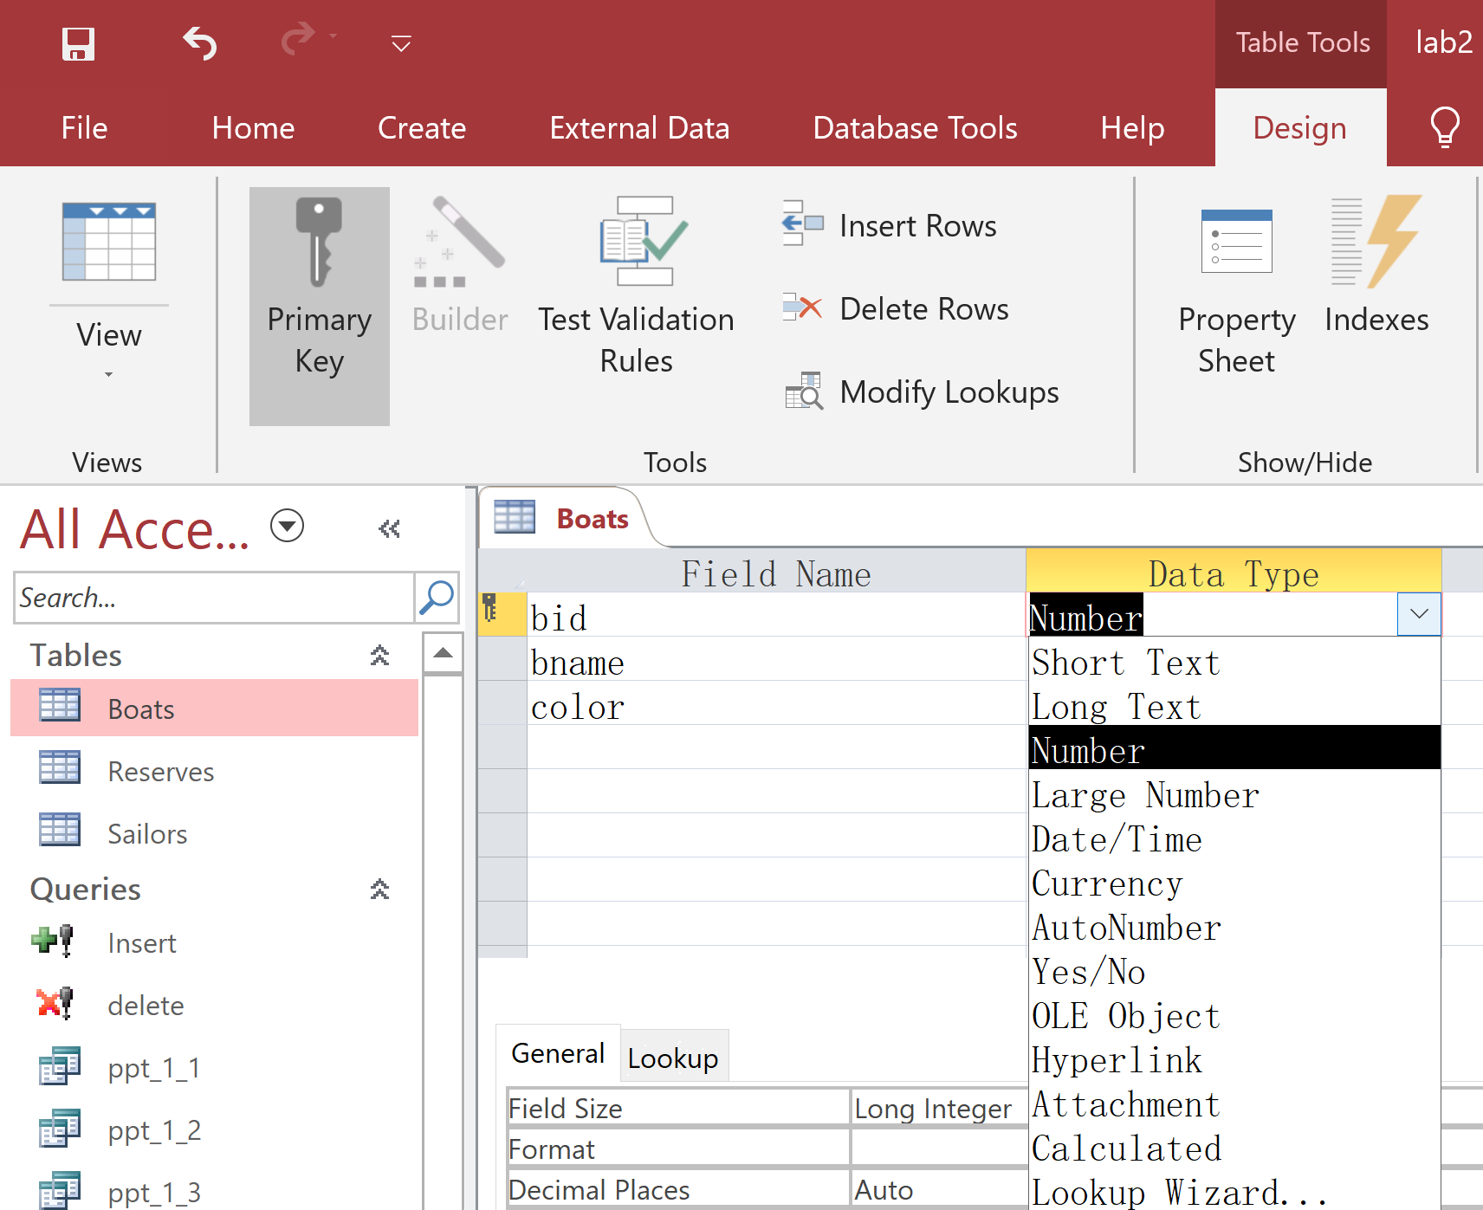
4.1 Domain integrity constraint
Notes:
放github截图及网址，分两部分，数据库 和txt ，指出 并说明 兼容性问题

Slide 18
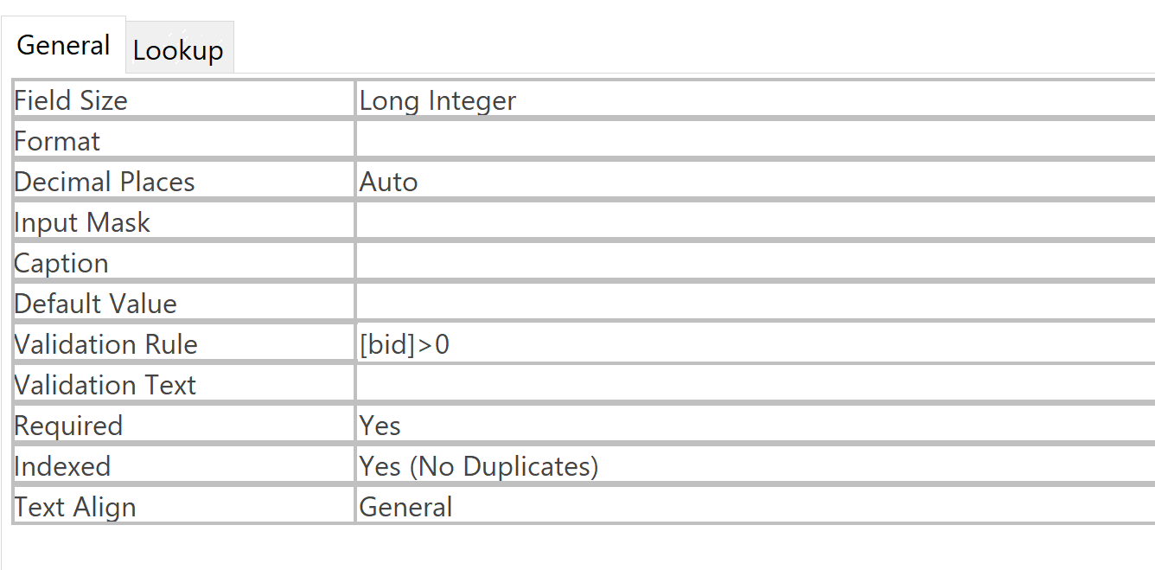
4.1 Domain integrity constraint
Notes:
放github截图及网址，分两部分，数据库 和txt ，指出 并说明 兼容性问题

Slide 19
4.1 Domain integrity constraint
INSERT INTO Boats VALUES('abc','spring','red')
Notes:
放github截图及网址，分两部分，数据库 和txt ，指出 并说明 兼容性问题

Slide 20
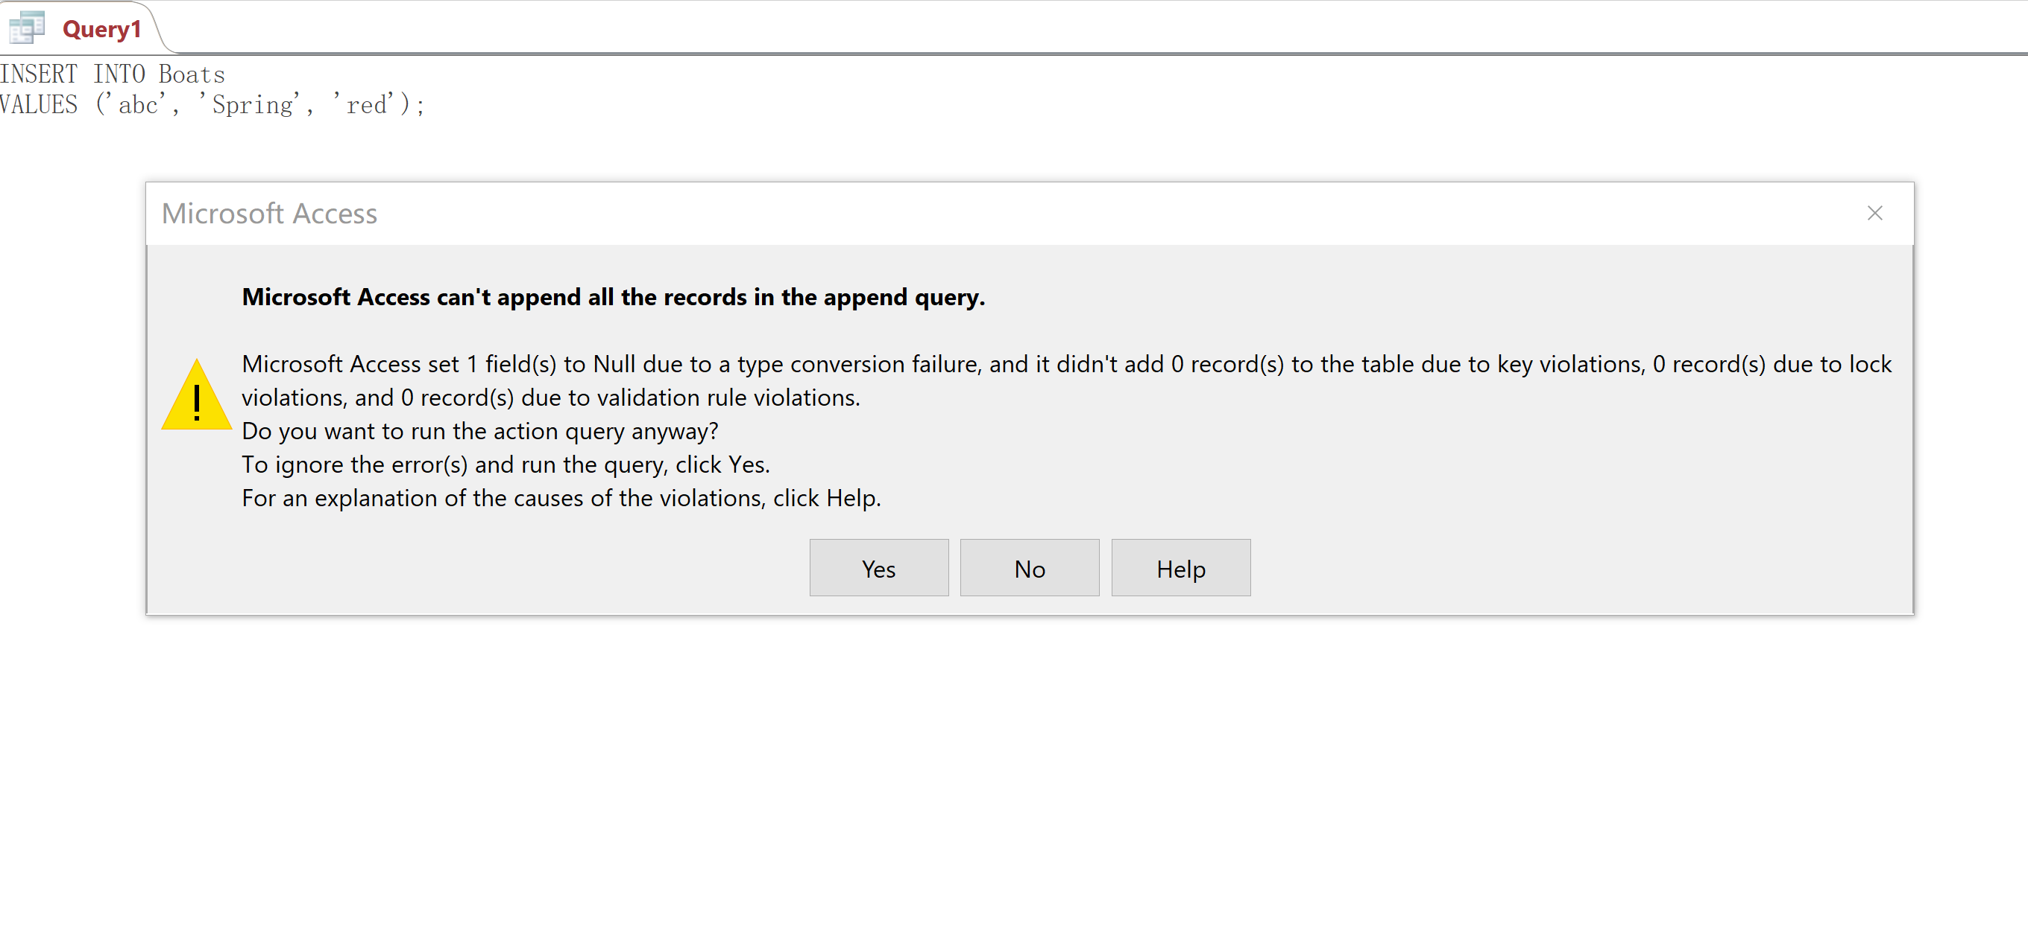
4.1 Domain integrity constraint
Notes:
放github截图及网址，分两部分，数据库 和txt ，指出 并说明 兼容性问题

Slide 21
4.1 Domain integrity constraint
UPDATE Boats SET bid = -10 WHERE bid = 103
Notes:
放github截图及网址，分两部分，数据库 和txt ，指出 并说明 兼容性问题

Slide 22
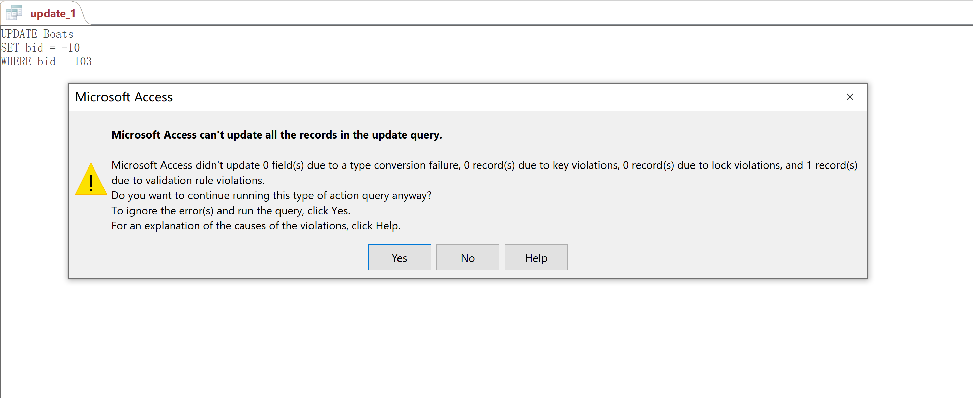
4.1 Domain integrity constraint
Notes:
放github截图及网址，分两部分，数据库 和txt ，指出 并说明 兼容性问题

Slide 23
4.2 Entity integrity constraint
Notes:
放github截图及网址，分两部分，数据库 和txt ，指出 并说明 兼容性问题

Slide 24
4.2 Entity integrity constraint
Notes:
放github截图及网址，分两部分，数据库 和txt ，指出 并说明 兼容性问题

Slide 25
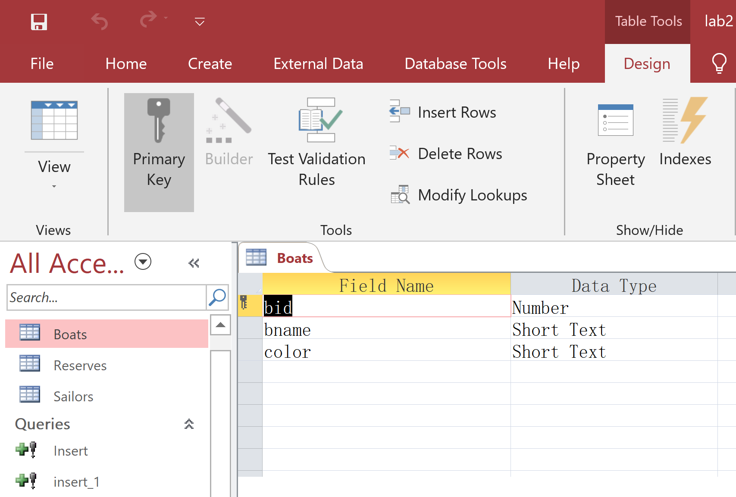
4.2 Entity integrity constraint
Notes:
放github截图及网址，分两部分，数据库 和txt ，指出 并说明 兼容性问题

Slide 26
4.2 Entity integrity constraint
INSERT INTO Boats VALUES(103,'winter','white')
Notes:
放github截图及网址，分两部分，数据库 和txt ，指出 并说明 兼容性问题

Slide 27
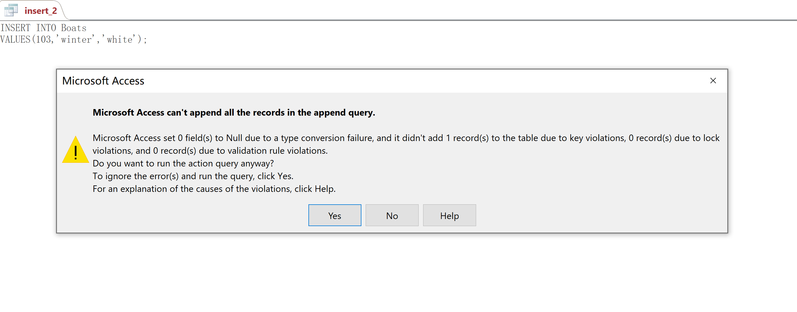
4.2 Entity integrity constraint
Notes:
放github截图及网址，分两部分，数据库 和txt ，指出 并说明 兼容性问题

Slide 28
4.2 Entity integrity constraint
INSERT INTO Boats VALUES(Null,'winter','white')
Notes:
放github截图及网址，分两部分，数据库 和txt ，指出 并说明 兼容性问题

Slide 29
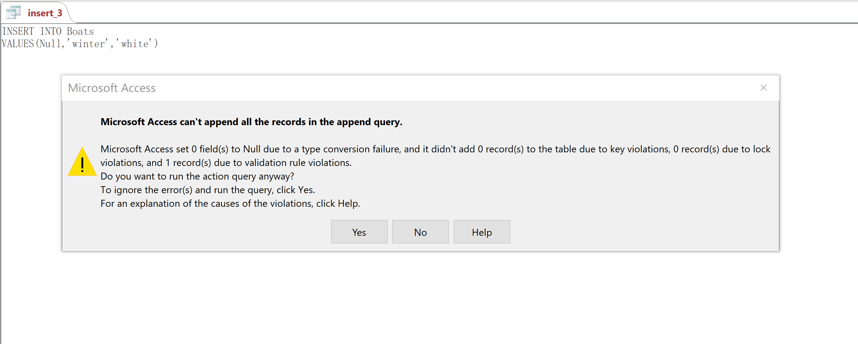
4.2 Entity integrity constraint
Notes:
放github截图及网址，分两部分，数据库 和txt ，指出 并说明 兼容性问题

Slide 30
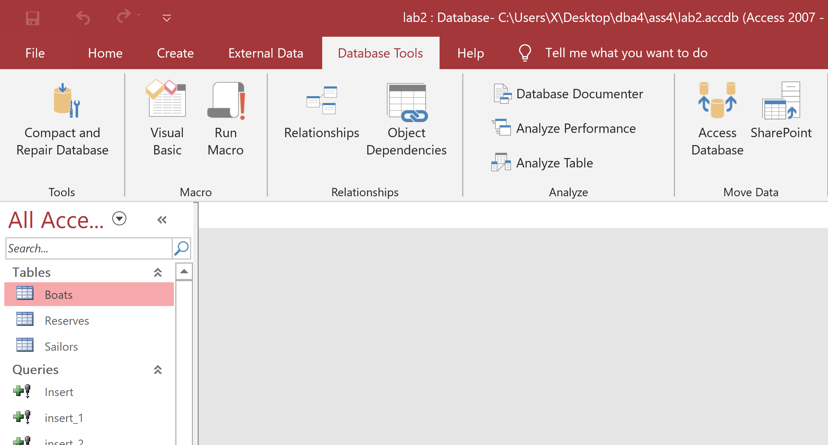
4.3 Referential integrity constraint
Notes:
放github截图及网址，分两部分，数据库 和txt ，指出 并说明 兼容性问题

Slide 31
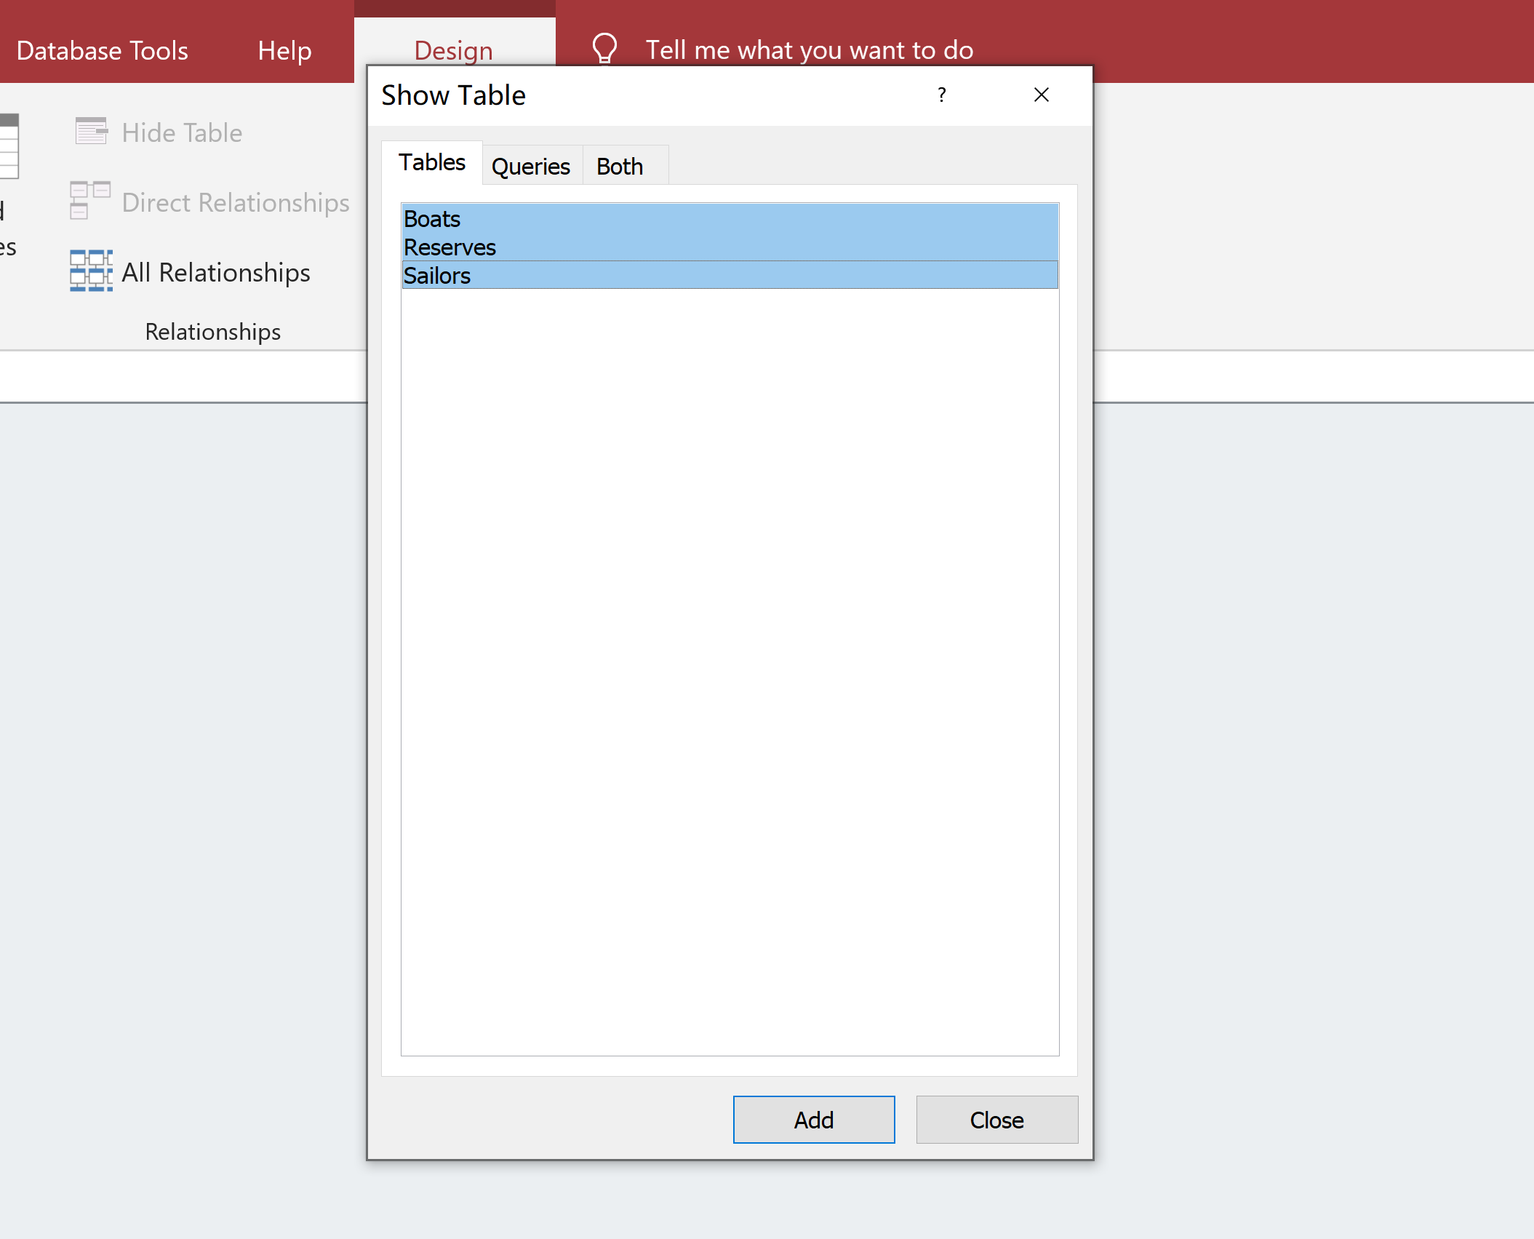
4.3 Referential integrity constraint
Notes:
放github截图及网址，分两部分，数据库 和txt ，指出 并说明 兼容性问题

Slide 32
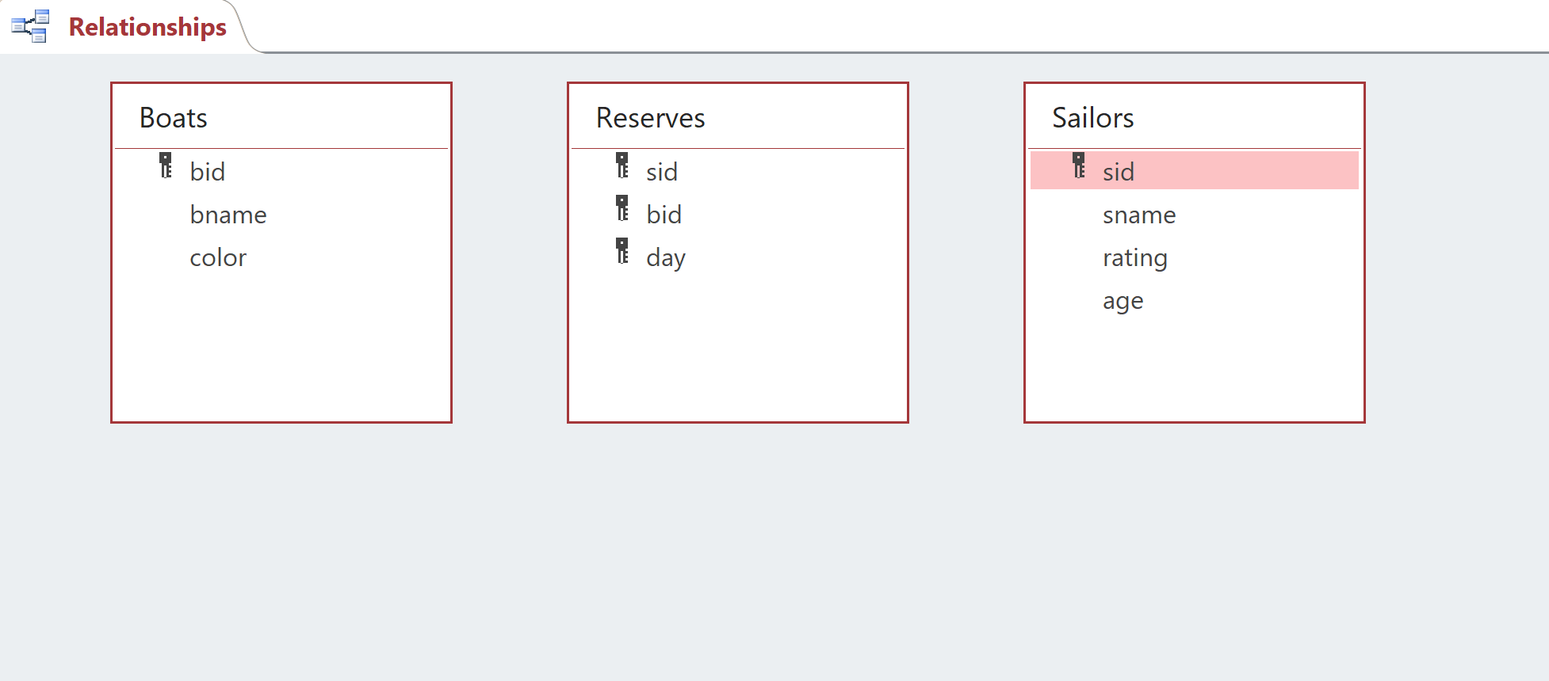
4.3 Referential integrity constraint
Notes:
放github截图及网址，分两部分，数据库 和txt ，指出 并说明 兼容性问题

Slide 33
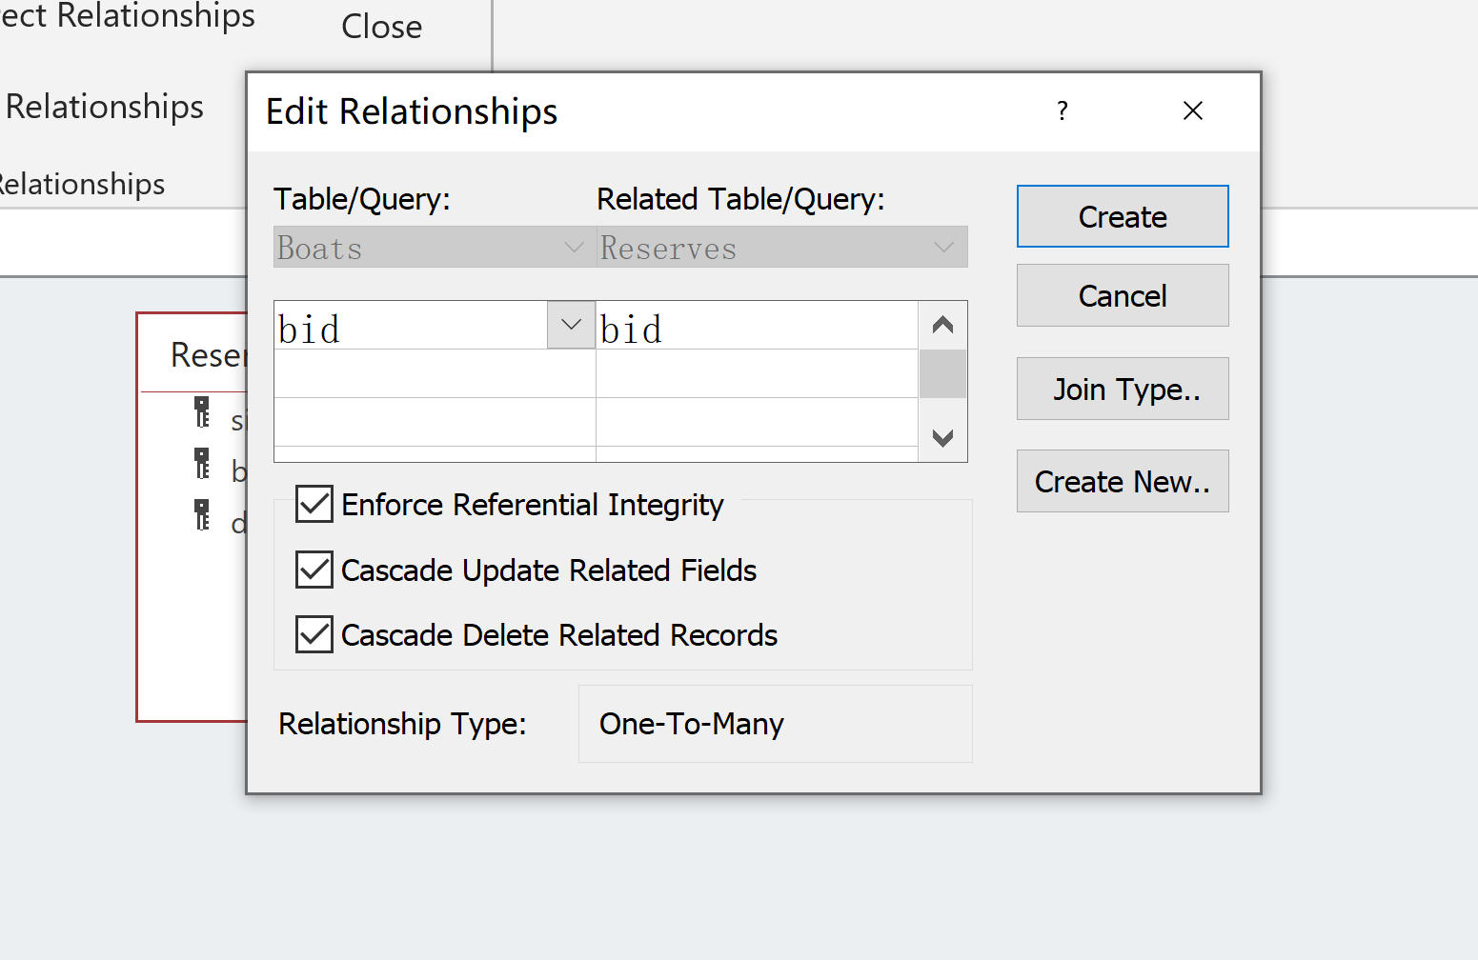
4.3 Referential integrity constraint
Notes:
放github截图及网址，分两部分，数据库 和txt ，指出 并说明 兼容性问题

Slide 34
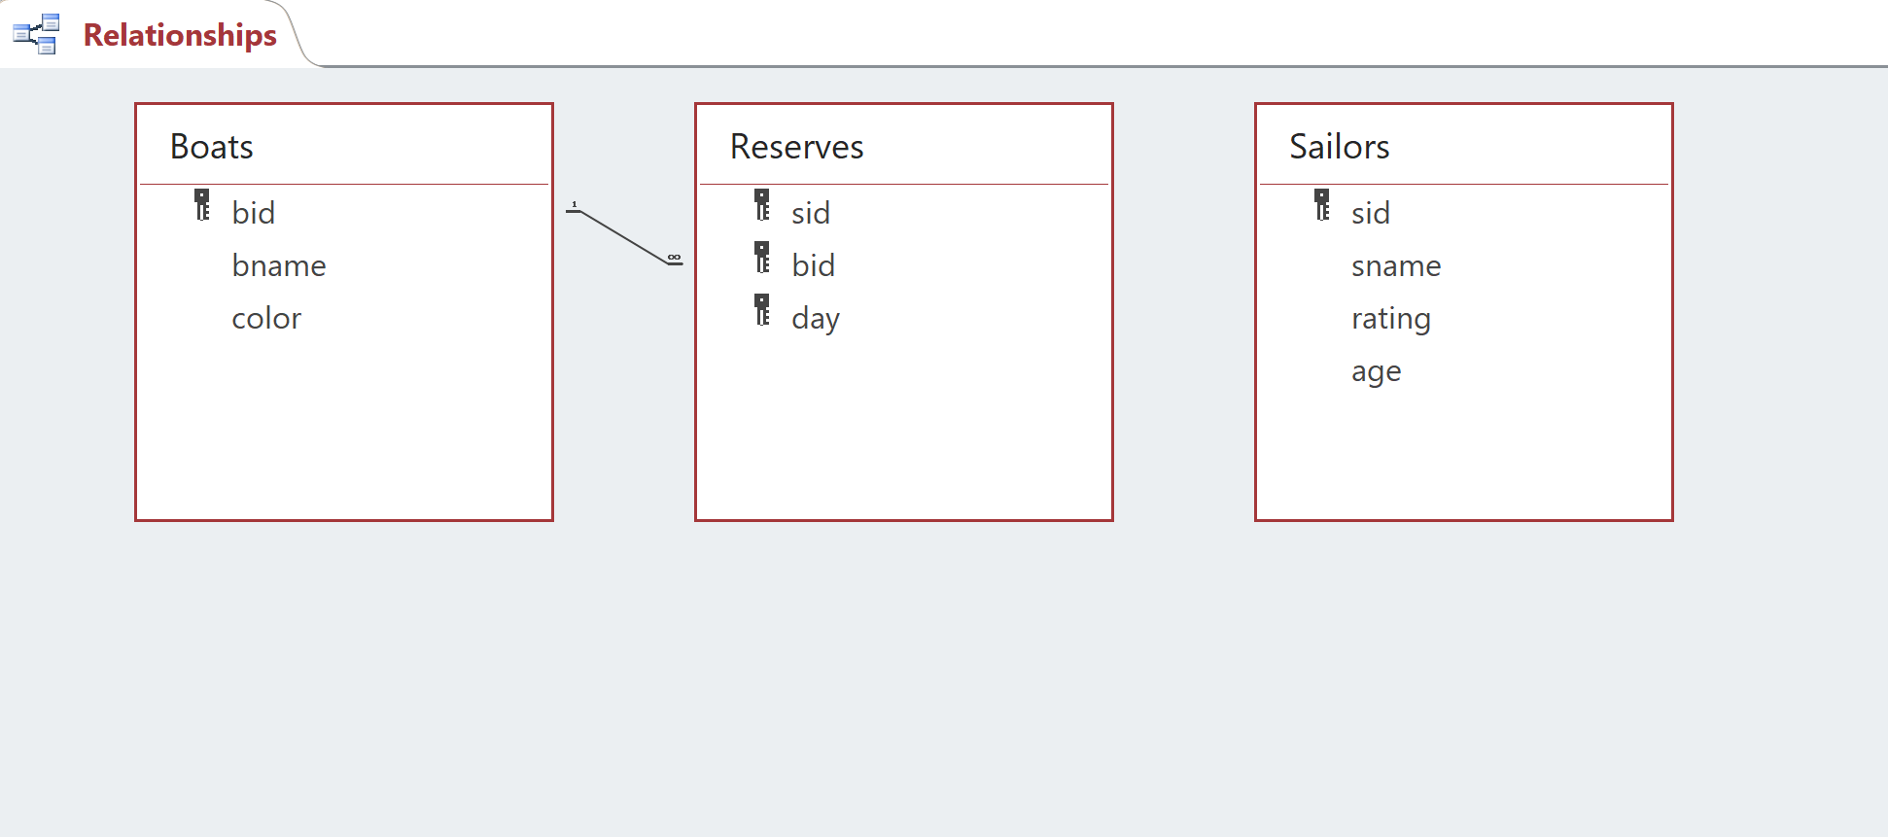
4.3 Referential integrity constraint
Notes:
放github截图及网址，分两部分，数据库 和txt ，指出 并说明 兼容性问题

Slide 35
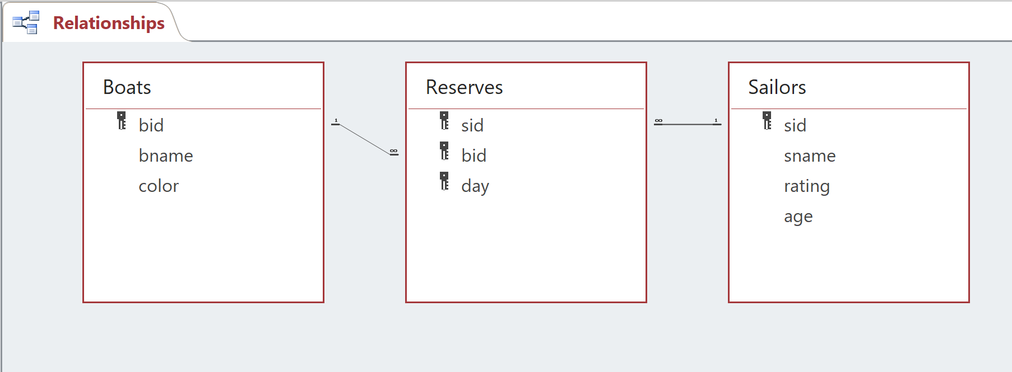
4.3 Referential integrity constraint
Notes:
放github截图及网址，分两部分，数据库 和txt ，指出 并说明 兼容性问题

Slide 36
4.3 Referential integrity constraint
Notes:
放github截图及网址，分两部分，数据库 和txt ，指出 并说明 兼容性问题

Slide 37
4.3 Referential integrity constraint
INSERT INTO Reserves VALUES(22,1000,'2019/10/6')
Notes:
放github截图及网址，分两部分，数据库 和txt ，指出 并说明 兼容性问题

Slide 38
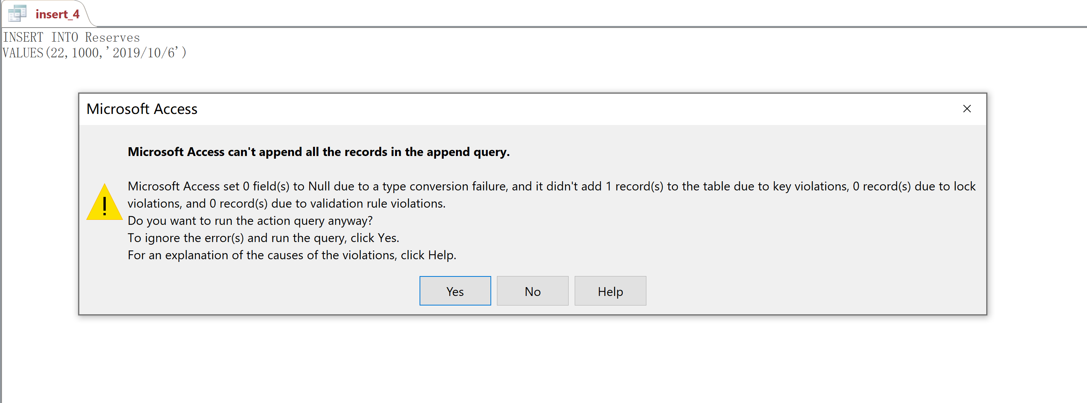
4.3 Referential integrity constraint
Notes:
放github截图及网址，分两部分，数据库 和txt ，指出 并说明 兼容性问题

Slide 39
Assignment4
Notes:
Now this is the second assignment

Slide 40
Content
For Domain integrity constraint, Entity integrity constraint and Referential integrity constraint, you should give each integrity constraint “INSERT”,”DELETE” and ”UPDATE” SQL statements to prove it.(At least 9 statements totally)
Notes:
The content of assignment are listing in ppt
You should Write SQL queries that answer the questions below (one query per question) and run them on the Microsoft ACCESS Database System using its SQL interpreter.
Note that one query per question
And for each question you have to write exactly one SQL statement. And creation of temporary tables is not allowed

Slide 41
Database Schema
The schema of the database is provided below (keys are in bold, field types are omitted):
student(sid, sname, sex, age, year, gpa)
dept(dname, numphds)
prof(pname, dname)
course(cno, cname, dname)
major(dname, sid)
section(dname, cno, sectno, pname)
enroll(sid, grade, dname, cno, sectno)
Before you start writing SQL, it is a good idea to take a look at the database and familiarize yourself with its contents.
Notes:
The database schema is the university database same with your assignment 1.
Which include 7 tables, student, dept, prof, course ……

Slide 42
Data Files
Download the following data files from https://github.com/zygardxerneas/database
course.txt
dept.txt
enroll.txt
major.txt
prof.txt
section.txt
student.txt
Notes:
The data file is also same with last assignment1,and if you already create the university database, you don’t need download these txt file.
If you not , you can download these file and create university database.

Slide 43
Demand
This is an individual assignment –no group submissions are allowed. Hand in an ACCESS database that contains at least nine statements. The database should contain nine queries, named as follows:
Insert1
Insert2
…
Delete1
…
Update3
Hand in a report which indicates your answers.(Figure is important. You should give your analysis about your sql statements.)
Notes:
This is the demand of this assignment
Note that for any question, when you finish SQL query, you must save it
And the database should contains the answers to the twelve questions, twelve queries should be named as :query1, query 2……
And hand in a report

Slide 44
Submission
File name format:
Sno_A4.zip
including:
report_A4.doc
university_A4.accdb
Deadline:
Beijing time, November, 19th ,23:59:59
Notes:
Finally, the submission demand are as follows:
Attention: the the deadline is

