Slide 1
Lab 4
Notes:
Hello everyone im sunkai and this is guobaoshen, today we will introduce lab 4 to help you familiar to sql query

Slide 2
outline
1.Result of Midterm
2.Key to Question4(SQL Statements)
3.Key to Question 5
Notes:
Our class has 4 part . We will tell you how to Download lab2.accdb first. And we will introduce how to use sql in access step by step. Then we will give you 4 examples to practise. Finally part4 is assignment2, and please finish it under class and hand in it in 2 weeks.

Slide 3
Notes:
Our class has 4 part . We will tell you how to Download lab2.accdb first. And we will introduce how to use sql in access step by step. Then we will give you 4 examples to practise. Finally part4 is assignment2, and please finish it under class and hand in it in 2 weeks.

Slide 4
2. Analysis of SQL Statements
In the library management system, there are three tables: student table, book table and borrow table.
Student(sid, sname, department, gender)
/*gender(“F”: female, ”M”: male). */
Book(bid, bname)
Borrow(sid, bid, date)
Notes:
和之前的boat sailor reserve表类似

Slide 5
2. Analysis of SQL Statements
Question 1:
How to find the id of student who borrows book which id is 521 or 520 in 2019;
Notes:
一个表就可以了 因为borrow有sid这一row

Slide 6
2. Analysis of SQL Question 1
SELECT SID
FROM BORROW
WHERE (((Year([DATE]))=2019) AND
((BORROW.[BID])=521 OR (BORROW.[BID])=520))
Notes:
一个表就可以了 因为borrow有sid这一row

Slide 7
2. Analysis of SQL Statements
Question 2
How to find the girl’s name in CS who borrows book which id is 630
Notes:
Cs means computer science it’s a department，and you need to know we find girl·s name so gender should be “F‘’

Slide 8
2. Analysis of SQL Question 2
SELECT S.SNAME
FROM BORROW AS B, STUDENT AS S
WHERE B.BID=630 AND S.SID=B.SID AND
S.DEPARTMENT ="CS" AND S.SEX="F";
Notes:
放github截图及网址，分两部分，数据库 和txt ，指出 并说明 兼容性问题

Slide 9
2. Analysis of SQL Statements
Question 3:
How to find the name of student who borrows the most books.
Notes:
放github截图及网址，分两部分，数据库 和txt ，指出 并说明 兼容性问题

Slide 10
2. Analysis of difficult Question 3
SELECT DISTINCT S.SNAME
FROM STUDENT AS S, BORROW AS B
WHERE S.SID=B.SID AND B.SID IN (
SELECT TOP 1 SID
FROM BORROW
GROUP BY SID
ORDER BY COUNT(*) DESC)
Notes:
放github截图及网址，分两部分，数据库 和txt ，指出 并说明 兼容性问题

Slide 11
2. Analysis of SQL Statements
Question 4:
How to find the name of book which is borrowed only once and print student`s name who borrows this book.
Notes:
放github截图及网址，分两部分，数据库 和txt ，指出 并说明 兼容性问题

Slide 12
2. Analysis of difficult Question 4
SELECT B1.BNAME,S.SNAME
FROM BOOK AS B1,STUDENT AS S,BORROW AS B2
WHERE B1.BID=B2.BID
AND S.SID=B2.SID AND B2.BID IN(
SELECT BID
FROM BORROW
GROUP BY BID
HAVING COUNT(*)=1)
Notes:
放github截图及网址，分两部分，数据库 和txt ，指出 并说明 兼容性问题

Slide 13
2. Analysis of SQL Statements
Question 5:
How to find the name of student who borrows the books including all books that student(sid = 111) borrows.
Notes:
放github截图及网址，分两部分，数据库 和txt ，指出 并说明 兼容性问题

Slide 14
2. Analysis of difficul Question 5
SELECT sname
FROM Student
WHERE sid IN
(SELECT DISTINCT SID
FROM BORROW AS X
WHERE NOT EXISTS (
SELECT *
FROM BORROW AS Y
WHERE Y.SID=111 AND NOT EXISTS (
SELECT * FROM BORROW AS Z
WHERE Z.SID=X.SID AND Z.BID=Y.BID)
));
Notes:
放github截图及网址，分两部分，数据库 和txt ，指出 并说明 兼容性问题

Slide 15
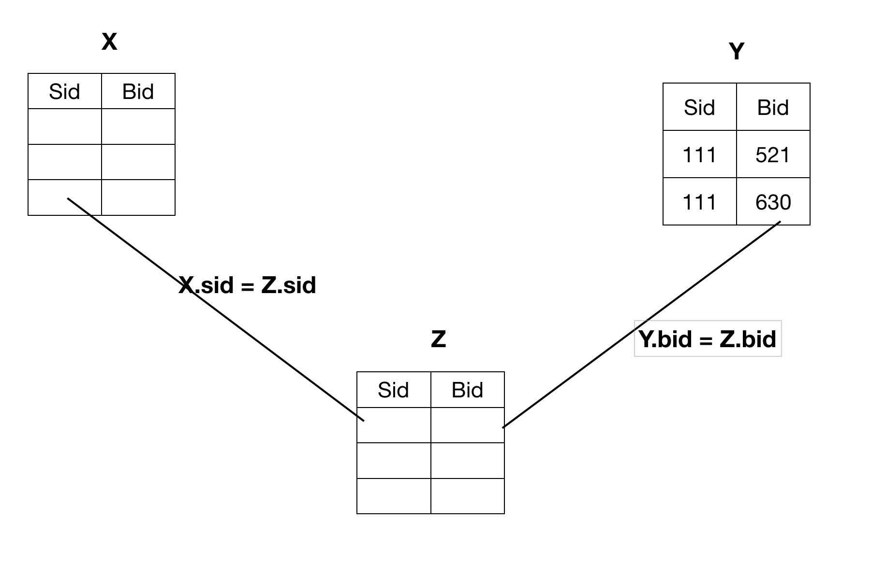
2. Analysis of difficul Question 5
Notes:
放github截图及网址，分两部分，数据库 和txt ，指出 并说明 兼容性问题

Slide 16
3. Analysis of Question 5
Question 5.a:
There is a borrow table and the data schema is as follows:
Borrow(studentID, bookID, date)
ALL
or <bookID, data>
Notes:
一个仓库有多个雇员，每个雇员仅在一个仓库工作，一种零件只会被一个雇员负责，但一个雇员可以负责多个零件

Slide 17
3. Analysis of Question 5
Question 5.b:
There is a work relationship table and the data schema is as follows:
Work(warehouseID, employeeID, componentID, quantity)
One warehouse has multiple employees, and each employee only works in one warehouse. In each warehouse, one type of components is composed of one employee is responsible, but one employee can be responsible for a variety of components. Analyze all possible candidate keys for this pattern
Notes:
一个仓库有多个雇员，每个雇员仅在一个仓库工作，一种零件只会被一个雇员负责，但一个雇员可以负责多个零件

Slide 18
3. Analysis of Question 5
Question 5.b:
There is a work relationship table and the data schema is as follows:
Work(warehouseID, employeeID, componentID, quantity)
{employeeID, componentID}
{warehouseID, componentID}
Notes:
一个仓库有多个雇员，每个雇员仅在一个仓库工作，一种零件只会被一个雇员负责，但一个雇员可以负责多个零件
candidate key is the key that can uniquely identified one record（relationship） 知道雇员id，能够确定工厂，然后再知道零件id，就能确定一条记录 在一个工厂里面，知道零件id，也能确定雇员id

