Slide 1
Outline
1. Essential to a good database design
2. Some of the considerations
3. Design Process
4. Example
5. Assignment3

Slide 2
1. What is essential to a good database design?
1.1 Reduces redundancy
1.2 Provides access with information a user needs to join tables together
1.3 Ensures data accuracy and integrity
1.4 Accommodates your data processing and reporting needs

Slide 3
2. Some of the considerations
2.1 Design a schema logically based on business requirements.
2.2 Define the physical layout of the database.
2.3 Define the security for the schema.
2.4 Define and use the appropriate naming conventions.

Slide 4
3. Design Process
3.1 Define the purpose of the database
3.2 Gather Data, Organize in tables and Specify the Primary Keys
3.3 Create Relationships among Tables
3.4 Refine & Normalize the Design

Slide 5
Example
http://47.107.131.96/

Slide 6
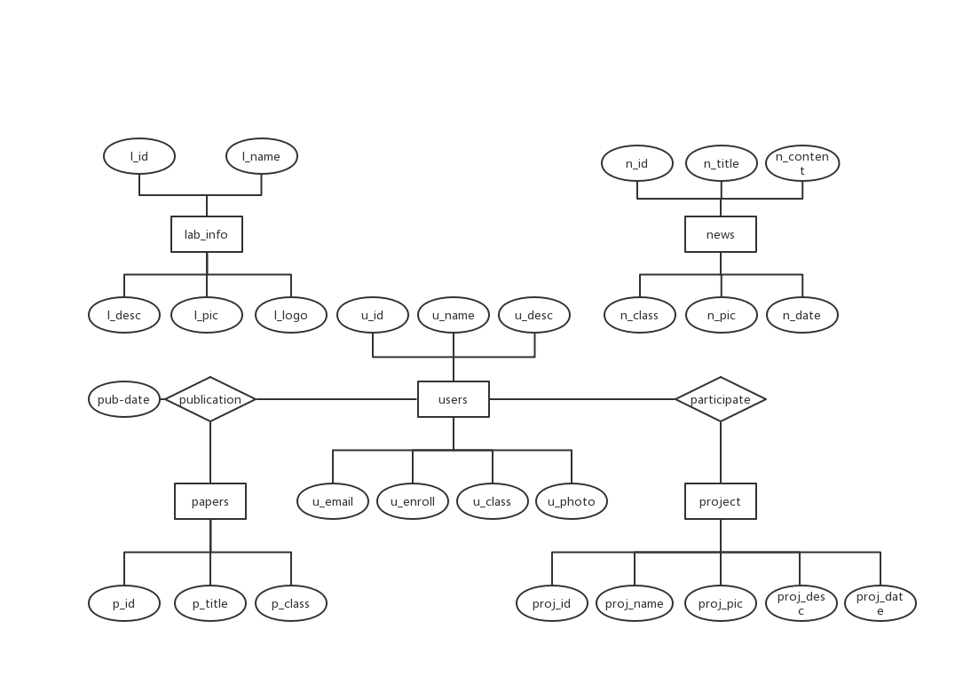

Slide 7
Assignment3

Slide 8
Content
For example, very simple application based on university database (without programming)
A student grade management
Involving at least 3~4 tables in university database
Can design an application background by yourselves.
Use the tools offered by Access directly to implement the interface, queries, report, etc.

Slide 9
Demands
Show your completed application to supervisor
Hand in a report about the assignment
Main contents
Database design(including E-R diagram)
Function design(describe what function you want to design)
Database query(not too simple)
Hand in your .mdb database with the application

Slide 10
Submission
File name format:
Sno1_Sno2_A3.zip
including:
report_A3.doc
university_A3.mdb
Deadline: Beijing time, November 12th, 23:59:00

