Slide 1

House prices prediction
IST 707 Final presentation
Zijun Yi, Xiaoben Yin
Professor: Yang Yang

Slide 2
Project overview
What are some important factors on Housing sales price?
Is it the garage size? Age of the house? etc...
Fortunately, we have dataset on residential homes in Ames, Iowa, we would be able to predict the final price of each home.

Slide 3
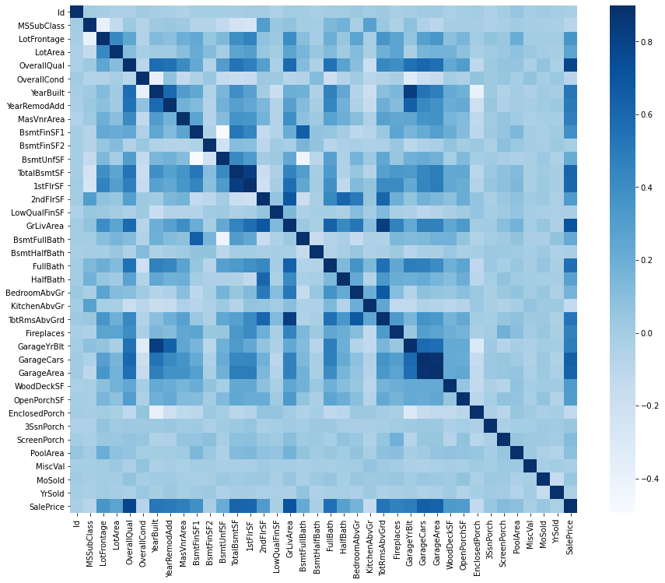
Dataset description
The data set we are going to use is from Kaggle, Ames Housing Dataset 1 by Dean De Cock. The
dataset contains 1460 rows and 81 columns. It contains a detailed description of a house, some
important columns are GrLivArea , the size of the living area, OvreallQua l, the overall quality,
GarageArea , garage size, etc.

Slide 4
Data Description
[1] "Id" "MSSubClass" "MSZoning" "LotFrontage" "LotArea" "Street" "Alley" "LotShape" "LandContour" "Utilities"
[11] "LotConfig" "LandSlope" "Neighborhood" "Condition1" "Condition2" "BldgType" "HouseStyle" "OverallQual" "OverallCond" "YearBuilt"
[21] "YearRemodAdd" "RoofStyle" "RoofMatl" "Exterior1st" "Exterior2nd" "MasVnrType" "MasVnrArea" "ExterQual" "ExterCond" "Foundation"
[31] "BsmtQual" "BsmtCond" "BsmtExposure" "BsmtFinType1" "BsmtFinSF1" "BsmtFinType2" "BsmtFinSF2" "BsmtUnfSF" "TotalBsmtSF" "Heating"
[41] "HeatingQC" "CentralAir" "Electrical" "X1stFlrSF" "X2ndFlrSF" "LowQualFinSF" "GrLivArea" "BsmtFullBath" "BsmtHalfBath" "FullBath"
[51] "HalfBath" "BedroomAbvGr" "KitchenAbvGr" "KitchenQual" "TotRmsAbvGrd" "Functional" "Fireplaces" "FireplaceQu" "GarageType" "GarageYrBlt"
[61] "GarageFinish" "GarageCars" "GarageArea" "GarageQual" "GarageCond" "PavedDrive" "WoodDeckSF" "OpenPorchSF" "EnclosedPorch" "X3SsnPorch"
[71] "ScreenPorch" "PoolArea" "PoolQC" "Fence" "MiscFeature" "MiscVal" "MoSold" "YrSold" "SaleType" "SaleCondition"
[81] "SalePrice"

Slide 5
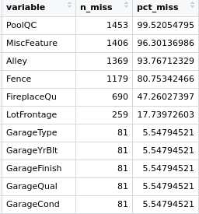
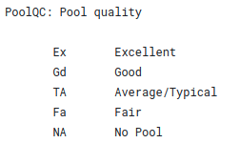
Missing values
First we took a look at the missing value, as expected there
are many missing value in category Like Pool, Fence, Fire Place.

Slide 6
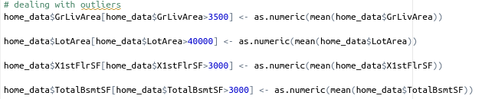
Missing values
First we took a look at the missing value, as expected there
are many missing value in category Like Pool, Fence, Fire Place.

Slide 7
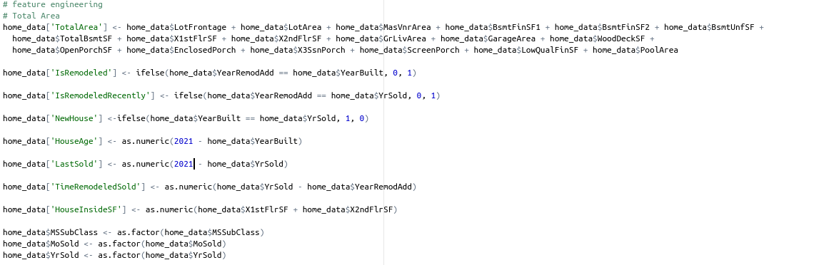
Feature engineering

Slide 8
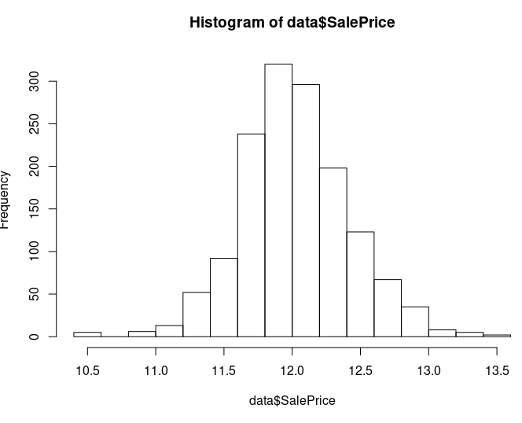
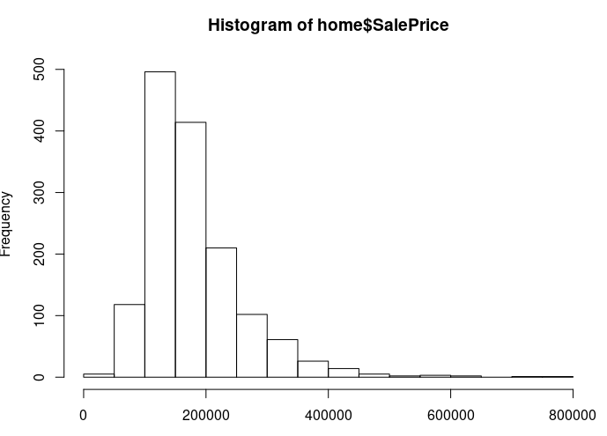
Feature engineering

Slide 9

Linear Regression
In order to run Linear Regression, we need to convert all the categorical variables to numerical variables, we will be using fastDummies Packages.
Thus we will have 239 columns. Then train linear regression models with

Slide 10


Linear regression

Slide 11
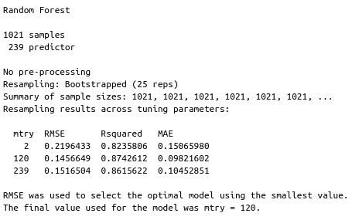
Random forest

Slide 12


Random forest
For Random forest model we will be using the caret Package.
Results:
We can see the Random forest got a 0.83 R^2. Although they take a much longer time to train, this model still got a lower R squared, which is not expected.

Slide 13
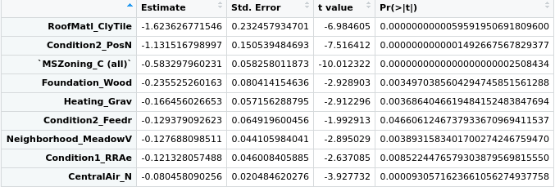
Feature importances
Roof tile
Overall Condition
The Zone house is in
Foundation
Overall Quality

Slide 14
Feature importances
Roof tile
Overall Condition
The Zone house is in
Foundation
Overall Quality

Slide 15
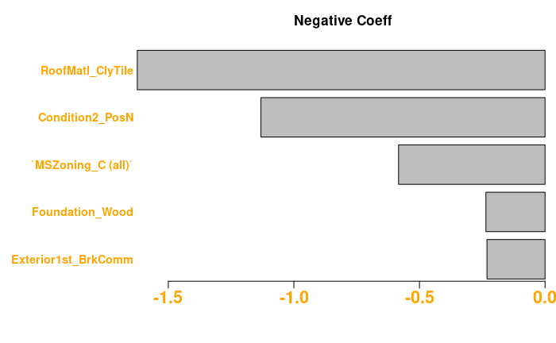
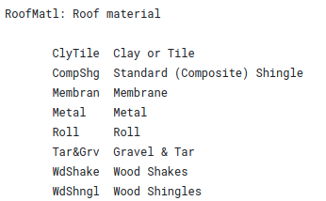
Feature importances
The zone house is in
Overall Condition
Overall Quality

Slide 16
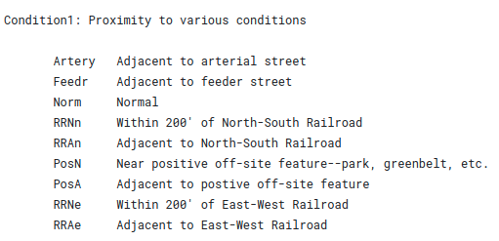
Feature importances
The zone house is in
Overall Condition
Overall Quality

Slide 17
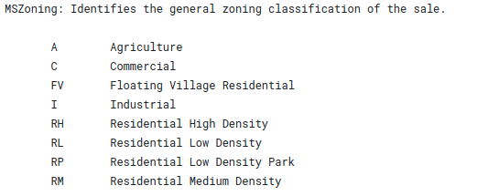
Feature importances
The zone house is in
Overall Condition
Overall Quality

Slide 18
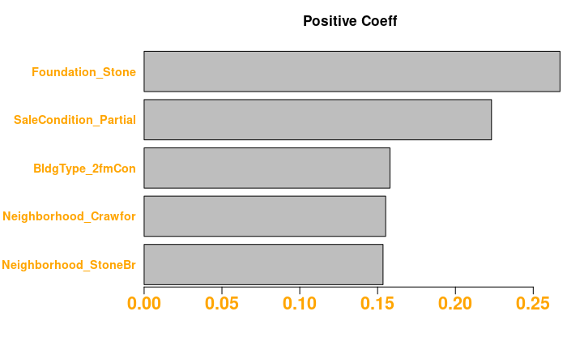
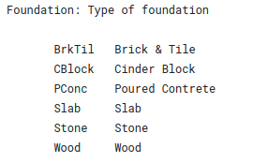
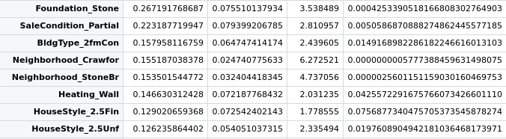
Feature importances
The zone house is in
Overall Condition
Overall Quality

Slide 19
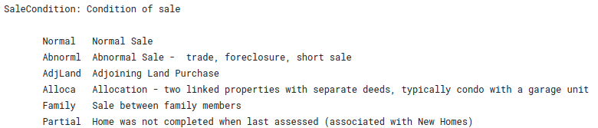
Feature importances
The zone house is in
Overall Condition
Overall Quality

Slide 20
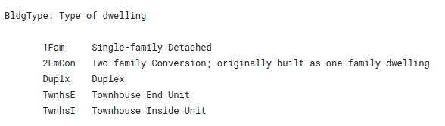
Feature importances
The zone house is in
Overall Condition
Overall Quality

Slide 21
Thank you!

