Slide 1

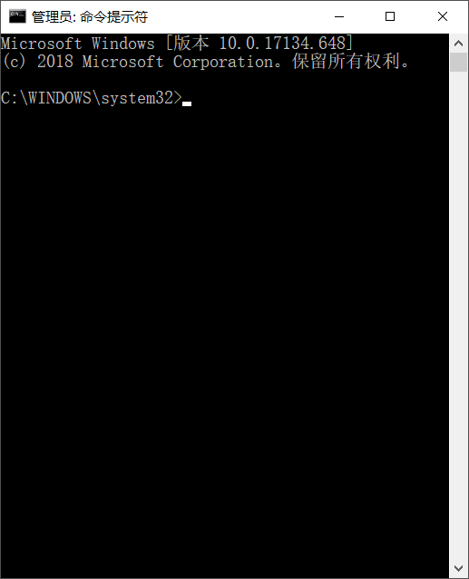
管理员: terminal
测试探测参数 = {
"probe_mode": "verticalDetection",
"send_recv_mode": "send_recv",
"probe_interval": 0,
"groups_number": 1,
"repetition_number": 32,
"freq_mode": "COS",
"freq_start": 2,
"freq_step": 0.05,
"freq_end": 20,
"code_id": 160001,
"code_duration": 25.6,
"pulse_length": 360
}
发送次数 = 500
接收次数 = 500
出错次数 = 0
正确率 = 100%

Slide 2


Sorting System
Map :
C:/map.json
New Map
height :
22
width :
22
charging :
4
pack up :
4
put down :
21
Robots :
1
unit
goods :
1000
pack
START

Slide 3
卷卷专属

Slide 4
Y
width
height
0
X

Slide 5
Y
width
50FPS
速度：
= 10/FPS
= 500/s
= 5route/s
转速：
= 4°/FPS
= 200°/s
height
100
0
X

Slide 6
8
9
7
6
2
1
3
5
4

Slide 7
4
5
3
2
1

Slide 8
(-3, 0)
( n, 0)
(-3-n, 0)
( 0, 1)
(-3,-1)

Slide 10
up
left
right
down

