Slide 1
Zylin CPU
Soft CPU Demo
Øyvind Harboe, General Manager, Zylin AS

Slide 2



Demo
Xilinx XC3S400
Runs TCP/IP stack & web server under eCos
Wishbone interfaces
16 bit DDR SDRAM

Slide 3
Zylin eCosBoard
FPGA
Registers
ARM7
Interface
WishBone
MUX
32-bit
Atomic
Access
WishBone
MUX
Ethernet
Core
Access
Correct
Ethernet
Core
CPU
Ethernet
DDR
Bridge
DDR
Ctrl
SDRAM
zpu_system
ZPU
Core
ZPU
wb
Bridge
WishBone
MUX
ZPU
eCosBoard 1.1 w/ZPU

Slide 4
Dhrystone 2.1
Feeble 16 bit DRAM memory subsystem
ZPU – 1.8 DMIPS using 16 bit DRAM only
AT91FR40162R ARM7 - 3 DMIPS using SRAM + DRAM

Slide 5
Games
No operating system. libgloss + newlib.
Standard C applications
Eliza – simple text based
Sumeria - uses -lm math library

Slide 6
eCos TCP/IP
TCP/IP stack
eCos web server, e.g. configuration pages, status, logs

Slide 7
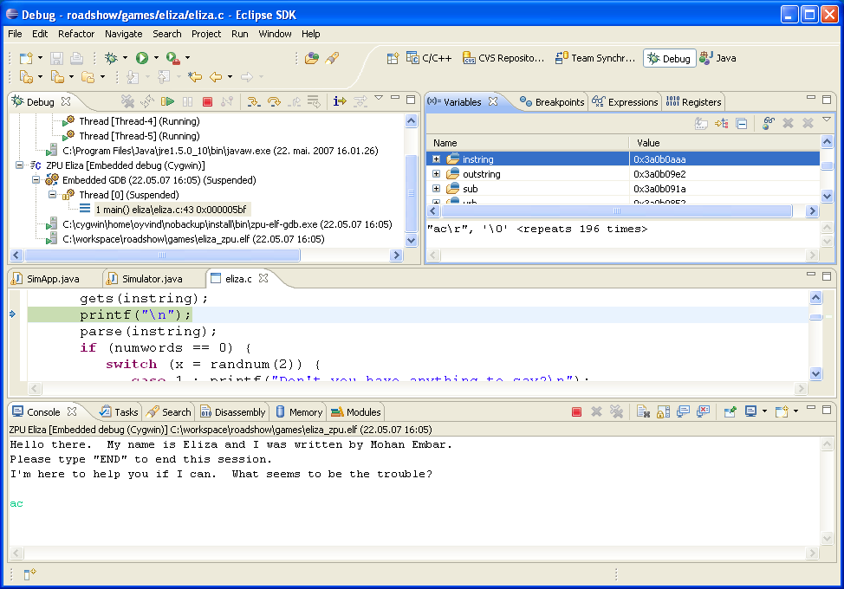
ISS – GDB & CDT

Slide 8
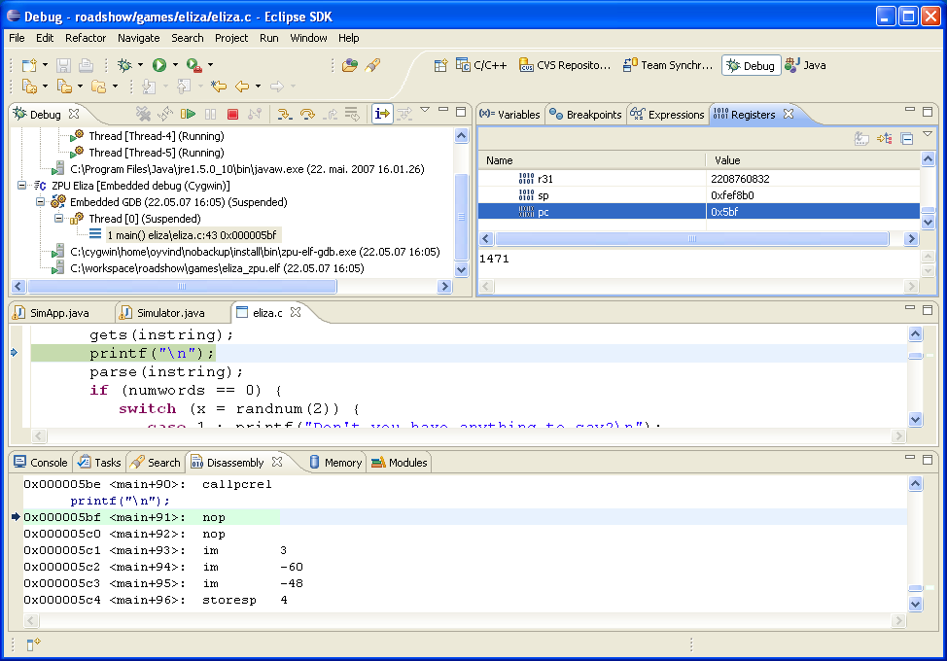
ISS – GDB & CDT

Slide 9
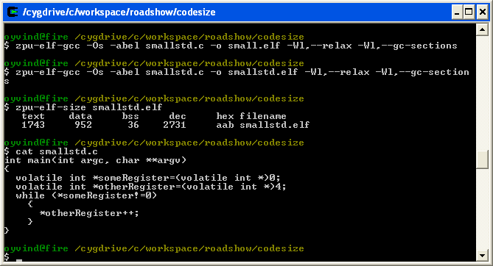
Toolchain codesize

Slide 10
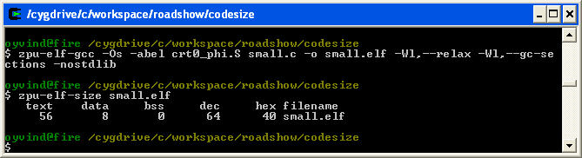
Toolchain codesize – custom startup
Use more FPGA resources, reduce fixed overhead

Slide 11
Demo summary
DMIPS
Games – standard C with math library, etc.
eCos - TCP/IP stack and drivers
ISS – Instruction set simulator and debugger

Slide 12
Questions?

