Slide 1

ZPU
Zylin soft-CPU
Øyvind Harboe
General Manager
Zylin AS

Slide 2
ZPU key features
Targeted at FPGA devices
Smallest configuration <500 LUT, 20 DMIPS
Code size consistently <66% of ARM 32 non-thumb
32 bit programming model
GCC toolchain
eCos HAL, popular opensource embedded OS

Slide 3
Demo
Xilinx XC3S400 FPGA
Dhrystone 2.1
eCos hello world application

Slide 4
Demo - 2
Dhrystone 2.1
  -Os
  -O2
  -O3

Slide 5
Demo - 3
eCos hello world
Multithreading
Interrupts support(current ZPU does not have interrupts)
<20kBytes

Slide 6
Building FPGA binary image
Compile C++ application:
  $ zpu-elf-gcc hello.c -o hello.elf -abel
  “-abel” tells GCC which instruction set and corresponding runtime libraries to use
Convert to VHDL ROM image
  $ sh genrom.sh hello
Build FPGA binary image using normal procedure

Slide 7
ZPU architecture
0 operand/stack based
like the Transputer, x86 FPU, CLR/Java, etc.)
  IM 5
  LOADSP 20
  ADD
8 bit wide instructions
Scales well for range reasonable to implement in FPGA

Slide 8
ZPU opcodes
1xxx xxxx IM
  Pushes 7 bit signed integer onto stack
010x xxxx LOADSP
  Pushes value at memory address SP+xxxxx*4 onto stack
011x xxxx STORESP
  Pops value on stack and stores it at address SP+xxxxx*4

Slide 9
ZPU opcodes - 2
001x xxxx EMULATE
  High-level opcodes without further structure, e.g. BRANCH, CALL, RETURN
000x xxxx
  Low-level opcodes without further structure, e.g. ADD, NOT.

Slide 10
ZPU opcodes - 3
The 0 operand architecture allows flexible and small microcode(no HDL changes necessary) for EMULATE category instructions
Smallest ZPU implements 16 instructions, which is > minimum possible # of instructions

Slide 11
ZPU GCC backend
GCC is most known for its support of register architectures with a large number of registers
GCC is also used for stack based architectures(e.g. Transputer, x86 FPU)
E.g. M68HC11 has very few registers
ZPU backend uses standard 0-operand techniques and invents some new tricks

Slide 12
ZPU GCC backend - 2
The ZPU backend maps the GCC register concept onto stack slots in the stack frame(this different from pseudo registers)
Allows taking full advantage of LOADSP/STORESP
ZPU backend has various unique stack architecture specific optimizations
  Dead stack slot elimination(similar to REG_DEAD).

Slide 13
ZPU GCC backend - 3
0 operand architecture allows excellent code size characteristics
IM + IDIM flag & linker relaxation
  IM 1 ; push 1 onto stack, sets IDIM flag
  IM 1 ; shifts value on stack 7 bits to the left
  ; and ors in 7 new bits
  CALL

Slide 14
ZPU GCC runtime libraries
Multilib support
  ZPU alpha HDL
  More advanced instruction sets
  Combinations of optimising for size, speed, etc.
Runtime detection of RAM, MHz and IO base, encoded in HDL

Slide 15
ZPU GCC testsuite
GCC comes with comprehensive testsuite
The ZPU toolchain passes the entire GCC toolchain testsuite: check-gcc, check-c++, check-libstdc++-v3
Expect <10 issues at any one time during development
  Need to upgrade to GCC 3.4.3, GDB 6.3
  A couple of ZPU backend issues that will become moot

Slide 16
ZPU simulator
Multiple variants of the ZPU supported
  ZPU alpha HDL
  16 Mbyte RAM version for GCC testsuite
Instruction level profiling histograms
HDL simulation trace file support(more about which later)

Slide 17
eCos ZPU HAL
Multiple variants of the ZPU
  ZPU alpha HDL
  Simulated w/16 MByte of RAM. Test TCP/IP loopback.
Interrupts support
Diagnostic serial IO

Slide 18
ZPU alpha version HDL
Proof of concept
Verification ISS performance model
Small implementation(<500LUT)
32 Kbytes dual-port FPGA RAM
90 Mhz
UART
Performance counters

Slide 19
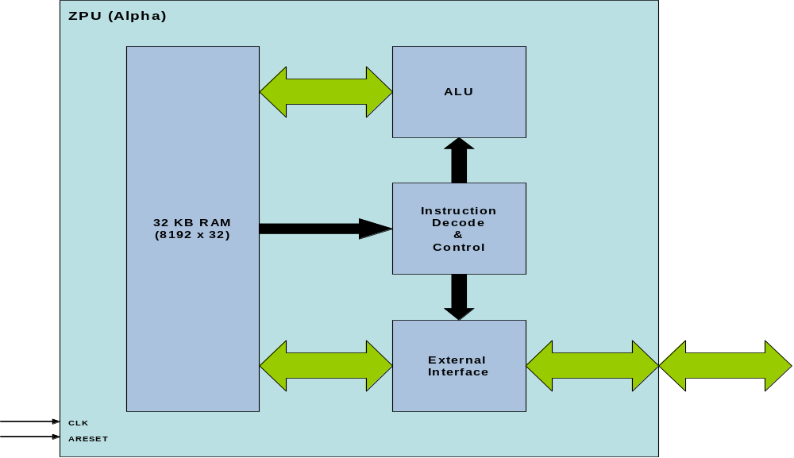
ZPU alpha version HDL -2

Slide 20
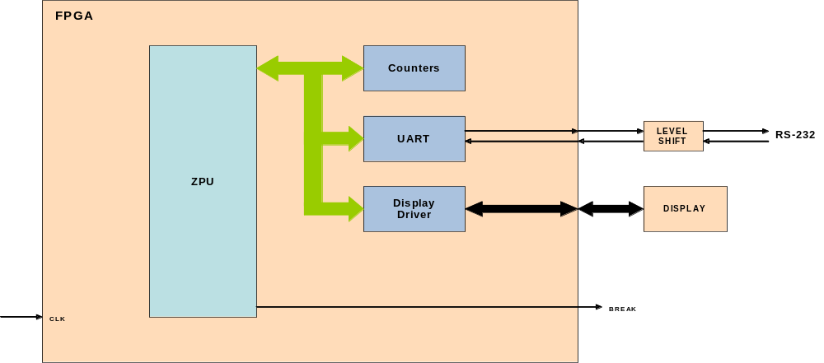
ZPU alpha version HDL - 3

Slide 21
ZPU alpha version HDL - 4
Simulation trace output to file
The GDB server/simulator supports trace file
GDB debugger breaks on ISS != trace file
Useful for debugging early start-up issues
Verify cycle accuracy of ISS performance model

Slide 22
ZPU alpha version HDL - 5
Simulation trace output used for ZPU HDL regression testing
Trace integration w/GDB less useful for real-world applications.
Point of diminishing returns as test bench becomes more complicated, e.g. asynchronous UART events

Slide 23
ZPU alpha version HDL - 6
Further development should be done on actual target hardware
Completion of memory subsystem
DDR RAM module to increase range of tests
Interrupts
Increase span of configurable performance envelope from(more instructions/pipelining)
More IO => MAC.

Slide 24
Eclipse CDT ZPU plugin
Eclipse CDT is a GUI frontend for GDB
Altera, TI, STmicro, etc. choice for IDE
Zylin published a generic embedded GDB plugin 2004
Will be developed with additional ZPU specific GUI components

Slide 25
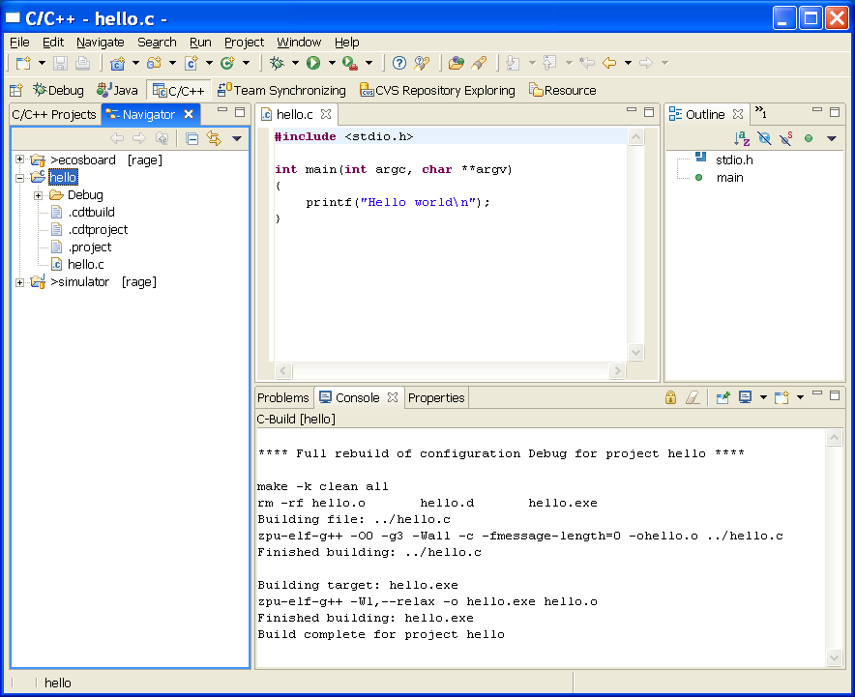
Minimal hello world
Interactive demonstration. Compile & debug.

Slide 26
Minimal hello world - 2
Basic hello world, using newlib
eCos TCP/IP loopback test applications

Slide 27
Questions?

