Slide 1


Hacking on
OpenStack’s
Nova Source Code
2012-01-08
Luo, Zhongyue
zhongyue@staff.sina.com.cn

Slide 2
TODO
Intro
The source code structure of Nova
  File structure
  Component architecture
An example
Contributing
Conclusion

Slide 3
Intro
What is OpenStack? and Nova?
WHY shoud I listen to this?
Can we actually hack the code in 30min?
Why should I trust this guy?

Slide 4
Source code structure of Nova
Macro vs Micro(DIY)
File structure
Component Architecture
File structure ↔ Component Architecture

Slide 5
But first...terminologies
Service
Topic
Nova component → Service.create(Topic)
Manager (abst) ⊂ Nova component
Drivers (impl) ⊂ Manager
  ex) linux_net, miniDNS, Quantum
Lazy plugging → Value based module loading
AMQP → Advanced Message Queue Protocol
API → REST & Inner

Slide 6
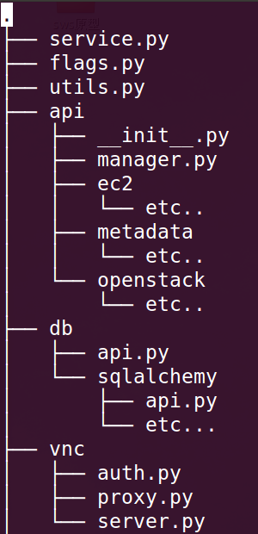
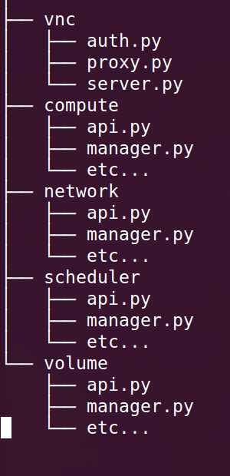
File structure
”start”
”configs”
”helpers”
”is a topic”
”is a topic”
”is a topic”
”is a topic”

Slide 7
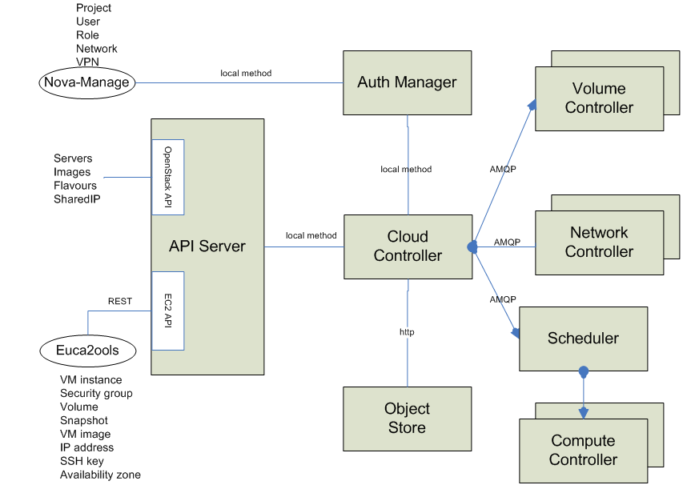
Component architecture
Tenant
http://nova.openstack.org/nova.concepts.html

Slide 8
Component architecture
”/etc/nova/nova.conf”
”ec2”, ”osapi”
?

Slide 9
”network”
?
?

Slide 10
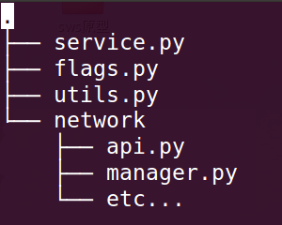
Component revisited
Network service
”network”
Periodic
task
Topic: network
Manager
Driver: linux_net
Reads message from Queue
Returns results back to DB or Queue
Network API
Looks up DB
Sends message to Queue
- Cast: Send and forget
- Call: Send and wait

Slide 11

Component architecture revisited
DB
API
API
Queue
API
API
WSGI

Slide 12
An example
Let’s allocate a floating-ip to an instance with a fixed-ip
DB
”compute API”
API
1
API
Queue
API
Allocate 10.2.3.11 to a-fake-uuid?
Do you have permission?
I wonder if a-fake-uuid is legit?
I’ll ask compute API...
API
WSGI
POST /v2/a-fake-tenant/servers/a-fake-uuid/action

Slide 13
An example
Yup, a-fake-uuid is valid.
Oh, and its fixed-ip is 192.168.0.8.
Take it from here network API!
DB
2
”compute API”
API
3
API
Queue
”network API”
API
API
WSGI

Slide 14
An example
”nova-network”
So translate 192.168.0.8 to 10.2.3.11?
I’ll tell nova-network to run
”associate_floating_ip”.
Ok, my casting is done.
Go check the mail box.
DB
We got a message!
Title:
”associate_floating_ip”
”compute API”
API
5
API
4
Queue
”network API”
API
API
WSGI

Slide 15
An example
”nova network”
7
iptables
6
DB
DB update...Done.
Running iptables-save...Done.
”compute API”
API
API
Queue
”network API”
API
API
WSGI

Slide 16
An example
”nova network”
Did the allocation succeed?
DB
2
”compute API”
API
3
1
API
Queue
Here’s the details of a-fake-uuid.
”network API”
API
4
API
WSGI
You want to see if the allocation was a success?
I’ll check with compute API...
GET /v2/a-fake-tenant/servers/a-fake-uuid

Slide 17
OpenStack Nova architecture
”nova network”
”nova volume”
”nova compute”
DB
”compute API”
API
API
”scheduler API”
Queue
”network API”
API
”nova scheduler”
API
WSGI
”volume API”

Slide 18
Contributing
LaunchPad
  http://launchpad.net/~openstack
Documents
  http://docs.openstack.org/
More info
  http://wiki.openstack.org/HowToContribute

Slide 19
Conclusion
Structure of code and components of Nova
An example
How to get involved
http://github.com/lzyeval/talk-COSUG-2012
http://launchpad.net/~lzyeval

