Slide 1


Hacking on
OpenStack’s
Nova Source Code
2012-01-08
Luo, Zhongyue
zhongyue@staff.sina.com.cn

Slide 2
TODO
Intro
The source code structure of Nova
  File structure
  Component architecture
An example
Contributing
Conclusion

Slide 3
Intro
What is Openstack? And Nova?
WHY shoud I listen to this?
Can we actually hack the code in 30min?
Why should I trust this guy?

Slide 4
Source code structure of Nova
Macro vs Micro(DIY)
File structure
Component Architecture
File structure ↔ Component Architecture

Slide 5
But first...terminologies
Service
Topic
Nova component → Service.create(Topic)
Manager ⊂ Nova component
Drivers ⊂ Manager
  ex) linux_net, miniDNS, Quantum
Lazy plugging → Value based module loading
AMQP → Advanced Message Queue Protocol
API → REST & Inner

Slide 6
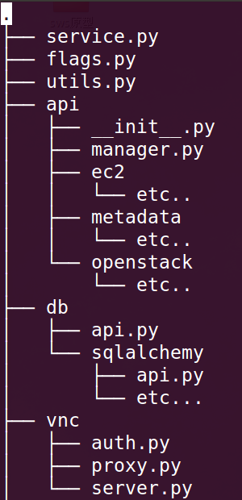
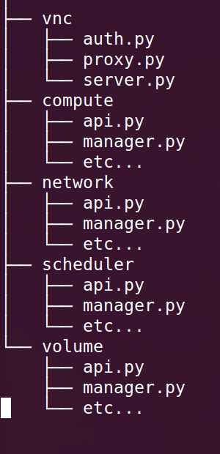
File structure
”start”
”configs”
”helpers”
”vm-topic”
”net-topic”
”bal-topic”
”vhdd-topic”

Slide 7
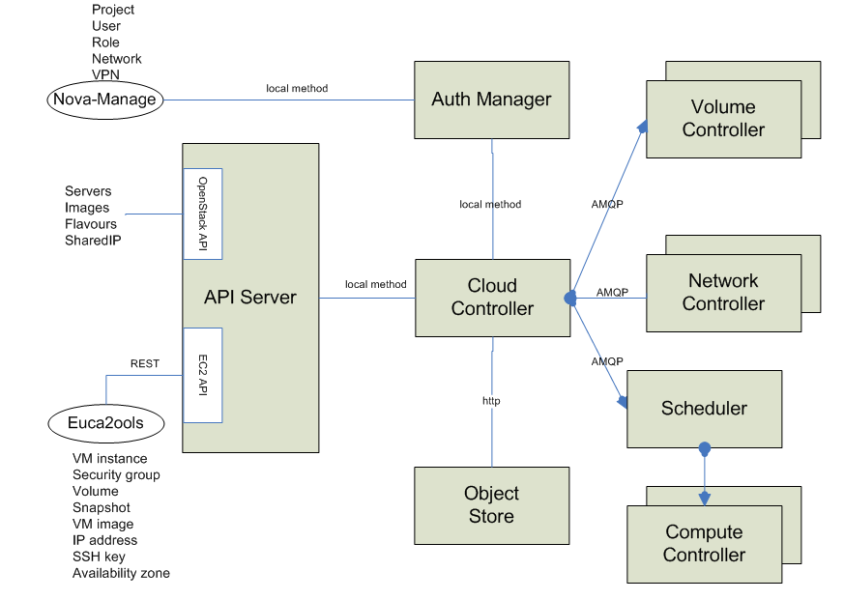
Component architecture
Tenant
http://nova.openstack.org/nova.concepts.html

Slide 8
Component architecture
”/etc/nova/nova.conf”
”ec2”, ”osapi”
?

Slide 9
”network”
?
?

Slide 10
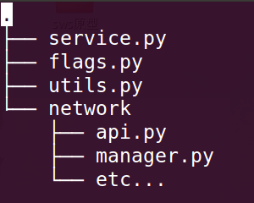
Code - Component relation
Network service
”network”
Periodic
Process
Topic: network
Manager
Driver: linux_net
Reads message from Queue
Returns results back to DB or Queue
Network API
Looks up DB
Sends message to Queue
- Cast: Send and forget
- Call: Send and wait

Slide 11

Code - Component relation
DB
API
API
Queue
API
API
WSGI

Slide 12
An example
Let’s allocate a floating-ip to an instance with a fixed-ip
DB
”compute API”
API
1
API
Queue
API
API
WSGI
POST /os-floating-ip

Slide 13
An example
DB
2
”compute API”
API
3
API
Queue
”network API”
API
API
WSGI

Slide 14
An example
”nova-network”
DB
”compute API”
API
5
API
4
Queue
”network API”
API
API
WSGI

Slide 15
An example
”nova network”
6
iptables
7
DB
”compute API”
API
API
Queue
”network API”
API
API
WSGI

Slide 16
An example
”nova network”
DB
2
”compute API”
API
3
1
API
Queue
”network API”
API
4
API
WSGI
GET /os-floating-ip

Slide 17
Code - Component relation
”nova network”
”nova volume”
”nova compute”
DB
”compute API”
API
API
”scheduler API”
Queue
”network API”
API
”nova scheduler”
API
WSGI
”volume API”

Slide 18
Contributing
LaunchPad
  http://launchpad.net/~openstack
Documents
  http://docs.openstack.org/
More info
  http://wiki.openstack.org/HowToContribute

Slide 19
Conclusion
Structure of code and components of Nova
An example
How to get involved
http://github.com/lzyeval/talk-COSUG-2012
http://launchpad.net/~lzyeval

