Slide 1

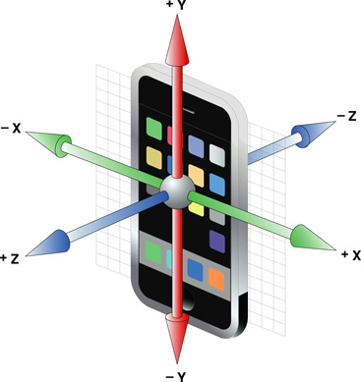
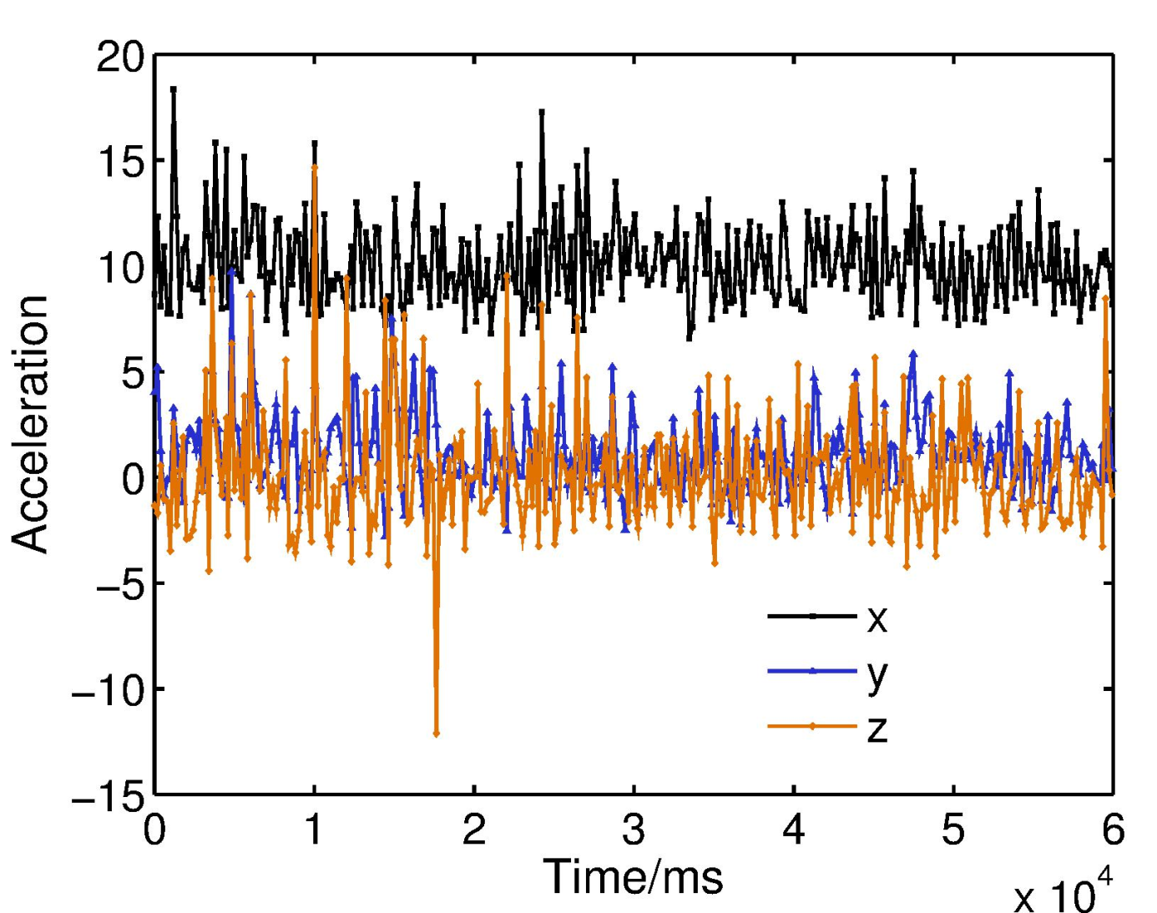
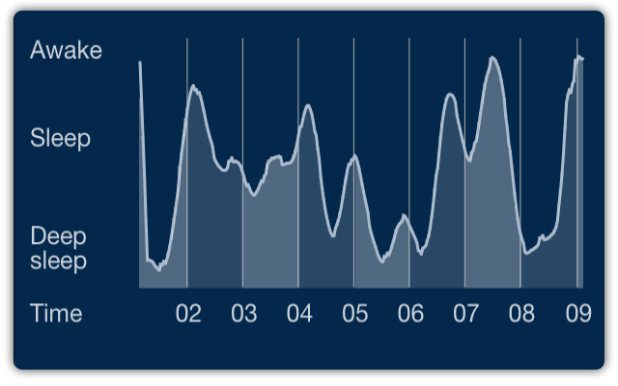






Biometric in Motion: Identification Using Acceleration Data
Zexi Mao, Siqi Tian, Yuchen Wu, Yimeng Zhang §Carnegie Mellon University (Authors are listed in alphabetic order.)
Motivation and Goals
Sensors inside your smartphone are much more powerful than you can image, especially accelerometer!
Show you where you are without GPS (indoor)?
Tell you why you did not sleep well last night?
Identify who is using the phone right now!
Does movement of human have some pattern
Does it strong enough to identify you?
How hard it is to take advantage of much data to identify you
Is the computing time-consuming
How much data is required
How can we take advantage of such technique
Health monitoring
Anti-theft
Emergency detection
Advertising without cookie
Do some evil?
A big privacy issue inside the accelerometer
How much data we can give out before exploit who we are
How to prevent such leaking
Approach
Raw data
Preprocess
Classifier
Results
Parameter selection
Accuracy
Smaller data reduces accuracy?
Features of sensor impact accuracy more than pattern of human ?
how to reduce it
Future Work
More sophisticated identifier
Identify different phase of motion, i.e., walking, biking, driving or running
A toolkit for mobile devices based on such technique
Privacy guard for jamming raw accelerometer data
Keep calm and do not touch your cellphone
Acknowledgement
Accelerometer data for this project is provided by Kaggle predictive modeling competition.
Some of the pictures are from Internet.

