Slide 1

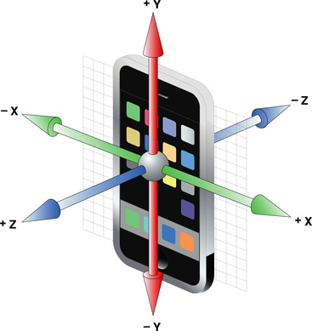
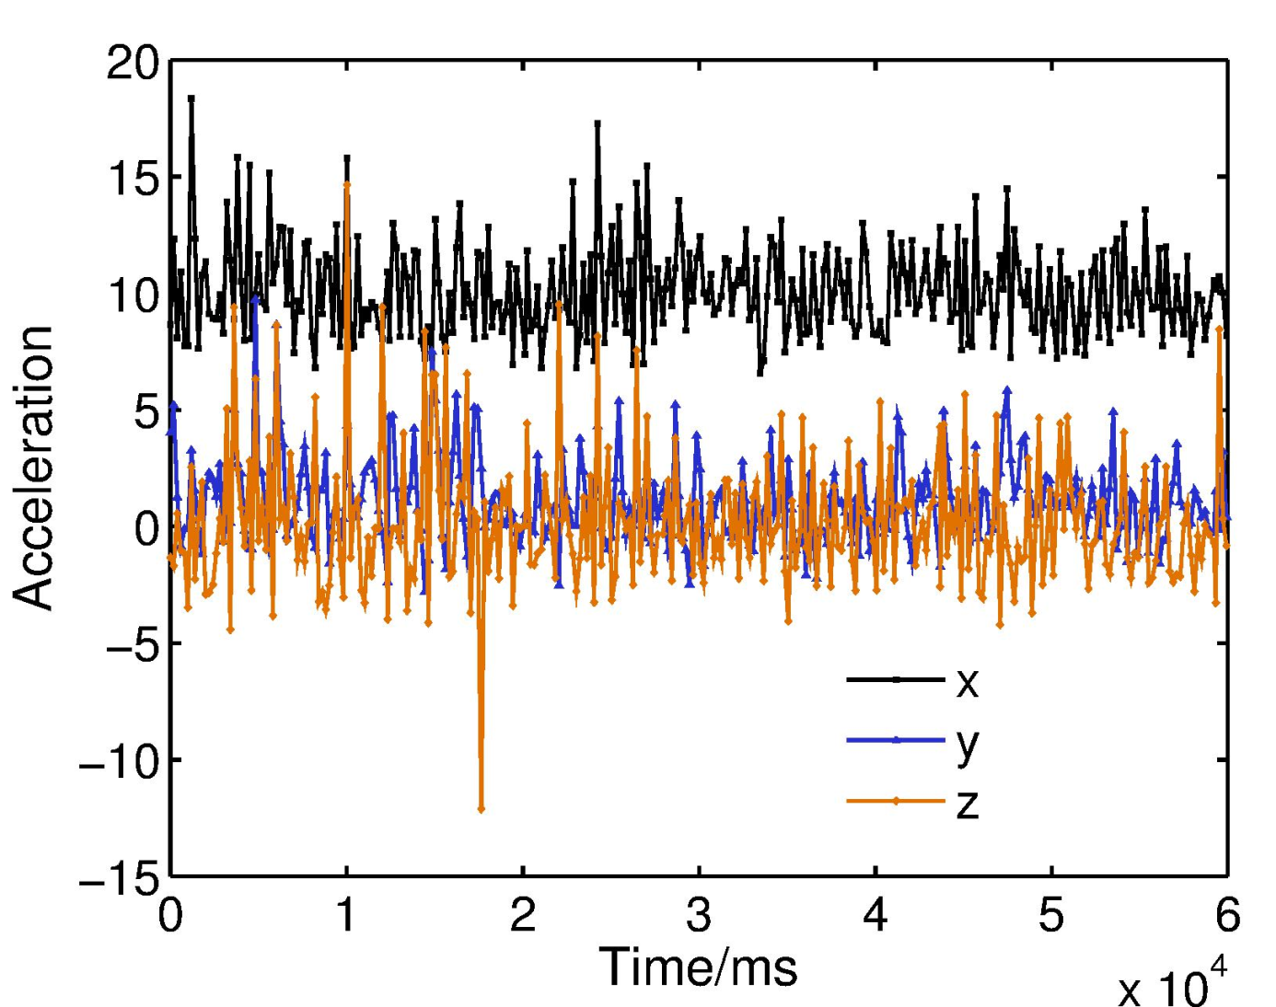
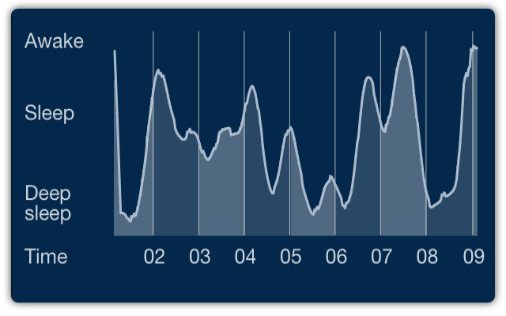






Biometric in Motion: Identification Using Acceleration Data (#25)
Zexi Mao, Siqi Tian, Yuchen Wu, Yimeng Zhang §Carnegie Mellon University (Authors are listed in alphabetical order.)
Motivation and Goals
Sensors inside your smartphone are much more powerful than you can imagine, especially accelerometer!
Show you where you are without GPS (indoor)?
Tell you why you did not sleep well last night?
Identify who is using the phone right now!
Does movement of human have some pattern
Is it strong enough to identify you?
How hard it is to take advantage of accelerometer data to identify you
Is the computation time-consuming
How much data is required
A big privacy issue
Is identification possible without leaking trajectory data?
Use some statistics of the trajectory data, like hash of fingerprint in A7 chip
Approach
Preprocessing
Segmentation
Re-sampling
Features
FFT of resampled readings
Statistics from resampled readings
Statistics from raw readings (depends on type of device, a little hack)
Classifiers
SVM with RBF kernel
L₂-regularized logistic regression
Results
Feature combination
FFT + resampled + raw statistics (hack, maybe unsafe)
resampled + raw statistics (hack, safe)
resampled statistics (no hack, safe)
Area under the ROC curve (given by Kaggle)
Ranking ~50/600+ on Kaggle. SVM result in the future, seemingly worse than LR.
Conclusions
For high-dimensional features, linear methods tend to perform better
Results of using safe features is acceptable, but further improvement is needed
Hack features (statistic from raw readings) are useful in limited scenarios
 | resampled | resampled + raw | FFT + resampled + raw
Logistic regression (LIBLINEAR) | 0.844 | 0.897 | 0.902
Keep calm and do not touch your cellphone
Data set
Dataset from the Kaggle competition “Accelerometer Biometric Competition”.
387 long training sequences from 387 devices (users).
90024 short testing sequences each with a proposed label X.
Given a testing sequence and the X, give a belief about if X is the real label.
Performance evaluated in area under the ROC curve.
Future Work
More sophisticated classifier
Reduce training data to see how much data is required to achieve certain performance
Analyze time & power required for training and testing, and speed up computation
Some of the pictures are from Internet.

