Slide 1
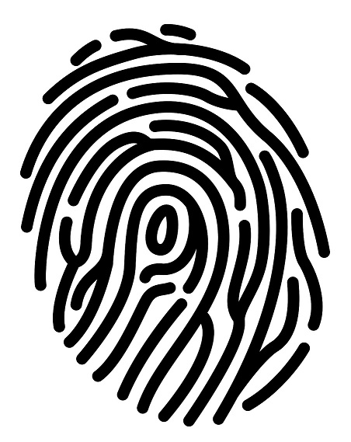
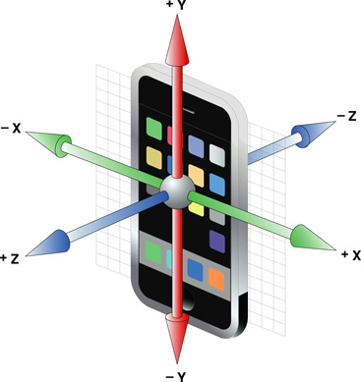
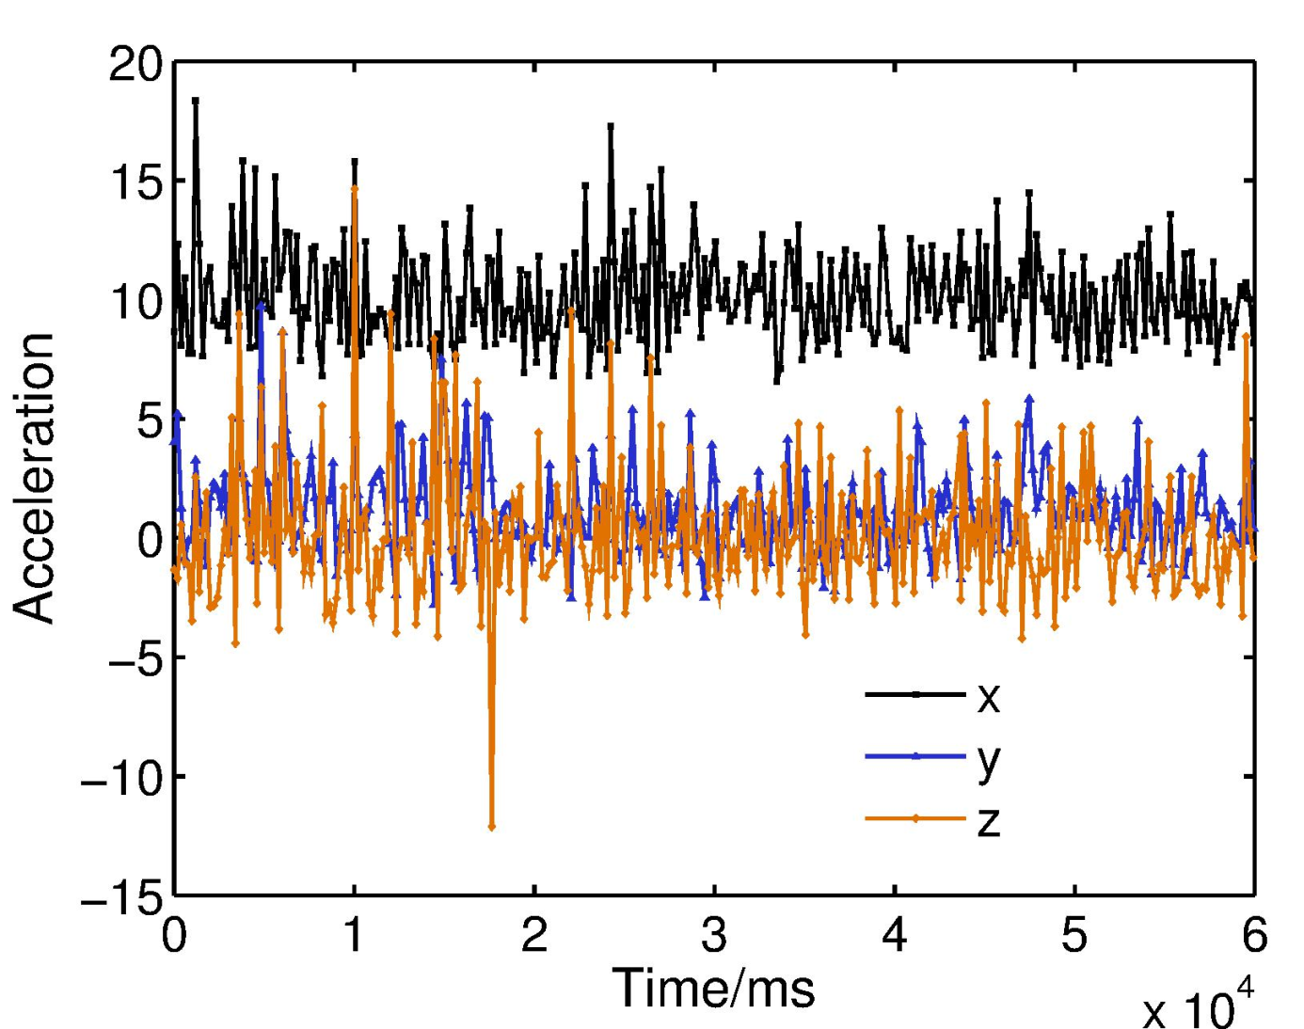
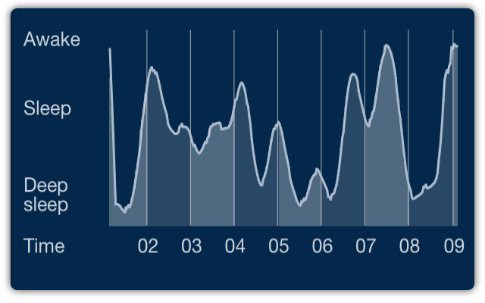






Biometric in Motion: Identification Using Acceleration Data
Zexi Mao, Siqi Tian, Yuchen Wu, Yimeng Zhang §Carnegie Mellon University (Authors are listed in alphabetical order.)
Motivation and Goals
Sensors inside your smartphone are much more powerful than you can image, especially accelerometer!
Show you where you are without GPS (indoor)?
Tell you why you did not sleep well last night?
Identify who is using the phone right now!
Does movement of human have some pattern
Does it strong enough to identify you?
How hard it is to take advantage of much data to identify you
Is the computing time-consuming
How much data is required
How can we take advantage of such technique
Health monitoring
Anti-theft
Emergency detection
Advertising without cookie
Do some evil?
A big privacy issue inside the accelerometer
How much data we can give out before exploit who we are
How to prevent such leaking
Approach
Preprocess
Segmentation
Adjacent sample points
with time difference
larger than 10s are segmented
Re-sampling
Uniformly re-sampling each sequence with fixed time interval
Features
Frequency domain features (FFT)
Statistic features
Classifiers
k-NN
SVM with RBF kernel
L₂-regularized logistic regression
Results
Feature selection
FFT + statistics (tend to be unsafe)
Statistics only (safe)
Area under the ROC curve
Insert the table here
Conclusions
For high-dimensional features, linear methods tend to perform better
Results of using safe feature is acceptable, but further improvement is needed
Future Work
More sophisticated identifier
Identify different phase of motion, i.e., walking, biking, driving or running
A toolkit for mobile devices based on such technique
Privacy guard for jamming raw accelerometer data
Keep calm and do not touch your cellphone
Acknowledgement
Accelerometer data for this project is provided by Kaggle predictive modeling competition.
Some of the pictures are from Internet.

