Slide 1
Yield Curve Curvature Mean-Reverting Trading Strategies
Yumeng Zhang, 12372205
Hengxu Zhu, 12368409
Siyang Qu, 12375854
Notes:
The pitch book must contain introductory slides motivating the project idea.
The Jupyter notebook must have
longer and more complete expositions about the project idea
initial code for obtaining, cleaning, formatting and arranging the data you will be using for your project
at least three graphs showing some of the data values used
Both the pitch book and Jupyter notebook must have student names and IDs specified as for the final submission

Slide 2
Motivating Idea
Expect the yield curve to mean-revert to an unconditional level
Deviations in the curvature of the yield curve from historical norms are computed to make bets on future prices
If the curvature is higher (lower) than the historical average, bet that they’ll decrease (increase) towards the historical average

Slide 3
Historical Evidence
U.S. Treasury bonds trade within tight, finite bounds
The interest rate term structures in other countries also exhibit similar patterns
Evidence that some form of mean-reversion mechanism is at work that prevents the yield curve from drifting to extreme levels or shapes over time

Slide 4
Theoretical Evidence
The yield curve is known to mean-revert because it reflects the market's expectations of future economic growth and inflation
This mean-reversion is driven by the tendency of market participants to correct for mispricing and to adjust their expectations as new information becomes available
Expectation Hypothesis suggests that the difference between expected return on short and long term fixed income strategies is constant

Slide 5
Dataset
The data are extracted from Quandl and are the treasury bonds yield curve from August 2001 to July 2022
The spot rates are then converted to zero coupon rates and yield curves are computed using interpolation

Slide 6
Unconditional Yield Curve
Unconditional Yield Curve works as a trigger in our trading strategy
It determines the long-short action for each investment period
Three different methods are used to calculate the unconditional curve so that we can compare to extract the best strategy

Slide 7
Strategies
Barbell Strategy (Bets on the curvatures)
Invest in two ends of the yield and shorting the middle (or vice versa)
The overarching strategies allow us to
identify deviations from expectation at any given point in time
construct long/short trades based on the mean-reversion assumption
Example:
If curvature for 3 adjacent bonds mean-reverts is smaller than that of the unconditional curve, then we long the front and back bond and short the other.

Slide 8
Methods & Analysis
Tune hyperparameters associated with trade sizes on a period of training set and report out-of-sample performance on the test set
Test performance after accounting for transaction/trading cost
Profits & Losses attribution on both training and test set to understand the relationship between individual strategies

Slide 9
Experiment Setup
“True” yield curve
Historical average
Exponential decay, with coefficient = 0.1
Exponential decay, with coefficient = 0.1, window size = 20
Transaction/borrow cost: fed fund rate
Capital allocation: Equal allocation to each instrument

Slide 10
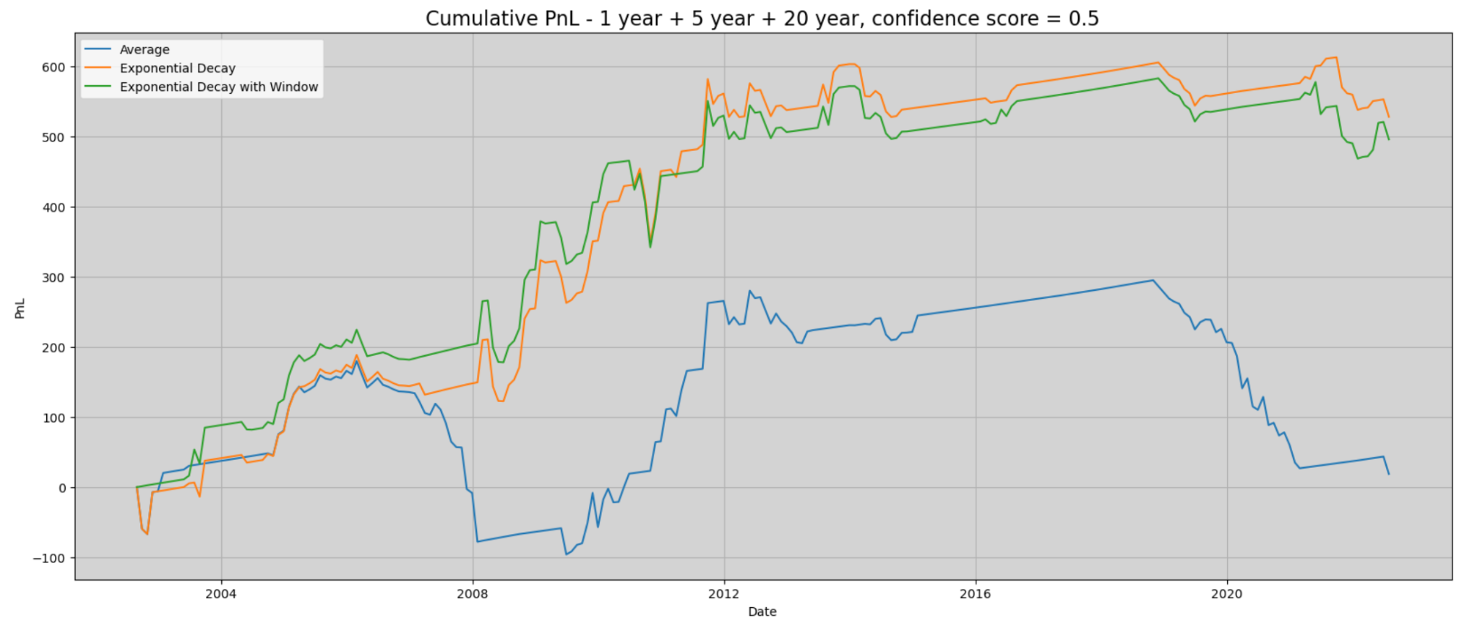
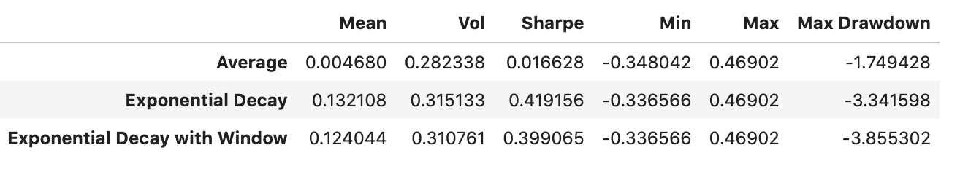
Simulations

Slide 11
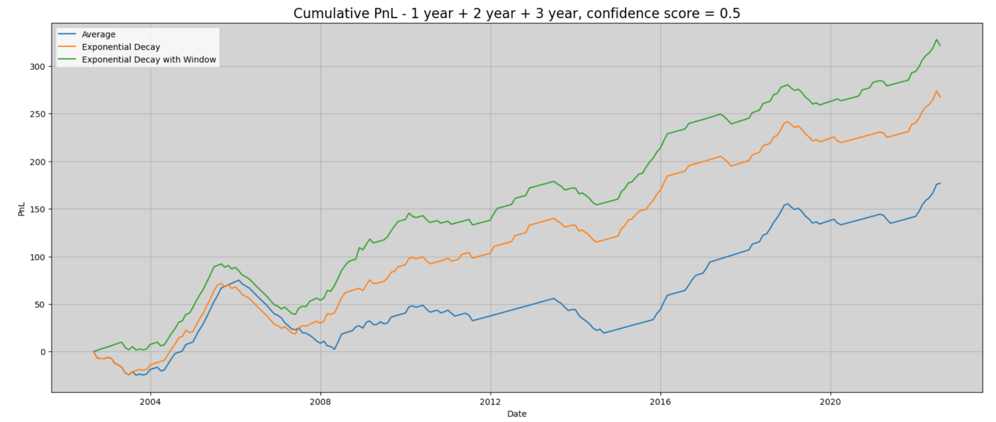
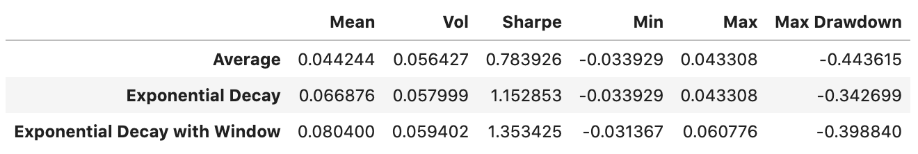
Simulations

Slide 12
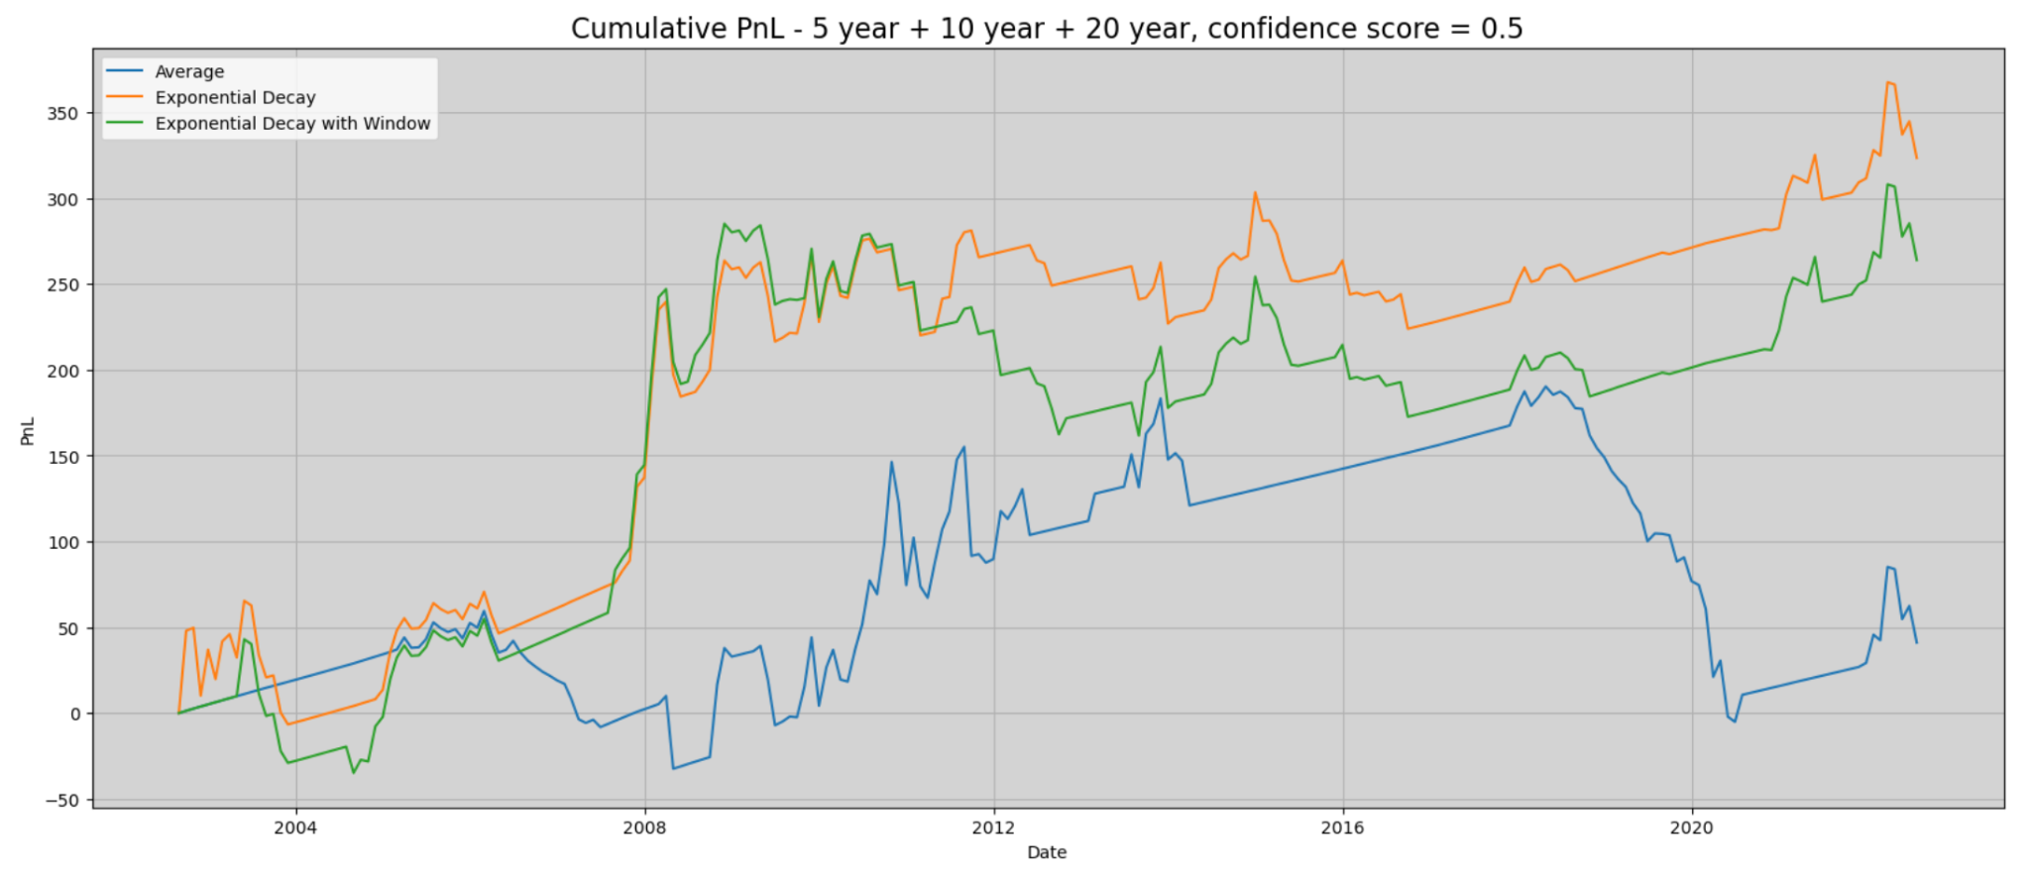
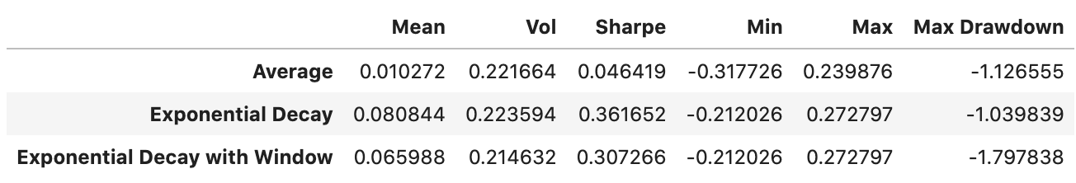
Simulations

Slide 13
Conclusions
The combination of short, middle and long term bonds gives the best returns.
The short term combination gives a decent return of 8% and sharpe of 1.35 → recommended for investors.
However, different combinations of maturities yield very different result. The fact that this is likely dependent on market condition is a practical limitation when deciding on the combination of securities to trade.

