Slide 1
Machine Learning & Pattern Recognition
Xin Xin(辛鑫)
xinxin@sdu.edu.cn
https://xinxin-me.github.io/

Slide 2
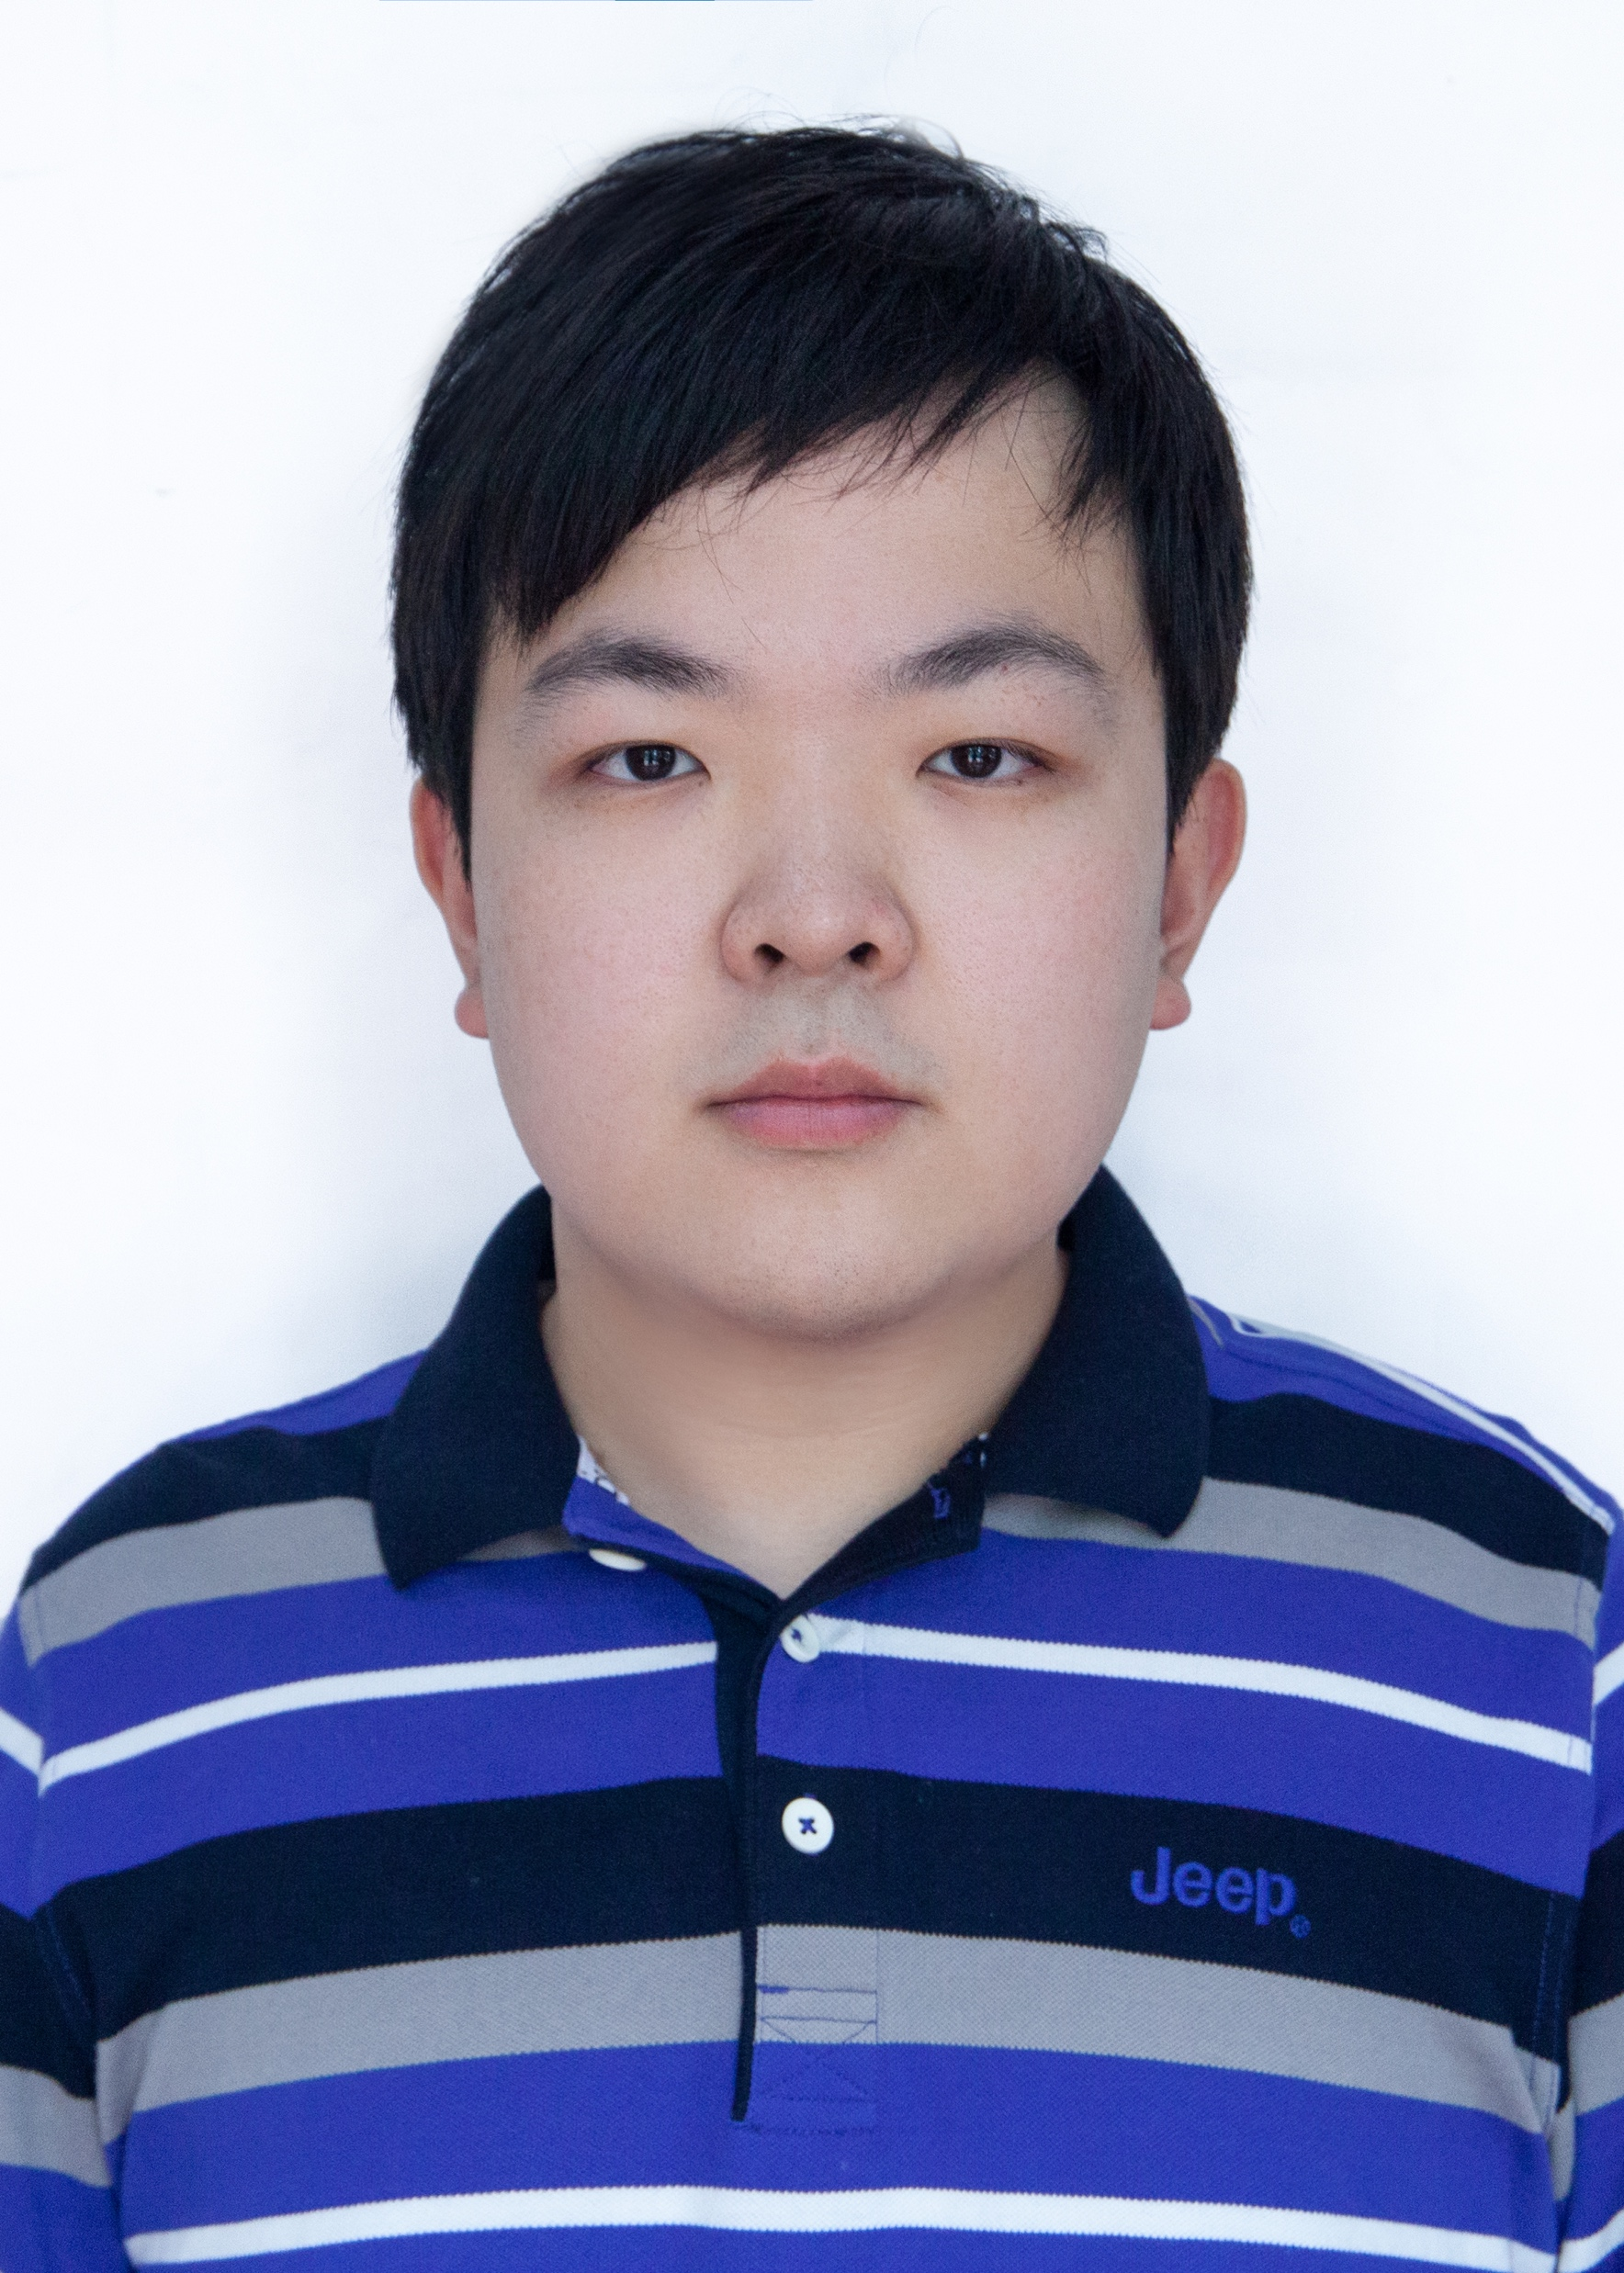
About Me
Dr. Xin Xin (辛鑫)
Associate Professor
Dept. of Computer Science & Technology
Office: N3-3楼
E-mail: xinxin@sdu.edu.cn
Wechat: xinxinsducs
Consultation: by appointment
Ph.D., University of Glasgow (2017-2021)
Master, Shanghai Jiaotong University (2014-2017)
Bachelor, Xi’an Jiaotong University (2010-2014)
Research Interests:
Recommender Systems
Information Retrieval
Machine Learning
Reinforcement Learning

Slide 3
Objectives
To equip students with knowledge of common statistical machine learning and pattern recognition algorithms and techniques.

Slide 4
Prerequisites
Familiar with probability, and linear algebra (vector spaces and matrix theory) as thought in typical undergraduate courses.
https://www.bilibili.com/video/av6731067
Familiar with programming environments such as MATLAB, Python or be able to program in standard languages such as C, C++, etc.

Slide 5
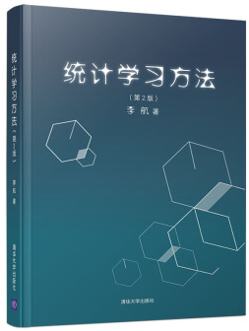

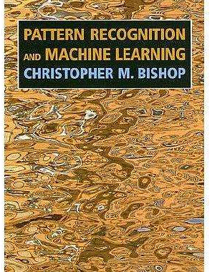
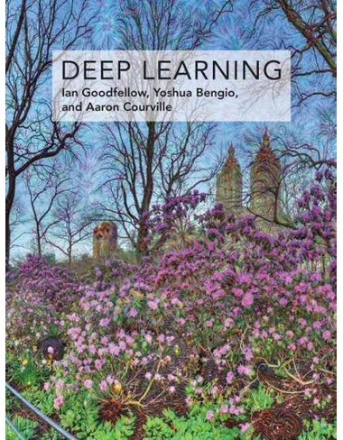
Text Book and References
统计学习方法 第二版（李航）
机器学习 （周志华）
Pattern Recognition and Machine Learning (Christopher Bishop) (E-edition)
Deep Learning (Ian Goodfellow, Yoshua Bengio, Aaron Courville) (E-edition)
Lectures are important, but not enough.
You are strongly suggested to explore more (via the Internet or even just the wikipedia).
Notes:
就是这样的notes

Slide 6
Assessments
Lecture slides in PDF format
Via the QQ group
Experiments (25%-30%)
Will be released soon.
Final Project (25%-30%)
Will be released soon.
Final Exam (40%-50%)
Closed-book, 2 hrs.

Slide 7
Schedule
Experiments: Weeks 2-17，Wednesday，9-10。
Will notify through QQ group.

Slide 8
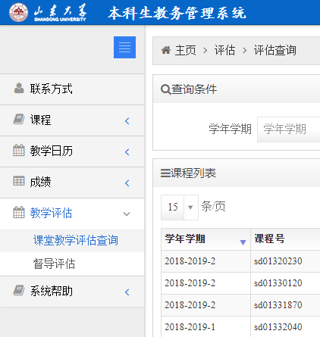
Feedbacks
Gather feedback via the education admin system.
Your opinions do matter.
If you find any typos (or any other problems) in the slides, please feel free to contact me at xinxin@sdu.edu.cn or talk to me directly in the class. Thanks!

Slide 9
Syllabus
I plan to introduce the following topics…
1. Introduction to Machine Learning
2. Review of linear algebra & probability
8. Support Vector Machine
3. Linear Algorithms
9. Decision Tree
4. Optimization methods (GD, Newton, Momentum, SGD…)
10. Feature Selection
5. Unsupervised Feature Extraction (PCA)
11. Ensemble Methods (Bagging and Boosting)
6. Supervised Feature Extraction (LDA)
12. Model Evaluation
7. Bayesian Decision Theory

Slide 10

Hope you would enjoy it.

