Slide 1
Machine Learning & Pattern Recognition
Xin Xin(辛鑫)
xinxin@sdu.edu.cn
https://xinxin-me.github.io/

Slide 2
Outline
What is Machine Learning?
Applications of Machine Learning.
Components of Machine Learning.
Types of Machine Learning.

Slide 3
Outline
What is Machine Learning?
Applications of Machine Learning.
Components of Machine Learning.
Types of Machine Learning.

Slide 4
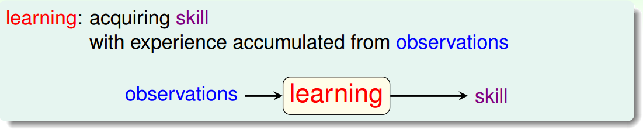
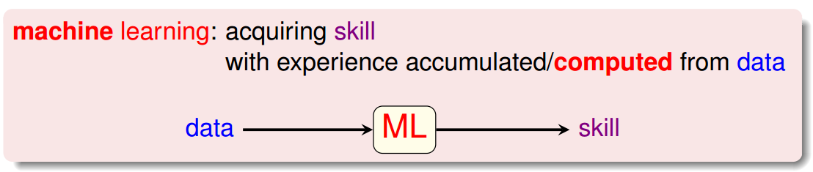

Definition of Machine Learning
学习，是指通过阅读、听讲、思考、研究、实践等途径获得知识和技能的过程。

Slide 5
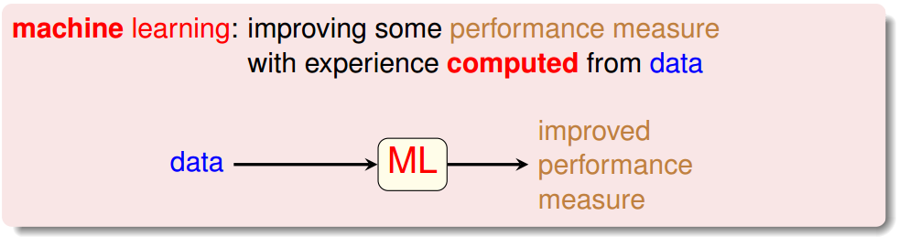
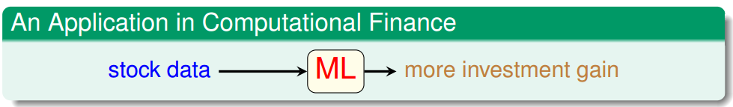

Definition of Machine Learning
e.g., prediction accuracy

Slide 6
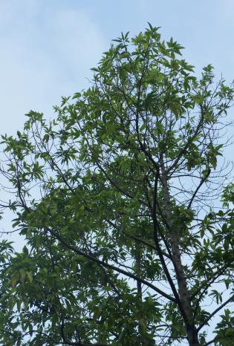
Why Do We Use Machine Learning?
“Define” trees and hand-program: difficult;
Learn from data (observations) and recognize;
“ML-based tree recognition system” can be easier to build than hand-programmed system.
Human cannot define the solution easily.

Slide 7
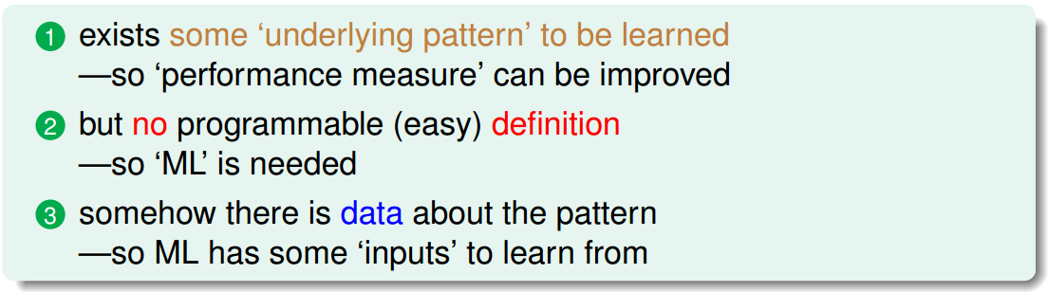

Key Essence of Machine Learning

Slide 8
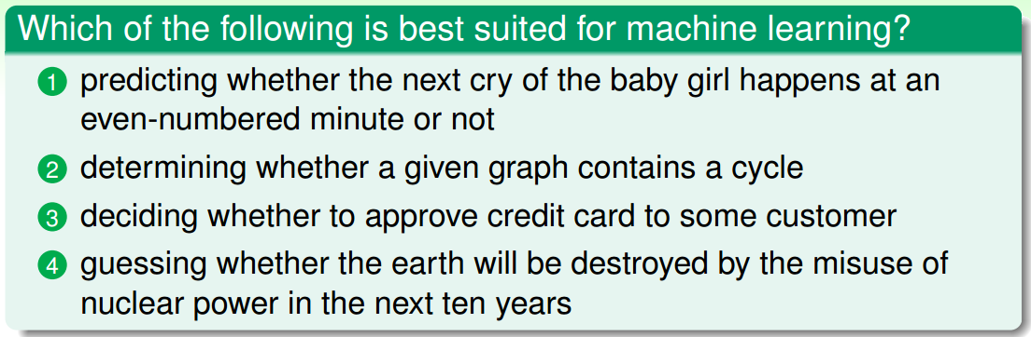
Exercise

Slide 9
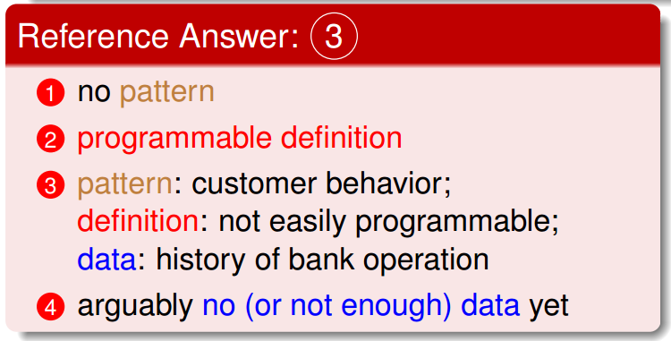
Exercise

Slide 10
Outline
What is Machine Learning?
Applications of Machine Learning.
Components of Machine Learning.
Types of Machine Learning.

Slide 11
Outline
What is Machine Learning?
Applications of Machine Learning.
Components of Machine Learning.
Types of Machine Learning.

Slide 12
Applications of Machine Learning
Daily Needs
Food
Clothing
Housing
Transportation
Entertainment
Law
Medical
Education

Slide 13
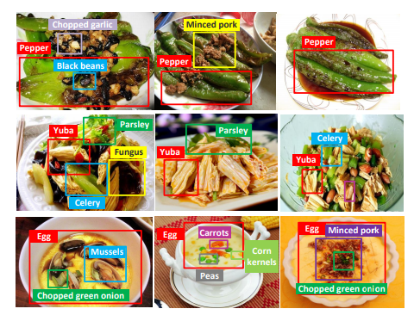
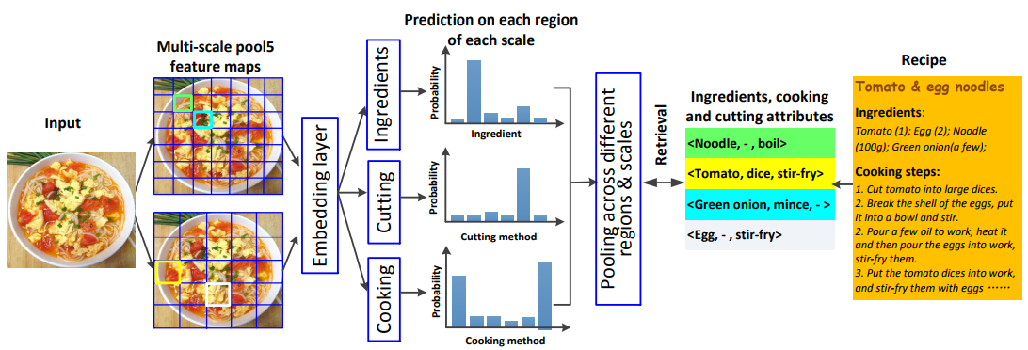
Food
Ingredient Recognition (Chen et al. 2017)
Data:
The food categories: xiachufang and meishijie.
All the images : Baidu and Google image search.
Notes:
for cooking recipe retrieval

Slide 14
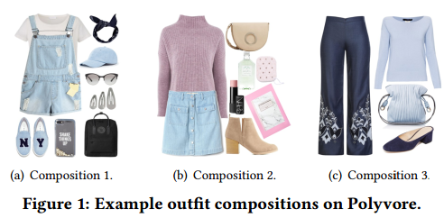
Clothing
Clothing matching (Song et al. 2018)
Data: Outfit compositions collected from the Polyvore (website).
-
B
outique -
How to match clothing
OPEN

Slide 15
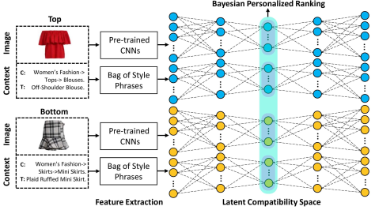
Clothing
Clothing matching (Song et al. 2018)
Data: Outfit compositions collected from the Polyvore (website).

Slide 16
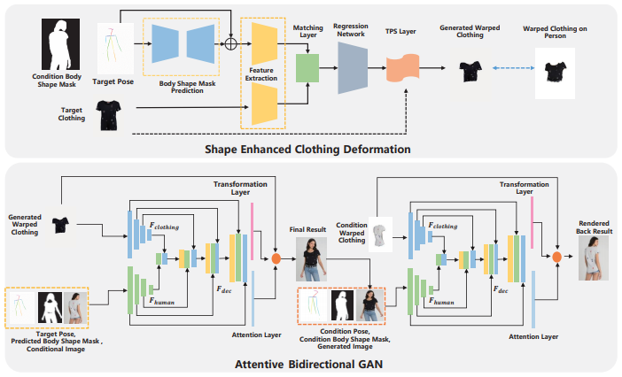
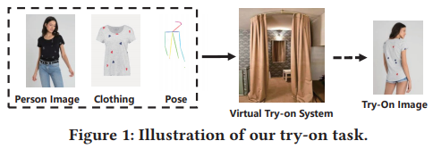
Clothing
Virtual Try-on with Arbitrary Poses (Zheng et al. 2019)
Data: Fashion-oriented ecommerce website---Zalando.
Figure 2: Illustration of the proposed scheme.

Slide 17
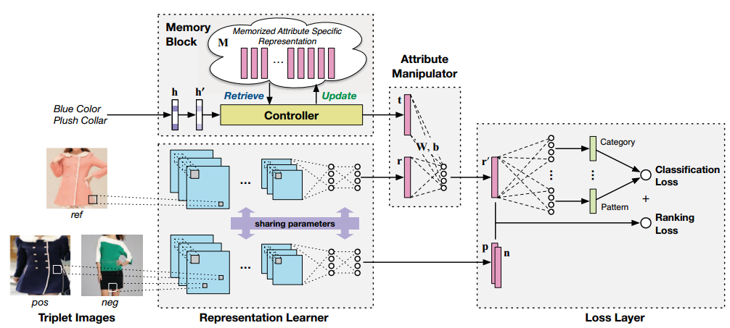
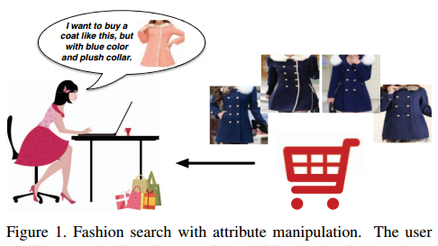
Clothing
Interactive Fashion Search(Wu et al. 2017)
Data: Public dataset (DARN and DeepFashion). Images with attribute annotations.

Slide 18
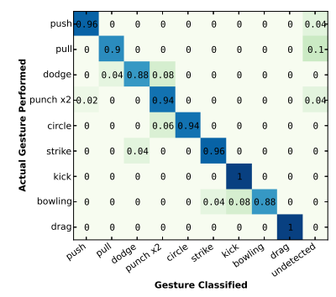
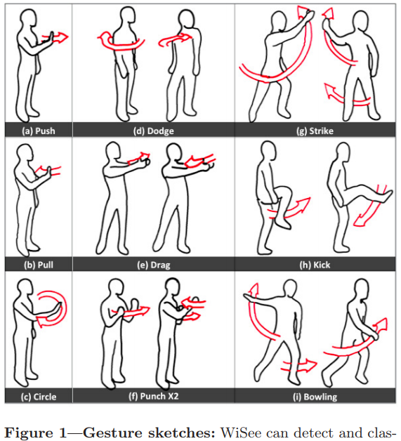
Housing
Gesture Recognition Using Wireless Signals (Pu et al. 2013, 2015)
Data: 5 users perform gestures in an office and a two-bedroom.
Gesture sketches
Notes:
As computing moves increasingly away from the desktop, there is a growing need for new ways to interact with computer interfaces. The Xbox Kinect is an example of a commercially available input sensor that enables gesture-based interaction using depth sensing and computer vision. The commercial success of these kinds of devices has spurred interest in developing new user interfaces that remove the need for a traditional keyboard and mouse. Gestures enable a whole new set of interaction techniques for always-available computing embedded in the environment. For example, using a swipe hand motion in-air, a user could control the musi volume while showering, or change the song playing on a music system installed in the living room while cooking, or turn up the thermostat while in bed. Such a capability can enable applications in diverse domains including home-automation, elderly health care, and gaming. However, the burden of installation and cost make most vision-based sensing devices hard to deploy at scale, for example, throughout an entire home or building. Given these limitations, researchers have explored ways to move some of the sensing onto the body and reduce the need for environmental sensors

Slide 19
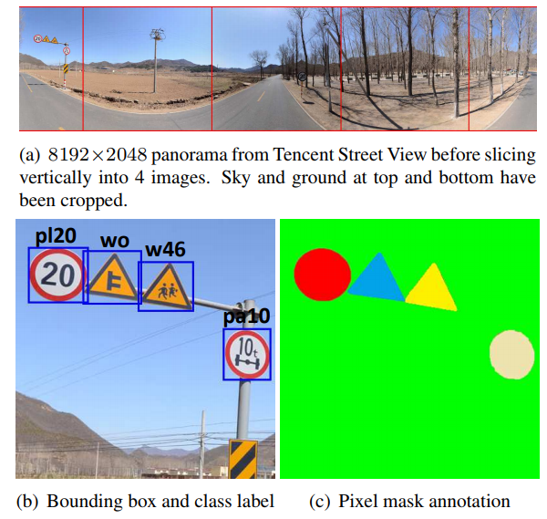
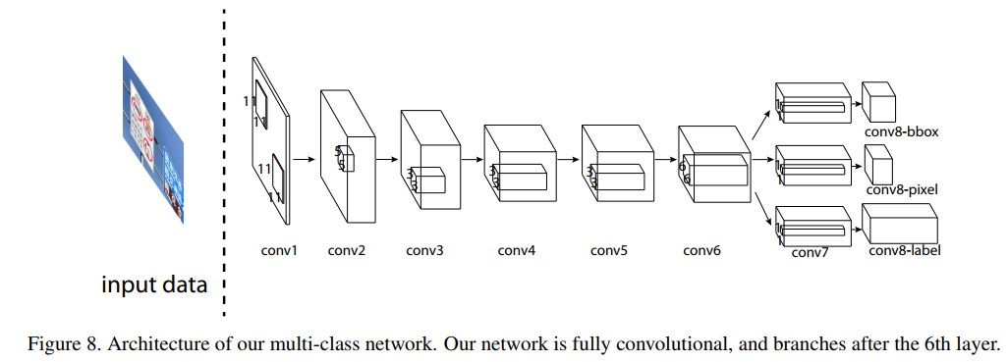
Transportation
Traffic-Sign Detection (Zhu et al. 2016)
Data: Tencent street views with manual annotation.
Benchmark
Notes:
Our benchmark contains 100000 high resolution images in which all traffic-signs are annotated with class label, bounding box, and pixel mask. T。 Traffic-Sign Detection and Classification in the Wild

Slide 20
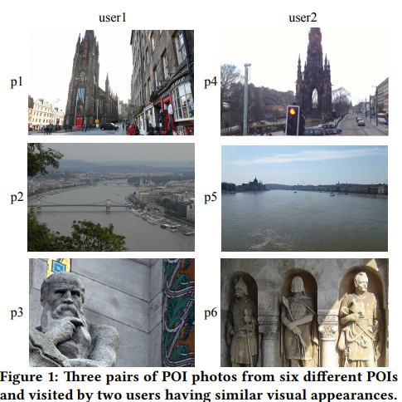
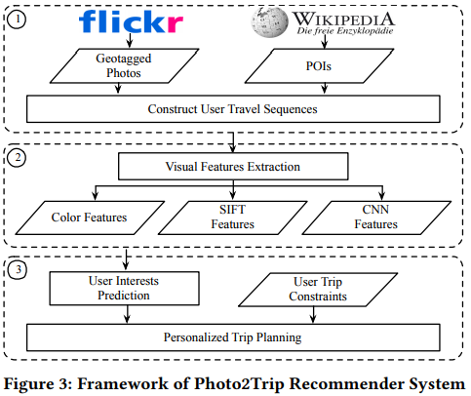
Transportation
Personalized Tour Recommendation (Zhao et al. 2017)
Data: Public dataset (Flicker).
Notes:
Our benchmark contains 100000 high resolution images in which all traffic-signs are annotated with class label, bounding box, and pixel mask. T。 Traffic-Sign Detection and Classification in the Wild

Slide 21
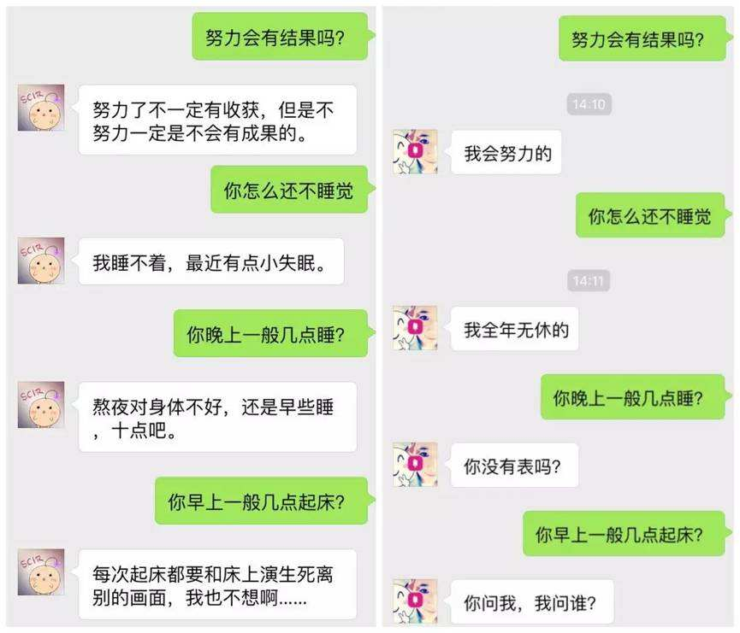

Entertainment
Chatting Bot (Microsoft 2014, Zhang et al. 2017, Want et al. 2018)
Harbin Institute of Technology
Benben
Microsoft Xiaobing

Slide 22
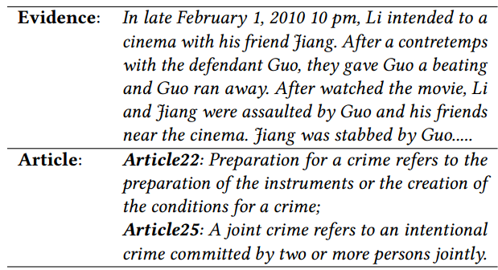


Law
Crime Classification (Wang et al. 2018)
Data: Collected from the China Judgments Online.
Task: Determine the specific articles (as labels) that the evidence (document) violated (multi-label classification).
An example of the judgement case, including an evidence and two articles violated.
http://wenshu.court.gov.cn/Index
Notes:
In juridical field, judges usually need to consult several relevant cases to determine the specifc articles that the evidence violated

Slide 23
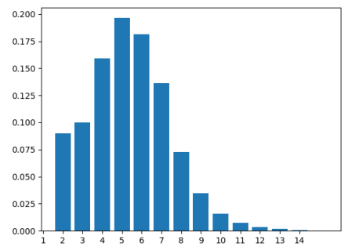
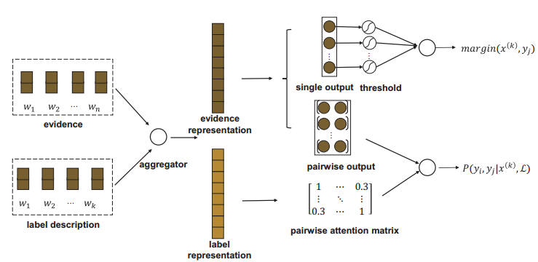
Law
Crime Classification (Wang et al. 2018)
Data: Collected from the China Judgments Online.
Task: Determine the specific articles (as labels) that the evidence (document) violated (multi-label classification).
Distribution of article set size over evidences.
The overall architecture of the proposed model.
Notes:
In juridical field, judges usually need to consult several relevant cases to determine the specifc articles that the evidence violated

Slide 24
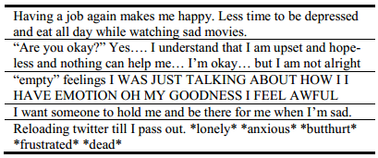
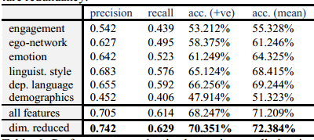
Medical
Predicting depression via social media. (Choudhury et al. 2013)
Data: Social Media Data (Tweets).
Task: Predict a binary response variable (depressed/not depressed).
Example posts from users in the depression class.
Performance metrics in depression prediction in posts using various models.

Slide 25

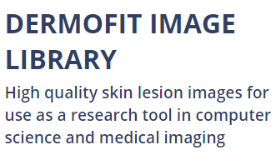

Medical
Classification of skin cancer. (Esteva et al. 2017)
Data: The ISIC Dermoscopic Archive, the Edinburgh Dermofit Library and data from the Stanford Hospital (129,450 clinical images).
Open-access dermatology repositories
Data from the hospital.

Slide 26
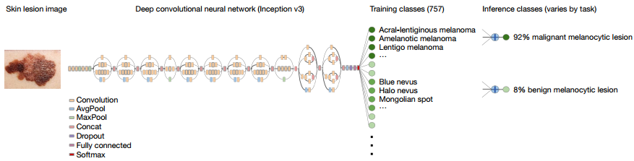
Medical
Classification of skin cancer. (Esteva et al. 2017)
Task: Two binary classification use cases:
Keratinocyte carcinomas vs benign seborrheic keratoses;
Malignant melanomas(恶性黑色素瘤) vs benign nevi(良性痣).
Proposed framework.

Slide 27
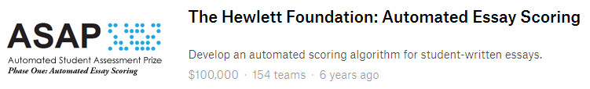
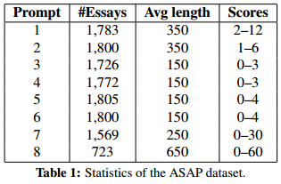
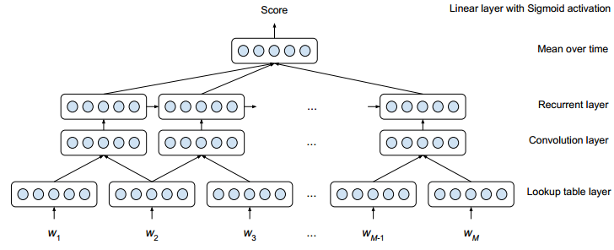
Education
Automated Essay Scoring. (Taghipour et al. 2016)
Data: Public dataset provide by the following competition (2012).

Slide 28

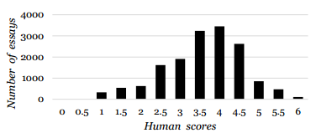
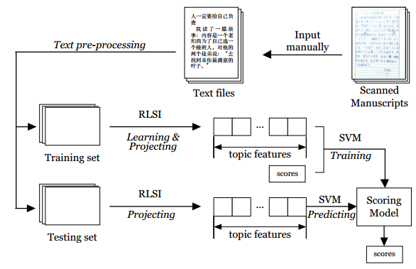
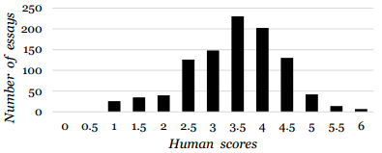
Education
Automated Essay Scoring. (Hao et al. 2014)
Data: Essays from the MHK (the minorities-oriented Chinese level test).
Training set (total 15,776 essays)
The flowchart of the proposed method.
Testing set (total 1,000 essays)

Slide 29
Outline
What is Machine Learning?
Applications of Machine Learning.
Components of Machine Learning.
Types of Machine Learning.

Slide 30
Outline
What is Machine Learning?
Applications of Machine Learning.
Components of Machine Learning.
Types of Machine Learning.

Slide 31
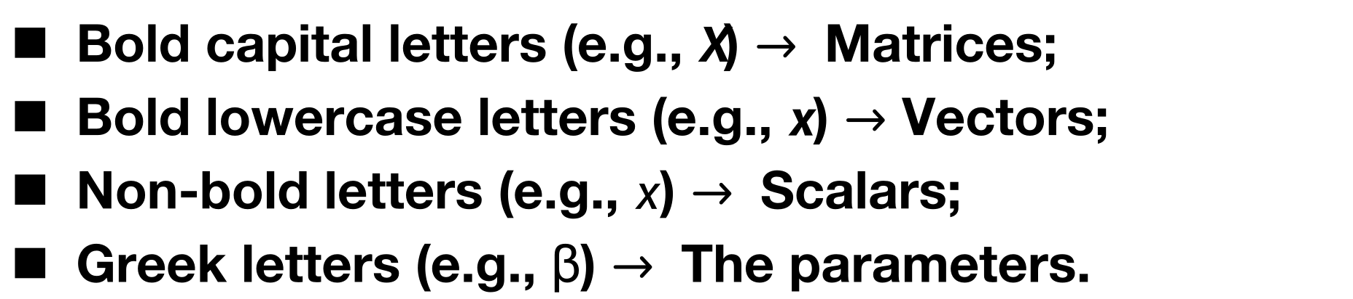
Basic Notations
Bold capital letters (e.g., $X$) $→$Matrices;
Bold lowercase letters (e.g., $x$) $→$ Vectors;
Non-bold letters (e.g., $x$) $→$Scalars;
Greek letters (e.g., β) $→$The parameters.

Slide 32

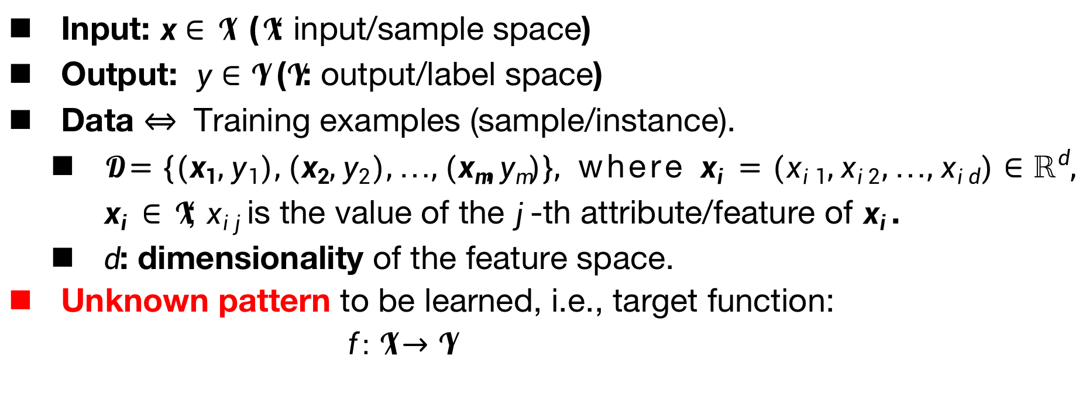
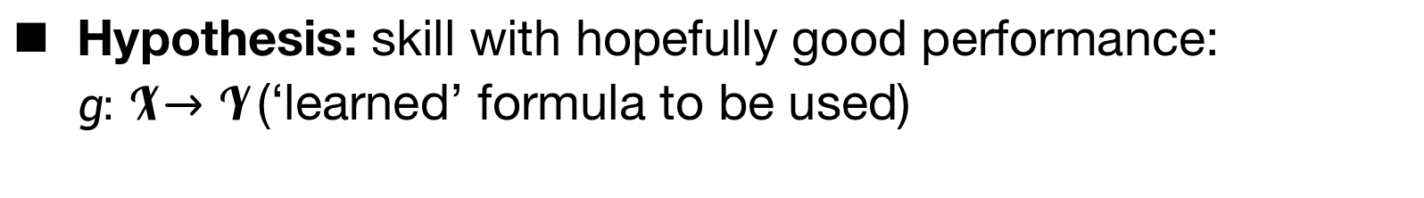
Basic Notations
Input: $x∈𝓧$ ($𝓧$: input/sample space)
Output: $y∈𝓨$ ($𝓨$: output/label space)
Data $⇔$Training examples (sample/instance).
$𝓓=\left\{(x_{1},y_{1}),(x_{2},y_{2}),…,(x_{m},y_{m})\right\},$ where $x_{i}=(x_{i1},x_{i2},…,x_{id})∈ℝ^{d},$ $x_{i}∈𝓧$; $x_{ij}$is the value of the $j$-th attribute/feature of $x_{i}$.
$d$: dimensionality of the feature space.
Unknown pattern to be learned, i.e., target function:
$f:𝓧→𝓨$
Hypothesis: skill with hopefully good performance: $g:𝓧→𝓨$ (‘learned’ formula to be used)

Slide 33
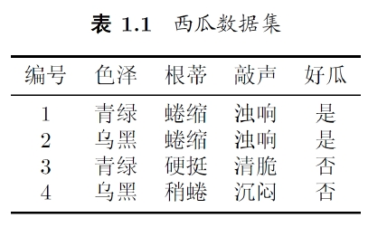
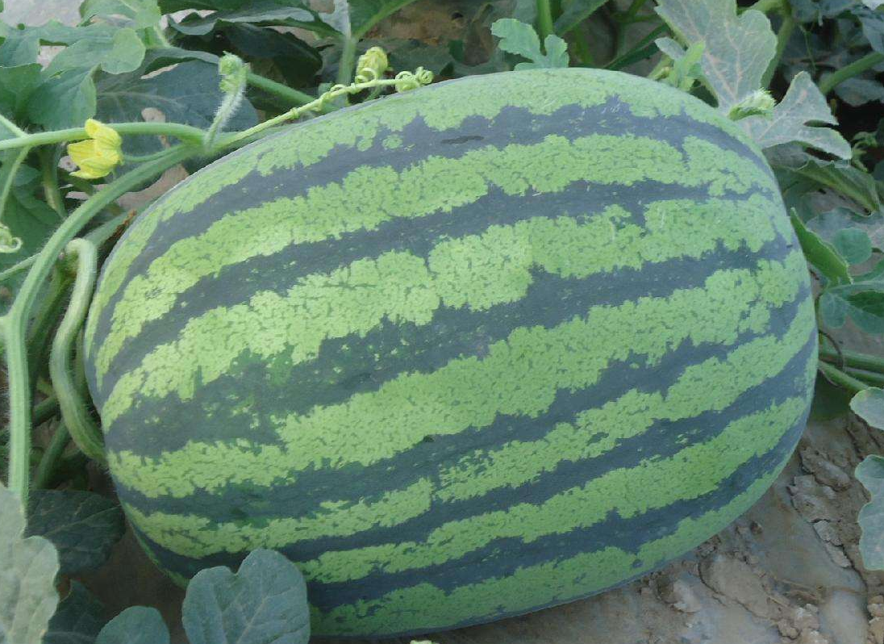
Watermelon Classification
Is the given watermelon good?

Slide 34
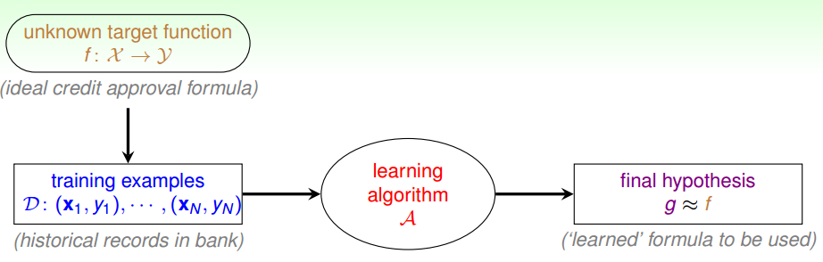
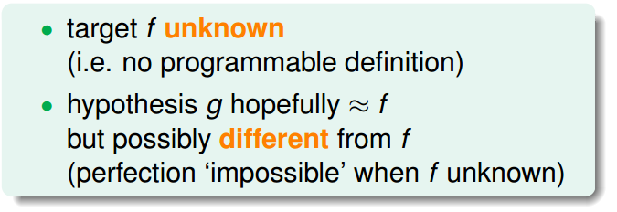
Learning Flow
(Ideal classification formula)
、
(Watermelons in hand)
(‘Learned’ classification formula to be used)
What does g look like?

Slide 35
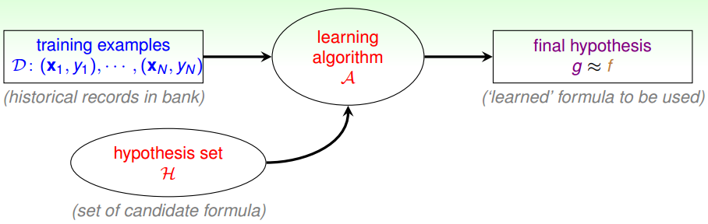
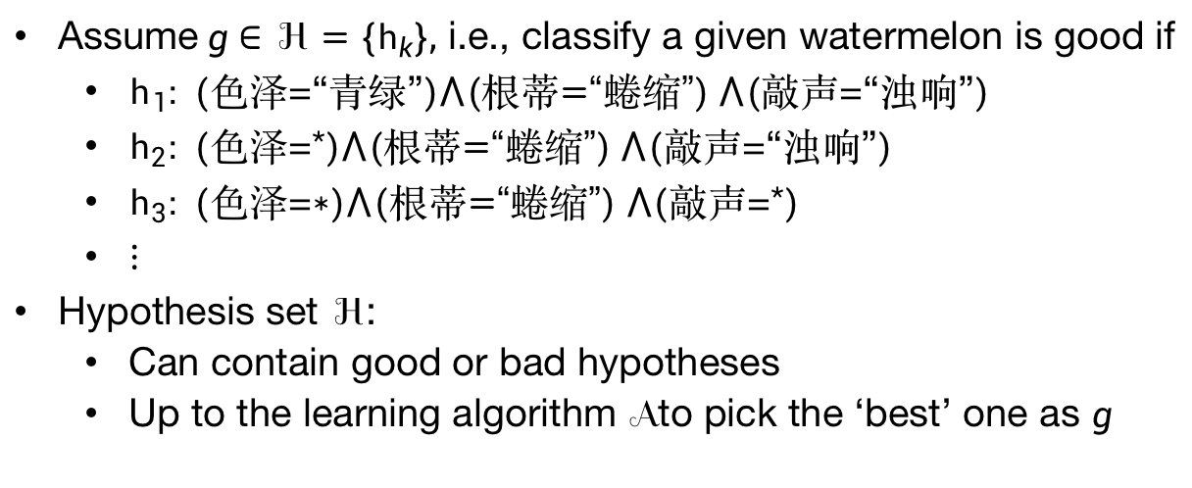
Learning Model
(Watermelons in hand)
(‘Learned’ classification formula to be used)
Assume$g∈ℋ=\left\{h_{k}\right\},$ i.e., classify a given watermelon is good if
$h_{1}: ($色泽=“青绿”$)⋀(根蒂\text{=“}蜷缩\text{”}) ⋀($敲声=“浊响”$)$
$h_{2}: ($色泽=*$)⋀(根蒂\text{=“}蜷缩\text{”}) ⋀($敲声=“浊响”$)$
$h_{3}: ($色泽=$∗)⋀(根蒂\text{=“}蜷缩\text{”}) ⋀($敲声=*$)$
$⋮$
Hypothesis set $ℋ$:
Can contain good or bad hypotheses
Up to the learning algorithm $𝒜$ to pick the ‘best’ one as $g$

Slide 36
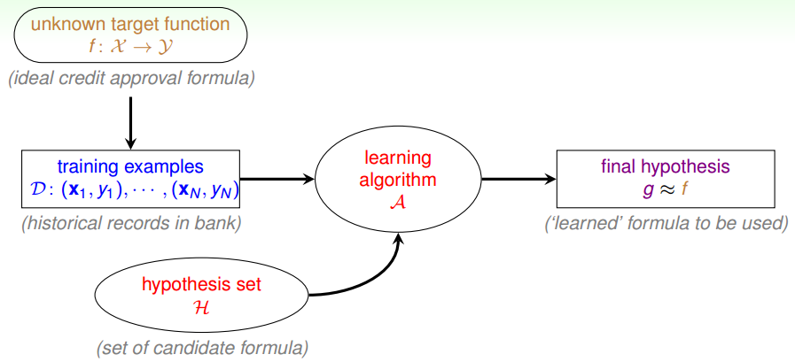
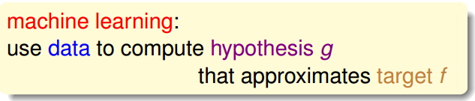
Practical Definition of Machine Learning
(Ideal classification formula)
、
(Watermelons in hand)
(‘Learned’ classification formula to be used)

Slide 37
Outline
What is Machine Learning?
Applications of Machine Learning.
Components of Machine Learning.
Types of Machine Learning.

Slide 38
Outline
What is Machine Learning?
Applications of Machine Learning.
Components of Machine Learning.
Types of Machine Learning.

Slide 39
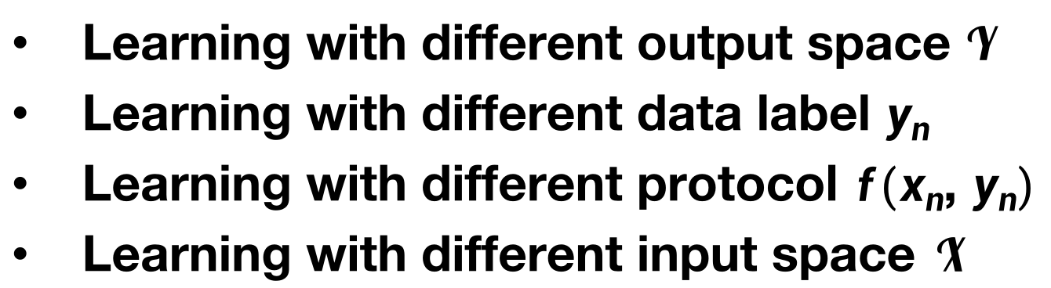
Categories of Machine Learning
Learning with different output space $𝓨$
Learning with different data label $y_{n}$
Learning with different protocol $f(x_{n}$, $y_{n})$
Learning with different input space $𝓧$

Slide 40
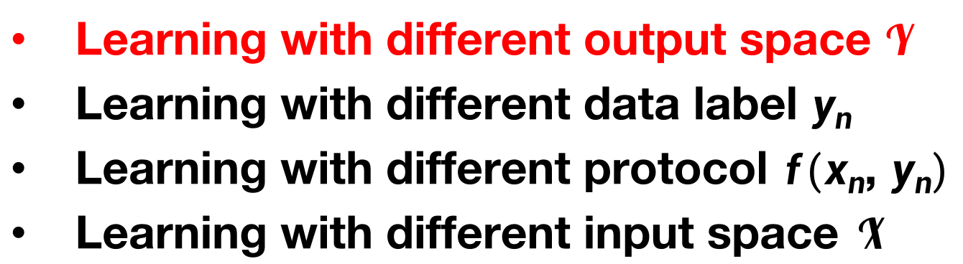
Categories of Machine Learning
Learning with different output space $𝓨$
Learning with different data label $y_{n}$
Learning with different protocol $f(x_{n}$, $y_{n})$
Learning with different input space $𝓧$

Slide 41
Binary Classification
(Ideal classification formula)
、
(Watermelons in hand)
(‘Learned’ classification formula to be used)
Good?
{Yes (1), Not (-1)}
$y=\left\{−1,1\right\}$ or $\left\{0,1\right\}$ : binary classification.

Slide 42
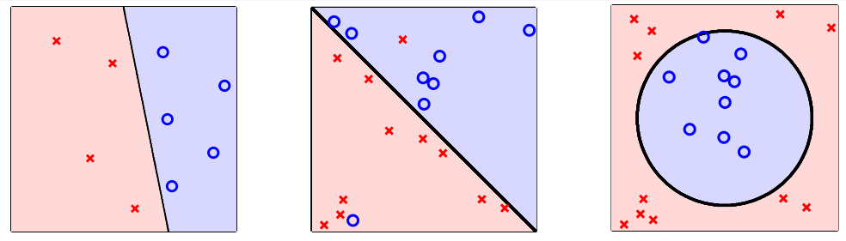

Binary Classification
$y=\left\{−1,1\right\}$ or $\left\{0,1\right\}$
Finding decision boundaries
Other Binary Classification Problems
Credit approve/disapprove
Email spam/non-spam
Patient sick/not sick
Ad profitable/not profitable

Slide 43



Multiclass Classification
$\left|𝒴\right|>2$.

Slide 44

Multiclass vs Multi-label Classification
What color is the cat in this photo?
Cailco
(三色)
Orange Tabby
(虎斑)
Tuxedo
(燕尾服)

Slide 45

Multiclass vs Multi-label Classification
Multiclass classification refers to the setting when there are > 2 possible class labels (e.g., calico, orange tabby, tuxedo).

Slide 46
Multiclass vs Multi-label Classification
What color and sex is the cat in this photo?
Cailco
Female
Orange Tabby
Male
Tuxedo
Male

Slide 47

Multiclass vs Multi-label Classification
Multi-label classification refers to the setting when there > 1 label you want to predict.

Slide 48
Multiclass vs Multi-label Classification
Multiclass classification
It’s possible to create multiclass classifiers out of binary classifiers.
One vs Rest (One vs All)
Each classifier predicts whether the instance belongs to the target class.
All pairs
Trains a binary classifier for every pair of classes. Whichever class “wins” more pairwise classifications will be the final prediction.

Slide 49
Multiclass vs Multi-label Classification
Multiclass classification
It’s possible to create multiclass classifiers out of binary classifiers.
One vs Rest (One vs All)
Each classifier predicts whether the instance belongs to the target class.
All pairs
Trains a binary classifier for every pair of classes. Whichever class “wins” more pairwise classifications will be the final prediction.
Multi-label classification
Train separate classifier for each label.
But there might be correlations between the classes.
Calico cats are almost always female.
Orange cats are more often male.

Slide 50


Regression: Patient Recovery Prediction Problem
Regression: fitting a curve/plane to data

Slide 51

Regression: Patient Recovery Prediction Problem
Images (Instagram) $⇒$ Popularity prediction
E-commerce product $⇒$ Sale prediction

Slide 52

Mini Summary
Learning with different output space $𝒴$
Binary classification: $𝒴=\left\{−1,+1\right\}$
Multiclass classification:$𝒴=\left\{1,2,…,K\right\}$
Regression: $𝒴=ℝ$

Slide 53

Exercise
multilabel classification

Slide 54

Categories of Machine Learning
Learning with different output space $𝓨$
Learning with different data label $y_{n}$
Learning with different protocol $f(x_{n}$, $y_{n})$
Learning with different input space $𝓧$

Slide 55

Supervised Learning
Every $x_{n}$ comes with corresponding $y_{n}$.
$𝓓=\left\{(x_{1},y_{1}),(x_{2},y_{2}),…,(x_{m},y_{m})\right\}$

Slide 56

Supervised Learning
Characteristics of the Supervised Learning
We are primarily interested in prediction.
The possible values of what we want to predict are specified, and we have some training cases for which its value is known.
$𝓓=\left\{(x_{1},y_{1}),(x_{2},y_{2}),…,(x_{m},y_{m})\right\}$

Slide 57

Supervised Learning

Slide 58


Supervised Learning vs Unsupervised Learning
Every $x_{n}$ comes with corresponding $y_{n}$.
$𝓓=\left\{(x_{1},y_{1}),(x_{2},y_{2}),…,(x_{m},y_{m})\right\}$
Assume that we do not have the $y_{n}$ for every $x_{n}. 𝓓=\left\{x_{1},x_{2},…,x_{m}\right\}$
Bad
Good
Supervised classification
Unsupervised clustering
(Ground Truth) Labels: Good; Bad.
(Learned) Latent concepts: Art; Sports.

Slide 59

Unsupervised Learning
For an unsupervised learning problem, we do not focus on prediction of any particular thing, but rather try to find interesting aspects of the data $𝓓=\left\{x_{1},x_{2},…,x_{m}\right\}$.
Examples
We may find clusters of patients with similar symptoms (diseases).
We may find clusters of images with the similar visual characteristics.
We may find clusters of people with the similar interests.
We may find clusters of articles with the similar topics.

Slide 60

Unsupervised Learning

Slide 61
Semi-supervised Learning (with some $y_{n}$)
$𝓓=\left\{{\left(x_{1},y_{1}\right),\left(x_{2},y_{2}\right),…,\left(x_{k},y_{k}\right), x}_{k+1},x_{k+2},…,x_{m}\right\}$.
Bad
Good
Supervised
Semi-supervised
Unsupervised

Slide 62

Semi-supervised Learning (with some $y_{n}$)
$𝓓=\left\{{\left(x_{1},y_{1}\right),\left(x_{2},y_{2}\right),…,\left(x_{k},y_{k}\right), x}_{k+1},x_{k+2},…,x_{m}\right\}$.
Semi-supervised learning: leverage unlabeled data to avoid “expensive” labeling.
Examples

Slide 63
Mini Summary
Supervised learning:
using X_train and Y_train, learn a general classifier to label any point.
Semi-supervised learning:
using X_train and Y_train, and X_unlabeled learn a general classifier to label any point.

Slide 64
Reinforcement Learning
Thus far: Learning from examples
Missing: actions (Learn from implicit data, often sequentially)
Teach Your Dog How to Sit: We say ‘Sit Down’

Slide 65

Reinforcement Learning
Thus far: Learning from examples
Missing: actions (Learn from implicit data, often sequentially)
Teach Your Dog How to Sit: We say ‘Sit Down’
Action1: The dog pees on the ground.
We cannot easily show the dog that $y_{n}=$sit when $x_{n}=$‘sit down’, but we can punish this action.

Slide 66

Reinforcement Learning
Thus far: Learning from examples
Missing: actions (Learn from implicit data, often sequentially)
Teach Your Dog How to Sit: We say ‘Sit Down’
Action1: The dog pees on the ground.
We cannot easily show the dog that $y_{n}=$sit when $x_{n}=$‘sit down’, but we can punish this action.
Action2: The dog sits down.
Cannot easily show the dog that $y_{n}=$sit when $x_{n}=$‘sit down’, but we can reward this action.

Slide 67


Reinforcement Learning
Scenario 1
(Punish)
Scenario 2
(Reward)

Slide 68
What Makes Reinforcement Learning Different?
There is no supervisor, only a reward signal.
Time really matters (sequential).
Agent’s actions affect the subsequent data it receives.
Reinforcement learning is based on the reward hypothesis.
All goals can be described by the maximization of expected cumulative reward.
Agent goal: maximize cumulative reward.
Select actions to maximize the expected cumulative reward.

Slide 69
Reinforcement Learning
Fly stunt manoeuvre in a helicopter (直升机特技飞行)
+ reward for following desired trajectory
- reward for crashing
Make a humanoid robot walk
+ reward for forward motion
- reward for falling over
Recycling robot
+ reward for finding cans
- reward for running out of battery
Ad system
+ user click
- no click

Slide 70

Reinforcement Learning
Go Playing

Slide 71

Reinforcement Learning
Chat-bot

Slide 72

Reinforcement Learning

Slide 73

Exercise

Slide 74

Categories of Machine Learning
Learning with different output space $𝓨$
Learning with different data label $y_{n}$
Learning with different protocol $f(x_{n}$, $y_{n})$
Learning with different input space $𝓧$

Slide 75

Batch Learning
Batch (offline) learning: learn from all known data (a very common protocol).
Examples
Batch of (email, spam yes/no) $⇒$ spam filter
Batch of (patient info, cancer yes/no) $⇒$ cancer prediction
Batch of (video, location label) $⇒$ video location prediction
Batch of customer data $⇒$ group of customers (interest)
Batch of documents $⇒$ group of documents (topic)

Slide 76

Batch Learning
Batch (offline) learning: learn from all known data (a very common protocol).
We typically assume that:
The learning algorithm $𝒜$ is deterministic,
$𝒜$ does not depend on the ordering of the points in the training set.

Slide 77

Online Learning
Online learning: learn from the sequential data.
Examples
Online Spam filter ($𝒜$ is the learning algorithm)
Observe an email $x_{t};$
Predict spam label with current $g_{t}=𝒜(x_{t})$
Receive ‘ground truth’ $y_{t}$ from the user, and then update $g_{t}$ with $(x_{t},y_{t})$, i.e., $g_{t+1}=𝒜(g_{t},(x_{t},y_{t}))$

Slide 78
Online Learning
Online learning: learn from the sequential data.
Other Examples
A recommendation system (e.g., IMDB) that is constantly learning from the ratings given by users and making appropriate recommendations to users.
The Facebook production ranking systems used in ads ranking and newsfeed ranking use a combination of online learning and offline learning to provide the best results.
Notes:
This system should not stop learning, or it will become obsolete as soon as a considerable number of newer movies and newer reviews come around.

Slide 79

Active Learning
Active learning is well-motivated in modern machine learning problems where data may be abundant but labels are scarce or expensive to obtain.
Speech Recognition.
(Phonemes Annotation).
Notes:
Speech recognition. Accurate labeling of speech utterances is extremely time consuming and requires trained linguists. Zhu (2005a) reports that annotation at the word level can take ten times longer than the actual audio (e.g., one minute of speech takes ten minutes to label), and annotating phonemes can take 400 times as long (e.g., nearly seven hours). The problem is compounded for rare languages or dialects.

Slide 80

Active Learning
Active learning is well-motivated in modern machine learning problems where data may be abundant but labels are scarce or expensive to obtain.
Active learning (sequentially) queries the $y_{n}$ of the strategically chosen $x_{n}$, which is to be labeled by an oracle (e.g., a human annotator).
Key hypothesis: if the learning algorithm is allowed to choose the data from which it learns, it will perform better with less training.
Notes:
A learner may begin with a small number of instances in the labeled training set L, request labels for one or more carefully selected instances, learn from the query results, and then leverage its new knowledge to choose which instances to query next. Once a query has been made, there are usually no additional assumptions on the part of the learning algorithm. The new labeled instance is simply added to the labeled set L, and the learner proceeds from there in a standard supervised way.

Slide 81

Active Learning
An illustrative example of pool-based active learning. (a) A toy data set of 400 instances. (b) A logistic regression model trained with 30 labeled instances using random sampling. (c) A logistic regression model trained with 30 actively queried instances using uncertainty sampling.
Uncertainty sampling: label those points for which the current model is least certain as to what the correct output should be.

Slide 82

Active Learning
The pool-based active learning cycle .
Notes:
A learner may begin with a small number of instances in the labeled training set L, request labels for one or more carefully selected instances, learn from the query results, and then leverage its new knowledge to choose which instances to query next. Once a query has been made, there are usually no additional assumptions on the part of the learning algorithm. The new labeled instance is simply added to the labeled set L, and the learner proceeds from there in a standard supervised way.

Slide 83

Categories of Machine Learning
Learning with different output space $𝓨$
Learning with different data label $y_{n}$
Learning with different protocol $f(x_{n}$, $y_{n})$
Learning with different input space $𝓧$

Slide 84
Concrete Features
(size, mass) for coin classification
(MFCC, Zero Crossing Rate, etc.) for speech recognition
Customer info (gender, occupation, etc.) for credit approval
Patient info (height, weight, etc. ) for cancer diagnosis

Slide 85
Concrete Features
(size, mass) for coin classification
(MFCC, Zero Crossing Rate, etc.) for speech recognition
Customer info (gender, occupation, etc.) for credit approval
Patient info (height, weight, etc. ) for cancer diagnosis
Often including “human intelligence” on the learning task

Slide 86
Concrete Features
(size, mass) for coin classification
(MFCC, Zero Crossing Rate, etc.) for speech recognition
Customer info (gender, occupation, etc.) for credit approval
Patient info (height, weight, etc. ) for cancer diagnosis
Often including “human intelligence” on the learning task
Concrete features: the “easy” ones for ML.

Slide 87


Raw Features
Digit recognition problem: features $⇒$ {0,1,2,…,9}.

Slide 88

Raw Features
Digit recognition problem: features $⇒$ {0,1,2,…,9}.
(Supervised multiclass classification problem).

Slide 89


Raw Features
Raw features (image pixels, speech signal, etc.): often need human or machines (e.g., neural networks) to convert to concrete ones.

Slide 90

Abstract Features

Slide 91
Abstract Features
Abstract Features also need ‘feature conversion/construction’ by human or machines.

Slide 92

Types of Machine Learning
Learning with different output space $𝓨$
[classification], [regression]
Learning with different data label $y_{n}$
[supervised], un/semi-supervised, reinforcement
Learning with different protocol $f(x_{n}$, $y_{n})$
[batch], online, active
Learning with different input space $𝓧$
[concrete, raw], abstract

Slide 93
Remarks
Example:
Logistic regression
Example: MLPs
Deep learning
Example:
Knowledge bases
Example: Shallow aotoencoder
Representation learning
Machine learning
AI

