Slide 1
Machine Learning & Pattern Recognition
Xin Xin(辛鑫)
xinxin@sdu.edu.cn
https://xinxin-me.github.io/

Slide 2
Linear Regression

Slide 3
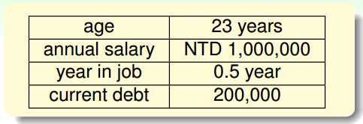

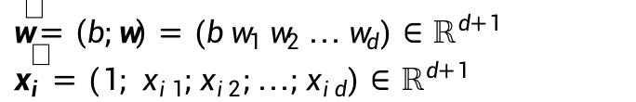
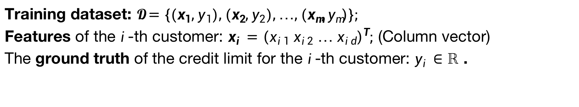
Linear Regression
Training dataset: $𝓓=\left\{\left(x_{1},y_{1}\right),\left(x_{2},y_{2}\right),…,\left(x_{m},y_{m}\right)\right\};$
Features of the $i$-th customer: $x_{i}={\left(x_{i1} x_{i2} … x_{id}\right)}^{T};$ (Column vector)
The ground truth of the credit limit for the $i$-th customer: $y_{i}∈ℝ$ .
Linear regression: $h\left(x_{i}\right)=w^{T}x_{i}+b=\sum_{j=1}^{d}{w_{j}x_{ij}+b}$, where $w={\left(w_{1} w_{2} … w_{d}\right)}^{T}∈ℝ^{d}$
For simplicity, the bias $b$ can be merged into the weight $w$:
$$h\left(x_{i}\right)={\hat{w}}^{T}\hat{x_{i}}$$
$\hat{w}=\left(b;w\right)=(b w_{1} w_{2} … w_{d})∈ℝ^{d+1}$
$\hat{x_{i}}=\left(1; x_{i1};x_{i2};…;x_{id}\right)∈ℝ^{d+1}$

Slide 4
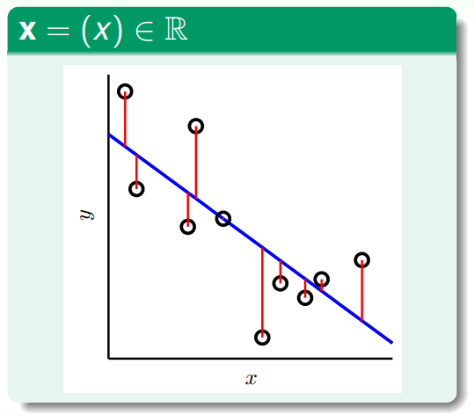
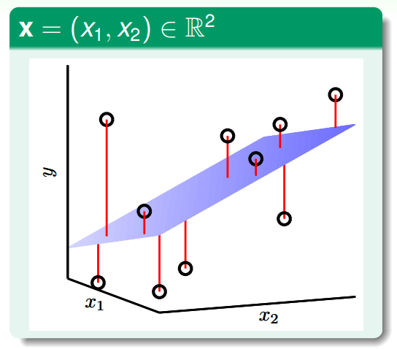
Linear Regression
To-be-learned parameter
Linear regression hypothesis: $h\left(x_{i}\right)=w^{T}x_{i}=\sum_{j=0}^{d}{w_{j}x_{ij}}, x_{i0}=1$
Linear regression: find lines/hyperplanes with small residuals.
Popular/historical squared error measure:
$$L\left(h\left(x\right),y\right)={(\hat{y}−y)}^{2}$$

Slide 5

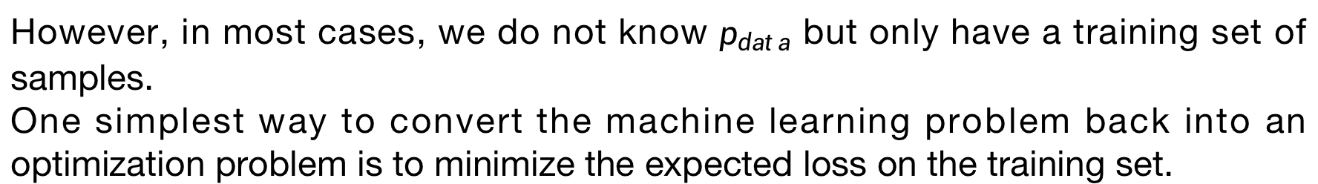

Empirical Error
We prefer to minimize the objective function where the expectation is taken across the data generating distribution $p_{data}$rather than just over the finite training set:
$$J^{∗}\left(θ\right)=𝔼_{\left(x,y\right)\sim p_{data}}L(h\left(x,θ\right),y)$$
However, in most cases, we do not know $p_{data}$ but only have a training set of samples.
One simplest way to convert the machine learning problem back into an optimization problem is to minimize the expected loss on the training set.
$$J\left(θ\right)=𝔼_{\left(x,y\right)\sim {\hat{P}}_{data}}L(h\left(x,θ\right),y)$$
Replacing the true distribution $p_{data}(x,y)$ with the empirical distribution ${\hat{P}}_{data}(x,y)$ defined by the training set.

Slide 6


Linear Regression
Popular/historical error measure:
squared error $L\left(h\left(x\right),y\right)={(\hat{y}−y)}^{2}$
$$E\left(w\right)=\sum_{i=1}^{m}{{\left(h\left(x_{i}\right)−y_{i}\right)}^{2}}$$
$$w^{T}x_{i}$$
Next: How to minimize $E\left(w\right)$?

Slide 7
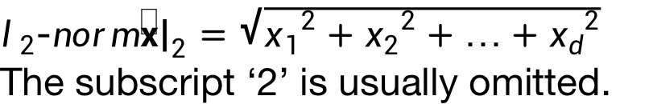


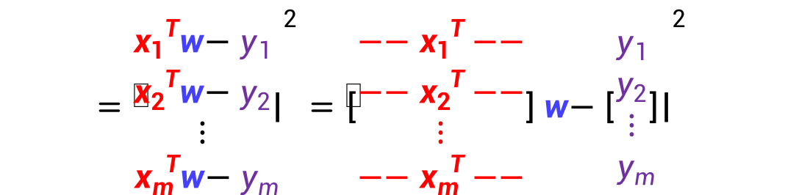
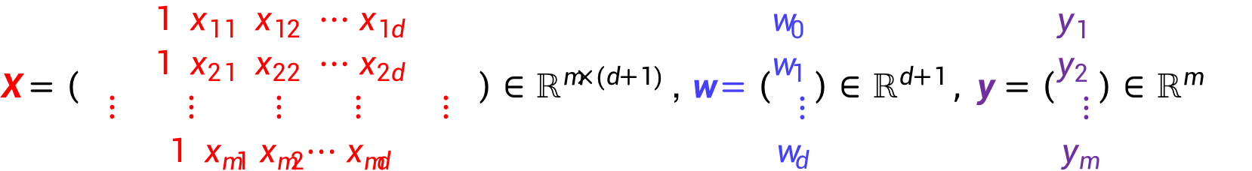
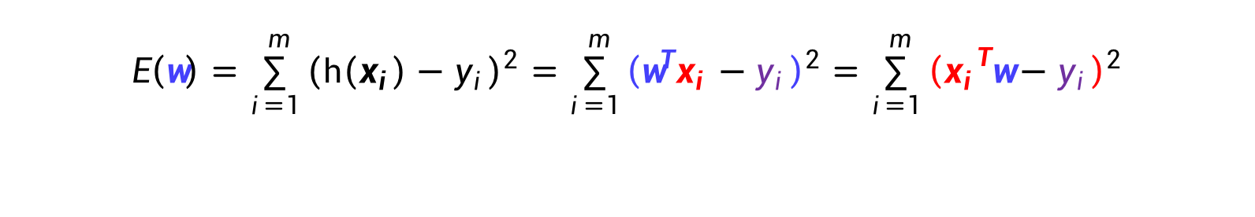
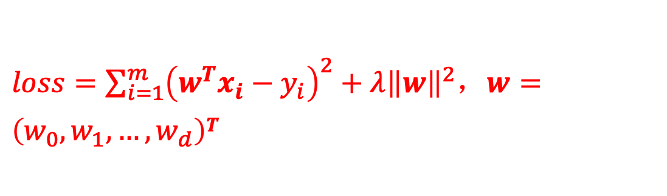
$loss=\sum_{i=1}^{m}{{\left(w^{T}x_{i}−y_{i}\right)}^{2}}+λ{\left\|w\right\|}^{2}，w=\left(w_{0},w_{1},…,w_{d}\right)T$
Matrix Form of $E\left(w\right)$
$$E\left(w\right)=\sum_{i=1}^{m}{{\left(h\left(x_{i}\right)−y_{i}\right)}^{2}}=\sum_{i=1}^{m}{{\left(w^{T}x_{i}−y_{i}\right)}^{2}}=\sum_{i=1}^{m}{{\left({x_{i}}^{T}w−y_{i}\right)}^{2}}$$
$$={\left\|\begin{aligned}{x_{1}}^{T}w−y_{1} \\ {x_{2}}^{T}w−y_{2} \\ ⋮ \\ {x_{m}}^{T}w−y_{m}\end{aligned}\right\|}^{2}={\left\|\left[\begin{aligned}{{−−x}_{1}}^{T}−− \\ {{−−x}_{2}}^{T}−− \\ ⋮ \\ {{−−x}_{m}}^{T}−−\end{aligned}\right]w−\left[\begin{aligned}y_{1} \\ y_{2} \\ ⋮ \\ y_{m}\end{aligned}\right]\right\|}^{2}$$
$l_{2}$-$norm$ ${\left\|x\right\|}_{2}=\sqrt{{x_{1}}^{2}+{x_{2}}^{2}+…+{x_{d}}^{2}}$
The subscript ‘2’ is usually omitted.
$=$ ${\left\|Xw−y\right\|}^{2}$
$X=\left(\begin{aligned}1 x_{11} { x}_{12}{ ⋯ x}_{1d} \\ 1 x_{21} { x}_{22}{ ⋯ x}_{2d} \\ ⋮ ⋮ ⋮ ⋮ ⋮ \\ 1 x_{m1}{ x}_{m2}{⋯ x}_{md}\end{aligned}\right)$ $∈ℝ^{m×(d+1) }$, $w=\left(\begin{aligned}w_{0} \\ w_{1} \\ ⋮ \\ w_{d}\end{aligned}\right)∈ℝ^{d+1 }, y=\left(\begin{aligned}y_{1} \\ y_{2} \\ ⋮ \\ y_{m}\end{aligned}\right)$ $∈ℝ^{m }$

Slide 8
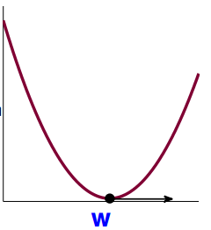


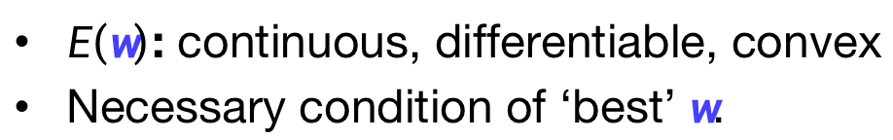


A continuous, twice differentiable function of several variables is convex on a convex set if and only if its Hessian matrix is positive semidefinite on the interior of the convex set.
Matrix Form of $E\left(w\right)$
$$\min{E\left(w\right)}=\min{{\left\|Xw−y\right\|}^{2}}$$
$E\left(w\right)$: continuous, differentiable, convex
Necessary condition of ‘best’ $w$.
$$∇E\left(w\right)=\left[\begin{aligned}\frac{∂E}{∂w_{0}}(w) \\ \frac{∂E}{∂w_{1}}(w) \\ ⋮ \\ \frac{∂E}{∂w_{d}}(w)\end{aligned}\right]=\left[\begin{aligned}0 \\ 0 \\ ⋮ \\ 0\end{aligned}\right]$$
$$E\left(w\right)$$
Not possible to ‘roll down’
Task: find the $w^{∗}$ such that $∇E\left(w^{∗}\right)=0$

Slide 9













The Gradient $∇E\left(w\right)$
$$\min_{w}{E\left(w\right)={\left\|Xw−y\right\|}^{2}}$$
$$={\text{(}Xw−y\text{)}}^{T} \text{(}Xw−y\text{)}{ }$$
$$=w^{T}X^{T}Xw−2w^{T}X^{T}y+y^{T}y$$
$$A$$
$$b$$
$$c$$
One $w$ only
Vector $w$
$$E\left(w\right)=(aw^{2}−2bw+c)$$
$$E\left(w\right)=(w^{T}Aw−2w^{T}b+c)$$
$$∇E\left(w\right)=2aw−2b$$
$$∇E\left(w\right)=?$$

Slide 10
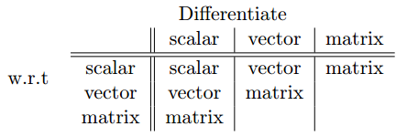
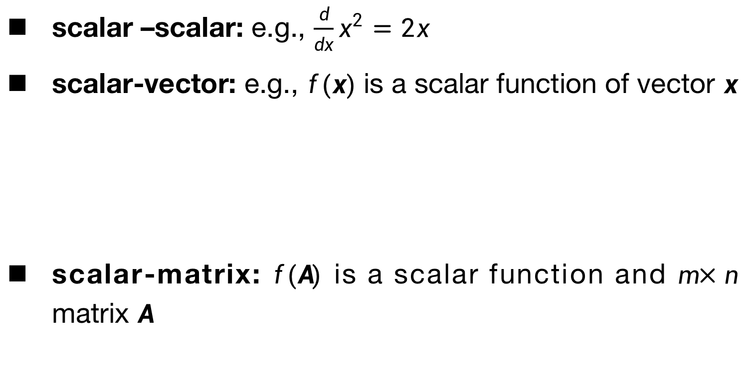
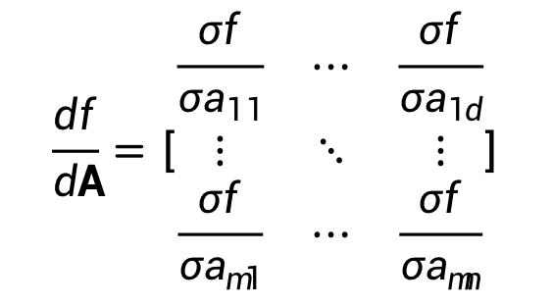


Derivatives
scalar –scalar: e.g., $\frac{d}{dx}x^{2}=2x$
scalar-vector: e.g., $f(x)$is a scalar function of vector $x$
scalar-matrix: $f(A)$ is a scalar function and $m×n$ matrix $A$
$$\frac{df}{dx}=\left[\begin{aligned}\frac{σf}{σx_{1}} \\ ⋮ \\ \frac{σf}{σx_{d}}\end{aligned}\right]$$
$$x=\left[\begin{aligned}x_{1} \\ x_{2} \\ ⋮ \\ x_{d}\end{aligned}\right]$$
$$\frac{df}{dA}=\left[\begin{matrix}\frac{σf}{σa_{11}} & ⋯ & \frac{σf}{σa_{1d}} \\ ⋮ & ⋱ & ⋮ \\ \frac{σf}{σa_{m1}} & ⋯ & \frac{σf}{σa_{mn}}\end{matrix}\right]$$
https://en.wikipedia.org/wiki/Matrix_calculus

Slide 11
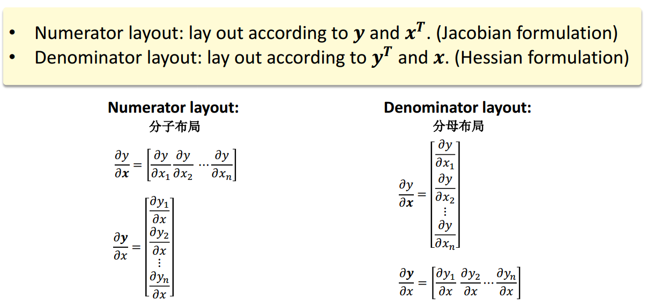
Matrix Calculus

Slide 12

Commonly Used Derivatives
$\frac{d}{dx}(Ax) =A^{T}$
$\frac{dx}{dx} =I$
$\frac{dy^{T}x}{dx} =\frac{dx^{T}y}{dx}=y$
$\frac{d}{dx}{(x}^{T}Ax)=\left\{\begin{aligned}\left(A+A^{T}\right)x \\ 2Ax\end{aligned}\right.$
If A square
If A symmetric
https://en.wikipedia.org/wiki/Matrix_calculus

Slide 13

The Gradient $∇E\left(w\right)$
$$\min_{w}{E\left(w\right)={\left\|Xw−y\right\|}^{2}={\text{(}Xw−y\text{)}}^{T} \text{(}Xw−y\text{)} =w^{T}X^{T}Xw−2w^{T}X^{T}y+} y^{T}y$$
$$A$$
$$b$$
$$c$$
One $w$ only
Vector $w$
$$E\left(w\right)=(aw^{2}−2bw+c)$$
$$E\left(w\right)=(w^{T}Aw−2w^{T}b+c)$$
$$∇E\left(w\right)=2aw−2b$$
$$∇E\left(w\right)=2Aw−2b$$
$$∇E\left(w\right)=2\left(X^{T}Xw−X^{T}y\right)$$

Slide 14







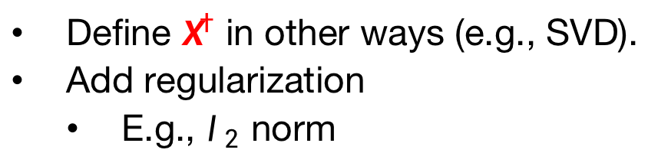


Optimal Linear Regression Weights
Task: find $w^{∗}$ such that $∇E\left(w^{∗}\right)=2\left(X^{T}Xw−X^{T}y\right)=0$
Invertible/positive definite $X^{T}X$
Singular $X^{T}X$
Unique solution
Define $X^{†}$ in other ways (e.g., SVD).
Add regularization
E.g., $l_{2}$ norm
$$w^{∗}={(X^{T}X)}^{−1}X^{T}y$$
$$λ>0$$
$$\min{E\left(w\right)}=\min{{\left\|Xw−y\right\|}^{2}+λ{\left\|w\right\|}^{2}}$$
pseudo-inverse $X^{†}$
Note: $X^{†}X=I$
, but $XX^{†}≠I$
$$∇E\left(w^{∗}\right)=2\left(X^{T}Xw+λw−X^{T}y\right)=0$$
If $X$ is square and invertible, $X^{†}=X^{−1}.$
$$\left(X^{T}X+λI\right)w=X^{T}y$$
Invertible?

Slide 15



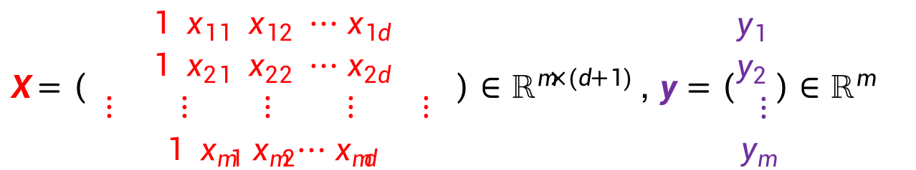
Linear Regression Algorithm
1. From $𝓓$, construct input matrix $X$ and output vector $y$ by
$X=\left(\begin{aligned}1 x_{11} { x}_{12}{ ⋯ x}_{1d} \\ 1 x_{21} { x}_{22}{ ⋯ x}_{2d} \\ ⋮ ⋮ ⋮ ⋮ ⋮ \\ 1 x_{m1}{ x}_{m2}{⋯ x}_{md}\end{aligned}\right)$ $∈ℝ^{m×(d+1) }$, $y=\left(\begin{aligned}y_{1} \\ y_{2} \\ ⋮ \\ y_{m}\end{aligned}\right)∈ℝ^{m }$
2. Calculate pseudo-inverse
$$X^{†}∈ℝ^{(d+1)×m }$$
3. Return
$$w^{∗}=X^{†}y{∈ℝ}^{(d+1) }$$
Simple and efficient（？） with good $X^{†}$

Slide 16
Logistic Regression

Slide 17
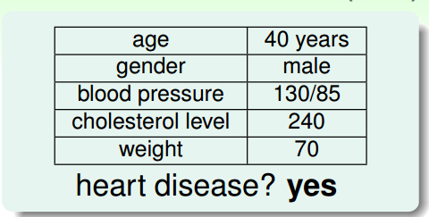
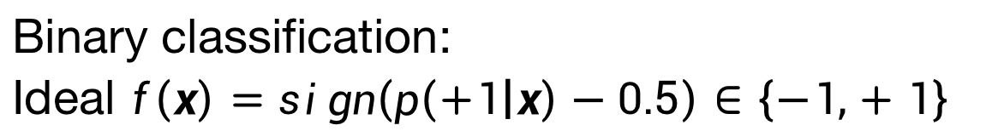
Heart Attack Prediction Problem
Binary classification:
Ideal $f\left(x\right)=sign\left(p\left(+1 | x\right)−0.5\right)∈\left\{−1,+1\right\}$

Slide 18
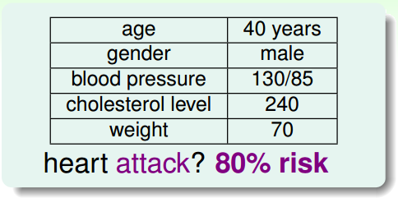

Heart Attack Prediction Problem
’Soft’ Binary classification:
$f\left(x\right)=$ $p\left(+1 | x\right)∈[0,1]$

Slide 19
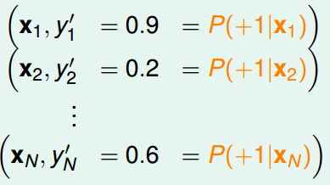
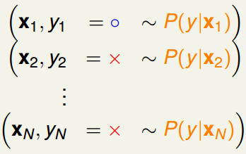
Soft Binary classification:
Target function $f\left(x\right)=$ $p\left(+1 | x\right)∈[0,1]$
Ideal data
Actual data
Same data as hard binary classification, different target function

Slide 20
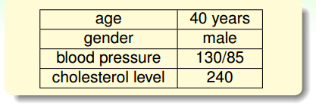
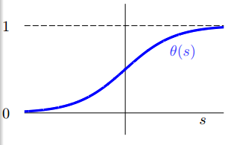



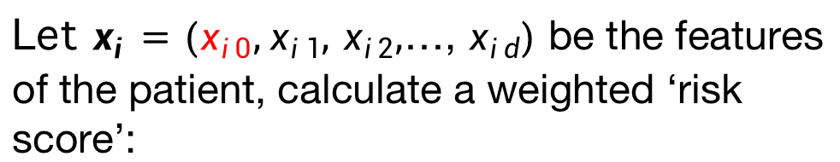
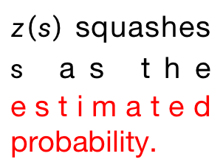
Logistic Hypothesis
Let $x_{i}=(x_{i0},x_{i1},$ $x_{i2},$…, $x_{id})$ be the features of the patient, calculate a weighted ‘risk score’:
$$s=\sum_{j=0}^{d}{w_{j}x_{ij}}=w^{T}x_{i},$$
$z\left(s\right)$ squashes $s$ as the estimated probability.
$z\left(s\right)$
Convert the score to estimated probability by logistic function $z\left(s\right)$.
Logistic hypothesis: $h(x_{i}) =z(w^{T}x_{i})$

Slide 21
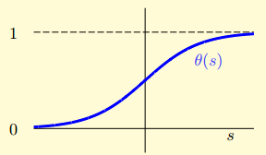




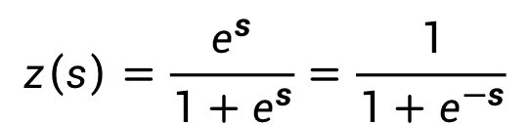




Logistic Function
$$z\left(s\right)=\frac{e^{s}}{1+e^{s}}=\frac{1}{1+e^{−s}}$$
$z\left(s\right)$
smooth, monotonic, sigmoid function of $s$
Bound
$z\left(s\right)∈[0,1]$
$z \left(−∞\right)=0$
$$z\left(0\right)=0.5$$
$z\left(∞\right)=$1
Symmetric
$$1 −z(s) =z(−s)$$
Gradient
$$z^{′}(s) =z(s)(1 −z(s))$$
Logistic regression use $h(x) =z(w^{T}x)$ to approximate the target $f\left(x\right)=$ $p\left(+1 | x\right)$

Slide 22
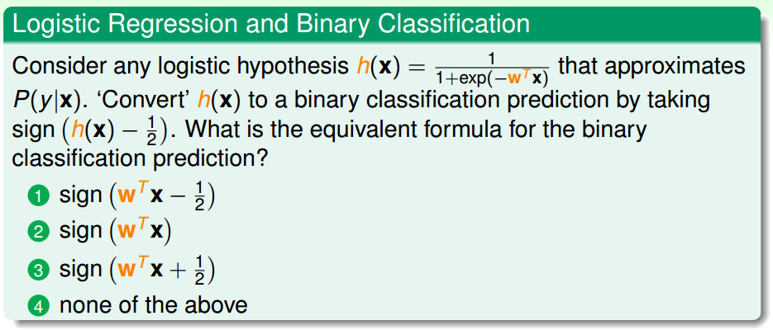
Exercise

Slide 23
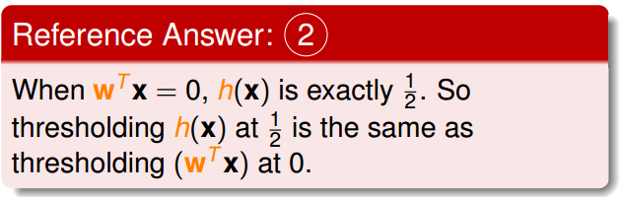
Exercise

Slide 24
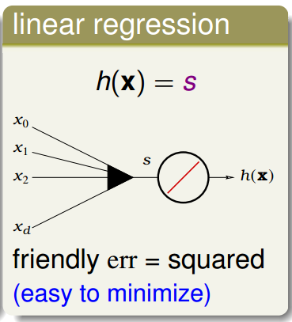
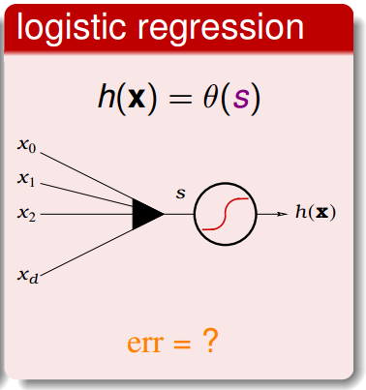

Linear Models
$z\left(s\right)$
How to define the cost (error) function for logistic regression?

Slide 25
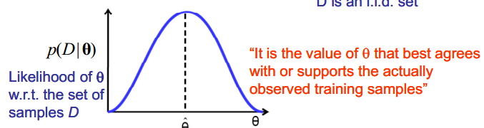

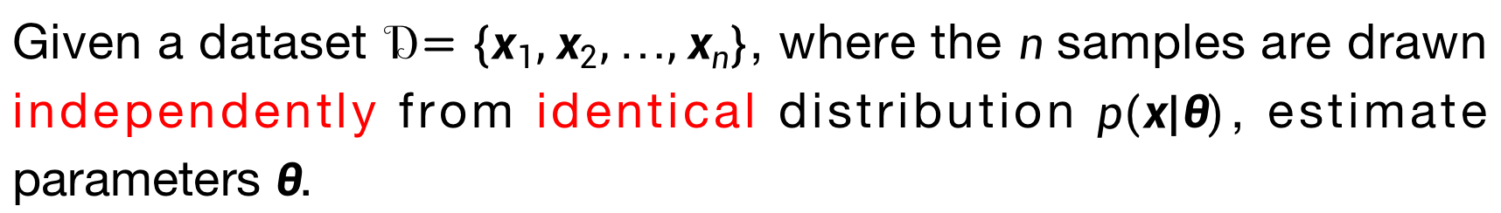

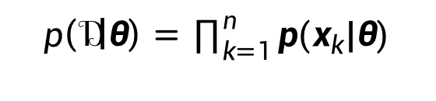

Maximum-Likelihood Estimation
Given a dataset $𝒟=\{x_{1},x_{2},…,x_{n}\}$, where the $n$ samples are drawn independently from identical distribution $p(x|θ)$, estimate parameters $θ$.
ML estimate parameters $θ$ maximizes $p(𝒟|θ)$
$𝒟$ is an i.i.d set
$$\hat{θ}=arg \max_{θ}{p(𝒟|θ)}$$
$$p\left(𝒟 | θ\right)=\prod_{k=1}^{n}{p(x_{k}|θ)}$$
$$\hat{θ}$$

Slide 26





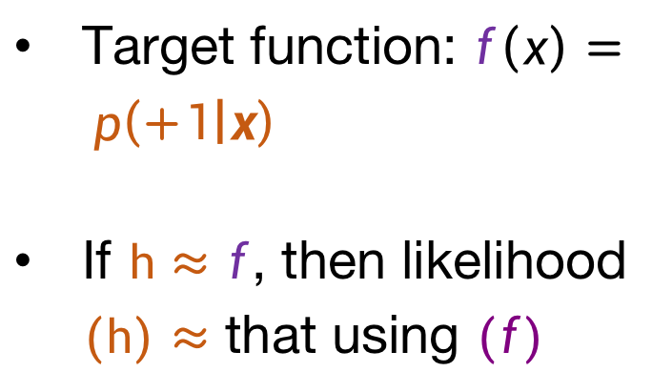

Logistic Regression--$y∈\{0,1\}$
Consider $𝒟=\{\left(x_{1},+\right),\left(x_{2},−\right),…,(x_{m},−)\}$
Likelihood that $h$ generates $𝒟$
$$p\left(x_{1}\right)h\left(x_{1}\right)$$
Target function: $f\left(x\right)= p\left(+1 | x\right)$
If $h≈f$, then likelihood $(h)≈$ that using $(f)$
$$p\left(x_{2}\right)(1−h\left(x_{2}\right))$$
$$…$$
$$p\left(x_{m}\right)(1−h\left(x_{m}\right))$$

Slide 27
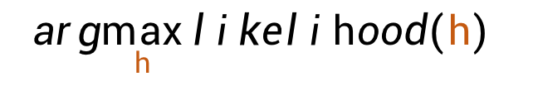
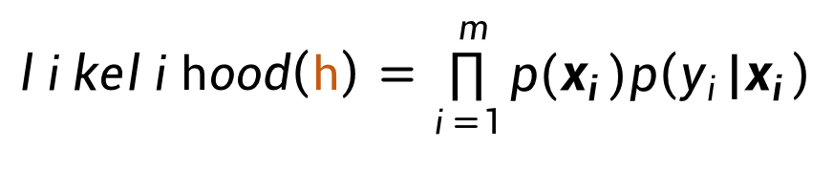
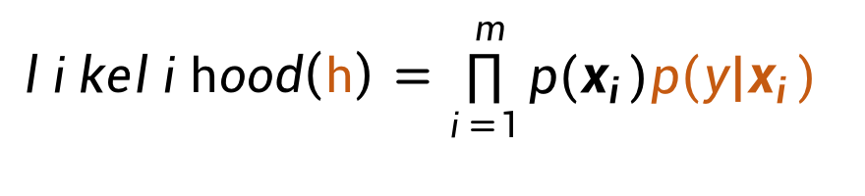
Likelihood of Logistic Regression
$$likelihood\left(h\right)=\prod_{i=1}^{m}{p(x_{i})p(y|x_{i})}$$
Goal:
$$arg\max_{h}{likelihood(h) }$$
Consider $𝒟=\{\left(x_{1},+\right),\left(x_{2},−\right),…,(x_{m},−)\}$
$$likelihood\left(h\right)=\prod_{i=1}^{m}{p(x_{i})p\left(y_{i}|x_{i}\right)}$$
$=p\left(x_{1}\right)h\left(x_{1}\right)p\left(x_{2}\right)(1−h\left(x_{2}\right))⋯$ $p\left(x_{m}\right)(1−h\left(x_{m}\right))$

Slide 28
Likelihood of Logistic Regression
$$likelihood\left(h\right)=\prod_{i=1}^{m}{p(x_{i})p(y|x_{i})}$$
Goal:
$$arg\max_{h}{likelihood(h) }$$
Consider $𝒟=\{\left(x_{1},+\right),\left(x_{2},−\right),…,(x_{m},−)\}$
$$likelihood\left(h\right)=\prod_{i=1}^{m}{p(x_{i})p\left(y_{i}|x_{i}\right)}$$
$=p\left(x_{1}\right)h\left(x_{1}\right)p\left(x_{2}\right)(1−h\left(x_{2}\right))⋯$ $p\left(x_{m}\right)(1−h\left(x_{m}\right))$
We remove all the $p\left(x_{i}\right)$ which remains the same for all the hypothesis $h .$

Slide 29

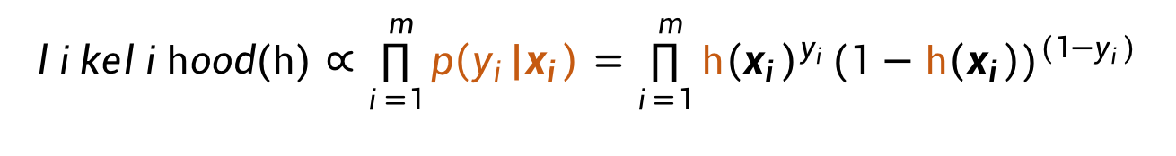


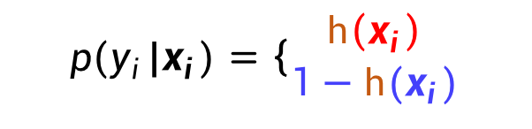
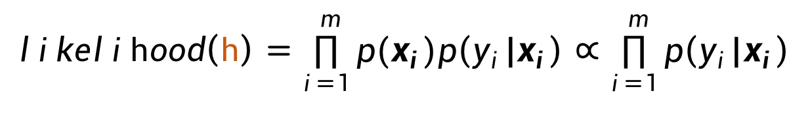
Likelihood of Logistic Regression
$$likelihood\left(h\right)=\prod_{i=1}^{m}{p(x_{i})p\left(y_{i}|x_{i}\right)}∝\prod_{i=1}^{m}{p\left(y_{i}|x_{i}\right)}$$
$$p(y_{i}|x_{i})=\left\{\begin{aligned}h\left(x_{i}\right) \\ 1−h(x_{i})\end{aligned}\right.$$
for $y_{i}=1$
$$⟺$$
$$p\left(y_{i} | x_{i}\right)={h\left(x_{i}\right)}^{y_{i}}{(1−h\left(x_{i}\right))}^{(1−y_{i})}$$
for$y_{i}=0$
Bernoulli distribution
$$likelihood(h)∝\prod_{i=1}^{m}{p\left(y_{i} | x_{i}\right)}=\prod_{i=1}^{m}{{h\left(x_{i}\right)}^{y_{i}}{(1−h\left(x_{i}\right))}^{(1−y_{i})}}$$

Slide 30
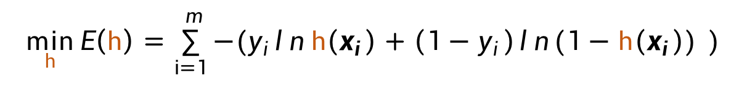




Log-Likelihood of Logistic Regression
$$\min_{h}{E\left(h\right)=\sum_{i=1}^{m}{−(y_{i}ln h\left(x_{i}\right)+\left(1−y_{i}\right)\ln{(1−h\left(x_{i}\right)) })}}$$
Negative Log-likelihood
Cross-entropy loss
$$H\left(p,q\right)=−\sum_{x}{p\left(x\right)log⁡(q(x))}$$
$p∈\left\{y,1−y\right\}$
$q∈\{h\left(x\right),1−h\left(x\right)\}$
Cross-entropy
$$\min_{w}{\sum_{i=1}^{m}{\left[−y_{i}ln\left(\frac{1}{1+e^{−w^{T}x_{i}}}\right)−\left(1−y_{i}\right)ln\left(\frac{1}{1+e^{w^{T}x_{i}}}\right)\right]}}$$
Negative Log-likelihood
$$\min_{w}{\sum_{i=1}^{m}{\left[{−y}_{i}w^{T}x_{i}+ln(1+e^{w^{T}x_{i}})\right]}}$$

Slide 31




Minimize $E\left(w\right)$
$$\min_{w}{E\left(w\right)=\sum_{i=1}^{m}{\left[{−y}_{i}w^{T}x_{i}+ln(1+e^{w^{T}x_{i}})\right]}}$$
Cross-entropy loss
$E\left(w\right)$: continuous, differentiable, twice-differentiable, convex
We want to find the valley
$$E\left(w\right)$$
$$∇E\left(w\right)=0$$

Slide 32

$$\min_{w}{E\left(w\right)=\sum_{i=1}^{m}{\left[{−y}_{i}w^{T}x_{i}+ln(1+e^{w^{T}x_{i}})\right]}}$$
Matrix Calculus

Slide 33



Gradient $∇E\left(w\right)$
$$∇E\left(w\right)=\sum_{i=1}^{m}{\left[{−y}_{i}x_{i}+\frac{e^{w^{T}x_{i}}}{1+e^{w^{T}x_{i}}}x_{i}\right]=\sum_{i=1}^{m}{\left[z\left(w^{T}x_{i}\right){−y}_{i}\right]x_{i}}}=0$$
$∇E\left(w\right)$ is a non-linear equation of $w$
It is hard to derive the closed form solution. :-(

Slide 34
Gradient $∇E\left(w\right)$
$$∇E\left(w\right)=\sum_{i=1}^{m}{\left[{−y}_{i}x_{i}+\frac{e^{w^{T}x_{i}}}{1+e^{w^{T}x_{i}}}x_{i}\right]=\sum_{i=1}^{m}{\left[z\left(w^{T}x_{i}\right){−y}_{i}\right]x_{i}}}=0$$
Apply the iterative optimization to the logistic regression.

Slide 35
Iterative Optimization

Slide 36




Optimization Methods
Optimization: either minimize or maximize some function $f(x)$ by altering $x.$
In most cases, optimization refers to the minimization of $f\left(x\right).$
Maximization $f\left(x\right)$
Minimization $−f\left(x\right)$
$f\left(x\right):$ objective function, cost function, loss function, error function.
The value that minimize $f\left(x\right)$: $x^{∗}=\arg{\min{f\left(x\right)}}.$

Slide 37
Optimization Methods
Deterministic Optimization
The data for the given problem are known accurately.
Stochastic Optimization
Refers to a collection of methods for minimizing or maximizing an objective function when randomness is present.

Slide 38


Deterministic Optimization
First-order methods: methods that use only the gradient.
Second-order methods: methods that also use the Hessian matrix.
$${H(f)}_{i,j}=\frac{∂^{2}}{∂x_{i}∂x_{j}}f(x)$$
$x$: multiple input dimensions.

Slide 39


Taylor Approximation
Expansion at $x_{0}$
Examples
Notes:
In some cases, we may be able to avoid running this iterative algorithm, and just jump directly to the critical point by solving the equation ∇xf(x) = 0 for x.

Slide 40



Gradient Descent [Cauchy 1847]
Motivation: to minimize the local first-order Taylor approximation of $f$
$$\min_{x}{f(x)}≈\min_{x}{f\left(x_{t}\right)+∇f{\left(x_{t}\right)}^{T}(x−x_{t})}$$
Update rule:
$$x_{t+1}=x_{t}−η_{t}∇f\left(x_{t}\right)$$
Where $η_{t}>0$ is the step-size (learning rate).
Notes:
In some cases, we may be able to avoid running this iterative algorithm, and just jump directly to the critical point by solving the equation ∇xf(x) = 0 for x.

Slide 41



Interpretation
Reduce $f(x)$ by moving $x$ in small steps with opposite sign of the derivative.
Update rule:
$$x_{t+1}=x_{t}−η_{t}∇f\left(x_{t}\right)$$
Critical/stationary points: Points where $f^{′}\left(x\right)=0$
驻点
An illustration of gradient descent.

Slide 42



Interpretation
At each iteration, consider the expansion
$$f\left(x\right)≈f\left(x_{t}\right)+{∇f\left(x_{t}\right)}^{T} \left(x−x_{t}\right)+\frac{1}{2η_{t}}{\left\|x−x_{t}\right\|}^{2}$$
Linear approximation of $f$
Proximity term with weight $\frac{1}{2η_{t}}$
Quadratic approximation, replacing usual $∇^{2}f\left(x\right)$ by $\frac{1}{η_{t}}I$:
$$x_{t+1}=x_{t}−η_{t}∇f\left(x_{t}\right)$$
Notes:
In some cases, we may be able to avoid running this iterative algorithm, and just jump directly to the critical point by solving the equation ∇xf(x) = 0 for x.

Slide 43



$$f\left(x\right)≈f\left(x_{t}\right)+{∇f\left(x_{t}\right)}^{T} \left(x−x_{t}\right)+\frac{1}{2η_{t}}{\left\|x−x_{t}\right\|}^{2}$$
Interpretation
Blue point is $x_{t}$, red point is $x_{t+1}$.
Notes:
In some cases, we may be able to avoid running this iterative algorithm, and just jump directly to the critical point by solving the equation ∇xf(x) = 0 for x.

Slide 44


Global VS Local Minimum
Global minimum: a point that obtains the absolute lowest value of $f(x)$.
Local minimum: a point where $f(x)$ is lower than at all neighboring points.
Saddle points: some critical points are neither maxima or minima.
鞍点
Types of critical points
Minimum
Maximum
Saddle points

Slide 45


Global VS Local Minimum
Global minimum: a point that obtains the absolute lowest value of $f(x)$.
Local minimum: a point where $f(x)$ is higher than at all neighboring points.
Saddle points: some critical points are neither maxima or minima.
鞍点
Notes:
Optimization algorithms may fail to find a global minimum when there are multiple local minima or plateaus present. In the context of deep learning, we generally accept such solutions even though they are not truly minimal, so long as they correspond to significantly low values of the cost function.

Slide 46

Different Starting Points
Gradient Descent with different starting points are illustrated in different colors.
(a): Strictly convex function: Converge to the global optimum.
(b): Non-convex function: Different paths may end up at different local optima.
Notes:
Optimization algorithms may fail to find a global minimum when there are multiple local minima or plateaus present. In the context of deep learning, we generally accept such solutions even though they are not truly minimal, so long as they correspond to significantly low values of the cost function.

Slide 47

Gradient Descent [Cauchy 1847]
$$x_{t+1}=x_{t}−η_{t}∇f\left(x_{t}\right)$$
Gradient Descent requires a step size $η$ controlling the amount of gradient updated to the current point at each iteration.
It is naïve to set $η_{t}=η$ for all iterations.
How to choose step sizes?
Notes:
Optimization algorithms may fail to find a global minimum when there are multiple local minima or plateaus present. In the context of deep learning, we generally accept such solutions even though they are not truly minimal, so long as they correspond to significantly low values of the cost function.

Slide 48

Fixed Step Sizes
Considering $f\left(x\right)=(10x_{1}^{2}+x_{2}^{2})/2$
Notes:
Optimization algorithms may fail to find a global minimum when there are multiple local minima or plateaus present. In the context of deep learning, we generally accept such solutions even though they are not truly minimal, so long as they correspond to significantly low values of the cost function.

Slide 49


Fixed Step Sizes
Considering $f\left(x\right)=(10x_{1}^{2}+x_{2}^{2})/2$
If $η$ is too big, can lead to divergence.
The learning function oscillates away from the optimal point.
As shown, it oscillates after 8 steps.
Notes:
Optimization algorithms may fail to find a global minimum when there are multiple local minima or plateaus present. In the context of deep learning, we generally accept such solutions even though they are not truly minimal, so long as they correspond to significantly low values of the cost function.

Slide 50


Fixed Step Sizes
Considering $f\left(x\right)=(10x_{1}^{2}+x_{2}^{2})/2$
If $η$ is too small, takes longer time for the function to converge.
As shown, GD after 100 steps.
Notes:
Optimization algorithms may fail to find a global minimum when there are multiple local minima or plateaus present. In the context of deep learning, we generally accept such solutions even though they are not truly minimal, so long as they correspond to significantly low values of the cost function.

Slide 51

Fixed Step Sizes
Considering $f\left(x\right)=(10x_{1}^{2}+x_{2}^{2})/2$
Same example, gradient descent after 40 appropriately sized steps.
Notes:
Optimization algorithms may fail to find a global minimum when there are multiple local minima or plateaus present. In the context of deep learning, we generally accept such solutions even though they are not truly minimal, so long as they correspond to significantly low values of the cost function.

Slide 52

Fixed Step Sizes
Considering $f\left(x\right)=x^{2}/2$
Notes:
Optimization algorithms may fail to find a global minimum when there are multiple local minima or plateaus present. In the context of deep learning, we generally accept such solutions even though they are not truly minimal, so long as they correspond to significantly low values of the cost function.

Slide 53



Deterministic Optimization
First-order methods: methods that use only the gradient.
Second-order methods: methods that also use the Hessian matrix.
Suppose $f:ℝ^{n}→ℝ$ is a function taking as input a vector ${x∈ℝ}^{n}$ and outputting a scalar $f(x)∈ℝ$; if all second partial derivatives of $f$ exist and are continuous over the domain of the function, then the Hessian matrix $H$ of $f$ is a square $n×n$ matrix, usually defined as follows.
$$H=∇^{2}f=\left[\begin{aligned}\frac{∂^{2}f}{∂x_{1}^{2}} \frac{∂^{2}f}{∂x_{1}x_{2}} ⋯\frac{∂^{2}f}{∂x_{1}x_{n}} \\ \frac{∂^{2}f}{∂x_{2}x_{1}} \frac{∂^{2}f}{∂x_{2}^{2}}⋯\frac{∂^{2}f}{∂x_{2}x_{n}} \\ ⋮ ⋮ ⋱ ⋮ \\ \frac{∂^{2}f}{∂x_{n}x_{1}}\frac{∂^{2}f}{∂x_{n}x_{2}}⋯\frac{∂^{2}f}{∂x_{n}^{2}}\end{aligned}\right]$$
, or
$$H_{ij}=\frac{∂^{2}f}{∂x_{i}x_{j}}$$

Slide 54


Newton’s Methods
Motivation: to minimize the local second-order Taylor approximation of $f$.
$\min_{x}{f(x)}≈\min_{x}{f\left(x_{t}\right)+∇f{\left(x_{t}\right)}^{T}\left(x−x_{t}\right)+\frac{1}{2}{\left(x−x_{t}\right)}^{T}∇^{2}f\left(x_{t}\right)\left(x−x_{t}\right)}$
Take the derivative of $x$ on both side, we have,
$$\frac{df(x)}{dx}=∇f\left(x_{t}\right)+∇^{2}f\left(x_{t}\right)\left(x−x_{t}\right)=0$$
Update rule: suppose $∇^{2}f\left(x_{t}\right)$ is positive definite,
$$x=x_{t}−{[∇^{2}f\left(x_{t}\right)]}^{−1}∇f\left(x_{t}\right)$$
Notes:
Optimization algorithms may fail to find a global minimum when there are multiple local minima or plateaus present. In the context of deep learning, we generally accept such solutions even though they are not truly minimal, so long as they correspond to significantly low values of the cost function.

Slide 55

Newton’s Methods
Motivation: to minimize the local second-order Taylor approximation of $f$.
$$\min_{x}{f(x)}≈\min_{x}{f\left(x_{t}\right)+f^{′}\left(x_{t}\right)\left(x−x_{t}\right)+\frac{1}{2}f^{′′}\left(x_{t}\right){\left(x−x_{t}\right)}^{2}}$$
Take the derivative of $x$ on both side, we have,
$$f^{′}\left(x\right)=f^{′}\left(x_{t}\right)+f^{′′}\left(x_{t}\right)\left(x−x_{t}\right)=0$$
Update rule: suppose $f^{′′}\left(x_{t}\right)≠0$,
$$x=x_{t}−\frac{f^{′}\left(x_{t}\right)}{f^{′′}\left(x_{t}\right)}$$
Notes:
Optimization algorithms may fail to find a global minimum when there are multiple local minima or plateaus present. In the context of deep learning, we generally accept such solutions even though they are not truly minimal, so long as they correspond to significantly low values of the cost function.

Slide 56




Newton’s Methods
In numerical analysis, Newton’s Methods is to find successively better approximations to the roots of a real-valued function, $(i.e, f(z)=0)$.
$z=z_{t}−\frac{f\left(z_{t}\right)}{f^{′}\left(z_{t}\right)}$
In optimization, we want to find the stationary point $f^{′}\left(x_{t}\right)=0$, i.e.,
$x=x_{t}−\frac{f^{′}\left(x_{t}\right)}{f^{′′}\left(x_{t}\right)}$
Notes:
Optimization algorithms may fail to find a global minimum when there are multiple local minima or plateaus present. In the context of deep learning, we generally accept such solutions even though they are not truly minimal, so long as they correspond to significantly low values of the cost function.

Slide 57
Newton’s Methods
Advantage:
More accurate local approximation of the objective,
The convergence is much faster.
Disadvantage:
Need to compute the second derivatives
Need to compute the inverse of Hessian (time/storage consuming)
Notes:
Optimization algorithms may fail to find a global minimum when there are multiple local minima or plateaus present. In the context of deep learning, we generally accept such solutions even though they are not truly minimal, so long as they correspond to significantly low values of the cost function.

Slide 58
Go back to logistic regression
Notes:
Optimization algorithms may fail to find a global minimum when there are multiple local minima or plateaus present. In the context of deep learning, we generally accept such solutions even though they are not truly minimal, so long as they correspond to significantly low values of the cost function.

Slide 59



Gradient $∇E\left(w\right)$
$∇E\left(w\right)=\sum_{i=1}^{m}{\left[{−y}_{i}x_{i}+\frac{e^{w^{T}x_{i}}}{1+e^{w^{T}x_{i}}}x_{i}\right]=}\sum_{i=1}^{m}{\left[z\left(w^{T}x_{i}\right){−y}_{i}\right]x_{i}}=X^{T}(\hat{y}−y)$
$X=\left(\begin{aligned}1 x_{11} { x}_{12}{ ⋯ x}_{1d} \\ 1 x_{21} { x}_{22}{ ⋯ x}_{2d} \\ ⋮ ⋮ ⋮ ⋮ ⋮ \\ 1 x_{m1}{ x}_{m2}{⋯ x}_{md}\end{aligned}\right)=\left(\begin{aligned}x_{1}^{T} \\ x_{2}^{T} \\ ⋮ \\ x_{m}^{T}\end{aligned}\right)∈ℝ^{m×(d+1) }$, $\hat{y}=\left(\begin{aligned}z\left(w^{T}x_{1}\right) \\ z\left(w^{T}x_{2}\right) \\ ⋮ \\ z\left(w^{T}x_{m}\right)\end{aligned}\right)∈ℝ^{m }, y=\left(\begin{aligned}y_{1} \\ y_{2} \\ ⋮ \\ y_{m}\end{aligned}\right)$ $∈ℝ^{m }$
Apply the Newton’s method to the logistic regression,
$$x=x_{t}−{[∇^{2}f\left(x_{t}\right)]}^{−1}∇f\left(x_{t}\right)$$
$$w=w_{t}−{H(w_{t})}^{−1}∇E\left(w_{t}\right)$$
Need to solve,
$$H=∇^{2}E\left(w\right)=\frac{∇E\left(w\right)}{∇w}=?$$

Slide 60




Gradient $∇E\left(w\right)$
$∇E\left(w\right)=\sum_{i=1}^{m}{\left[z\left(w^{T}x_{i}\right){−y}_{i}\right]x_{i}}$
$H=∇^{2}E\left(w\right)=\frac{∇E\left(w\right)}{∇w}$
$H=\sum_{i=1}^{m}{\frac{∇\{z\left(w^{T}x_{i}\right)x_{i}\}}{∇w}}$

Slide 61



Gradient $∇E\left(w\right)$
$∇E\left(w\right)=\sum_{i=1}^{m}{\left[z\left(w^{T}x_{i}\right){−y}_{i}\right]x_{i}}$
$H=∇^{2}E\left(w\right)=\frac{∇E\left(w\right)}{∇w}$
$H=\sum_{i=1}^{m}{\frac{∇\{z\left(w^{T}x_{i}\right)x_{i}\}}{∇w}}$
$$a: z\left(w^{T}x_{i}\right)$$
$$u(w):x_{i}$$
$\frac{∇z\left(w^{T}x_{i}\right)}{∇w}$ is a scalar –by-vector problem.

Slide 62

Gradient $∇E\left(w\right)$
$\frac{∇z\left(w^{T}x_{i}\right)}{∇w}$ is a scalar –by-vector problem

Slide 63



Gradient $∇E\left(w\right)$
$\frac{∇z\left(w^{T}x_{i}\right)}{∇w}$ is a scalar –by-vector problem
$\frac{∇z\left(w^{T}x_{i}\right)}{∇w}=z\left(w^{T}x_{i}\right)z\left(−w^{T}x_{i}\right)x_{i}$
$u:w^{T}x_{i}$
$z:g$

Slide 64


Gradient $∇E\left(w\right)$
$∇E\left(w\right)=\sum_{i=1}^{m}{\left[z\left(w^{T}x_{i}\right){−y}_{i}\right]x_{i}}$
$H=∇^{2}E\left(w\right)=\frac{∇E\left(w\right)}{∇w}$
$H=\sum_{i=1}^{m}{\frac{∇\{z\left(w^{T}x_{i}\right)x_{i}\}}{∇w}}$
$$a: z\left(w^{T}x_{i}\right)$$
$$u(w):x_{i}$$
$\frac{∇z\left(w^{T}x_{i}\right)}{∇w}=z\left(w^{T}x_{i}\right)z\left(−w^{T}x_{i}\right)x_{i}$
$H=\sum_{i=1}^{m}{x_{i}z\left(w^{T}x_{i}\right)z\left(−w^{T}x_{i}\right)x_{i}^{T}}$

Slide 65

Gradient $∇E\left(w\right)$
$∇E\left(w\right)=\sum_{i=1}^{m}{\left[{−y}_{i}x_{i}+\frac{e^{w^{T}x_{i}}}{1+e^{w^{T}x_{i}}}x_{i}\right]=}\sum_{i=1}^{m}{\left[z\left(w^{T}x_{i}\right){−y}_{i}\right]x_{i}}=X^{T}(\hat{y}−y)$
$X=\left(\begin{aligned}1 x_{11} { x}_{12}{ ⋯ x}_{1d} \\ 1 x_{21} { x}_{22}{ ⋯ x}_{2d} \\ ⋮ ⋮ ⋮ ⋮ ⋮ \\ 1 x_{m1}{ x}_{m2}{⋯ x}_{md}\end{aligned}\right)=\left(\begin{aligned}x_{1}^{T} \\ x_{2}^{T} \\ ⋮ \\ x_{m}^{T}\end{aligned}\right)∈ℝ^{m×(d+1) }$, $\hat{y}=\left(\begin{aligned}z\left(w^{T}x_{1}\right) \\ z\left(w^{T}x_{2}\right) \\ ⋮ \\ z\left(w^{T}x_{m}\right)\end{aligned}\right)∈ℝ^{m }, y=\left(\begin{aligned}y_{1} \\ y_{2} \\ ⋮ \\ y_{m}\end{aligned}\right)$ $∈ℝ^{m }$
$H=∇^{2}E\left(w\right)=\frac{∇E\left(w\right)}{∇w}=\sum_{i=1}^{m}{x_{i}z\left(w^{T}x_{i}\right)z\left(−w^{T}x_{i}\right)x_{i}^{T}}=X^{T}R\text{X}$
$R∈ℝ^{m×m}$ is a diagonal matrix with elements $R_{ii}=z\left(w^{T}x_{i}\right)z\left(−w^{T}x_{i}\right)$
Apply the Newton’s method to the logistic regression,
$$w=w_{t}−{H(w_{t})}^{−1}∇E\left(w_{t}\right)$$

Slide 66



Compare with Linear Regression
For the linear regression with the sum-of-squares error function, we have,
$$E\left(w\right)={\left\|Xw−y\right\|}^{2}={\text{(}Xw−y\text{)}}^{T} \text{(}Xw−y\text{)}$$
$∇E\left(w\right)=X^{T}Xw−X^{T}y$
$H=∇^{2}E\left(w\right)=\frac{∇E\left(w\right)}{∇w}=X^{T}\text{X}$
$H$is a constant: the error function is quadratic.
Apply the Newton’s method to the linear regression,
$$w=w_{t}−{H\left(w_{t}\right)}^{−1}∇E\left(w_{t}\right)$$
$$w=w_{t}−{\left(X^{T}\text{X}\right)}^{−1}\left(X^{T}Xw_{t}−X^{T}y\right)={\left(X^{T}\text{X}\right)}^{−1}X^{T}y$$
Closed-form
The Newton method gives the exact solution in one step.

Slide 67

Summary
Linear Regression
Problem
Use hyperplanes to approximate real values
Error (Cost) function
Least square
$E\left(w\right)$: continuous, differentiable, convex
Algorithm
Analytic solution with pseudo-inverse

Slide 68

Summary
Logistic Regression
Problem
$P(+1|x)$as target and $z\left(w^{T}x_{i}\right)$ as hypotheses
Error (Cost) Function
Negative log-likelihood (cross-entropy)
$E\left(w\right)$: continuous, differentiable, twice-differentiable, convex
Optimization
Iterative methods, e.g., Gradient descent, Newton’s method

Slide 69









Exercise
$$y∈\{0,1\}$$
Target function: $f\left(x\right)= p\left(+1 | x\right)$
$$p\left(y | x\right)=\left\{\begin{aligned}h\left(x\right) \\ 1−h(x)\end{aligned}\right.$$
for $y=1$
$$⟺$$
for$y=0$
$$y∈\{−1,1\}$$
Target function: $f\left(x\right)= p\left(+1 | x\right)$
$$p\left(y | x\right)=\left\{\begin{aligned}h\left(x\right) \\ 1−h(x)\end{aligned}\right.$$
for $y=1$
$$⟺$$
for$y=−1$
Can you derive the objective function?

Slide 70









Logistic Regression--$y∈\{−1,1\}$
Consider $𝒟=\{\left(x_{1},+\right),\left(x_{2},−\right),…,(x_{m},−)\}$
$$p(y|x_{i})=\left\{\begin{aligned}h\left(x_{i}\right) \\ 1−h(x_{i})\end{aligned}\right.$$
for $y=+1$
$$h(x_{i})=P(+1|x_{i})$$
$$⇔$$
for $y=−1$
$$p(y|x_{i})=\left\{\begin{aligned}h\left(x_{i}\right) \\ h\left(−x_{i}\right)\end{aligned}\right.$$
for $y=+1$
$$⇔$$
$$⇔$$
$$p(y|x_{i})=h\left(yx_{i}\right)$$
for $y=−1$
$$z\left(s\right)=\frac{e^{s}}{1+e^{s}}=\frac{1}{1+e^{−s}}$$
$$1 −z(s) =z(−s)$$

Slide 71







Logistic Regression--$y∈\{−1,1\}$
Consider $𝒟=\{\left(x_{1},+\right),\left(x_{2},−\right),…,(x_{m},−)\}$
$$likelihood\left(h\right)=\prod_{i=1}^{m}{p(x_{i})p(y_{i}|x_{i})}=p\left(x_{1}\right)h\left(x_{1}\right)p\left(x_{2}\right)h\left(−x_{2}\right)…p\left(x_{m}\right)h\left(−x_{m}\right)$$
$$\max_{h}{likelihood(h) }∝\prod_{i=1}^{m}{p(y_{i}|x_{i})}=\prod_{i=1}^{m}{h\left(y_{i}x_{i}\right)}=\prod_{i=1}^{m}{θ\left(y_{i}w^{T}x_{i}\right)}$$
$$\min_{w}{−\sum_{i=1}^{m}{\ln{θ\left(y_{i}w^{T}x_{i}\right)}} }$$
$$\min_{w}{−\sum_{i=1}^{m}{\ln{1/(1+e^{−y_{i}w^{T}x_{i}}) }} }$$
$$⇔$$
$$\min_{w}{−\frac{1+y_{i}}{2}\sum_{i=1}^{m}{\ln{\frac{1}{1+e^{−w^{T}x_{i}}}}}−\frac{1−y_{i}}{2}\sum_{i=1}^{m}{\ln{\frac{1}{1+e^{w^{T}x_{i}}}}}}$$
Cross-entropy loss for
$y∈\{−1,1\}$

Slide 72


Logistic Regression--$y∈\{−1,1\}$
$$H\left(p,q\right)=−\sum_{x}{p\left(x\right)log⁡(q(x))}$$
$p∈\left\{\frac{1+y_{i}}{2},\frac{1−y_{i}}{2}\right\}$
$q∈\{h\left(x\right),1−h\left(x\right)\}$
Cross-entropy
$$\min_{w}{−\frac{1+y_{i}}{2}\sum_{i=1}^{m}{\ln{\frac{1}{1+e^{−w^{T}x_{i}}}}}−\frac{1−y_{i}}{2}\sum_{i=1}^{m}{\ln{\frac{1}{1+e^{w^{T}x_{i}}}}}}$$
$$\min_{w}{−\sum_{i=1}^{m}{\ln{1/(1+e^{−y_{i}w^{T}x_{i}}) }} }$$
Simplified function

