Slide 1
Machine Learning & Pattern Recognition
Xin Xin(辛鑫)
xinxin@sdu.edu.cn
https://xinxin-me.github.io/

Slide 2
Unsupervised Feature Extraction
Principal Component Analysis (PCA)

Slide 3
What is feature extraction?
Feature extraction (dimensionality reduction/feature reduction) refers to the mapping of the original high‐dimensional data into a low‐dimensional space.
Criterion for feature reduction can be different based on different problem setting.
Unsupervised setting: minimize the information loss
Supervised setting: maximize the class discrimination

Slide 4
Feature Extraction VS. Feature Selection
Feature extraction
All original features are used.
Transformed features are linear combinations of the original features
Feature selection
Only a subset of the original features are used.

Slide 5
Why Feature Extraction?
Visualization: projection of high‐dimensional data onto 2D or 3D
Data compression: efficient storage and retrieval
Noise removal: positive effect on accuracy

Slide 6
Feature Extraction Algorithms
Unsupervised
Principal Component Analysis (PCA)
Nonnegative Matrix Factorization (NMF)
Independent Component Analysis (ICA) [Reading]
Supervised
Linear Discriminant Analysis (LDA)
General Graph Embedding (GE) [Reading]
Canonical Correlation Analysis (CCA) [Reading, encouraged]
Semi‐supervised
Research topic [Further study, encouraged]

Slide 7
Principal Component Analysis (PCA)
PCA is a technique that is widely used for applications such as dimensionality reduction, lossy data compression, feature extraction, and data visualization (Jolliffe, 2002).
Map the original high‐dimensional data into a low‐dimensional space.

Slide 8
Principal Component Analysis (PCA)
Principal component analysis, or PCA, is a technique that is widely used for applications such as dimensionality reduction, lossy data compression, feature extraction, and data visualization (Jolliffe, 2002).
Two commonly used definitions of PCA
Maximum variance formulation
The variance of the projected data is maximized.
Minimum-error formulation
Minimizes the average projection cost

Slide 9
Maximum Variance Formulation
The central idea of PCA is to reduce the dimensionality of a data set consisting of a large number of interrelated variables, while retaining as much as possible of the variation present in the data set.
This is achieved by transforming to a new set of variables, the principal components (PCs), which are uncorrelated, and are ordered by the fraction of the total information each retains, so that the first few retain most of the variation present in all of the original variables.

Slide 10


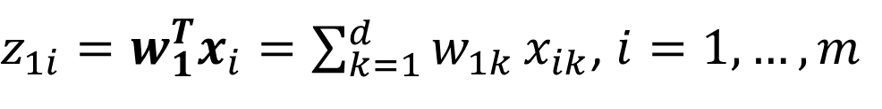


Algebraic Derivation of PCs
Given a sample set of $m$ observations on a vector of $d$ variables
$$\{x_{1},x_{2},…,x_{m}\}∈ℝ^{d}$$
Define the first PC of the samples by the linear projection $w_{1}∈ℝ^{d}$
$z_{1i}=w_{1}^{T}x_{i}=\sum_{k=1}^{d}{w_{1k}}x_{ik}$, $i=1,…,m$
where
$$w_{1}={ (w_{11},w_{12},…,w_{1d})}^{T}$$
$$x_{i}={ (x_{i1},x_{i2},…,x_{id})}^{T}$$
$$z_{1}= \{z_{11},z_{12},…,z_{1m}\}$$
$w_{1}$is chosen such that$var[z_{1}]$ is maximum.

Slide 11

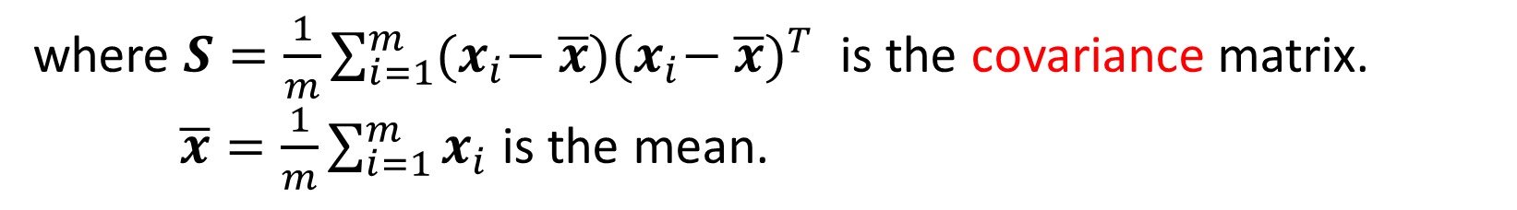
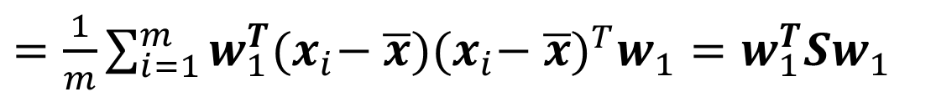
Algebraic Derivation of PCs
To find $w_{1}$, first note that
$var\left[z_{1}\right]=E[{(z_{1}−{\overline{z}}_{1})}^{2}]=\frac{1}{m}\sum_{i=1}^{m}{{(w_{1}^{T}x_{i}−w_{1}^{T}\overline{x})}^{2}}$
$=\frac{1}{m}\sum_{i=1}^{m}{w_{1}^{T}{(x}_{i}− \overline{x}){{(x}_{i}− \overline{x})}^{T}w_{1}}=w_{1}^{T}Sw_{1}$
where $S=\frac{1}{m}\sum_{i=1}^{m}{{(x}_{i}− \overline{x}){{(x}_{i}− \overline{x})}^{T}}$ is the covariance matrix.
$\overline{x}=\frac{1}{m}\sum_{i=1}^{m}{x_{i}}$ is the mean.

Slide 12


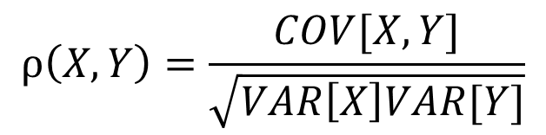
Covariance and Correlation Coefficient
For two random variables $X$ and $Y$，
Covariance
$$COV\left[X,Y\right]=E\left[\left\{X−E\left[X\right]\right\}\{Y−E\left[Y\right]\}\right]=E\left[XY\right]−E\left[X\right]E[Y]$$
The extent to which $X$ and $Y$vary together.
$$\left|COV[X,Y]\right|≤\sqrt{VAR\left[X\right]VAR\left[Y\right]}$$
Cauchy–Schwarz inequality.
柯西-施瓦茨不等式
Correlation coefficient $ρ$ (normalized covariance)
$$ρ\left(X,Y\right)=\frac{COV[X,Y]}{\sqrt{VAR\left[X\right]VAR[Y]}}$$

Slide 13

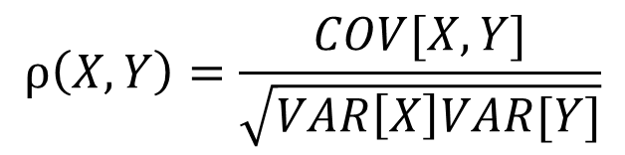
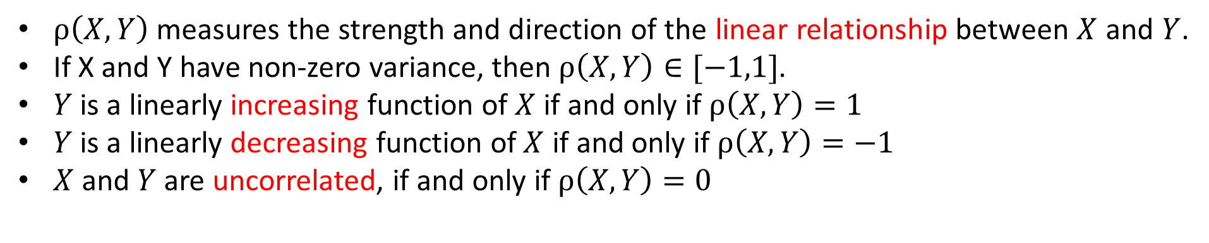
Interpretation of The Correlation Coefficient $ρ$
Correlation coefficient $ρ$ (normalized covariance)
$$ρ\left(X,Y\right)=\frac{COV[X,Y]}{\sqrt{VAR\left[X\right]VAR[Y]}}$$
$ρ\left(X,Y\right)$ measures the strength and direction of the linear relationship between $X$ and $Y$.
If X and Y have non-zero variance, then $ρ\left(X,Y\right)∈[−1,1]$.
$Y$ is a linearly increasing function of $X$ if and only if $ρ\left(X,Y\right)=1$
$Y$ is a linearly decreasing function of $X$ if and only if $ρ\left(X,Y\right)=−1$
$X$ and $Y$ are uncorrelated, if and only if $ρ\left(X,Y\right)=0$

Slide 14
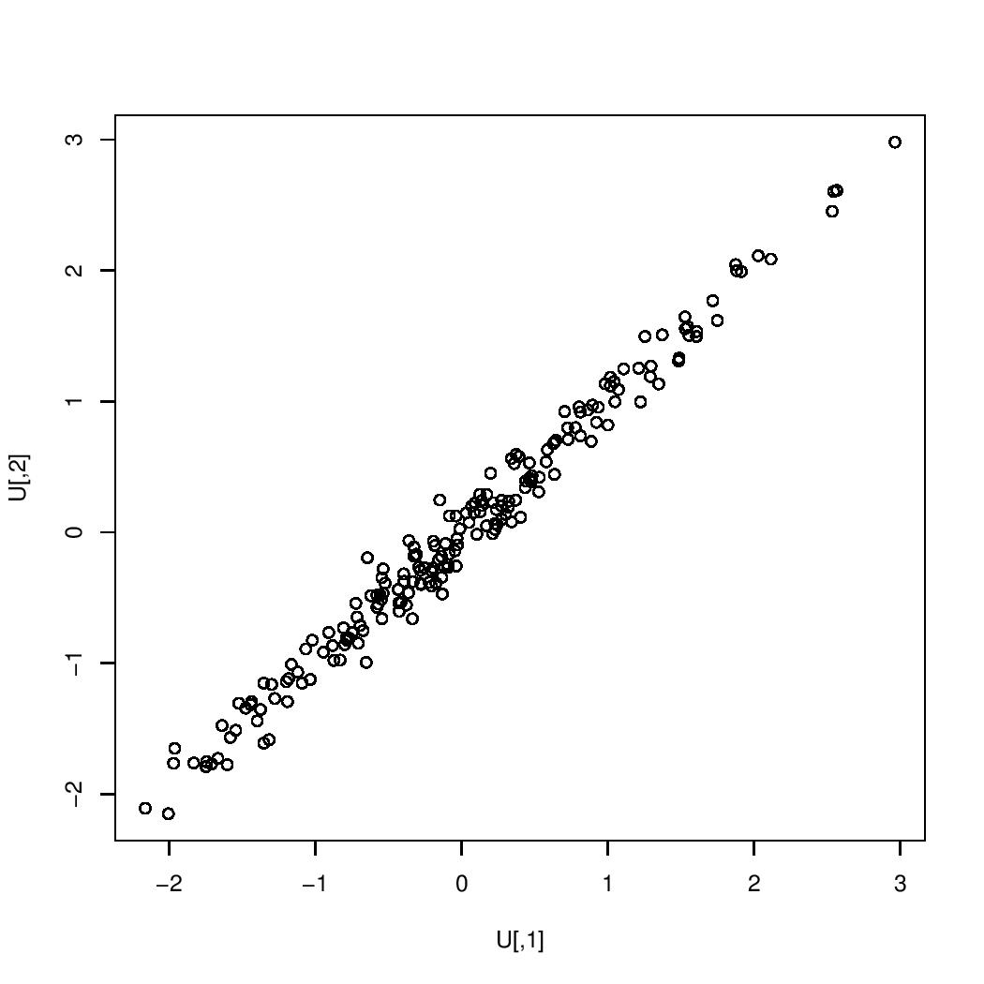
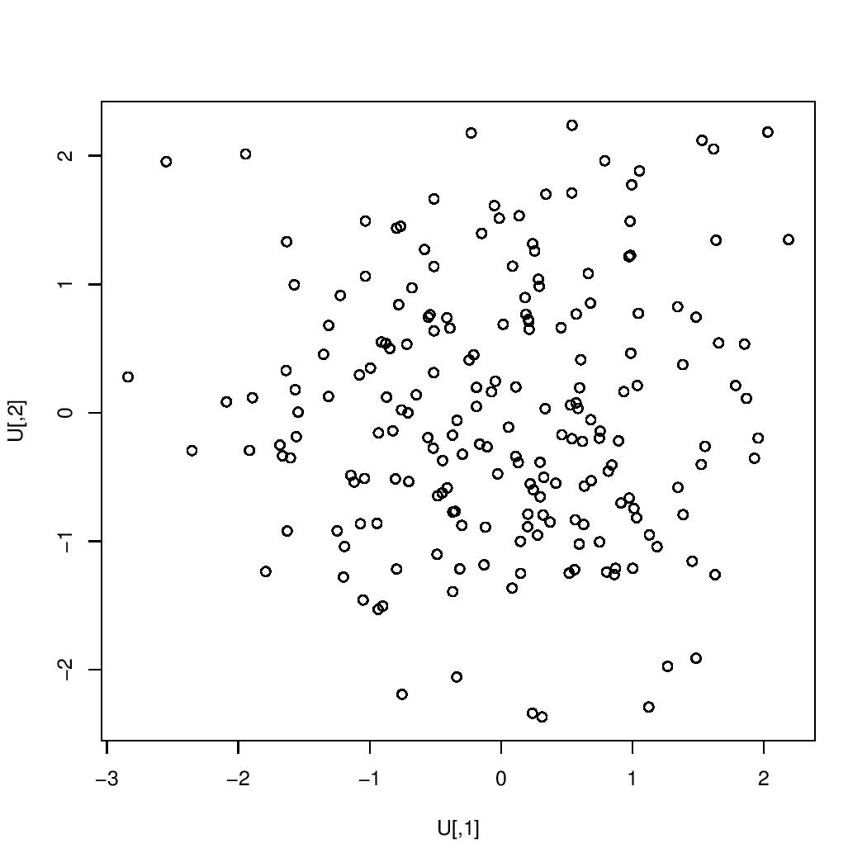
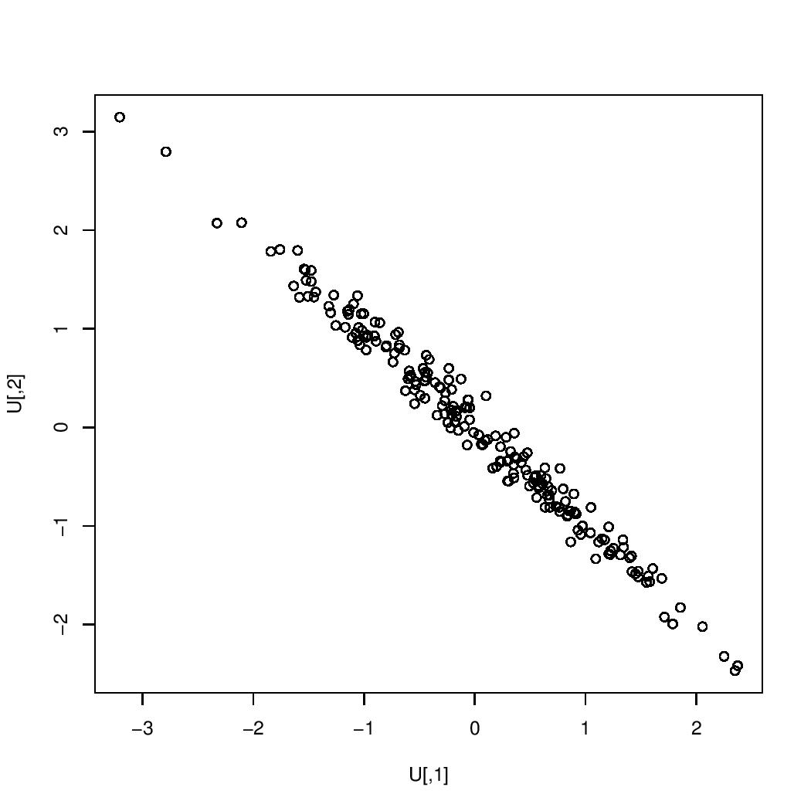





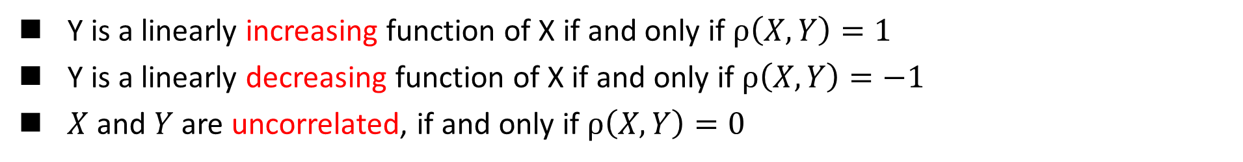





Interpretation of The Correlation Coefficient $ρ$
Y is a linearly increasing function of X if and only if $ρ\left(X,Y\right)=1$
Y is a linearly decreasing function of X if and only if $ρ\left(X,Y\right)=−1$
$X$ and $Y$ are uncorrelated, if and only if $ρ\left(X,Y\right)=0$
$$ρ\left(X,Y\right)=0.99$$
$$ρ\left(X,Y\right)=0$$
$$ρ\left(X,Y\right)=−0.99$$
$$Y$$
$$Y$$
$$Y$$
$$X$$
$$X$$
$$X$$

Slide 15

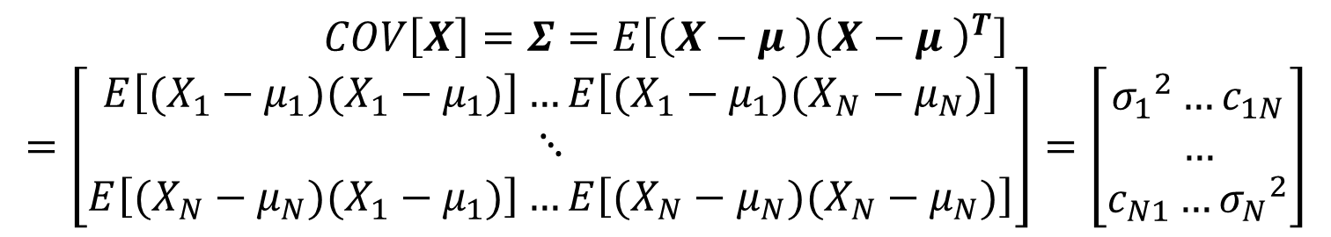
Covariance Matrix
Given random vector, $\vec{X}={ [x_{1},x_{2},…,x_{N}]}^{T}$, we define,
Mean vector
$$E\left[X\right]={ [E[X_{1}],{E[X}_{2}],…,{E[X}_{N}]]}^{T}=\left[μ_{1}μ_{2}…μ_{N}\right]=μ$$
Covariance matrix
$$COV\left[X\right]=Σ=E\left[\left(X−μ \right){\left(X−μ \right)}^{T}\right]$$
$$=\left[\begin{aligned}E\left[(X_{1}−μ_{1})(X_{1}−μ_{1})\right]…E\left[(X_{1}−μ_{1})(X_{N}−μ_{N})\right] \\ ⋱ \\ E\left[(X_{N}−μ_{N})(X_{1}−μ_{1})\right]…E\left[(X_{N}−μ_{N})(X_{N}−μ_{N})\right]\end{aligned}\right]=\left[\begin{aligned}{σ_{1}}^{2}…c_{1N} \\ … \\ c_{N1}…{σ_{N}}^{2}\end{aligned}\right]$$

Slide 16

Covariance Matrix
The covariance matrix indicates the tendency of each pair of dimensions (features) in a random vector to vary together, i.e., to co-vary.
Important Properties
If $x_{i}$ and $x_{k}$ tend to increase together, then $c_{ik}>0$
If $x_{i}$ tends to decrease when $x_{k}$ increases, then $c_{ik}<0$
If $x_{i}$ and $x_{k}$ are uncorrelated, then $c_{ik}=0$
${|c}_{ik}|≤σ_{i}σ_{k}$, where $σ_{i}$ is the standard deviation of $x_{i}$
$c_{ii}={σ_{i}}^{2}=VAR(x_{i})$
Symmetric: $c_{ji}=c_{ij}$
Positive semi-definite:
Eigenvalues are nonnegative
Determinant is nonnegative, $\left|C\right|≥0$

Slide 17
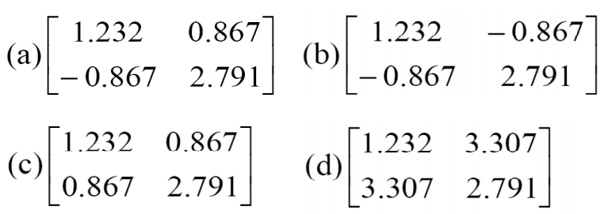
Covariance Matrix
You are given the heights and weights of a certain set of individuals in unknown units. Which one of the following four matrices is the most likely to be the sampled covariance matrix?

Slide 18

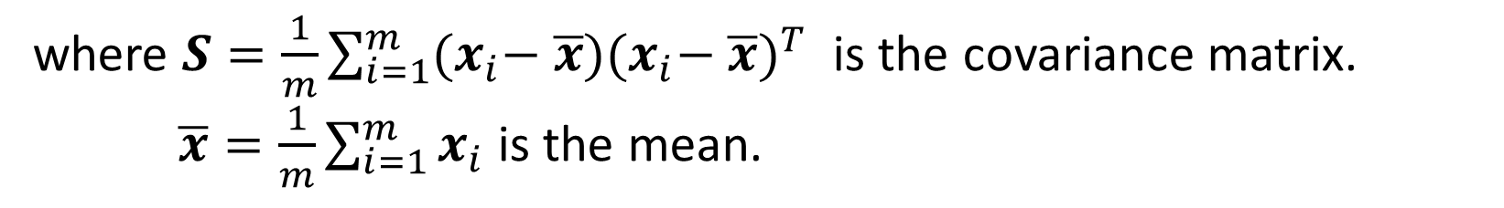
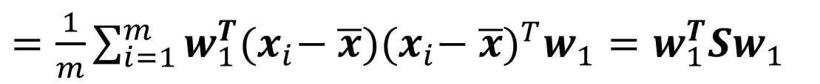

Algebraic Derivation of PCs
To find $w_{1}$, first note that
$var\left[z_{1}\right]=E[{(z_{1}−{\overline{z}}_{1})}^{2}]=\frac{1}{m}\sum_{i=1}^{m}{{(w_{1}^{T}x_{i}−w_{1}^{T}\overline{x})}^{2}}$
$=\frac{1}{m}\sum_{i=1}^{m}{w_{1}^{T}{(x}_{i}− \overline{x}){{(x}_{i}− \overline{x})}^{T}w_{1}}=w_{1}^{T}Sw_{1}$
where $S=\frac{1}{m}\sum_{i=1}^{m}{{(x}_{i}− \overline{x}){{(x}_{i}− \overline{x})}^{T}}$ is the covariance matrix.
$\overline{x}=\frac{1}{m}\sum_{i=1}^{m}{x_{i}}$ is the mean.
The covariance matrix $S$is symmetric.
The eigenvectors must be orthogonal（正交） to one another.
The eigenvalues of $S$ must all be $≥ 0$

Slide 19



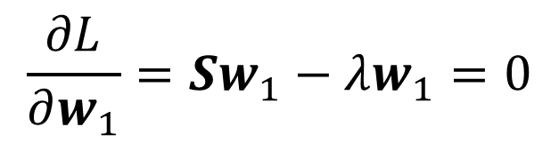

Algebraic Derivation of PCs
To find $w_{1}$ that maximizes $var\left[z_{1}\right]$ subject to $w_{1}^{T}w_{1}$=1
We use the Lagrange multiplier, we maximize the following function:
$$L=w_{1}^{T}Sw_{1}+λ\left(1−w_{1}^{T}w_{1}\right)$$
$$\frac{∂L}{∂w_{1}}=Sw_{1}−λw_{1}=0$$
$$⇒$$
$$⇒$$
$$(S−λI_{d})w_{1}=0$$

Slide 20






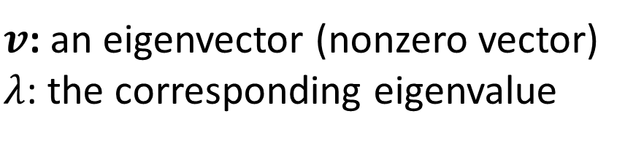

Eigenvectors and Eigenvalues
Definition: $v$ is an eigenvector of matrix $A$ $∈ℝ^{m∗m}$ if there exists a scalar $λ$, such that:
$v$: an eigenvector (nonzero vector)
$λ$: the corresponding eigenvalue
$$Av=λv$$
Computation
$$Av=λv$$
$$\left(A−λI\right)v=0$$
$$v≠0$$
$$⇒$$
$$\left|A−λI\right|=0$$

Slide 21

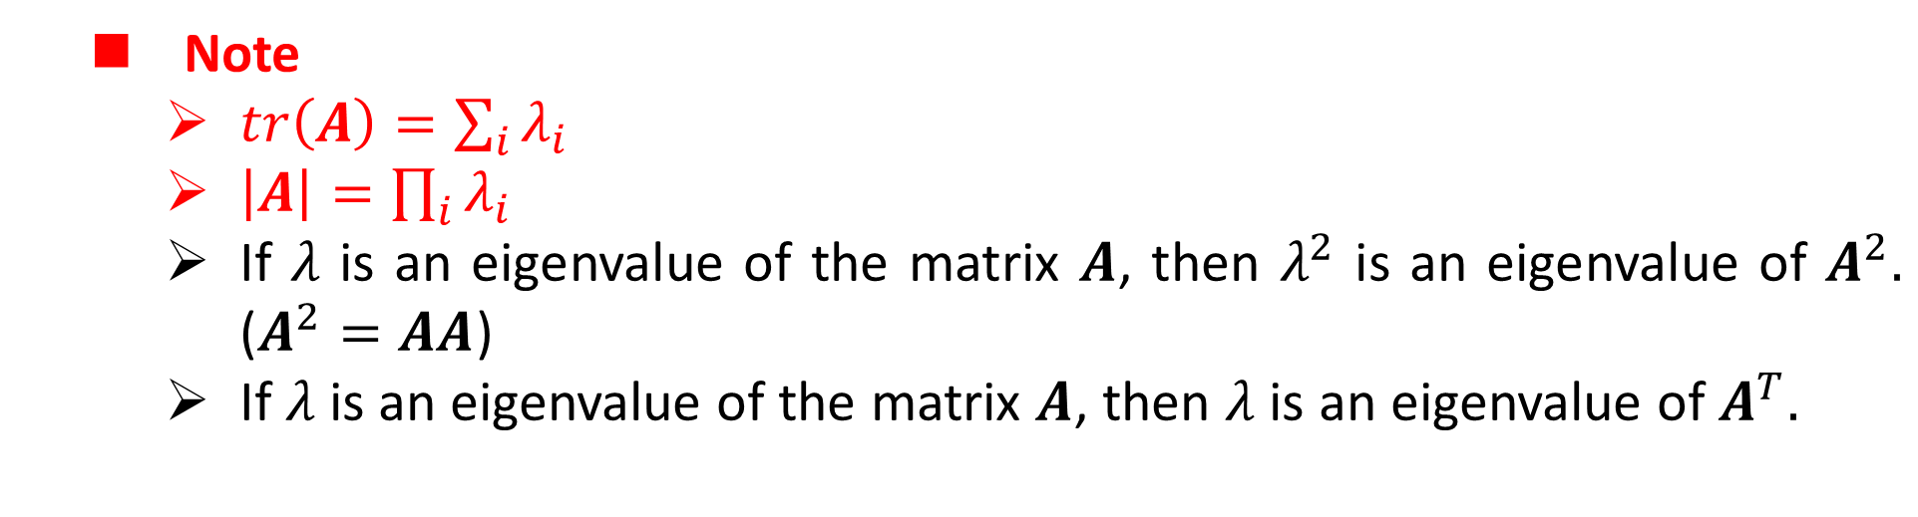
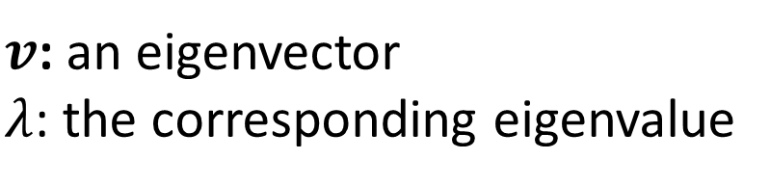
Eigenvectors and Eigenvalues
Definition: $v$ is an eigenvector of matrix $A∈ℝ^{m∗m}$ if there exists a scalar $λ$, such that:
$v$: an eigenvector
$λ$: the corresponding eigenvalue
$$Av=λv$$
Note
$tr\left(A\right)=\sum_{i}{λ_{i}}$
$\left|A\right|=\prod_{i}{λ_{i}}$
If $λ$ is an eigenvalue of the matrix $A$, then $λ^{2}$ is an eigenvalue of $A^{2}.$ ($A^{2}=AA$)
If $λ$ is an eigenvalue of the matrix $A$, then $λ$is an eigenvalue of $A^{T}.$

Slide 22
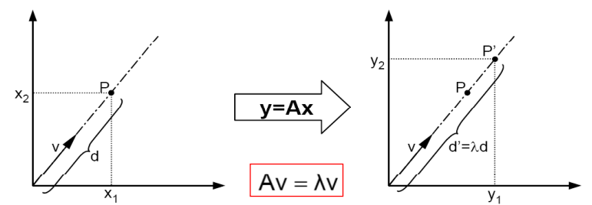
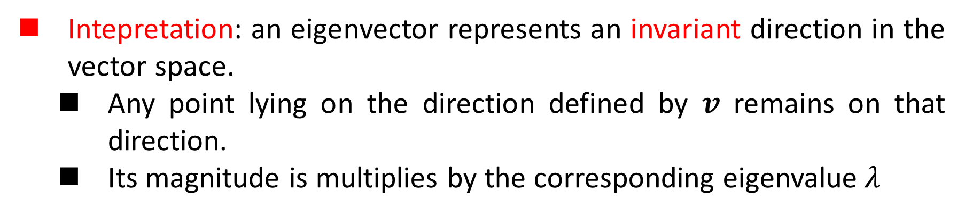
Eigenvectors and Eigenvalues
Intepretation: an eigenvector represents an invariant direction in the vector space.
Any point lying on the direction defined by $v$ remains on that direction.
Its magnitude is multiplies by the corresponding eigenvalue$λ$

Slide 23


Algebraic Derivation of PCs
To find $w_{1}$ that maximizes $var\left[z_{1}\right]$ subject to $w_{1}^{T}w_{1}$=1
We use the Lagrange multiplier, we maximize the following function:
$$L=w_{1}^{T}Sw_{1}+λ(1−w_{1}^{T}w_{1})$$
$$\frac{∂L}{∂w_{1}}=Sw_{1}−λw_{1}=0$$
$$⇒$$
$$⇒$$
$$(S−λI_{d})w_{1}=0$$
Therefore $w_{1}$ is an eigenvector of $S,λ$ is the associated eigenvalue.
Which eigenvector should we choose?

Slide 24
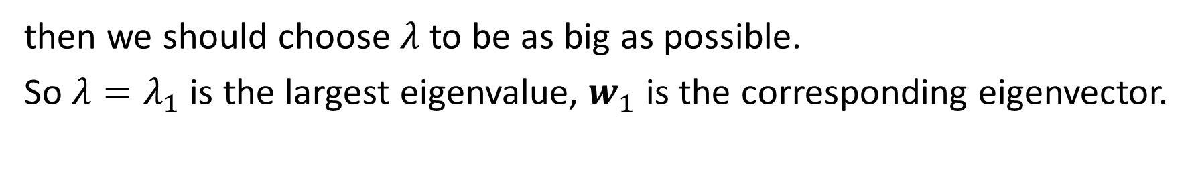

Algebraic Derivation of PCs
If we recognize that the quantity to be maximized
$$L=w_{1}^{T}Sw_{1}=λ$$
then we should choose $λ$ to be as big as possible.
So $λ=λ_{1}$ is the largest eigenvalue, $w_{1}$ is the corresponding eigenvector.
We have got the 1st PC. Now, let’s go to the 2nd PC.

Slide 25
Algebraic Derivation of PCs
The 2nd PC, $w_{2}^{T}x$ maximize $w_{2}^{T}Sw_{2}$ subject to being uncorrelated with $w_{1}^{T}x$
The uncorrelation constraint can be expressed as
$$COV\left(w_{1}^{T}x,w_{2}^{T}x\right)=w_{1}^{T}Sw_{2}=w_{1}^{T}λ_{1}w_{2}=λ_{1}w_{1}^{T}w_{2}=0$$
Using Lagrange multiplier, we will maximize
$$w_{2}^{T}Sw_{2}+λ_{2}\left(1−w_{2}^{T}w_{2}\right)−φw_{1}^{T}w_{2}$$

Slide 26
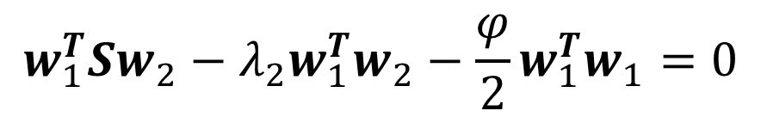

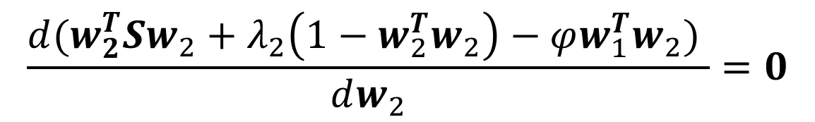
Algebraic Derivation of PCs
Differentiation w.r.t. $w_{2}$yields,
$$\frac{d(w_{2}^{T}Sw_{2}+λ_{2}\left(1−w_{2}^{T}w_{2}\right)−φw_{1}^{T}w_{2}) }{dw_{2}}=0$$
$$2Sw_{2}−2λ_{2}w_{2}−φw_{1}=0$$
If we left multiply $w_{1}$,
$$w_{1}^{T}Sw_{2}−λ_{2}w_{1}^{T}w_{2}−\frac{φ}{2}w_{1}^{T}w_{1}=0$$
what does it imply?

Slide 27



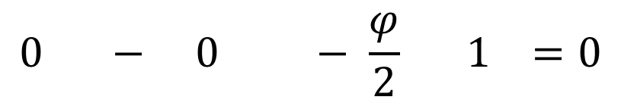
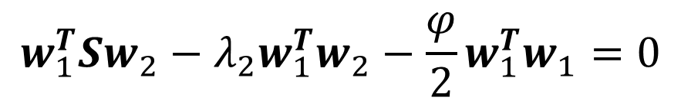

Algebraic Derivation of PCs
$$w_{1}^{T}Sw_{2}−λ_{2}w_{1}^{T}w_{2}−\frac{φ}{2}w_{1}^{T}w_{1}=0$$
$$0 − 0 − \frac{φ}{2} 1 =0$$
$φ$ must be zero and then we re-check the derivative,
$$Sw_{2}−λ_{2}w_{2}−φw_{1}=0$$
$$⇒$$
$$Sw_{2}−λ_{2}w_{2}=0$$
The same strategy of choosing $w_{2}$ to be the eigenvector associated with the second largest eigenvalue $λ_{2}$ yields the second PC.

Slide 28
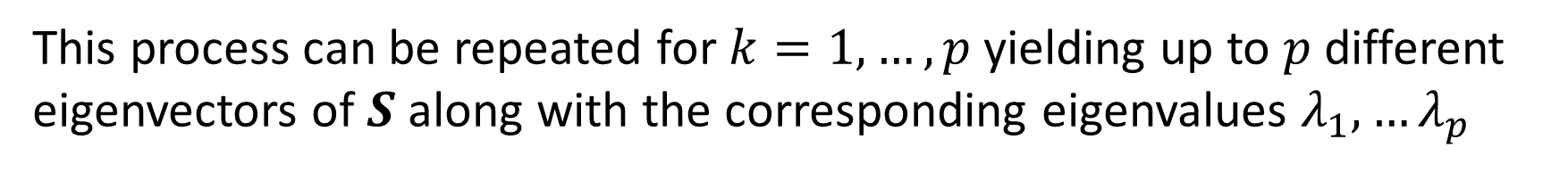
Algebraic Derivation of PCs
This process can be repeated for $k=1,…,p$yielding up to $p$ different eigenvectors of $S$ along with the corresponding eigenvalues $λ_{1},…λ_{p}$
The variance of each of the PCs are given by
$$var\left[z_{k}\right]= var\left[w_{k}^{T}x\right]=λ_{k}, k=1,…,p$$

Slide 29
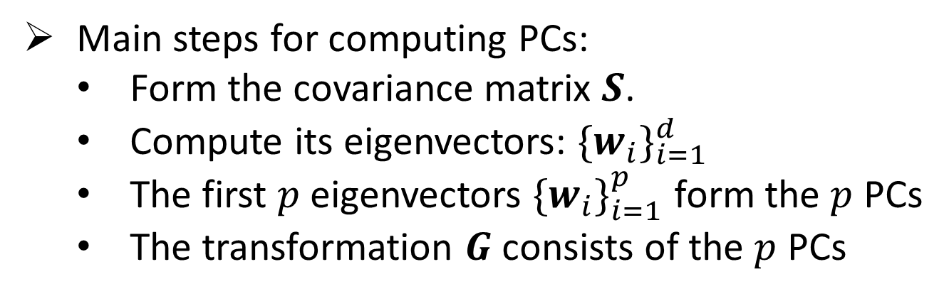


Algebraic Derivation of PCs
Main steps for computing PCs:
Form the covariance matrix $S$.
Compute its eigenvectors: ${\{w_{i}\}}_{i=1}^{d}$
The first $p$ eigenvectors ${\{w_{i}\}}_{i=1}^{p}$ form the $p$ PCs
The transformation $G$ consists of the $p$ PCs
$G←\left[w_{1},w_{2},…,w_{p}\right]∈ℝ^{d×p}$
$$y=G^{T}x∈ℝ^{p}$$

Slide 30
Principal Component Analysis (PCA)
Principal component analysis, or PCA, is a technique that is widely used for applications such as dimensionality reduction, lossy data compression, feature extraction, and data visualization (Jolliffe, 2002).
Two commonly used definitions of PCA
Maximum variance formulation
The variance of the projected data is maximized.
Minimum-error formulation
Minimizes the average projection cost

Slide 31
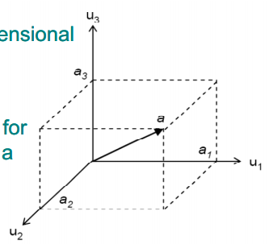
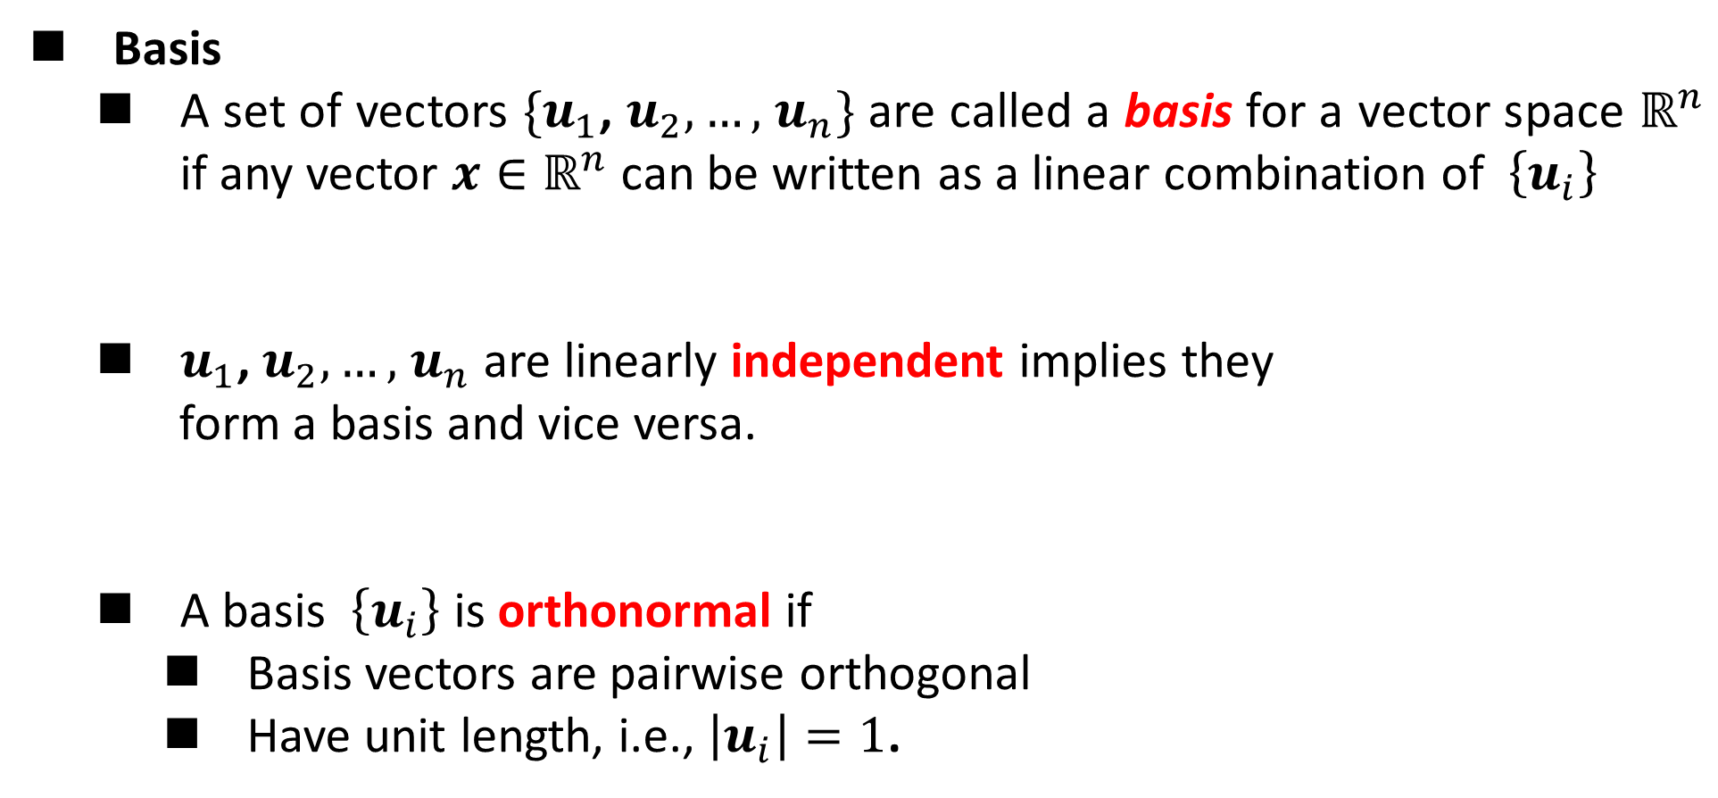
Minimum-error Formulation
Basis
A set of vectors $\{u_{1}$, $u_{2},…,$ $u_{n}\}$ are called a basis for a vector space $ℝ^{n}$ if any vector $x∈ℝ^{n}$ can be written as a linear combination of $\left\{u_{i}\right\}$
$u_{1}$, $u_{2},…,$ $u_{n}$ are linearly independent implies they
form a basis and vice versa.
A basis $\left\{u_{i}\right\}$ is orthonormal if
Basis vectors are pairwise orthogonal
Have unit length, i.e., $\left|u_{i}\right|=1$.
$$x=a_{1}u_{1}+a_{2}u_{2}+⋯+a_{n}u_{n}$$
$a_{1}u_{1}+a_{2}u_{2}+⋯+a_{n}u_{n}=0⇒a_{k}=0$

Slide 32
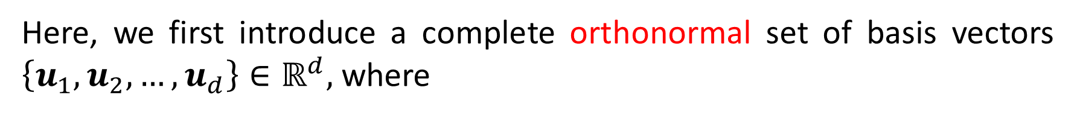


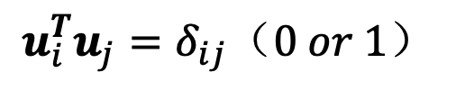

Minimum-error Formulation
Here, we first introduce a complete orthonormal set of basis vectors $\left\{u_{1},u_{2},…,u_{d}\right\}∈ℝ^{d},$ where
$$u_{i}^{T}u_{j}=δ_{ij}（0 or 1）$$
Each data point can be represented by a linear combination of the basis vectors:
$x_{n}=\sum_{i=1}^{d}{α_{ni}}u_{i}$
$α_{ni}=x_{n}^{T}u_{i}$
$x_{n}=\sum_{i=1}^{d}{(x_{n}^{T}u_{i})}u_{i}$

Slide 33
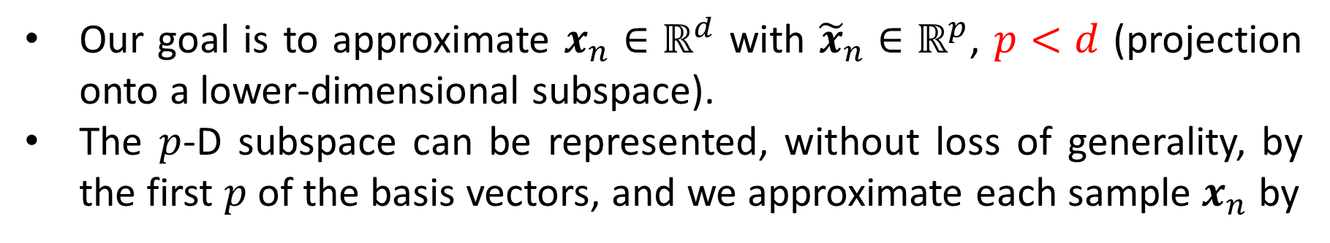

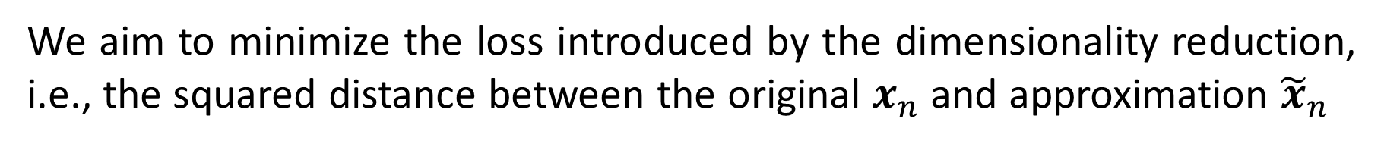
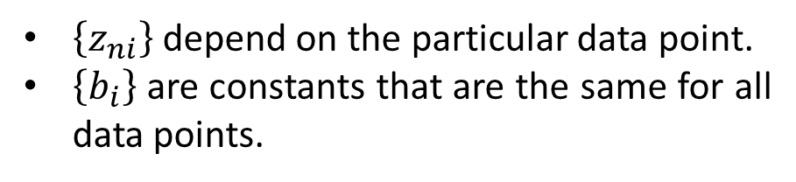
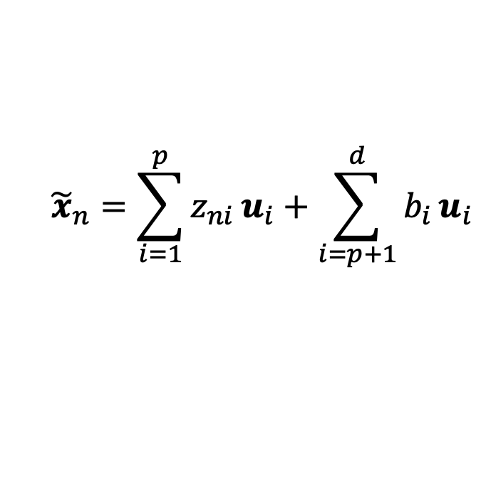
Minimum-error Formulation
Our goal is to approximate $x_{n}∈ℝ^{d}$ with ${\tilde{x}}_{n}∈ℝ^{p}$, $p<d$ (projection onto a lower-dimensional subspace).
The $p$-D subspace can be represented, without loss of generality, by the first $p$ of the basis vectors, and we approximate each sample $x_{n}$ by
$${\tilde{x}}_{n}=\sum_{i=1}^{p}{z_{ni}}u_{i}+\sum_{i=p+1}^{d}{b_{i}}u_{i}$$
$\left\{z_{ni}\right\}$ depend on the particular data point.
$\left\{b_{i}\right\}$ are constants that are the same for all data points.
We aim to minimize the loss introduced by the dimensionality reduction, i.e., the squared distance between the original $x_{n}$ and approximation ${\tilde{x}}_{n}$
$$J=\frac{1}{m}\sum_{n=1}^{m}{{\left\|x_{n}−{\tilde{x}}_{n}\right\|}^{2}}$$

Slide 34




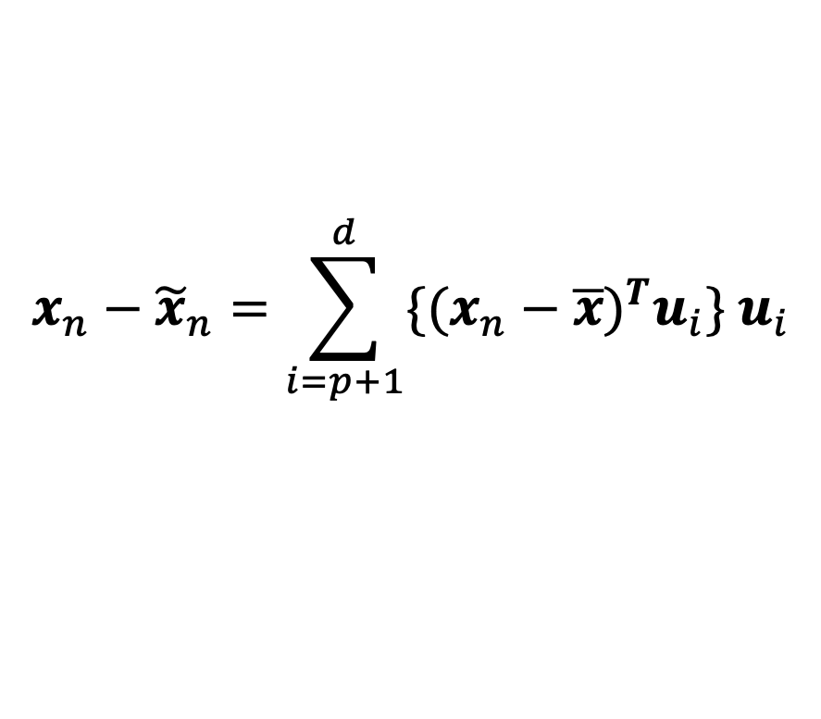
Minimum-error Formulation
To minimize
$$J=\frac{1}{m}\sum_{n=1}^{m}{{\left\|x_{n}−{\tilde{x}}_{n}\right\|}^{2}}$$
${\tilde{x}}_{n}=\sum_{i=1}^{p}{z_{ni}}u_{i}+\sum_{i=p+1}^{d}{b_{i}}u_{i}$
Taking the derivative w.r.t. $z_{nj}$ and setting to zero, we have
$$z_{nj}=x_{n}^{T}u_{j}, j=1,…,p$$
Leaving for
Your homework.
Taking the derivative w.r.t. $b_{j}$ and setting to zero, we have
$$b_{j}={\overline{x}}^{T}u_{j}, j=p+1,…,d$$
Substituting $z_{nj}$ and $b_{j}$, and make use of $x_{n}=\sum_{i=1}^{d}{(x_{n}^{T}u_{i})}u_{i}$, we have
$$x_{n}−{\tilde{x}}_{n}=\sum_{i=p+1}^{d}{\{{(x_{n}−\overline{x})}^{T}u_{i}\} u_{i}}$$

Slide 35
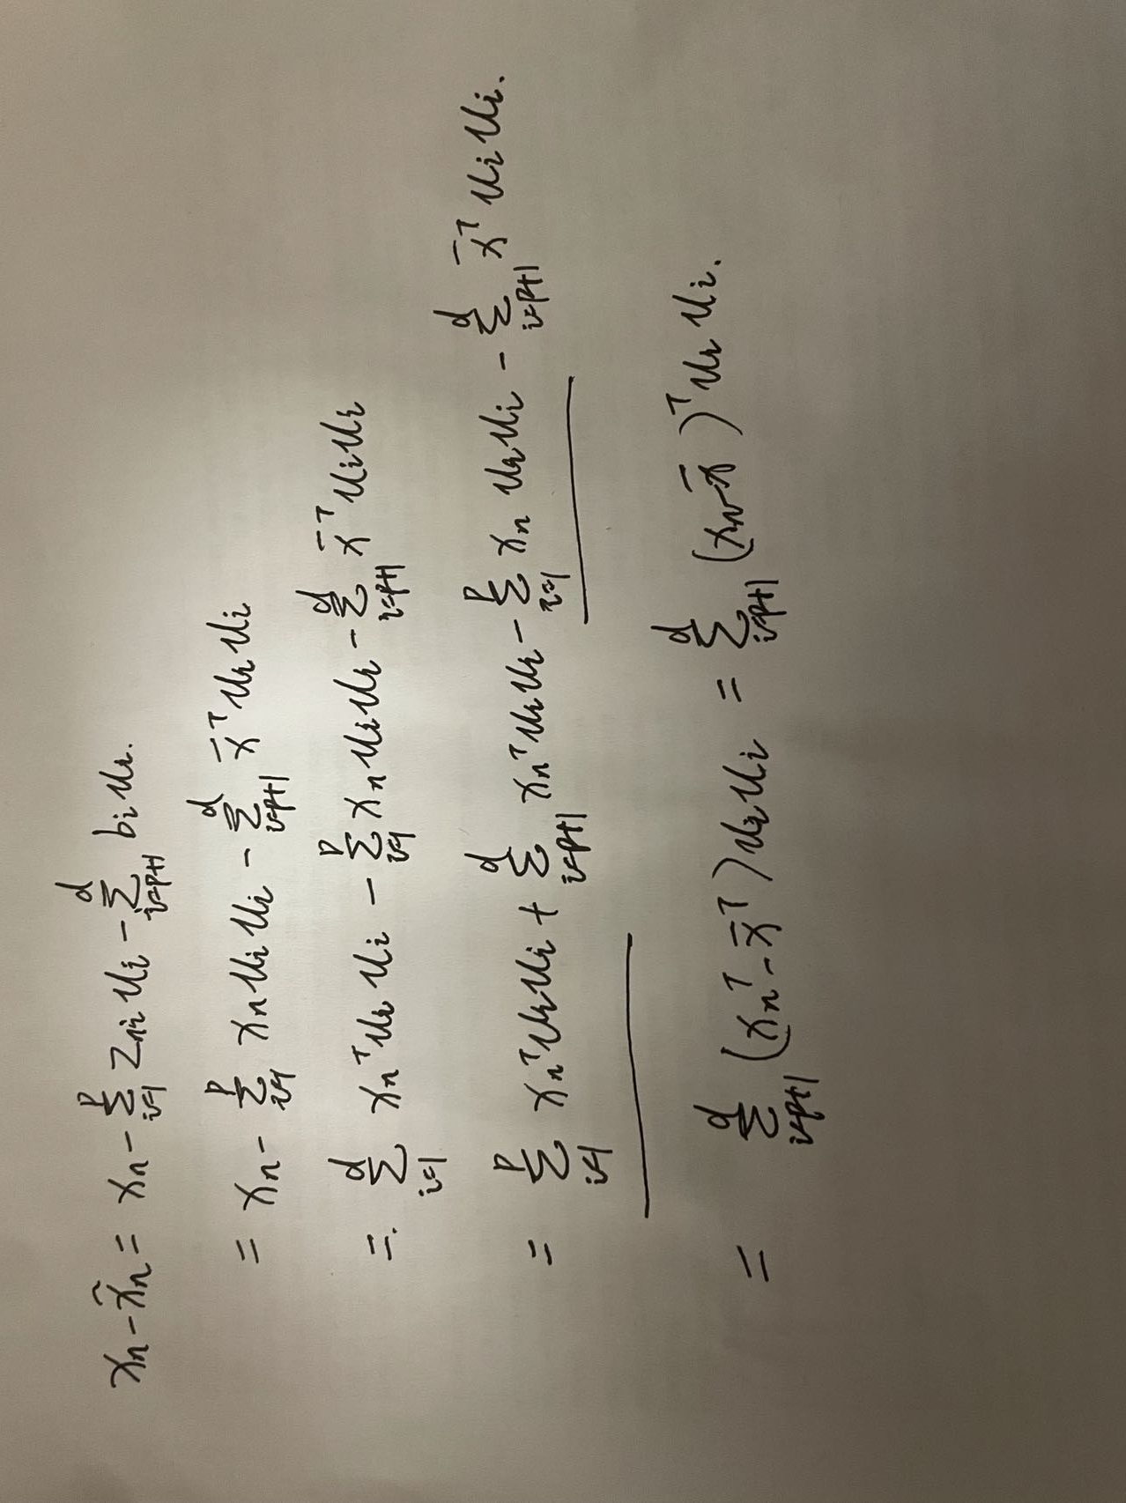

Slide 36


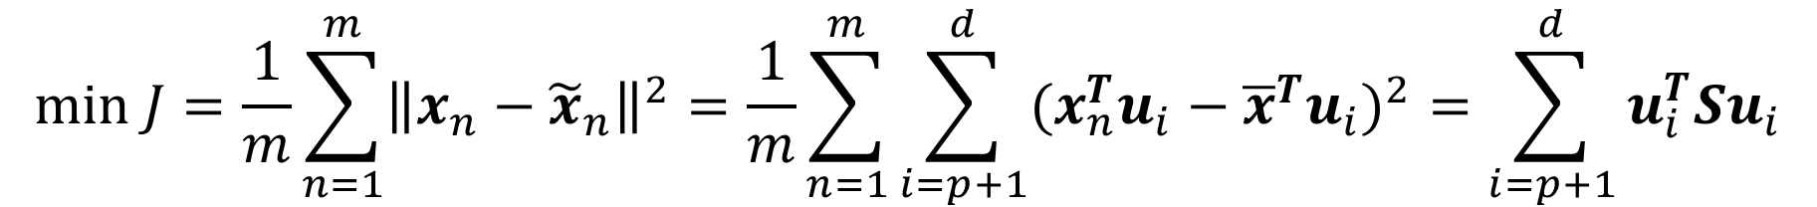
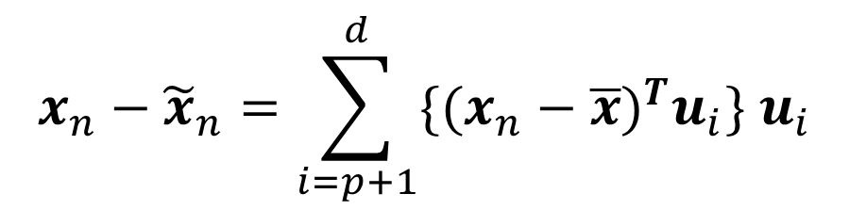
Minimum-error Formulation
${\tilde{x}}_{n}=\sum_{i=1}^{p}{z_{ni}}u_{i}+\sum_{i=p+1}^{d}{b_{i}}u_{i}$
$$x_{n}−{\tilde{x}}_{n}=\sum_{i=p+1}^{d}{\{{(x_{n}−\overline{x})}^{T}u_{i}\} u_{i}}$$
$x_{n}−{\tilde{x}}_{n}$ lies in the space orthogonal to the principal subspace, why?
Then
$$min J=\frac{1}{m}\sum_{n=1}^{m}{{\left\|x_{n}−{\tilde{x}}_{n}\right\|}^{2}}=\frac{1}{m}\sum_{n=1}^{m}{\sum_{i=p+1}^{d}{{(x_{n}^{T}u_{i}−{\overline{x}}^{T}u_{i})}^{2}}}=\sum_{i=p+1}^{d}{u_{i}^{T}Su_{i}}$$
Let us try to obtain some intuition about the result by considering the case of $d=2$ and $p=1$.

Slide 37
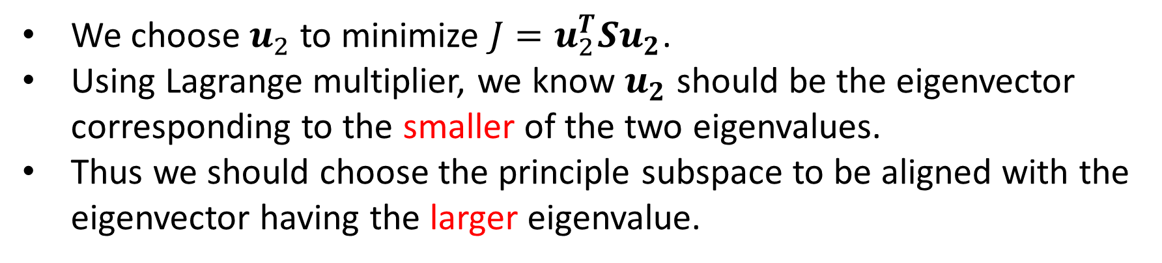

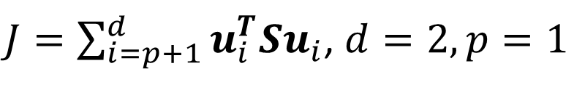
Minimum-error Formulation
$J=\sum_{i=p+1}^{d}{u_{i}^{T}Su_{i}}$, $d=2,p=1$
We choose $u_{2}$ to minimize $J=u_{2}^{T}Su_{2}$.
Using Lagrange multiplier, we know $u_{2}$ should be the eigenvector corresponding to the smaller of the two eigenvalues.
Thus we should choose the principle subspace to be aligned with the eigenvector having the larger eigenvalue.
For the case when the eigenvalues are equal, any choice of principal direction will give rise to the same value of $J$.

Slide 38
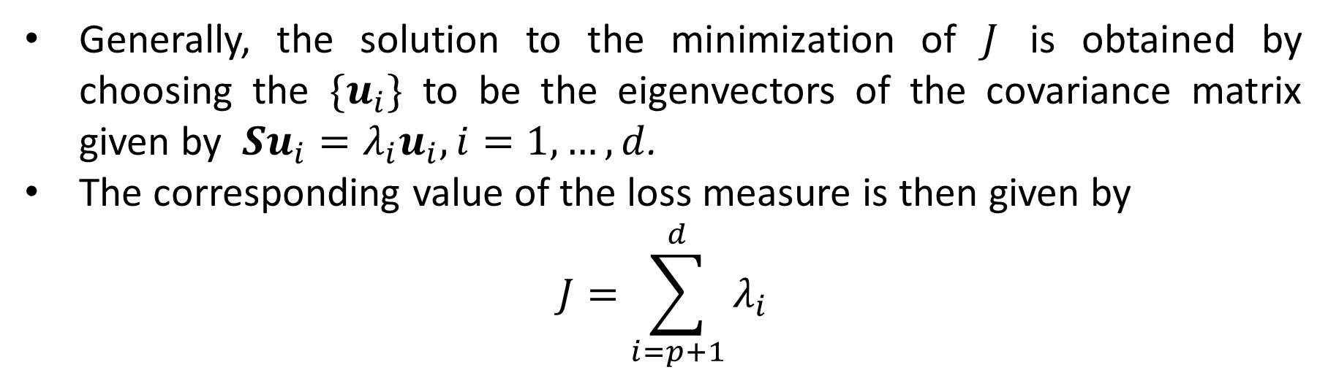

Minimum-error Formulation
Generally, the solution to the minimization of $J$ is obtained by choosing the $\{u_{i}\}$ to be the eigenvectors of the covariance matrix given by $Su_{i}=λ_{i}u_{i}, i=1,…,d$.
The corresponding value of the loss measure is then given by
$$J=\sum_{i=p+1}^{d}{λ_{i}}$$
Eigenvectors defining the principal subspace are those corresponding to the $p$ largest eigenvalues.

Slide 39

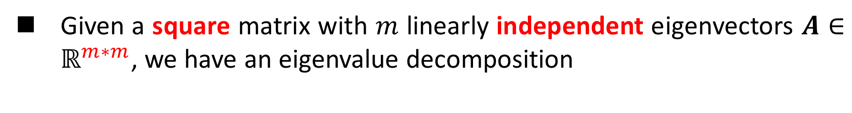


Eigenvalue Decomposition
Given a square matrix with $m$ linearly independent eigenvectors $A∈ℝ^{m∗m}$, we have an eigenvalue decomposition
$$AV=VΛ$$
$$A=VΛV^{−1}$$
Note
Columns of $V$ are eigenvectors of $A$
Diagonal elements of $Λ$are eigenvalues of $A$
$Λ=diag\left(λ_{1},λ_{2},…,λ_{m}\right), λ_{i}≥λ_{i+1}$

Slide 40

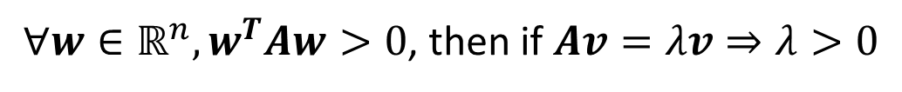

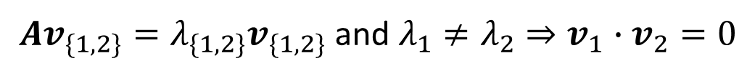
Eigenvalue Decomposition
Note
If$A$is non-singular
All eigenvalues are non-zero
If A is real and symmetric
All eigenvalues are real.
The eigenvectors for distinct eigenvalues are orthogonal.
If A is positive definite, then all eigenvalues are positive.
If $\left|A−λI\right|=0$ and $A=A^{T}$ $⇒λ∈ℝ$
$Av_{\{1,2\}}=λ_{\{1,2\}}v_{\{1,2\}}$ and $λ_{1}≠λ_{2}⇒v_{1}∙v_{2}=0$
$∀w∈ℝ^{n},w^{T}Aw>0$, then if $Av=λv⇒λ>0$

Slide 41
Singular Value Decomposition (SVD)
In practice, we compute the PCs via singular value decomposition (SVD) on the centered data matrix.

Slide 42
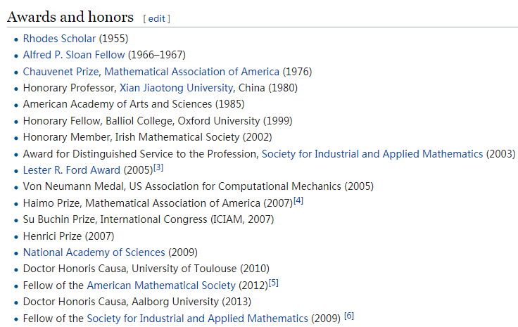

Singular Value Decomposition (SVD)
“The highpoint of linear algebra”--- Gillert Strang
1934~

Slide 43







SVD
rank: the number of linearly independent rows (or columns)
$$0≤rank(A)≤min⁡(m,n)$$
Any $m×n$ matrix $A$ of rank $r$ can be decomposed into: $A=UΣV^{T}$
For $m>n$
$$U_{m×m}$$
$$Σ_{m×n}$$
$$V_{n×n}$$
Orthogonal matrix $U$: $U^{T}U=I_{m×m}$, and $UU^{T}=I_{m×m}.$
The columns of $U$ are defined as left singular vectors.
Orthogonal matrix $V$:$V^{T}V=I_{n×n}$ , and $VV^{T}=I_{n×n}.$
The columns of $V$ are defined as right singular vectors.
Rectangular diagonal matrix $Σ$: we arrange the singular values as $σ_{1}≥σ_{2}≥…≥σ_{r}>0.$
An orthogonal matrix is a square matrix whose columns and rows are orthogonal unit vectors (orthonormal vectors).

Slide 44

SVD
A

Slide 45


Singular Value Decomposition (SVD)
$U$ and $V$ are orthogonal matrices. The columns of $U$ and $V$ are basis vectors in $ℝ^{m}$ and $ℝ^{n}$, respectively.
The linear transformation $A$ can be interpreted as a composition of three geometrical transformations: a rotation or reflection ($V^{T}$), followed by a coordinate-by-coordinate scaling ($Σ$), followed by another rotation or reflection ($U$).

Slide 46





Singular Value Decomposition (SVD)
Illustration of the SVD of a real 2×2 matrix $A=UΣV^{T}$.
Top: The action of $A$.
Left: The action of $V^{T}$, a rotation.
Bottom: The action of $Σ$, a scaling by the singular values $σ_{1}$ horizontally and $σ_{2}$ vertically.
Right: The action of $U$, another rotation.
$$A$$
$$A$$

Slide 47








Singular Value Decomposition (SVD)
$$A=\left[\begin{matrix}3 & 1 \\ 2 & 1\end{matrix}\right]$$
Given the matrix
$$U=\left[\begin{matrix}0.8174 & −0.5760 \\ 0.5760 & 0.8174\end{matrix}\right]$$
$$Σ=\left[\begin{matrix}3.8643 & 0 \\ 0 & 0.2588\end{matrix}\right]$$
$$V^{T}=\left[\begin{matrix}0.9327 & 0.3606 \\ −0.3606 & 0.9327\end{matrix}\right]$$
Let us focus on the transformation of the original basis vectors by $A$
$$e_{1}=\left[\begin{aligned}1 \\ 0\end{aligned}\right]$$
$$e_{2}=\left[\begin{aligned}0 \\ 1\end{aligned}\right]$$
First, by rotation $V^{T}$, we have
$$V^{T}e_{1}=\left[\begin{aligned}0.9327 \\ −0.3606\end{aligned}\right]$$
$$V^{T}e_{2}=\left[\begin{aligned}0.3606 \\ 0.9327\end{aligned}\right]$$

Slide 48




Singular Value Decomposition (SVD)
$$A=\left[\begin{matrix}3 & 1 \\ 2 & 1\end{matrix}\right]$$
Given the matrix
$$U=\left[\begin{matrix}0.8174 & −0.5760 \\ 0.5760 & 0.8174\end{matrix}\right]$$
$$Σ=\left[\begin{matrix}3.8643 & 0 \\ 0 & 0.2588\end{matrix}\right]$$
$$V^{T}=\left[\begin{matrix}0.9327 & 0.3606 \\ −0.3606 & 0.9327\end{matrix}\right]$$
Second, by $Σ$, we scale $V^{T}e_{1}$ and $V^{T}e_{2}$ along with the original coordinate system ($e_{1}$, $e_{2}$)
$$ΣV^{T}e_{1}=\left[\begin{aligned}3.6042 \\ −0.0933\end{aligned}\right]$$
$$ΣV^{T}e_{2}=\left[\begin{aligned}1.3935 \\ 0.2414\end{aligned}\right]$$
Last, by rotation $U$, we have
$$UΣV^{T}e_{1}=\left[\begin{aligned}3 \\ 2\end{aligned}\right]$$
$$UΣV^{T}e_{2}=\left[\begin{aligned}1 \\ 1\end{aligned}\right]$$

Slide 49

Singular Value Decomposition (SVD)
Any $m×n$ matrix $A$ of rank $r$ can be decomposed into: $A=UΣV^{T}$
For $m>n$
$$U_{m×m}$$
$$Σ_{m×n}$$
$$V_{n×n}$$
Special Properties:
The columns of $U$ (i.e., left singular vectors) are eigenvectors of $AA^{T}$.
The columns of $V$ (i.e., right singular vectors) are eigenvectors of $A^{T}A$.
Eigenvalues $λ_{1},…,λ_{r}$ of $AA^{T}$ are the eigenvalues of $A^{T}A$.
Singular value $σ_{i}=\sqrt{λ_{i}}$.

Slide 50




Singular Value Decomposition (SVD)
Prove that the columns of $V$ (i.e., right singular vectors) are eigenvectors of $A^{T}A$.
$$A^{T}A={(UΣV^{T})}^{T}UΣV^{T}=VΣ^{T}ΣV^{T}$$
This is the eigen-decomposition of $A^{T}A$.
$V$ is the eigenvector matrix of $A^{T}A$, and $Σ^{T}Σ$ is the eigenvalue matrix of $A^{T}A,$ i.e., singular values are positive square roots of eigenvalues.
Theorem1: Every symmetric matrix $M$ is orthogonally diagonalizable, i.e., there exists an orthogonal matrix $Q$ (i.e., $Q^{T}=Q^{−1}$) such that $Q^{T}MQ=D$ (i.e., $M=QDQ^{T}$) is a diagonal matrix. (https://en.wikipedia.org/wiki/Diagonalizable_matrix)

Slide 51







Compact SVD
Only the $r=rank(A)$column vectors of $U$ and $r$ row vectors of $V^{T}$ corresponding to the non-zero singular values $Σ_{r}$ are calculated.
$m>n$
Economy version $A=U_{r}Σ_{r}{V_{r}}^{T}$
$$Σ_{r}=diag\left(σ_{1},…,σ_{r}\right)$$
$$m×r$$
$$r×r$$
$$r×n$$
Any information loss?

Slide 52






Truncated SVD
Only $k$ column vectors of $U$ and $k$ row vectors of $V^{T}$ corresponding to the non-zero singular values $Σ_{k}$ are calculated, $0<k<r,$ $r=rank(A)$.
$m>n$
More Economical $A=U_{k}Σ_{k}{V_{k}}^{T}$
$$Σ_{k}=diag\left(σ_{1},…,σ_{k}\right)$$
$$m×k$$
$$k×k$$
$$k×n$$
Truncated SVD is no longer an exact decomposition of the original matrix.

Slide 53


SVD Application1-Latent Semantic Indexing (LSI)
LSI was proposed to address two problems with the vector space model
synonymy: many ways to refer to the same object, e.g. car and automobile
leads to poor recall (recall: portion of the target items that the system selected)
polysemy: most words have more than one distinct meaning, e.g. model, python, chip
leads to poor precision (precision: portion of selected items that the system got right)

Slide 54






SVD Application1-Latent Semantic Indexing (LSI)
LSI is a technique that projects queries and documents into a space with “latent” semantic dimensions.
In the latent semantic space, a query and a document can have high cosine similarity even if they don’t share any terms, as long as their terms are semantically similar in a sense.
$$k=3$$
$$U_{k}$$
$$Σ_{k}$$
$${V_{k}}^{T}$$
$$A$$

Slide 55




SVD Application2-Pseudoinverse
SVD can be used for computing the pseudoinverse of a matrix.
$$A=UΣV^{T}$$
$$\left[\begin{aligned}\begin{matrix}\frac{1}{σ_{1}} \\ \\ \end{matrix}\begin{matrix} \\ ⋱ \\ \end{matrix}\begin{matrix} \\ \\ \frac{1}{σ_{r}}\end{matrix}\begin{matrix} \\ \\ \end{matrix}\begin{matrix} \\ \\ \end{matrix}\begin{matrix} \\ \\ \end{matrix}\begin{matrix}0 \\ ⋮ \\ ⋮\end{matrix}\begin{matrix}… \\ \\ \end{matrix}\begin{matrix}0 \\ ⋮ \\ ⋮\end{matrix} \\ \begin{matrix} \\ \\ \end{matrix}\begin{matrix} \\ \\ \end{matrix}\begin{matrix} \\ \\ \end{matrix}\begin{matrix}0 \\ \\ \end{matrix}\begin{matrix} \\ ⋱ \\ \end{matrix}\begin{matrix} \\ \\ 0\end{matrix}\begin{matrix}⋮ \\ ⋮ \\ 0\end{matrix}\begin{matrix} \\ \\ ⋯\end{matrix}\begin{matrix}⋮ \\ ⋮ \\ 0\end{matrix}\end{aligned}\right]$$
$Σ^{†}$: pseudoinverse of $Σ$ by replacing every non-zero diagonal entry by its reciprocal and transposing the matrix.
$$A^{†}=VΣ^{†}U^{T}$$
$AA^{†}A=UΣV^{T}VΣ^{†}U^{T}UΣV^{T}=$ $UΣΣ^{†}ΣV^{T}=UΣV^{T}=A$

Slide 56


SVD Application3-PCA
In practice, we compute the PCs via singular value decomposition (SVD) on the centered data matrix.
Form the centered data matrix:
Compute its SVD:
where $U$ and $V$ are orthogonal matrices, $D$ is a diagonal matrix.
$$X=[ \left(x_{1}−\overline{x}\right);…;(x_{m}−\overline{x})]∈ℝ^{d×m}$$
$$X=U_{d×d}D_{d×m}{(V_{m×m})}^{T}$$

Slide 57




SVD Application3-PCA
Note that the scatter/covariance matrix can be written as
The eigenvectors of $S$ are the columns of $U$ and the eigenvalues are the diagonal elements of $D^{2}$.
Take only a few significant eigenvalue-eigenvector pairs $p≪d$. The new reconstructed sample from low-dim space is:
$$S=XX^{T}=UD^{2}U^{T}$$
$X=U_{d×d}D_{d×m}{(V_{m×m})}^{T}$
$${\hat{x}}_{i}=\overline{x}+U_{d×p}{\left(U_{d×p}\right)}^{T}(x_{i}−\overline{x})$$

Slide 58


SVD Application4-Reconstruction
$${\hat{x}}_{i}=\overline{x}+U_{d×p}{\left(U_{d×p}\right)}^{T}(x_{i}−\overline{x})$$

Slide 59

Advantages of Using SVD for PCA
No need to compute the covariance matrix $S=XX^{T}$
Numerically more accurate, since the formation of $XX^{T}$ can cause loss of precision.
For example, the Läuchli matrix:
$${\left(\begin{matrix}1 & 1 & 1 \\ ε & 0 & 0 \\ \begin{aligned}0 \\ 0\end{aligned} & \begin{aligned}ε \\ 0\end{aligned} & \begin{aligned}0 \\ ε\end{aligned}\end{matrix}\right)}^{T}$$
where $ε$ is a tiny number.

Slide 60







Visualize PCs
The columns of 𝑼 are eigenvectors of $S=AA^{T}$.
$$y=U^{T}x$$
$$U=\left[\begin{matrix}↑ \\ u_{1} \\ ↓\end{matrix}\begin{matrix}↑ \\ u_{2} \\ ↓\end{matrix}\right]$$
$$y=U^{T}x$$
$$x=Uy$$
$$u_{2}$$
$$u_{1}$$

Slide 61



Visualize PCs
The columns of 𝑼 are eigenvectors of $S=AA^{T}$.
$$y=U^{T}x$$
Data points are represented in a rotated orthogonal coordinate system: the origin is the mean of the data points and the axes are provided by the eigenvectors.

Slide 62

The Necessity of Centralization
V2_centered
V2
V1
V1_centered

Slide 63


How Many PCs to Keep?
To choose $p$based on percentage of energy to retain, we can use the following criterion (smallest $p$):
$\frac{\sum_{i=1}^{p}{λ_{i}}}{\sum_{i=1}^{d}{λ_{i}}}≥Threshold (e.g., 0.95)$

Slide 64


PCA-Applications
Data Compression
We represent the eigenvectors as images of the same size as the data points.

Slide 65
PCA-Applications
Data Preprocessing
The goal is not dimensionality reduction but rather the transformation of a data set in order to standardizing the data.
Important in allowing subsequent pattern recognition algorithms to be applied successfully to the data set.
Typically, it is done when the original variables are measured in different order of magnitudes or have significantly different variability.

Slide 66

PCA-Applications
Data Preprocessing
The goal is not dimensionality reduction but rather the transformation of a data set in order to standardizing the data.
Traditionally, we can made a linear re-scaling of the individual variables such that each variable had zero mean and unit variance.
$$\frac{x_{ni}−{\overline{x}}_{i}}{σ_{i}}$$
However, using PCA we can make a more substantial normalization of the data to give
it zero mean and unit covariance, so that variables become decorrelated.

Slide 67

PCA-Applications
Data Preprocessing
The goal is not dimensionality reduction but rather the transformation of a data set in order to standardizing the data.
We first write the eigenvalue decomposition $SU=UΛ$
$$y_{n}=Λ^{−\frac{1}{2}}U^{T}(x_{n}−\overline{x})$$
Then for each data point, we define
Clearly, $\{y_{n}\}$ have zero mean, and we thus have the covariance matrix
$$\frac{1}{m}\sum_{n=1}^{m}{y_{n}y_{n}^{T}}=\frac{1}{m}\sum_{n=1}^{m}{Λ^{−\frac{1}{2}}U^{T}(x_{n}−\overline{x}){(x_{n}−\overline{x})}^{T}UΛ^{−\frac{1}{2}} }=Λ^{−\frac{1}{2}}U^{T}SUΛ^{−\frac{1}{2}}=Λ^{−\frac{1}{2}}ΛΛ^{−\frac{1}{2}}=I$$
This operation is known as whitening or sphereing the data

Slide 68




PCA-Applications
Data Preprocessing
The goal is not dimensionality reduction but rather the transformation of a data set in order to standardizing the data.
Principal axes of this normalized data set.
Original data
$$\frac{x_{ni}−{\overline{x}}_{i}}{σ_{i}}$$
$$y_{n}=Λ^{−\frac{1}{2}}U^{T}(x_{n}−\overline{x})$$

Slide 69

PCA-Applications
Data Visualization
Each data point is projected onto a two-dimensional principal subspace.

Slide 70

PCA and Classification
Classification with PCA
Project both training and testing data into the PCs space
For each testing sample, use Nearest Neighbor for classification
Issue: accuracy is sensitive to the number of PCs
PCA may not be always an optimal feature extraction technique for classification.
Suppose there are $C$classes in the training data
PCA is based on the sample covariance which characterizes the scatter of the entire data set, irrespective of class‐membership.
The projection axes chosen by PCA might not provide good discrimination power.

Slide 71

PCA and Classification

Slide 72
Summary
Two commonly used definitions of PCA
Maximum variance formulation
Minimum-error formulation
Covariance Matrix
Symmetric, Positive semi-definite
Lagrange Multiplier
Constrained system → Unconstrained system
Critical points
Data Point Reconstruction
SVD
U, V orthogonal matrix
PCA Applications

Slide 73





SVD Application-Pseudoinverse
SVD can be used for computing the pseudoinverse of a matrix.
For $A∈𝕂^{m∗n},$ a pseudoinverse of $A$ is defined as a matrix $A^{†}∈𝕂^{n∗m}$ satisfying all of the following four criteria, known as the Moore-Penrose conditions.
$AA^{†}A=A$
$A^{†}AA^{†}=A^{†}$
${(AA^{†})}^{∗}=AA^{†}$
自共轭矩阵
$$M_{ij}=\overline{M_{ji}}$$
${(A^{†}A)}^{∗}=A^{†}A$

