Slide 1
Machine Learning & Pattern Recognition
Xin Xin(辛鑫)
xinxin@sdu.edu.cn
https://xinxin-me.github.io/

Slide 2
Bayes Classifiers

Slide 3
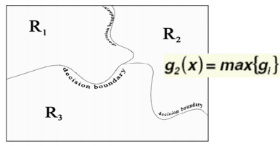
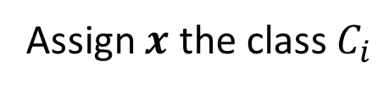
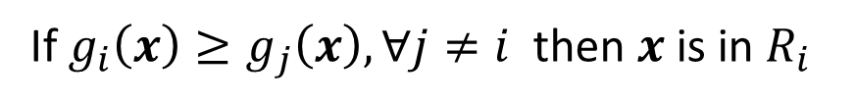

Classifiers and Discriminant Functions
Classifiers can be represented in terms of a set of discriminant function $g_{i}(x)$, $i=1,…C$.
The classifier assigns the class $C_{i}$ to $x$ if:
$g_{i}\left(x\right)≥g_{j}\left(x\right), ∀j≠i$
Feature space divided into $C$ decision regions $R_{i}$’s
If $g_{i}\left(x\right)≥g_{j}\left(x\right), ∀j≠i$ then $x$ is in $R_{i}$
Assign $x$ the class $C_{i}$
Decision Boundary

Slide 4
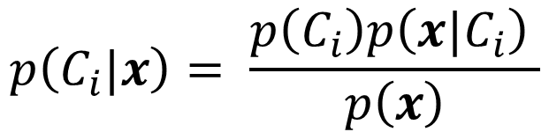
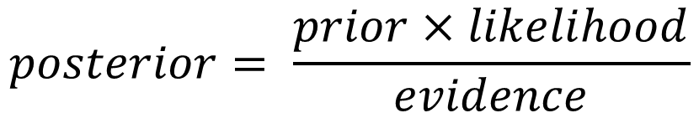

Bayes Decision Rule
先验概率
Prior: A priori probability $p(C_{i})$
$\sum_{i=1}^{M}{p\left(C_{i}\right)}=1$
证据因子
Evidence: Probability density of feature $x$: $p\left(x\right)$
似然(类条件概率)
Likelihood: Class-conditional probability density: $p\left(x|C_{i}\right)$
后验概率
Posterior: Probability of class $C_{i}$for a given feature value $x$: $p\left(C_{i}|x\right)$
$$p\left(C_{i}|x\right)= \frac{p\left(C_{i}\right)p\left(x|C_{i}\right) }{p\left(x\right)}$$
$$posterior= \frac{prior×likelihood}{evidence}$$

Slide 5
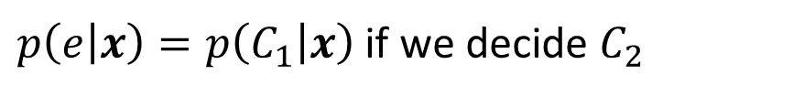

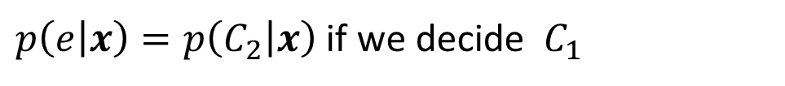
Bayes Decision Rule
Consider the binary classification.
Probability of error when observing $x$:
$p\left(e | x\right)=p\left(C_{1} | x\right)$ if we decide $C_{2}$
$p\left(e | x\right)=p\left(C_{2} | x\right)$ if we decide $C_{1}$
Average probability of error
$$p(e)=\int_{−∞}^{∞}{p\left(e | x\right)p\left(x\right)dx}$$
Bayes decision rule for minimizing the probability of error:
decide $C_{1}$ if $p\left(C_{1} | x\right)>p\left(C_{2} | x\right)$; otherwise decide $C_{2}$

Slide 6
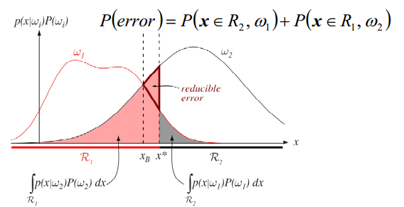











Bayes Error Rate—Minimum Error Rate
Bayes decision rule for minimizing the probability of error:
decide $C_{1}$ if $p\left(C_{1} | x\right)>\left(C_{2} | x\right)$; otherwise decide $C_{2}$
$$p\left(x | C_{i}\right)p(C_{i})$$
$$p\left(e\right)=p\left(x∈ℛ_{2},C_{1}\right)+p(x∈ℛ_{1},C_{2})$$
Equal posterior probability
$$C_{1}$$
$$C_{2}$$
$x^{∗}$: nonoptimal decision point.
Pink area: the probability of errors for deciding $C_{1}$ when the nature is $C_{2};$
Gray area: the converse.
$x_{B}$: decision boundary of Bayes decision, where the reducible error is eliminated and the total shaded area is minimum possible (Bayes error rate).
Bayes error rate: the minimum achievable error rate for a classification problem.
Reducible error
$$x$$
$$ℛ_{1}$$
$$x_{B}$$
$$x^{∗}$$
$$ℛ_{2}$$
$$\int_{ℛ_{1}}{p\left(x | C_{2}\right)p\left(C_{2}\right)dx}$$
$$\int_{ℛ_{2}}{p\left(x | C_{1}\right)p\left(C_{1}\right)dx}$$

Slide 7
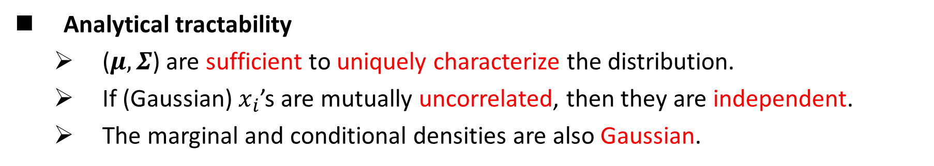
Why Gaussian
Analytical tractability
($μ, Σ$) are sufficient to uniquely characterize the distribution.
If (Gaussian) $x_{i}$’s are mutually uncorrelated, then they are independent.
The marginal and conditional densities are also Gaussian.
Ubiquity-Frequently observed
Central limit theorem (Many distributions we wish to model are truly close to being normal distributions.

Slide 8
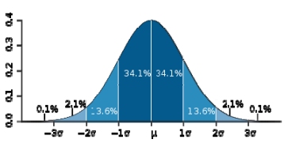
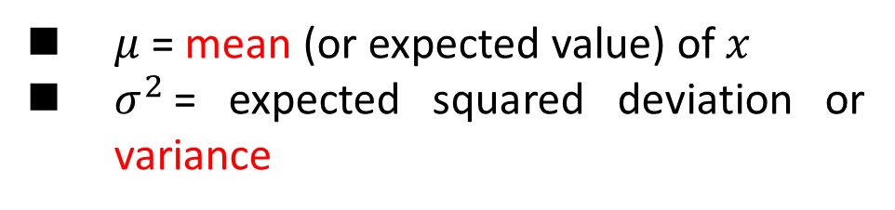
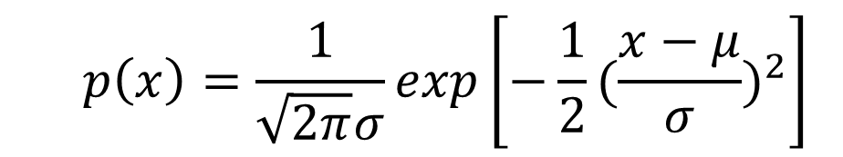
Normal/Gaussian Distribution of a Random Variable
Probability density function:
$$p\left(x\right)=\frac{1}{\sqrt{2π}σ}exp\left[−\frac{1}{2}{(\frac{x−μ}{σ})}^{2}\right]$$
$μ$ = mean (or expected value) of $x$
$σ^{2}$= expected squared deviation or variance

Slide 9
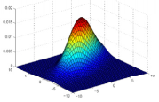
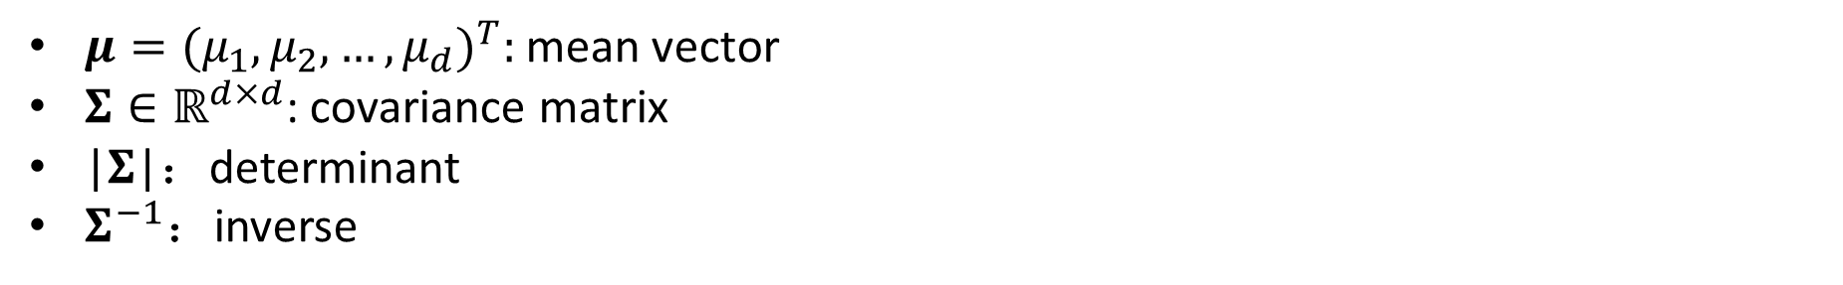

Gaussian
Multivariate Gaussian
$p\left(x\right)=\frac{1}{{(2π)}^{d/2}{|Σ|}^{1/2}}exp\left[−\frac{1}{2}{\left(x−μ\right)}^{T}Σ^{−1}\left(x−μ\right)\right]$
$μ={(μ_{1},μ_{2},…,μ_{d})}^{T}:$ mean vector
$Σ∈ℝ^{d×d}$: covariance matrix
|$Σ$|：determinant
$Σ^{−1}：$inverse
$$Σ=\left[\begin{matrix}σ_{1}^{2} & ⋯ & σ_{1d} \\ ⋮ & ⋱ & ⋮ \\ σ_{d1} & ⋯ & σ_{d}^{2}\end{matrix}\right]$$

Slide 10
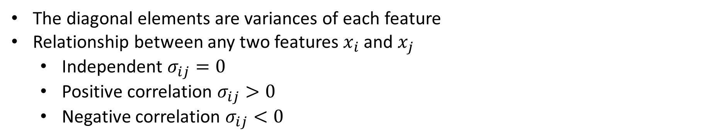
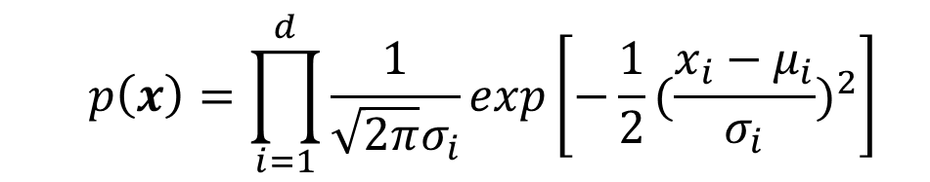

Covariance Matrix
The diagonal elements are variances of each feature
Relationship between any two features $x_{i}$ and $x_{j}$
Independent $σ_{ij}=0$
Positive correlation $σ_{ij}>0$
Negative correlation $σ_{ij}<0$
$$Σ=\left[\begin{matrix}σ_{1}^{2} & ⋯ & σ_{1d} \\ ⋮ & ⋱ & ⋮ \\ σ_{d1} & ⋯ & σ_{d}^{2}\end{matrix}\right]$$
If $Σ$ is diagonal:
$p\left(x\right)=\frac{1}{{(2π)}^{d/2}{|Σ|}^{1/2}}exp\left[−\frac{1}{2}{\left(x−μ\right)}^{T}Σ^{−1}\left(x−μ\right)\right]$
$$p\left(x\right)=\prod_{i=1}^{d}{\frac{1}{\sqrt{2π}σ_{i}}exp\left[−\frac{1}{2}{(\frac{x_{i}−μ_{i}}{σ_{i}})}^{2}\right]}$$

Slide 11
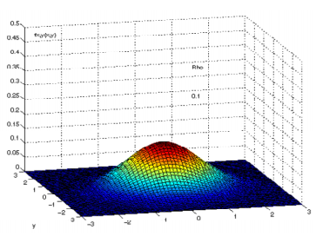
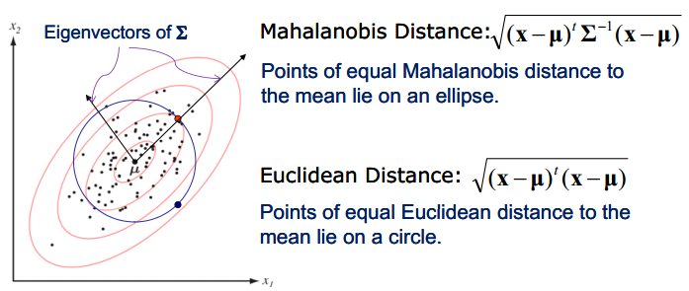
Mahalanobis Distance
Probability density function:
$p\left(x\right)=\frac{1}{{(2π)}^{d/2}{|Σ|}^{1/2}}exp\left[−\frac{1}{2}{\left(x−μ\right)}^{T}Σ^{−1}\left(x−μ\right)\right]$
Mean vector: $μ$ Covariance matrix: $Σ$
Mahalanobis distance:
$\sqrt{{\left(x−μ\right)}^{T}Σ^{−1}\left(x−μ\right) }$
$\sqrt{{\left(x−μ\right)}^{T}Σ^{−1}\left(x−μ\right) }$
Represents the distance of the test point $x$from the mean $μ$.
If $Σ=I,$ Mahalanobis distance $↔$ Euclidean distance.
$\sqrt{{\left(x−μ\right)}^{T}\left(x−μ\right) }$

Slide 12
Independent Gaussian Models
Special Case: Assume that $x_{1}$ and $x_{2}$ are independent.
$p\left(x_{1}\right)=\frac{1}{\sqrt{2π}σ_{1}}exp\left[−\frac{1}{2}{(\frac{x_{1}−μ_{1}}{σ_{1}})}^{2}\right]$
$p\left(x_{2}\right)=\frac{1}{\sqrt{2π}σ_{2}}exp\left[−\frac{1}{2}{(\frac{x_{2}−μ_{2}}{σ_{2}})}^{2}\right]$
$p\left(x_{1}\right)p\left(x_{2}\right)=\frac{1}{2πσ_{1}σ_{2}}exp\left[\frac{1}{2}{\left(x−μ\right)}^{T}Σ^{−1}\left(x−μ\right)\right]$
$x=\left[x_{1} x_{2}\right]$
$$μ=\left[μ_{1} μ_{2}\right]$$
$$Σ=diag(σ_{1}^{2},σ_{2}^{2})$$

Slide 13
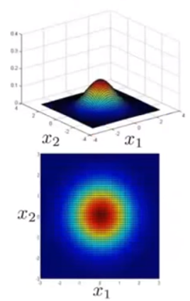
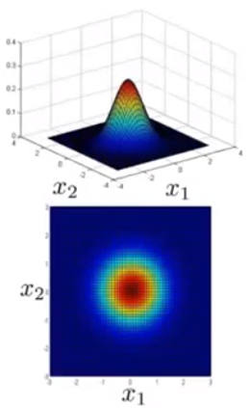
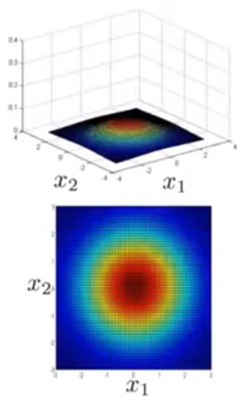


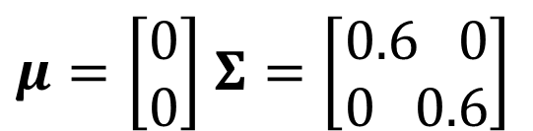


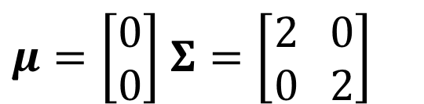




Multivariate Gaussian Examples
$μ=\left[\begin{aligned}0 \\ 0\end{aligned}\right]$ $Σ=\left[\begin{aligned}1 0 \\ 0 1\end{aligned}\right]$
$μ=\left[\begin{aligned}0 \\ 0\end{aligned}\right]$ $Σ=\left[\begin{aligned}0.6 0 \\ 0 0.6\end{aligned}\right]$
$μ=\left[\begin{aligned}0 \\ 0\end{aligned}\right]$ $Σ=\left[\begin{aligned}2 0 \\ 0 2\end{aligned}\right]$
$x_{2}$
$x_{1}$
$x_{2}$
$x_{2}$
$x_{1}$
$x_{1}$
$x_{2}$
$x_{2}$
$x_{2}$
$x_{1}$
$x_{1}$
$x_{1}$

Slide 14
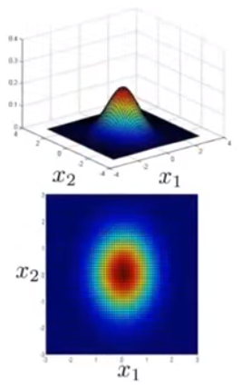
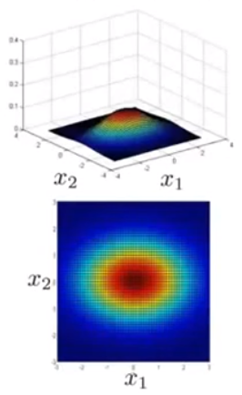
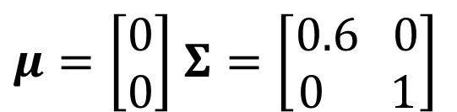
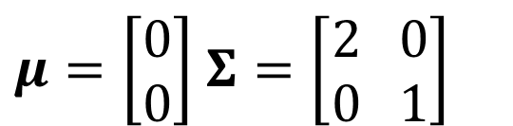
Multivariate Gaussian Examples
$μ=\left[\begin{aligned}0 \\ 0\end{aligned}\right]$ $Σ=\left[\begin{aligned}1 0 \\ 0 1\end{aligned}\right]$
$μ=\left[\begin{aligned}0 \\ 0\end{aligned}\right]$ $Σ=\left[\begin{aligned}0.6 0 \\ 0 1\end{aligned}\right]$
$μ=\left[\begin{aligned}0 \\ 0\end{aligned}\right]$ $Σ=\left[\begin{aligned}2 0 \\ 0 1\end{aligned}\right]$
$x_{2}$
$x_{1}$
$x_{2}$
$x_{2}$
$x_{1}$
$x_{1}$
$x_{2}$
$x_{2}$
$x_{2}$
$x_{1}$
$x_{1}$
$x_{1}$

Slide 15
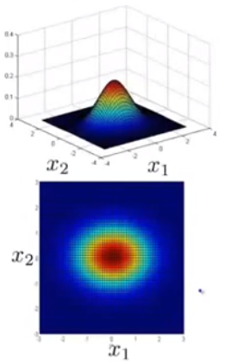
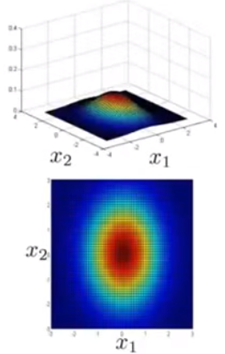





Multivariate Gaussian Examples
$μ=\left[\begin{aligned}0 \\ 0\end{aligned}\right]$ $Σ=\left[\begin{aligned}1 0 \\ 0 1\end{aligned}\right]$
$μ=\left[\begin{aligned}0 \\ 0\end{aligned}\right]$ $Σ=\left[\begin{aligned}1 0 \\ 0 0.6\end{aligned}\right]$
$μ=\left[\begin{aligned}0 \\ 0\end{aligned}\right]$ $Σ=\left[\begin{aligned}1 0 \\ 0 2\end{aligned}\right]$
$x_{2}$
$x_{1}$
$x_{2}$
$x_{2}$
$x_{1}$
$x_{1}$
$x_{2}$
$x_{2}$
$x_{2}$
$x_{1}$
$x_{1}$
$x_{1}$

Slide 16
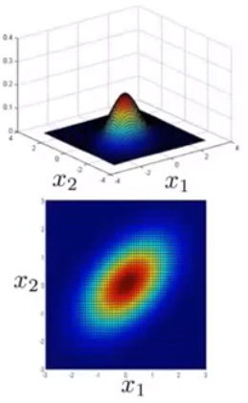
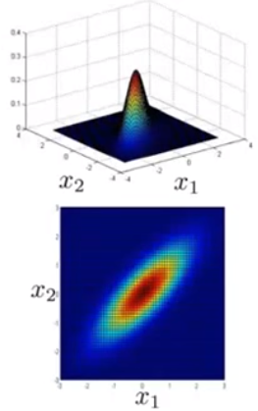
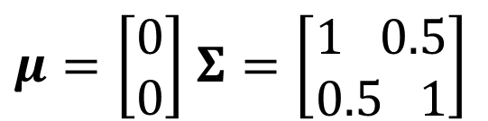
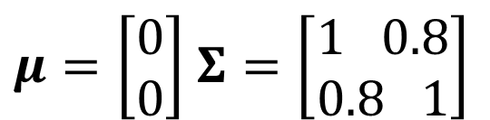
Multivariate Gaussian Examples
$μ=\left[\begin{aligned}0 \\ 0\end{aligned}\right]$ $Σ=\left[\begin{aligned}1 0 \\ 0 1\end{aligned}\right]$
$μ=\left[\begin{aligned}0 \\ 0\end{aligned}\right]$ $Σ=\left[\begin{aligned}1 0.5 \\ 0.5 1\end{aligned}\right]$
$μ=\left[\begin{aligned}0 \\ 0\end{aligned}\right]$ $Σ=\left[\begin{aligned}1 0.8 \\ 0.8 1\end{aligned}\right]$
$x_{2}$
$x_{1}$
$x_{2}$
$x_{2}$
$x_{1}$
$x_{1}$
$x_{2}$
$x_{2}$
$x_{2}$
$x_{1}$
$x_{1}$
$x_{1}$

Slide 17
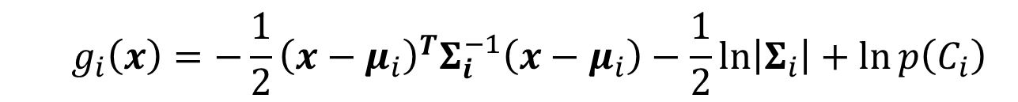
Discriminant Functions for Gaussian
For the minimum error rate, we take
$$g_{i}\left(x\right)=\ln{p\left(C_{i}|x\right)}∝\ln{p\left(x|C_{i}\right)}+\ln{p\left(C_{i}\right)}$$
Case of multivariate Gaussian
$p\left(x|C_{i}\right)=\frac{1}{{(2π)}^{d/2}{|Σ_{i}|}^{1/2}}exp\left[−\frac{1}{2}{\left(x−μ_{i}\right)}^{T}{Σ_{i}}^{−1}\left(x−μ_{i}\right)\right]$
$$g_{i}\left(x\right)=−\frac{1}{2}{\left(x−μ_{i}\right)}^{T}Σ_{i}^{−1}\left(x−μ_{i}\right)−\frac{1}{2}ln\left|Σ_{i}\right|+\ln{p\left(C_{i}\right)}$$

Slide 18
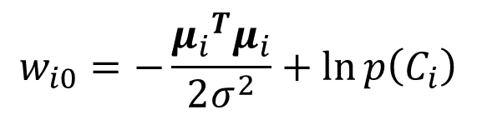
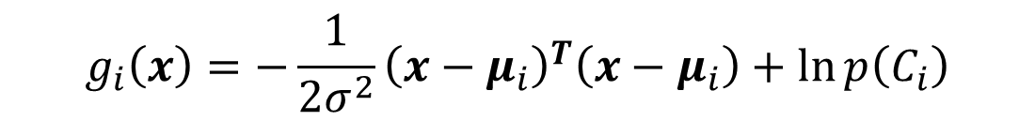

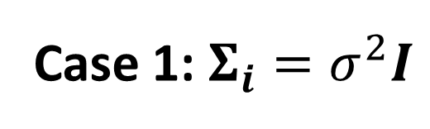

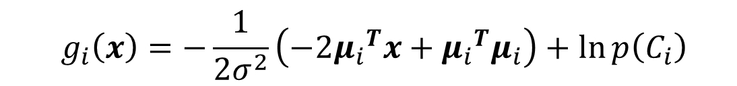

Case 1: $Σ_{i}=σ^{2}I$
All features are independent and have the same variance for all classes.
$$g_{i}\left(x\right)=−\frac{1}{2}{\left(x−μ_{i}\right)}^{T}Σ_{i}^{−1}\left(x−μ_{i}\right)−\frac{1}{2}ln\left|Σ_{i}\right|+\ln{p\left(C_{i}\right)}$$
Euclidean distance${\left\|x−μ_{i}\right\|}^{2}$
$$g_{i}\left(x\right)=−\frac{1}{2σ^{2}}{\left(x−μ_{i}\right)}^{T}\left(x−μ_{i}\right)+\ln{p\left(C_{i}\right)}$$
$$g_{i}\left(x\right)=−\frac{1}{2σ^{2}}\left(−2{μ_{i}}^{T}x+{μ_{i}}^{T}μ_{i}\right)+\ln{p\left(C_{i}\right)}$$
$$g_{i}\left(x\right)={w_{i}}^{T}x+w_{i0}$$
bias
Linear discriminant function
$$w_{i}=\frac{μ_{i}}{σ^{2}}$$
$$w_{i0}=−\frac{{μ_{i}}^{T}μ_{i}}{2σ^{2}}+\ln{p\left(C_{i}\right)}$$

Slide 19
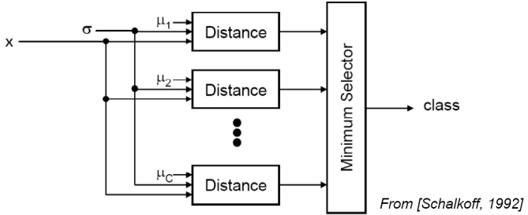
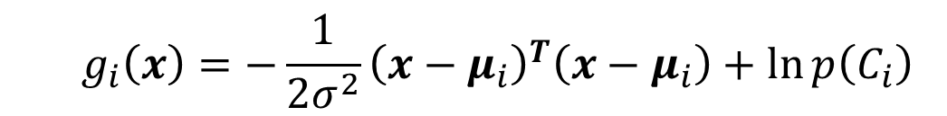

Case 1: $Σ_{i}=σ^{2}I$
Minimum Distance Classifier
$$g_{i}\left(x\right)=−\frac{1}{2σ^{2}}{\left(x−μ_{i}\right)}^{T}\left(x−μ_{i}\right)+\ln{p\left(C_{i}\right)}$$
$$g_{i}\left(x\right)=−{\left(x−μ_{i}\right)}^{T}\left(x−μ_{i}\right)$$
Assume equal priors

Slide 20

Case 1: $Σ_{i}=σ^{2}I$
A classifier that uses linear discriminant functions is called “a linear machine”
The decision surfaces for a linear machine are pieces of hyperplanes defined by
$$g_{i}\left(x\right)=g_{j}\left(x\right)$$
$$−\frac{1}{2σ^{2}}\left(−2{μ_{i}}^{T}x+{μ_{i}}^{T}μ_{i}\right)+\ln{p\left(C_{i}\right)}=−\frac{1}{2σ^{2}}\left(−2{μ_{j}}^{T}x+{μ_{j}}^{T}μ_{j}\right)+\ln{p\left(C_{j}\right)}$$
$$\left({μ_{i}}^{T}x−\frac{1}{2}{μ_{i}}^{T}μ_{i}\right)+σ^{2}\ln{p\left(C_{i}\right)}=\left({μ_{j}}^{T}x−\frac{1}{2}{μ_{j}}^{T}μ_{j}\right)+σ^{2}\ln{p\left(C_{j}\right)}$$
$${(μ_{i}−μ_{j})}^{T}x−\frac{1}{2}{\left(μ_{i}−μ_{j}\right)}^{T}(μ_{i}+μ_{j})+σ^{2}\ln{\frac{p\left(C_{i}\right)}{p\left(C_{j}\right)}}=0$$
The hyperplane separating $R_{i}$ and $R_{j}$ always orthogonal to the line linking the means!

Slide 21
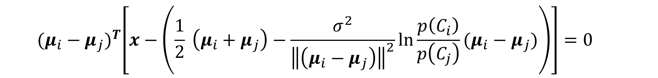
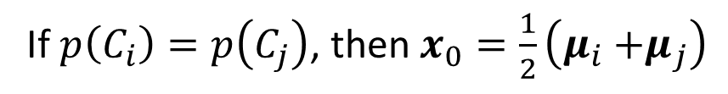
Case 1: $Σ_{i}=σ^{2}I$
$${(μ_{i}−μ_{j})}^{T}x−\frac{1}{2}{\left(μ_{i}−μ_{j}\right)}^{T}(μ_{i}+μ_{j})+σ^{2}\ln{\frac{p\left(C_{i}\right)}{p\left(C_{j}\right)}}=0$$
$${(μ_{i}−μ_{j})}^{T}\left[x−\left(\frac{1}{2} \left(μ_{i}+μ_{j}\right)−\frac{σ^{2}}{{\left\|\left(μ_{i}−μ_{j}\right)\right\|}^{2}}\ln{\frac{p\left(C_{i}\right)}{p\left(C_{j}\right)}(μ_{i}−μ_{j})}\right)\right]=0$$
$${\left(μ_{i}−μ_{j}\right)}^{T}(x−x_{0})=0$$
If $p\left(C_{i}\right)=p\left(C_{j}\right)$, then $x_{0}=\frac{1}{2}\left(μ_{i}{+μ}_{j}\right)$
The mean $\frac{1}{2}\left(μ_{i}{+μ}_{j}\right)$ is on the hyperplane (i.e, the hyperplane passes through it).

Slide 22
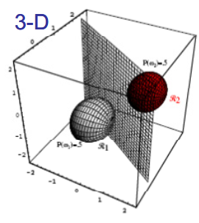
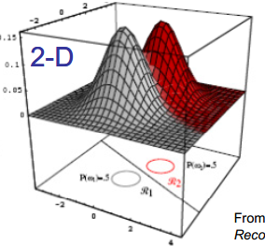

















Decision surface for Case 1: $Σ_{i}=σ^{2}I$
$$p\left(x|C_{i}\right)$$
$$C_{1}$$
$$C_{2}$$
$p\left(C_{2}\right)=$0.5
$$R_{2}$$
$p\left(C_{2}\right)=$0.5
$p\left(C_{1}\right)=$0.5
$$R_{1}$$
$p\left(C_{1}\right)=$0.5
$$R_{2}$$
$$R_{1}$$
$$R_{2}$$
$$R_{1}$$
$p\left(C_{1}\right)=$0.5
$p\left(C_{2}\right)=$0.5

Slide 23














Priors and Decision Boundary
$${(μ_{i}−μ_{j})}^{T}\left[x−\left(\frac{1}{2} \left(μ_{i}+μ_{j}\right)−\frac{σ^{2}}{{\left\|\left(μ_{i}−μ_{j}\right)\right\|}^{2}}\ln{\frac{p\left(C_{i}\right)}{p\left(C_{j}\right)}(μ_{i}−μ_{j})}\right)\right]=0$$
$$p\left(x|C_{i}\right)$$
$$C_{2}$$
$$C_{1}$$
$p\left(C_{2}\right)=$0.2
$$R_{2}$$
$p\left(C_{1}\right)=$0.8
$$R_{1}$$
$$R_{1}$$
$$R_{2}$$
$p\left(C_{1}\right)=$0.7
$p\left(C_{2}\right)=$0.3

Slide 24




Case 2: $Σ_{i}=Σ$
Covariance of all classes are identical but arbitrary
$$g_{i}\left(x\right)=−\frac{1}{2}{\left(x−μ_{i}\right)}^{T}Σ_{i}^{−1}\left(x−μ_{i}\right)−\frac{1}{2}ln\left|Σ_{i}\right|+\ln{p\left(C_{i}\right)}$$
$$g_{i}\left(x\right)=−\frac{1}{2}{\left(x−μ_{i}\right)}^{T}Σ^{−1}\left(x−μ_{i}\right)+\ln{p\left(C_{i}\right)}$$
Squared Mahalanobis Distance
${\left(x−μ_{i}\right)}^{T}Σ^{−1}\left(x−μ_{i}\right)$

Slide 25





Mahalanobis Distance vs Euclidean Distance
$$x_{2}$$
Mahalanobis Distance
$\sqrt{{\left(x−μ_{i}\right)}^{T}Σ^{−1}\left(x−μ_{i}\right)}$
Points of equal Mahalanobis distance to the mean lies on an ellipse.
Euclidean Distance
$\sqrt{{\left(x−μ_{i}\right)}^{T}\left(x−μ_{i}\right)}$
Points of equal Euclidean distance to the mean lies on a circle.
$$x_{1}$$

Slide 26



Case 2: $Σ_{i}=Σ$
Covariance of all classes are identical but arbitrary
$$g_{i}\left(x\right)=−\frac{1}{2}{\left(x−μ_{i}\right)}^{T}Σ_{i}^{−1}\left(x−μ_{i}\right)−\frac{1}{2}ln\left|Σ_{i}\right|+\ln{p\left(C_{i}\right)}$$
$$g_{i}\left(x\right)=−\frac{1}{2}{\left(x−μ_{i}\right)}^{T}Σ^{−1}\left(x−μ_{i}\right)+\ln{p\left(C_{i}\right)}$$
$$g_{i}\left(x\right)={w_{i}}^{T}x+w_{i0}$$
bias
Linear discriminant function
$$w_{i}=Σ^{−1}μ_{i}$$
$$w_{i0}=−\frac{1}{2}{μ_{i}}^{T}Σ^{−1}μ_{i}+\ln{p\left(C_{i}\right)}$$

Slide 27


Decision Boundaries for Case 2: $Σ_{i}=Σ$
$$g_{i}\left(x\right)=g_{j}\left(x\right)$$
$$−\frac{1}{2}{\left(x−μ_{i}\right)}^{T}Σ^{−1}\left(x−μ_{i}\right)+\ln{p\left(C_{i}\right)}=−\frac{1}{2}{\left(x−μ_{j}\right)}^{T}Σ^{−1}\left(x−μ_{j}\right)+\ln{p\left(C_{j}\right)}$$
$$\left({μ_{i}}^{T}Σ^{−1}x−\frac{1}{2}{μ_{i}}^{T}Σ^{−1}μ_{i}\right)+\ln{p\left(C_{i}\right)}=\left({μ_{j}}^{T}Σ^{−1}x−\frac{1}{2}{μ_{j}}^{T}Σ^{−1}μ_{j}\right)+\ln{p\left(C_{j}\right)}$$
$${(Σ^{−1}μ_{i}−Σ^{−1}μ_{j})}^{T}x−\frac{1}{2}{\left(μ_{i}−μ_{j}\right)}^{T}Σ^{−1}(μ_{i}+μ_{j})+\ln{\frac{p\left(C_{i}\right)}{p\left(C_{j}\right)}}=0$$
The hyperplane separating $R_{i}$ and $R_{j}$ is generally not orthogonal to the line linking the means!

Slide 28

Decision Boundaries for Case 2: $Σ_{i}=Σ$
$${(Σ^{−1}μ_{i}−Σ^{−1}μ_{j})}^{T}x−\frac{1}{2}{\left(μ_{i}−μ_{j}\right)}^{T}Σ^{−1}(μ_{i}+μ_{j})+\ln{\frac{p\left(C_{i}\right)}{p\left(C_{j}\right)}}=0$$
$${(Σ^{−1}μ_{i}−Σ^{−1}μ_{j})}^{T}\left(x−\frac{1}{2} \left(μ_{i}+μ_{j}\right)+\frac{\ln{p\left(C_{i}\right)/p\left(C_{j}\right)}}{{\left(μ_{i}−μ_{j}\right)}^{T}Σ^{−1}\left(μ_{i}−μ_{j}\right)}\left(μ_{i}−μ_{j}\right)\right)=0$$
$${\left(Σ^{−1}μ_{i}−Σ^{−1}μ_{j}\right)}^{T}(x−x_{0})=0$$
If $p\left(C_{i}\right)=p\left(C_{j}\right)$, then $x_{0}=\frac{1}{2}\left(μ_{i}{+μ}_{j}\right)$, which is on the hyperplane (i.e, the hyperplane passes through it).
Just generally not orthogonal.

Slide 29


Case 3: $Σ_{i}={σ_{i}}^{2}I$
Each class has a different covariance matrix, proportional to the identity matrix.
$$g_{i}\left(x\right)=−\frac{1}{2}{\left(x−μ_{i}\right)}^{T}Σ_{i}^{−1}\left(x−μ_{i}\right)−\frac{1}{2}ln\left|Σ_{i}\right|+\ln{p\left(C_{i}\right)}$$
Quadratic discriminant function
$$g_{i}\left(x\right)=−\frac{1}{2σ_{i}^{2}}{\left(x−μ_{i}\right)}^{T}\left(x−μ_{i}\right)−\frac{d}{2}ln⁡(σ_{i}^{2})+\ln{p\left(C_{i}\right)}$$

Slide 30









Case 3: $Σ_{i}={σ_{i}}^{2}I$
$$g_{i}\left(x\right)=−\frac{1}{2σ_{i}^{2}}{\left(x−μ_{i}\right)}^{T}\left(x−μ_{i}\right)−\frac{d}{2}ln⁡(σ_{i}^{2})+\ln{p\left(C_{i}\right)}$$
Decision boundary
$${μ_{1}=[3 3]}^{T}$$
$${μ_{2}=[−3 −3]}^{T}$$
$$σ_{1}=2$$
$$σ_{2}=4$$
$$g_{1}\left(x\right)=g_{2}\left(x\right)$$
$$−\frac{1}{8}{\left(x−μ_{1}\right)}^{T}\left(x−μ_{1}\right)−\ln\left(4\right)+\ln{p\left(C_{1}\right)}=−\frac{1}{32}{\left(x−μ_{2}\right)}^{T}\left(x−μ_{2}\right)−ln⁡(16)+\ln{p\left(C_{2}\right)}$$
$$−4{\left(x−μ_{1}\right)}^{T}\left(x−μ_{1}\right)−32\ln\left(4\right)+32ln{r}=−{\left(x−μ_{2}\right)}^{T}\left(x−μ_{2}\right)−32ln⁡(16)$$
$$−3x^{T}x+{μ_{2}}^{T}μ_{2}−4{μ_{1}}^{T}μ_{1}+8x^{T}μ_{1}−2x^{T}μ_{2}−32\ln\left(\frac{1}{4}\right)+32ln{r}=0$$
$$x^{T}x−\frac{10}{3}x^{T}μ_{1}+18−\frac{32}{3}\ln{4}−\frac{32}{3}ln{r}=0$$
$r=$ $p\left(C_{1}\right)/p\left(C_{2}\right)$
$${\left(x−\left[\begin{aligned}5 \\ 5\end{aligned}\right]\right)}^{T}\left(x−\left[\begin{aligned}5 \\ 5\end{aligned}\right]\right)=32\left(1+\frac{\ln{4r}}{3}\right)$$

Slide 31





Case 4: $Σ_{i}=$arbitrary
Each class has a different covariance matrix.
$$g_{i}\left(x\right)=−\frac{1}{2}{\left(x−μ_{i}\right)}^{T}Σ_{i}^{−1}\left(x−μ_{i}\right)−\frac{1}{2}ln\left|Σ_{i}\right|+\ln{p\left(C_{i}\right)}$$
Quadratic discriminant function
$$g_{i}\left(x\right)=x^{T}W_{i}x+{w_{i}}^{T}x+w_{i0}$$
$$W_{i}=−\frac{1}{2}Σ_{i}^{−1}$$
$$w_{i}=Σ_{i}^{−1}μ_{i}$$
$$w_{i0}=−\frac{1}{2}{μ_{i}}^{T}Σ_{i}^{−1}μ_{i}−\frac{1}{2}ln\left|Σ_{i}\right|+\ln{p\left(C_{i}\right)}$$

Slide 32




Case 4: $Σ_{i}$=arbitrary
$$g_{i}\left(x\right)=x^{T}W_{i}x+{w_{i}}^{T}x+w_{i0}$$
The decision boundaries are hyperquadrics
Hyperplanes, pairs of hyperplanes, hyperspheres, hyperellipsoids, hyperparaboloids, hyperhyperboloids.
超平面，超平面对，超球面，超椭球，超抛物面，超双曲面

Slide 33







Case 4: $Σ_{i}$=arbitrary
$$p\left(x|C_{i}\right)$$
$$C_{2}$$
$$C_{1}$$
$$R_{1}$$
$$R_{2}$$
$$R_{1}$$
Non-simply connected decision regions can arise for Gaussians having unequal variance.

Slide 34
Summary
The Bayes classifier for normally distributed classes (general case) is a quadratic classifier.
The Bayes classifier for normally distributed classes with equal covariance matrices is a linear classifier.

Slide 35
Naïve Bayes Classifier

Slide 36
Naïve Bayes Classifier
A Naive Bayes classifier is a simple probabilistic classifier based on applying Bayes' theorem (from Bayesian statistics) with strong (naive) independence assumptions.
Independent feature model
Assumes that the presence (or absence) of a particular feature of a class is unrelated to the presence (or absence) of any other feature.
For example, a fruit may be considered to be an apple if it is red, round, and about 4" in diameter.
Even if these features depend on each other or upon the existence of the other features, a naive Bayes classifier considers all of these properties to independently contribute to the probability that this fruit is an apple.

Slide 37
Naïve Bayes Classifier
In spite of their naive design and apparently over-simplified assumptions, naive Bayes classifiers have worked quite well in many complex real-world situations.
In 2004, analysis of the Bayesian classification problem has shown that there are some theoretical reasons for the apparently unreasonable efficacy of naive Bayes classifiers.^{[1]}
Still, a comprehensive comparison with other classification methods in 2006 showed that Bayes classification is outperformed by more current approaches, such as boosted trees or random forests.^{[2]}
It only requires a small amount of training data to estimate the parameters (means and variances of the variables) necessary for classification.
Because independent variables are assumed, only the variances of the variables for each class need to be determined and not the entire covariance matrix.

Slide 38



Naïve Bayes Probabilistic Model
Abstractly, the probability model for a classifier is a conditional model
$$p(C|F_{1},…,F_{d})$$
$C$: outcome or class; $F1,…,Fd$: feature variables.
Problem: if the number of features $d$ is large or when a feature can take on a large number of values, then basing such a model on probability tables is infeasible.
We therefore reformulate the model to make it more tractable.
Using Bayes' theorem, we write
$p\left(C | F_{1},…,F_{d}\right)= \frac{p\left(C\right)p(F_{1},…,F_{d}|C)}{p(F_{1},…,F_{d})}$

Slide 39




Naïve Bayes Probabilistic Model
$p\left(C | F_{1},…,F_{d}\right)= \frac{p\left(C\right)p(F_{1},…,F_{d}|C)}{p(F_{1},…,F_{d})}$
$$p(C,F_{1},…,F_{d})$$
In plain English the above equation can be written as
$$posterior= \frac{prior×likelihood}{evidence}$$
In practice we are only interested in the numerator of that fraction, since the denominator does not depend on $C$ and the values of the features $Fi$ are given, so that the denominator is effectively constant.

Slide 40


Naïve Bayes Probabilistic Model
$$p\left(C,F_{1},…,F_{d}\right)$$
= $p\left(C\right)p\left(F_{1},…,F_{d}|C\right)$
= $p\left(C\right)p\left(F_{1}|C\right)p\left(F_{2},…,F_{d}|C,F1\right)$
= $p\left(C\right)p\left(F_{1}|C\right)p\left(F2|C,F_{1}\right)p\left(F_{3},…,F_{d}|C,F1{,F}_{2}\right)$
= $p\left(C\right)p\left(F_{1}|C\right)p\left(F2|C,F_{1}\right)p\left(F3|C,F_{1},F2\right)p\left(F_{4},…,F_{d}|C,F1{,F}_{2},F3\right)$
= $p\left(C\right)p\left(F_{1}|C\right)p\left(F2|C,F_{1}\right)p\left(F3|C,F_{1},F2\right)⋯p\left(F_{d} |C,F1{,F}_{2},F3,⋯,F_{d−1}\right)$
“Naive” Assumption: each feature $F_{i}$ is conditionally independent of every other feature $F_{j}$ for $j≠i :$
$$p\left(F_{i} | C,F_{j}\right)=p(F_{i}|C)$$

Slide 41


Naïve Bayes Probabilistic Model
The joint model can be expressed as
$p(C,F_{1},⋯F_{d})=p\left(C\right)P(F_{1}|C)$ $P(F_{2}|C)$ $P\left(F_{3} | C\right)⋯$
$$=p(C)\prod_{i=1}^{d}{p(F_{i}|C)}$$
Therefore, we have,
$$p\left(C | F_{1},…,F_{d}\right)= \frac{1}{Z}p(C)\prod_{i=1}^{d}{p(F_{i}|C)}$$
where $Z$ (the evidence) is a scaling factor dependent only on $F_{1},⋯F_{d}$ , i.e., a constant if the values of the feature variables are known.

Slide 42



Naïve Bayes Probabilistic Model
$$p\left(C | F_{1},…,F_{d}\right)= \frac{1}{Z}p(C)\prod_{i=1}^{d}{p(F_{i}|C)}$$
This model is factored into a class prior $p(C)$ and independent probability distributions $p(Fi|C)$.
If there are $k$ classes and if a model for each $p(Fi|C = c)$ can be expressed in terms of $r$ parameters, then the corresponding naive Bayes model has $(k−1)+drk$ parameters.
In practice, $k=2$ often (binary classification) and $r=1$ (Bernoulli feature: $P_{r}\left(X=1\right)=p,P_{r}\left(X=0\right)=1−p$) are common, and so the total number of parameters of the naive Bayes model is $2d+1$, where $d$ is the number of features used for classification.

Slide 43






Parameter Estimation
We can use the maximum likelihood estimates of the probabilities.
Given a dataset $𝒟=\{x_{1},x_{2},…,x_{n}\}$, where the $n$ samples are drawn independently from identical distribution $p(x|θ)$, estimate parameters $θ$.
ML estimate parameters $θ$ maximizes $p(𝒟|θ)$
$𝒟$ is an i.i.d set
$$p\left(𝒟 | θ\right)=\prod_{k=1}^{n}{p(x_{k}|θ)}$$
$$\hat{θ}=arg \max_{θ}{p(𝒟|θ)}$$
$$\hat{θ}$$

Slide 44

Maximum-Likelihood Estimation
ML estimate parameters $θ$ maximizes $p(X,C|θ)$, $X=[F_{1},F_{2},…,F_{d}]$
$$\hat{θ}=arg \max_{θ}{p(X,C|θ)}$$
All model parameters (i.e., class priors and feature probability distributions) can be approximated with relative frequencies from the training set.
Why?

Slide 45


Maximum-Likelihood Estimation
All model parameters (i.e., class priors and feature probability distributions) can be approximated with relative frequencies from the training set.
Let us consider the MLE for binomial distribution ($N$ independent Bernoulli Trials),
Let $X\sim B\left(N,p\right),$ and the actual data (number of successes) $X=k$, then its likelihood is
$$L\left(p|k\right)=P\left(X=k|p\right)=C_{N}^{k}p^{k}{(1−p)}^{N−k}$$
$$\frac{∂lnL\left(p|k\right)}{∂p}=\frac{k}{p}−\frac{N−k}{1−p}=0$$
Taking the derivative of $lnL(p|k)$ with respect to $p$:
Then we have,
$$p=\frac{k}{N}$$

Slide 46



Parameter Estimation (Maximum-Likelihood Estimation)
Let $X\sim B\left(N,p\right),$ and the actual data $X=k$, then based on MLE, we have $p=\frac{k}{N}.$
A class' prior may be estimated as (prior for a given class) = (number of samples in the class) / (total number of samples), or just assuming equiprobable classes (i.e., priors = 1 / (number of classes)).
$$p(C=c)=\frac{\sum_{i=1}^{N}{I(C=c)}}{N}$$
$$p(C=c)=\frac{1}{K}$$
or
We can estimate the independent probability distribution $p(F_{j}=f_{j}|C=c)$ as follows:
$$p(F_{j}=f_{j}|C=c)=\frac{\sum_{i=1}^{N}{I(F_{j}=f_{j},C=c)}}{\sum_{i=1}^{N}{I(C=c)}}$$

Slide 47


Parameter Estimation
If one is dealing with continuous data, a typical assumption is that the continuous values associated with each class are distributed according to a Gaussian distribution.
For example, suppose the training data contains a continuous attribute, $x$. We first segment the data by the class, and then compute the mean $u_{c}$ and variance $σ_{c}^{2}$of $x$ in each class $c$.
Let $u_{c}$ be the mean of $x$ associated with class $c$, and $σ_{c}^{2}$ be the variance.
Then $P(x=v|c)$ can be computed by plugging $v$ into the equation as follows:
$$P\left(x=v | c\right)= \frac{1}{\sqrt{2πσ_{c}^{2}}} e^{−\frac{\left(v−u_{c}\right)2}{{2σ}_{c}^{2}}}$$

Slide 48

Constructing a classifier from the probability model
The discussion so far has derived the independent feature model, that is, the naive Bayes probability model.
The naive Bayes classifier combines this model with a decision rule.
One common rule is to pick the hypothesis that is most probable; this is known as the maximum a posteriori or MAP decision rule.
The corresponding classifier is defined as follows:
$$classify\left(f_{1},⋯f_{d}\right)= arg\max_{c}{p(C=c)\prod_{i=1}^{d}{p(F_{i}=f_{i}|C=c)}}$$

Slide 49

Examples--Sex Classification
Problem: Classify whether a given person is a male or a female based on the measured features. The features include height, weight, and foot size.
Example training set.

Slide 50


Examples--Sex Classification
The classifier created from the training set using a Gaussian distribution assumption would be:
Let's say $P(male)= P(female) = 0.5.$
If we determine $P(C)$ based on frequency in the training set, we happen to get the same answer.

Slide 51

Testing
A testing sample to be classified as a male or female.
$$posterior (male) = P(male)∗P(height|male)∗P(weight|male)∗P(foot size|male) / evidence$$
$$posterior (female) = P(female)∗P(height|female)∗P(weight|female)∗P(foot size|female) / evidence$$
$$evidence=P(male)∗P(height|male)∗P(weight|male)∗P(footsize|male)+P(female)∗P(height|female)∗P(weight|female)∗P(foot size|female)$$
The evidence may be ignored since it is a positive constant.

Slide 52

Testing
$P(male) = 0.5$
$P(height|male) = 1.5789$
$P(weight|male) = 5.9881e^{−6}$
$P(foot size|male) = 1.3112e^{−3}$
$posterior numerator \left(male\right)= their product = 6.1984e^{−9}$
$P(female) = 0.5$
$P(height|female) = 2.2346e^{−1}$
$P(weight|female) = 1.6789e^{−2}$
$P(foot size|female) = 2.8669e^{−1}$
$posterior numerator (female) = their product = 5.3778e^{−4}$
Since posterior numerator (female) > posterior numerator (male), the sample is female.

Slide 53



Document Classification
Consider the binary document classification of spam/non-spam E-mails.
We can model a document with a set of words, where the (independent) probability that the $i$-th word occurs in a document from class $C$ can be written as
$$P(w_{i}|C)$$
Assume that words are not dependent on the length of the document, position within the document with relation to other words, or other document-context.
$$p\left(D | C\right)= \prod_{i}{P(w_{i}|C) }$$

Slide 54

Document Classification
What is the probability that a given document $D$ belongs to a given class $C$ i.e., $p(C|D)$?
Bayes' theorem
$$p\left(C | D\right)= \frac{p\left(C\right)}{p\left(D\right)}p(D|C)$$

Slide 55





Document Classification
Bayes' theorem
$$p\left(C | D\right)= \frac{p\left(C\right)}{p\left(D\right)}p(D|C)$$
Assume that there are only 2 mutually exclusive classes, S and ¬S (e.g. spam/not spam),
$$p\left(D | S\right)= \prod_{i}{P(w_{i}|S) } and p\left(D | \text{¬}S\right)= \prod_{i}{P(w_{i}|\text{¬}S) }$$
$$p\left(S | D\right)= \frac{p(S)}{p(D)}\prod_{i}{P\left(w_{i} | S\right) }and p\left(\text{¬}S | D\right)=\frac{p(\text{¬}S)}{p(D)}\prod_{i}{P(w_{i}|\text{¬}S) }$$
$$\frac{p\left(S | D\right)}{p\left(\text{¬}S | D\right)}= \frac{p(S)\prod_{i}{p(w_{i}|S)}}{p(\text{¬}S)\prod_{i}{p(w_{i}|\text{¬}S)}}$$
$$\frac{p\left(S | D\right)}{p\left(\text{¬}S | D\right)}= \frac{p(S) }{p(\text{¬}S) }\prod_{i}{\frac{p(w_{i}|S)}{p(w_{i}|\text{¬}S)}}$$

Slide 56



Document Classification
$$\frac{p\left(S | D\right)}{p\left(\text{¬}S | D\right)}= \frac{p(S) }{p(\text{¬}S) }\prod_{i}{\frac{p(w_{i}|S)}{p(w_{i}|\text{¬}S)}}$$
The probability ratio $p(S|D)/p(¬S|D)$can be expressed in terms of a series of likelihood ratios.
Taking the logarithm of all these ratios, we have:
log-likelihood ratios（对数似然比）
$$\ln\left(\frac{p\left(S | D\right)}{p\left(\text{¬}S | D\right)}\right)=\ln\left(\frac{p\left(S\right)}{p\left(\text{¬}S\right)}\right)+\sum_{i}{ln⁡(\frac{p(w_{i}|S)}{p(w_{i}|\text{¬}S)})}$$
Finally, the document can be classified as follows.
It is spam if $p(S|D)>p(¬S|D)$ (i.e., $ln⁡(\frac{p(S|D)}{p(\text{¬}S|D)})>0$ ), otherwise it is not spam.

Slide 57


Sample Correction
$$p(F_{j}=f_{j}|C=c)=\frac{\sum_{i=1}^{N}{I(F_{j}=f_{j},C=c)}}{\sum_{i=1}^{N}{I(C=c)}}$$
$$classify\left(f_{1},⋯f_{d}\right)= arg\max_{c}{p(C=c)\prod_{i=1}^{d}{p(F_{i}=f_{i}|C=c)}}$$
If a given class and feature value never occur together in the training set then the frequency-based probability estimate will be zero.
This is problematic since it will wipe out all information in the other probabilities when they are multiplied.
It is therefore often desirable to incorporate a small-sample correction in all probability estimates such that no probability is ever set to be exactly zero.

Slide 58






Sample Correction
$$p_{λ}\left(C=c\right)=\frac{\sum_{i=1}^{N}{I\left(C=c\right)}+λ}{N+Kλ};$$
$K$: the total number of classes
$$p_{λ}\left(F_{j}=f_{j} | C=c\right)=\frac{\sum_{i=1}^{N}{I\left(F_{j}=f_{j},C=c\right)}+λ}{\sum_{i=1}^{N}{I\left(C=c\right)+S_{j}λ}};$$
$$λ≥0$$
$S_{j}$: the total number of possible values of $F_{j}$
$λ=0:$ maximum-likelihood estimation
$λ=1:$ Laplace Smoothing
Notably, under this correction, we still have, $\sum_{j=1}^{S_{j}}{p_{λ}\left(F_{j}=f_{j},C=c\right)}=1$
Please refer to https://zhuanlan.zhihu.com/p/24291822 for detailed derivation.

Slide 59
Remarks
Despite the fact that the far-reaching independence assumptions are often inaccurate, the naive Bayes classifier has several properties that make it surprisingly useful in practice.
The decoupling of the class conditional feature distributions means that each distribution can be independently estimated as a one dimensional distribution. This in turn helps to alleviate problems stemming from the curse of dimensionality.
Like all probabilistic classifiers under the MAP decision rule, it arrives at the correct classification as long as the correct class is more probable than any other class; hence class probabilities do not have to be estimated very well.

Slide 60
Reference
[1] Harry Zhang "The Optimality of Naive Bayes". FLAIRS2004 conference. (available online: PDF (http://www.cs.unb.ca/profs/hzhang/publications/FLAIRS04ZhangH.pdf)) [2] Caruana, R. and Niculescu-Mizil, A.: "An empirical comparison of supervised learning algorithms". Proceedings of the 23rd international conference on Machine learning, 2006.
[3] George H. John and Pat Langley (1995). Estimating Continuous Distributions in Bayesian Classifiers. Proceedings of the Eleventh Conference on Uncertainty in Artificial Intelligence. pp. 338-345. Morgan Kaufmann, San Mateo.

Slide 61

Conclusion
Naïve assumption: independent features.
$posterior= \frac{prior×likelihood}{evidence}$
Maximum Likelihood Estimates
Discrete features
Continuous features
Sample Correction
Laplace Smoothing

