Slide 1
Machine Learning & Pattern Recognition
Xin Xin(辛鑫)
xinxin@sdu.edu.cn
https://xinxin-me.github.io/

Slide 2
Support Vector Machines

Slide 3
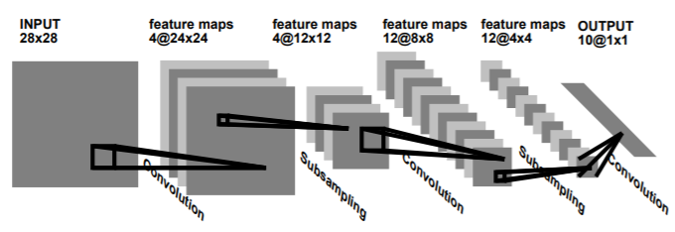
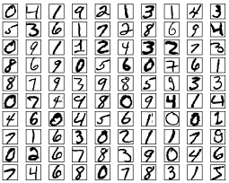
A Brief History of SVM
SVM is related to statistical learning theory [3].
SVM is first introduced in 1992 [1].
Success in handwritten digit recognition
1.1% test error rate for SVM. The same as that of a carefully constructed neural network, LeNet 4 [2].
Architecture of LeNet1. LeNet 4 is an expanded version of LeNet 1, consisting of about 260,000 connections, and about 17,000 free parameters.
[1] B.E. Boser et al. A Training Algorithm for Optimal Margin Classifiers. Proceedings of the Fifth Annual Workshop on Computational Learning Theory 5 144-152, Pittsburgh, 1992. [2] L. Bottou et al. Comparison of classifier methods: a case study in handwritten digit recognition. Proceedings of the 12th IAPR International Conference on Pattern Recognition, vol. 2, pp. 77-82, 1994. [3] V. Vapnik. The Nature of Statistical Learning Theory. 2nd edition, Springer, 1999

Slide 4
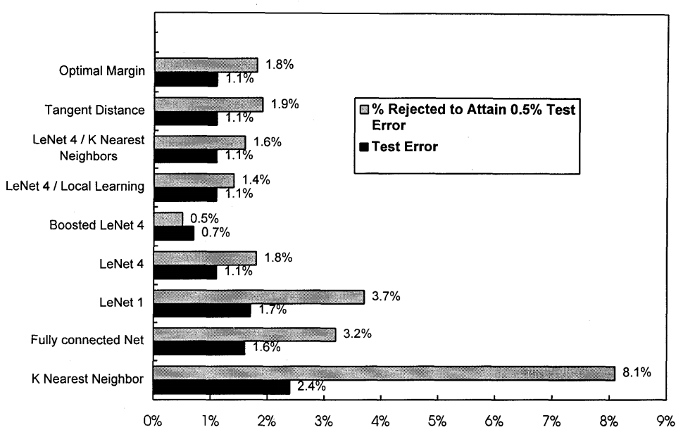
A Brief History of SVM
SVM is related to statistical learning theory [3].
SVM is first introduced in 1992 [1].
Success in handwritten digit recognition
1.1% test error rate for SVM. The same as that of a carefully constructed neural network, LeNet 4 [2].

Slide 5
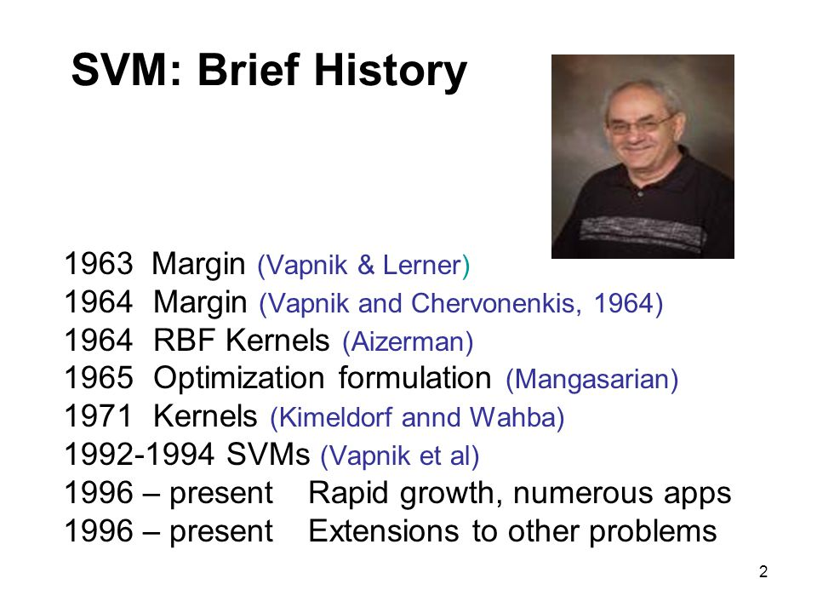

Slide 6

A Brief History of SVM
Vapnik born in the Soviet Union (1936)
Master: mathematics, the Uzbek State University (1958)
Ph.D: statistics at the Institute of Control Sciences, Moscow (1964)
Worked at the Institute of Control Sciences (until 1990)
Then joined AT&T Bell Labs (1991)
While at AT&T, Vapnik and colleagues developed the SVM (1995)
Inducted into U.S. National Academy of Engineering (2006)
Joined Facebook AI Research (2014)

Slide 7



Vapnik
2017
2019
2021

Slide 8

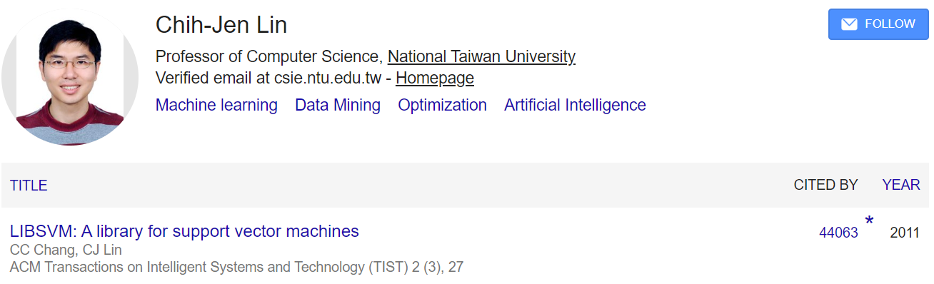
A Brief History of SVM
2017
2019

Slide 9
What Is a Good Decision Boundary?

Slide 10
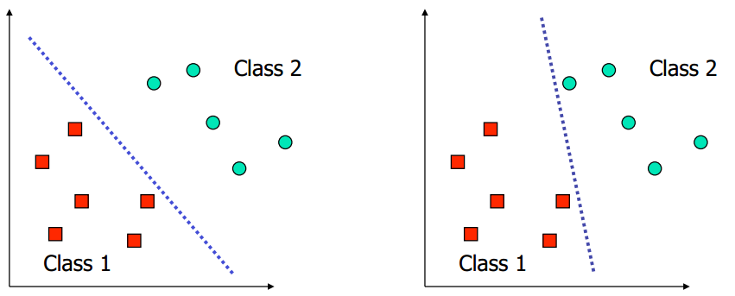
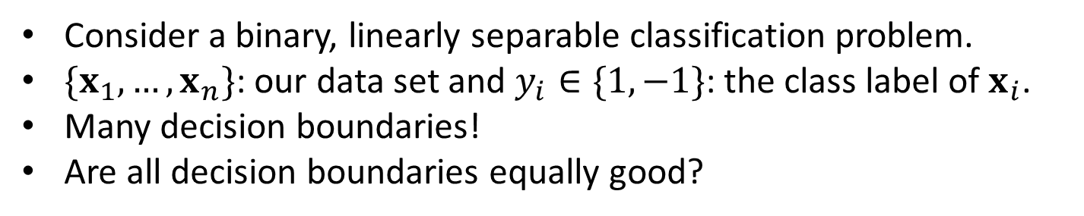
What Is a Good Decision Boundary?
Consider a binary, linearly separable classification problem.
$\{x_{1},…,x_{n}\}$: our data set and $y_{i}∈\{1,−1\}$: the class label of $x_{i}$.
Many decision boundaries!
Are all decision boundaries equally good?
Examples of Bad Decision Boundaries

Slide 11
What Is a Good Decision Boundary?
Consider a binary, linearly separable classification problem.
$\{x_{1},…,x_{n}\}$: our data set and $y_{i}∈\{1,−1\}$: the class label of $x_{i}$.
Many decision boundaries!
Are all decision boundaries equally good?
Given a training set, we aim to find a decision boundary that allows us to make all correct and confident (meaning far from the decision boundary) predictions on the training examples.

Slide 12
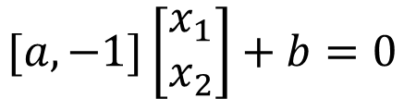










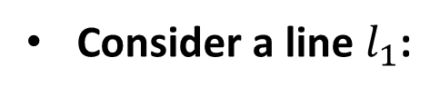

Preliminary
Consider a line $l_{1}$:
$$x→x_{1}$$
$$[a, −1]\left[\begin{aligned}x_{1} \\ x_{2}\end{aligned}\right]+b=0$$
$$y=ax+b$$
$$⟹$$
$$ax_{1}+(−1)x_{2}+b=0$$
$$⟹$$
$$y→x_{2}$$
Vector representation:
$$w^{T}x+b=0$$
$$w={\left[w_{1} w_{2}\right]}^{T} x={\left[x_{1} x_{2}\right]}^{T}$$
$$y=ax+b$$
$$w={\left[a, −1\right]}^{T}$$
$$g\left(x,y\right)=ax−y+b=0 w={\left[∇_{x}g,∇_{y}g\right]}^{T}$$
What is the meaning of $w$?

Slide 13








Preliminary
Consider a line $l_{1}$:
$$y=ax+b$$
$$w={\left[a, −1\right]}^{T}$$
Consider $β={\left[1,a\right]}^{T}$, $β$ should be parallel to the line $l_{1}$.
We found that
$w^{T}β=0 → β⊥w$.
Vector $w$ is perpendicular to the line $l_{1}$.
$$b$$
$$β$$
$$(1,a)$$
$$−\frac{b}{a}$$
$$w$$

Slide 14
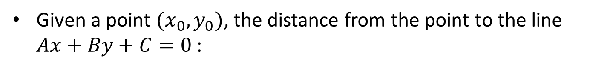
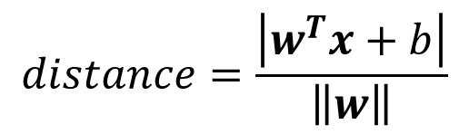
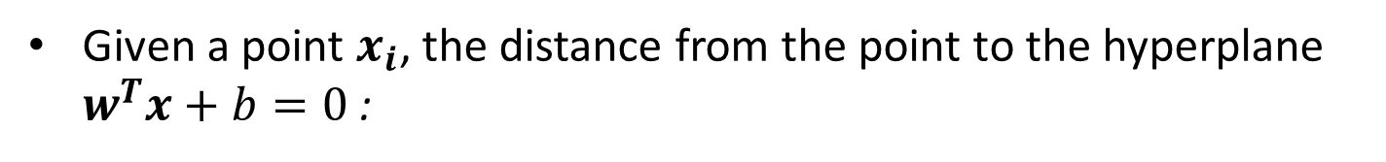
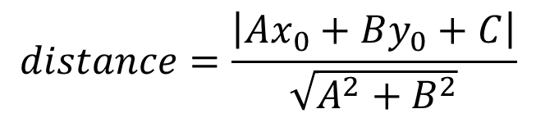
Preliminary
Given a point $(x_{0},y_{0})$, the distance from the point to the line $Ax+By+C=0$ :
$$distance=\frac{\left|Ax_{0}+By_{0}+C\right|}{\sqrt{A^{2}+B^{2}}}$$
Given a point $x_{i}$, the distance from the point to the hyperplane $w^{T}x+b=0$ :
$$distance=\frac{\left|w^{T}x+b\right|}{\left\|w\right\|}$$

Slide 15
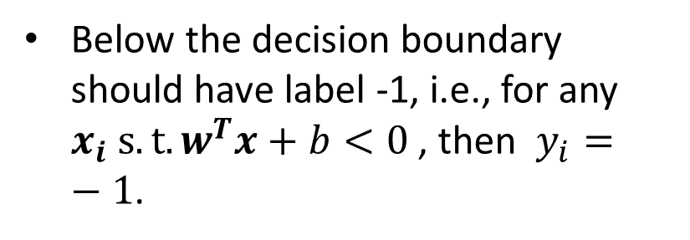

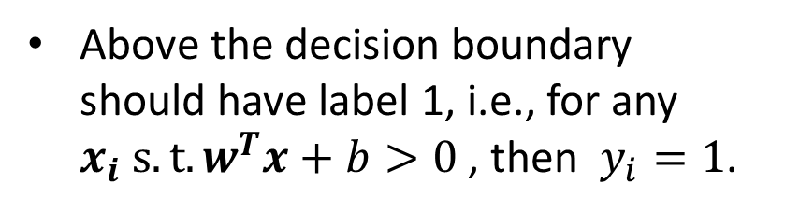

What Is a Good Decision Boundary?
We aim to find the hyperplane (i.e., decision boundary) linearly separating our classes.
Our boundary will have equation:
$$w^{T}x+b=0$$
Above the decision boundary should have label 1, i.e., for any $x_{i} s.t.w^{T}x+b>0$ , then $y_{i}=1$.
Decision boundary
Below the decision boundary should have label -1, i.e., for any $x_{i} s.t.w^{T}x+b<0$ , then $y_{i}=−1$.
$$f\left(x\right)=sign(w^{T}x+b)$$

Slide 16
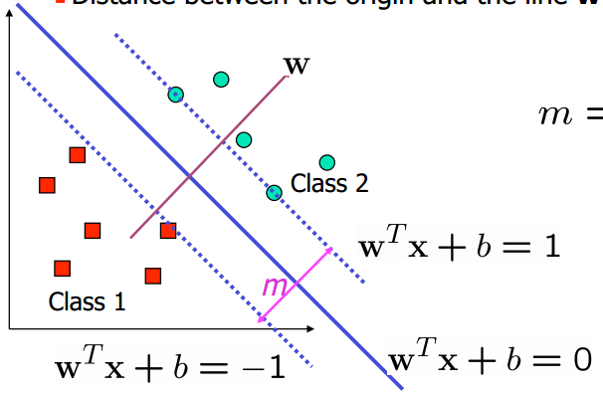
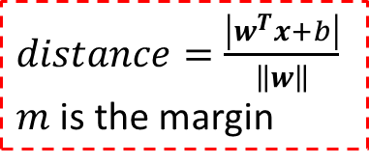




What Is a Good Decision Boundary?
Moreover, we hope the hyperplane lies in the middle
$\left\{\begin{aligned}(w^{T}x_{i}+b)/\left\|w\right\|≥\frac{m}{2} \\ (w^{T}x_{i}+b)/\left\|w\right\|≤−\frac{m}{2}\end{aligned}\right.$
$$∀ y_{i}=1$$
$distance=\frac{\left|w^{T}x+b\right|}{\left\|w\right\|}$
$m$ is the margin
$$∀ y_{i}=−1$$
cv
$m$ is the margin

Slide 17






What Is a Good Decision Boundary?
Moreover, we hope the hyperplane lies in the middle
$\left\{\begin{aligned}(w^{T}x_{i}+b)/\left\|w\right\|≥\frac{m}{2} \\ (w^{T}x_{i}+b)/\left\|w\right\|≤−\frac{m}{2}\end{aligned}\right.$
$$∀ y_{i}=1$$
$distance=\frac{\left|w^{T}x+b\right|}{\left\|w\right\|}$
$m$ is the margin
$$∀ y_{i}=−1$$
Can be re-written as
$$\left\{\begin{aligned}{w_{p}}^{T}x_{i}+b_{p}≥1 \\ {w_{p}}^{T}x_{i}+b_{p}≤−1\end{aligned}\right.$$
$$∀ y_{i}=1$$
$$w_{p}=\frac{2w}{\left\|w\right\|m}$$
$$b_{p}=\frac{2b}{\left\|w\right\|m}$$
$$∀ y_{i}=−1$$
Interestingly, we found that
${w_{p}}^{T}x+b_{p}=0$ and $w^{T}x+b=0$ is the same hyperplane.

Slide 18




What Is a Good Decision Boundary?
Therefore,
$$\left\{\begin{aligned}w^{T}x_{i}+b ≥ 1 \\ w^{T}x_{i}+b ≤−1\end{aligned}\right.$$
$$∀ y_{i}=1$$
$y_{i}(w^{T}x_{i}+b)$ $≥1$
$$∀ y_{i}=−1$$
cv

Slide 19
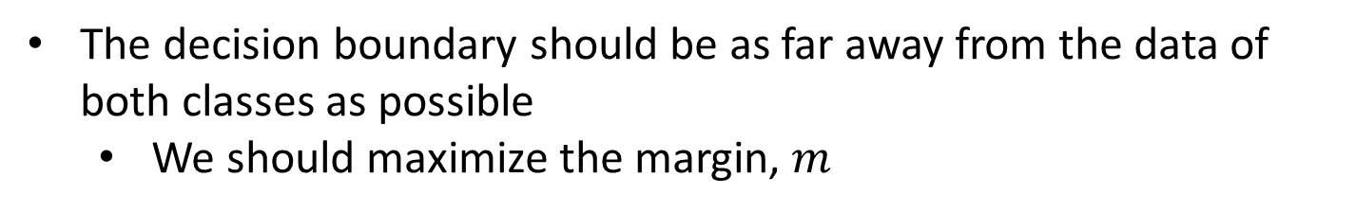


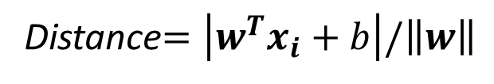
Large-margin Decision Boundary
The decision boundary should be as far away from the data of both classes as possible
We should maximize the margin, $m$
cv
For the support vectors (data points nearest to the hyperplane)
cv
Distance$=\left|w^{T}x_{i}+b\right|/\left\|w\right\|$
$$=1/\left\|w\right\|$$
$$m=2/\left\|w\right\|$$

Slide 20

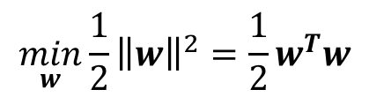


Optimization Problem
The decision boundary can be found by solving the following constraint optimization problem
$$\max_{w}{2/\left\|w\right\|}$$
s.t. $y_{i}(w^{T}x_{i}+b)$ $≥1, i=1,2,…,n$
To solve the problem efficiently, we transformed it into a form:
$$\min_{w}{\frac{1}{2}{\left\|w\right\|}^{2}=\frac{1}{2}}w^{T}w$$
s.t. $y_{i}(w^{T}x_{i}+b)$ $≥1, i=1,2,…,n$
The above is an optimization problem with a convex quadratic objective and only linear constraints.

Slide 21

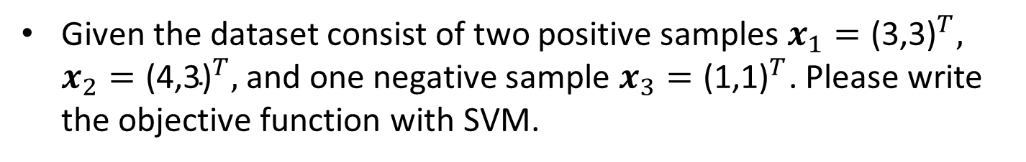



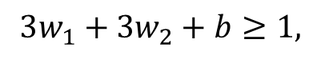
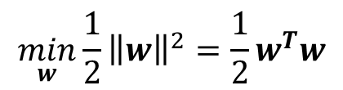
Exercise
$$\min_{w}{\frac{1}{2}{\left\|w\right\|}^{2}=\frac{1}{2}}w^{T}w$$
s.t. $y_{i}(w^{T}x_{i}+b)$ $≥1, i=1,2,…,n$
Given the dataset consist of two positive samples $x_{1}={\text{(3,3)}}^{T},$ $x_{2}={\text{(}\text{4}\text{,3)}}^{T},$ and one negative sample $x_{3}={\text{(}\text{1}\text{,}\text{1}\text{)}}^{T}$. Please write the objective function with SVM.
Answer
$$\min_{w,b}{\frac{1}{2}{\left\|w\right\|}^{2}=\frac{1}{2}w_{1}^{2}+\frac{1}{2}w_{2}^{2}}$$
s.t.
$3w_{1}+3w_{2}+b≥1,$
$4w_{1}+3w_{2}+b≥1,$
$−w_{1}−w_{2}−b≥1,$

Slide 22
Large-margin Decision Boundary
The optimization problem can be solved using commercial quadratic programming (QP 二次规划) code.
However, here we will turn to the Lagrange duality.
The dual form will allow us to derive an efficient algorithm to solve the optimization problem.
Typically do much better than generic QP software.
The dual form will allow us to use kernels to get optimal margin classifiers to work efficiently in very high dimensional spaces.
Let’s temporarily put aside SVM, and talk about solving constrained optimization problems.

Slide 23


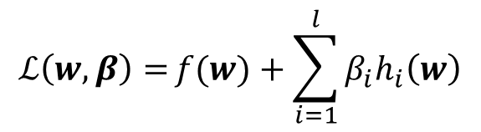



Constrained Optimization
Consider a problem of the following form:
$$\min_{w}{f(w)}$$
s.t. $h_{i}\left(w\right)=0, i=1,…,l.$
Lagrange multiplier method:
$$ℒ\left(w,β\right)={f(w)}+\sum_{i=1}^{l}{{β_{i}h}_{i}\left(w\right)}$$
$β_{i}$’s are the Lagrange multipliers.
No constraint now.
Set the partial derivatives to zero:
$$\frac{∂ℒ\left(w,β\right)}{∂w_{j}}={0}$$
$$\frac{∂ℒ\left(w,β\right)}{∂β_{i}}={0}$$

Slide 24



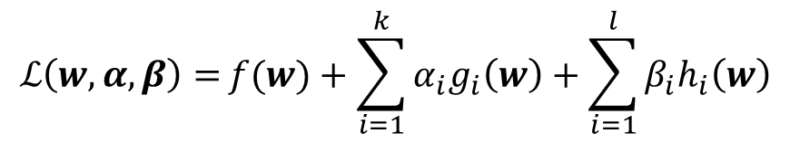
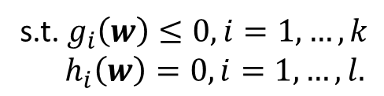
Optimization with Inequality Constraints
Generalize this to constrained optimization problems in which we may have inequality as well as equality constraints.
Consider the following primal optimization problem:
$$\min_{w}{f(w)}$$
s.t. $g_{i}\left(w\right)≤0, i=1,…,k$
$h_{i}\left(w\right)=0, i=1,…,l.$
Generalized Lagrangian
$α_{i}$’s and $β_{i}$’s are the Lagrange multipliers.
$$ℒ\left(w,α,β\right)={f(w)}+\sum_{i=1}^{k}{{α_{i}g}_{i}\left(w\right)}+\sum_{i=1}^{l}{{β_{i}h}_{i}\left(w\right)}$$
$$α_{i}≥0$$
Why?

Slide 25

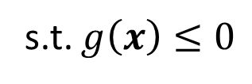
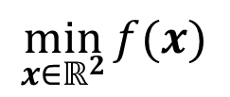
Optimization with Inequality Constraints
Consider the following primal optimization problem:
$$\min_{x∈ℝ^{2}}{f(x)}$$
s.t. $g\left(x\right)≤0$
Example1:

Slide 26
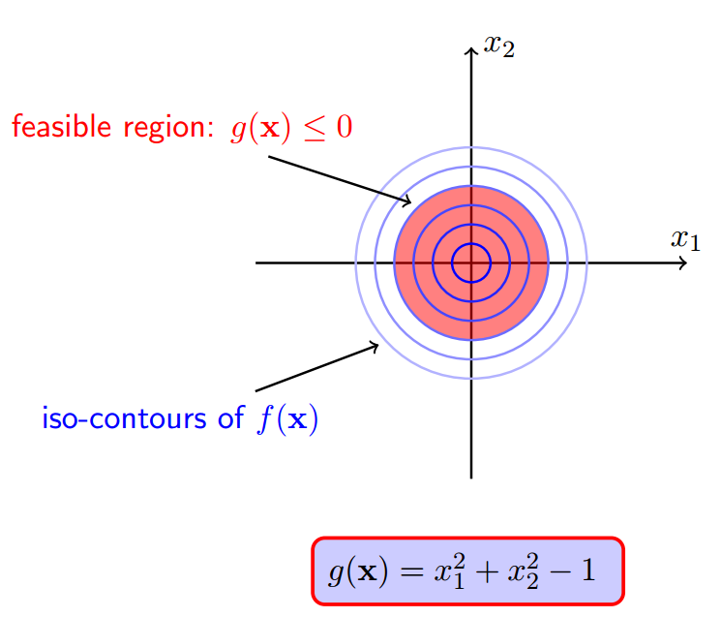
Optimization with Inequality Constraints

Slide 27
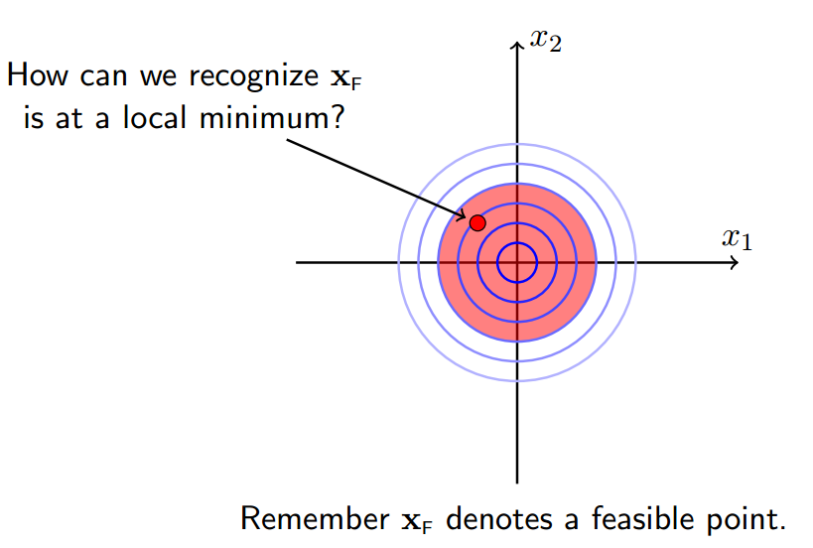
Optimization with Inequality Constraints

Slide 28
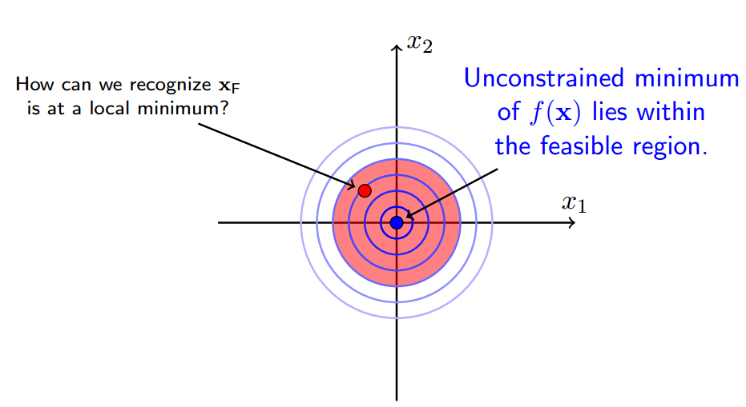
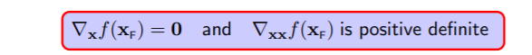
Optimization with Inequality Constraints

Slide 29
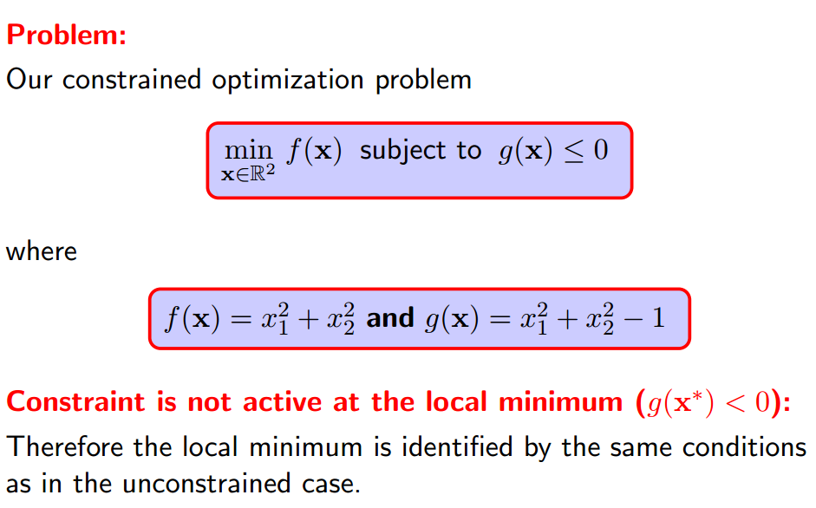
Optimization with Inequality Constraints

Slide 30
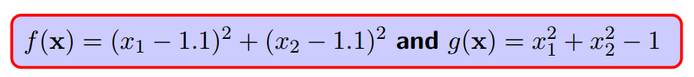
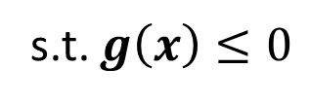
Optimization with Inequality Constraints
Consider the following primal optimization problem:
$$\min_{x∈ℝ^{2}}{f(x)}$$
s.t. $g\left(x\right)≤0$
Example2:

Slide 31
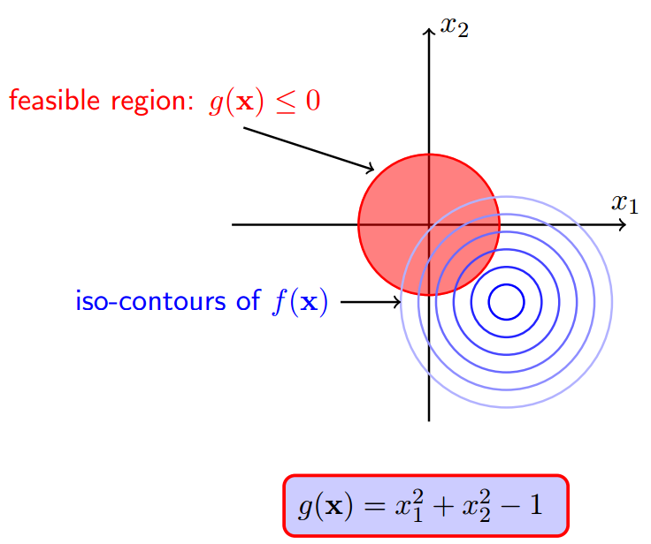
Optimization with Inequality Constraints

Slide 32
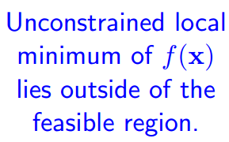
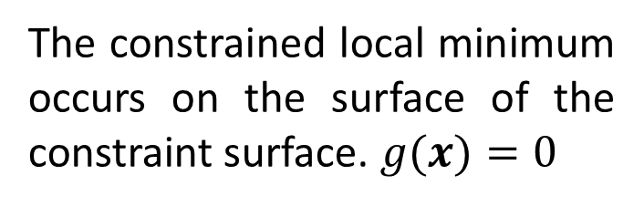
Optimization with Inequality Constraints
The constrained local minimum occurs on the surface of the constraint surface. $g(x)=0$

Slide 33
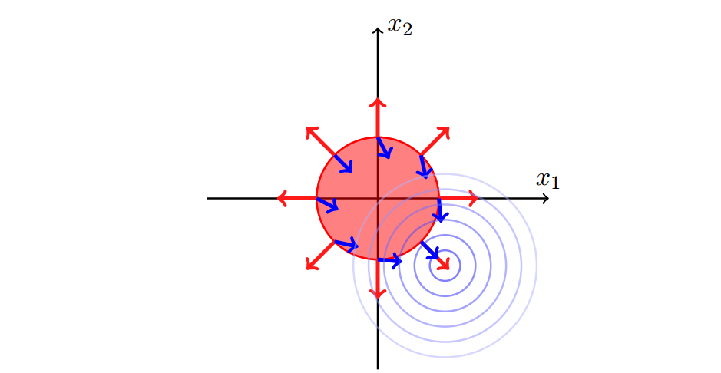




Optimization with Inequality Constraints
Red: $∇_{x}g(x)$
Blue: $−∇_{x}f(x)$

Slide 34

Optimization with Inequality Constraints

Slide 35

Optimization with Inequality Constraints
http://www.csc.kth.se/utbildning/kth/kurser/DD3364/Lectures/KKT.pdf

Slide 36


Lagrange Duality

Slide 37







Lagrange Duality
Consider the following primal optimization problem:
$$\min_{w}{f(w)}$$
s.t. $g_{i}\left(w\right)≤0, i=1,…,k$
$h_{i}\left(w\right)=0, i=1,…,l.$
Generalized Lagrangian
$α_{i}$’s and $β_{i}$’s are the Lagrange multipliers.
$$ℒ\left(w,α,β\right)={f(w)}+\sum_{i=1}^{k}{{α_{i}g}_{i}\left(w\right)}+\sum_{i=1}^{l}{{β_{i}h}_{i}\left(w\right)}$$
$$α_{i}≥0$$
Consider the quantity:
$$θ_{𝒫}\left(w\right)=\max_{α,β,α_{i}≥0}{ℒ\left(w,α,β\right)}$$
If $w$ is given and violates any primal constraint (i.e., $g_{i}\left(w\right)>0$ or $h_{i}\left(w\right)≠0$ for some $i$), then what happens? $θ_{𝒫}\left(w\right)=$?

Slide 38






Lagrange Duality
If $w$ is given and violates ay primal constraint (i.e., $g_{i}\left(w\right)>0$ or $h_{i}\left(w\right)≠0$ for some $i$),
$$ℒ\left(w,α,β\right)={f(w)}+\sum_{i=1}^{k}{{α_{i}g}_{i}\left(w\right)}+\sum_{i=1}^{l}{{β_{i}h}_{i}\left(w\right)}$$
$$θ_{𝒫}\left(w\right)=\max_{α,β,α_{i}≥0}{ℒ\left(w,α,β\right)}=∞$$
Therefore, if the constraints are indeed satisfied for a given $w$, then $θ_{𝒫}\left(w\right)=f(w)$
Consequently…
$$θ_{𝒫}\left(w\right)=\left\{\begin{aligned}f(w) \\ ∞\end{aligned}\right.$$
if $w$satisfies primal constraints
otherwise.

Slide 39




Lagrange Duality
The primal problem which is the same problem as our original optimization problem.
Consequently…
$$\min_{w}{f(w)}$$
$$\min_{w}{θ_{𝒫}\left(w\right)}=\min_{w}{\max_{α,β,α_{i}≥0}ℒ\left(w,α,β\right)}$$
s.t. $g_{i}\left(w\right)≤0, i=1,…,k$
$h_{i}\left(w\right)=0, i=1,…,l.$
How to optimize it?
DIFFICULT!
It is hard to explicitly express the objective function $θ_{𝒫}\left(w\right)$.
Thus it is hard to calculate the derivative with respect with $w$.

Slide 40




Lagrange Duality
Primal optimization problem
$$\min_{w}{θ_{𝒫}\left(w\right)}=\min_{w}{\max_{α,β,α_{i}≥0}ℒ\left(w,α,β\right)}$$
Let us look at a slightly different problem. We define:
$$θ_{𝒟}\left(α,β\right)=\min_{w}{ℒ\left(w,α,β\right)}$$
$𝒟$ refers to “dual”.
We can now pose the dual optimization problem:
$$\max_{α,β,α_{i}≥0}{θ_{𝒟}\left(α,β\right)}=\max_{α,β,α_{i}≥0}\min_{w} ℒ\left(w,α,β\right)$$
How are the primal and the dual problems related?

Slide 41


Lagrange Duality
How are the primal and the dual problems related?
$$d^{∗}=\max_{α,β,α_{i}≥0}\min_{w} ℒ\left(w,α,β\right)≤\min_{w}{\max_{α,β,α_{i}≥0}ℒ\left(w,α,β\right)}=p^{∗}$$
“max min” is always less than or equal to the “min max”
For any $w,α,β$, we have
$$θ_{𝒟}\left(α,β\right)=\min_{w} ℒ\left(w,α,β\right) ≤ℒ\left(w,α,β\right)≤{\max_{α,β,α_{i}≥0}ℒ\left(w,α,β\right)}=θ_{𝒫}\left(w\right)$$
Then we have
$$\max_{α,β,α_{i}≥0}\min_{w} ℒ\left(w,α,β\right)≤\min_{w}{\max_{α,β,α_{i}≥0}ℒ\left(w,α,β\right)}$$
Under certain conditions (Karush-Kuhn-Tucker or KKT), we will have $d^{∗}=p^{∗}$(strong duality).

Slide 42




Lagrange Duality
When strong duality ($d^{∗}=p^{∗}$), we can solve the primal problem by solving the dual problem!
Sufficient conditions for strong duality:
The Hessian matrix of $f/g$ is positive semi-definite;
$h_{i}\left(w\right)=a_{i}^{T}w+b_{i}$
Condition: Suppose $f$ and the $g_{i}$’s are convex, and the $h_{i}$’s are affine. Suppose further that there exists some $w$ so that $g_{i}\left(w\right)<0$ for all $i$ (strictly feasible).
These conditions are all satisfied by the SVM optimization problem!
Then, there must exist $w^{∗}$, $α^{∗}$, $β^{∗}$, so that $w^{∗}$ is the solution to the primal problem, $α^{∗}$, $β^{∗}$ are the solution to the dual problem, and $d^{∗}=p^{∗}=ℒ\left(w^{∗}\text{, }α^{∗}\text{, }β^{∗}\right)$. $w^{∗}$, $α^{∗}$, $β^{∗}$ satisfy the Karush-Kuhn-Tucker (KKT) condition.

Slide 43











KKT Conditions
$$\frac{∂ℒ\left(w^{∗}\text{, }α^{∗}\text{, }β^{∗}\right)}{∂w_{i}}={0}$$
$$i=1,…,n$$
$$\frac{∂ℒ\left(w^{∗}\text{, }α^{∗}\text{, }β^{∗}\right)}{∂β_{i}}={0}$$
$$i=1,…,l$$
$${α_{i}}^{∗}g_{i}\left(w^{∗}\right)=0$$
$$i=1,…,k$$
$$g_{i}\left(w^{∗}\right)≤0$$
$$i=1,…,k$$
$${α_{i}}^{∗}≥0$$
$$i=1,…,k$$
Note: If some $w^{∗}$, $α^{∗}$, $β^{∗}$ satisfy the KKT conditions, then it is also a solution to the primal and dual problems.

Slide 44











Large-margin Decision Boundary
$$\min_{w}{\frac{1}{2}{\left\|w\right\|}^{2}=\frac{1}{2}}w^{T}w$$
$$\min_{w}{θ_{𝒫}\left(w\right)}=\min_{w}{\max_{α,α_{i}≥0}ℒ\left(w,α\right)}$$
s.t. $y_{i}(w^{T}x_{i}+b)$ $≥1, i=1,2,…,n$
The Lagrangian
$$ℒ\left(w,b, α\right)={f(w)}+\sum_{i=1}^{n}{α_{i}(1−y_{i}(w^{T}x_{i}+b))}$$
Consider the dual optimization problem,
We first take the derivative
$$\max_{α,α_{i}≥0}{θ_{𝒟}\left(α\right)}=\max_{α,α_{i}≥0}\min_{w} ℒ\left(w,α\right)$$
$$\frac{∂ℒ\left(w,b, α\right)}{∂w}={w}+\sum_{i=1}^{n}{−α_{i}y_{i}x_{i}}=0$$
$$w^{∗}=\sum_{i=1}^{n}{α_{i}y_{i}x_{i}}$$
$$⇒$$
$$\frac{∂ℒ\left(w,b, α\right)}{∂b}=\sum_{i=1}^{n}{−α_{i}y_{i}}=0$$
$$0=\sum_{i=1}^{n}{α_{i}y_{i}}$$
$$⇒$$

Slide 45









Large-margin Decision Boundary
Dual optimization problem
$$\max_{α,α_{i}≥0}{θ_{𝒟}\left(α\right)}=\max_{α,α_{i}≥0}\min_{w} ℒ\left(w,α\right)$$
$$ℒ\left(w,b, α\right)={f(w)}+\sum_{i=1}^{n}{α_{i}(1−y_{i}(w^{T}x_{i}+b))}$$
$$ℒ\left(w^{∗},b, α\right)=\frac{1}{2}{{\left(\sum_{i=1}^{n}{α_{i}y_{i}x_{i}}\right)}^{T}\left(\sum_{i=1}^{n}{α_{i}y_{i}x_{i}}\right)}+\sum_{i=1}^{n}{α_{i}\left(1−y_{i}{\left(\sum_{i=1}^{n}{α_{i}y_{i}x_{i}}\right)}^{T}x_{i}\right)}−b\sum_{i=1}^{n}{α_{i}y_{i}}$$
$$ℒ\left(w^{∗}, α\right)=\sum_{i=1}^{n}{α_{i}−}\frac{1}{2}\sum_{i=1}^{n}{\sum_{j=1}^{n}{α_{i}α_{j}y_{i}y_{j}{x_{i}}^{T}x_{j}}}$$
$$w^{∗}=\sum_{i=1}^{n}{α_{i}y_{i}x_{i}}$$
$$0=\sum_{i=1}^{n}{α_{i}y_{i}}$$
Dual optimization problem
$$\max_{α}{\sum_{i=1}^{n}{α_{i}−}}\frac{1}{2}\sum_{i=1}^{n}{\sum_{j=1}^{n}{α_{i}α_{j}y_{i}y_{j}{x_{i}}^{T}x_{j}}}$$
s.t. $α_{i}≥0$, $i=1,…,n$
$\sum_{i=1}^{n}{α_{i}y_{i}}=0$

Slide 46






Exercise
Given the dataset consist of two positive samples $x_{1}={\text{(3,3)}}^{T},$ $x_{2}={\text{(}\text{4}\text{,3)}}^{T},$ and one negative sample $x_{3}={\text{(}\text{1}\text{,}\text{1}\text{)}}^{T}$. Please write the objective function of the dual optimization problem of SVM.
$$\max_{α}{\sum_{i=1}^{3}{α_{i}−}}\frac{1}{2}\sum_{i=1}^{3}{\sum_{j=1}^{3}{α_{i}α_{j}y_{i}y_{j}{x_{i}}^{T}x_{j}}}$$
Answer
s.t. $α_{i}≥0$, $i=1,…,3$
$\sum_{i=1}^{3}{α_{i}y_{i}}=0$
$$\max_{α}{α_{1}+α_{2}+α_{3}−}\frac{1}{2}\left(18α_{1}^{2}+25α_{2}^{2}+2α_{3}^{2}+42α_{1}α_{2}−12α_{1}α_{3}−14α_{2}α_{3}\right)$$
s.t. $α_{i}≥0$, $i=1,…,3$
$α_{1}+α_{2}−α_{3}=0$

Slide 47
Dual optimization problem
$$\max_{α}{\sum_{i=1}^{n}{α_{i}−}}\frac{1}{2}\sum_{i=1}^{n}{\sum_{j=1}^{n}{α_{i}α_{j}y_{i}y_{j}{x_{i}}^{T}x_{j}}}$$
s.t. $α_{i}≥0$, $i=1,…,n$
$\sum_{i=1}^{n}{α_{i}y_{i}}=0$
How to optimize?

Slide 48



Coordinate Ascent
坐标上升法
Consider trying to solve the unconstrained optimization problem
$$\max_{α}{L(α_{1},α_{2},…,α_{l})}$$
Coordinate Ascent
Loop until convergence:$\{$
For $i=1,…l\{$
$$α_{i}≔arg\max_{{\hat{α}}_{i}}{L(α_{1},…,α_{i−1},{\hat{α}}_{i},α_{i+1},…α_{l})}$$
$\}$
$\}$
In the innermost loop of this algorithm, we will hold all the variables except for some $α_{i}$ fixed, and re-optimize $L$ with respect to just the parameter $α_{i}$.

Slide 49

Coordinate Ascent
The ellipses are the contours of the objective function.
Coordinate ascent was initialized at (2, -2).
The path that it took on its way to the global maximum is plotted.
Note: Coordinate ascent takes a step that’s parallel to one of the axes, since only one variable is being optimized at a time.

Slide 50






Sequential Minimal Optimization
序列最小最优化
Dual optimization problem:
$$\max_{α}{\sum_{i=1}^{n}{α_{i}−}}\frac{1}{2}\sum_{i=1}^{n}{\sum_{j=1}^{n}{α_{i}α_{j}y_{i}y_{j}{x_{i}}^{T}x_{j}}}$$
s.t. $α_{i}≥0$, $i=1,…,n$
$\sum_{i=1}^{n}{α_{i}y_{i}}=0$
Let’s say we have a set of $α_{i}$’s that satisfy the constraints.
Suppose we hold $α_{2},…,α_{n}$ fixed, can we take a coordinate ascent step and optimize the function with respect to $α_{1}$?
$$\sum_{i=1}^{n}{α_{i}y_{i}}=0$$
$$α_{1}=−y_{1}\sum_{i=2}^{n}{α_{i}y_{i}}$$
NO!!!

Slide 51


Sequential Minimal Optimization
序列最小最优化
We must update at least two of $α_{i}$’s simultaneously.
SMO
Repeat until convergence:$\{$
1. Select some pair $α_{i}$ and $α_{j}$ to update next (using a heuristic manner that tries to pick the two that will allow us to make the biggest progress towards the global maximum).
2. Re-optimize $L(α)$ with respect to $α_{i}$ and $α_{j}$, while holding
all the other $α_{k}$’s $(k≠i,j)$fixed.
$\}$
SMO is efficient as that the update to $α_{i}$ and $α_{j}$ can be computed very efficiently.

Slide 52



Deriving The Efficient Update
Suppose we have a set of $α_{i}$’s that satisfy the constraints.
And we decided to hold $α_{3},…,α_{n}$ fixed, and optimize the objective function with respect to $α_{1}$ and $α_{2}$.
Based on the constraint, we have
$$α_{1}y_{1}+α_{2}y_{2}=−\sum_{i=3}^{n}{α_{i}y_{i}}=ζ$$
Constant
$$L\left(α_{1},α_{2},…,α_{n}\right)=\sum_{i=1}^{n}{α_{i}−}\frac{1}{2}\sum_{i=1}^{n}{\sum_{j=1}^{n}{α_{i}α_{j}y_{i}y_{j}{x_{i}}^{T}x_{j}}}$$
$$L\left(α_{1},α_{2},…,α_{n}\right)=L(y_{1}(ζ−α_{2}y_{2}),α_{2},…,α_{n})$$
This is some quadratic function with $α_{2}.$
Once we have $α_{2}^{new},$we can obtain $α_{1}^{new}$ with $α_{1}y_{1}+α_{2}y_{2}=ζ$

Slide 53









How To Get $w^{∗}$?
KKT: $\frac{∂ℒ\left(w^{∗}\text{, }α^{∗}\text{, }β^{∗}\right)}{∂w_{i}}={0}$
$$ℒ\left(w,b, α\right)=\frac{1}{2}{w^{T}w }+\sum_{i=1}^{n}{α_{i}(1−y_{i}(w^{T}x_{i}+b))}$$
Remember that
$$\frac{∂ℒ\left(w,b, α\right)}{∂w}={w}+\sum_{i=1}^{n}{−α_{i}y_{i}x_{i}}=0$$
$$w=\sum_{i=1}^{n}{α_{i}y_{i}x_{i}}$$
$$\frac{∂ℒ\left(w,b, α\right)}{∂b}=\sum_{i=1}^{n}{−α_{i}y_{i}}=0$$
$$0=\sum_{i=1}^{n}{α_{i}y_{i}}$$
$$w^{∗}=\sum_{i=1}^{n}{α_{i}^{∗}y_{i}x_{i}}=\sum_{i∈𝒮}{α_{i}^{∗}y_{i}x_{i}}$$
$𝒮=\left\{i | α_{i}>0,i=1,2,…,n\right\}$ is the set of index of support vectors.

Slide 54






How To Get $b^{∗}$?
In practice, we can derive $b^{∗}$ as follows,
cv
Option1: Note that given $w^{∗}$
$$b^{∗}=−\frac{\max_{i:y_{i}=−1}{{w^{∗}}^{T}x_{i}}+\min_{ i:y_{i}=1}{{w^{∗}}^{T}x_{i}}}{2}$$
Option2: Note that given any support vector, we have $y_{s}f\left(x_{s}\right)=1$
$$y_{s}\left(\left(\sum_{i∈𝒮}{α_{i}y_{i}{x_{i}}^{T}}\right)x_{s}+b\right)=1$$
$$b =\frac{1}{y_{s}}−\sum_{i∈𝒮}{α_{i}y_{i}{x_{i}}^{T}x_{s}}$$
$$⟹$$
In reality, we use the following more robust method
$$b^{∗}=\frac{1}{\left|𝒮\right|}\sum_{s∈𝒮}{\left(\frac{1}{y_{s}}−\sum_{i∈𝒮}{α_{i}y_{i}{x_{i}}^{T}x_{s}}\right)}$$

Slide 55




How To Get $b^{∗}$?
Question: can we have no support vector?
$$α^{∗}=0$$
Answer: No.
If $α^{∗}=0$, then $w^{∗}=0.$ (This is not the optimal solution for the primal optimization problem)
$$\min_{w}{\frac{1}{2}{\left\|w\right\|}^{2}=\frac{1}{2}}w^{T}w$$
s.t. $y_{i}(w^{T}x_{i}+b)$ $≥1, i=1,2,…,n$

Slide 56




Characteristics of The Solution
Many of the $α_{i}$’s are zero (why?)
$w$ is a linear combination of a small number of data points.
$$w^{∗}=\sum_{i=1}^{n}{α_{i}y_{i}x_{i}}=\sum_{i∈𝒮}{α_{i}y_{i}x_{i}}$$
Support vectors (SV):
$x_{i}$ with a non-zero $α_{i}$
The decision boundary is determined only by the SV.

Slide 57
Test Phase
Once we have trained a Support Vector Machine, how can we use it?

Slide 58

Test Phase
We simply determine on which side of the decision boundary a given test sample $x$ lies and assign the corresponding class label. i.e. we take the class of $x$ to be $sign(w^{T}x+b)$
cv

Slide 59


SVM Algorithm

Slide 60

Regularization and The Non-separable Case
In some cases (due to the outliers), it is not clear that finding a separating hyperplane is exactly what we’d want to do.
Figure (a) shows an optimal margin classifier, and when a single outlier is added in the upper-left region (Figure b), it causes the decision boundary to make a dramatic swing, and the resulting classifier has a much smaller margin (sensitive to outliers).
(a) Linearly separable
(b) Linearly separable with outliers

Slide 61

Regularization and The Non-separable Case
In some cases (due to the outliers), it is not clear that finding a separating hyperplane is exactly what we’d want to do.
In some cases (Figure c), the data cannot be perfectly linearly separable.
$$×$$
(a) Linearly separable
(b) Linearly separable with outliers
(c) Non-linearly separable

Slide 62







Regularization and The Non-separable Case
To make the algorithm work for non-linearly separable datasets as well as be less sensitive to outliers, we introduce the positive slack variables $ξ_{i}$ in constraints (hard margin → soft margin):
$$\left\{\begin{aligned}w^{T}x_{i}+b≥ 1−ξ_{i} \\ w^{T}x_{i}+b≤−1+ξ_{i} \\ ξ_{i}≥0\end{aligned}\right.,$$
$$y_{i}=1$$
$$y_{i}=−1$$
$$∀ i$$
$ξ_{i}=0$: no error for $x_{i}$.
For an error to occur, the corresponding $ξ_{i}$ must exceed 1, so $\sum_{i}{ξ_{i}}$is an upper bound on the number of training errors.

Slide 63





Regularization and The Non-separable Case
A natural way to assign an extra cost for errors as follow,
$$\min_{w}{\frac{1}{2}{\left\|w\right\|}^{2}+C}{\left(\sum_{i}{ξ_{i}}\right)}^{k}$$
$C$ is a parameter to be chosen by the user, a larger $C$ refers to assigning a higher penalty to errors.
For simplicity, we set $k=1$.
We reformulate our optimization ($l_{1}$ regularization) as follows,
$$\min_{w}{\frac{1}{2}{\left\|w\right\|}^{2}+C}\sum_{i=1}^{n}{ξ_{i}}$$
s.t. $y_{i}(w^{T}x_{i}+b)$ $≥1−ξ_{i}, i=1,2,…,n$
$$ξ_{i}≥0, i=1,2,…,n$$

Slide 64




Regularization and The Non-separable Case
$$\min_{w}{\frac{1}{2}{\left\|w\right\|}^{2}+C}\sum_{i=1}^{n}{ξ_{i}}$$
s.t. $y_{i}(w^{T}x_{i}+b)$ $≥1−ξ_{i}, i=1,2,…,n$
$$ξ_{i}≥0, i=1,2,…,n$$
Examples are permitted to have margin less than 1
If an example has margin 1 − $ξ_{i}$ (with $ξ_{i}$> 0), we pay a cost of the objective function being increased by $Cξ_{i}$.
$C$controls the relative weighting between the two goals
Making the ${\left\|w\right\|}^{2}$ small (makes the margin large);
Ensuring that most examples have margin at least 1.

Slide 65









Regularization and The Non-separable Case
As before, we can form the Lagrangian,
$$ℒ\left(w,b,ξ,α,r\right)={\frac{1}{2}{\left\|w\right\|}^{2}+C\sum_{i=1}^{n}{ξ_{i}}}−\sum_{i=1}^{n}{α_{i}\left[y_{i}\left(w^{T}x_{i}+b\right)−1+ξ_{i}\right]}−\sum_{i=1}^{n}{r_{i}ξ_{i}}$$
$α_{i}$’s and $r_{i}$’s are our Lagrange multipliers (constrained to be $≥ 0$)
Setting the derivatives with respect to $w,b$, and $ξ_{i}$ to zero;
$$w=\sum_{i=1}^{n}{α_{i}y_{i}x_{i}}=\sum_{i∈𝒮}{α_{i}y_{i}x_{i}}$$
$$0=\sum_{i=1}^{n}{α_{i}y_{i}}$$
$$0=C−α_{i}−r_{i}$$
Then the dual problem,
$\max_{α}{\sum_{i=1}^{n}{α_{i}−}}\frac{1}{2}\sum_{i=1}^{n}{\sum_{j=1}^{n}{α_{i}α_{j}y_{i}y_{j}{x_{i}}^{T}x_{j}}}$
s.t. ${0≤α}_{i}≤C$, $i=1,…,n$
Similar to the linear separable case, except that there is an upper bound $C$on $α_{i}.$
$\sum_{i=1}^{n}{α_{i}y_{i}}=0$

Slide 66


Sequential Minimal Optimization
序列最小最优化
Now, we know that $α_{1}$ and $α_{2}$ must lie within the box $[0, C]×[0, C]$ shown. Also plotted is the line $α_{1}y_{1}+α_{2}y_{2}=ζ$, on which we know $α_{1}$ and $α_{2}$ must lie.
Note, from these constraints, we know $L≤α_{2}≤H$; otherwise, $(α_{1},α_{2})$ can’t simultaneously satisfy both the box and the straight line constraint. In this example, $L = 0$.

Slide 67





Deriving The Efficient Update
If we ignore the box constraint $\left(L≤α_{2}≤H\right),$ then we can easily maximize the quadratic function. Let $α_{2}^{new,unclipped}$ denote the resulting value of $α_{2}.$
$$α_{2}^{new}=\left\{\begin{aligned}H \\ α_{2}^{new,unclipped} \\ L \end{aligned}\right.$$
if $α_{2}^{new,unclipped}>H$
if $L≤α_{2}^{new,unclipped}≤H$
Then we have
if $α_{2}^{new,unclipped}<L$

Slide 68





Soft-margin SVM
$$\frac{∂ℒ\left(w^{∗}\text{, }α^{∗}\text{, }β^{∗}\right)}{∂w_{i}}={0}$$
$$i=1,…,n$$
$$\min_{w}{\frac{1}{2}{\left\|w\right\|}^{2}+C}\sum_{i=1}^{n}{ξ_{i}}$$
$$\frac{∂ℒ\left(w^{∗}\text{, }α^{∗}\text{, }β^{∗}\right)}{∂β_{i}}={0}$$
$$i=1,…,l$$
$${α_{i}}^{∗}g_{i}\left(w^{∗}\right)=0$$
$$i=1,…,k$$
s.t. $y_{i}(w^{T}x_{i}+b)$ $≥1−ξ_{i}, i=1,2,…,n$
$$g_{i}\left(w^{∗}\right)≤0$$
$$i=1,…,k$$
$$ξ_{i}≥0, i=1,2,…,n$$
$${α_{i}}^{∗}≥0$$
$$i=1,…,k$$
The KKT conditions are
$α_{i}≥0,$ $r_{i}≥0$;
$$ξ_{i}≥0, y_{i}\left(w^{T}x_{i}+b\right)−1+ξ_{i}≥0$$
$$α_{i}\left(y_{i}\left(w^{T}x_{i}+b\right)−1+ξ_{i}\right)=0$$
$$r_{i}ξ_{i}=0$$
Support vectors ($α_{i}>0$) are examples for which $y_{i}\left(w^{T}x_{i}+b\right)≤1$
If $α_{i}<C$, $0=C−α_{i}−r_{i}$, then $ξ_{i}=0$. These are called unbound SV $y_{i}\left(w^{T}x_{i}+b\right)=1$.
If $α_{i}=C$ (bound SV), then $ξ_{i}$can be greater the zero, in which case the SV are margin errors.

Slide 69


Soft-margin SVM
If $α_{i}=C$ (bound SV), then $y_{i}\left(w^{T}x_{i}+b\right)=1−ξ_{i}$.
If $0≤ξ_{i}<1$, $x_{i}$ is correctly classified
If $ξ_{i}>1$, $x_{i}$ is misclassified.
If $ξ_{i}=1$, $x_{i}$ is on the decision boundary.

Slide 70







Alternative Objective with Hinge loss
In a sense, we can formulate the soft-margin SVM with hinge loss,
$$\min_{w}{\sum_{i=1}^{n}{{[1{−y}_{i}(w^{T}x_{i}+b)]}_{+}+λ}{\left\|w\right\|}^{2}}$$
Hinge loss
$${[z]}_{+}=\left\{\begin{aligned}z , z>0 \\ 0 , z≤0\end{aligned}\right.$$
$${L\left(y (w^{T}x+b)\right)=[1−y (w^{T}x+b)]}_{+}$$
$$\min_{w}{\frac{1}{2}{\left\|w\right\|}^{2}+C\sum_{i=1}^{n}{ξ_{i}}}$$
$$\min_{w}{\sum_{i=1}^{n}{{[1{−y}_{i}(w^{T}x_{i}+b)]}_{+}+λ}{\left\|w\right\|}^{2}}$$
s.t. $y_{i}(w^{T}x_{i}+b)$ $≥1−ξ_{i},$
$$i=1,2,…,n$$
$$ξ_{i}≥0, i=1,2,…,n$$

Slide 71








Hinge loss
$$\min_{w}{\frac{1}{2}{\left\|w\right\|}^{2}+C\sum_{i=1}^{n}{ξ_{i}}}$$
$$\min_{w}{\sum_{i=1}^{n}{{[1{−y}_{i}(w^{T}x_{i}+b)]}_{+}+λ}{\left\|w\right\|}^{2}}$$
s.t. $y_{i}(w^{T}x_{i}+b)$ $≥1−ξ_{i},$
$$i=1,2,…,n$$
$$ξ_{i}≥0, i=1,2,…,n$$
Let ${[1{−y}_{i}(w^{T}x_{i}+b)]}_{+}=ξ_{i}≥0$,
When $1{−y}_{i}\left(w^{T}x_{i}+b\right)>0$, then $y_{i}\left(w^{T}x_{i}+b\right)=1−ξ_{i}$
When $1{−y}_{i}\left(w^{T}x_{i}+b\right)≤0$, $ξ_{i}=0$, then $y_{i}\left(w^{T}x_{i}+b\right)≥1−ξ_{i}$
$$\min_{w}{\sum_{i=1}^{n}{ξ_{i}+λ{\left\|w\right\|}^{2}}}$$
Let $λ=\frac{1}{2C}$
$$\min_{w}{\frac{1}{C}\left(\frac{1}{2}{\left\|w\right\|}^{2}+C\sum_{i=1}^{n}{ξ_{i}}\right)}$$

Slide 72


Hinge loss
Hinge loss is the upper bound of the 0-1 loss (misclassification).
Hinge Loss
0-1 Loss
$$y(w^{T}x+b)$$

Slide 73

Mini-Summary
Support Vector Machine
Lagrange Duality
Constrained Optimization: Inequality Constraint
Karush-Kuhn-Tucker (KKT) condition
Coordinate Ascent
Sequential Minimal Optimization
Regularization for SVM
$C$, $ξ_{i}$

