Slide 1
Machine Learning & Pattern Recognition
Xin Xin(辛鑫)
xinxin@sdu.edu.cn
https://xinxin-me.github.io/

Slide 2
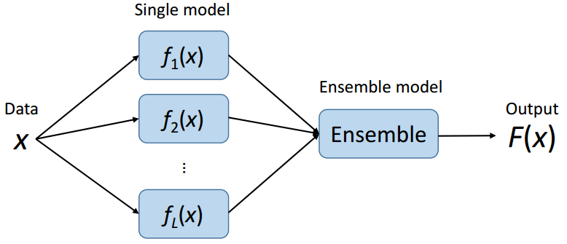
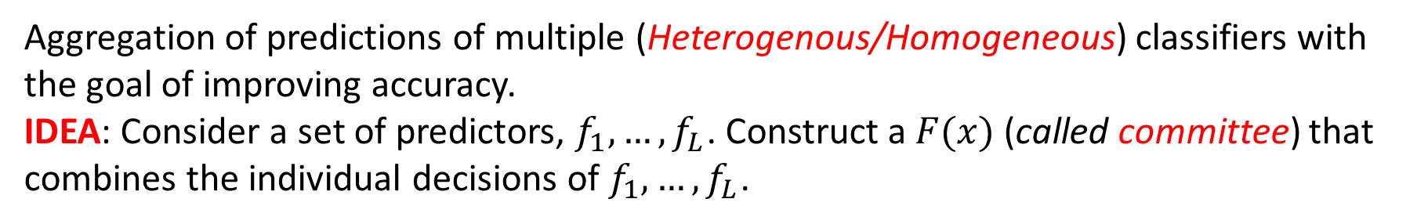
Ensemble Learning
Aggregation of predictions of multiple (Heterogenous/Homogeneous) classifiers with the goal of improving accuracy.
IDEA: Consider a set of predictors, $f_{1},…,f_{L}$. Construct a $F(x)$ (called committee) that combines the individual decisions of $f_{1},…,f_{L}$.

Slide 3
Ensemble Learning
Heterogenous (Hybrid) Ensemble:
A heterogeneous ensemble is an ensemble with a set of base classifiers that consist of models created using different algorithms.
E.g. The outputs of decision tree classifiers could be combined with the outputs of SVM.
Homogeneous Ensemble:
Homogeneous ensemble refers to the fact that all of the base classifiers are of a single type (e.g., decision trees), differing by model parameters, the data used for training, or a combination of the two.
E.g., bagging and boosting.

Slide 4
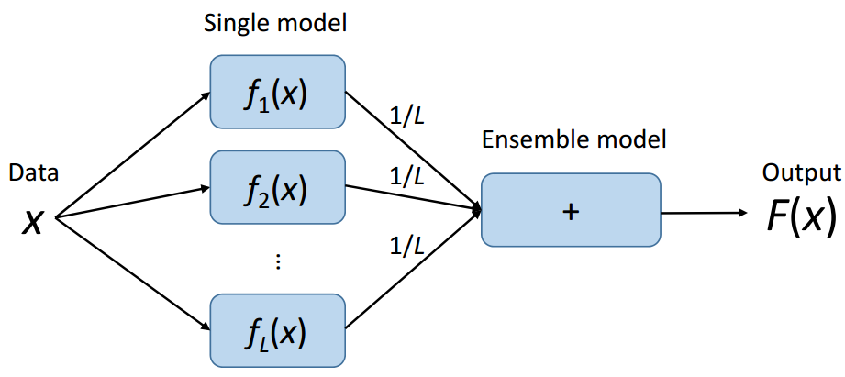
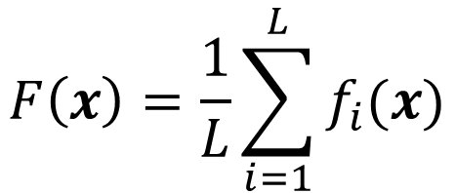
Combining Predictors: Averaging
$$F\left(x\right)=\frac{1}{L}\sum_{i=1}^{L}{f_{i}(x)}$$
Averaging for regression; voting for classification.

Slide 5
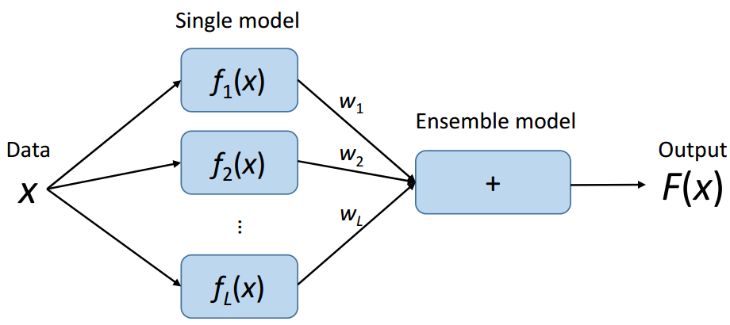
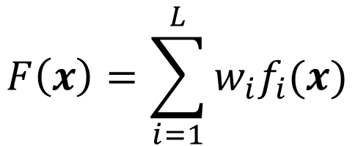
Combining Predictors: Weighted Averaging
$$F\left(x\right)=\sum_{i=1}^{L}{w_{i}f_{i}(x)}$$
Just like linear regression or classification
Note: single model will not be updated when training ensemble model

Slide 6
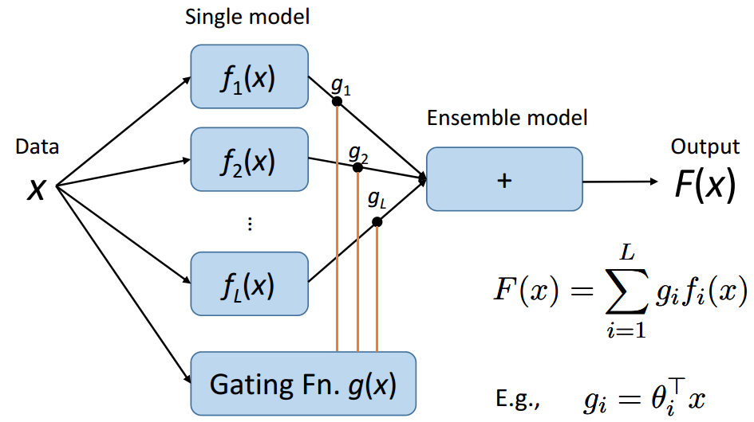
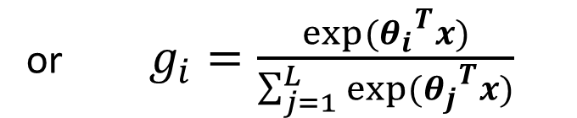
Combining Predictors: Gating
Learnable gating functions
or $g_{i}=\frac{exp⁡({θ_{i}}^{T}x)}{\sum_{j=1}^{L}{exp⁡({θ_{j}}^{T}x)}}$
Just like linear regression or classification
Note: single model will not be updated when training ensemble model

Slide 7
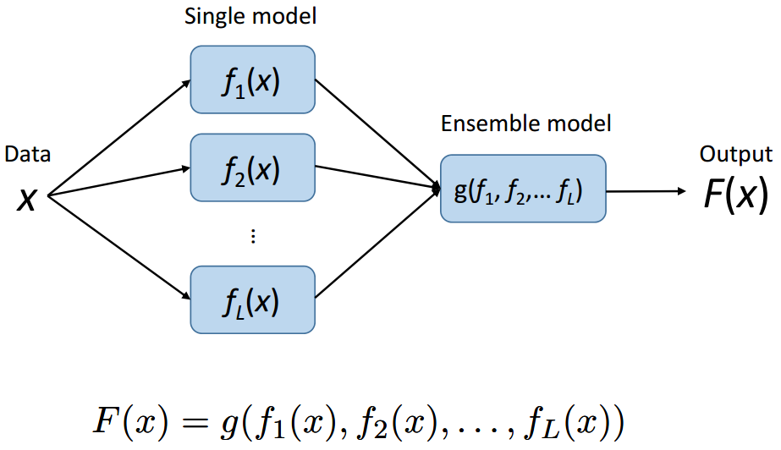
Combining Predictors: Stacking
$$F(x)=g⁡(f_{1}\left(x\right),f_{2}\left(x\right),…,f_{L}\left(x\right))$$
This is the general formulation of an ensemble.

Slide 8
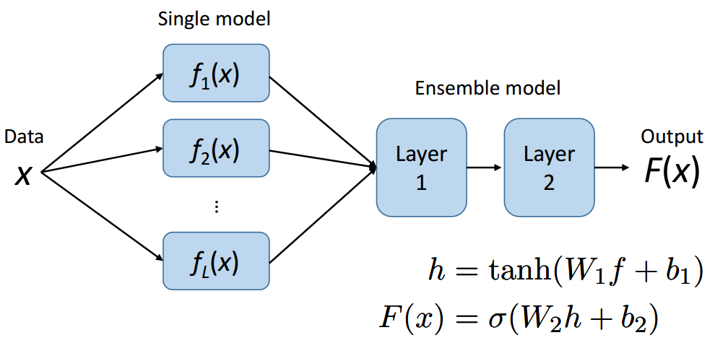


Combining Predictors: Multi-Layer
$$h=tanh⁡(w_{1}f+b_{1})$$
$F\left(x\right)=σ(w_{2}h+b_{2})$
Use the neural network as the ensemble model.

Slide 9
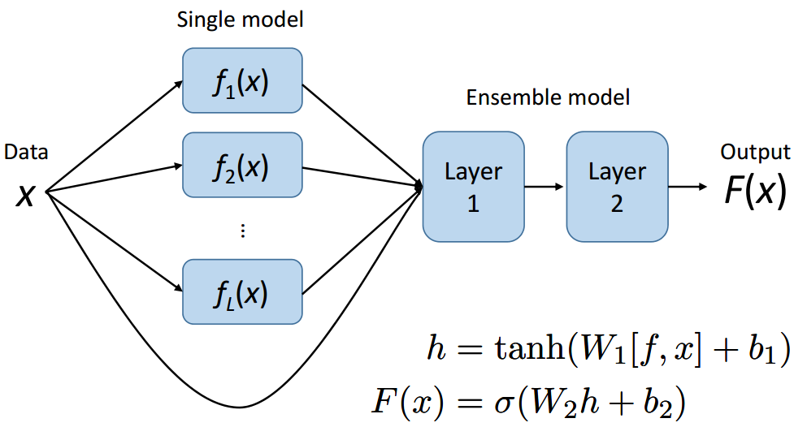


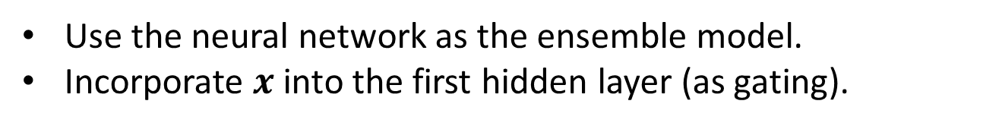
Combining Predictors: Multi-Layer
$$h=tanh⁡(w_{1}\left[f,x\right]+b_{1})$$
$F\left(x\right)=σ(w_{2}h+b_{2})$
Use the neural network as the ensemble model.
Incorporate $x$ into the first hidden layer (as gating).

Slide 10
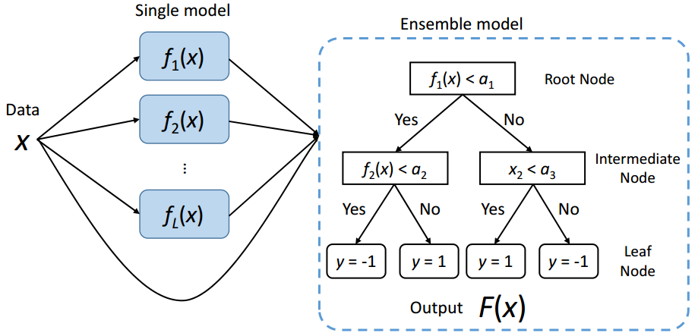
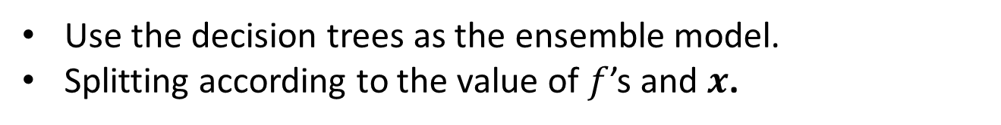
Combining Predictors: Tree Models
Use the decision trees as the ensemble model.
Splitting according to the value of $f$’s and $x$.

Slide 11
Some Intuitions on Why Ensemble Methods Work…

Slide 12
Intuitions
Utility of combining diverse, independent opinions in human decision-making.
Majority Vote Suppose we have 5 completely independent classifiers
If accuracy is 70% for each
How about the majority vote accuracy?

Slide 13

Intuitions
Utility of combining diverse, independent opinions in human decision-making.
Majority Vote Suppose we have 5 completely independent classifiers
If accuracy is 70% for each
$10×({0.7}^{3}) ({0.3}^{2})+5×({0.7}^{4})(0.3)+ ({0.7}^{5})$
83.7% majority vote accuracy
101 such classifiers
99.9% majority vote accuracy

Slide 14
How good are ensemble methods?
Let’s look at some Competitions…

Slide 15

Netflix Prize Competition
Supervised Learning Task:
Training data is a set of users and ratings 1, 2, 3, 4, 5 stars) those users have given to movies.
Construct a classifier that given a user and an unrated movie, correctly classifies that movie as either 1, 2, 3, 4, or 5 stars
$1 million prize for a 10% improvement over Netflix’s current movie recommender/classifier (MSE = 0.9514)

Slide 16
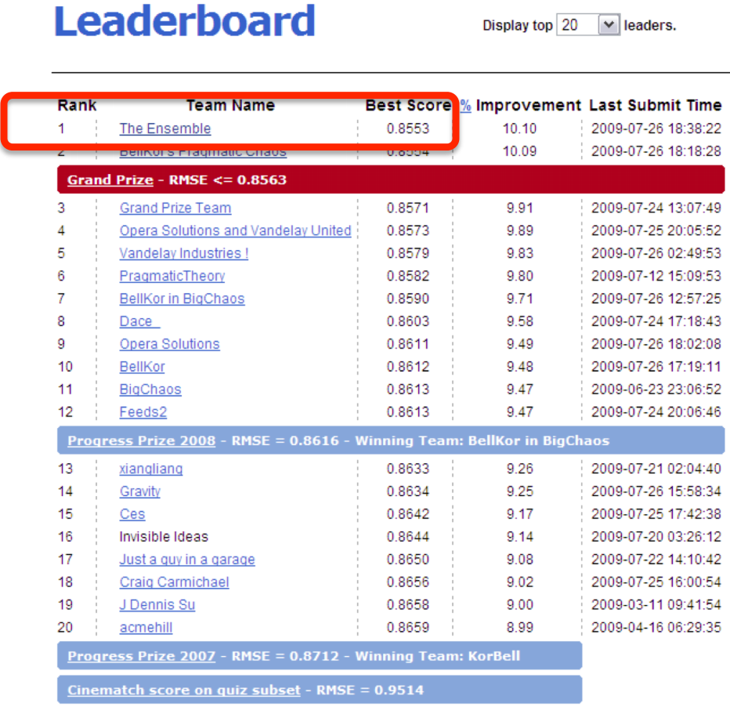
Netflix Prize Competition
An ensemble of more than 800 predictors

Slide 17

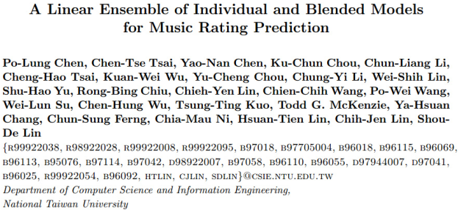
KDD-Cup 2011 Yahoo!Music Recommendation
Supervised Learning Task:
Training data is the Yahoo! Music Dataset
Predict the user’s rating on a music, given some users’ ratings on some music
With music information (e.g., album, artist, genre IDs)
Winner
From a graduate course of National Taiwan University—an ensemble of 221 predictors.

Slide 18
Machine learning contests are usually won by methods using model averaging over dozens of models.

Slide 19
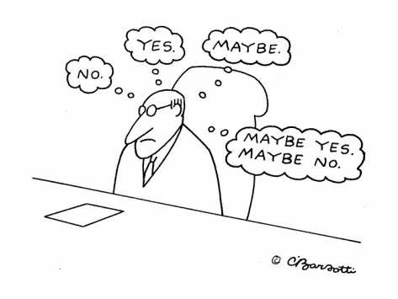
Can Any Ensemble Boost the Performance?

Slide 20
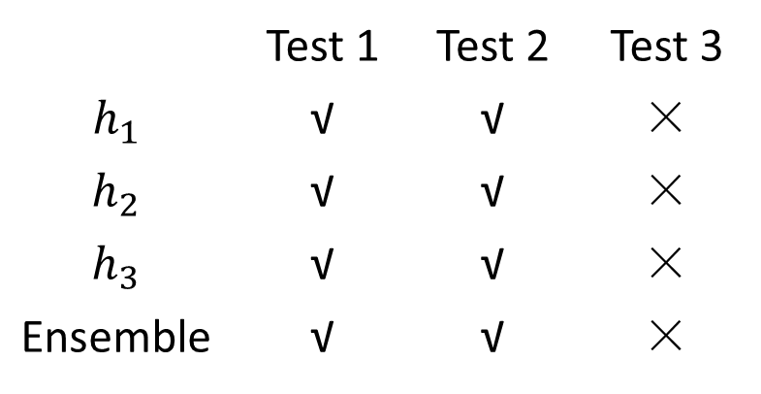
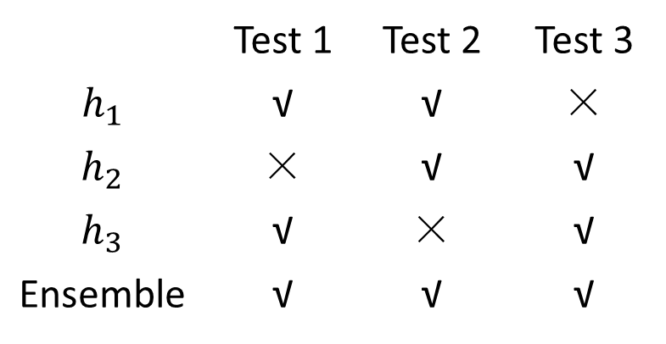
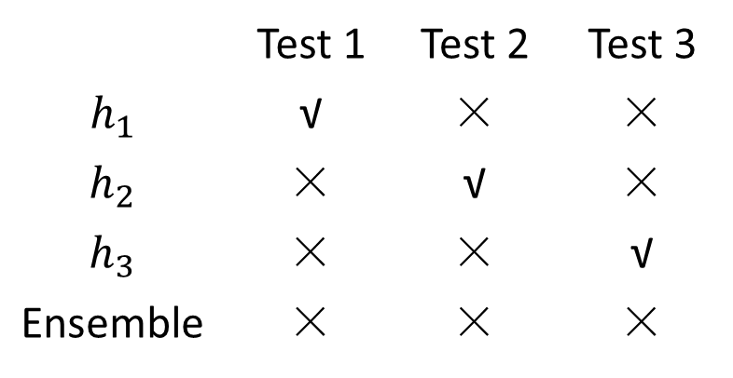
Different Ensemble
 | Test 1 | Test 2 | Test 3
$h_{1}$ | √ | √ | ×
$h_{2}$ | × | √ | √
$h_{3}$ | √ | × | √
Ensemble | √ | √ | √
 | Test 1 | Test 2 | Test 3
$h_{1}$ | √ | √ | ×
$h_{2}$ | √ | √ | ×
$h_{3}$ | √ | √ | ×
Ensemble | √ | √ | ×
(a) Ensemble: Positive Effect.
(b) Ensemble: No Effect.
 | Test 1 | Test 2 | Test 3
$h_{1}$ | √ | × | ×
$h_{2}$ | × | √ | ×
$h_{3}$ | × | × | √
Ensemble | × | × | ×
(c) Ensemble: Negative Effect.

Slide 21
Diversity for Ensemble Input
Successful ensembles require diversity
Predictors may make different mistakes
Encourage to
Involve different types of predictors
Vary the training sets
Vary the feature sets
Cause of the Mistake | Diversification Strategy
Pattern was difficult | Try different models
Overfitting | Vary the training sets
Some features are noisy | Vary the set of input features

Slide 22
Ensemble Methods
Parallel Methods
Bagging
Random Forest
Sequential Methods
Boosting (Adaboost)
Gradient Boosting Decision Trees

Slide 23
Bagging: Bootstrap Aggregating
A technique to reduce generalization error by combining several models.
Idea: train several different models separately, then have all of the models vote on the output for test examples.
Underlying philosophy: different models will usually not make all the same errors on the test set.
Allows the same kind of model/training algorithm/objective function to be reused several times.

Slide 24
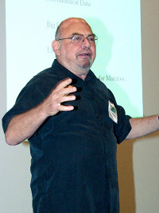
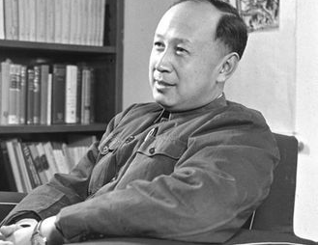
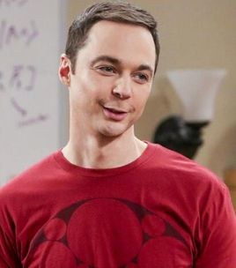
Leo Breiman (1928–2005)
Born in New York City, 1928
Graduated from Roosevelt High School, 1945.
Degree in physics from the California Institute of Technology (Caltech), 1949.
Master degree in mathematics from Columbia University, 1950.
In fact, he wants to learn philosophy..
Ph.D. from UC Berkeley, 1954.
Then hired to teach probability theory at UCLA (earned tenure 1960-1967)
Writing books (Probability Theory)
Spend the next 13 years as a consultant (1969-1982).

Slide 25
Leo Breiman (1928–2005)
Statistician at the University of California, Berkeley (1980-1993)
A member of the United States National Academy of Science.
Important Contributions
CART [1984]
Bagging [1994]
Random Forest [2001]
Some of Breiman's best work was done after retirement...

Slide 26

Leo Breiman (1928–2005)
http://statistics.berkeley.edu/memory/leo-breiman

Slide 27

https://www.researchgate.net/publication/48178196_Remembering_Leo_Breiman#pfb

Slide 28
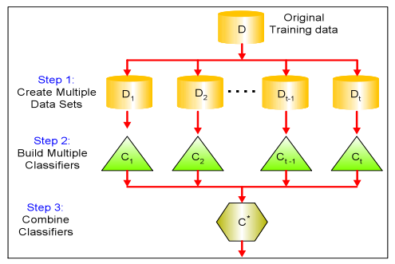

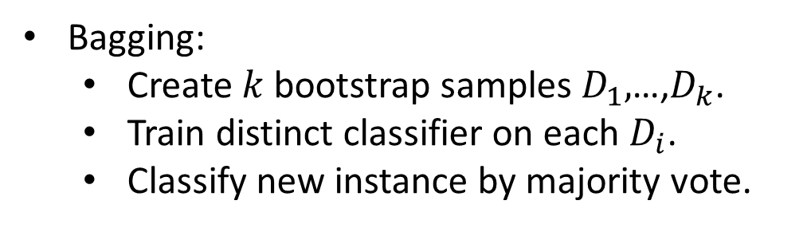
Bagging
Leo Breiman (1994)
Take repeated bootstrap samples from training set $D$.
Bootstrap sampling: Given set $D$ containing $N$ training examples, create $D^{′}$ by drawing $N$examples at random with replacement from $D$.
Bagging:
Create $k$ bootstrap samples $D_{1},$…,$D_{k}$.
Train distinct classifier on each $D_{i}$.
Classify new instance by majority vote.

Slide 29
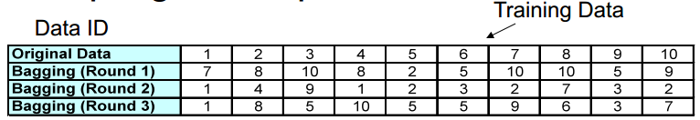

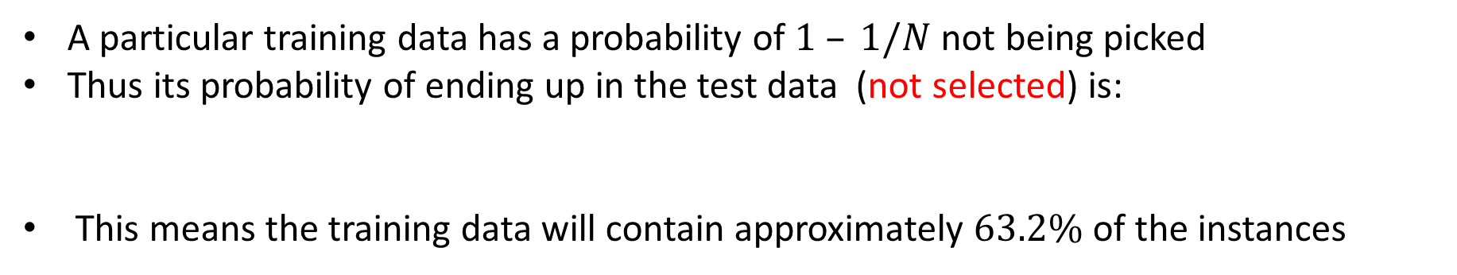
Bagging
Sampling with replacement
A particular training data has a probability of $1 – 1/N$not being picked
Thus its probability of ending up in the test data (not selected) is:
This means the training data will contain approximately $63.2\%$ of the instances
${(1 – 1/N)}^{N}≈e^{−1}=0.368$

Slide 30
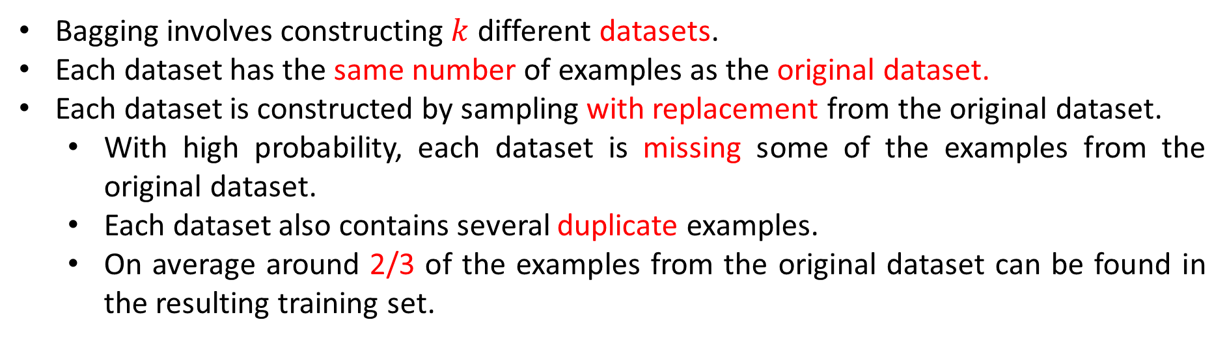
Bagging
Bagging involves constructing $k$ different datasets.
Each dataset has the same number of examples as the original dataset.
Each dataset is constructed by sampling with replacement from the original dataset.
With high probability, each dataset is missing some of the examples from the original dataset.
Each dataset also contains several duplicate examples.
On average around 2/3 of the examples from the original dataset can be found in the resulting training set.
This works best when perturbing the training set can cause significant changes in the estimated model.

Slide 31
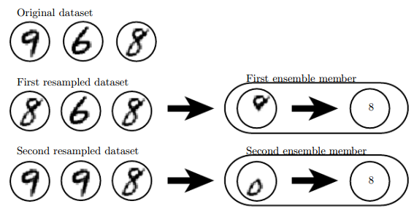
Why Does Bagging Work?
Suppose we train an ‘8’ detector on the dataset, containing an ‘8’, a ‘6’ and a ‘9’.
Suppose we make two different resampled datasets by sampling with replacement.
The first dataset omits the ‘9’ and repeats the ‘8’.
The detector learns that a loop on top of the digit corresponds to an ‘8’.
The second dataset omits the ‘6’ and repeats the ‘9’.
The detector learns that a loop on the bottom of the digit corresponds to an ‘8’.
Original dataset
Each of these individual classification rules is brittle.
But if we average their outputs then the detector is robust, achieving maximal confidence only when both loops of the ‘8’ are present.
First resampled dataset
First ensemble member
Second resampled dataset
Second ensemble member

Slide 32
Ensemble Methods
Parallel Methods
Bagging
Random Forest
Sequential Methods
Boosting (Adaboost)
Gradient Boosting Decision Trees

Slide 33
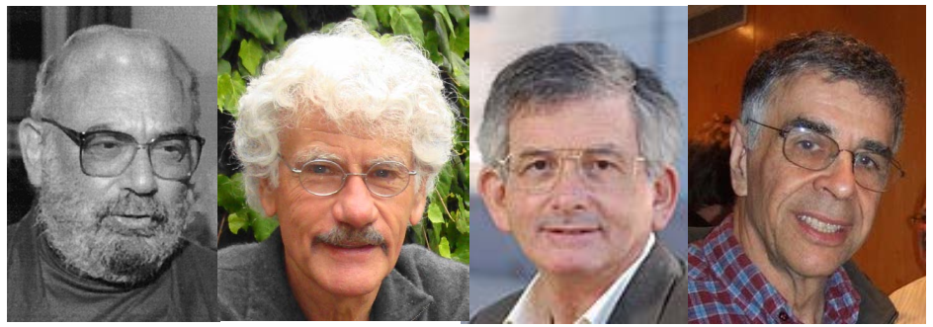
CART (1984)
Breiman Friedman Olshen Stone
UC Berkeley
Stanford University
Stanford University
UC Berkeley

Slide 34
CART
Grow a binary tree.
At each node, split the data into two child nodes.
For regression, the predicted value at a node is the average response variable for all observations in the node.
For classification, the predicted class is the most common class in the node (majority voting).

Slide 35
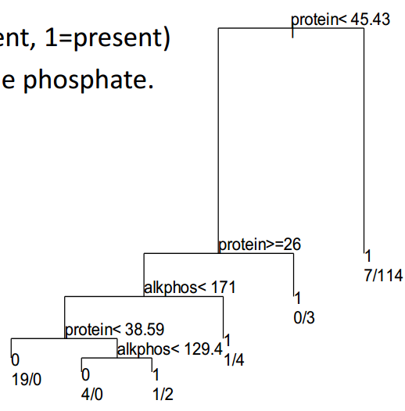

A Classification Tree
Predict hepatitis (0=absent, 1=present)
Using protein and alkaline phosphate.
“Yes” goes left.

Slide 36
Advantages of CART
Applicable to both regression and classification problems
Handle categorical predictors naturally
Computationally simple and quick to fit, even for large problems.
Non-parametric
Can handle highly non-linear interactions and classification boundaries.
Very easy to interpret if the tree is small.

Slide 37
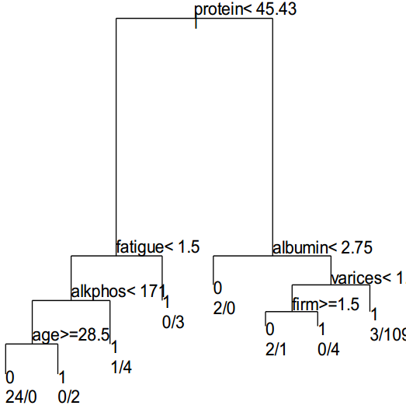
Advantages of CART (Cont.)
The picture of the tree can give valuable insights into which variables are important and where.
The leaf nodes suggest a natural clustering of data.

Slide 38
Disadvantages of CART
Accuracy: current methods, such as SVM and ensemble classifiers often have 30% lower error rates than CART.
Instability: if we change the data a little, the tree picture can change a lot. So the interpretation is not as straightforward as it appears.
Today, we can do better!
Random Forest

Slide 39
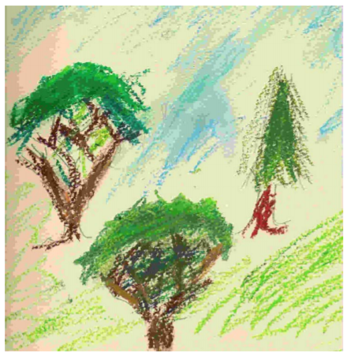
Random Forest
Ensemble method specifically designed for decision tree classifiers.
Random forest is a substantial modification of bagging that builds a large collection of de-correlated trees, and then average them.

Slide 40
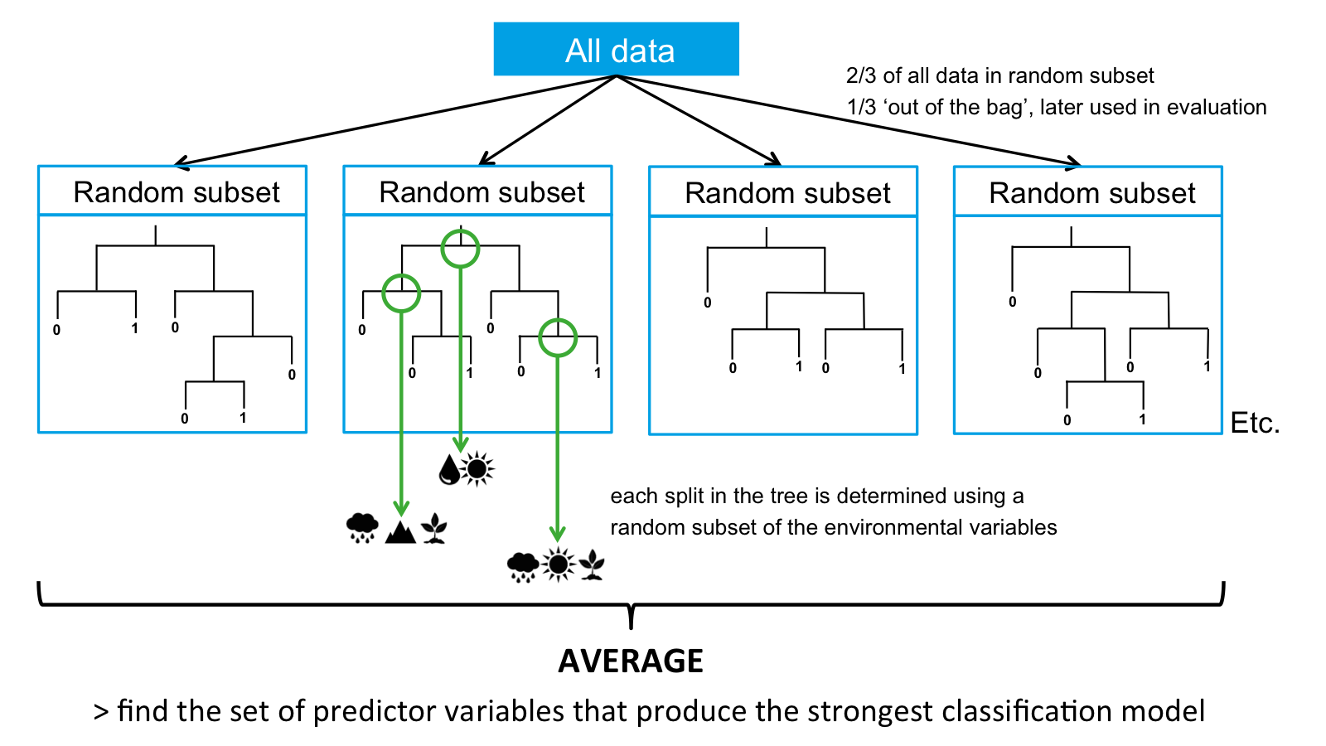
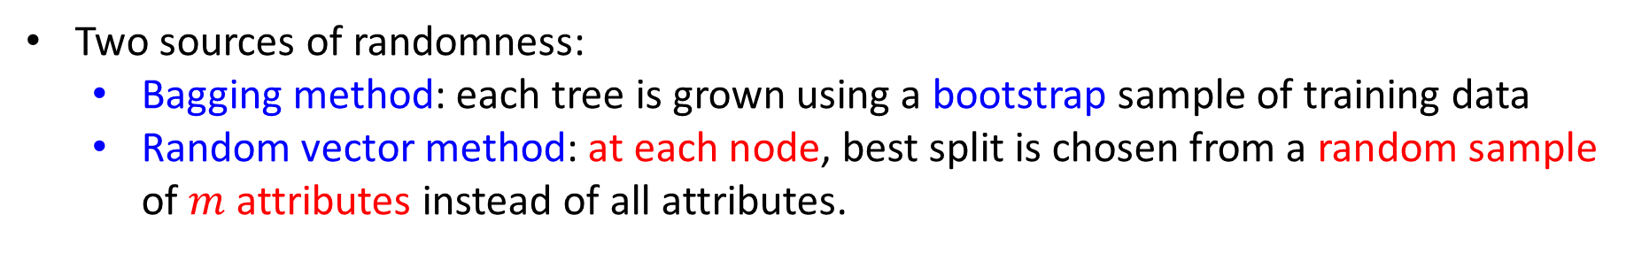
Random Forest
Two sources of randomness:
Bagging method: each tree is grown using a bootstrap sample of training data
Random vector method: at each node, best split is chosen from a random sample of $m$ attributes instead of all attributes.

Slide 41
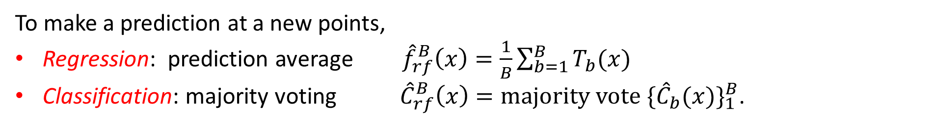
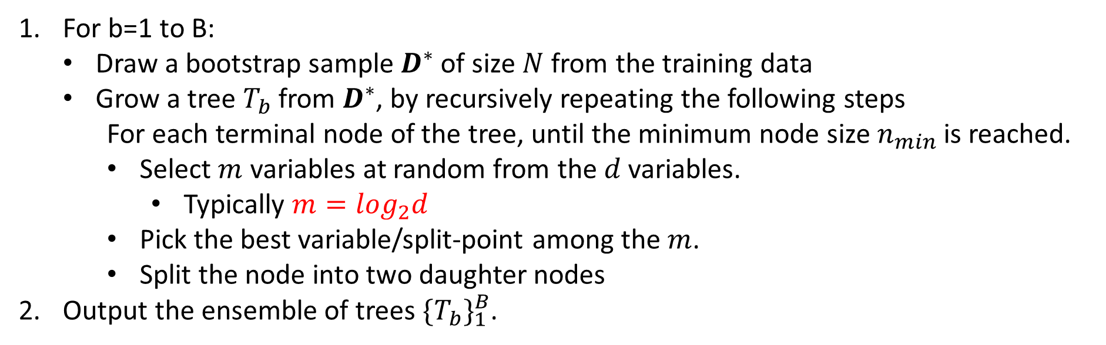
Random Forest Algorithm
For b=1 to B:
Draw a bootstrap sample $D^{∗}$ of size $N$ from the training data
Grow a tree $T_{b}$ from $D^{∗}$, by recursively repeating the following steps
For each terminal node of the tree, until the minimum node size $n_{min}$ is reached.
Select $m$ variables at random from the $d$ variables.
Typically $m=\log_{2}d$
Pick the best variable/split-point among the $m$.
Split the node into two daughter nodes
Output the ensemble of trees ${\{T_{b}\}}_{1}^{B}$.
To make a prediction at a new points,
Regression: prediction average ${\hat{f}}_{rf}^{B}\left(x\right)=\frac{1}{B}\sum_{b=1}^{B}{T_{b}(x)}$
Classification: majority voting ${\hat{C}}_{rf}^{B}\left(x\right)=majority vote {\{{\hat{C}}_{b}(x)\}}_{1}^{B}$.

Slide 42
Inherit Many Advantages of CART
Applicable to both regression and classification problems
Handle categorical predictors naturally
Computationally simple and quick to fit, even for large problems.
Non-parametric
Can handle highly non-linear interactions and classification boundaries.
Very easy to interpret if the tree is small. NO!

Slide 43
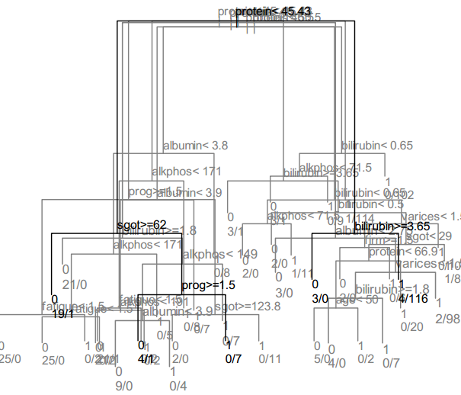
But Do Not Inherit…
The picture of the tree can give valuable insights into which variables are important and where.
The terminal nodes suggest a natural clustering of data.

Slide 44
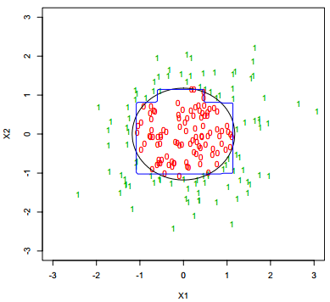
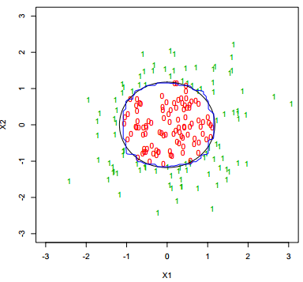
Decision Boundary: Bagging
Bagging averages many trees, and produces smoother decision boundaries.
Single Tree
Bagging

Slide 45
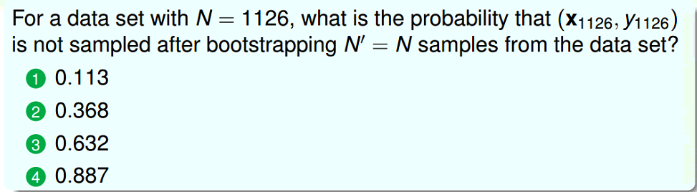
Exercise

Slide 46
Ensemble Methods
Parallel Methods
Bagging
Random Forest
Sequential Methods
Boosting (Adaboost)
Gradient Boosting Decision Trees

Slide 47
Boosting
Boosting is a powerful technique for combining multiple ‘base’ classifiers to produce a form of committee whose performance can be significantly better than that of any of the base classifiers.
Boosting can give good results even if the base classifiers have a performance that is only slightly better than random, and hence sometimes the base classifiers are known as weak learners.
AdaBoost, short for ‘adaptive boosting’, developed by Freund and Schapire 1996).

Slide 48
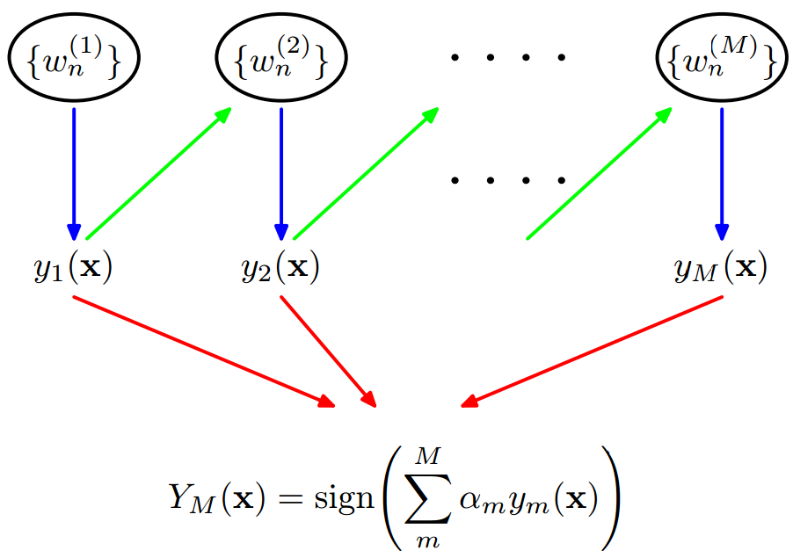
Boosting
The base classifiers are trained in sequence,
Each base classifier is trained using a weighted form of the data set,
The weighting coefficient associated with each data point depends on the performance of the previous classifiers.
Points that are misclassified by one of the base classifiers are given greater weight when used to train the next classifier in the sequence.
Once all the classifiers have been trained, their predictions are then combined through a weighted majority voting scheme.
Additive model

Slide 49
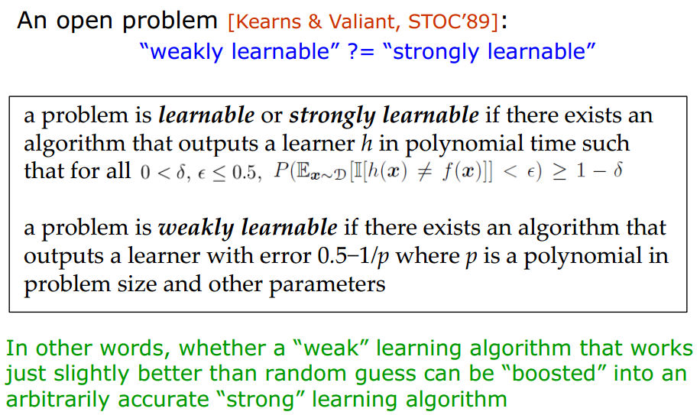
The Born of AdaBoost

Slide 50
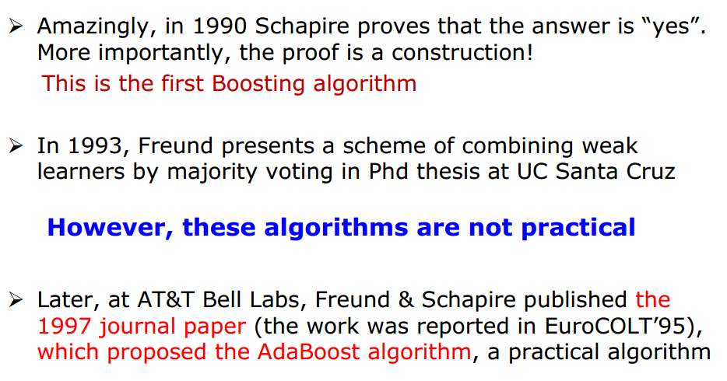
The Born of AdaBoost

Slide 51
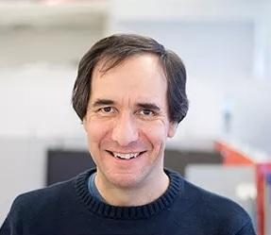
AdaBoost
A Principal Researcher at Microsoft Research in New York City.
He received his PhD from MIT in 1991.
After a short post-doc at Harvard, he joined the technical staff at AT&T Labs (formerly AT&T Bell Laboratories) in 1991.
In 2002, he became a Professor of Computer Science at Princeton University.
He joined Microsoft Research in 2014.
His awards include the 1991 ACM Doctoral Dissertation Award, the 2003 Gödel Prize, and the 2004 Kanelakkis Theory and Practice Award (both of the last two with Yoav Freund).
He is a fellow of the AAAI, and a member of both the National Academy of Engineering and the National Academy of Sciences.
Robert Schapire

Slide 52
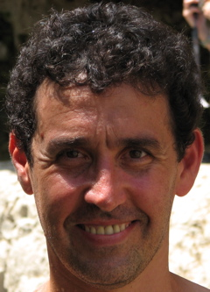
AdaBoost
A professor of Computer Science and Engineering at UC San Diego.
An internationally known researcher in the field of machine learning, a field which bridges computer science and statistics.
Best known for his joint work with Dr. Robert Schapire on the Adaboost algorithm.
Awarded the 2003 Gödel prize in Theoretical Computer Science, as well as the Kanellakis Prize in 2004.
Yoav Freund

Slide 53
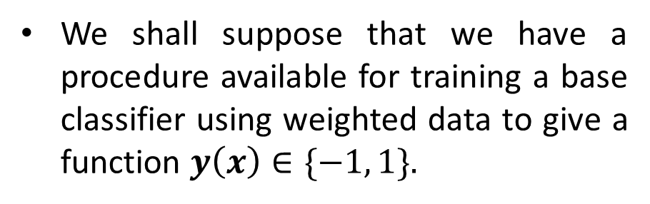
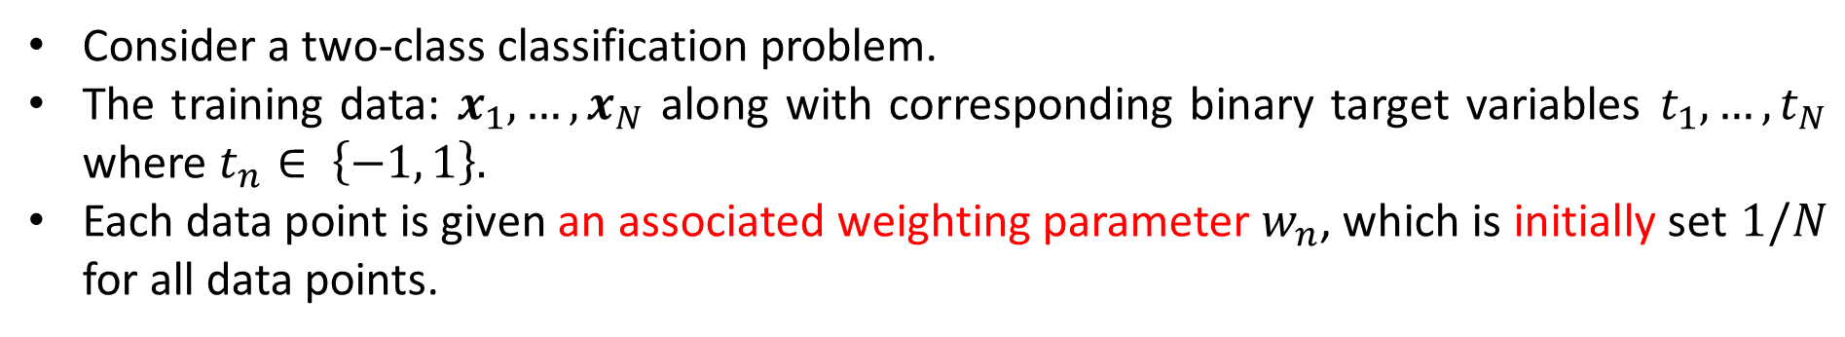
AdaBoost
Consider a two-class classification problem.
The training data: $x_{1},…,x_{N}$ along with corresponding binary target variables $t_{1},…,t_{N}$ where $t_{n}∈ \left\{−1, 1\right\}.$
Each data point is given an associated weighting parameter $w_{n}$, which is initially set $1/N$ for all data points.
We shall suppose that we have a procedure available for training a base classifier using weighted data to give a function $y\left(x\right)∈\{−1, 1\}.$

Slide 54
AdaBoost
At each stage, AdaBoost trains a new classifier using a data set in which the weighting coefficients are adjusted according to the performance of the previously trained classifier.
Give greater weight to the misclassified data points.
When the desired number of base classifiers have been trained, they are combined to form a committee using coefficients that give different weight to different base classifiers.

Slide 55

Solomatine, Dimitri P., and Durga L. Shrestha. "AdaBoost. RT: a boosting algorithm for regression problems." 2004 IEEE International Joint Conference on Neural Networks (IEEE Cat. No. 04CH37541). Vol. 2. IEEE, 2004.

Slide 56
Originally designed for solving classification problems, boosting can also be extended to regression (Friedman, 2001).
Friedman et al. (2000) gave a very simple interpretation of boosting in terms of the sequential minimization of an exponential error function.

Slide 57



Exponential Error Function 指数损失函数
[proposed by Schapire and Singer 1998 as an upper bound on misclassification error]
Loss
4
Squared error
Misclassification error
$$J=\sum_{n=1}^{N}{{(t_{n}−f(x_{n}))}^{2}}$$
3.5
Squared error
3
Exponential loss
2.5
Exponential loss
2
1.5
$$J=\sum_{n=1}^{N}{exp⁡\{−t_{n}f(x_{n})\}}$$
1
0.5
0
-1.5
-1
-0.5
0
0.5
1
1.5
2
$$tf(x)$$

Slide 58

Exponential Error Function 指数损失函数
[proposed by Schapire and Singer 1998 as an upper bound on misclassification error]
Loss
4
Misclassification error
Exponential loss is a monotone, smooth upper bound on misclassification loss.
Leads to simple reweighting scheme.
3.5
Squared error
3
Exponential loss
2.5
2
1.5
1
0.5
0
-1.5
-1
-0.5
0
0.5
1
1.5
2
$$tf(x)$$

Slide 59






AdaBoost
Consider the exponential error function
$t_{n}∈ \{−1, 1\}$ : target value.
$$E=\sum_{n=1}^{N}{exp⁡\{−t_{n}f_{m}(x_{n})\}}$$
$$f_{m}(x_{n})=\sum_{l=1}^{m}{⁡α_{l}y_{l}(x)}$$
$y_{l}(x)∈ \{−1, 1\}$: prediction value of the $l$-th base classifier.
$m$: iteration number.
For testing, new data points are classified by
$$f_{M}(x_{n})=\sum_{m=1}^{M}{⁡α_{m}y_{m}(x)}$$
$$Y_{M}\left(x\right)=sign(f_{M}(x))=sign\left(\sum_{m=1}^{M}{α_{m}y_{m}\left(x\right)}\right)$$

Slide 60





AdaBoost
Consider the exponential error function
$t_{n}∈ \{−1, 1\}$ : ground truth.
$$E=\sum_{n=1}^{N}{exp⁡\{−t_{n}f_{m}(x_{n})\}}$$
$$f_{m}(x_{n})=\sum_{l=1}^{m}{⁡α_{l}y_{l}(x)}$$
$y_{l}(x)∈ \{−1, 1\}$: prediction value of the $l$-th base classifier.
$m$: iteration number.
Our goal is to minimize $E$ with respect to both the weighting coefficients $α_{l}$and the parameters of the base classifiers $y_{l}(x)$.
Suppose that $y_{1}\left(x\right),…,y_{m−1}(x)$ and $α_{1},…,α_{m−1}$ are fixed.
Minimize $E$with respect to only both $α_{m}$ and parameters of the model $y_{m}(x)$.
$$E=\sum_{n=1}^{N}{exp⁡\{−t_{n}f_{m−1}\left(x_{n}\right)−t_{n}α_{m}y_{m}(x_{n})\}}$$
$$=\sum_{n=1}^{N}{{\overline{w}}_{n}^{m}exp⁡\{−t_{n}α_{m}y_{m}(x_{n})\}}$$
${\overline{w}}_{n}^{m}$ can be treated as constants.

Slide 61




AdaBoost
$$E=\sum_{n=1}^{N}{{\overline{w}}_{n}^{m}exp⁡\{−t_{n}α_{m}y_{m}(x_{n})\}}$$
Let $𝒯_{m}$ and $ℳ_{m}$ denote the set of data points that are correctly classified and misclassified by $y_{m}\left(x\right).$
Can you rewrite $E$?
$$E=e^{−α_{m}}\sum_{n∈𝒯_{m}}{{\overline{w}}_{n}^{m}}+e^{α_{m}}\sum_{n∈ℳ_{m}}{{\overline{w}}_{n}^{m}}$$
$$=(e^{α_{m}}−e^{−α_{m}})\sum_{n=1}^{N}{{\overline{w}}_{n}^{m}I(y_{m}\left(x_{n}\right)≠t_{n})}+e^{−α_{m}}\sum_{n=1}^{N}{{\overline{w}}_{n}^{m}}$$

Slide 62




AdaBoost
$$E=(e^{α_{m}}−e^{−α_{m}})\sum_{n=1}^{N}{{\overline{w}}_{n}^{m}I(y_{m}\left(x_{n}\right)≠t_{n})}+e^{−α_{m}}\sum_{n=1}^{N}{{\overline{w}}_{n}^{m}}$$
Minimize $E$ with respect to $y_{m}\left(x\right),$ $α_{m}$ as constants. It is equivalent to minimize,
$$J_{m}=\sum_{n=1}^{N}{{\overline{w}}_{n}^{m}I(y_{m}\left(x_{n}\right)≠t_{n})}$$
Weighted error function
Minimizing $E$ with respect to $α_{m}$, we can obtain,
Weighted error rate
$$α_{m}=\frac{1}{2}\ln\left\{\frac{1−ε_{m}}{ε_{m}}\right\}$$
$$ε_{m}=\frac{\sum_{n=1}^{N}{{\overline{w}}_{n}^{m}I(y_{m}\left(x_{n}\right)≠t_{n})}}{\sum_{n=1}^{N}{{\overline{w}}_{n}^{m}}}$$
where

Slide 63


Exercise
According to $α_{m}=\frac{1}{2}\ln\left\{\frac{1−ε_{m}}{ε_{m}}\right\}$, when would $α_{m}>0$?
A: $ε_{m}<1/2$
B: $ε_{m}>1/2$
C: $ε_{m}≠0$
D: $ε_{m}≠1$
$ε_{m}<1/2$ means that $y_{m}$ is useful for final prediction $Y_{M}$ and weighted error rate of $y_{m}$ is better than random.

Slide 64









AdaBoost
Having found $y_{m}\left(x\right)$ and $α_{m},$ the weights are updated as
$${\overline{w}}_{n}^{\left(m+1\right)}={\overline{w}}_{n}^{m}exp⁡\{−t_{n}α_{m}y_{m}(x_{n})\}$$
$${\overline{w}}_{n}^{m}=\exp\left\{−t_{n}f_{m−1}\left(x_{n}\right)\right\}$$
For practical algorithm, we make
$$ε_{m}=\frac{\sum_{n=1}^{N}{{\overline{w}}_{n}^{m}I(y_{m}\left(x_{n}\right)≠t_{n})}}{\sum_{n=1}^{N}{{\overline{w}}_{n}^{m}}}=\sum_{n=1}^{N}{w_{n}^{m}I(y_{m}\left(x_{n}\right)≠t_{n})}$$
$$w_{n}^{m}=\frac{{\overline{w}}_{n}^{m}}{\sum_{n=1}^{N}{{\overline{w}}_{n}^{m}}}$$
$$w_{n}^{\left(m+1\right)}=\frac{w_{n}^{m}}{Z_{m}}exp⁡\{−t_{n}α_{m}y_{m}(x_{n})\}$$
$$w_{n}^{m+1}=\frac{{\overline{w}}_{n}^{m+1}}{\sum_{n=1}^{N}{{\overline{w}}_{n}^{m+1}}}=\frac{{\overline{w}}_{n}^{m}exp⁡\{−t_{n}α_{m}y_{m}(x_{n})\}}{\sum_{n=1}^{N}{{\overline{w}}_{n}^{m}exp⁡\{−t_{n}α_{m}y_{m}(x_{n})\}}}$$
$$Z_{m}=\sum_{n=1}^{N}{w_{n}^{m}exp⁡\{−t_{n}α_{m}y_{m}(x_{n})\}}$$
$$w_{n}^{m+1}=\frac{w_{n}^{m}exp⁡\{−t_{n}α_{m}y_{m}(x_{n})\}}{\sum_{n=1}^{N}{w_{n}^{m}exp⁡\{−t_{n}α_{m}y_{m}(x_{n})\}}}$$

Slide 65









$w_{n}^{ (m)}$ increases for points that are misclassified.
$w_{n}^{ (m)}$ decreases for that are correctly classified.
The successive classifier is forced to put greater emphasis on points that were misclassified by the previous classifier.
Points that continue to be misclassified by the successive classifier receive greater weight.
$ε_{m}$: weighted error rate of each base classifier.
$α_{m}:$ gives larger weight to more accurate classifier.
$$ε_{m}=\sum_{n=1}^{N}{w_{n}^{m}I(y_{m}\left(x_{n}\right)≠t_{n})}$$
and then calculate
$$α_{m}=\frac{1}{2}\ln\left\{\frac{1−ε_{m}}{ε_{m}}\right\}$$
$(c)$Update the data weighting coefficients
$$w_{n}^{\left(m+1\right)}=\frac{w_{n}^{m}}{Z_{m}}exp⁡\{−t_{n}α_{m}y_{m}(x_{n})\}$$
$$Z_{m}=\sum_{n=1}^{N}{w_{n}^{m}exp⁡\{−t_{n}α_{m}y_{m}(x_{n})\}}$$
normalization

Slide 66

Exercise
For four examples with $w_{n}^{1}=\frac{1}{4}$ for all examples. If $y_{1}$ predicts the first example wrongly but all the other three examples correctly. After the re-weighting, what is $\frac{w_{1}^{2}}{w_{2}^{2}}$?
A: 4
B: 3
C: 1/3
D: 1/4

Slide 67




$$x>v$$
$+$
$$−$$
Decision Stump: one-level decision tree.
A decision tree with one internal node (the root) which is immediately connected to the terminal nodes (its leaves).
A decision stump makes a prediction based on the value of just a single input feature.
Notes:
It is a sequential procedure that builds a complex classifier out of simpler ones by combining them additively.

Slide 68

Notes:
It is a sequential procedure that builds a complex classifier out of simpler ones by combining them additively.

Slide 69

Notes:
It is a sequential procedure that builds a complex classifier out of simpler ones by combining them additively.

Slide 70

Notes:
It is a sequential procedure that builds a complex classifier out of simpler ones by combining them additively.

Slide 71

Notes:
It is a sequential procedure that builds a complex classifier out of simpler ones by combining them additively.

Slide 72
Exercise
Given the following training dataset,
X | 0 | 1 | 2 | 3 | 4 | 5 | 6 | 7 | 8 | 9
T | 1 | 1 | 1 | -1 | -1 | -1 | 1 | 1 | 1 | -1
Use Adaboost with the base (weak) classifier $x>v$ or $x<v$.

Slide 73






Given the following training dataset,
X | 0 | 1 | 2 | 3 | 4 | 5 | 6 | 7 | 8 | 9
T | 1 | 1 | 1 | -1 | -1 | -1 | 1 | 1 | 1 | -1
1 1 1 -1 -1 -1 -1 -1 -1 -1
$$y_{1}$$
$$w_{n}^{1}=\frac{1}{10},n=1,2,…,10$$
Initialize the sample weights
Training the base classifier with $w_{n}^{1}$’s, we have $v=2.5$
$$y_{1}(x)=\left\{\begin{aligned}1, x<2.5 \\ −1, x>2.5\end{aligned}\right.$$
With $y_{1}\left(x\right),$ we have the error rate $ε_{1}=0.3$
The weight for $y_{1}(x)$, $α_{1}=\frac{1}{2}\ln\left(\frac{1−ε_{1}}{ε_{1}}\right)=0.4236$
$$f_{1}\left(x\right)=0.4236y_{1}\left(x\right)$$
$sign[f_{1}\left(x\right)]$ has 3 error samples.

Slide 74







Given the following training dataset,
1 1 1 -1 -1 -1 -1 -1 -1 -1
$$y_{1}$$
X | 0 | 1 | 2 | 3 | 4 | 5 | 6 | 7 | 8 | 9
T | 1 | 1 | 1 | -1 | -1 | -1 | 1 | 1 | 1 | -1
1 1 1 1 1 1 1 1 1 -1
$$y_{2}$$
$$w_{n}^{\left(m+1\right)}=\frac{w_{n}^{m}}{Z_{m}}exp⁡\{−t_{n}α_{m}y_{m}(x_{n})\}$$
$$Z_{m}=\sum_{n=1}^{N}{w_{n}^{m}exp⁡\{−t_{n}α_{m}y_{m}(x_{n})\}}$$
Update the sample weights
$$(w_{1}^{2},w_{2}^{2},…,w_{10}^{2})=(0.07143,0.07143,0.07143,0.07143,0.07143,0.07143,0.16667,0.16667,0.16667,0.07143)$$
$$y_{2}(x)=\left\{\begin{aligned}1, x<8.5 \\ −1, x>8.5\end{aligned}\right.$$
Training the base classifier with $w_{n}^{2}$’s, we have $v=8.5$
With $y_{2}\left(x\right),$ we have the error rate $ε_{2}=0.2143$
The weight for $y_{2}(x)$, $α_{2}=\frac{1}{2}\ln\left(\frac{1−ε_{2}}{ε_{2}}\right)=0.6496$
$$f_{2}\left(x\right)=0.4236y_{1}\left(x\right)+0.6496y_{2}(x)$$
$sign[f_{2}\left(x\right)]$ has 3 error samples.

Slide 75






Given the following training dataset,
$$y_{1}$$
1 1 1 -1 -1 -1 -1 -1 -1 -1
1 1 1 1 1 1 1 1 1 -1
$$y_{2}$$
X | 0 | 1 | 2 | 3 | 4 | 5 | 6 | 7 | 8 | 9
T | 1 | 1 | 1 | -1 | -1 | -1 | 1 | 1 | 1 | -1
-1 -1 -1 -1 -1 -1 1 1 1 1
$$y_{3}$$
$$w_{n}^{\left(m+1\right)}=\frac{w_{n}^{m}}{Z_{m}}exp⁡\{−t_{n}α_{m}y_{m}(x_{n})\}$$
$$Z_{m}=\sum_{n=1}^{N}{w_{n}^{m}exp⁡\{−t_{n}α_{m}y_{m}(x_{n})\}}$$
Update the sample weights
$$(w_{1}^{3},w_{2}^{3},…,w_{10}^{3})=(0.0455, 0.0455, 0.0455, 0.1667, 0.1667, 0.1667, 0.1060, 0.1060, 0.1060, 0.0455)$$
$$y_{3}(x)=\left\{\begin{aligned}−1, x<5.5 \\ 1, x>5.5\end{aligned}\right.$$
Training the base classifier with $w_{n}^{3}$’s, we have $v=5.5$
With $y_{3}\left(x\right),$ we have the error rate $ε_{3}=0.1820$
The weight for $y_{3}(x)$, $α_{3}=\frac{1}{2}\ln\left(\frac{1−ε_{3}}{ε_{3}}\right)=0.7514$
$$f_{3}\left(x\right)=0.4236y_{1}\left(x\right)+0.6496y_{2}\left(x\right)+0.7514y_{3}(x)$$

Slide 76





Given the following training dataset,
X | 0 | 1 | 2 | 3 | 4 | 5 | 6 | 7 | 8 | 9
T | 1 | 1 | 1 | -1 | -1 | -1 | 1 | 1 | 1 | -1
$$y_{1}: x<2.5$$
1 1 1 -1 -1 -1 -1 -1 -1 -1
$$y_{2}: x<8.5$$
1 1 1 1 1 1 1 1 1 -1
$y_{3}: x>5.5$
-1 -1 -1 -1 -1 -1 1 1 1 1
Final $sign[f_{3}\left(x\right)]$
1 1 1 -1 -1 -1 1 1 1 -1
$$f_{3}\left(x\right)=0.4236y_{1}\left(x\right)+0.6496y_{2}\left(x\right)+0.7514y_{3}(x)$$
$sign[f_{3}\left(x\right)]$ has 0 error.

Slide 77






$$f_{M}(x_{n})=\sum_{l=1}^{M}{⁡α_{l}y_{l}(x)}$$
AdaBoost—Training Error
$$Y_{M}\left(x\right)=sign\left(f_{M}(x_{n})\right)$$
$γ_{m}=\frac{1}{2}−ε_{m}$
Freund and Schapire prove the training error of AdaBoost is
$$\frac{1}{N}\sum_{n=1}^{N}{I(Y_{M}\left(x_{n}\right)≠t_{n})}≤\frac{1}{N}\sum_{n=1}^{N}{\exp\left(−t_{n}f_{M}\left(x\right)\right)}=\prod_{m=1}^{M}{Z_{m}}≤exp⁡\left(−2\sum_{γ=1}^{M}{γ_{m}^{2}}\right)$$
When $Y_{M}\left(x_{n}\right)≠t_{n}$, $t_{n}f_{M}\left(x\right)<0$, then $\exp\left(−t_{n}f_{M}\left(x\right)\right)≥1$
$$\frac{1}{N}\sum_{n=1}^{N}{I(Y_{M}\left(x_{n}\right)≠t_{n})}≤\frac{1}{N}\sum_{n=1}^{N}{\exp\left(−t_{n}f_{M}\left(x\right)\right)}$$
$$w_{n}^{\left(m+1\right)}=\frac{w_{n}^{m}}{Z_{m}}exp⁡\{−t_{n}α_{m}y_{m}(x_{n})\}$$
Next we will use

Slide 78







AdaBoost—Training Error
$$w_{n}^{\left(m+1\right)}=\frac{w_{n}^{m}}{Z_{m}}exp⁡\{−t_{n}α_{m}y_{m}(x_{n})\}$$
$$\frac{1}{N}\sum_{n=1}^{N}{\exp\left(−t_{n}f_{M}\left(x\right)\right)}=\frac{1}{N}\sum_{n=1}^{N}{\exp\left(−t_{n}\sum_{m=1}^{M}{α_{m}y_{m}(x_{n})}\right)}$$
$$=\sum_{n=1}^{N}{w_{n}^{1}\prod_{m=1}^{M}{\exp\left(−t_{n}α_{m}y_{m}(x_{n})\right)}}$$
$$=Z_{1}\sum_{n=1}^{N}{w_{n}^{2}\prod_{m=2}^{M}{\exp\left(−t_{n}α_{m}y_{m}(x_{n})\right)}}$$
$$=Z_{1}Z_{2}\sum_{n=1}^{N}{w_{n}^{3}\prod_{m=3}^{M}{\exp\left(−t_{n}α_{m}y_{m}(x_{n})\right)}}$$
$$=\prod_{m=1}^{M}{Z_{m}}$$
$$\frac{1}{N}\sum_{n=1}^{N}{I(Y_{M}\left(x_{n}\right)≠t_{n})}≤\frac{1}{N}\sum_{n=1}^{N}{\exp\left(−t_{n}f_{M}\left(x\right)\right)}=\prod_{m=1}^{M}{Z_{m}}≤exp⁡\left(−2\sum_{γ=1}^{M}{γ_{m}^{2}}\right)$$

Slide 79









AdaBoost—Training Error
$$α_{m}=\frac{1}{2}\ln\left\{\frac{1−ε_{m}}{ε_{m}}\right\}$$
$$ε_{m}=\sum_{n=1}^{N}{w_{n}^{m}I(y_{m}\left(x_{n}\right)≠t_{n})}$$
$$Z_{m}=\sum_{n=1}^{N}{w_{n}^{m}exp⁡\{−t_{n}α_{m}y_{m}(x_{n})\}}=\sum_{n:Y_{M}\left(x_{n}\right)=t_{n}}{w_{n}^{m}exp⁡(−α_{m})}+\sum_{n:Y_{M}\left(x_{n}\right)≠t_{n}}{w_{n}^{m}exp⁡(α_{m})}$$
$$=(1−ε_{m})exp⁡(−α_{m})+ε_{m}exp⁡(α_{m})$$
$$=(1−ε_{m})exp\left\{−\frac{1}{2}\ln\left(\frac{1−ε_{m}}{ε_{m}}\right)\right\}⁡+ε_{m}exp\left\{\frac{1}{2}\ln\left(\frac{1−ε_{m}}{ε_{m}}\right)\right\}$$
$$=2\sqrt{(1−ε_{m})ε_{m}}$$
$$=\sqrt{1−4γ_{m}^{2}}$$
Let $γ_{m}=\frac{1}{2}−ε_{m}$
$$\prod_{m=1}^{M}{Z_{m}}≤exp⁡\left(−2\sum_{γ=1}^{M}{γ_{m}^{2}}\right)$$
$$\sqrt{1−4γ_{m}^{2}}≤e^{−2γ_{m}^{2}}$$
To prove
Next we need to prove

Slide 80








AdaBoost—Training Error
Let
$$x=4γ_{m}^{2}∈[0,1]$$
$$f\left(x\right)=e^{−x}+x−1$$
$f^{′}\left(x\right)=−e^{−x}+1≥0$ for $x∈[0,1]$
$$f\left(x\right)≥f\left(0\right)=0$$
$$\sqrt{1−4γ_{m}^{2}}≤e^{−2γ_{m}^{2}}$$
$$e^{−4γ_{m}^{2}}+4γ_{m}^{2}−1≥0$$
$$Z_{m}≤e^{−2γ_{m}^{2}}$$
$$\frac{1}{N}\sum_{n=1}^{N}{I(Y_{M}\left(x_{n}\right)≠t_{n})}≤\frac{1}{N}\sum_{n=1}^{N}{\exp\left(−t_{n}f_{M}\left(x\right)\right)}=\prod_{m=1}^{M}{Z_{m}}≤exp⁡\left(−2\sum_{γ=1}^{M}{γ_{m}^{2}}\right)$$

Slide 81


AdaBoost—Training Error
If there exist some $γ>0$ so that $γ_{m}≥γ$ for all $m$, then
$$\frac{1}{N}\sum_{n=1}^{N}{I(Y_{M}\left(x_{n}\right)≠t_{n})}≤exp⁡\left(−2Mγ^{2}\right)$$
Namely, under this condition, the training error drops exponentially fast.
Notably, AdaBoost does not need to know the lower bound $γ$, which makes it different from previous boosting methods.
AdaBoost, is adaptive because that it adapts to the training error rate of each weak learner. This is the basis of its name — “Ada” is short for “adaptive.”

Slide 82


AdaBoost—Generalization Error
Freund & Schapire [JCSS97] proved that the generalization error of AdaBoost
is bounded by:
$$R\left(θ\right)≤R_{emp}\left(θ\right)+\tilde{𝒪}⁡\left(\sqrt{\frac{HM}{N}}\right)$$
with probability at least $1−η.$
$H$: VC-dimension of base learners
$N$: the number of training instances.
$M$: the number of learning rounds
$\tilde{𝒪}(∙)$ is used instead of $𝒪(∙)$ to hide logarithmic terms and constant factors.

Slide 83


AdaBoost—Generalization Error
Freund & Schapire [JCSS97] proved that the generalization error of AdaBoost
is bounded by:
$$R\left(θ\right)≤R_{emp}\left(θ\right)+\tilde{𝒪}⁡\left(\sqrt{\frac{HM}{N}}\right)$$
This bound suggests that boosting will overfit if run for too many rounds, i.e., as $M$ becomes large.
However, several authors observed empirically that boosting often does not overfit, even when run for thousands of rounds.

Slide 84

The Mystery
AdaBoost often does not overfit in real practice!
AdaBoost drives the training error to zero.
Further iterations continue to improve test error in many examples.
Understanding why AdaBoost seems resistant to overfitting is the most fascinating fundamental theoretical issue.

Slide 85

AdaBoost
Significant Advantages
Very accurate prediction
Very simple (just 10 lines of code as Schapire said)
Wide and successful applications
Sound theoretical foundation
…
Gödel Prize (2003)
Freund & Schapire, A decision theoretic generalization of on-line learning and an application to Boosting. Journal of Computer and System Sciences, 1997, 55: 119-139.

Slide 86
Why AdaBoost High Impact?
It is simple yet effective.
Can be applied to almost all tasks where one wants to apply machine learning techniques.
For example, in computer vision, the Viola-Jones detector
AdaBoost using harr-like features in a cascade structure
It generates the Boosting Family of algorithms.
A lot of Boosting algorithms: AdaBoost.M1, AdaBoost.MR, FilterBoost, GentleBoost, GradientBoost, MadaBoost, LogitBoost, LPBoost, MultiBoost, RealBoost, RobustBoost,…
There are sound theoretical results.

Slide 87

Boosting vs Bagging
2000 points from Nested Spheres in $ℝ^{10}$. Leftmost term is a single tree.

Slide 88

Summary
Classification And Regression Tree.
Binary tree.
Gini index/residual sum of squares.
Easy to interpret.
Classification Trees

Slide 89

Summary
Boostrap Aggregating (Leo Breiman).
Idea: train several different models separately, then majority voting.
Usually treats each predictor trained on a bootstrap set with the same weight.
Averaging Trees
Classification Trees
Bagging

Slide 90
Summary
Tries to de-correlate the bootstrap-trained predictors (decision trees) by sampling features.
Two sources of randomness:
Random training samples;
Random attributes.
Cleverer Averaging of Trees
Averaging Trees
Classification Trees
Bagging
Random Forests

Slide 91
Summary
Boosting strategically learns and combines the next predictor based on previous predictors.
Learn in sequence.
Using a weighted form of the data set.
E.g., AdaBoost.
Cleverer Averaging of Trees
Cleverer Averaging of Trees
Averaging Trees
Classification Trees
Bagging
Random Forests
Boosting

Slide 92


Exponential Error Function
For binary classification, consider the exponential error function
$$J(f)=𝔼[exp⁡\{−tf(x)\}]$$
$$t∈ \{−1, 1\}$$
It is almost equivalent to the logistic cross-entropy loss (for $t=+1, t=−1$ labels).
Let us revisit the logistic cross entropy loss!

Slide 93







Logistic Regression--$t∈\{0,1\}$
Logistic regression use $h(x) =θ(w^{T}x)$ to approximate the target $f\left(x\right)=$ $p\left(+1 | x\right)$
$$θ\left(s\right)=\frac{e^{s}}{1+e^{s}}=\frac{1}{1+e^{−s}}$$
Consider $𝒟=\{\left(x_{1},+\right),\left(x_{2},−\right),…,(x_{m},−)\}$
$$p(t_{i}|x_{i})=\left\{\begin{aligned}h\left(x_{i}\right) \\ 1−h(x_{i})\end{aligned}\right.$$
for $t_{i}=1$
$$⟺$$
$$p\left(t_{i} | x_{i}\right)={h\left(x_{i}\right)}^{t_{i}}{(1−h\left(x_{i}\right))}^{(1−t_{i})}$$
for$t_{i}=0$
Bernoulli distribution
$$likelihood\left(h\right)=\prod_{i=1}^{m}{p(x_{i})p(t_{i}|x_{i})}∝\prod_{i=1}^{m}{p\left(t_{i} | x_{i}\right)}=\prod_{i=1}^{m}{{h\left(x_{i}\right)}^{t_{i}}{(1−h\left(x_{i}\right))}^{(1−t_{i})}}$$

Slide 94





Logistic Regression--$t∈\{0,1\}$
$$\min_{h}{E\left(h\right)=\sum_{i=1}^{m}{−(t_{i}ln h\left(x_{i}\right)+\left(1−t_{i}\right)\ln{(1−h\left(x_{i}\right)) })}}$$
Negative Log-likelihood
Cross-entropy loss
$$H\left(p,q\right)=−\sum_{x}{p\left(x\right)log⁡(q(x))}$$
$p∈\left\{t,1−t\right\}$
$q∈\{h\left(x\right),1−h\left(x\right)\}$
Cross-entropy
$$\min_{w}{\sum_{i=1}^{m}{\left[−t_{i}ln\left(\frac{1}{1+e^{−w^{T}x_{i}}}\right)−\left(1−t_{i}\right)ln\left(\frac{1}{1+e^{w^{T}x_{i}}}\right)\right]}}$$
Negative Log-likelihood
$$\min_{w}{\sum_{i=1}^{m}{\left[{−t}_{i}w^{T}x_{i}+ln(1+e^{w^{T}x_{i}})\right]}}$$

Slide 95














Logistic Regression--$t∈\{−1,1\}$
$$θ\left(z\right)=\frac{e^{z}}{1+e^{z}}=\frac{1}{1+e^{−z}}$$
Consider $𝒟=\{\left(x_{1},+\right),\left(x_{2},−\right),…,(x_{m},−)\}$
$$p(t|x_{i})=\left\{\begin{aligned}h\left(x_{i}\right) \\ 1−h(x_{i})\end{aligned}\right.$$
for $t=+1$
$$h(x_{i})=P(+1|x_{i})$$
$$⇔$$
for $t=−1$
$$p(t|x_{i})=\left\{\begin{aligned}h\left(x_{i}\right) \\ h\left(−x_{i}\right)\end{aligned}\right.$$
for $t=+1$
$$⇔$$
$$⇔$$
$$p(t|x_{i})=h\left(tx_{i}\right)$$
for $t=−1$
$$1 −θ(z) = θ(−z)$$

Slide 96








Logistic Regression--$t∈\{−1,1\}$
Consider $𝒟=\{\left(x_{1},+\right),\left(x_{2},−\right),…,(x_{m},−)\}$
$$likelihood\left(h\right)=\prod_{i=1}^{m}{p(x_{i})p(t_{i}|x_{i})}=p\left(x_{1}\right)h\left(x_{1}\right)p\left(x_{2}\right)h\left(−x_{2}\right)…p\left(x_{m}\right)h\left(−x_{m}\right)$$
$$\max_{h}{likelihood(h) }∝\prod_{i=1}^{m}{p(t_{i}|x_{i})}=\prod_{i=1}^{m}{h\left(t_{i}x_{i}\right)}=\prod_{i=1}^{m}{θ\left(t_{i}w^{T}x_{i}\right)}$$
$$\min_{w}{−\sum_{i=1}^{m}{\ln{θ\left(t_{i}w^{T}x_{i}\right)}} }$$
$$\min_{w}{−\sum_{i=1}^{m}{\ln{1/(1+e^{−t_{i}w^{T}x_{i}}) }} }$$
$$⇔$$
$$\min_{w}{−\frac{1+t_{i}}{2}\sum_{i=1}^{m}{\ln{\frac{1}{1+e^{−w^{T}x_{i}}}}}−\frac{1−t_{i}}{2}\sum_{i=1}^{m}{\ln{\frac{1}{1+e^{w^{T}x_{i}}}}}}$$
Cross-entropy loss for
$t∈\{−1,1\}$

Slide 97




Exponential Error Function
For binary classification, consider the exponential error function
$$J(f)=𝔼[exp⁡\{−tf(x)\}]$$
$$t∈ \{−1, 1\}$$
It is almost equivalent to the logistic cross entropy loss (for $t=+1, t=−1$ labels).
$$\min_{w}{−\frac{1+t_{i}}{2}\sum_{i=1}^{m}{\ln{\frac{1}{1+e^{−w^{T}x_{i}}}}}−\frac{1−t_{i}}{2}\sum_{i=1}^{m}{\ln{\frac{1}{1+e^{w^{T}x_{i}}}}}}$$
$$\min_{w}{−\frac{1+t_{i}}{2}\sum_{i=1}^{m}{\ln{\frac{1}{1+e^{−f\left(x_{i}\right)}}}}−\frac{1−t_{i}}{2}\sum_{i=1}^{m}{\ln{\frac{1}{1+e^{f\left(x_{i}\right)}}}}}$$

Slide 98




Exponential Error Function
For binary classification, consider the exponential error function
$$J(f)=𝔼[exp⁡\{−tf(x)\}]$$
$$t∈ \{−1, 1\}$$
It is almost equivalent to the logistic cross entropy loss (for $t=+1, t=−1$ labels).
Logistic cross entropy loss
$$ℒ\left(t,x\right)=−\frac{1+t}{2}\log{\frac{e^{f\left(x\right)}}{1+e^{f\left(x\right)}}}−\frac{1−t}{2}\log{\frac{1}{1+e^{f\left(x\right)}}}$$
$$ℒ\left(t,x\right)=−\frac{1+t}{2}\left(f\left(x\right)−\log\left(1+e^{f\left(x\right)}\right)\right)+\frac{1−t}{2}\log\left(1+e^{f\left(x\right)}\right)=−\frac{1+t}{2}f\left(x\right)+\log\left(1+e^{f\left(x\right)}\right)$$
$$ℒ\left(t,x\right)=\log{\frac{1+e^{f\left(x\right)}}{e^{\frac{1+t}{2}f\left(x\right)}}}=\left\{\begin{aligned}\log\left(1+e^{f\left(x\right)}\right) if t=−1 \\ \log\left(1+e^{−f\left(x\right)}\right) if t=+1\end{aligned}\right.$$
$$ℒ\left(t,x\right)=\log\left(1+e^{−tf\left(x\right)}\right)$$
$≈$Exponential error loss

Slide 99



Exponential Error Function
For binary classification, consider the exponential error function
$$J(f)=𝔼[exp⁡\{−tf(x)\}]$$
$$t∈ \{−1, 1\}$$
It is almost equivalent to the logistic cross entropy loss (for $t=+1, t=−1$ labels).
In addition
$$𝔼[exp⁡\{−tf(x)\}]=\int{\left[p\left(t=1 | x\right)e^{−f\left(x\right)}+p(t=−1|x)e^{f\left(x\right)}\right]p\left(x\right)dx}$$
$$𝔼[exp⁡\{−tf(x)\}|x]=\left[p\left(t=1 | x\right)e^{−f\left(x\right)}+p(t=−1|x)e^{f\left(x\right)}\right]$$
$$\frac{∂𝔼[exp⁡\{−tf(x)\}|x]}{∂f(x)}=−p\left(t=1 | x\right)e^{−f\left(x\right)}+p\left(t=−1 | x\right)e^{f\left(x\right)}=0$$
$$f\left(x\right)=\frac{1}{2}\ln{\frac{p\left(t=1 | x\right)}{p\left(t=−1 | x\right)}}$$
$$p(t=1|x)=\frac{e^{2f\left(x\right)}}{1+e^{2f\left(x\right)}}$$
Hence, AdaBoost and Logistic Regression are equivalent up to a factor 2.

