Slide 1
CS302 Design and Analysis of Algorithm
1

Slide 2
Course Introduction
Credit Hours: 3
3 credit hours of class lectures

Slide 3
Prerequisite
Enforced
CS201 Data Structures

Slide 4
Books
T. Cormen, C. Leiserson, R. Rivest, and C. Stein. Introduction to Algorithms, 3rd Edition, MIT Press, 2011.
Introduction to the Design and Analysis of Algorithms by Anany Levitin

Slide 5
Reference Books
Data Structures and Algorithms
A. V. Aho, J. E. Hopcroft, J. D. Ullman

Slide 6
Course Objective
The course introduces students to advanced techniques in data structures as well as design and analysis of high-performance and scalable algorithms & their engineering applications.
What should you expect in this course?
Overview of some advanced data structures.
A number of algorithms and computational techniques to solve complex programming problems.
Programming
What should you learn by the end of this course
Ability to design and implement algorithms and techniques in the broad area of computational sciences

Slide 7
Revision
Data structures let the input and output be represented
in a way that can be handled efficiently and effectively.
array
Linked list
queue
tree
stack

Slide 8
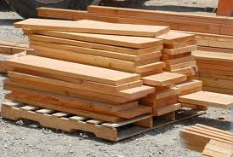
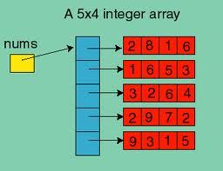
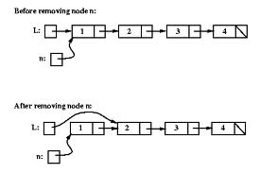
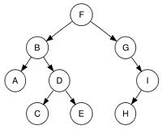
Data Structures
Arrays
Stack
Tree
Linked List

Slide 9
Some mysterious
processing
Input
Output
Data Structures + Algorithms = Programs

Slide 10
Data Structure Applications
Arrays
Consecutive memory locations
lists (one dimensional arrays)
matrices (two dimensional arrays)
database applications
to implement other data structures, such as heaps, hash tables, queues, stacks, strings
Stacks
expression evaluation and syntax parsing
Queues
scheduling
transportation
operations management

Slide 11
Data Structure Applications
Trees
efficient searching of data (Binary search tree)
manipulate hierarchical data
manipulate sorted data
Linked lists
can be used to implement several other common abstract data structures, such as
stacks
queues
symbolic expressions, and etc

Slide 12
Important characteristics of a good software
A good design
Easy to implement
Easy to use
Easy to maintain
Reliable solution of the given problem

Slide 13
So, what exactly is an Algorithm
Algorithm:
A finite set of statements that guarantees an optimal solution in finite interval of time

Slide 14
Algorithm
Finite sequence of instructions.
Each instruction having a clear meaning.
Each instruction requiring finite amount of effort.
Each instruction requiring finite time to complete.

Slide 15
Algorithm
Finite sequence of instructions.
An input should not take the program in an infinite loop
Each instruction having a clear meaning.
Very subjective. What is clear to me, may not be clear to you.
Each instruction requiring finite amount of effort.
Very subjective. Finite on a super computer or a P4?
Each instruction requiring finite time to complete.
Very subjective. 1 min, 1 hr, 1 year or a lifetime?

Slide 16
Algorithm Definition
A finite set of statements that guarantees an optimal solution in finite interval of time

Slide 17
Good Algorithms?
Run in less time
Consume less memory
But computational resources (time complexity) is usually more important
Memory is not an issue now-a-days
Why time is important in algorithms?
Usability
Multiple users

Slide 18
Measuring Efficiency
The efficiency of an algorithm is a measure of the amount of resources consumed in solving a problem of size n.
The resource we are most interested in is time
We can use the same techniques to analyze the consumption of other resources, such as memory space.
It would seem that the most obvious way to measure the efficiency of an algorithm is to run it and measure how much processor time is needed
Is it correct
No, Computer has multiple processes to execute

Slide 19
Factors
Hardware
Operating System
Compiler
Size of input
Nature of Input
Algorithm
Which should be improved?

Slide 20
Tentative Outline
Introduction to Algorithms
The role of algorithms in computers
Asymptotic functions and notations (Best Worst, Average)
Analyzing Complexities in Loops
Sorting techniques and their analysis (I): n2:
Insertion sort
Bubble sort
Selection sort

Slide 21
Sorting techniques and their analysis(II): nlogn:
(Divide-and-Conquer Strategy)
Recursion example
Iterative (Tree)
Master theorem
Substitution (Optional)
Quick sort
Iterative (Tree)
Master theorem
Substitution (Optional)
Merge sort
Iterative (Tree)
Master theorem
Substitution (Optional)
Master Theorem
Heap sort
External sort (K-way)(Optional)
Shell sort (Polynomial time)
Sorting in linear time
Count sort
Radix sort
Bucket sort

Slide 22
Maximum sub array
Brute force/Divide and Conquer
String Searching Algorithm
Naive string matching Algorithm
KMP
Rabin Karp
B Trees
(Insertion, Deletion, Searching)
B+ Trees
(Insertion, Deletion, Searching)
Skip Lists (optional)
(Insertion, Deletion, Searching)
Np Problem
Solution to Np problem
Analysis to NP problem
Graph Algorithms
Representation
BFS
DFS

Slide 23
Topological sort(Optional)
Finding Critical Path
Connectedness and Isomorphism of Graph (Optional) Single Source Shortest Path Algorithm
Dijkstra's Algorithm
Bellman Ford
All pair shortest path Algorithm
Floyd Warshall
Dynamic Programming/Greedy algorithms
Rod Cutting Problem (Optional)
Knapsack Problem
Chain Matrix Multiplication-1
Chain Matrix Multiplication-2
Evolutionary Algorithms Intro.

Slide 24
What is the specification of algorithm?
We can specify an algorithm by 3 types:
Using Natural language
Pseudocode
Flowchart.

Slide 25
Analysis of an Algorithm
What is analysis of an algorithm?
Algorithm analysis is an important part of a computational complexity theory.
There two types of analysis:
1.priori
2.posteriori
Priori Analysis is the theoretical estimation of resources required.
Posterior Analysis done after implement the algorithm on a target machine. In a posteriori analysis, we analyze actual statistics about the algorithm's consumption of time and space, while it is executing.

Slide 26
Strengthening the Informal Definition
Important Features:
Finiteness: Algorithm should end in finite amount of steps
Definiteness : each instruction should be clear
Input: valid input clearly specified
Output: single/multiple valid output
Effectiveness: steps are sufficiently simple and basic
Generality: the algorithm should be applicable to all problems of a similar form

Slide 27
Algorithm analysis
Objective:
Performance analysis is the criteria for judging the algorithm.
It have direct relationship to efficiency.
When we solve a problem ,there may be more then one algorithm to solve a problem, through analysis we find the run time of an algorithms and we choose the best algorithm which takes lesser run time.

Slide 28
Running Time
Most algorithms transform input objects into output objects.
The running time of an algorithm typically grows with the input size.
We focus on the worst-case running time.
Easier to analyze
Crucial to applications such as games, finance and robotics

Slide 29
Experimental Studies
Write a program implementing the algorithm
Run the program with inputs of varying size and composition
Use a method like (tic; toc; in Matlab) to get an accurate measure of the actual running time
Plot the results

Slide 30
Limitations of Experiments
It is necessary to implement the algorithm, which may be difficult
Results may not be indicative of the running time on other inputs not included in the experiment.
In order to compare two algorithms, the same hardware and software environments must be used

Slide 31
Theoretical Analysis
Uses a high-level description of the algorithm (Pseudo code) instead of an implementation
Characterizes running time as a function of the input size, n.
Considers all possible inputs
Allows us to evaluate the speed of an algorithm independent of the hardware/software environment

Slide 32
Running Time of an Algorithm
Depends upon
Input Size
Nature of Input
Generally, time grows with size of input, so running time of an algorithm is usually measured as function of input size.
Running time is measured in terms of number of steps/primitive operations performed
Independent from machine, OS

Slide 33
Analysis of Algorithms
An algorithm is a finite set of precise instructions for performing a computation or for solving a problem.
What is the goal of analysis of algorithms?
To compare algorithms mainly in terms of running time but also in terms of other factors (e.g., memory requirements, programmer's effort etc.)
What do we mean by running time analysis?
Determine how running time increases as the size of the problem increases.

Slide 34
Finding running time of an Algorithm / Analyzing an Algorithm
Running time is measured by number of steps/primitive operations performed
Steps means elementary operation like
,+, *,<, =, A[i] etc
We will measure number of steps taken in term of size of input

Slide 35
Performance vs Efficiency
Performance is the measure of quality of the work done by any machine.
Efficiency is the ratio of desired output to the required input for any machine.

Slide 36
Be careful to differentiate between
Performance: How much time/memory/disk/... is actually used when a program is run. This depends on the machine, compiler, etc. as well as the code.
Complexity: How do the resource requirements of a program or algorithm scale, i.e., what happens as the size of the problem being solved gets larger.
Efficiency: The efficiency of an algorithm is a measure of the amount of resources consumed in solving a problem of size n.

Slide 37
Types of Analysis
Worst case
Provides an upper bound on running time
An absolute guarantee that the algorithm would not run longer, no matter what the inputs are
Best case
Provides a lower bound on running time
Input is the one for which the algorithm runs the fastest
Average case
Provides a prediction about the running time
Assumes that the input is random

Slide 38
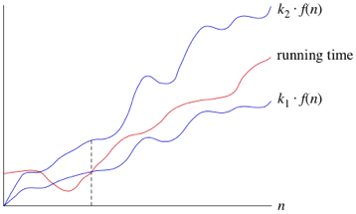
Theta
Theta notation describe the tighter bound of algorithm.
It basically combine the upper bound and also the lower bound of algorithm.
c2.f(n)
T(n)
c.f(n)

Slide 39
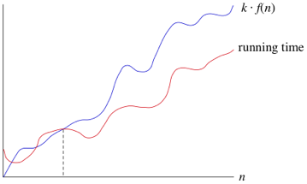
Upper Bounds: Big-O
This notation is known as the upper bound of the algorithm, or a Worst Case of an algorithm.
Consider Linear Search algorithm, in which we traverse an array elements, one by one to search a given number.
In Worst case, starting from the front of the array, we find the element or number we are searching for at the end, which will lead to a time complexity of n, where n represents the number of total elements
c.f(n)
T(n)

Slide 40
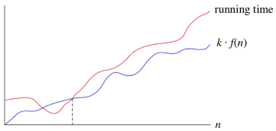
Lower Bounds: Omega
Big Omega notation is used to define the lower bound of any algorithm or we can say the best case of any algorithm.
This always indicates the minimum time required for any algorithm for all input values, therefore the best case of any algorithm.
In simple words, when we represent a time complexity for any algorithm in the form of big-Ω, we mean that the algorithm will take atleast this much time to complete it's execution. It can definitely take more time than this too.
T(n)
c.f(n)

Slide 41
Asymptotic Complexity
Running time of an algorithm as a function of input size n for large n.
Expressed using only the highest-order term in the expression for the exact running time.
Theoretically we bound an algorithm that it will take this much time
Instead of exact running time, say Θ(n²).
Describes behavior of algorithm/function in the limit.
The notations describe different rate-of-growth relations between the defining function and the defined set of functions .( Asymptotic Notation)

Slide 42
Three types of notations are used to asymptotically bound and algorithm
Big-O, Omega, and Theta are formal notational methods for stating the growth of resource needs (efficiency and storage) of an algorithm.
In simple words it describe how much resources(CPU cycles) are needed to execute said algorithm.

Slide 43
Asymptotic Notation
Θ, O, Ω, o, ω
Defined for functions over the natural numbers.
Ex: f(n) = Θ(n²).
Describes how f(n) grows in comparison to n².
Define a set of functions; in practice used to compare two function sizes.
The notations describe different rate-of-growth relations between the defining function and the defined set of functions.

Slide 44
Comparing Functions: Asymptotic Notation
Big Oh Notation:
Upper bound
Omega Notation:
Lower bound
Theta Notation:
Tighter bound

Slide 45
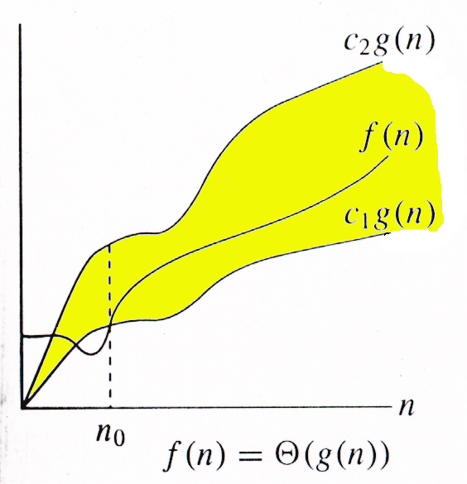
Θ-notation
For function g(n), we define Θ(g(n)), big-Theta of n, as the set:
Θ(g(n)) = {f(n) : ∃ positive constants c₁, c₂, and n_{0,} such that ∀n ≥ n₀,
we have 0 ≤ c₁g(n) ≤ f(n) ≤ c₂g(n)
}
Intuitively: Set of all functions that
have the same rate of growth as g(n).
g(n) is an asymptotically tight bound for f(n).

Slide 46
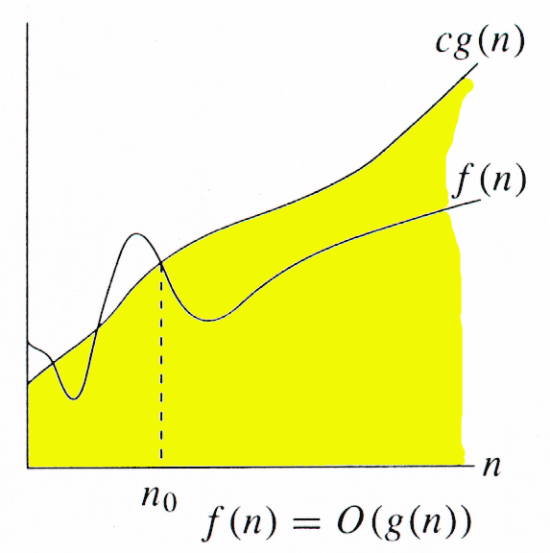
O-notation
For function g(n), we define O(g(n)), big-O of n, as the set:
O(g(n)) = {f(n) : ∃ positive constants c and n_{0,} such that ∀n ≥ n₀,
we have 0 ≤ f(n) ≤ cg(n) }
Intuitively: Set of all functions whose rate of growth is the same as or lower than that of g(n).
g(n) is an asymptotic upper bound for f(n).
f(n) = Θ(g(n)) ⇒ f(n) = O(g(n)).
Θ(g(n)) ⊂ O(g(n)).

Slide 47
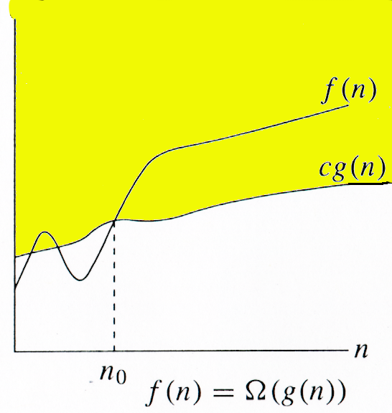
Ω -notation
For function g(n), we define Ω(g(n)), big-Omega of n, as the set:
Ω(g(n)) = {f(n) : ∃ positive constants c and n_{0,} such that ∀n ≥ n₀,
we have 0 ≤ cg(n) ≤ f(n)}
Intuitively: Set of all functions whose rate of growth is the same as or higher than that of g(n).
g(n) is an asymptotic lower bound for f(n).
f(n) = Θ(g(n)) ⇒ f(n) = Ω(g(n)).
Θ(g(n)) ⊂ Ω(g(n)).

Slide 48
Relations Between Θ, O, Ω

Slide 49
Relations Between Θ, Ω, O
Theorem : For any two functions g(n) and f(n), f(n) = Θ(g(n)) iff
f(n) = O(g(n)) and f(n) = Ω(g(n)).
I.e., Θ(g(n)) = O(g(n)) ∩ Ω(g(n))
In practice, asymptotically tight bounds are obtained from asymptotic upper and lower bounds.

Slide 50

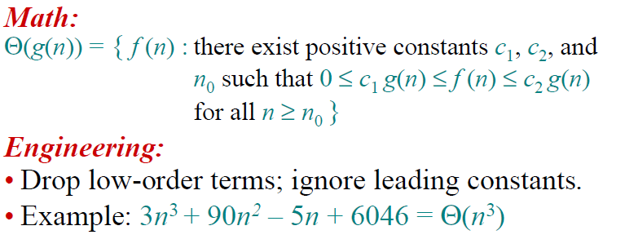

Slide 51
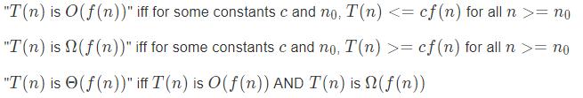
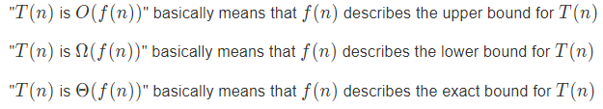
BigO, omega and theta
OR

Slide 52
Asymptotic Notation
O notation: asymptotic “less than”:
f(n)=O(g(n)) implies: f(n) “≤” g(n)
Ω notation: asymptotic “greater than”:
f(n)= Ω (g(n)) implies: f(n) “≥” g(n)
Θ notation: asymptotic “equality”:
f(n)= Θ (g(n)) implies: f(n) “=” g(n)

Slide 53
Thank You

