Slide 1
CS302 Design and Analysis of Algorithm
13

Slide 2
B Tree 2

Slide 3
Today’s Lecture
Deletion in B tree

Slide 4
B tree revise
Max Children = m
Min Children = Ciel (m/2)
Max Keys = m-1
Min Keys = Ciel (m/2) – 1
For order 5, or 5-way tree
Max children = 5
Min children = 3
Max keys = 4
Min keys = 2

Slide 5
Deletion Possibilities
1- Target Key -> Leaf Node
2- Target key -> Internal Node
3 – Target key -> Root Node

Slide 6
1- Target Key -> Leaf Node
1- Leaf node contains more then minimum number of keys
2- Leaf node contains minimum number of keys

Slide 7
1- Leaf node contains more then minimum number of keys For example delete 12
17
3
8
28
48
1
2
6
7
12
14
16
25
26
29
45
52
53
55
68

Slide 8
1- Leaf node contains more then minimum number of keys After delete 12, Does it violates any B tree property? No Is it still B tree? Yes
17
3
8
28
48
1
2
6
7
14
16
25
26
29
45
52
53
55
68

Slide 9
2- Leaf node contains minimum number of keys for example delete 14, here you cannot delete simple 14 because resulting tree will violate property of minimum no. of keys i- Borrow from Immediate Left node (Sibling) can he borrow ? yes
17
3
8
28
48
1
2
5
6
7
14
16
25
26
29
45
52
53
55
68

Slide 10
2- Leaf node contains minimum number of keys for example delete 14, here you cannot delete simple 14 because resulting tree will violate property of minimum no. of keys i- Borrow from Immediate Left node (Sibling) can he borrow ? Yes , With the help of parent, maximum value will go up and parent will go down.
17
3
7
28
48
1
2
5
6
8
16
25
26
29
45
52
53
55
68

Slide 11
2- Leaf node contains minimum number of keys for example delete 29, here you cannot delete simple 29 because resulting tree will violate property of minimum no. of keys ii- Borrow from Immediate Right node (Sibling) can he borrow ? Yes
17
3
7
28
48
1
2
5
6
8
16
25
26
29
45
52
53
55
68

Slide 12
2- Leaf node contains minimum number of keys for example delete 29, here you cannot delete simple 29 because resulting tree will violate property of minimum no. of keys ii- Borrow from Immediate Right node (Sibling) can he borrow ? Yes , With the help of parent, minimum value will go up and parent will go down.
17
3
7
28
52
1
2
5
6
8
16
25
26
45
48
53
55
68

Slide 13
2- Leaf node contains minimum number of keys for example delete 45, here you cannot delete simple 45 because resulting tree will violate property of minimum no. of keys iii- Neither left nor right (Sibling) can help, you can not borrow
24
3
7
15
28
52
59
1
2
5
6
9
11
16
18
25
26
45
48
53
55
63
68

Slide 14
2- Leaf node contains minimum number of keys for example delete 45, here you cannot delete simple 29 because resulting tree will violate property of minimum no. of keys iii- Neither left nor right (Sibling) can help, you can not borrow In this case merge with left or right siblings and parent will come down, we merging with left siblings
24
3
7
15
52
59
1
2
5
6
9
11
16
18
25
26
28
48
53
55
63
68

Slide 15
2- Target Key -> Internal Node
1- Inorder Predecessor
2- Inorder Successor
3- Merge Case

Slide 16
1- Inorder Predecessor for example delete 70, 70 is in Internal node, yes 70 have left and right child, Check maximum value in left sub tree. That is 68 and this node helps so replace.
80
10
50
70
77
90
95
4,5,6
15, 15, 16, 27
51, 52, 60, 68
73, 75
78. 79
81, 82, 89
92, 93
100, 110, 111

Slide 17
1- Inorder Predecessor for example delete 70, 70 is in Internal node, yes 70 have left and right child, Check maximum value in left sub tree. That is 68 and this node helps so replace and delete 70
80
10
50
68
77
90
95
4,5,6
15, 15, 16, 27
51, 52, 60
73, 75
78. 79
81, 82, 89
92, 93
100, 110, 111

Slide 18
2- Inorder Succesor for example delete 95, 95 is in Internal node, yes 95 have left and right child, Check minimum value in right sub tree. That is 100 and this node helps so replace and delete 95
80
10
50
68
77
90
95
4,5,6
15, 15, 16, 27
51, 52, 60
73, 75
78. 79
81, 82, 89
92, 93
100, 110, 111

Slide 19
2- Inorder Succesor for example delete 95, 95 is in Internal node, yes 95 have left and right child, Check minimum value in right sub tree. That is 100 and this node helps so replace and delete 95
80
10
50
68
77
90
100
4,5,6
15, 15, 16, 27
51, 52, 60
73, 75
78. 79
81, 82, 89
92, 93
110, 111

Slide 20
3- Merge Case for example delete 77, 77 is in Internal node, yes 77 have left and right child, Now both of its child's cannot helps. In this case we will merge the child also parent will merge and then delete the key.
80
10
50
68
77
90
100
4,5,6
15, 15, 16, 27
51, 52, 60
73, 75
78. 79
81, 82, 89
92, 93
110, 111

Slide 21
3- Merge Case for example delete 77, 77 is in Internal node, yes 77 have left and right child, Now both of its child's cannot helps. In this case we will merge the child also parent will merge and then delete the key.
80
10
50
68
90
100
4,5,6
14, 15, 16, 27
51, 52, 60
73, 75, 78, 79
81, 82, 89
92, 93
110, 111

Slide 22
3- Target node is Root for example delete 80, 80 is Root node, yes 80 have left and right child, Now check for in order predecessor or in order successor which ever helps otherwise merge.
80
10
50
68
90
100
4,5,6
14, 15, 16, 27
51, 52, 60
73, 75, 78, 79
81, 82, 89
92, 93
110, 111

Slide 23
3- Target node is Root- cont. for example delete 80, 80 is Root node, yes 80 have left and right child, Now check for in order predecessor or in order successor which ever helps otherwise merge.
79
10
50
68
90
100
4,5,6
14, 15, 16, 27
51, 52, 60
73, 75, 78
81, 82, 89
92, 93
110, 111

Slide 24
Home work. Delete, 100, 6, 27, 60, 16, 50,
79
10
50
68
90
100
4,5,6
14, 15, 16, 27
51, 52, 60
73, 75, 78
81, 82, 89
92, 93
110, 111

Slide 25
Rules of Deletion
Rule 1:
If entry to be deleted is not Leaf:
Swap it with successor under the natural order of keys
Delete entry from leaf

Slide 26
Rule 2
If leaf contains more than minimum number of entries, then one can be deleted with no further action

Slide 27
Rule 3:
If node contains less than minimum number of entries, consider the immediate siblings of the node.
If one of these siblings has more than minimum number of entries, then redistribute one entry from this sibling to the parent node and one entry from parent to the deficient node
If both immediate siblings have exactly minimum number of entries, then merge the deficient node with one of the immediate sibling node and one node from parent node.
If this leaves the parent with too few entries, then process is propagated upward

Slide 28
Pseudo code
If (entry to be deleted is not a leaf) then swap it with its successor
CurrentNode=leaf;
While (CurrentNode underflow)
Try to redistribute entries from immediate sibling into CurrentNode via the parent node;
If (impossible) then merge current node with a sibling and one entry from parent;
Current node=parent of currentNode;

Slide 29
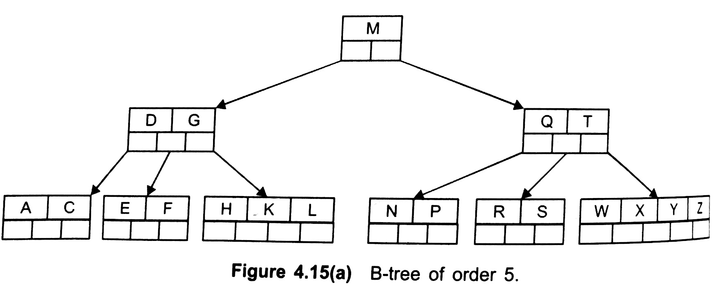
Example

Slide 30
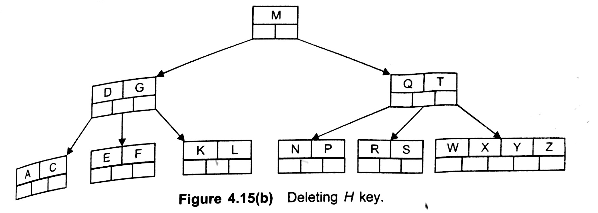
Delete H

Slide 31
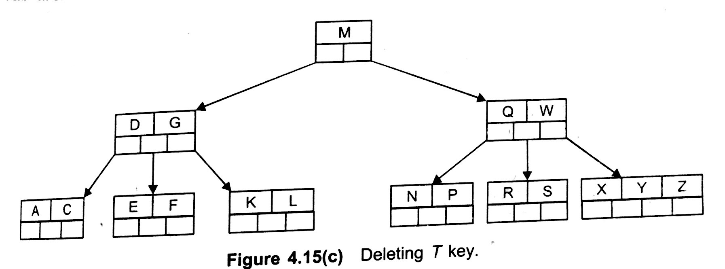
Delete T

Slide 32
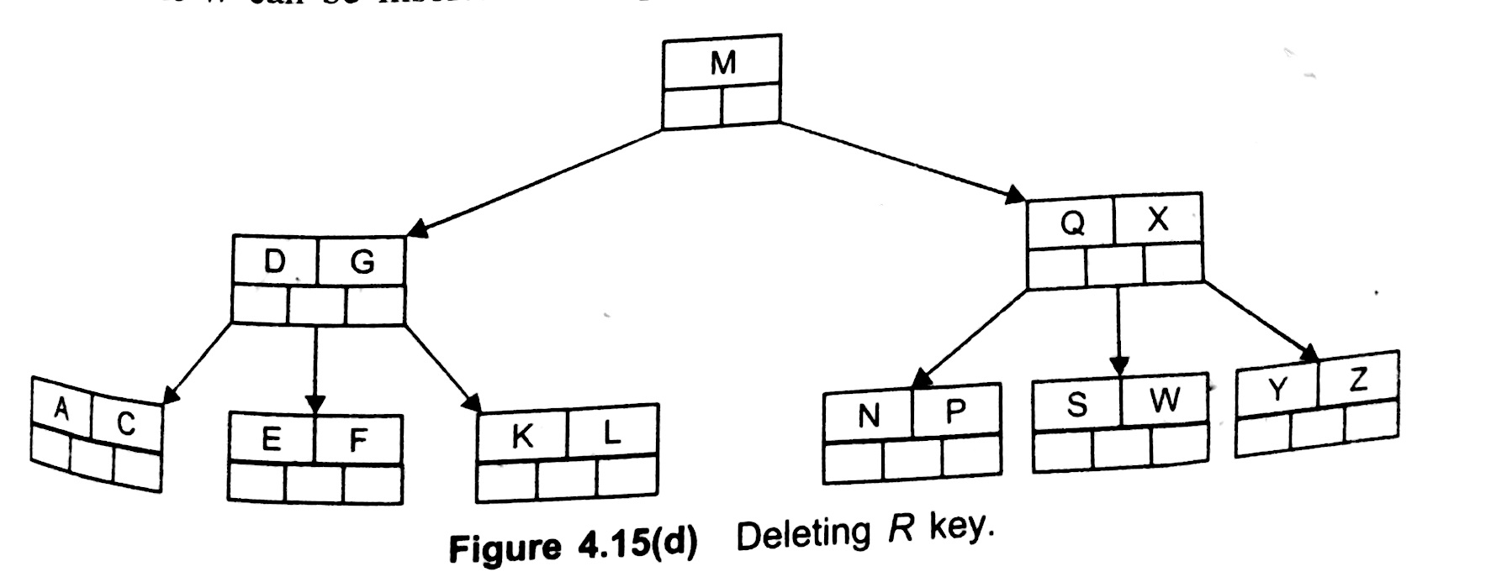
Delete R

Slide 33
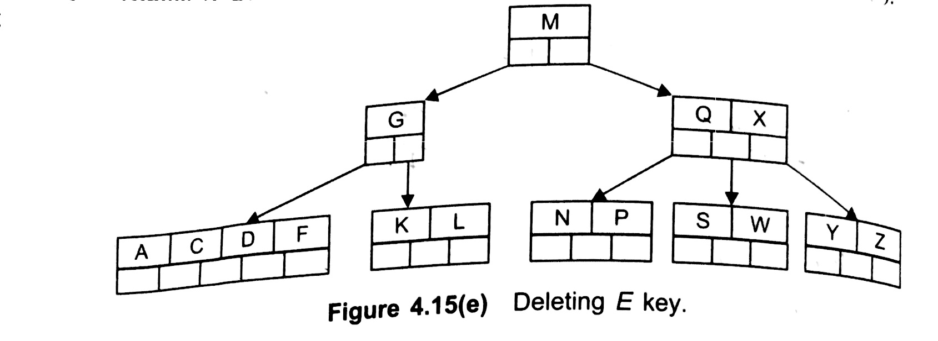
Delete E

Slide 34
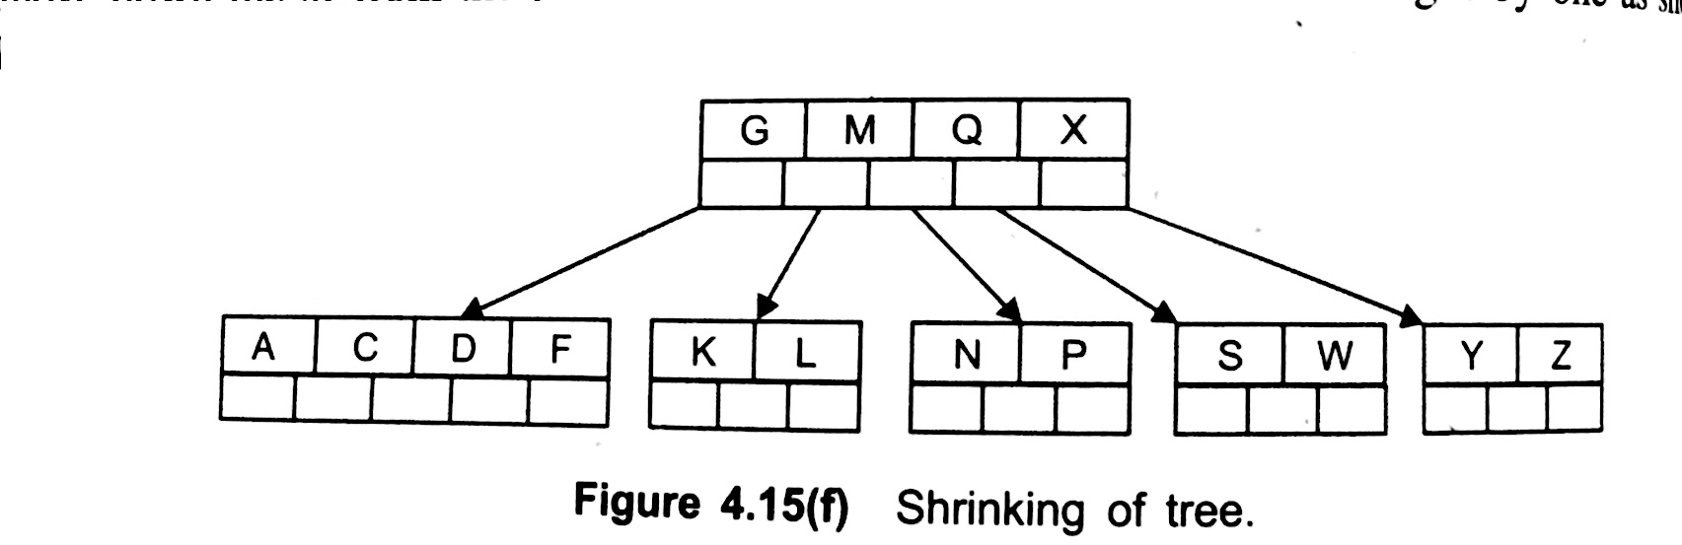
Delete E contd..

Slide 35
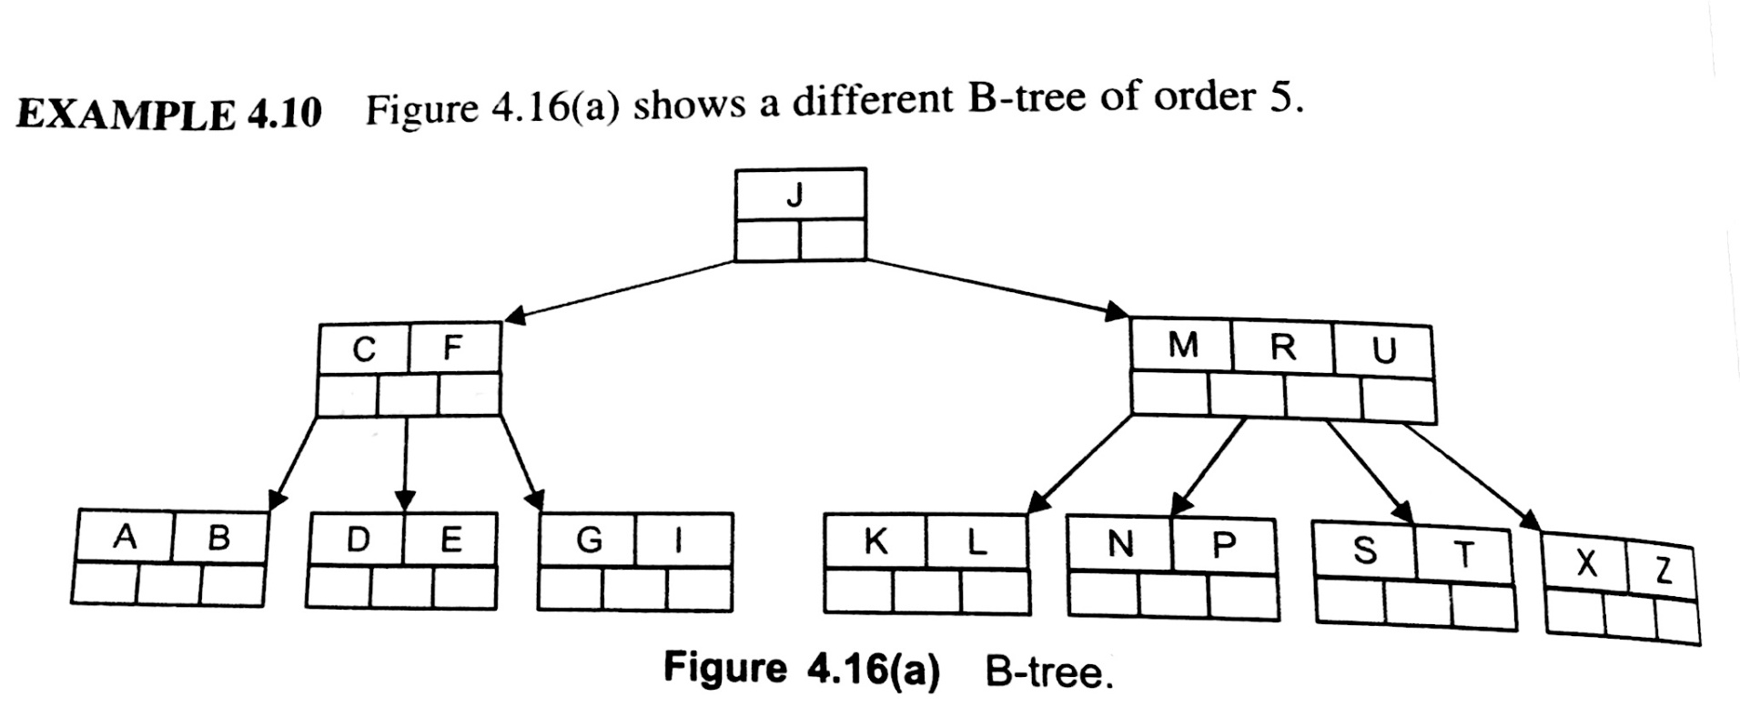
Example

Slide 36

Delete C

Slide 37
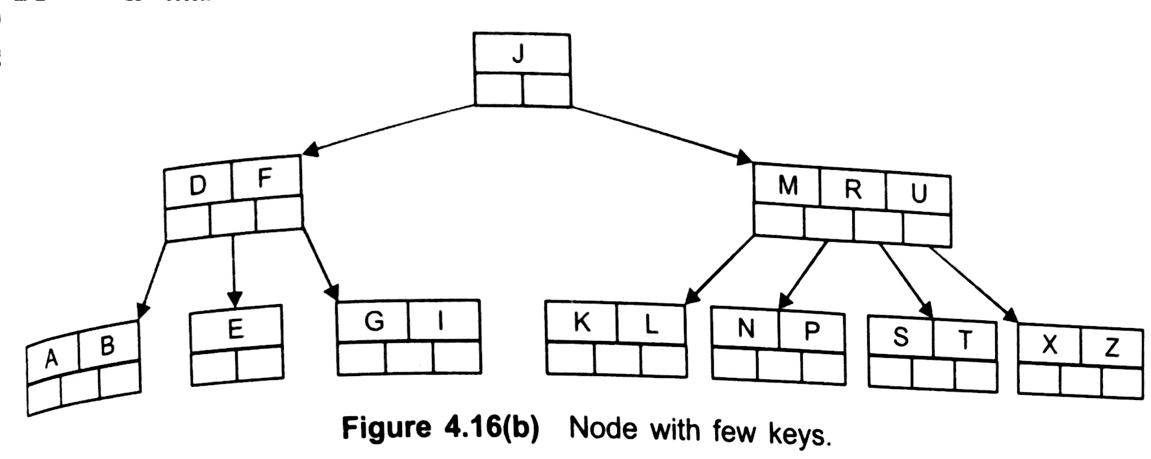

Slide 38
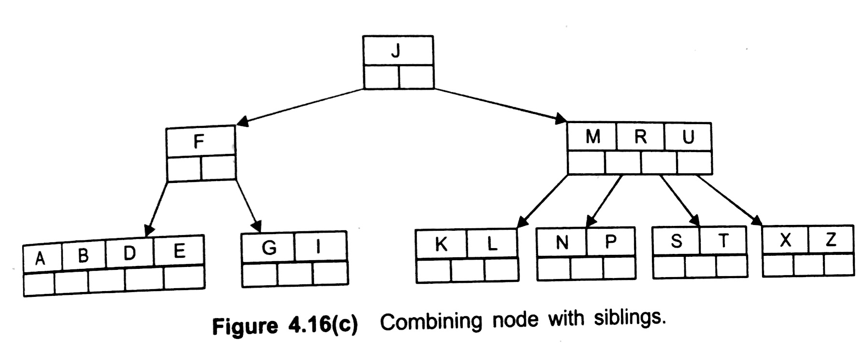

Slide 39
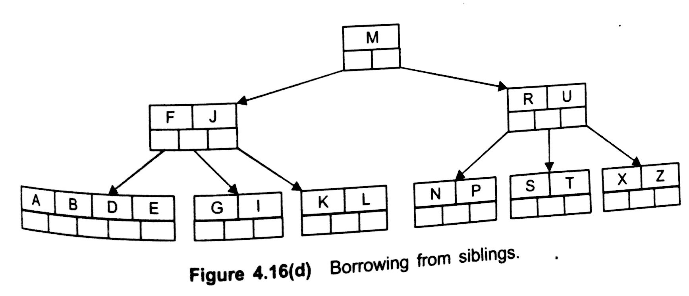

Slide 40
Task
Delete K
Delete F
Delete U

