Slide 1
Graph

Slide 2
Today’s Lecture
Graph Definition
Graph Terminology
Representation of Graph
Path and Cycle
Graph Traversal (BFS-DFS)

Slide 3
Recall
Graph
Vertex
Edge
Node
Arc
Element
Attribute
Weight
Value
Cost
Direction
Directed
Undirected
Digraph
Size
Degree
Adjacent
Incident
Neighbors
Connected
Not Connected
Source
Destination
Successor
Predecessor
Indegree
Outdegree
In edge
Out edge
Terminal
Path
Cycle
Simple
Acyclic
Adjacency Matrix
Adjacency List
Pros and Cons
Trees
Forests
Traversal
Queue
Stack
BFS
DFS
Analysis of BFS DFS

Slide 4
Graph definitions
A graph is a collection of nodes (or vertices, singular is vertex) and edges (or arcs)
Each node contains an element
Each edge connects two nodes together (or possibly the same node to itself) and may contain an edge attribute or weight

Slide 5
Directed And Undirected Graphs
There are two kinds of graphs: directed graphs (sometimes called digraphs) and undirected graphs
A directed graph is one in which the edges have a direction
An undirected graph is one in which the edges do not have a direction.

Slide 6
Directed And Undirected Graphs
start
400
Nantes
Paris
fill pan with water
take egg from fridge
350
590
120
340
Grenoble
Lyon
420
320
add salt to water
break egg into pan
Bordeaux
510
Monaco
boil water
Marseille
A directed graph
An undirected graph

Slide 7
Size and Degree
The size of a graph is the number of edges in it
The empty graph has size zero (no nodes)
If two nodes are connected by an edge, they are neighbors (and the nodes are adjacent to each other)
The degree of a node is the number of edges it has

Slide 8
For directed graphs,
In a directed graph vertex v is adjacent to u, if there is an edge leaving u and coming to v.
v is adjacent to u.
u is adjacent to w
If a directed edge goes from node S to node D, we call S the source and D the destination of the edge
The edge is an out-edge of S and an in-edge of D
S is a predecessor of D, and D is a successor of S
The in-degree of a node is the number of in-edges it has
The out-degree of a node is the number of out-edges it has
u
v
w
S
D

Slide 9
Path and Cycle
In graph theory, a path in a graph is a sequence of edges which connect a sequence of vertices. Path has a first vertex, called its start vertex, and a last vertex, called its end vertex. Both of them are called terminal vertices of the path.
A cycle is a path whose first and last nodes are the same
400
Example: (Paris, Nantes, Bordeaux, Lyon) is a path
Example: (Paris, Nantes, Lyon, Paris) is a cycle
A cyclic graph contains at least one cycle
An acyclic graph does not contain any cycles
Nantes
Paris
350
590
120
340
Grenoble
Lyon
420
320
Bordeaux
510
Monaco
Marseille
An undirected graph

Slide 10
Graph Representation
Adjacency-matrix Representation
Adjacency Lists Representation

Slide 11
Adjacency-matrix representation I
A
One simple way of representing a graph is the adjacency matrix
A 2-D array has a mark at [i][j] if there is an edge from node i to node j
B
C
D
E
F
G
A B C D E F G
A B C D E F G
The adjacency matrix is symmetric about the main diagonal
• This representation is only suitable for small graphs! (Why?)

Slide 12
Adjacency-matrix representation II
A
An adjacency matrix can equally well be used for digraphs (directed graphs)
A 2-D array has a mark at [i][j] if there is an edge from node i to node j
B
C
D
E
F
G
A B C D E F G
A B C D E F G
Again, this is only suitable for small graphs!

Slide 13
Adjacency Lists Representation
A graph of n nodes is represented by a one-dimensional array L of linked lists, where
L[i] is the linked list containing all the nodes adjacent to node i
The nodes in the list L[i] are in no particular order

Slide 14
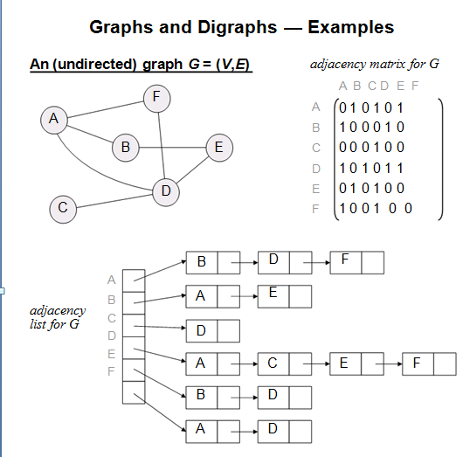
Adjacency Lists Representation

Slide 15
Pros and Cons of Adjacency Matrix
Pros and Cons of Adjacency Lists
Pros:
Simple to implement
Easy and fast to tell if a pair (i,j) is an edge: simply check if A[i][j] is 1 or 0
Cons:
No matter how few edges the graph has, the matrix takes O(n²) in memory

Slide 16
Pros and Cons of Adjacency Lists
Pros:
Saves on space (memory): the representation takes as many memory words as there are nodes and edge.
Cons:
It can take up to O(n) time to determine if a pair of nodes (i,j) is an edge: one would have to search the linked list L[i], which takes time proportional to the length of L[i].
Note:
Adjacency list is better for sparse graphs, adjacency matrix for dense graphs

Slide 17
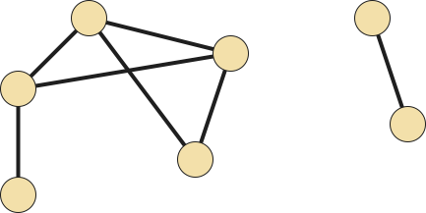
Graphs
A graph is a pair G = (V, E), where
V is a set of vertices
E is a set of pairs (v, w) with v, w ∈ V
We call the elements of V the vertices of G;
the elements of E are the edges of G.
Example:
V = {a, b, c, d, e, f, g}
E = {(a, c), (b, d), (b, e), (b, g),
(d, e), (d, g), (e, f)}
Vertices a and c are adjacent;
vertices f and g are not.
Vertex b and edge (b, g) are incident; vertex e and edge (d, g) are not.
edge (b, d) and edge(b,e) are incident because they share a common vertex
b
a
d
e
c
g
The neighborhood of vertex b is the set N(b) = {d, e, g}.
f
The degree deg(b) of vertex b is 3.

Slide 18
Terminology: Degree of a Vertex
The degree of a vertex is the number of edges incident related to that vertex
For directed graph,
The in-degree of a vertex is the number of edges incident to it.
The out-degree of a vertex is the number of edges incident from it.
if d_{i} is the degree of a vertex i in a graph G with n vertices and e edges, the number of edges is

Slide 19
Examples
0
0
in:1, out: 1
2
1
2
1
in: 1, out: 2
3
3
3
4
5
6
1
G1
1
2
in: 1, out: 0
1
1
G2

Slide 20
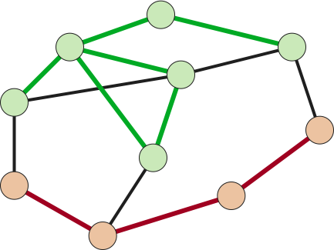
Paths and Cycles
P₁ = (g, d, e, b, d, a, h) is not simple.
A path is a sequence of vertices
P = (v₀, v₁, …, v_{k}) such that,
for 1 ≤ i ≤ k, edge (v_{i – 1},v_{i}) ∈ E.
Path P is simple if no vertex appears more than once in P.
a
d
h
b
g
j
e
f
c
i
P₂ = (f, i, c, j) is simple.

Slide 21
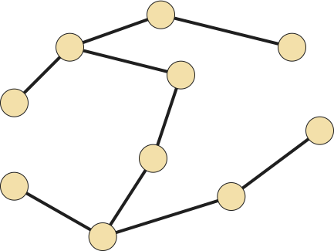

Trees and Forests
A tree is a graph that is connected and contains no cycles.
A forest is a graph that contains no cycles.
The connected components of a forest are trees.

Slide 22
Graph Traversal
Graph traversal is the process of writing out all the nodes of a simple, connected graph G in some organized way.
Algorithms, that apply for generalize traversal of any graph. They are:
Breadth First Search
Depth First Search

Slide 23
Graph Search
Choice of container
If a stack is used as the container for adjacent vertices, we get depth first search.
If a Queue is used as the container adjacent vertices, we get breadth first search.

Slide 24
Graph Search
The state of a vertex, u, is stored in a color variable as follows:
1. color[u] = White - for the "undiscovered" state, 2. color [u] = Gray - for the "discovered but not fully explored" state, and 3. color [u] = Black - for the "fully explored" state.

Slide 25
Breadth First Algorithm
Given graph G=(V,E) and source vertex s ∈ V
Create a queue Q
For each vertex u ∈ V – {s}
color[u] ← white
color[s] ← gray
Q← {s}
While Q ≠ ∅
{
u ← head[Q];
for each v ∈ Adjacent[u]
if color[v] = white
{
color[v] ← gray
Enqueue(Q,v)
}
Dequeue(Q)
color[u] ← black;
}
1
4
0
2
5
3

Slide 26
Breadth First Algorithm
Given graph G=(V,E) and source vertex s ∈ V
Create a queue Q
For each vertex u ∈ V – {s}
color[u] ← white
color[s] ← gray
Q← {s}
While Q ≠ ∅
{
u ← head[Q];
for each v ∈ Adjacent[u]
if color[v] = white
{
color[v] ← gray
Enqueue(Q,v)
}
Dequeue(Q)
color[u] ← black;
}
1
4
s
0
2
5
3
Q = ∅

Slide 27
Breadth First Algorithm
Given graph G=(V,E) and source vertex s ∈ V
Create a queue Q
For each vertex u ∈ V – {s}
color[u] ← white
color[s] ← gray
Q← {s}
While Q ≠ ∅
{
u ← head[Q];
for each v ∈ Adjacent[u]
if color[v] = white
{
color[v] ← gray
Enqueue(Q,v)
}
Dequeue(Q)
color[u] ← black;
}
1
4
s
0
2
5
3
Q = ∅

Slide 28
Breadth First Algorithm
Given graph G=(V,E) and source vertex s ∈ V
Create a queue Q
For each vertex u ∈ V – {s}
color[u] ← white
color[s] ← gray
Q← {s}
While Q ≠ ∅
{
u ← head[Q];
for each v ∈ Adjacent[u]
if color[v] = white
{
color[v] ← gray
Enqueue(Q,v)
}
Dequeue(Q)
color[u] ← black;
}
1
4
s
0
2
5
3
Q =
0

Slide 29
Breadth First Algorithm
Given graph G=(V,E) and source vertex s ∈ V
Create a queue Q
For each vertex u ∈ V – {s}
color[u] ← white
color[s] ← gray
Q← {s}
While Q ≠ ∅
{
u ← head[Q];
for each v ∈ Adjacent[u]
{ if color[v] = white
{
color[v] ← gray
Enqueue(Q,v)
} }
Dequeue(Q)
color[u] ← black;
}
1
4
0
2
5
u
3
Q =
0

Slide 30
Breadth First Algorithm
Given graph G=(V,E) and source vertex s ∈ V
Create a queue Q
For each vertex u ∈ V – {s}
color[u] ← white
color[s] ← gray
Q← {s}
While Q ≠ ∅
{
u ← head[Q];
for each v ∈ Adjacent[u]
if color[v] = white
{
color[v] ← gray
Enqueue(Q,v)
}
Dequeue(Q)
color[u] ← black;
}
1
4
0
2
5
u
3
Q =
0
1

Slide 31
Breadth First Algorithm
Given graph G=(V,E) and source vertex s ∈ V
Create a queue Q
For each vertex u ∈ V – {s}
color[u] ← white
color[s] ← gray
Q← {s}
While Q ≠ ∅
{
u ← head[Q];
for each v ∈ Adjacent[u]
if color[v] = white
{
color[v] ← gray
Enqueue(Q,v)
}
Dequeue(Q)
color[u] ← black;
}
1
4
0
2
5
u
3
Q =
0
1
2

Slide 32
Breadth First Algorithm
Given graph G=(V,E) and source vertex s ∈ V
Create a queue Q
For each vertex u ∈ V – {s}
color[u] ← white
color[s] ← gray
Q← {s}
While Q ≠ ∅
{
u ← head[Q];
for each v ∈ Adjacent[u]
if color[v] = white
{
color[v] ← gray
Enqueue(Q,v)
}
Dequeue(Q)
color[u] ← black;
}
1
4
0
2
5
u
3
Q =
0
1
2
3

Slide 33
Breadth First Algorithm
Given graph G=(V,E) and source vertex s ∈ V
Create a queue Q
For each vertex u ∈ V – {s}
color[u] ← white
color[s] ← gray
Q← {s}
While Q ≠ ∅
{
u ← head[Q];
for each v ∈ Adjacent[u]
if color[v] = white
{
color[v] ← gray
Enqueue(Q,v)
}
Dequeue(Q)
color[u] ← black;
}
1
4
0
1
2
5
u
3
Q =
0
1
2
3

Slide 34
Breadth First Algorithm
u
Given graph G=(V,E) and source vertex s ∈ V
Create a queue Q
For each vertex u ∈ V – {s}
color[u] ← white
color[s] ← gray
Q← {s}
While Q ≠ ∅
{
u ← head[Q];
for each v ∈ Adjacent[u]
if color[v] = white
{
color[v] ← gray
Enqueue(Q,v)
}
Dequeue(Q)
color[u] ← black;
}
1
4
0
1
2
5
3
Q =
0
1
2
3

Slide 35
Breadth First Algorithm
u
Given graph G=(V,E) and source vertex s ∈ V
Create a queue Q
For each vertex u ∈ V – {s}
color[u] ← white
color[s] ← gray
Q← {s}
While Q ≠ ∅
{
u ← head[Q];
for each v ∈ Adjacent[u]
if color[v] = white
{
color[v] ← gray
Enqueue(Q,v)
}
Dequeue(Q)
color[u] ← black;
}
1
4
0
1
2
5
3
Q =
0
1
2
3
4

Slide 36
Breadth First Algorithm
u
Given graph G=(V,E) and source vertex s ∈ V
Create a queue Q
For each vertex u ∈ V – {s}
color[u] ← white
color[s] ← gray
Q← {s}
While Q ≠ ∅
{
u ← head[Q];
for each v ∈ Adjacent[u]
if color[v] = white
{
color[v] ← gray
Enqueue(Q,v)
}
Dequeue(Q)
color[u] ← black;
}
1
4
0
1
2
5
3
Q =
0
1
2
3
4

Slide 37
Breadth First Algorithm
u
Given graph G=(V,E) and source vertex s ∈ V
Create a queue Q
For each vertex u ∈ V – {s}
color[u] ← white
color[s] ← gray
Q← {s}
While Q ≠ ∅
{
u ← head[Q];
for each v ∈ Adjacent[u]
if color[v] = white
{
color[v] ← gray
Enqueue(Q,v)
}
Dequeue(Q)
color[u] ← black;
}
1
4
0
1
2
5
3
Q =
0
1
2
3
4

Slide 38
Breadth First Algorithm
u
Given graph G=(V,E) and source vertex s ∈ V
Create a queue Q
For each vertex u ∈ V – {s}
color[u] ← white
color[s] ← gray
Q← {s}
While Q ≠ ∅
{
u ← head[Q];
for each v ∈ Adjacent[u]
if color[v] = white
{
color[v] ← gray
Enqueue(Q,v)
}
Dequeue(Q)
color[u] ← black;
}
1
4
0
1
2
5
3
Q =
0
1
2
3
4

Slide 39
Breadth First Algorithm
u
Given graph G=(V,E) and source vertex s ∈ V
Create a queue Q
For each vertex u ∈ V – {s}
color[u] ← white
color[s] ← gray
Q← {s}
While Q ≠ ∅
{
u ← head[Q];
for each v ∈ Adjacent[u]
if color[v] = white
{
color[v] ← gray
Enqueue(Q,v)
}
Dequeue(Q)
color[u] ← black;
}
1
4
0
1
2
5
3
Q =
0
1
2
3
4

Slide 40
Breadth First Algorithm
Given graph G=(V,E) and source vertex s ∈ V
Create a queue Q
For each vertex u ∈ V – {s}
color[u] ← white
color[s] ← gray
Q← {s}
While Q ≠ ∅
{
u ← head[Q];
for each v ∈ Adjacent[u]
if color[v] = white
{
color[v] ← gray
Enqueue(Q,v)
}
Dequeue(Q)
color[u] ← black;
}
1
4
0
1
2
5
3
u
Q =
0
1
2
3
4

Slide 41
Breadth First Algorithm
Given graph G=(V,E) and source vertex s ∈ V
Create a queue Q
For each vertex u ∈ V – {s}
color[u] ← white
color[s] ← gray
Q← {s}
While Q ≠ ∅
{
u ← head[Q];
for each v ∈ Adjacent[u]
if color[v] = white
{
color[v] ← gray
Enqueue(Q,v)
}
Dequeue(Q)
color[u] ← black;
}
1
4
0
1
2
5
3
u
Q =
0
1
2
3
4
5

Slide 42
Breadth First Algorithm
Given graph G=(V,E) and source vertex s ∈ V
Create a queue Q
For each vertex u ∈ V – {s}
color[u] ← white
color[s] ← gray
Q← {s}
While Q ≠ ∅
{
u ← head[Q];
for each v ∈ Adjacent[u]
if color[v] = white
{
color[v] ← gray
Enqueue(Q,v)
}
Dequeue(Q)
color[u] ← black;
}
1
4
0
1
2
5
3
u
Q =
0
1
2
3
4
5

Slide 43
Breadth First Algorithm
Given graph G=(V,E) and source vertex s ∈ V
Create a queue Q
For each vertex u ∈ V – {s}
color[u] ← white
color[s] ← gray
Q← {s}
While Q ≠ ∅
{
u ← head[Q];
for each v ∈ Adjacent[u]
if color[v] = white
{
color[v] ← gray
Enqueue(Q,v)
}
Dequeue(Q)
color[u] ← black;
}
1
4
0
1
2
5
3
u
Q =
0
1
2
3
4
5

Slide 44
Breadth First Algorithm
Given graph G=(V,E) and source vertex s ∈ V
Create a queue Q
For each vertex u ∈ V – {s}
color[u] ← white
color[s] ← gray
Q← {s}
While Q ≠ ∅
{
u ← head[Q];
for each v ∈ Adjacent[u]
if color[v] = white
{
color[v] ← gray
Enqueue(Q,v)
}
Dequeue(Q)
color[u] ← black;
}
1
4
0
1
2
5
3
u
Q =
0
1
2
3
4
5

Slide 45
Breadth First Algorithm
Given graph G=(V,E) and source vertex s ∈ V
Create a queue Q
For each vertex u ∈ V – {s}
color[u] ← white
color[s] ← gray
Q← {s}
While Q ≠ ∅
{
u ← head[Q];
for each v ∈ Adjacent[u]
if color[v] = white
{
color[v] ← gray
Enqueue(Q,v)
}
Dequeue(Q)
color[u] ← black;
}
1
4
0
1
2
5
3
Q =
0
u
1
2
3
4
5

Slide 46
Breadth First Algorithm
Given graph G=(V,E) and source vertex s ∈ V
Create a queue Q
For each vertex u ∈ V – {s}
color[u] ← white
color[s] ← gray
Q← {s}
While Q ≠ ∅
{
u ← head[Q];
for each v ∈ Adjacent[u]
if color[v] = white
{
color[v] ← gray
Enqueue(Q,v)
}
Dequeue(Q)
color[u] ← black;
}
1
4
0
1
2
5
3
Q = ∅
u

Slide 47
Ignore Vertex:
If an edge goes to completely explored vertex (black)
If an edge goes to discovered but not completely explored (Grey)

Slide 48
Task Example of Undirected Graph
Root is S
r
s
t
u
v
w
x
y

Slide 49
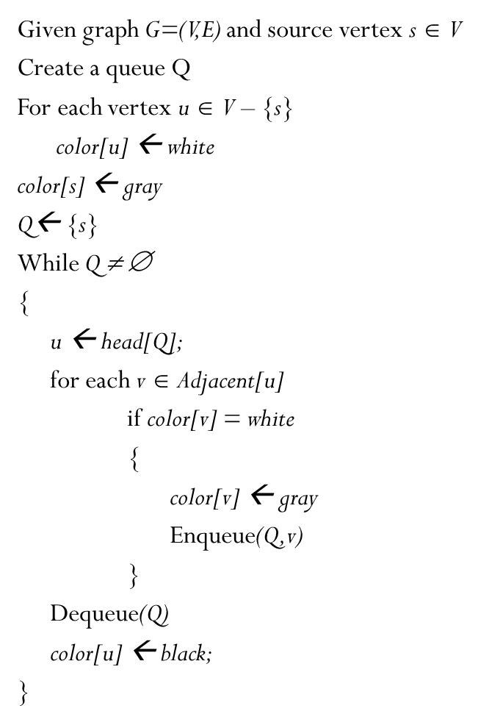
Analysis Of BFS
The while-loop in breadth-first search is executed at most |V| times. The reason is that every vertex enqueued at most once. So, we have O(V).
The for-loop inside the while-loop is executed at most |E| times if G is a directed graph or 2|E| times if G is undirected. In Directed graph we examine (u, v) only when u is dequeued. Therefore, every edge examined at most once if directed, at most twice if undirected. So, we have O(E).
Therefore, the total running time for breadth-first search traversal is O(V + E).

Slide 50
Ignore Vertex:
If an edge goes to completely explored vertex (black)
If an edge goes to discovered but not completely explored (Grey)

Slide 51
Graph Search
Choice of container
If a stack is used as the container for adjacent vertices, we get depth first search.
If a Queue is used as the container adjacent vertices, we get breadth first search.

Slide 52
Depth First Algorithm
Given graph G=(V,E) and source vertex s ∈ V
Create a stack S
For each vertex u ∈ V – {s}
color[u] ← white
color[s] ← gray
S← {s}
While S ≠ ∅
{
u = Pop(S)
for each v ∈ Adjacent[u]
if color[v] = white
{
color[v] ← gray
Push(S,v)
}
color[u] ← black;
}
1
4
s
0
2
5
3
S = ∅

Slide 53
Depth First Algorithm
Given graph G=(V,E) and source vertex s ∈ V
Create a stack S
For each vertex u ∈ V – {s}
color[u] ← white
color[s] ← gray
S← {s}
While S ≠ ∅
{
u = Pop(S)
for each v ∈ Adjacent[u]
if color[v] = white
{
color[v] ← gray
Push(S,v)
}
color[u] ← black;
}
1
4
s
0
2
5
3
S = ∅

Slide 54
Depth First Algorithm
Given graph G=(V,E) and source vertex s ∈ V
Create a stack S
For each vertex u ∈ V – {s}
color[u] ← white
color[s] ← gray
S← {s}
While S ≠ ∅
{
u = Pop(S)
for each v ∈ Adjacent[u]
if color[v] = white
{
color[v] ← gray
Push(S,v)
}
color[u] ← black;
}
1
4
s
0
2
5
3
S = ∅
0

Slide 55
Depth First Algorithm
Given graph G=(V,E) and source vertex s ∈ V
Create a stack S
For each vertex u ∈ V – {s}
color[u] ← white
color[s] ← gray
S← {s}
While S ≠ ∅
{
u = Pop(S)
for each v ∈ Adjacent[u]
if color[v] = white
{
color[v] ← gray
Push(S,v)
}
color[u] ← black;
}
1
4
0
2
u
5
3
S = ∅

Slide 56
Depth First Algorithm
Given graph G=(V,E) and source vertex s ∈ V
Create a stack S
For each vertex u ∈ V – {s}
color[u] ← white
color[s] ← gray
S← {s}
While S ≠ ∅
{
u = Pop(S)
for each v ∈ Adjacent[u]
if color[v] = white
{
color[v] ← gray
Push(S,v)
}
color[u] ← black;
}
1
4
0
2
u
5
3
S = ∅
1

Slide 57
Depth First Algorithm
Given graph G=(V,E) and source vertex s ∈ V
Create a stack S
For each vertex u ∈ V – {s}
color[u] ← white
color[s] ← gray
S← {s}
While S ≠ ∅
{
u = Pop(S)
for each v ∈ Adjacent[u]
if color[v] = white
{
color[v] ← gray
Push(S,v)
}
color[u] ← black;
}
1
4
0
2
u
5
3
S = ∅
3
2
1

Slide 58
Depth First Algorithm
Given graph G=(V,E) and source vertex s ∈ V
Create a stack S
For each vertex u ∈ V – {s}
color[u] ← white
color[s] ← gray
S← {s}
While S ≠ ∅
{
u = Pop(S)
for each v ∈ Adjacent[u]
if color[v] = white
{
color[v] ← gray
Push(S,v)
}
color[u] ← black;
}
1
4
0
2
u
5
3
S = ∅
3
2
1

Slide 59
Depth First Algorithm
Given graph G=(V,E) and source vertex s ∈ V
Create a stack S
For each vertex u ∈ V – {s}
color[u] ← white
color[s] ← gray
S← {s}
While S ≠ ∅
{
u = Pop(S)
for each v ∈ Adjacent[u]
if color[v] = white
{
color[v] ← gray
Push(S,v)
}
color[u] ← black;
}
1
4
0
2
u
5
3
S = ∅
3
2
1

Slide 60
Depth First Algorithm
Given graph G=(V,E) and source vertex s ∈ V
Create a stack S
For each vertex u ∈ V – {s}
color[u] ← white
color[s] ← gray
S← {s}
While S ≠ ∅
{
u = Pop(S)
for each v ∈ Adjacent[u]
if color[v] = white
{
color[v] ← gray
Push(S,v)
}
color[u] ← black;
}
1
4
0
2
5
3
u
S = ∅
3
2
1

Slide 61
Depth First Algorithm
Given graph G=(V,E) and source vertex s ∈ V
Create a stack S
For each vertex u ∈ V – {s}
color[u] ← white
color[s] ← gray
S← {s}
While S ≠ ∅
{
u = Pop(S)
for each v ∈ Adjacent[u]
if color[v] = white
{
color[v] ← gray
Push(S,v)
}
color[u] ← black;
}
1
4
0
2
5
3
u
S = ∅
5
3
2
1

Slide 62
Depth First Algorithm
Given graph G=(V,E) and source vertex s ∈ V
Create a stack S
For each vertex u ∈ V – {s}
color[u] ← white
color[s] ← gray
S← {s}
While S ≠ ∅
{
u = Pop(S)
for each v ∈ Adjacent[u]
if color[v] = white
{
color[v] ← gray
Push(S,v)
}
color[u] ← black;
}
1
4
0
2
5
3
u
S = ∅
5
3
2
1

Slide 63
Depth First Algorithm
Given graph G=(V,E) and source vertex s ∈ V
Create a stack S
For each vertex u ∈ V – {s}
color[u] ← white
color[s] ← gray
S← {s}
While S ≠ ∅
{
u = Pop(S)
for each v ∈ Adjacent[u]
if color[v] = white
{
color[v] ← gray
Push(S,v)
}
color[u] ← black;
}
1
4
0
2
5
3
u
S = ∅
3
5
2
1

Slide 64
Depth First Algorithm
Given graph G=(V,E) and source vertex s ∈ V
Create a stack S
For each vertex u ∈ V – {s}
color[u] ← white
color[s] ← gray
S← {s}
While S ≠ ∅
{
u = Pop(S)
for each v ∈ Adjacent[u]
if color[v] = white
{
color[v] ← gray
Push(S,v)
}
color[u] ← black;
}
1
4
0
2
5
3
u
S = ∅
4
3
5
2
1

Slide 65
Depth First Algorithm
Given graph G=(V,E) and source vertex s ∈ V
Create a stack S
For each vertex u ∈ V – {s}
color[u] ← white
color[s] ← gray
S← {s}
While S ≠ ∅
{
u = Pop(S)
for each v ∈ Adjacent[u]
if color[v] = white
{
color[v] ← gray
Push(S,v)
}
color[u] ← black;
}
1
4
0
2
5
3
u
S = ∅
4
3
5
2
1

Slide 66
Depth First Algorithm
Given graph G=(V,E) and source vertex s ∈ V
Create a stack S
For each vertex u ∈ V – {s}
color[u] ← white
color[s] ← gray
S← {s}
While S ≠ ∅
{
u = Pop(S)
for each v ∈ Adjacent[u]
if color[v] = white
{
color[v] ← gray
Push(S,v)
}
color[u] ← black;
}
1
4
0
2
u
5
0
3
S = ∅
4
3
5
2
1

Slide 67
Depth First Algorithm
Given graph G=(V,E) and source vertex s ∈ V
Create a stack S
For each vertex u ∈ V – {s}
color[u] ← white
color[s] ← gray
S← {s}
While S ≠ ∅
{
u = Pop(S)
for each v ∈ Adjacent[u]
if color[v] = white
{
color[v] ← gray
Push(S,v)
}
color[u] ← black;
}
1
4
0
2
u
5
0
3
S = ∅
4
3
5
2
1

Slide 68
Depth First Algorithm
Given graph G=(V,E) and source vertex s ∈ V
Create a stack S
For each vertex u ∈ V – {s}
color[u] ← white
color[s] ← gray
S← {s}
While S ≠ ∅
{
u = Pop(S)
for each v ∈ Adjacent[u]
if color[v] = white
{
color[v] ← gray
Push(S,v)
}
color[u] ← black;
}
1
4
0
0
2
u
5
0
3
S = ∅
4
3
5
2
1

Slide 69
Depth First Algorithm
Given graph G=(V,E) and source vertex s ∈ V
Create a stack S
For each vertex u ∈ V – {s}
color[u] ← white
color[s] ← gray
S← {s}
While S ≠ ∅
{
u = Pop(S)
for each v ∈ Adjacent[u]
if color[v] = white
{
color[v] ← gray
Push(S,v)
}
color[u] ← black;
}
1
4
0
0
2
u
5
0
3
S = ∅
4
3
5
2
1

Slide 70
Depth First Algorithm
Given graph G=(V,E) and source vertex s ∈ V
Create a stack S
For each vertex u ∈ V – {s}
color[u] ← white
color[s] ← gray
S← {s}
While S ≠ ∅
{
u = Pop(S)
for each v ∈ Adjacent[u]
if color[v] = white
{
color[v] ← gray
Push(S,v)
}
color[u] ← black;
}
1
4
0
0
2
0
u
5
0
3
S = ∅

Slide 71
Depth First Algorithm
Given graph G=(V,E) and source vertex s ∈ V
Create a stack S
For each vertex u ∈ V – {s}
color[u] ← white
color[s] ← gray
S← {s}
While S ≠ ∅
{
u = Pop(S)
for each v ∈ Adjacent[u]
if color[v] = white
{
color[v] ← gray
Push(S,v)
}
color[u] ← black;
}
1
0
4
0
0
2
0
u
5
0
3
S = ∅

Slide 72
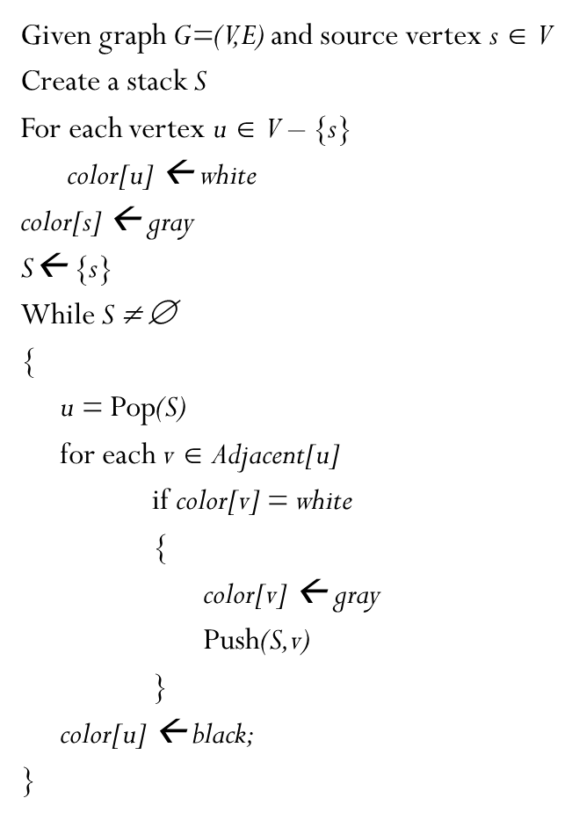
Analysis Of DFS
The for-loop inside the while-loop is executed at most |E| times if G is a directed graph or 2|E| times if G is undirected. In Directed graph we examine (u, v) only when u is dequeued. Therefore, every edge examined at most once if directed, at most twice if undirected. So, we have O(E).
Therefore, the total running time for depth-first search traversal is O(V + E).
If adjacency matrix is used as a container analysis will be O(V²)

Slide 73
V+E ?
v1 + (incident edges) + v2 + (incident edges) + .... + vn + (incident edges)
(v1 + v2 + ... + vn) + [(incident_edges v1) + (incident_edges v2) + ... + (incident_edges vn)]

Slide 74
Application of DFS
Topological ordering
Finding cycle in directed graph
Find strongly connected components

Slide 75
BASIS FOR COMPARISON | BFS | DFS
Basic | Vertex-based algorithm | Edge-based algorithm
Data structure used to store the nodes | Queue | Stack
Memory consumption | Inefficient | Efficient
Structure of the constructed tree | Wide and short | Narrow and long
Traversing fashion | Oldest unvisited vertices are explored at first. | Vertices along the edge are explored in the beginning.
Optimality | Optimal for finding the shortest distance, not in cost. | Not optimal
Application | Examines bipartite graph, connected component and shortest path present in a graph. | Examines two-edge connected graph, strongly connected graph, acyclic graph and topological order.

Slide 76
Key Differences Between BFS/DFS
BFS is vertex-based algorithm while DFS is an edge-based algorithm.
Queue data structure is used in BFS. On the other hand, DFS uses stack or recursion.
Memory space is efficiently utilized in DFS while space utilization in BFS is not effective.
BFS is optimal algorithm while DFS is not optimal.
DFS constructs narrow and long trees. As against, BFS constructs wide and short tree.

Slide 77
Task : Print cycles

