Slide 1
Lecture Graph Continues

Slide 2
Shortest Path
In graph theory the shortest path between two vertices in a graph is a path between those two vertices in such way that the sum of weights of edges in that path is the smallest than the sum of weights of edges in any path between those two vertices provided the graph is a weighted graph.
So the shortest path problem is to find such a path between the given vertices.

Slide 3
Single-Source Shortest Path Problem
Single-Source Shortest Path Problem - The problem of finding shortest paths from a source vertex v to all other vertices in the graph.
Dijkstra's Algorithm
Bellman Ford Algorithm

Slide 4
Dijkstra's algorithm
Dijkstra's algorithm - is a solution to the single-source shortest path problem in graph theory.
Works on both directed and undirected graphs.
Approach: Greedy
Input: Weighted graph G={E,V} and source vertex s∈V,
Output: the shortest path from a given source vertex s∈V to all other vertices

Slide 5
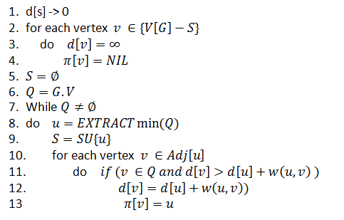
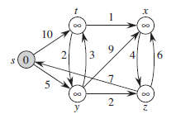
Dijkstra’s Algorithm

Slide 6
Example

Slide 7
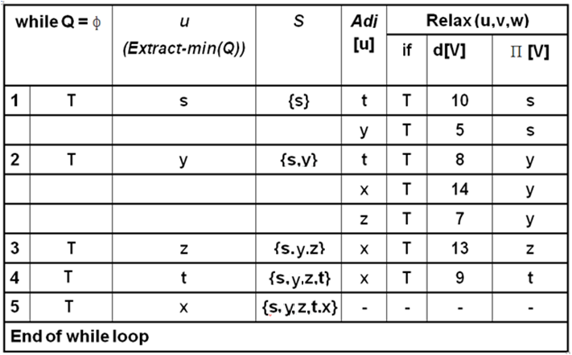
Example

Slide 8
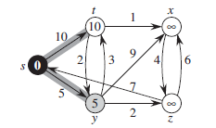

Slide 9
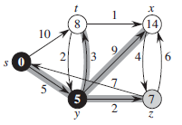
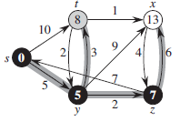

Slide 10
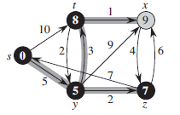
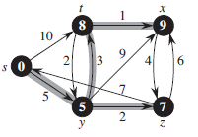

Slide 11
Analysis: O(E log V)
2-4 -> O(V)
6-> O(log V)
8 -> O(V log V)
10-13 -> O(E log (V) )
V+logv+vlogv+elogv

Slide 12
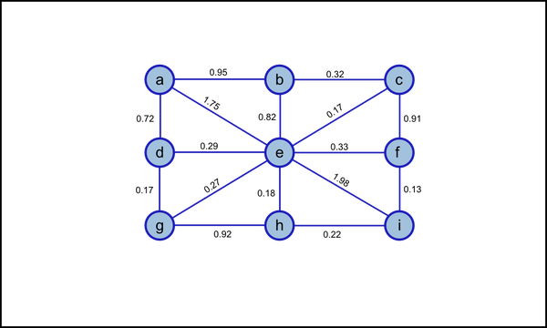
Task; Apply Djikstra: Start Node a.

Slide 13
Self Study
(Included in course)
Bell Man Ford Algorithm
and
its Analysis

Slide 14
Bellman Ford’s algorithm and Dijkstra’s algorithm
both are single-source shortest path algorithm, i.e. both determines the shortest distance of each vertex of a graph from a single source vertex.
However, there are some key differences between them. We follow the Dynamic Programming approach in Bellman Ford’s algorithm and Greedy approach in Dijkstra’s algorithm

Slide 15
Bellman Ford’s Algorithm | Dijkstra’s Algorithm
Bellman Ford’s Algorithm works when there is negative weight edge, it also detects the negative weight cycle. | Dijkstra’s Algorithm doesn’t work when there is negative weight edge.
The result contains the vertices which contains the information about the other vertices they are connected to. | The result contains the vertices containing whole information about the network, not only the vertices they are connected to.
It can easily be implemented in a distributed way. | It can not be implemented easily in a distributed way.
It is more time consuming than Dijkstra’s algorithm. Its time complexity is O(VE). | It is less time consuming. The time complexity is O(E logV).
Dynamic Programming approach is taken to implement the algorithm. | Greedy approach is taken to implement the algorithm.

