Slide 1
Lecture
Graph Continues

Slide 2
All-Pairs Shortest Paths Problem
Given a weighted digraph G=(V,E),determine the length of the shortest path (i.e., distance) between all pairs of vertices in G.
It aims to compute shortest path from each vertex v to every other vertex u.

Slide 3
Floyd-Warshall algorithm
Given a weighted graph, we want to know the shortest path from one vertex in the graph to another.
  The Floyd-Warshall algorithm determines the shortest path between all pairs of vertices in a graph, if there is no negative cycle.

Slide 4
Main idea
a path exists between two vertices i, j, if
  there is an edge from i to j; or
  there is a path from i to j going through intermediate vertices {1,….. k};
These are two situations:
    k is an intermediate vertex on the shortest path.
    k is not an intermediate vertex on the shortest path.

Slide 5
Matrix Representation
The graph is represented by an n x n matrix with the weights of the edges
Output Format: an n x n distance D=[ d_{i,j} ] where d_{i,j} is the distance from vertex i to j.

Slide 6
Floyd Warshall Algorithm
Floyd_Warshall (W) {
for i = 1 to n do { // initialize
for j = 1 to n do {
d[i,j] = W[i,j]
pred[i,j] = null
}
}
for k = 1 to n do // use intermediates {1..k}
for i = 1 to n do // ...from i
for j = 1 to n do // ...to j
if (d[i,k] + d[k,j]) < d[i,j]) {
d[i,j] = d[i,k] + d[k,j] // new shorter path length
pred[i,j] = k } // new path is through k pred[i.j] = pred[k,j]
return d // matrix of final distances
}

Slide 7
Compute shortest path using predecessor information
The pred[I, j] can be used to extract the final path.
Here is the idea, whenever we discover that the shortest path from i to j passes through an intermediate vertex k, we set pred[i,j] = k. If the shortest path does not pass through any intermediate vertex, then pred[I, j] = null.
To find the shortest path from i to j, we consult pred[I,j]. If it is null, then the shortest path is just the edge (i; j). Otherwise, we recursively compute the shortest path from i to pred[i, j] and the shortest path from pred[I, j] to j.

Slide 8
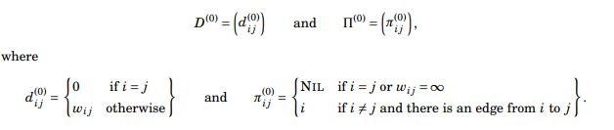

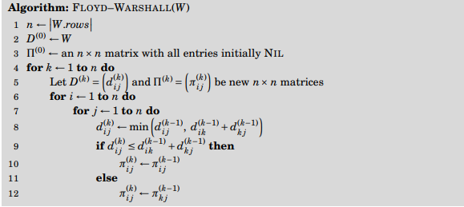

Slide 9
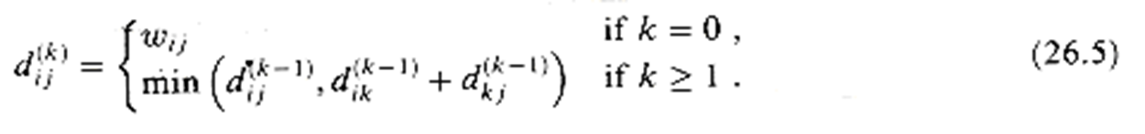
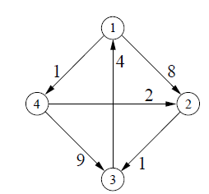
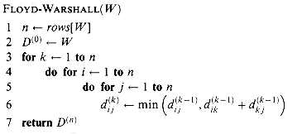
Example

Slide 10
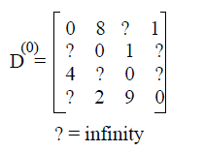
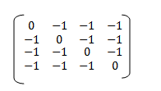
Initially
P⁽⁰⁾ ⁼

Slide 11
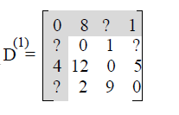
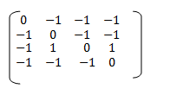
Ist Iteration: k=1
if (d[i,k] + d[k,j]) < d[i,j]) {
d[i,j] = d[i,k] + d[k,j]
pred[i,j] = k }
P⁽⁰⁾ ⁼
P⁽¹⁾ ⁼

Slide 12
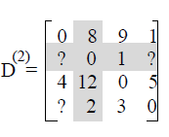
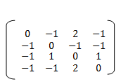
2nd Iteration: k=2
if (d[i,k] + d[k,j]) < d[i,j]) {
d[i,j] = d[i,k] + d[k,j]
pred[i,j] = k }
P⁽¹⁾ ⁼
P⁽²⁾ ⁼

Slide 13
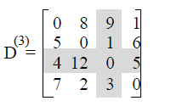
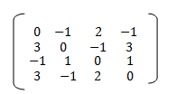
3rd Iteration: k=3
if (d[i,k] + d[k,j]) < d[i,j]) {
d[i,j] = d[i,k] + d[k,j]
pred[i,j] = k }
P⁽²⁾ ⁼
P⁽³⁾ ⁼

Slide 14
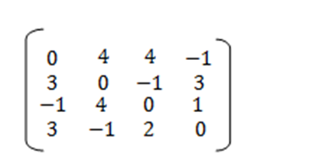
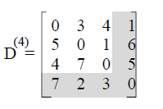
4th Iteration: k=4
if (d[i,k] + d[k,j]) < d[i,j]) {
d[i,j] = d[i,k] + d[k,j]
pred[i,j] = k }
P⁽³⁾ ⁼
P⁽⁴⁾ ⁼

Slide 15
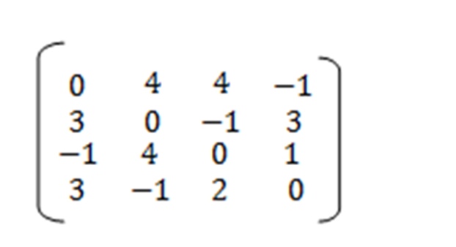
Shortest Path from 1 to 4
1->4
Shortest Path from 4 to 3
4->3 i-e 4->2->3
Shortest Path from 1 to 2
1->2: 1 4 2
Shortest Path from 1 to 3
1->3: 1 4 2 3

Slide 16
Analysis of Floyd Warshall Algorithm
O(n³)

Slide 17
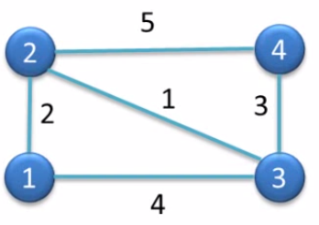
Task

Slide 18
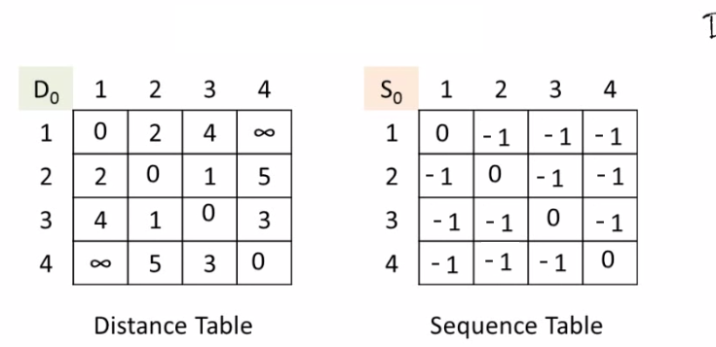
Initially

Slide 19
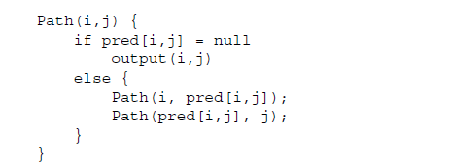
Compute shortest path using predecessor information

