Slide 1
CS302 Design and Analysis of Algorithm
2

Slide 2
Be careful to differentiate between
Performance: How much time/memory/disk/... is actually used when a program is run. This depends on the machine, compiler, etc. as well as the code.
Complexity: How do the resource requirements of a program or algorithm scale, i.e., what happens as the size of the problem being solved gets larger.
Efficiency: The efficiency of an algorithm is a measure of the amount of resources consumed in solving a problem of size n.

Slide 3

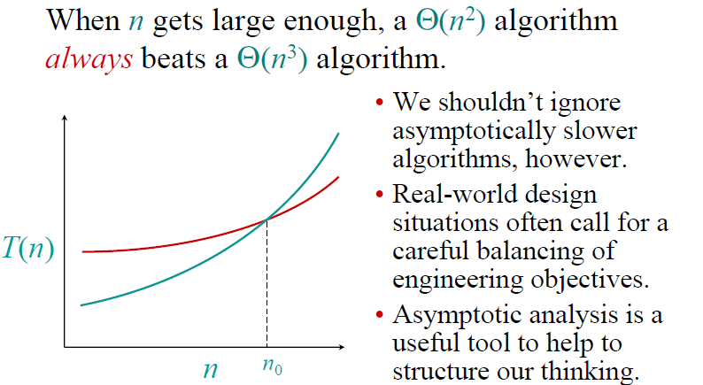

Slide 4
Example : Comparing Functions
Which function is better?
10 n² Vs n³

Slide 5
Comparing Functions
As inputs get larger, any algorithm of a smaller order will be more efficient than an algorithm of a larger order
0.05 N² = O(N²)
3N = O(N)
Time (steps)
N = 60
Input (size)

Slide 6
Big-Oh Notation
Even though it is correct to say “7n - 3 is O(n³)”, a better statement is “7n - 3 is O(n)”, that is, one should make the approximation as tight as possible
Simple Rule:
Drop lower order terms and constant factors
7n-3 is O(n)
8n²log n + 5n² + n is O(n²log n)

Slide 7
Performance Classification
f(n) | Classification
1 | Constant: run time is fixed, and does not depend upon n. Most instructions are executed once, or only a few times, regardless of the amount of information being processed
log n | Logarithmic: when n increases, so does run time, but much slower. Common in programs which solve large problems by transforming them into smaller problems.
n | Linear: run time varies directly with n. Typically, a small amount of processing is done on each element.
n log n | When n doubles, run time slightly more than doubles. Common in programs which break a problem down into smaller sub-problems, solves them independently, then combines solutions
n² | Quadratic: when n doubles, runtime increases fourfold. Practical only for small problems; typically the program processes all pairs of input (e.g. in a double nested loop).
n³ | Cubic: when n doubles, runtime increases eightfold
2^{n} | Exponential: when n doubles, run time squares. This is often the result of a natural, “brute force” solution.

Slide 8
Examples of algorithms
Here is a list of common asymptotic running times:
Θ(1): Constant time; can’t beat it!
Θ(log n): Inserting into a balanced binary tree; time to ﬁnd an item in a sorted array of length n using binary search.
Θ(n): About the fastest that an algorithm can run.
Θ(n log n): Best sorting algorithms.
Θ(n2), Θ(n3): Polynomial time. These running times are acceptable when the exponent of n is small or n is not to large, e.g., n ≤ 1000.
Θ(2^{n}), Θ(3^{n}): Exponential time. Acceptable only if n is small, e.g., n ≤ 50.
Θ(n!) : Acceptable only for really small n, e.g. n ≤ 20.

Slide 9
Classes of Complexities
Constant: O(c),
Logarithmic: O(log_{c} n),
Linear: O(n),
Quadratic: O(n²),
Cubic: O(n³),
Polynomial: O(n^{c})
Exponential: O(c^{n})

Slide 10
Size does matter
What happens if we double the input size N?
N log₂N 5N N log₂N N² 2^{N}
8 3 40 24 64 256
16 4 80 64 256 65536
32 5 160 160 1024 ~10⁹
64 6 320 384 4096 ~10¹⁹
128 7 640 896 16384 ~10³⁸
256 8 1280 2048 65536 ~10⁷⁶

Slide 11
Input Size dependency
Suppose a program has run time O(n!) and the run time for
n = 10 is 1 second
For n = 12, the run time is 2 minutes
For n = 14, the run time is 6 hours
For n = 16, the run time is 2 months
For n = 18, the run time is 50 years
For n = 20, the run time is 200 centuries

Slide 12
Best worst and average time complexity
Best case: The algorithm take as min time as it can.
Searching item in array
Found first item as key
Worst case: The algorithm take max time as it can
Searching item in array
Found the last item/ did not found item
Average case: The algorithm takes average time
Found in middle of array (Just example)

Slide 13
What is the relationship between Big O, Θ, Ω and best, worst, and average case of an algorithm?
The Ο and Ω notations do only describe the bounds of a function that describes the asymptotic behavior of the actual behavior of the algorithm. Here’s an example
Ω describes the lower bound:
f(n) ∈ Ω(g(n)) means the asymptotic behavior of f(n) is not less than g(n)·k for some positive k, so f(n) is always at least as much as g(n)·k.
Ο describes the upper bound:
f(n) ∈ Ο(g(n)) means the asymptotic behavior of f(n) is not more than g(n)·k for some positive k, so f(n) is always at most as much as g(n)·k.
We are usually interested in the worst case complexity

Slide 14
Best worst average vs Notations
These two can be applied on both the best case and the worst case for linear search:
best case: first element you look at is the one you are looking for
Ω(1): you need at least one lookup
Ο(1): you need at most one lookup
worst case: element is not present
Ω(n): you need at least n steps until you can say that the element you are looking for is not present
Ο(n): you need at most n steps until you can say that the element you are looking for is not present
But often we do only want to know the upper bound or tight bound as the lower bound has not much practical information.
Compare with finding max in array

Slide 15
Simple Example (1)
// Input: int A[N], array of N integers
// Output: Sum of all numbers in array A
int Sum(int A[], int N)
{
int s=0;
for (int i=0; i< N; i++)
s = s + A[i];
return s;
}
How should we analyse this?

Slide 16
Example of Basic Operations:
Arithmetic operations: *, /, %, +, -
Assignment statements of simple data types.
Simple conditional tests: if (x < 12) ...
method call (Note: the execution time of the method itself may depend on the value of parameter and it may not be constant)
a method's return statement
Memory Access
We consider an operation such as ++ , += , and *= as consisting of two basic operations.
Note: To simplify complexity analysis we will not consider memory access (fetch or store) operations.

Slide 17
Simple Complexity Analysis: Loops
We start by considering how to count operations in for-loops.
We use integer division throughout.
First of all, we should know the number of iterations of the loop; say it is x.
Then the loop condition is executed x + 1 times.
Each of the statements in the loop body is executed x times.
The loop-index update statement is executed x times.

Slide 18
Simple Example (2)
// Input: int A[N], array of N integers
// Output: Sum of all numbers in array A
int Sum(int A[], int N){
int s=0;
for (int i=0; i< N; i++)
s = s + A[i];
return s;
}
1
2
3
4
5
6
7
1,2,8: Once
3,4,5,6,7: Once per each iteration
of for loop, N iteration
Total: 5N + 3
The complexity function of the
algorithm is : f(N) = 5N +3
8

Slide 19
Simple Example (3) Growth of 5n+3
Estimated running time for different values of N:
N = 10 => 53 steps
N = 100 => 503 steps
N = 1,000 => 5003 steps
N = 1,000,000 => 5,000,003 steps
As N grows, the number of steps grow in linear proportion to N for this function “Sum”

Slide 20
What Dominates in Previous Example?
What about the +3 and 5 in 5N+3?
– As N gets large, the +3 becomes insignificant
– 5 is inaccurate, as different operations require varying amounts of time and also does not have any significant importance
Asymptotic Complexity: As N gets large, concentrate on the highest order term:
Drop lower order terms such as +3
Drop the constant coefficient of the highest order term i.e. N
The 5N+3 time bound is said to "grow asymptotically" like N

Slide 21
Simple Complexity Analysis: Loops (with <)
In the following for-loop:
The number of iterations is: (n – k ) / m
The initialization statement, i = k, is executed one time.
The condition, i < n, is executed (n – k) / m + 1 times.
The update statement, i = i + m, is executed (n – k) / m times.
Each of statement1 and statement2 is executed (n – k) / m times.
for (int i = k; i < n; i = i + m){
statement1;
statement2;
}

Slide 22
Simple Complexity Analysis: Loop Example
Find the exact number of basic operations in the following program fragment:
There are 2 assignments outside the loop => 2 operations.
The for loop actually comprises
an assignment (i = 0) => 1 operation
a test (i < n) => n + 1 operations
an increment (i++) => 2 n operations
the loop body that has three assignments, two multiplications, and an addition => 6 n operations
Thus the total number of basic operations is 6 * n + 2 * n + (n + 1) + 3
= 9n + 4
double x, y;
x = 2.5 ; y = 3.0;
for(int i = 0; i < n; i++){
a[i] = x * y;
x = 2.5 * x;
y = y + a[i];
}

Slide 23
Running Time Calculations
Simple for loop
int Sum (int N) {
/* 1 */ int sum = 0;
/* 2 */ for (int i =1; i <= N; i++)
/* 3 */ sum = sum + i * i * i;
/* 4 */ return sum ; }
Q: What is the running time?
Line 1 & 4 → 2 units of time → 2
Line 2 → 1 unit (initialize) + (N +1) tests + N Increments → 2N + 2
Line 3 → 4 units (1 add, 2 muls., 1 assign) * N executions → 4N
Total → 6N + 4
A: O(N)

Slide 24
Time complexity familiar tasks
Task
Getting a specific element from a list (array)
Dividing a list in half, dividing one halve in half, etc
Binary Search
Scanning (brute force search) a list
Nested for loops (k levels)
MergeSort
BubbleSort
Generate all subsets of a set of data
Generate all permutations of a set of data
Growth rate
O(1)
O(log₂N)
O(log₂N)
O(N)
O(N^{k})
O(N log₂N)
O(N²)
O(2^{N})
O(N!)

Slide 25
Standard Analysis Techniques
Constant time statements
Analyzing Loops
Analyzing Nested Loops
Analyzing Sequence of Statements
Analyzing Conditional Statements

Slide 26
Constant time statements
Simplest case: O(1) time statements
Assignment statements of simple data types int x = y;
Arithmetic operations: x = 5 * y + 4 - z;
Array referencing: A[j] = 5;
Array assignment: ∀ j, A[j] = 5;
Most conditional tests: if (x < 12) ...

Slide 27
Analyzing Loops
Any loop has two parts:
How many iterations are performed?
How many steps per iteration?
int sum = 0,j;
for (j=0; j < N; j++)
sum = sum +j;
Loop executes N times (0..N-1)
4 = O(1) steps per iteration
Total time is N * O(1) = O(N*1) = O(N)

Slide 28
Analyzing Loops
What about this for loop?
int sum =0, j;
for (j=0; j < 100; j++)
sum = sum +j;
Loop executes 100 times
4 = O(1) steps per iteration
Total time is 100 * O(1) = O(100 * 1) = O(100) = O(1)

Slide 29
Analyzing Nested Loops
Treat just like a single loop and evaluate each level of nesting as needed:
int j,k;
for (j=0; j<N; j++)
for (k=N; k>0; k--)
sum += k+j;
Start with outer loop:
How many iterations? N
How much time per iteration? Need to evaluate inner loop
Inner loop uses O(N) time
Total time is N * O(N) = O(N*N) = O(N²)

Slide 30
Analyzing Nested Loops
What if the number of iterations of one loop depends on the counter of the other?
int j,k;
for (j=0; j < N; j++)
for (k=0; k < j; k++)
sum += k+j;
Analyze inner and outer loop together:
Number of iterations of the inner loop is:
0 + 1 + 2 + ... + (N-1) = O(N²)

Slide 31
Analyzing Sequence of Statements
For a sequence of statements, compute their complexity functions individually and add them up
for (j=0; j < N; j++)
for (k =0; k < j; k++)
sum = sum + j*k;
for (l=0; l < N; l++)
sum = sum -l;
cout<<“Sum=”<<sum;
Total cost is O(N²) + O(N) +O(1) = O(N²)
O(N²)
O(N)
O(1)
SUM RULE

Slide 32
Analyzing Conditional Statements
What about conditional statements such as
if (condition)
statement1;
else
statement2;
where statement1 runs in O(N) time and statement2 runs in O(N²) time?
We use "worst case" complexity: among all inputs of size N, that is the maximum running time?
The analysis for the example above is O(N²)

Slide 33
O(Logn)
O(Logn) Time Complexity of a loop is considered as O(Logn) if the loop variables is divided / multiplied by a constant amount.
Here c is some positive integer
for (int i = 1; i <=n; i *= c)
{ // some O(1) expressions }
for (int i = n; i > 0; i /= c)
{ // some O(1) expressions }

Slide 34
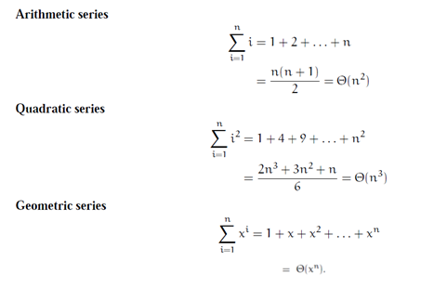


Important Summations that should be Committed to Memory.

Slide 35
Example (Dependent nested loop)
For (i=1;i<=n;i++)
{For(j=i; j<=n;j++)
{
//sequence of statements
}
}
Arithmetic series
n+ (n-1) +(n-2)+……1= n(n+1)/2 =O(n²)

Slide 36
Task
Design nested loop in which execution of inner instructions sum to quadratic series.
For (i=1;i<=n;i++)
for (j=1;j<=i^{2;} j++)
{ //sequence of statements
}
1+4+9+…..n2
= 2n³+3n²+n / 6
= O(n³)

Slide 37
Example (Nested loop)
for (int i = 1; i <=n; i *= 2)
{
for (int j = 1; j <= n; j *= 4)
{ // some O(1) expressions }
}
log base 2 n * log base 4 n
=O(log n)²

Slide 38
Task (Dependent Loop)
for (int j=n ; j>0; j=j/2)
{ for (int i=j; i<=n; i=i*2)
{
// sequence of statements}
}
1+2+3+4+…….+n
=n(n+1)/2
=O(n²)

Slide 39
Task (Dependent loop):
for (int j=n ; j>0; j=j/2)
{ for (int i=j; i<=n; i=i*4)
{
// sequence of statements}
}
1+1+2+2+3+3+……+n+n.
=n(n+1)/2 + n(n+1)/2
=n(n+1)
=O(n²)

Slide 40
Example
int fun()
{
int count = 0;
for (int i = n; i > 0; i /= 2)
for (int j = 0; j < i; j++)
count += 1;
return count;
}

Slide 41
Explanation: For a input integer n, the innermost statement is executed following times.
n + n/2 + n/4 + … 1
= O (n)

Slide 42
Task:
int fun(int n)
{
int count = 0;
for (int i = 0; i < n; i++)
for (int j = i; j > 0; j--)
count = count + 1;
return count;
}

Slide 43
Explanation
“count = count + 1”
0 + 1 + 2 + 3 + 4 + …. + (n-1) times.
=
=(n-1)(n-1+1)/2
=(n-1)(n)/2
=O(n²)

Slide 44
Task
for (i=0; i<n; i++)
{for (j=i; j<n;j++)
{
Sequence of statements….
}
}

Slide 45
Explanation
n + (n-1 ) + (n-2) +…… 2+1
=
=n(n+1)/2
=O(n²⁾

Slide 46
Analysis: Nested Loop Example Task:
for (i: 1 to n)
for (j: 1 to i)
for (k: j to i)
s = s + 1

Slide 47

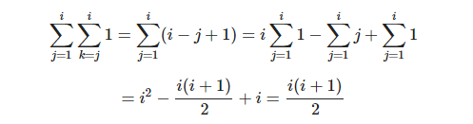
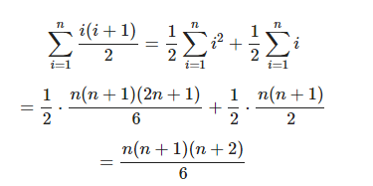

Slide 48
Coding example #1
for ( i=0 ; i<n ; i++ )
m += i;

Slide 49
Coding example #2
for ( i=0 ; i<n ; i++ )
for( j=0 ; j<n ; j++ )
sum[i] += entry[i][j];

Slide 50
Coding example #3
for ( i=0 ; i<n ; i++ )
for( j=0 ; j<i ; j++ )
m += j;

Slide 51
Coding example #4
i = 1;
while (i < n) {
tot += i;
i = i * 2;
}

Slide 52
Example #4: equivalent # of steps?
i = n;
while (i > 0) {
tot += i;
i = i / 2;
}

Slide 53
Coding example #5
for ( i=0 ; i<n ; i++ )
for( j=0 ; j<n ; j++ )
for( k=0 ; k<n ; k++ )
sum[i][j] += entry[i][j][k];

Slide 54
Coding example #6
for ( i=0 ; i<n ; i++ )
for( j=0 ; j<n ; j++ )
sum[i] += entry[i][j][0];
for ( i=0 ; i<n ; i++ )
for( k=0 ; k<n ; k++ )
sum[i] += entry[i][0][k];

Slide 55
Coding example #7
for ( i=0 ; i<n ; i++ )
for( j=0 ; j< sqrt(n) ; j++ )
m += j;

Slide 56
Coding example #8
for ( i=0 ; i<n ; i++ )
for( j=0 ; j< sqrt(995) ; j++ )
m += j;

Slide 57
Coding example #8 : Equivalent code
for ( i=0 ; i<n ; i++ )
{
m += j;
m += j;
m += j;
…
m += j; // 31 times
}

Slide 58
Coding example #9
int total(int n)
for( i=0 ; i < n; i++)
subtotal += i;
main()
for ( i=0 ; i<n ; i++ )
tot += total(i);

Slide 59
Coding example #9: Equivalent code
for ( i=0 ; i<n ; i++ ) {
subtotal = 0;
for( j=0 ; j < i; j++)
subtotal += j;
tot += subtotal;
}

Slide 60
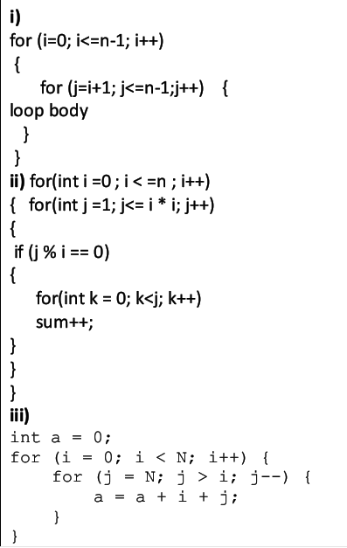
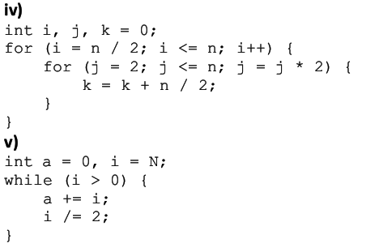
Example to see

Slide 61
Thank you

