Slide 1
CS302 Design and Analysis of Algorithm
4

Slide 2
Recurrence Relations

Slide 3
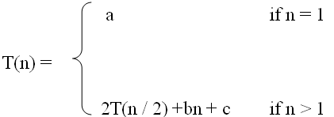

What is a recurrence relation?
A recurrence relation, T(n), is a recursive function of integer variable n.
Like all recursive functions, it has both recursive case and base case.
Example:
The portion of the definition that does not contain T is called the base case of the recurrence relation
The part that contains T is called the recurrent or recursive case.

Slide 4

Forming Recurrence Relations
For a given recursive method, the base case and the recursive case of its recurrence relation correspond directly to the base case and the recursive case of the method.
Example 1: Write the recurrence relation for the following method.
The base case is reached when n == 0. The method performs one comparison. Thus, the number of operations when n == 0, T(0), is some constant a.
When n > 0, the method performs two basic operations and then calls itself, using ONE recursive call, with a parameter n – 1.
Therefore the recurrence relation is:
public void f (int n) {
if (n > 0) {
System.out.println(n);
f(n-1);
}
}

Slide 5

Forming Recurrence Relations
Example 2: Write the recurrence relation for the following method.
The base case is reached when n == 1. The method performs one comparison and one return statement. Therefore, T(1), is constant c.
When n > 1, the method performs TWO recursive calls, each with the parameter n / 2, and some constant # of basic operations.
Hence, the recurrence relation is:
public int g(int n) {
if (n == 1)
return 2;
else
return 3 * g(n / 2) + g( n / 2) + 5;
}

Slide 6
Solving Recurrence Relations
Methods to solve recurrence relations that represent the running time of recursive methods:
Iteration method (unrolling and summing)
Recursion tree method
Master method

Slide 7
Iteration Method

Slide 8
Iteration Method
Back Substitution method
unrolling and summing
Iteration consist of repeatedly substituting the recurrence into itself to obtain an summation expression

Slide 9
Analysis Of Recursive Factorial method
Example: Form and solve the recurrence relation for the running time of factorial method and hence determine its big-O complexity:
T(0) = c
T(n) = b + T(n - 1)
= b + b + T(n - 2)
= b +b +b + T(n - 3)
…
= kb + T(n - k)
When n-k = 0, we have: n=k
T(n) = nb + T(n - n)
= bn + T(0)
= bn + c.
Therefore method factorial is O(n).
long factorial (int n) {
if (n == 0)
return 1;
else
return n * factorial (n – 1);
}

Slide 10
Analysis Of Recursive Binary Search
public int binarySearch (int target, int[] array,
int low, int high) {
if (low > high)
return -1;
else {
int middle = (low + high)/2;
if (array[middle] == target)
return middle;
else if(array[middle] < target)
return binarySearch(target, array, middle + 1, high);
else
return binarySearch(target, array, low, middle - 1);
}
}
The recurrence relation for the running time of the method is:
T(1) = a if n = 1 (one element array)
T(n) = T(n / 2) + b if n > 1

Slide 11
Analysis Of Recursive Binary Search
Expanding:
T(n) = T(n / 2) + b
= [T(n / 4) + b] + b = T (n / 2²) + 2b
= [T(n / 8) + b] + 2b = T(n / 2³) + 3b
= ……..
= T( n / 2^{k}) + kb
When n / 2^{k} = 1 ➔ n = 2^{k} ➔ k = log n, we have:
T(n) = T(1) + b log n
= a + b log n
Therefore, Recursive Binary Search is O(log n)

Slide 12
Home Work
T(n) = T(n-1) + bn
T(0) = c

Slide 13
Solution
T(n) = T(n-1) + bn
= (T(n-2) + b(n-1)) + bn = T(n-2) + bn+bn-b
= T(n-3) + b(n-2)) +b(n-1) + b(n) =T(n-3)+3bn-2b-b
= T(n-4) + b(n-3)+ b(n-2)) +b(n-1) + b(n) = T(n-4)+4bn-3b-2b-b
=T(n-4)+4bn-b[3+2+1]
= T(n-k)+kbn-b{(k-1) (k)/2}
n-k=0 => n=k
= T(0)+bn^2+b[(n-1)(n)/2]
=c+ bn^2+b[(n-1)(n)/2]
=O(n^2)

Slide 14
Recursion Tree Method

Slide 15
Recursion tree method
solving recurrences
expanding the recurrence into a tree
summing the cost at each level
Difference between depth and height of node

Slide 16
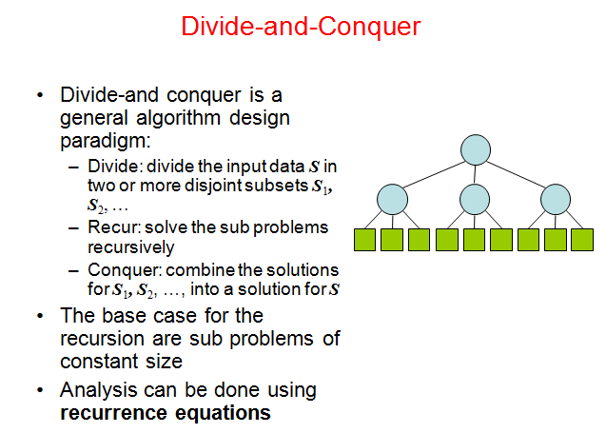

Slide 17
Recursion tree
Solve T(n) = 2T(n/2) + c n, where c > 0 is constant.
T(n)
Here Tree nodes represent costs incurred at various levels of the recursion

Slide 18
Recursion tree
Solve T(n) = 2T(n/2) + cn, where c > 0 is constant.
cn
T(n/2)
T(n/2)

Slide 19
Recursion tree
Solve T(n) = 2T(n/2) + cn, where c > 0 is constant.
cn
cn/2
cn/2
T(n/4)
T(n/4)
T(n/4)
T(n/4)

Slide 20
Recursion tree
Solve T(n) = 2T(n/2) + cn, where c > 0 is constant.
cn
cn/2
cn/2
cn/4
cn/4
cn/4
cn/4
…
Ο(1)

Slide 21
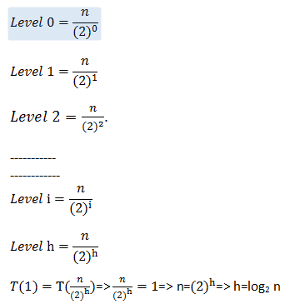
Determining depth/height of tree

Slide 22
Recursion tree
Solve T(n) = 2T(n/2) + cn, where c > 0 is constant.
cn
cn/2
cn/2
h = log n
cn/4
cn/4
cn/4
cn/4
…
Ο(1)

Slide 23
Recursion tree
Solve T(n) = 2T(n/2) + cn, where c > 0 is constant.
cn
cn
cn/2
cn/2
h = log n
cn/4
cn/4
cn/4
cn/4
…
Ο(1)

Slide 24
Recursion tree
Solve T(n) = 2T(n/2) + cn, where c > 0 is constant.
cn
cn
cn/2
cn/2
cn
h = log n
cn/4
cn/4
cn/4
cn/4
…
Ο(1)

Slide 25
Recursion tree
Solve T(n) = 2T(n/2) + cn, where c > 0 is constant.
cn
cn
cn/2
cn/2
cn
h = log n
cn/4
cn/4
cn/4
cn/4
cn
…
…
Ο(1)

Slide 26
Recursion tree
Solve T(n) = 2T(n/2) + cn, where c > 0 is constant.
cn
cn
cn/2
cn/2
cn
h = log n
cn/4
cn/4
cn/4
cn/4
cn
…
…
Ο(1)
#leaves = n
Ο(n)

Slide 27
Recursion tree
Solve T(n) = 2T(n/2) + cn, where c > 0 is constant.
cn
cn
cn/2
cn/2
cn
h = log n
cn/4
cn/4
cn/4
cn/4
cn
…
…
Ο(1)
#leaves = n
Ο(n)
Total = Ο(n log n)

Slide 28
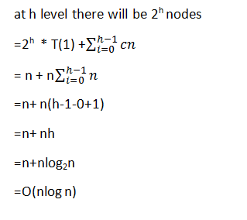

Slide 29

T(n) = T(n/3) + T(2n/3) + n. T(1) = 1 Solve it by recursion tree method
Task

Slide 30
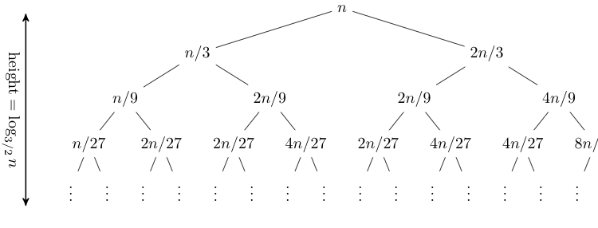
T(n) = T(n/3) + T(2n/3) + n, T(1) = 1
T(n) = T(n/3) + T(2n/3) + n.
T(1) = 1
Expanding out the first few levels, the recurrence tree is:
the closed form of this recurrence is O(n log n).

Slide 31
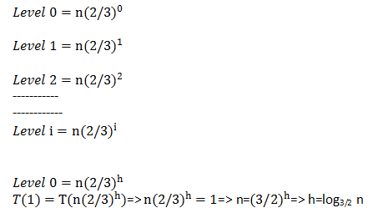
Determining Height of tree

Slide 32
Home Task: Do it yourself
Solve T(n) = 3T(n/4) + cn²,
where c > 0 is constant.

Slide 33
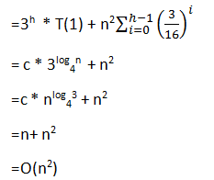

Slide 34
Home Task: Do it yourself
Solve T(n) = 2T(n/2) + n²

Slide 35
Example of recursion tree
Solve T(n) = T(n/4) + T(n/2) + n²:

Slide 36
Example of recursion tree
Solve T(n) = T(n/4) + T(n/2) + n²:
T(n)

Slide 37
Example of recursion tree
Solve T(n) = T(n/4) + T(n/2) + n²:
n²
T(n/4)
T(n/2)

Slide 38
Example of recursion tree
Solve T(n) = T(n/4) + T(n/2) + n²:
n²
(n/4)²
(n/2)²
T(n/16)
T(n/8)
T(n/8)
T(n/4)

Slide 39
Example of recursion tree
Solve T(n) = T(n/4) + T(n/2) + n²:
n²
(n/4)²
(n/2)²
(n/16)²
(n/8)²
(n/8)²
(n/4)²
…
Θ(1)

Slide 40
Example of recursion tree
Solve T(n) = T(n/4) + T(n/2) + n²:
n²
(n/4)²
(n/2)²
(n/16)²
(n/8)²
(n/8)²
(n/4)²
…
Θ(1)

Slide 41
Example of recursion tree
Solve T(n) = T(n/4) + T(n/2) + n²:
n²
(n/4)²
(n/2)²
(n/16)²
(n/8)²
(n/8)²
(n/4)²
…
Θ(1)

Slide 42
Example of recursion tree
Solve T(n) = T(n/4) + T(n/2) + n²:
n²
(n/4)²
(n/2)²
(n/16)²
(n/8)²
(n/8)²
(n/4)²
…
…
Θ(1)

Slide 43
Example of recursion tree
Solve T(n) = T(n/4) + T(n/2) + n²:
n²
(n/4)²
(n/2)²
(n/16)²
(n/8)²
(n/8)²
(n/4)²
…
…
Θ(1)
Total =
= Θ(n²)
geometric series

Slide 44
Appendix: geometric series
for x ≠ 1
for |x| < 1

Slide 45
Solving Recurrence Relations
Methods to solve recurrence relations that represent the running time of recursive methods:
Iteration method (unrolling and summing)
Recursion tree method
Master method

Slide 47
When not to use
You cannot use the Master Theorem if
T(n) is not monotone, e.g. T(n) = sin(x)
f(n) is not a polynomial, e.g., T(n)=2T(n/2)+2^n
b cannot be expressed as a constant.

Slide 48
Why to use
measure of algorithm efficiency
has a big impact on running time.
Big-O notation is used.
To deal with n items, time complexity can be O(1), O(log n), O(n), O(n log n), O(n²), O(n³), O(2^{n}), even O(n^{n}).

Slide 49
Master Theorem
The Master Theorem applies to recurrences of the following form:
T (n) = aT (n/b) + f (n)
where a ≥ 1 and b > 1 are constants and f (n) is an asymptotically positive function. There are 3 cases:
If f (n) = O(n^{logba – ε}) for some constant ε > 0, then T(n) = Θ(n^{logba}) .
If f (n) = Θ(n^{logba} lg^{k}n) with k ≥ 0., then T(n) = Θ(n^{logba} lg^{k+1}n)
If f (n) = Ω(n^{logba + ε}) with ε > 0, then T(n) = Θ( f (n) )

Slide 50
Examples
Ex. T(n) = 4T(n/2) + n
a = 4, b = 2 ⇒ n^{logba} = n²; f (n) = n.
CASE 1: f (n) = O(n^{2 – ε}) for ε >0.
∴ T(n) = Θ(n²).
Ex. T(n) = 4T(n/2) + n²
a = 4, b = 2 ⇒ n^{logba} = n²; f (n) = n².
CASE 2: f (n) = Θ(n²lg⁰n), that is, k = 0.
∴ T(n) = Θ(n²lg n).

Slide 51
Examples
Ex. T(n) = 4T(n/2) + n³
a = 4, b = 2 ⇒ n^{logba} = n²; f (n) = n³.
CASE 3: f (n) = Ω(n^{2 + ε}) for ε >0
and 4(cn/2)³ ≤ cn³ (reg. cond.) for c = 1/2.
∴ T(n) = Θ(n³).
Ex. T(n) = 4T(n/2) + n²/lg n
a = 4, b = 2 ⇒ n^{logba} = n²; f (n) = n²/lg n.
Master method does not apply. In particular, for every constant ε > 0, we have n^{ε} = ω(lg n).

Slide 52
Problems (Homework)
T (n) = 3T (n/2)+ n^2
T (n) = 4T (n/2)+ n^2
T (n) = 2T (n/2)+ n log n
T (n) = 3T (n/2)+ n
T (n) = 6T (n/3) + n² log n
T (n) = Θ(n2 log n) (Case ?)
T (n) = 4T (n/2) + n/ log n
T (n) = Θ(n^2) (Case ?)
T (n) = Θ(n^2 log n) (Case ?)
T (n) = n log^2 n (Case ?)
T (n) = Θ(n^lg 3) (Case ?)
T (n) = Θ(n²) (Case ?)

Slide 53
Thank you

